Slide 1
ITS3.24/HS12.9: Advances in plastic pollution monitoring across the Geosphere
Large-scale remote monitoring of riverine litter to evaluate effectiveness of clean-up technologies
Robrecht Moelans, Liesbeth De Keukelaere, Els Knaeps, Marian-Daniel Iordache, Klaas Pauly, Ils Reusen
www.inspire-europe.org / Inspire Europe (LinkedIn) / Inspire Europe (Facebook) / inspire_eu (Instagram) / INSPIRE_EUROPE (X)
Funded by the European Union. Views and opinions expressed are however those of the author(s) only and do not necessarily reflect those of the European Union or the European Climate, Infrastructure and Environment Executive Agency (CINEA). Neither the European Union nor the granting authority can be held responsible for them. This project has received funding under grant agreement No 101112879 (INSPIRE).

Slide 2
Introduction
Only high-resolution RGB data (camera on bridge or UAV)
Only macro-litter on rivers & riverbanks
Litter on Land
Target: hot spots & densities
Scene = more static
=> mobile camera (UAV)
More variation in background
Floating Litter
Target: number of floating items per time (flux)
Scene = very dynamic
=> fixed camera (bridge)
Camera set-up & installation

Slide 3
Floating Macro-Litter on Rivers

Slide 4
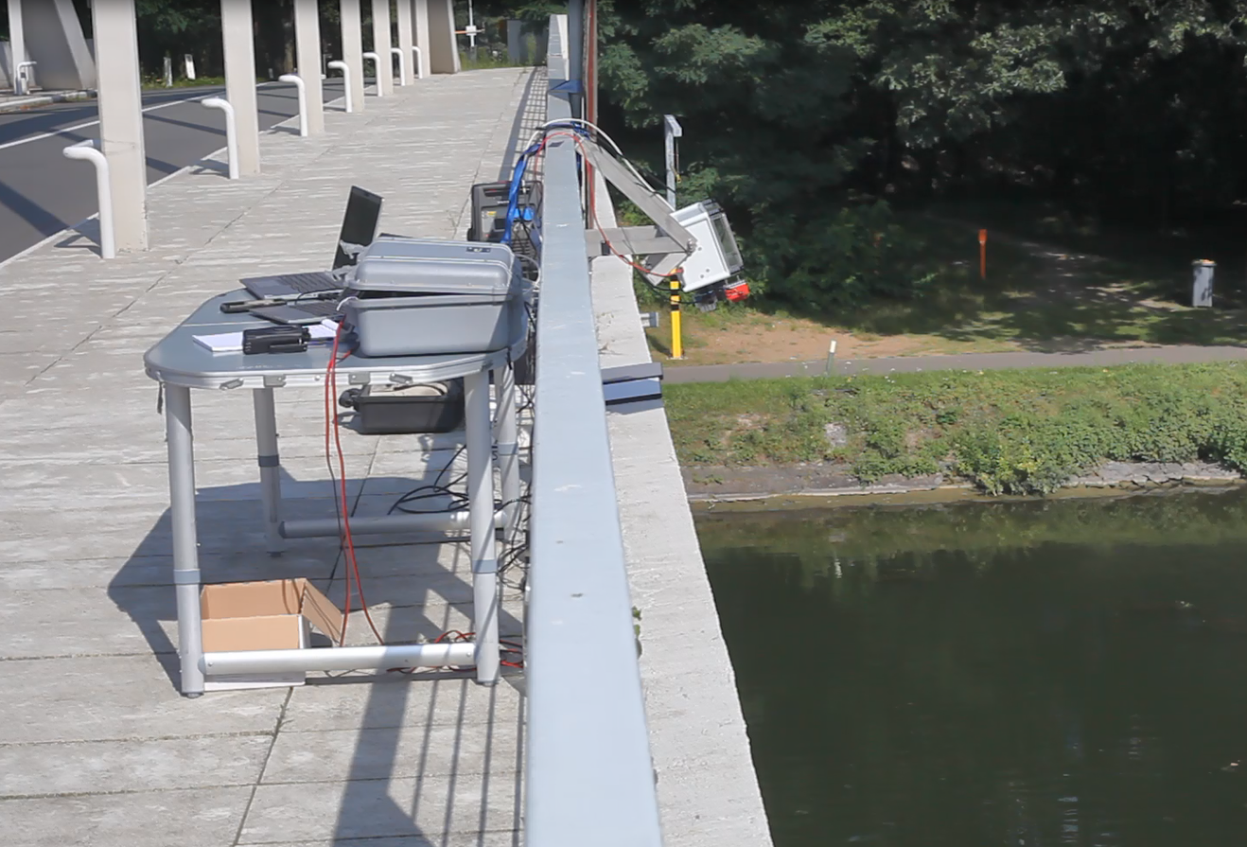
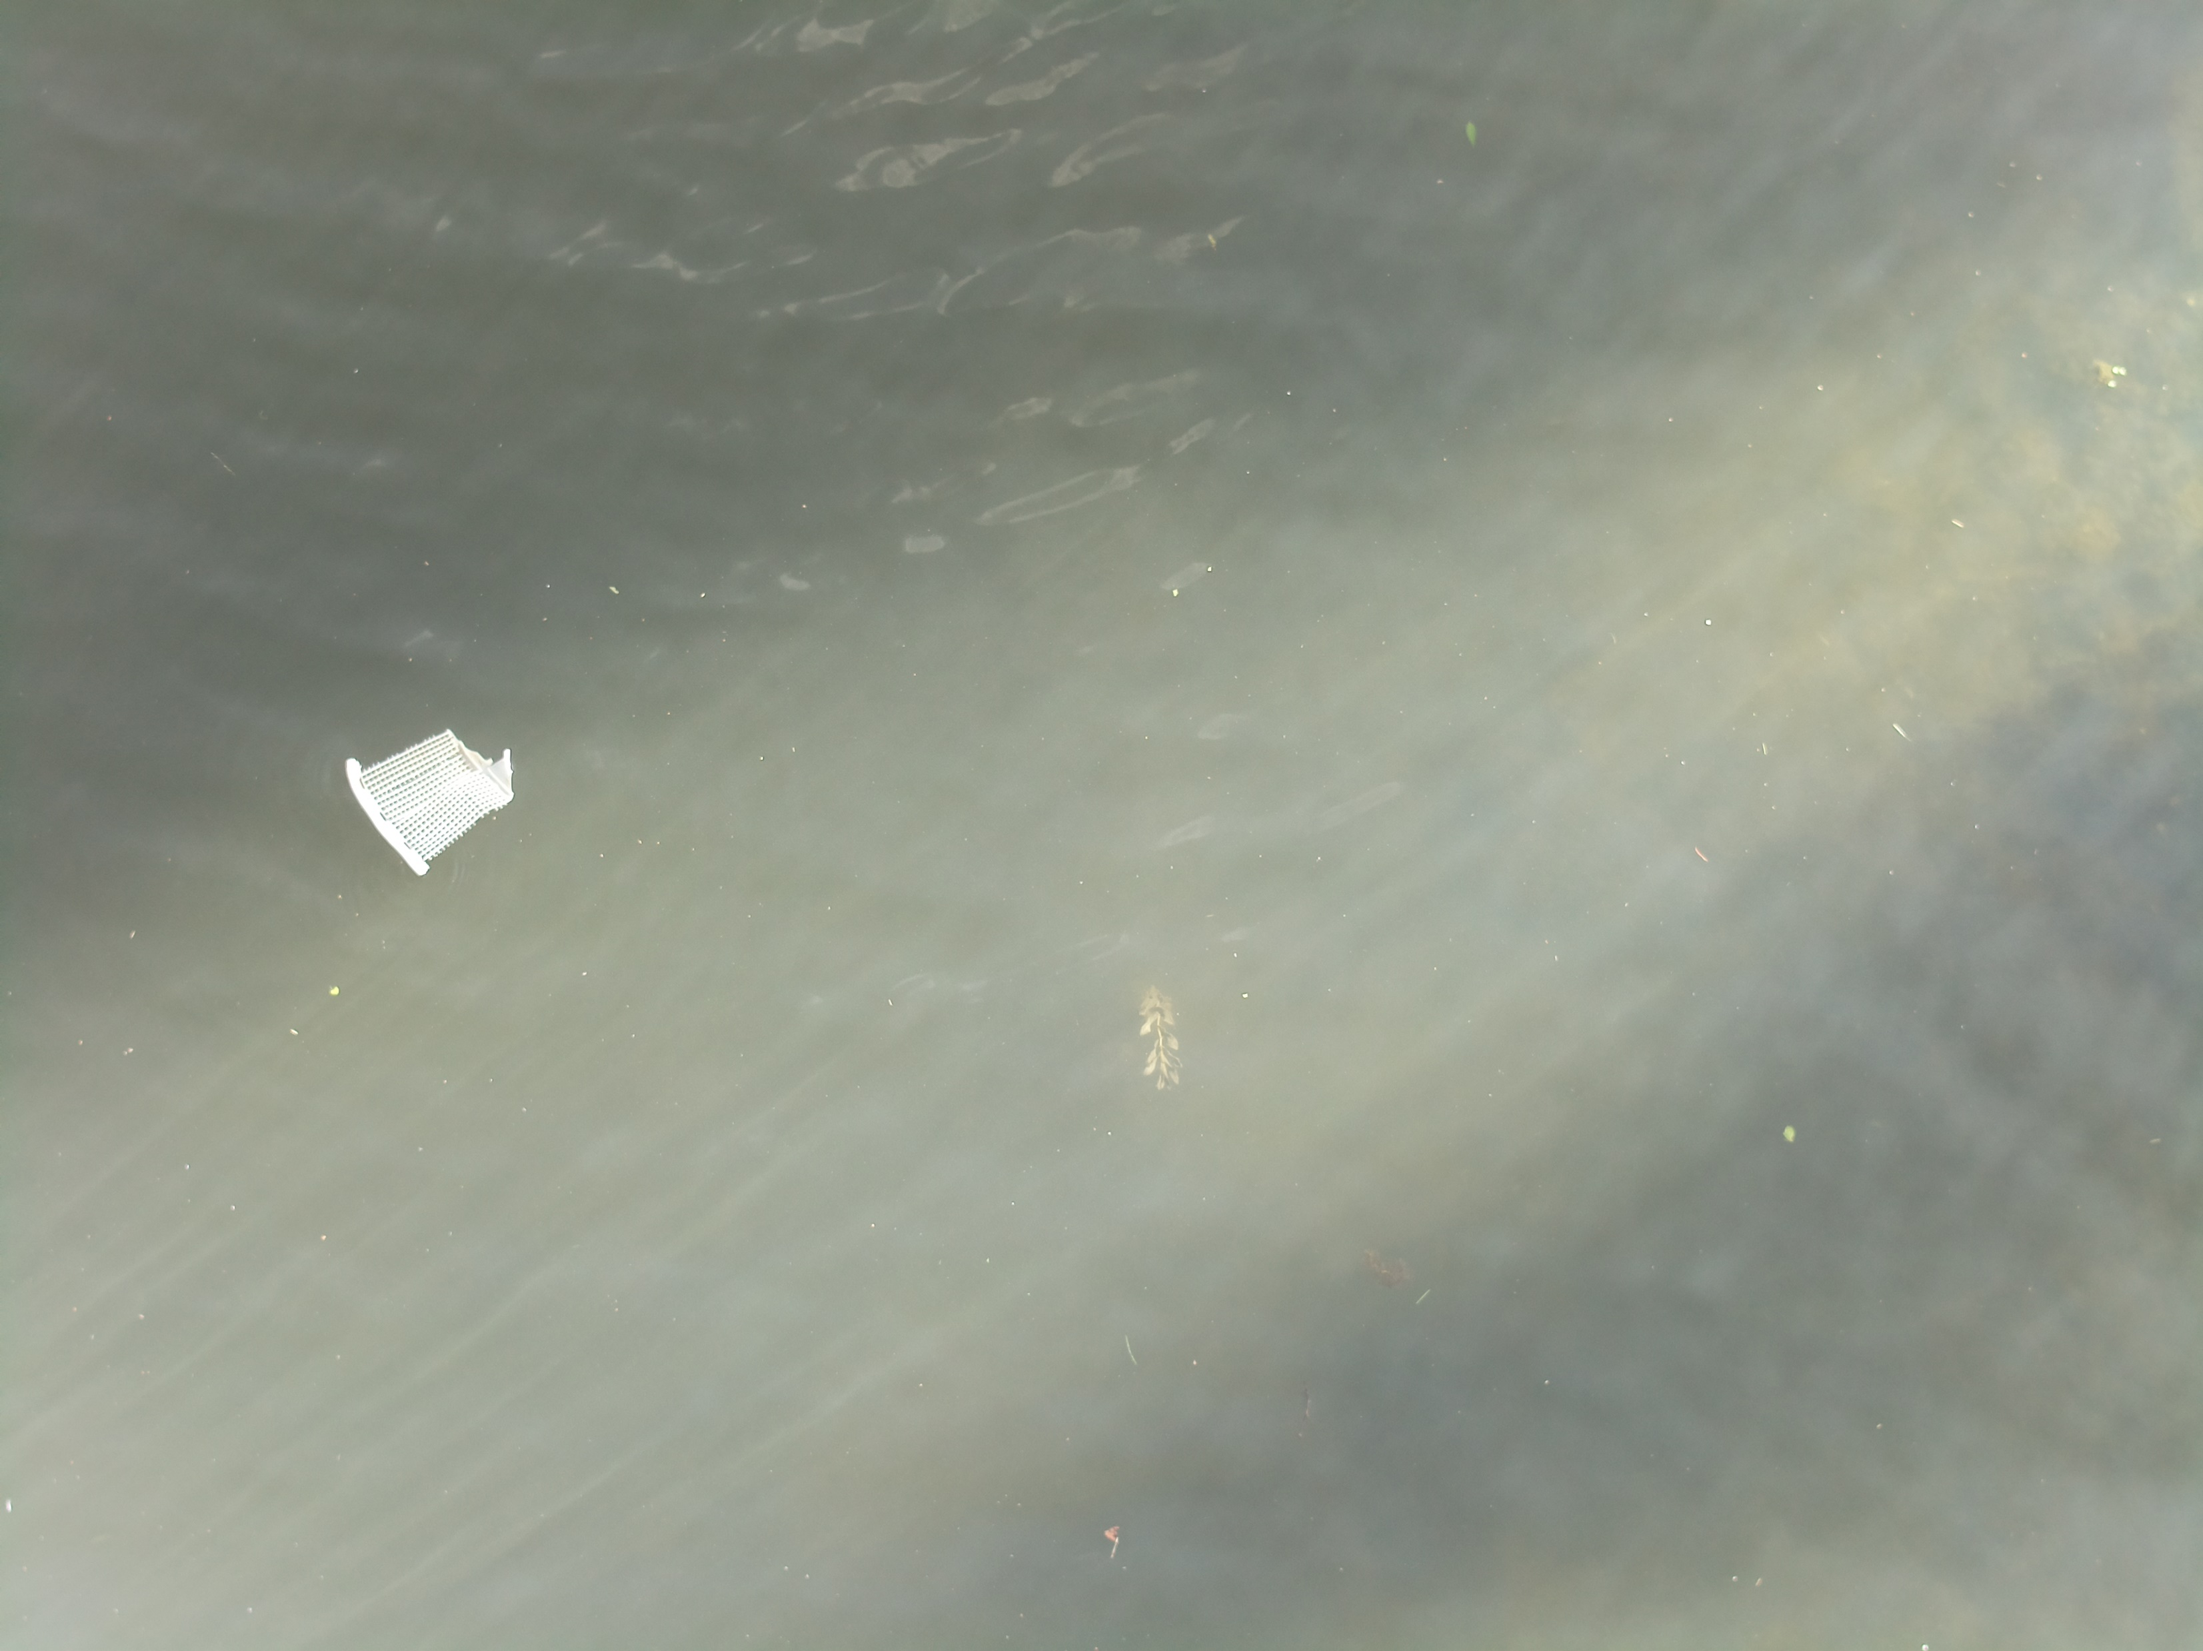
Test & Development Set-up
Multispectral VNIR
Multispectral SWIR
RGB
View of test set-up at bridge over canal (width 35m) close to VITO HQ (Mol – Belgium)
Example of image taken with RGB camera during release & catch experiment with litter received from the port of Antwerp
Test set-up useful for:
Generate training data, e.g. via release-and-catch experiments
Concept testing
Protocols developed and defined in Horizon Europe Project “INSPIRE”
www.inspire-europe.org / Inspire Europe (LinkedIn) / Inspire Europe (Facebook) / inspire_eu (Instagram) / @INSPIRE_EUROPE (X)

Slide 5
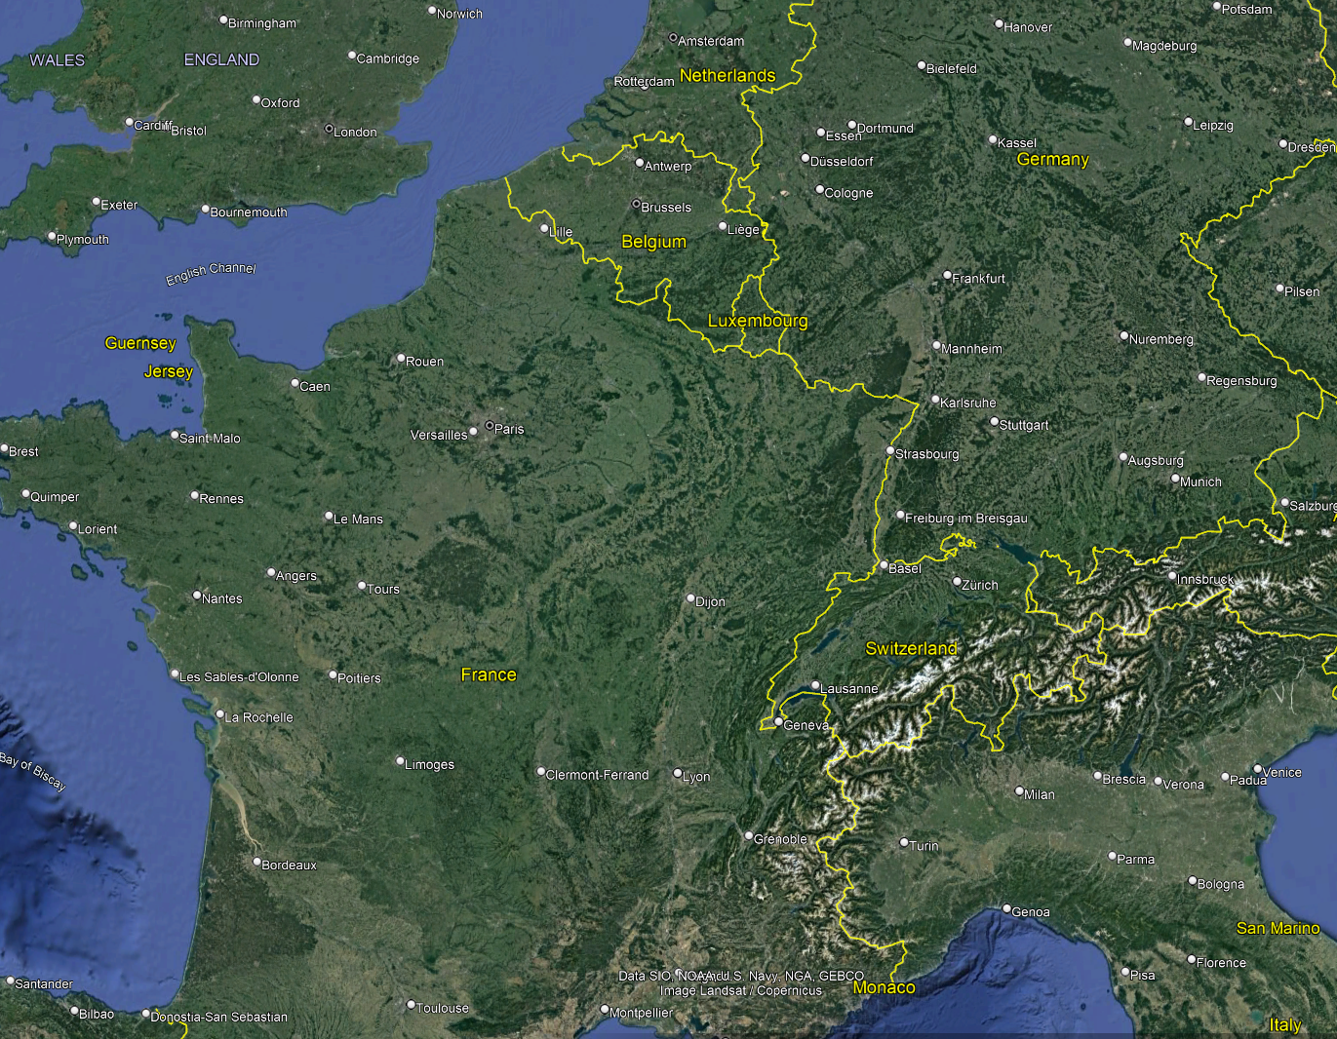
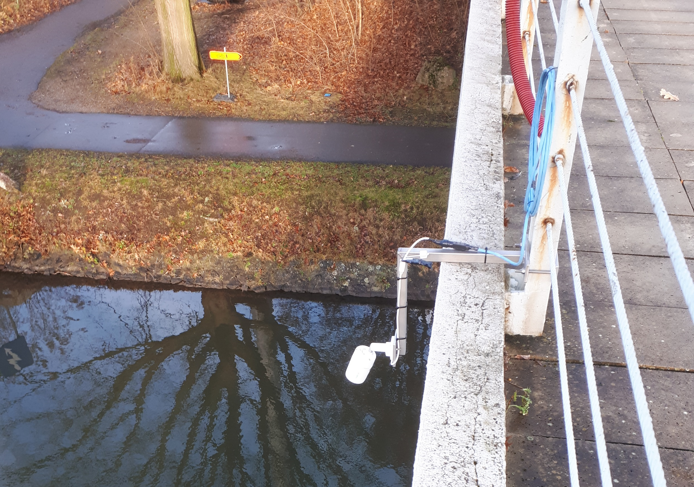
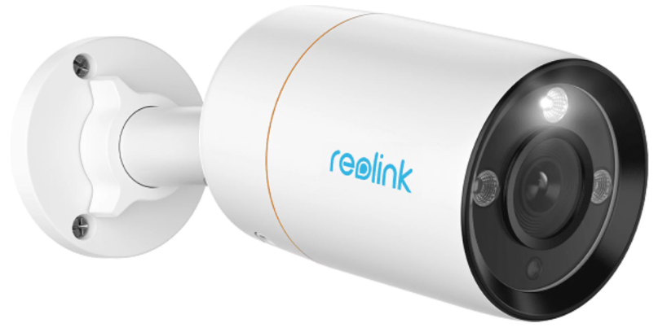
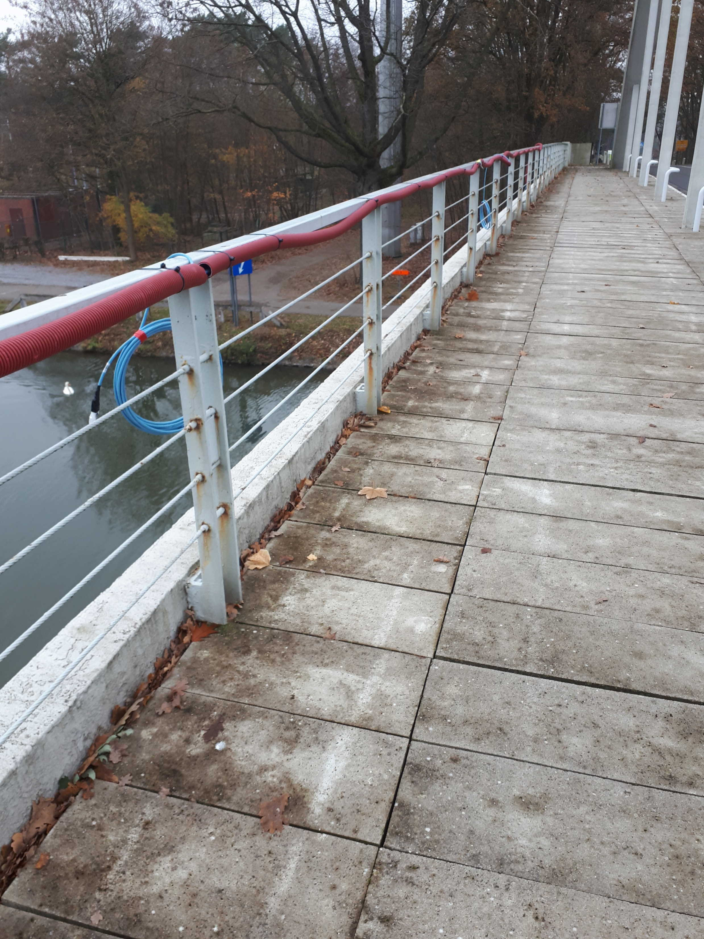
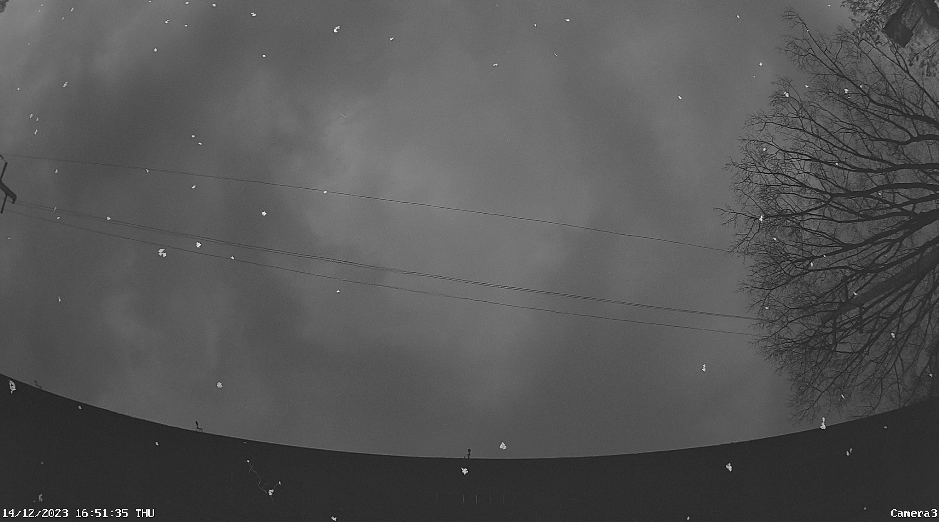
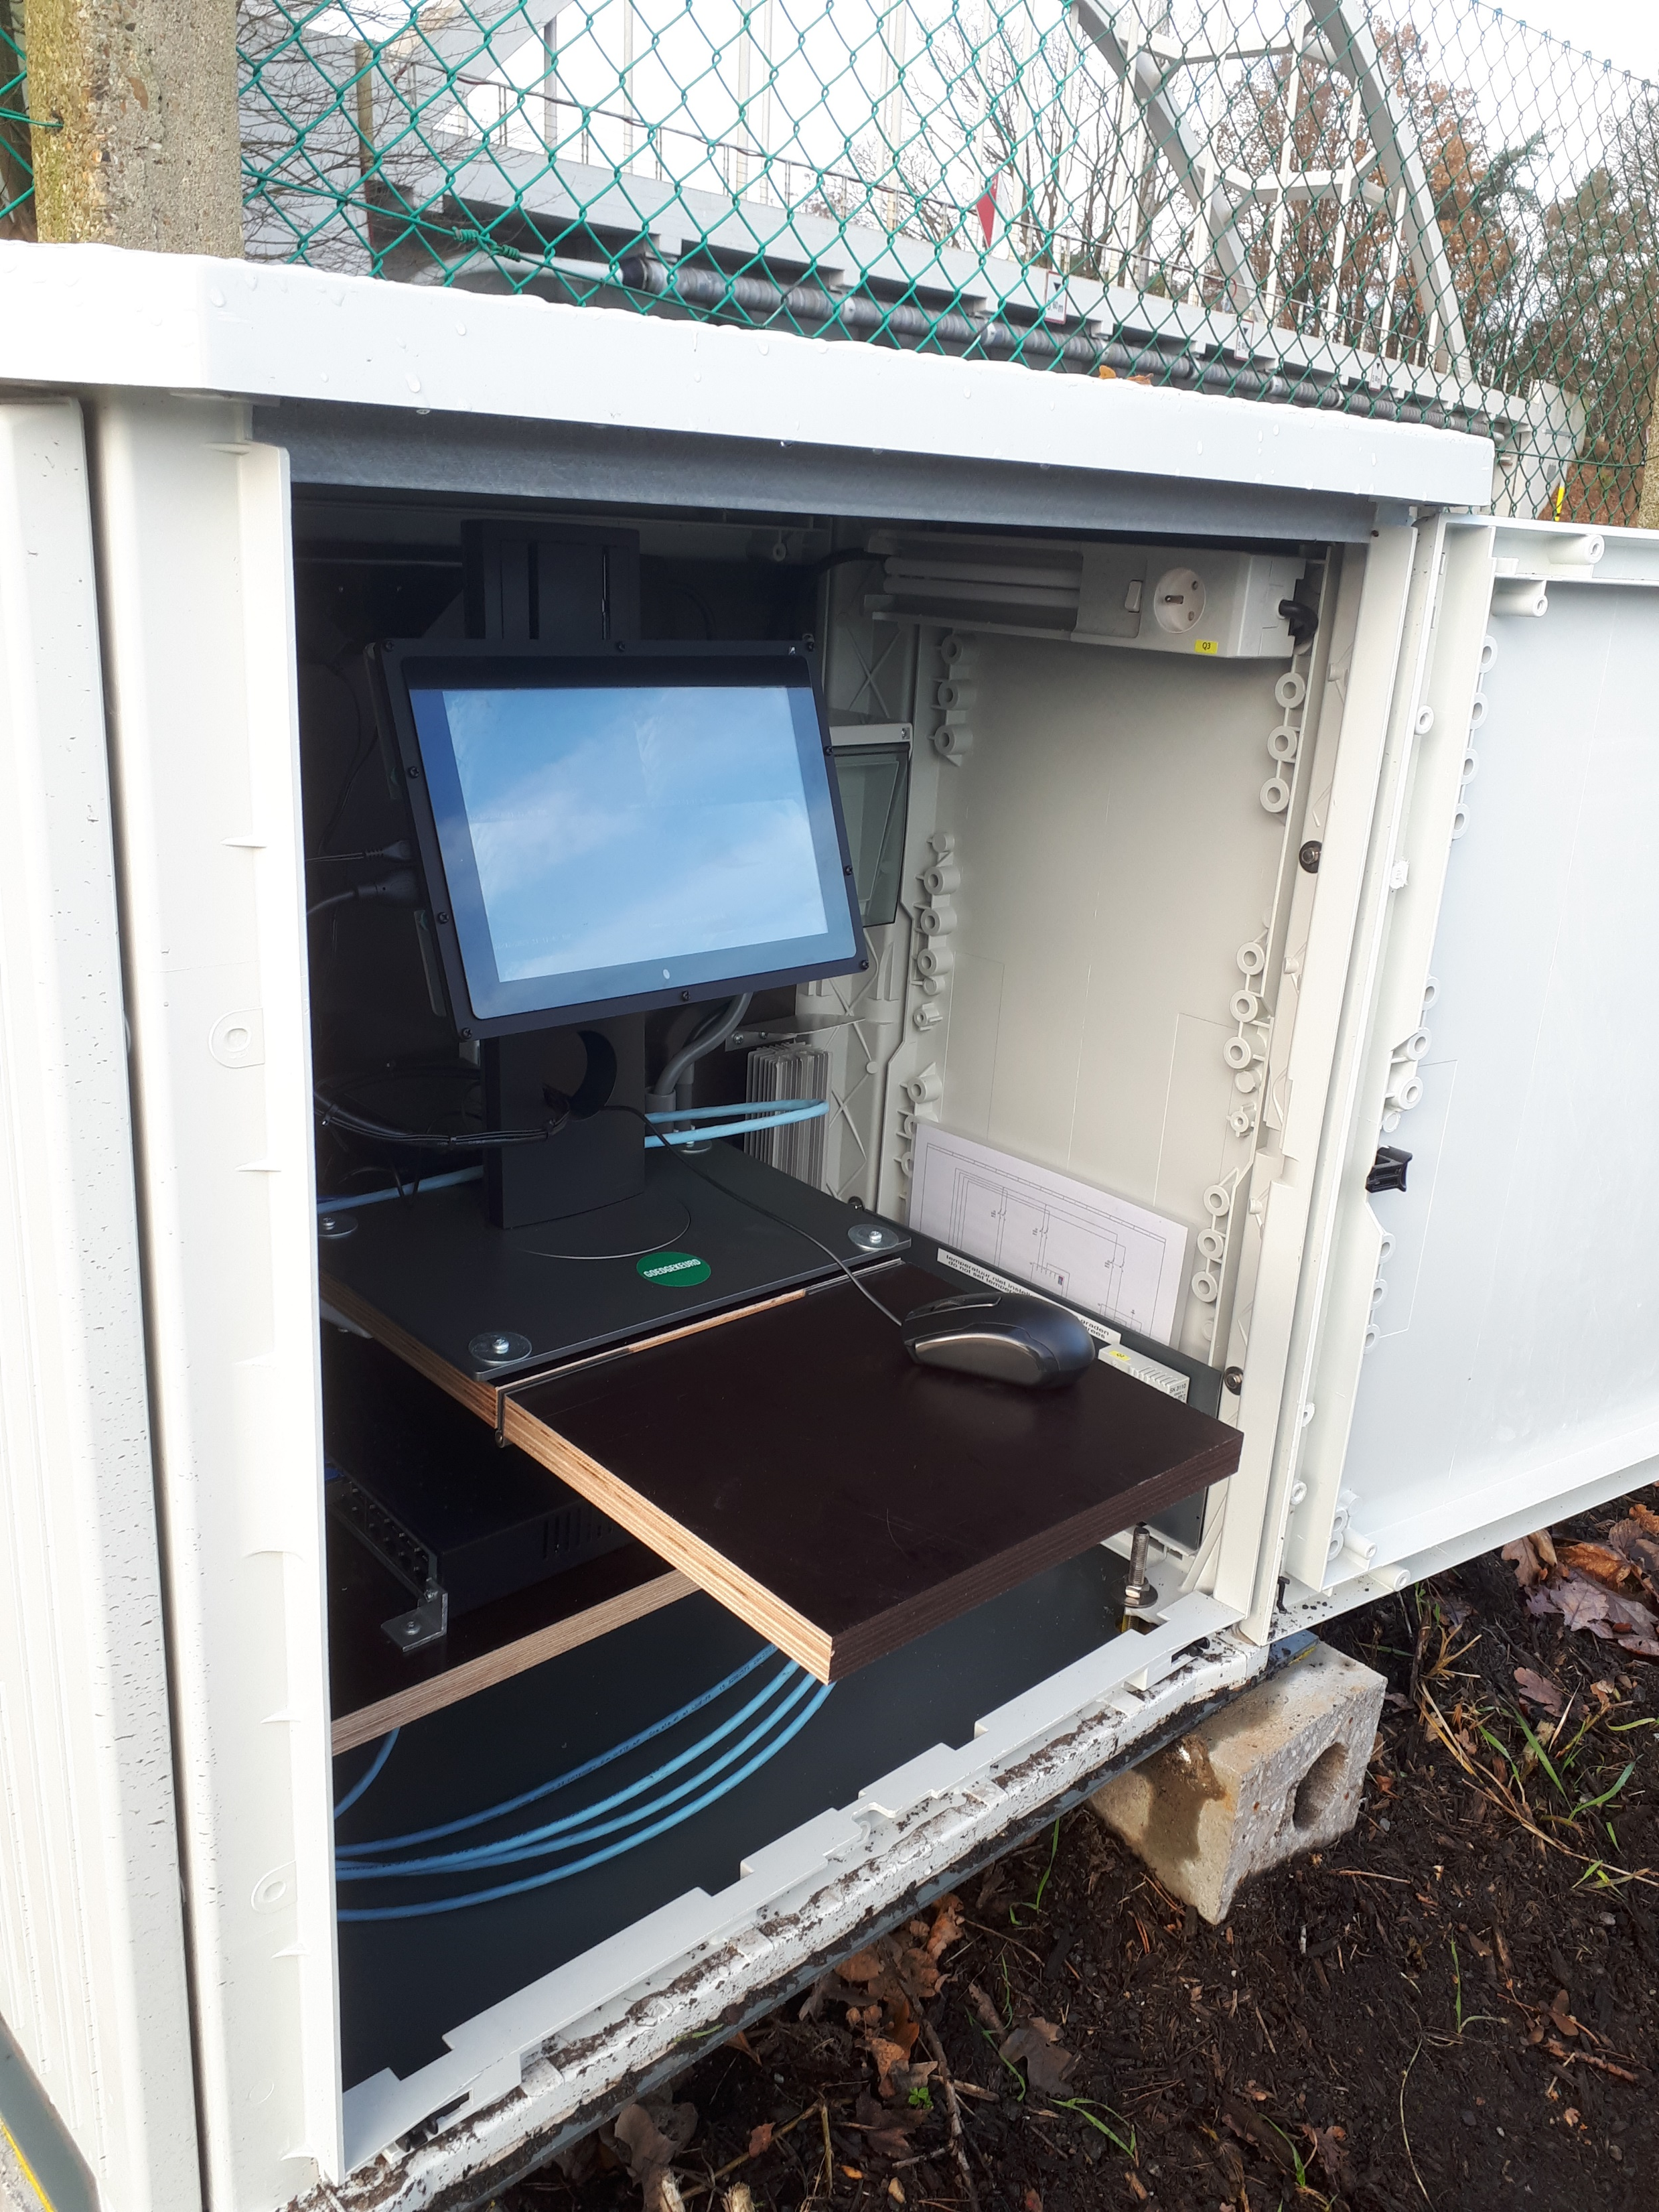
Operational Set-up
Rhine
Scheldt
Po
Source: Google Earth
Development => Operational
Equipment
Cost
Water resistant
Robust
Power supply
Remote connection & control
Recording schedule, storage & transfer
Specific site conditions
Auxiliary sensors
Example image taken with Reolink camera installed on bridge close to VITO HQ (Mol – Belgium)

Slide 6
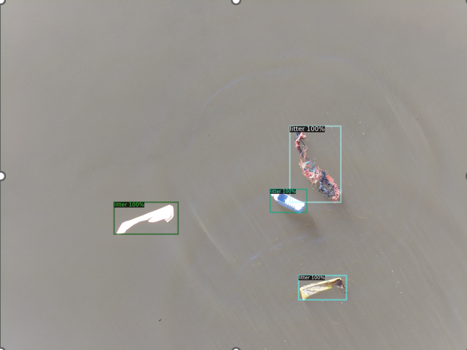
Detect Floating Macro-Litter Objects
Faster RCNN (Region-Based Convolutional Neural Network)
Detectron 2 platform of Meta AI
https://github.com/facebookresearch/detectron2
In general, very good results
Some false positives if water surface is less homogeneous:
Reflection at water surface (sun or sky)
Bottom visible (link with tide)
Waves
Shadows
Turbidity plumes
White caps / foam
=> Annotate more data
Image from RGB camera on bridge over canal close to VITO HQ
(Mol – Belgium)

Slide 7
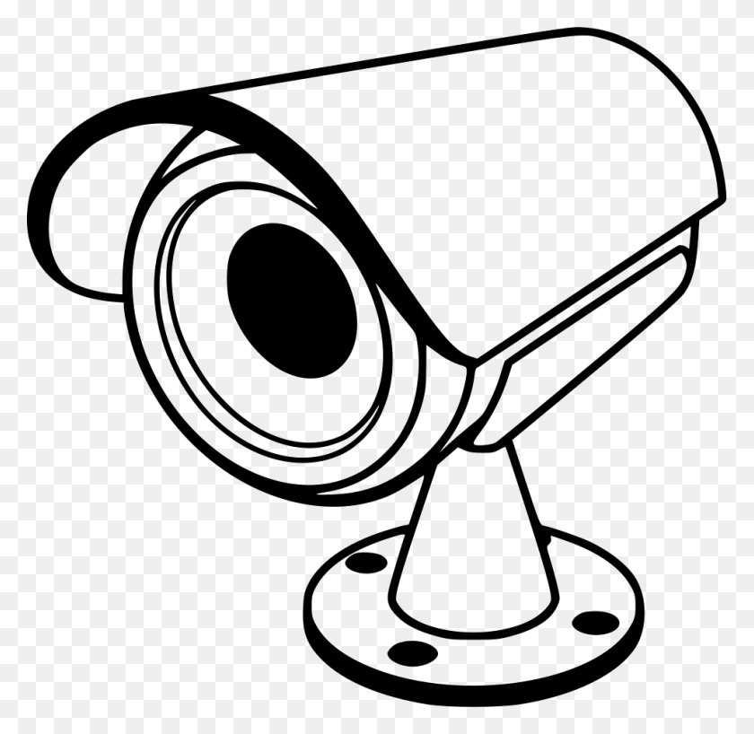
From Detecting Objects to Plastic Flux
Plastic Flux = how many plastic objects pass per unit time on a river
Camera on bridge: only objects at or close to water surface (floating)
Procedure
Install enough cameras to cover complete cross-section of river (tide!)
Detect plastic objects in individual images
Recognize same object in different images (frame rate, current, wind, etc.)
Add only new objects to object counter

Slide 8
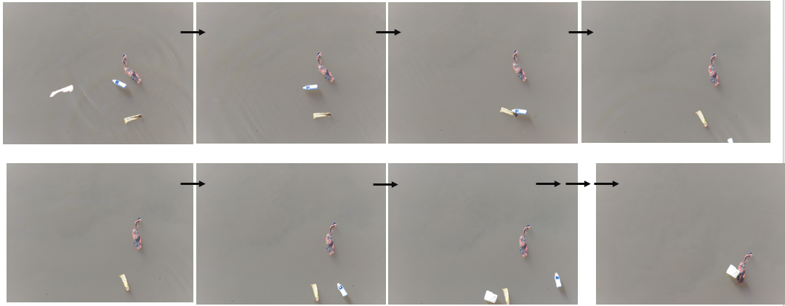
Plastic Flux: Example
Images from RGB camera on bridge over canal close to VITO HQ (Mol – Belgium)

Slide 9
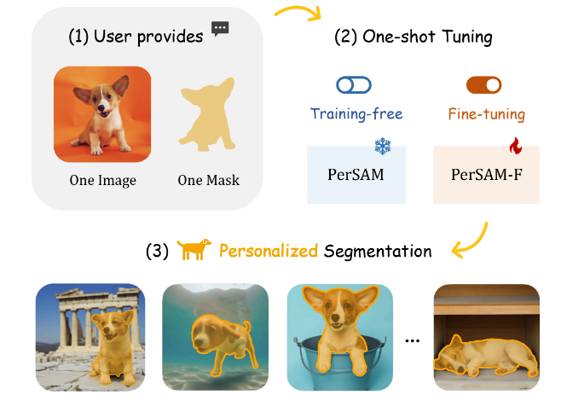
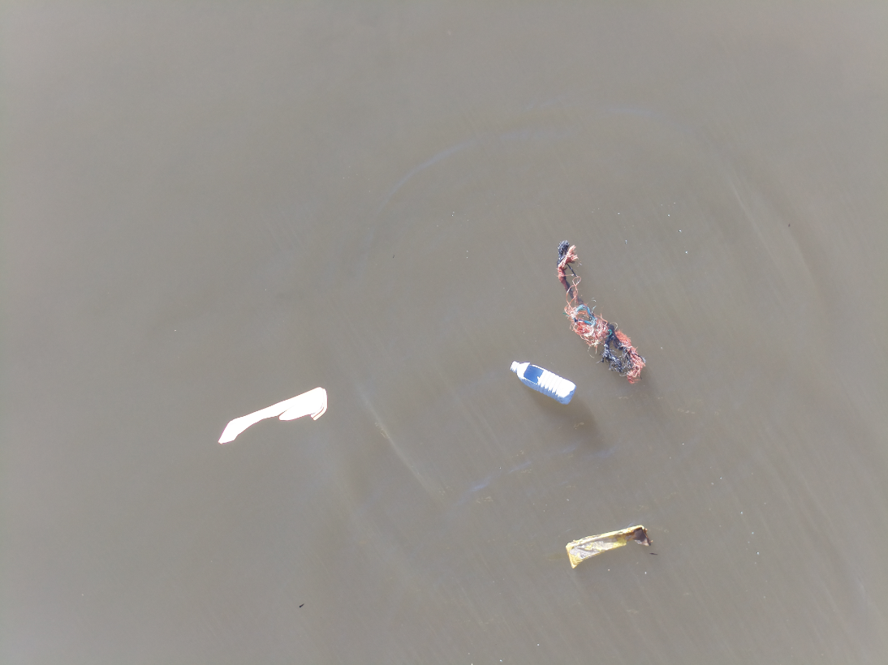
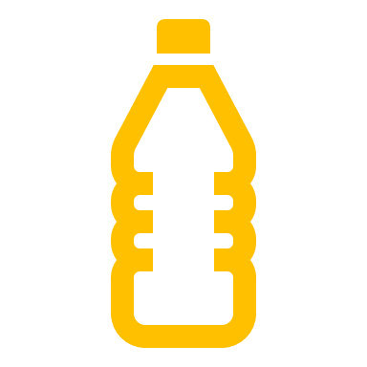
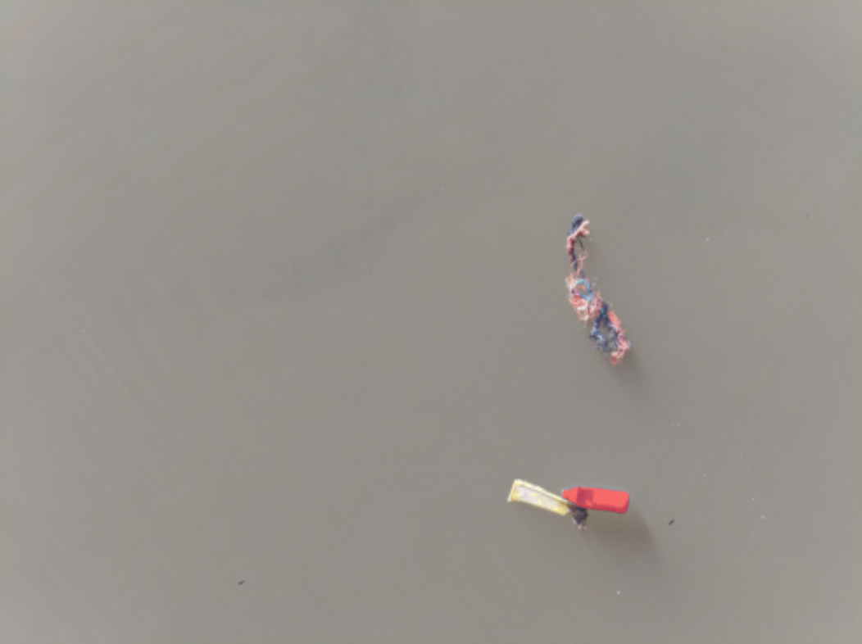
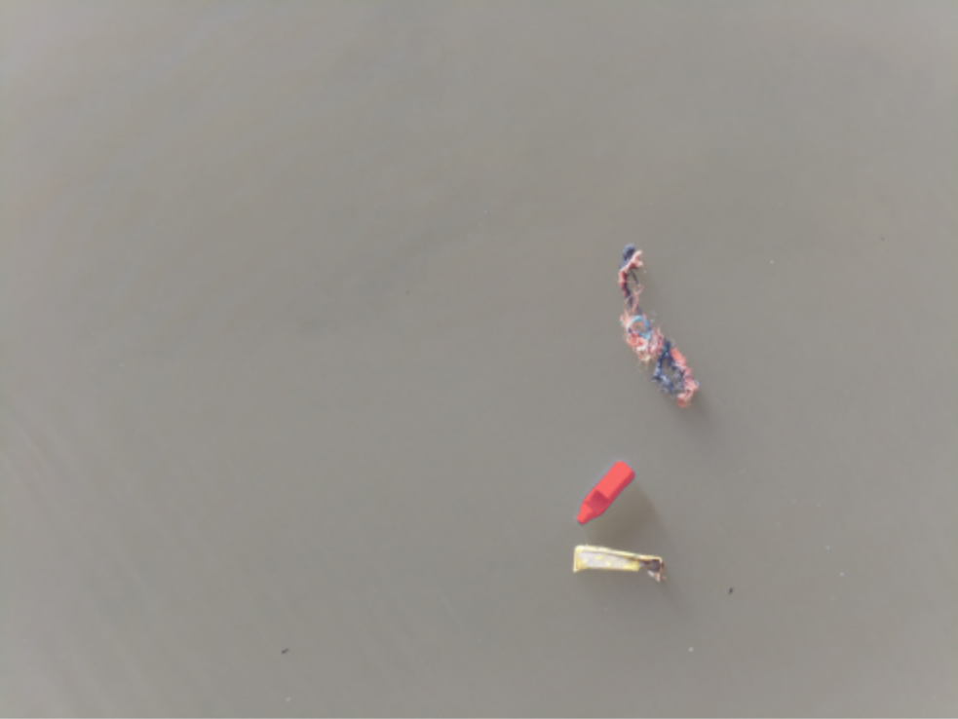
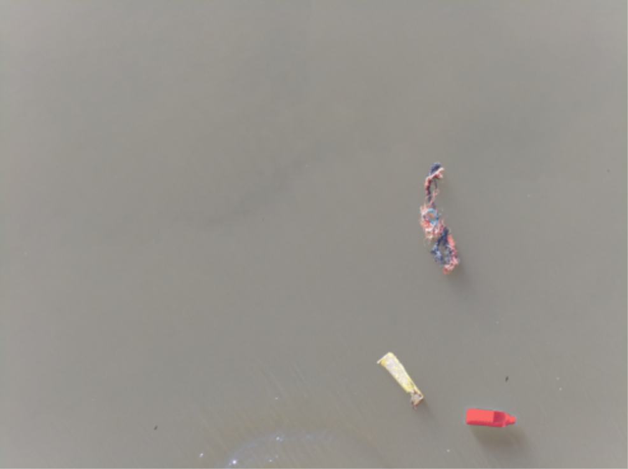
Personalize Segment Anything
(1) User provides
(2) One-shot Tuning
One Image
One Mask
(3) Personalized Segmentation
https://arxiv.org/pdf/2305.03048.pdf
Results generated based on tutorial Niels Rogge:
https://github.com/NielsRogge/Transformers-Tutorials/tree/master/PerSAM

Slide 10
Macro-Litter on Riverbank

Slide 11
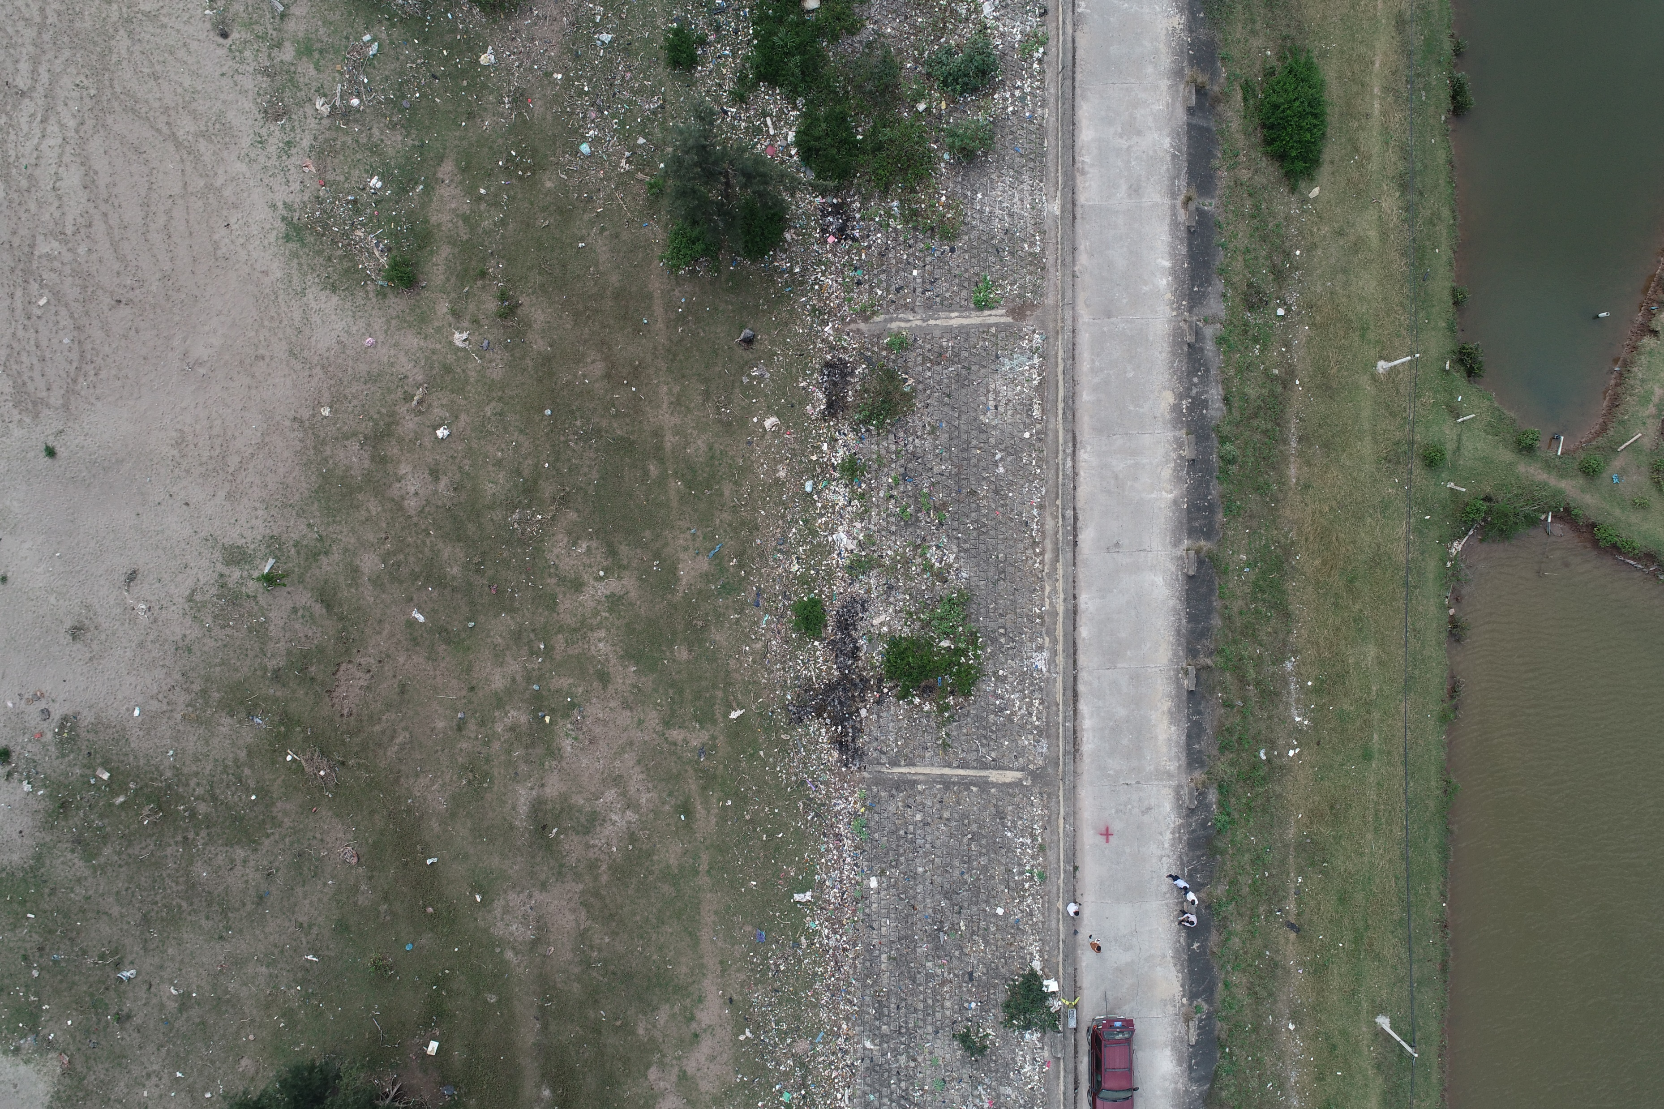
Data Acquisition on Land
Image taken with DJI Phantom 4 Pro at an altitude of 50 meter above the ground (Vietnam)

Slide 12
Detect Macro-Litter Objects
Image classification
Resnet-50 model trained with equal number of patches with and without litter
Prediction accuracy of 91.6%
Benefits of approach include:
Fast and simple to train
Can easily include more labelled data
End product easy to look at (binary map)
Litter patches
No litter patches

Slide 13
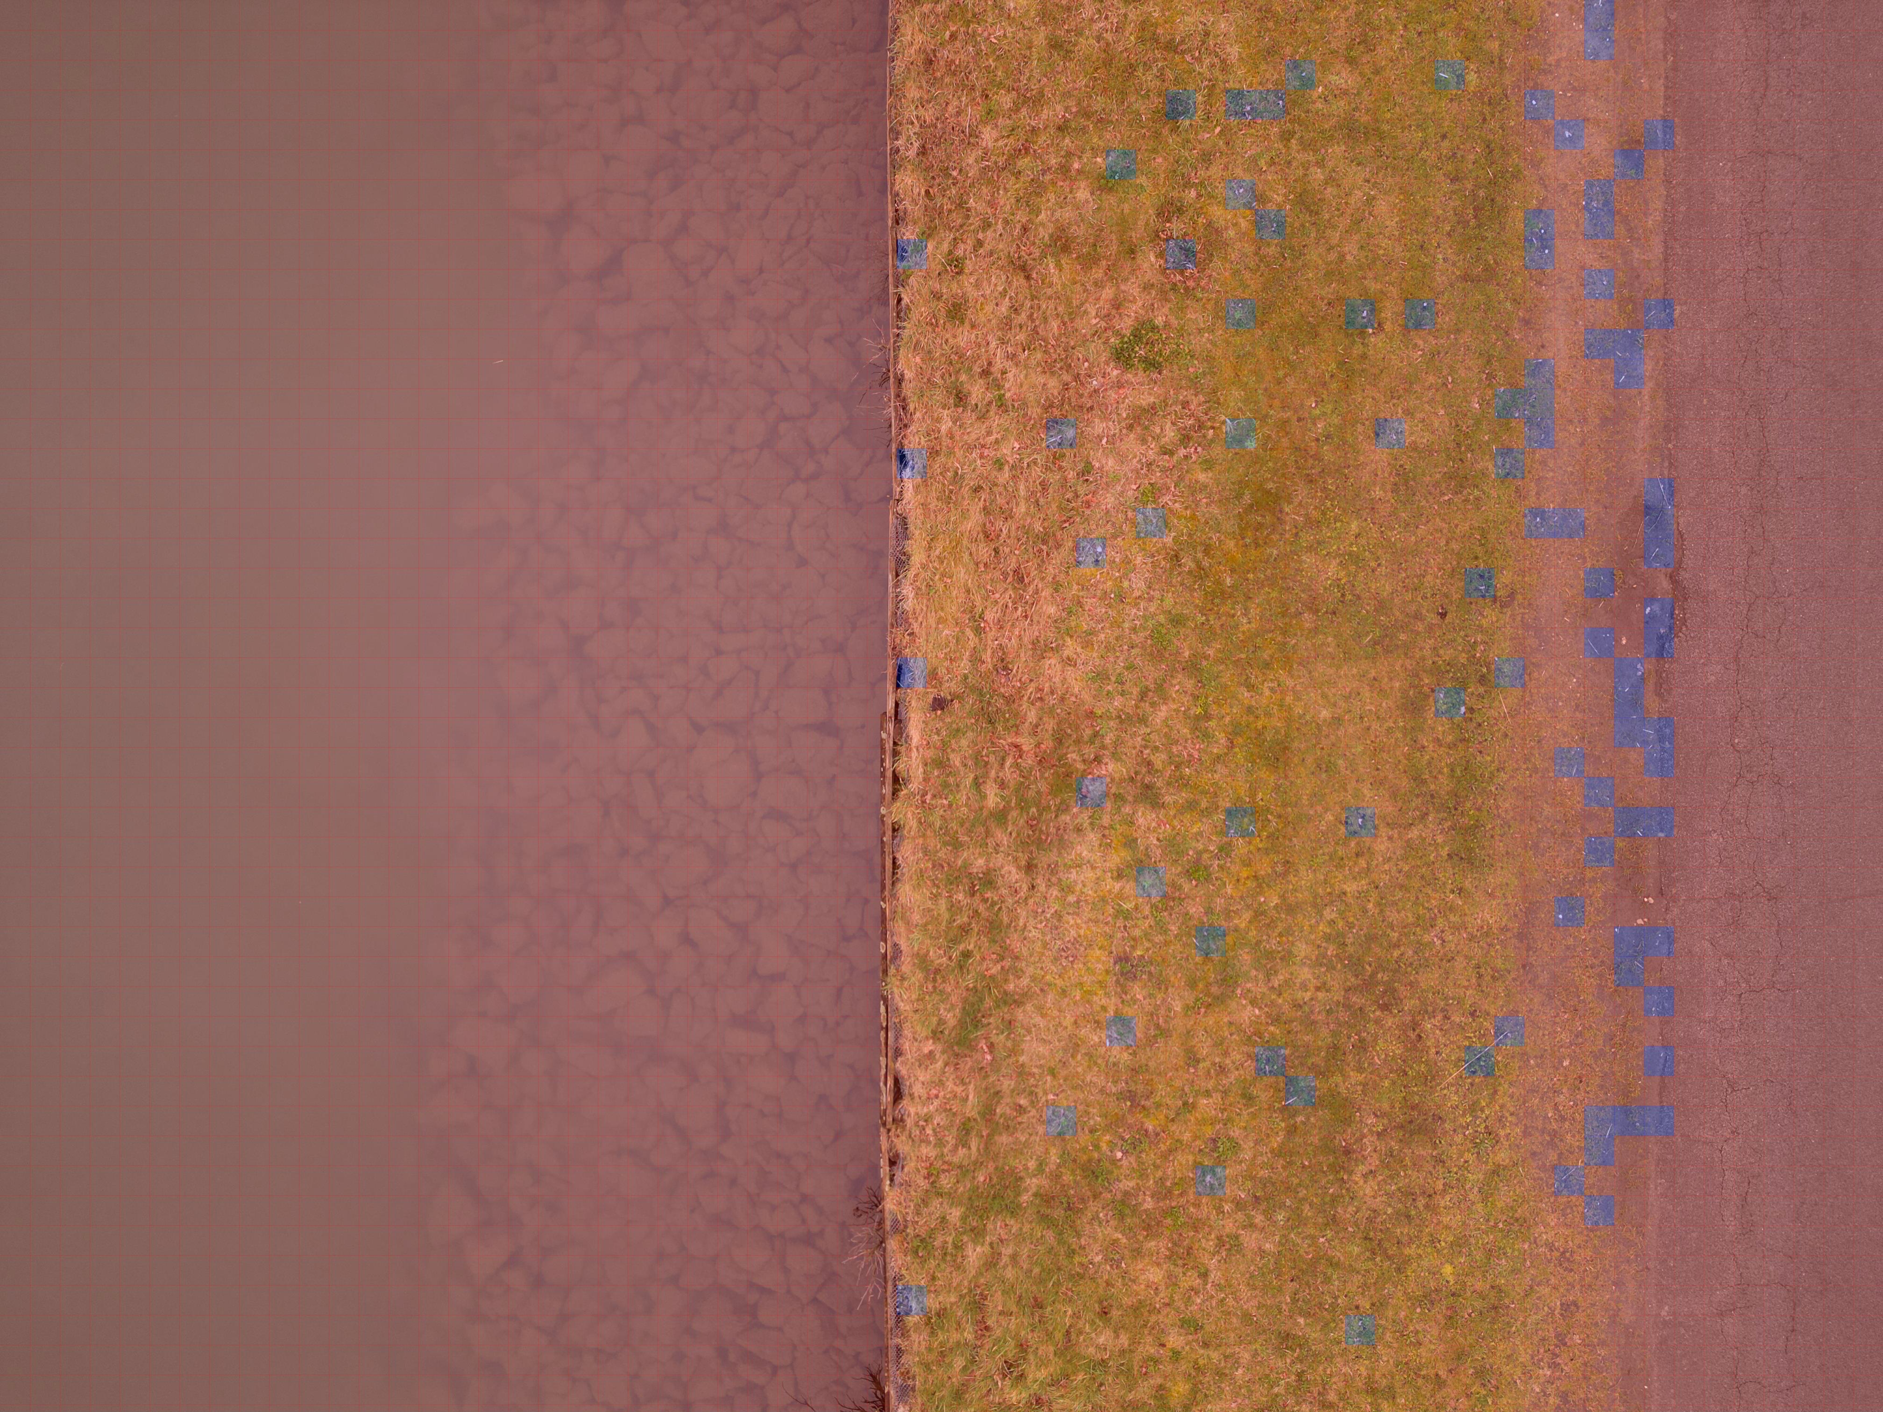
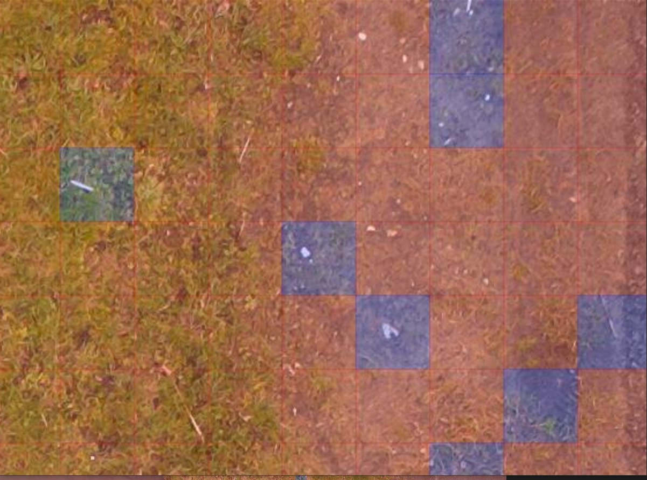
Detect Macro-Litter Objects
Blue = Litter detected in patch
Red = No litter detected in patch
Image taken with DJI Mini 3 Pro at an altitude of 15 meter above the ground (Bocholt-Herentals Canal in Belgium)

Slide 14
