Slide 1
Google’s cloud computing platform performance assessment of spatio-temporal and estimation for global water quality analysis and surface water mapping using integrated satellite data of MODIS (TERRA), Landsat- (8, 9), Sentinel‑2A/B and Planetscope
Presented By:
Abhinav Galodha, Senior Research Scholar, IIT Delhi
Supervisors
Prof. Brejesh Lall, DEE, IIT- Delhi
Prof. Shaikh Zia Ahammad, DBEB, IIT- Delhi
Dr. Sanya Anees, DECE, NSUT - Delhi
School of Interdisciplinary Research (SIRe), Indian Institute of Technology Delhi, India
1

Slide 2
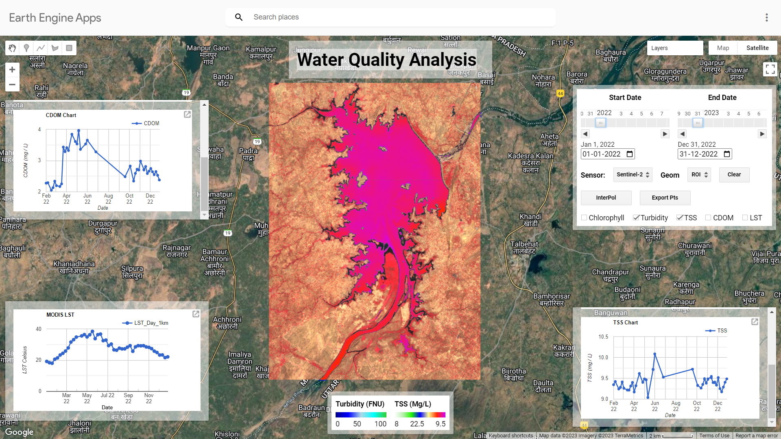
Work done I: Results & Discussion

Slide 3
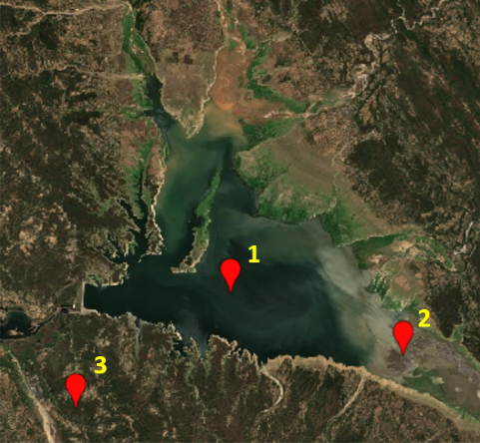
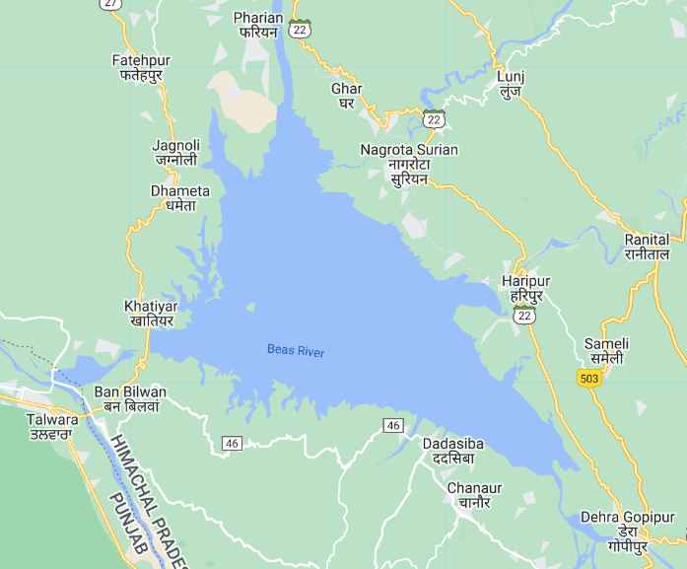
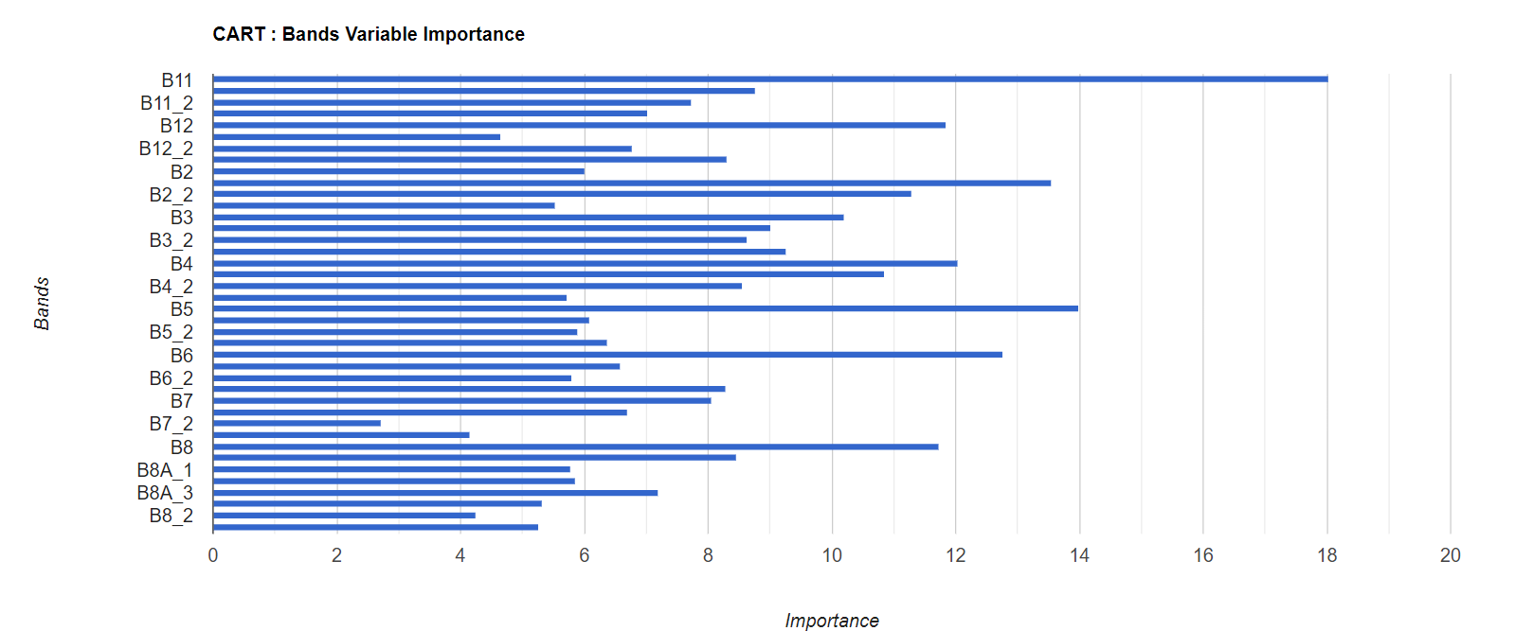
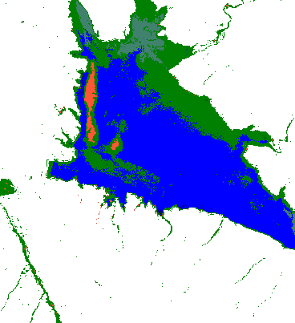
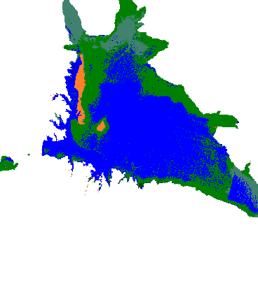
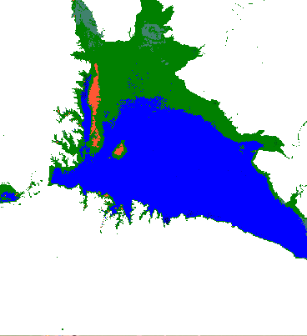
Work Done: ML Algorithms
(Water-Use classification)
Classifier Model Building | Validation accuracy
Random Forest | 84.848%
Support Vector Machine (SVM) | 78.787%
smileCART | 81.818%
SVM
CART
RF

Slide 4
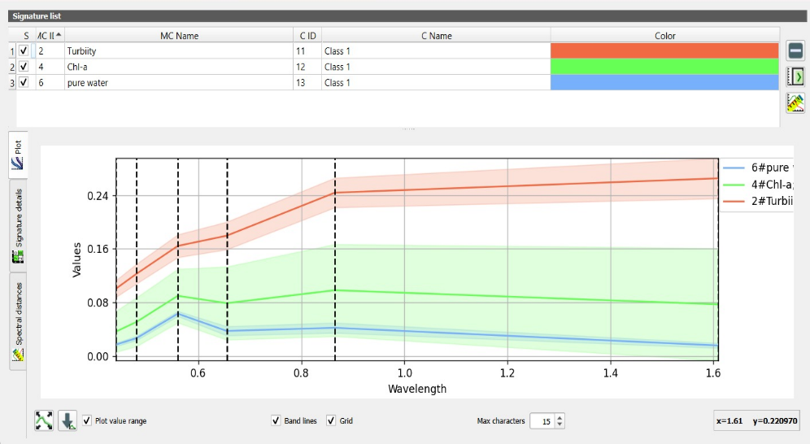
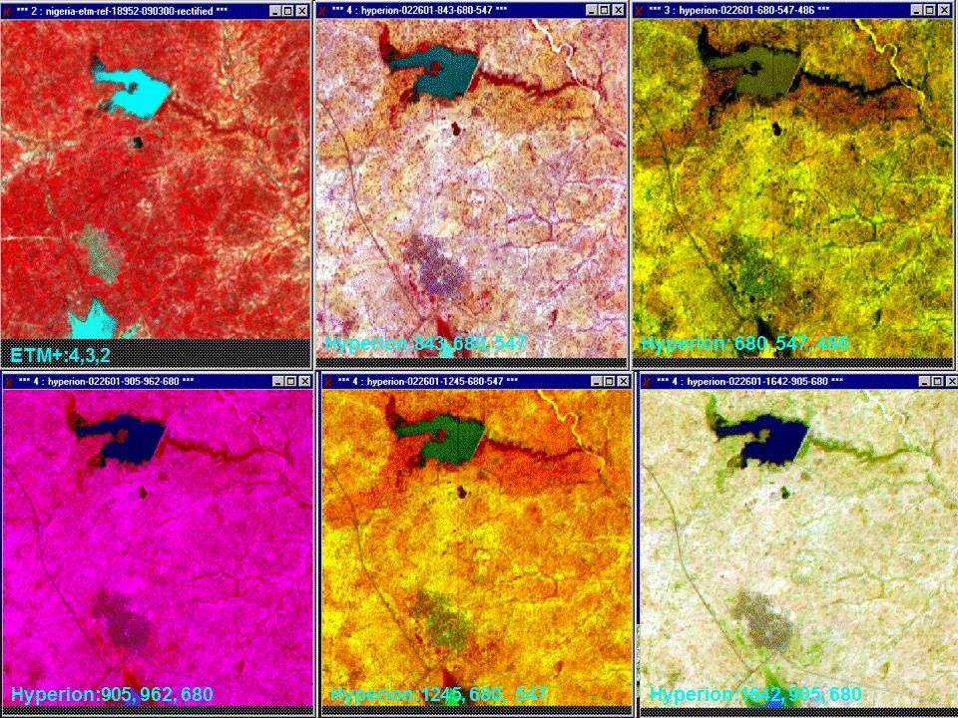
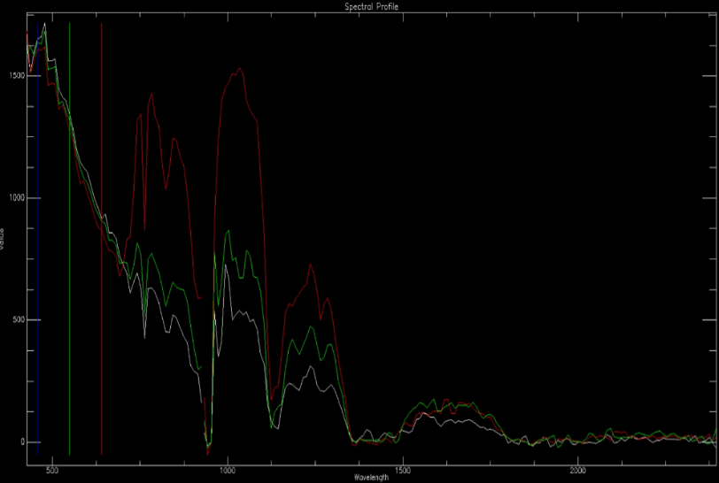
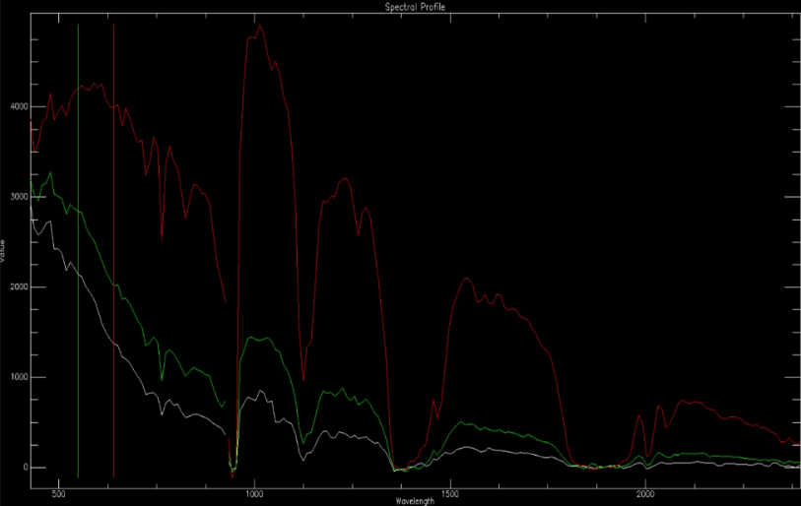
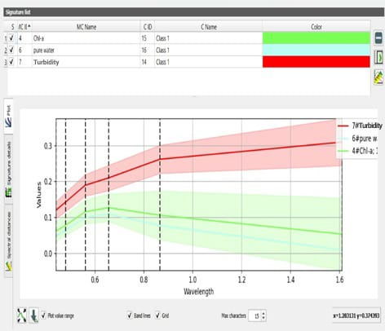
Work Done: Hyperspectral vs Multispectral Comparative Study
Hyperspectral
Multispectral
Yamuna
Dimensionality Réduction Techniques:
Principal Component Analysis (PCA)
Minimum Noise Fraction (MNF)
Reservoir

Slide 5
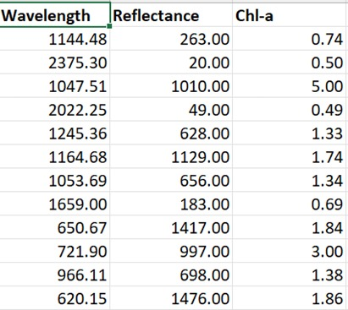
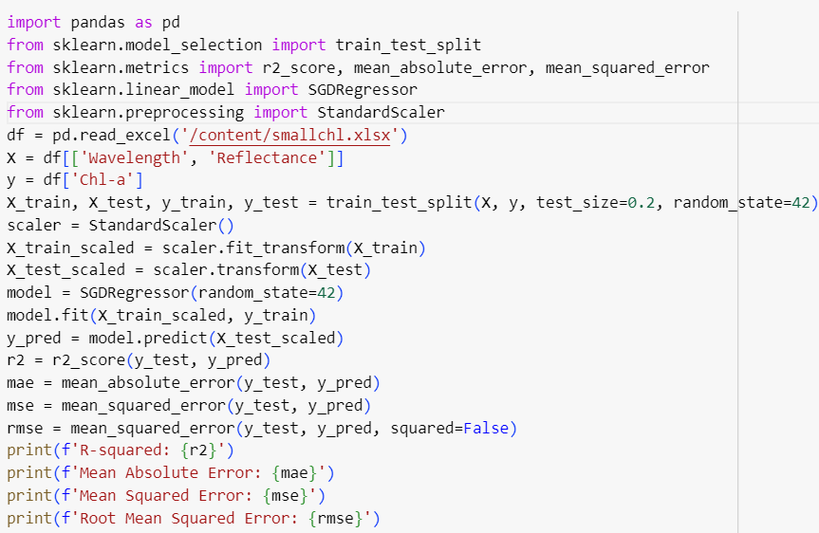
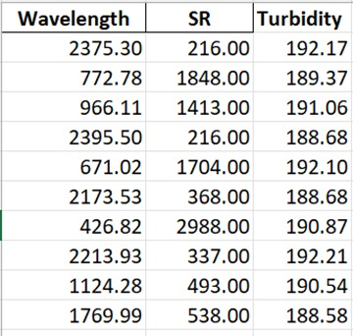
Work Done: SGD model for Chl-a estimation and Turbidity estimation
Input dataset
Model Training
Model Performance

