Slide 1
Exploring Regional-Scale Covariation: Atmospheric CO₂ Anomalies
Distribution Patterns, Vegetation Spread, and Climate Variables
Buddola Jagadish, Prabir Kumar Patra, and Mukunda Dev Behera

Slide 2
Contents
1. Motivation
2. Study area
3. Materials and Methods
4. Results and Discussion
5. Conclusions
6. References

Slide 3
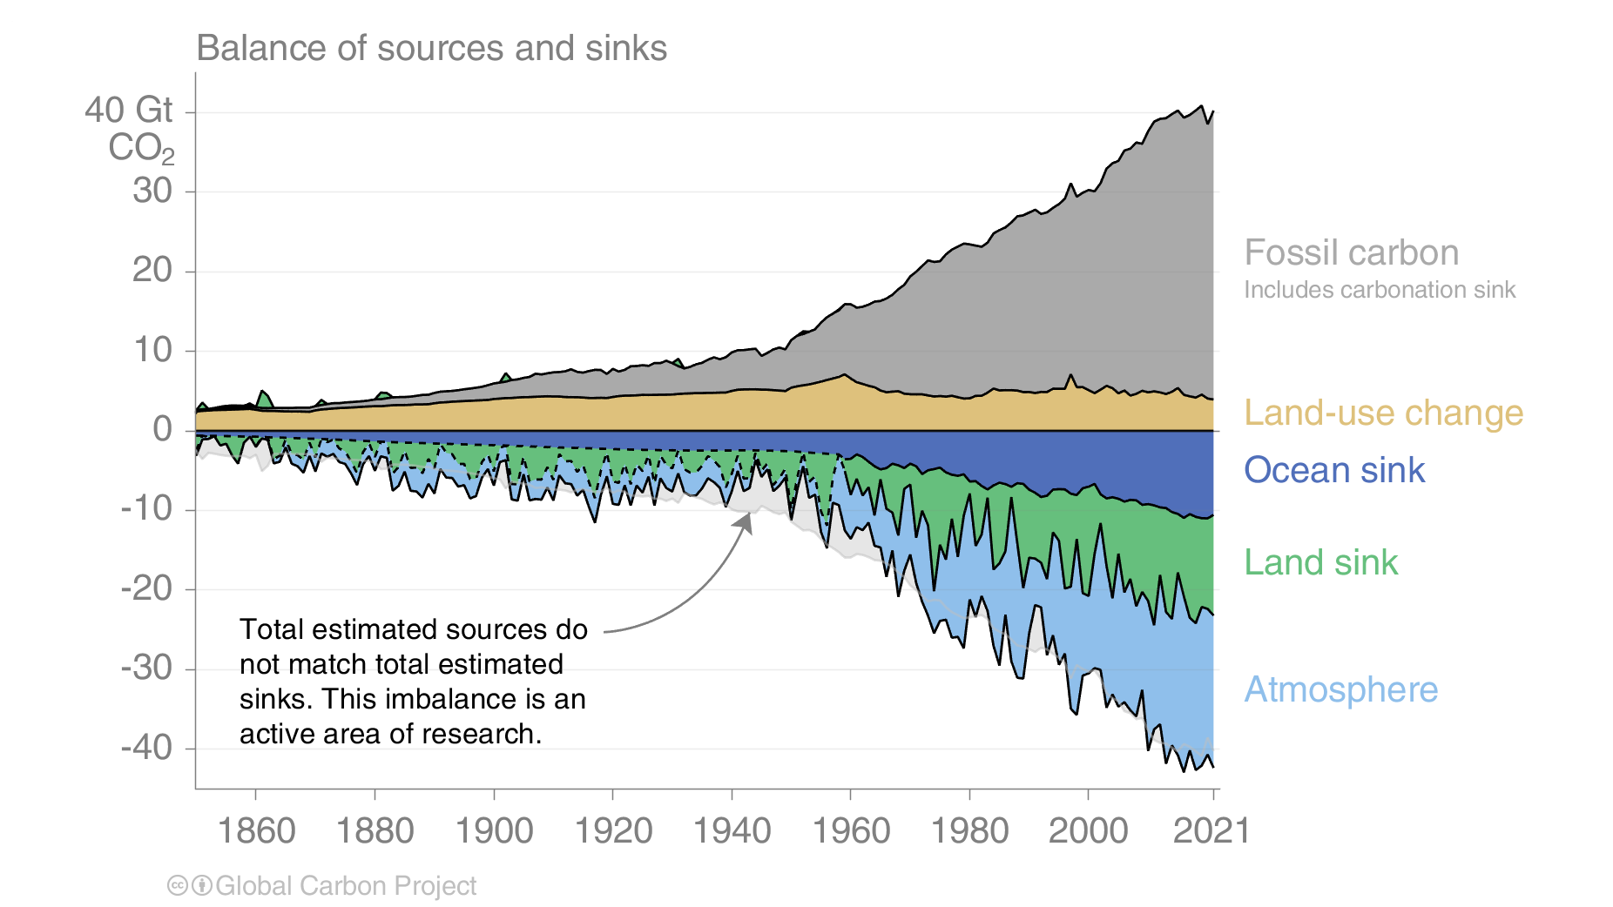
Carbon emissions are partitioned among the atmosphere and carbon sinks on land and in the ocean The “imbalance” between total emissions and total sinks is an active area of research
Motivation
Terrestrial ecosystems regulate the concentrations of CO₂ in the atmosphere through photosynthesis and respiration
Source: Friedlingstein et al 2023; Global Carbon Project 2023

Slide 4
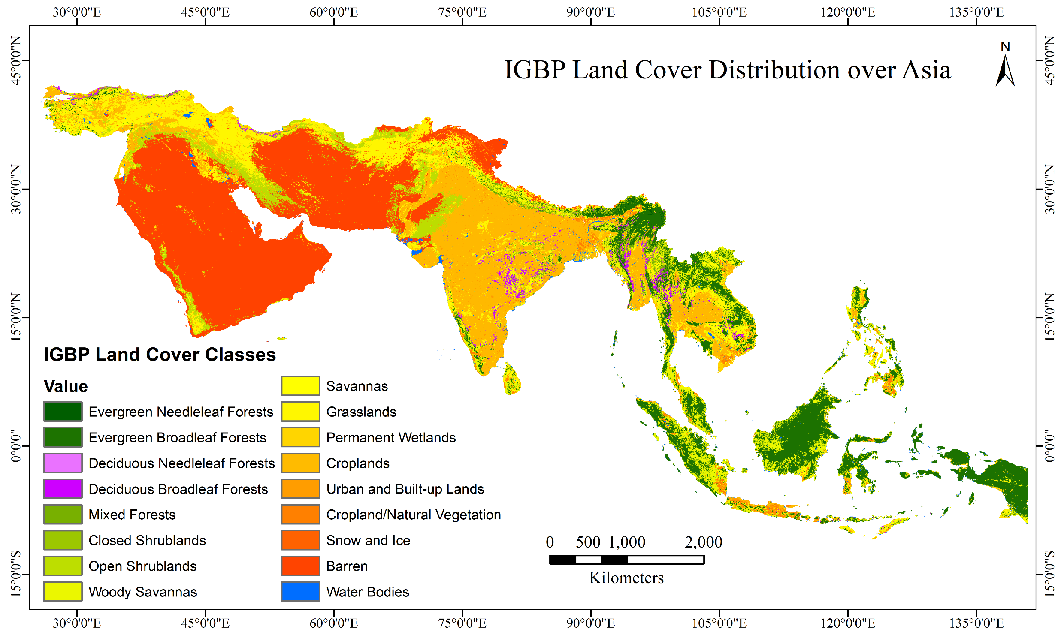
Hypothesis
Process models suggest that increasing atmospheric CO₂ drives the land and ocean sinks while climate change reduces the carbon sinks; the climate effect is largest in tropical and semi-arid land ecosystems.
Globally during the 2012-2021 decade, climate change reduced the land sink by ~17% and the ocean sink by ~4%
To Analyze the atmospheric CO₂ time series profile with the selected biophysical and meteorological variables
Source: Friedlingstein et al 2023; Global Carbon Project 2023

Slide 5
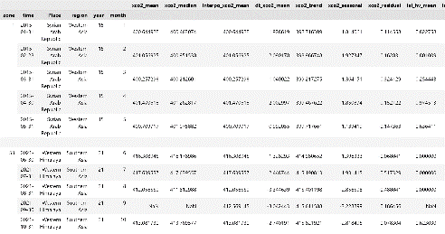
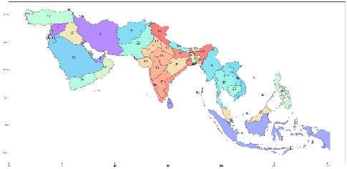
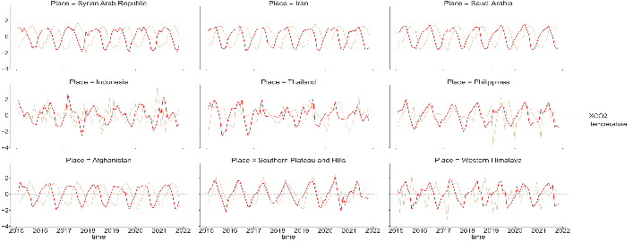
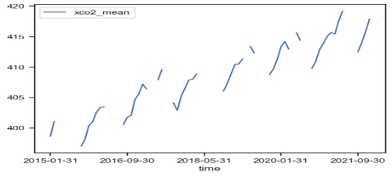
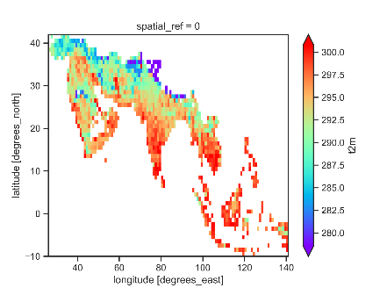
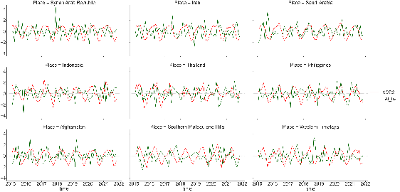
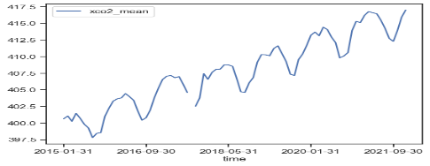
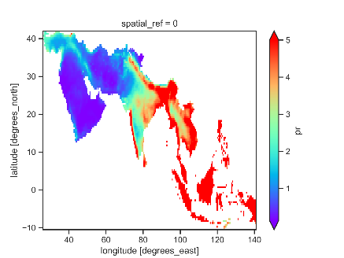
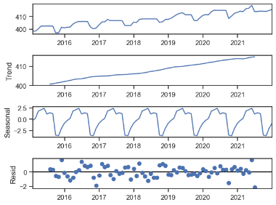
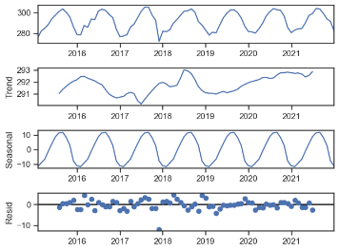
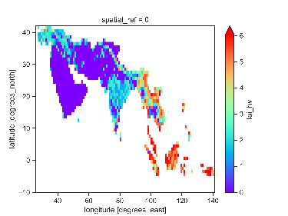
Materials and Methods
Data frame
XCO2 Daily
non grid
Zonal Time series analysis
Gridded data
Quality flag
Daily data
IAV and Anomalies
Missing data imputation
Air temperature
Time series creation
Bootstrap
analysis
Space time matching
Total precipitation
Time series Decomposition
Lead lag analysis
LAI

Slide 6
Results and Discussion

Slide 7
Maximum (Lag) correlation between XCO₂ and Bio-Climatic anomalies in each zone
Maximum Correlation:
Correlation
LAI-lv
LAI-hv
Precipitation
Temperature
Maximum Correlation occurrence at different (up to 4-months) Lag Period:
Lag in months
Latitude
Lag0
Lag1
Lag2
Lag3
Lag4
Significance (P Value) of Maximum Correlation occurrence:
P Value
Longitude
The tropical evergreen forest regions of SEA promptly exhibited a direct correlation between anomalies of CO₂ and temperature, as well as precipitation, with a positive effect
The arid zones of precipitation were negatively correlated with XCO2. which could indicate the dependency of precipitation on vegetation photosynthesis
Forest dominant regions of SA showed a negative correlation with high LAI and anomalies of CO_{2,} and vice versa (CO₂ withdraw through photosynthesis)

Slide 8
Maximum Correlation among Bio-Climatic anomalies in each zone
Maximum Correlation:
Temperature Vs LAI-lv
Temperature Vs LAI-hv
Temperature Vs Precipitation
Precipitation vs LAI-hv
Correlation
Precipitation vs LAI-lv
Maximum Correlation occurrence at different (up to 4-months) Lag Period:
Lag in months
Lag0
Lag1
Lag2
Lag3
Lag4
Latitude
Significance (P Value) of Maximum Correlation occurrence:
P Value
Longitude
Arid and semi-arid regions promptly exhibited a direct correlation between anomalies of LAI low and temperature (negative)
In Most of the regions, precipitation and low LAI correlated positively with different lags
In SEA, precipitation correlated negatively with high LAI (3 months lag )??
In SEA, temperature correlated negatively with precipitation (2 months lag )

Slide 9
Conclusions
In arid and semi-arid regions, precipitation could be a limiting factor for CO₂ withdrawal
Temperature and precipitation might not be a limiting factor for CO₂ withdrawal in tropical aseasonal forest-dominated regions
The tropical evergreen forest regions of SEA promptly exhibited a contemporaneous correlation between anomalies of CO₂ and temperature, as well as precipitation, with a positive effect
In SEA, precipitation correlated negatively with high LAI (3 months lag )
In SEA, temperature correlated negatively with precipitation (2 months lag)

Slide 10
References
Friedlingstein, P., O'sullivan, M., Jones, M.W., Andrew, R.M., Bakker, D.C., Hauck, J., Landschützer, P., Le Quéré, C., Luijkx, I.T., Peters, G.P. and Peters, W., 2023. Global carbon budget 2023. Earth System Science Data, 15(12), pp.5301-5369.
Budget, Global Carbon. "Global Carbon Budget 2023." (2023).
Rödenbeck, C., Zaehle, S., Keeling, R. and Heimann, M., 2020. The European carbon cycle response to heat and drought as seen from atmospheric CO2 data for 1999–2018. Philosophical Transactions of the Royal Society B, 375(1810), p.20190506.
Wang, W., Ciais, P., Nemani, R.R., Canadell, J.G., Piao, S., Sitch, S., White, M.A., Hashimoto, H., Milesi, C. and Myneni, R.B., 2013. Variations in atmospheric CO2 growth rates coupled with tropical temperature. Proceedings of the National Academy of Sciences, 110(32), pp.13061-13066.
Kondo, M., Ichii, K., Patra, P.K., Canadell, J.G., Poulter, B., Sitch, S., Calle, L., Liu, Y.Y., Van Dijk, A.I., Saeki, T. and Saigusa, N., 2018. Land use change and El Niño-Southern Oscillation drive decadal carbon balance shifts in Southeast Asia. Nature communications, 9(1), pp.1-11.

Slide 11
Thank you

