Slide 1
Seismic Site Characterization of Rajasthan, India with special emphasis on Seismic Hazard Microzonation study for few major populated cities
Pritam Singh and Sankar kumar Nath
Department of Geology and Geophysics
IIT Kharagpur, India-721302
SM8.1 - Assessment of Earthquake Related Hazards, Site Effects, and Microzonation , Room D2 on Monday, 15 April 2024, 09:45:EGU24-18652

Slide 2
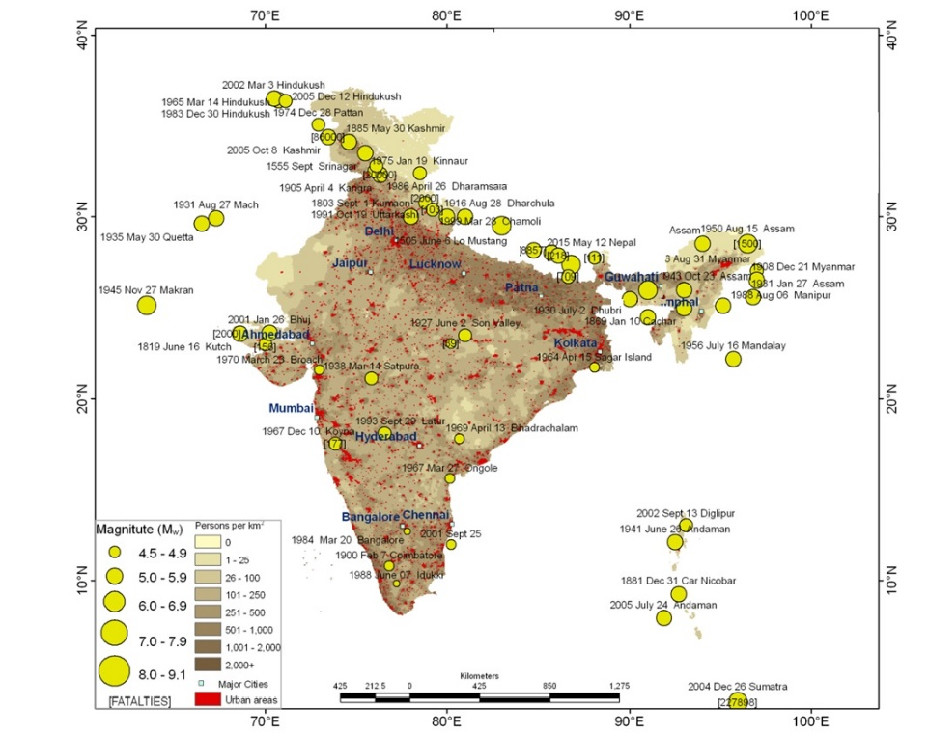
Introduction
Objectives
Methodology
Result
Conclusion
Isoseismal map of 2001 Bhuj Earthquake and damage building in Rajasthan.
Significant earthquake in India and its adjoining region depicted with epicentral location at the backdrop of population density distribution and major urban centers.

Slide 3
Introduction
Objectives
Methodology
Result
Conclusion
Followings are the major objectives of the present study:
Probabilistic Seismic Hazard Assessment (PSHA) at engineering bedrock considering both polygonal and tectonic sources for the state of Rajasthan.
Geophysical investigations worked out for effective shear wave velocity calculation.
Ground motion simulation using stochastic finite fault method for the earthquakes affecting Rajasthan.
Site response analysis for generating absolute site amplification distribution map for Rajasthan state.
Spatial distribution of surface-consistent Peak Ground Acceleration (PGA) for 10% probability of exceedance in 50 years for the state of Rajasthan.
Seismic hazard microzonation of four major cities in Rajasthan, namely Jaipur, Jodhpur, Jaisalmer and Udaipur.

Slide 4
Introduction
Objectives
Methodology
Result
Conclusion
Study Region:
(b)
(a)
(a) Seismotectonic map of Rajasthan and its surrounding and (b) Data coverage map of Rajasthan underlying surface geology.

Slide 5
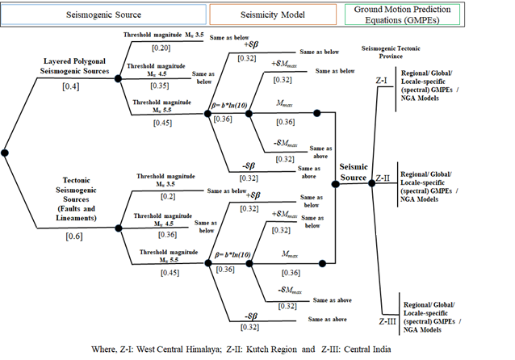
Introduction
Objectives
Methodology
Result
Conclusion
Computational Model for Probabilistic Seismic Hazard Analysis:
A logic tree framework implementing the fundamental PSHA formulation developed by Cornell (1968) and Esteva (1970):
Where, β = b ln(10), and b refers to the b-value of GR relation, m_{min} and m_{max} is the Minimum magnitude and Maximum magnitude.
(a>A):Annual frequency of exceedance of ground motion amplitude A,
λ :The activity rate for i^{th} source
P:Probability of a exceeding A given magnitude m at source-to-site distance r.
f_{r}(r):Probability density functions
f_{σ}(σ):Log - normal distribution
(Aleatory unceratainity)

Slide 6
Introduction
Objectives
Methodology
Result
Conclusion
Probabilistic Seismic Hazard Analysis at bedrock level:
Spatial distributions of Peak Ground Acceleration (PGA) at bedrock level for 10% probability of exceedance in 50 years for the state of Rajasthan

Slide 7
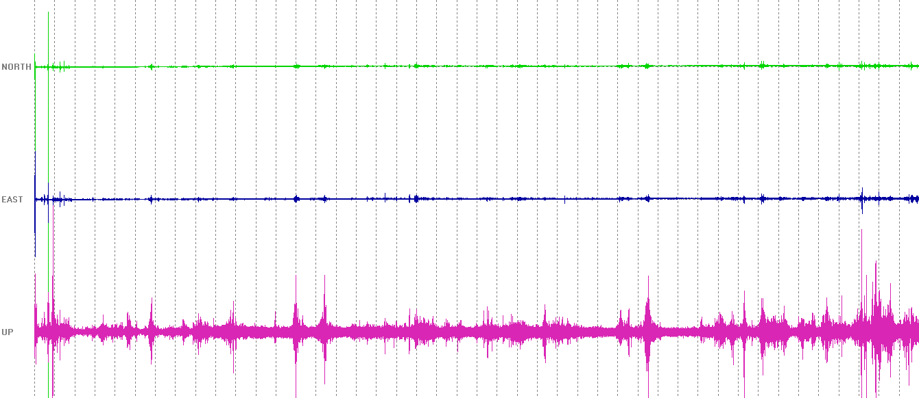
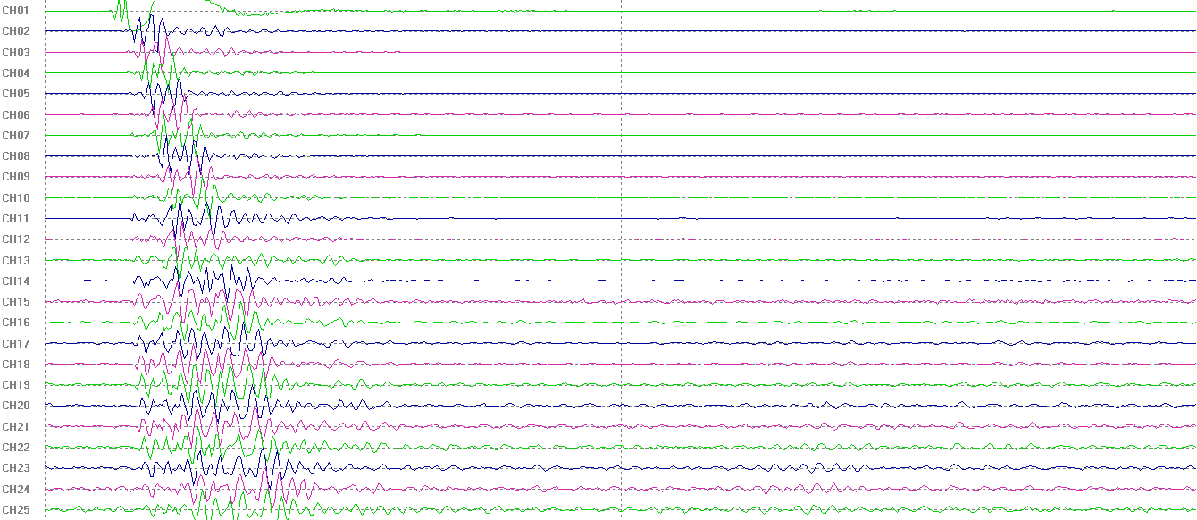
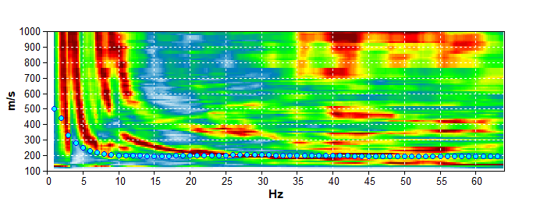
Introduction
Objectives
Methodology
Result
Conclusion
Geophysical Investigation: Ambient Noise Survey and Multi Channel Analysis of Surface Wave (MASW)
HVSR Technique:
HVSR$=\sqrt{\frac{\sum{P_{NS}\left(w\right)+\sum{P_{EW}\left(w\right)}}}{\sum{P_{v}(w)}}}$
Where, HVSR is the Horizontal/Vertical Spectral Ratio, $\sum{P_{NS}\left(w\right), \sum{P_{EW}\left(w\right)}}$and $\sum{P_{v}(w)}$are the power spectra of north-south, east-west and the vertical component respectively, the summation is taken over all the data blocks.
(a)
(c)
(d)
(f)
(e)
(b)
Representation of (a) Three component time-series data from Microtremor Survey, (b) average H/V curve in bold red line with synthesized H/V curve in bold blue and (c) synthesized 1D shear wave velocity with corresponding lithology inverted through H/V, (d) a 24-Channel MASW data, (e) Dispersion curves derived from MASW survey and (f) 1D shear wave velocity profile of the subsurface with corresponding obtained from Shastri Nagar (26.94°N, 75.80°E), Jaipur, Rajasthan.

Slide 8
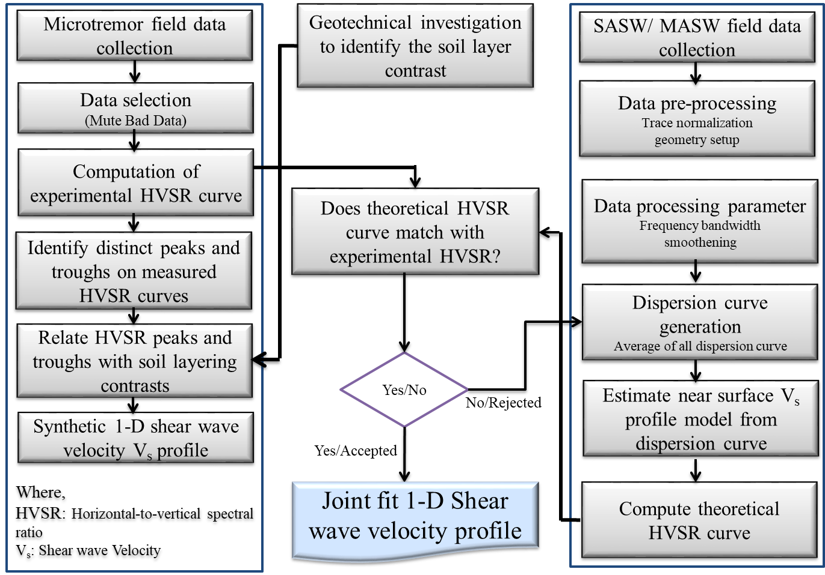
Introduction
Objectives
Methodology
Result
Conclusion
Joint inversion of H/V ratios and Dispersion curves:
(c)
(a)
(b)
Representative result of joint inversion of (a) Ambient Noise driven H/V curve and (b) dispersion curves derived from MASW survey and (c) 1D shear wave velocity profile of the subsurface with acquired at a site from Shastri Nagar (26.94°N, 75.80°E), Jaipur, Rajasthan.
The joint inversion of Rayleigh wave dispersion from SASW/MASW and H/V curves from microtremor record allows the retrieval of shear wave velocity profiles for the shallow subsoil.

Slide 9
Introduction
Objectives
Methodology
Result
Conclusion
Site Classification:
V_{S}³⁰ : Effective Shear wave velocity in top 30m depth of soil column
h_{i} : Thickness in meters
V_{i} : Shear wave velocity in m/s for the i^{th} layer from n layers in top 30m of the soil column.
Site Classification map of Rajasthan following Sun et al. (2018) site class.

Slide 10
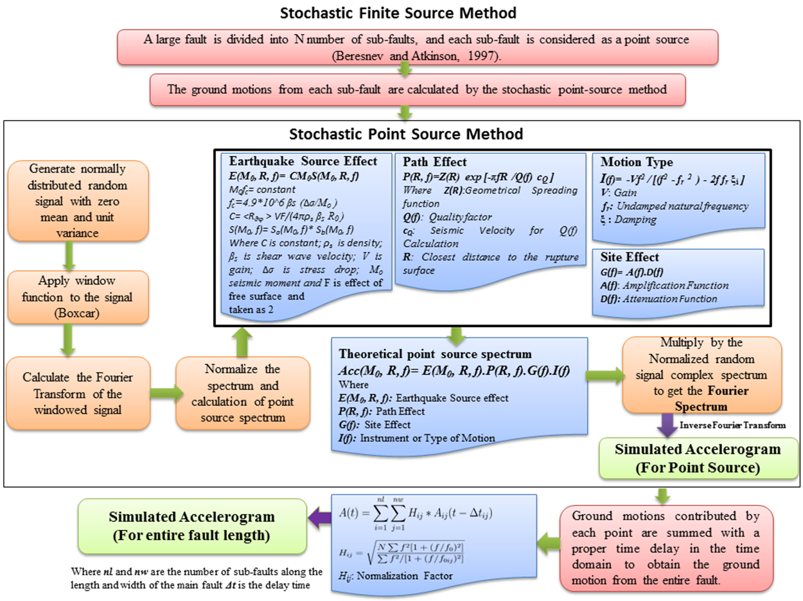
Introduction
Objectives
Methodology
Result
Conclusion
Ground Motion Simulation using “EXSIM”:
Earthquake source parameters used in this study
Parameter | 2001 Bhuj | 1938 Satpura | 1935 Quetta
Magnitude (M_{w}) | 7.6 | 6.2 | 7.7
Latitude | 23.36 | 21.53 | 29.50
Longitud | 70.34 | 75.83 | 66.80
Focal depth (km) | 20 | 40 | 20
Shear-wave velocity( β) (km/s) | 3.7 | 3.5 | 3.1
Crustal density (g/cm³) | 2.8 | 2.5 | 2.8
Stress drop(bars) | 160 | 110 | 567
Quality factor | 790f ^{0.35} | 800f ^{0.72} | 790f ^{0.35}
Kappa factor | 0.025 | 0.020 | 0.024
Strike | 298 | 124 | 33
Dip | 39 | 47 | 68
Pulsating area | 25% | 25% | 25%
Slip distribution | Random field | Random field | Random field
Geometrical spreading | 1/R (R<100 km) 1/R^{0.5} (R>100 km)
Windowing function | Saragoni and Hart (1974)
Damping | 5%

Slide 11
Introduction
Objectives
Methodology
Result
Conclusion
2D Site Response Analysis using “PLAXIS 2D”:

Slide 12
Introduction
Objectives
Methodology
Result
Conclusion
Surface-consistent Probabilistic Seismic Hazard:
(a)
(b)
Spatial distributions of (a) Absolute site Amplification Factor, and (b) Peak Ground Acceleration (PGA) at surface level for 10% probability of exceedance in 50 years for the state of Rajasthan

Slide 13
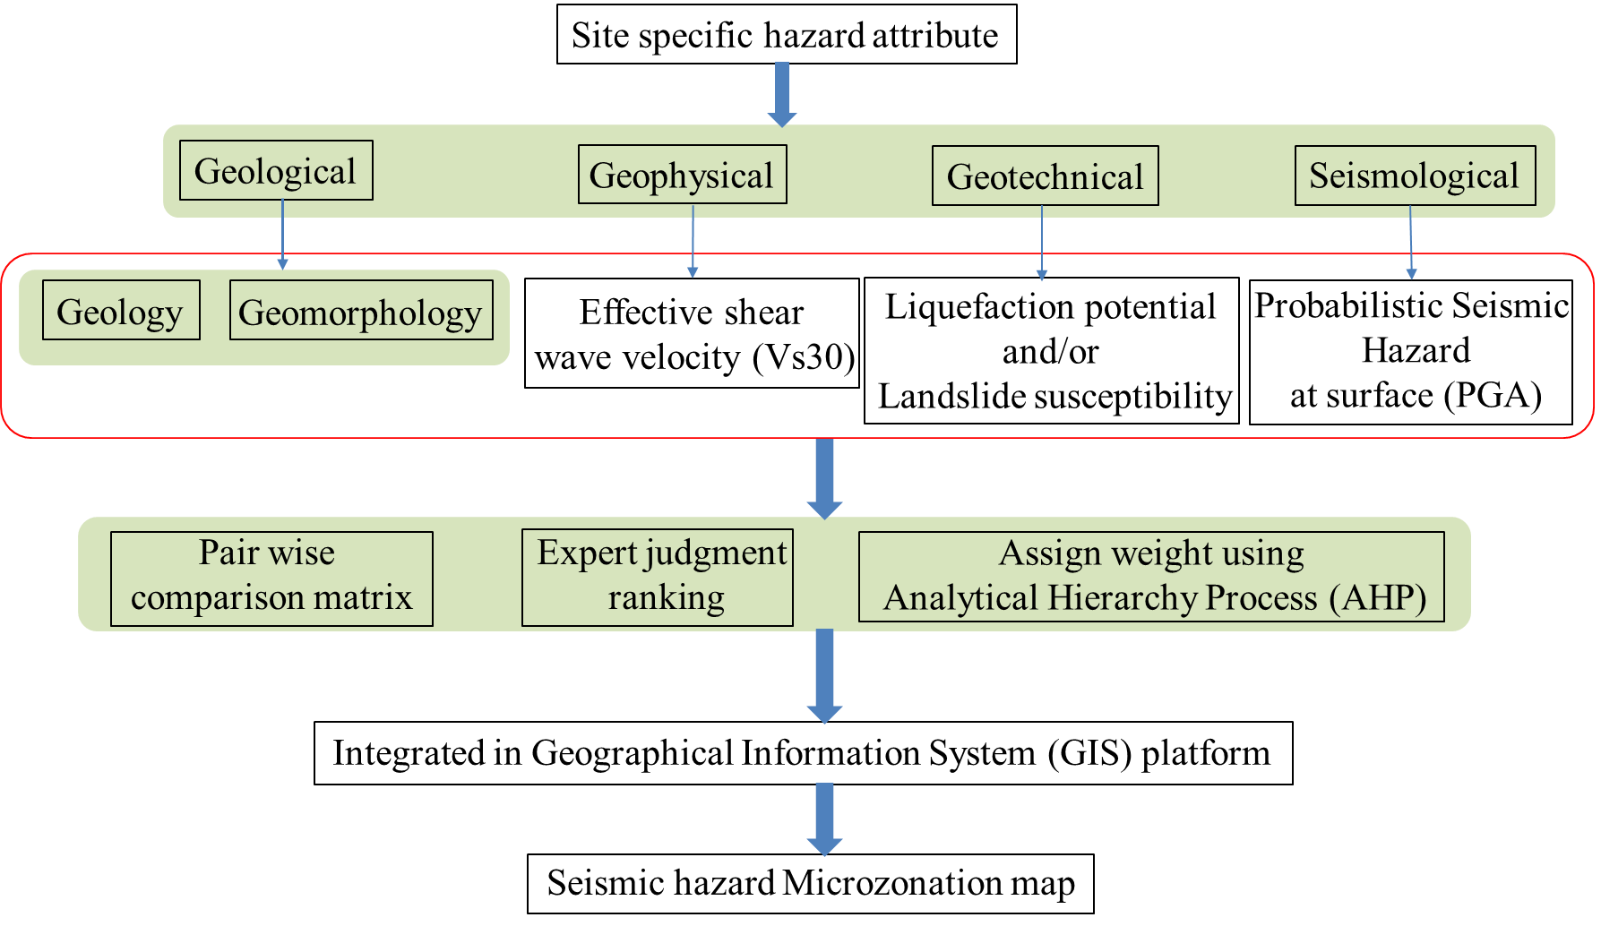
Introduction
Objectives
Methodology
Result
Conclusion
Seismic hazard Microzonation:
Analytical Hierarchy Process (AHP)

Slide 14
Introduction
Objectives
Methodology
Result
Conclusion
(a) Peak Ground Acceleration at surface, (b) Effective shear wave velocity, (c) Surface geology, (d) Geomorphology and (e) Seismic hazard Microzonation map of Jaipur city, Rajasthan.

Slide 15
Introduction
Objectives
Methodology
Result
Conclusion
Seismic hazard Microzonation:
(a)
(b)
(c)
Seismic hazard Microzonation map of (a) Jodhpur, (b) Jaisalmer and (c) Udaipur from the the state of Rajasthan.

Slide 16
Introduction
Objectives
Methodology
Result
Conclusion
Summary and Conclusion:
The Site classification mapping of the study region is believed to play an important role in large-scale seismic risk studies, site response analysis, site characterization, microzonation studies and earthquake-related disaster mitigation and management of the terrain.
Site characteristics have a substantial impact on a region's seismic hazard potential, hence its characterization has emerged as essential to estimate the seismic hazard connected to high-risk metropolitan areas around the world.
Based on the geophysical database, the current study evaluates a site response analysis towards holistic site characterization of the State of Rajasthan along with absolute amplification factor varying between 1.21 to 3.52.
The surface-consistent PGA distribution exhibits the range of 0.10-0.68 g for 10% probability of exceedance in 50 years. In order to accomplish an earthquake-safe urban development plan, these site criteria may eventually be incorporated in establishing new seismic design codes for Rajasthan.
Seismic hazard Microzonation of the four cities will play a crucial role in risk assessment, site specific design and improvement of safety standard for future seismic activities.

Slide 17
Introduction
Objectives
Methodology
Result
Conclusion
Major References Cited:
Cornell, C. A. (1968). Engineering Seismic Risk Analysis, Bulletin of Seismological Society of America, 58, 1583–1606, https://doi.org/10.1785/BSSA0580051583.
Esteva, L. (1970). Seismic Risk and Seismic Design Decisions, In Seismic Design for Nuclear Power Plants, R. J. Hansen (Editor), Massachusetts Institute of Technology Press, Cambridge, MA, USA, 142–82.
Nath, S. K. (2017). Probabilistic Seismic Hazard Atlas of 40 Cities in India. Geoscience Division, Ministry of Earth Sciences (MoES), Govt. of India, New Delhi, © MoES, Govt. of India, 457p.
Nath, S.K. (2016). Seismic Hazard, Vulnerability and Risk Microzonation Atlas of Kolkata. Geoscience Division, Ministry of Earth Sciences (MoES), Govt. of India, New Delhi.
Sun, C. G., Kim, H. S., and Cho, H. I. (2018). Geo-Proxy-Based Site Classification for Regional Zonation of Seismic Site Effects in South Korea. Applied Sciences 8(2), 314. https://doi.org/10.3390/app8020314.

Slide 18
Thank you

