Slide 1
Supplementary materials
The uplift of East Africa-Arabia swell: the signature of the mantle upwelling and spreading
Andrea Sembroni, Claudio Faccenna, Thorsten W. Becker, and Paola Molin

Slide 2
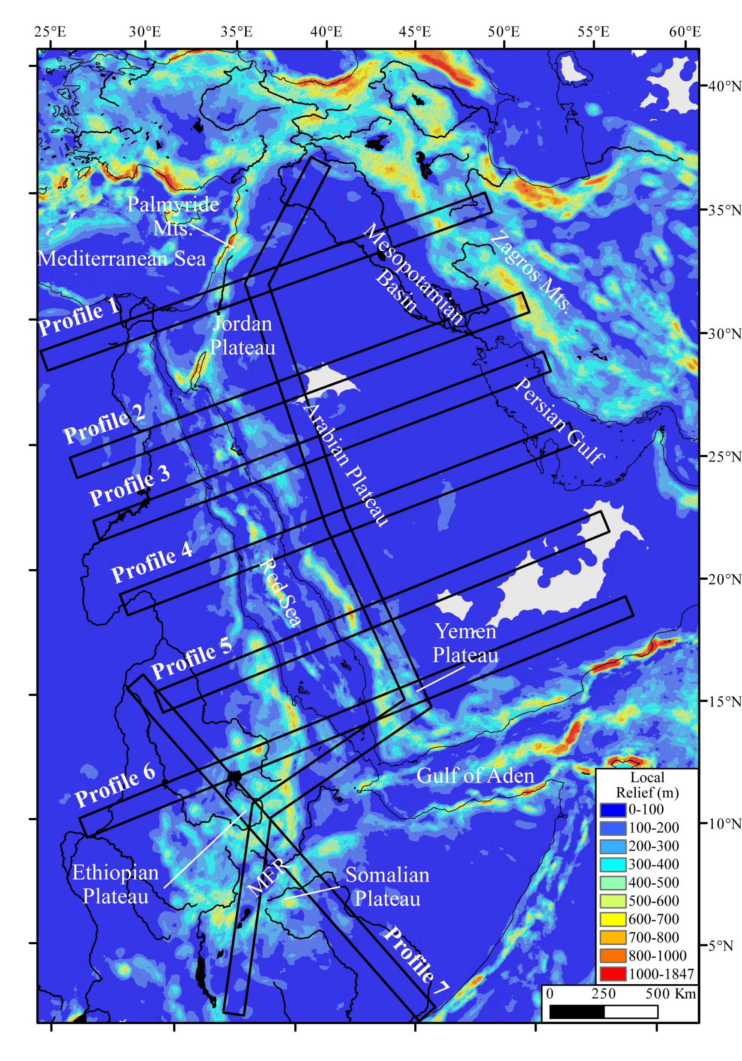
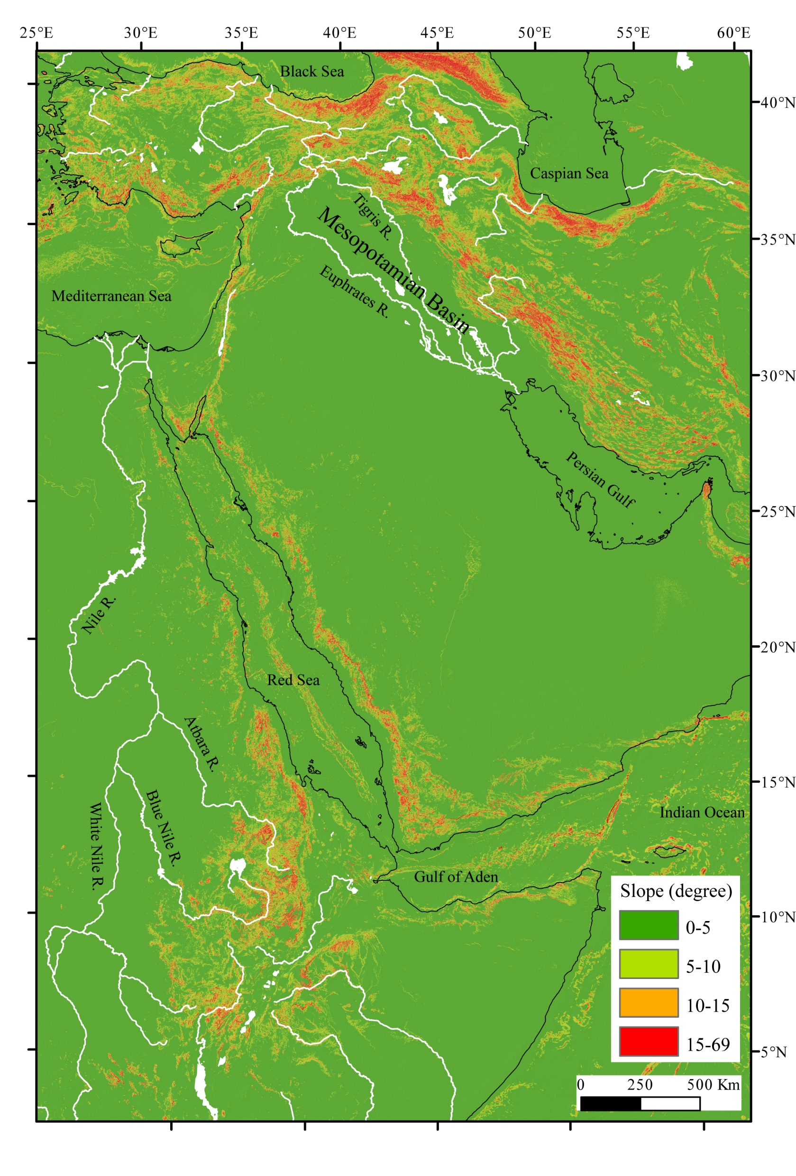
Local relief map of the study area realized in GIS environment by a circular smoothing window (30 km in radius).
Slope map

Slide 3
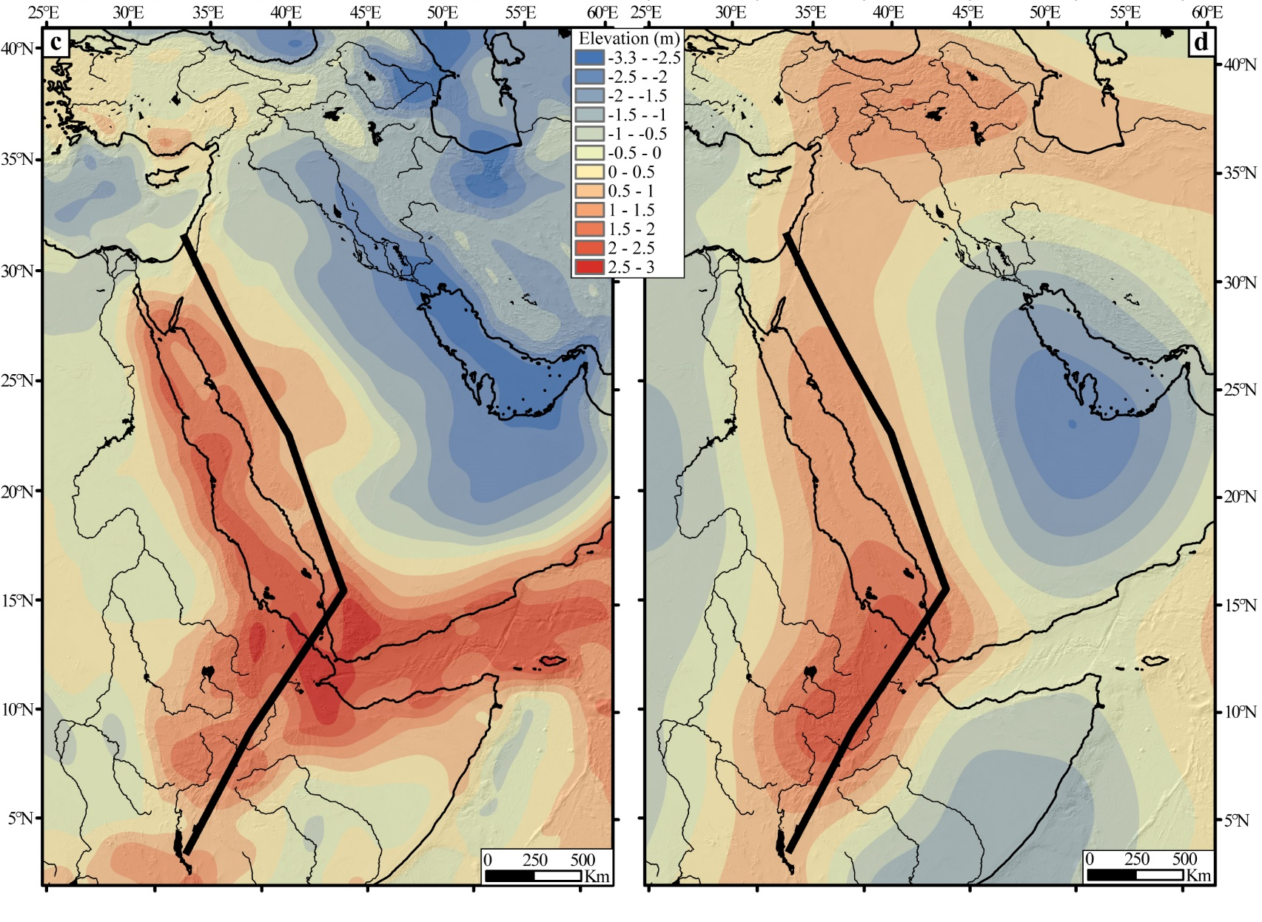
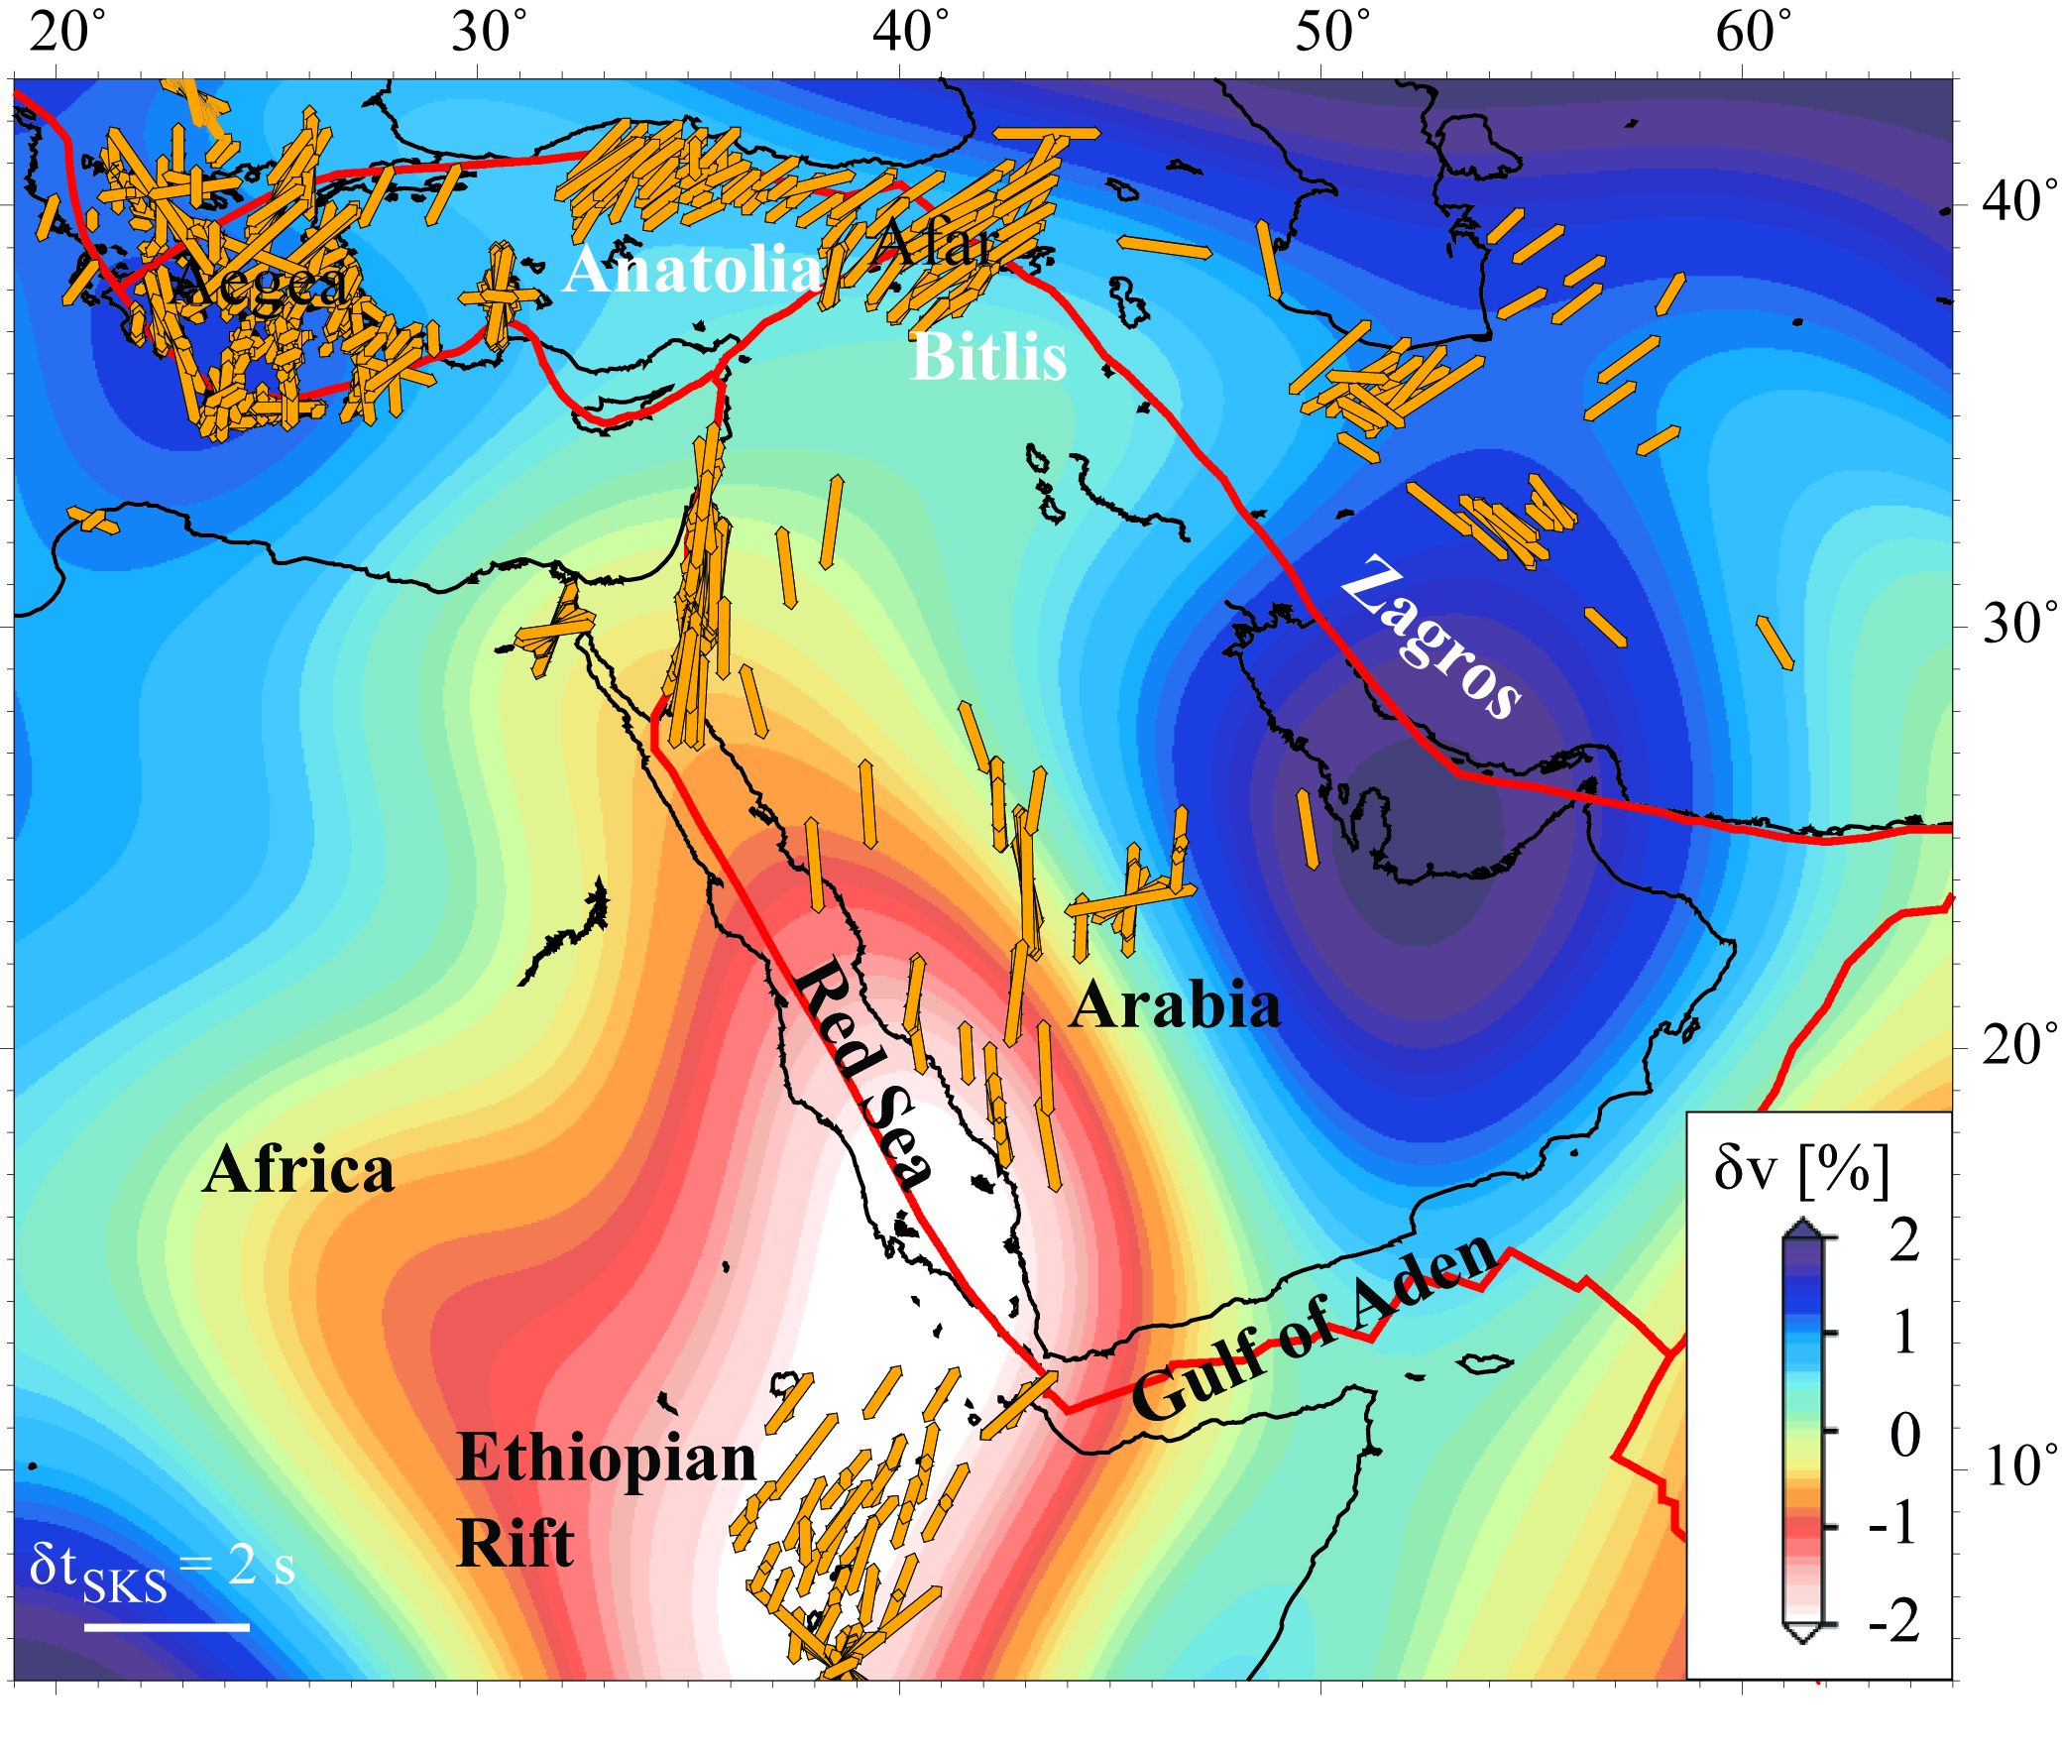
Tomography model averaged over uppermost mantle depths from 150 to 400 km. The yellow sticks indicate the fast velocity polarization orientation from azimuthal anisotropy (modified after Faccenna et al., 2013).
Residual topography
Dynamic
topography

Slide 4
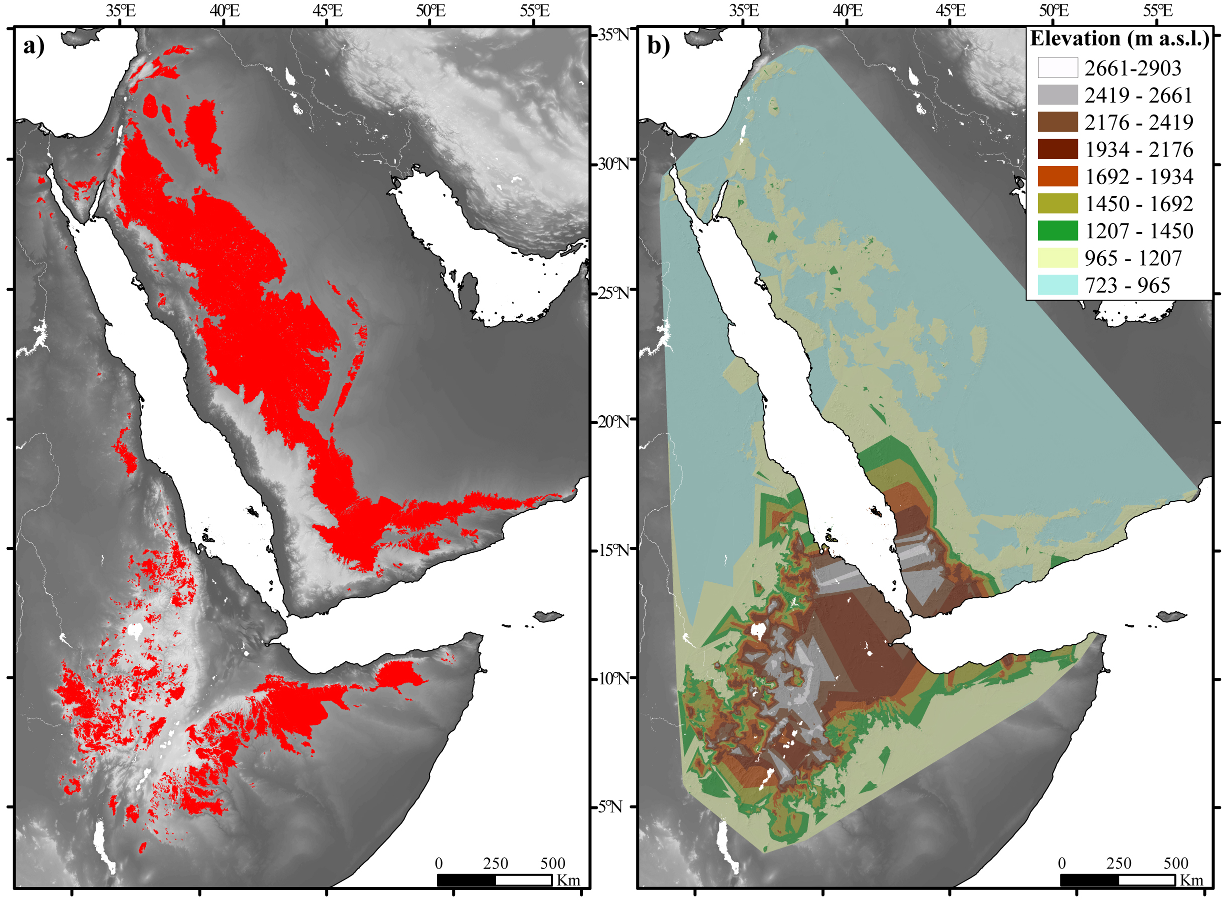
TIN surface obtained by interpolating the points at the edges of each surface remnants
East Africa - Arabia swell top surface remnants

Slide 5
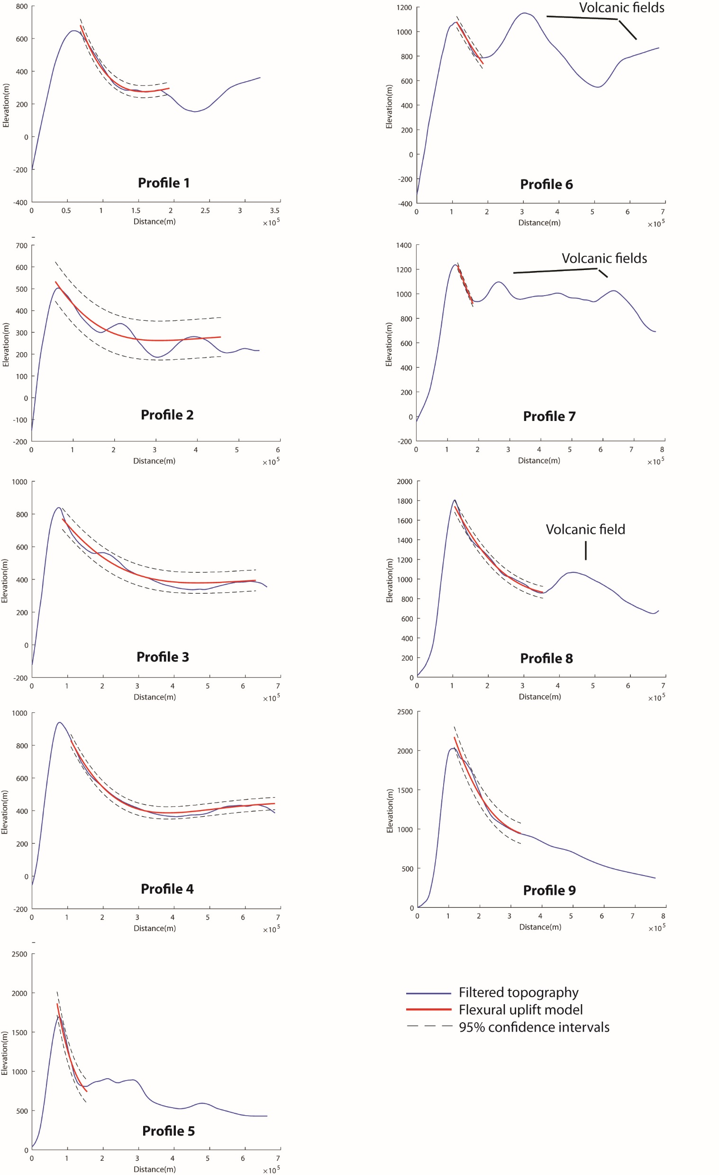
Traces of the topographic profiles extracted from the filtered topography (30 km radius smoothing circular window)

Slide 6
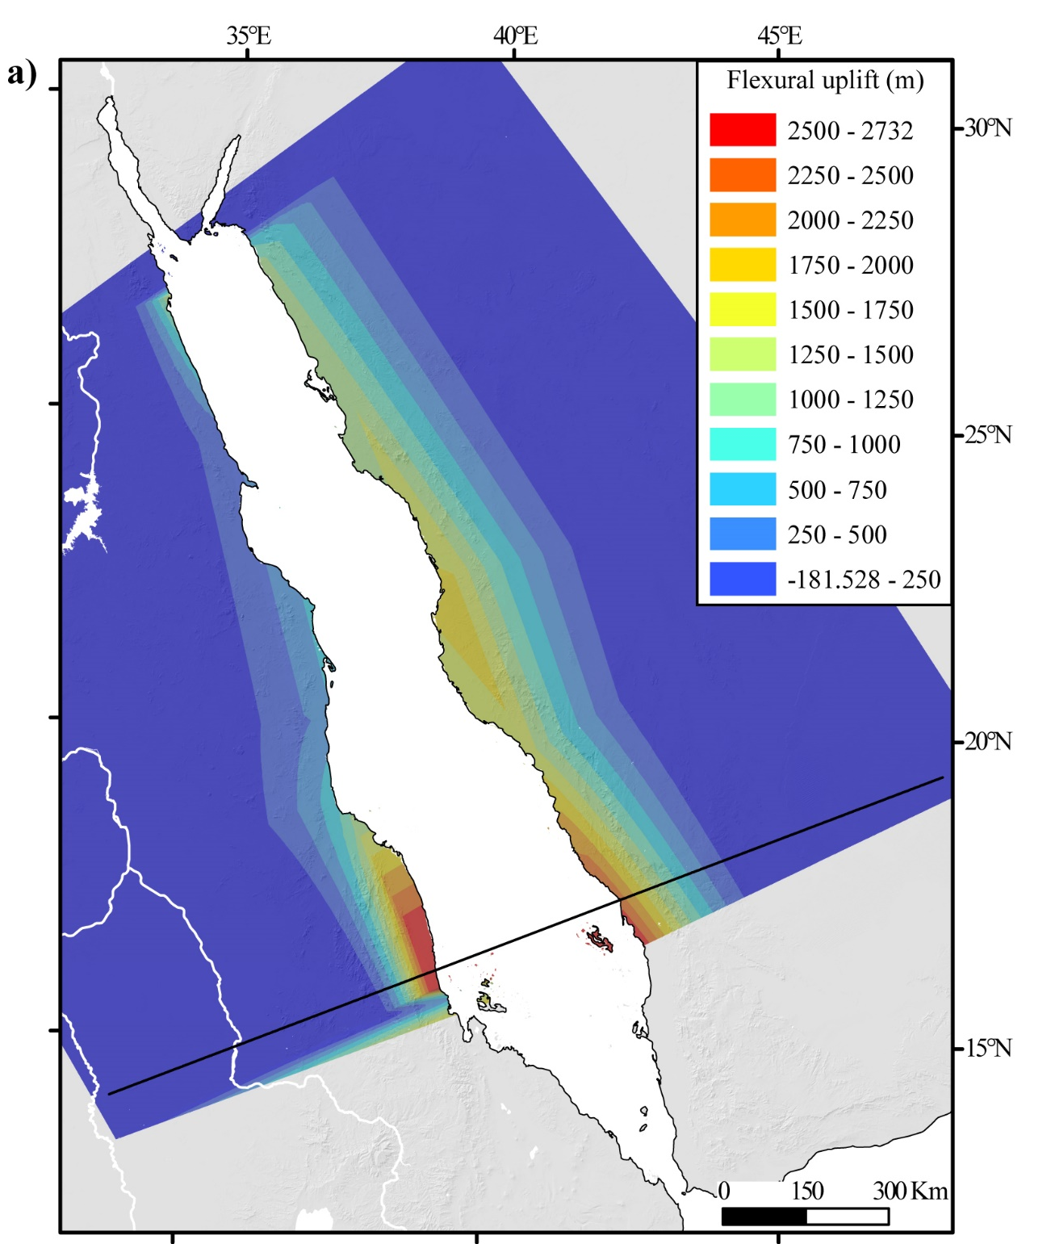

Slide 7
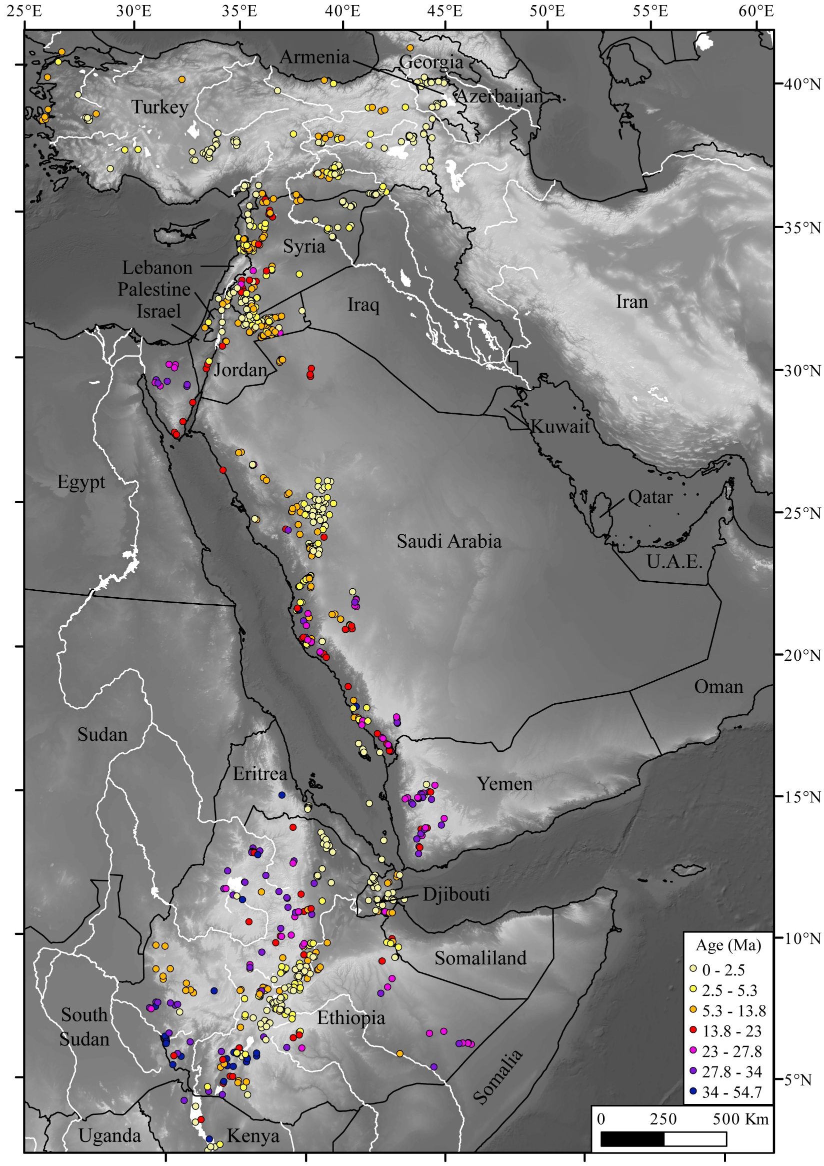
Volcanic deposits
Bimodal distribution characterized by a marked minimum at 16-17 Ma and at 8-9 Ma

Slide 8
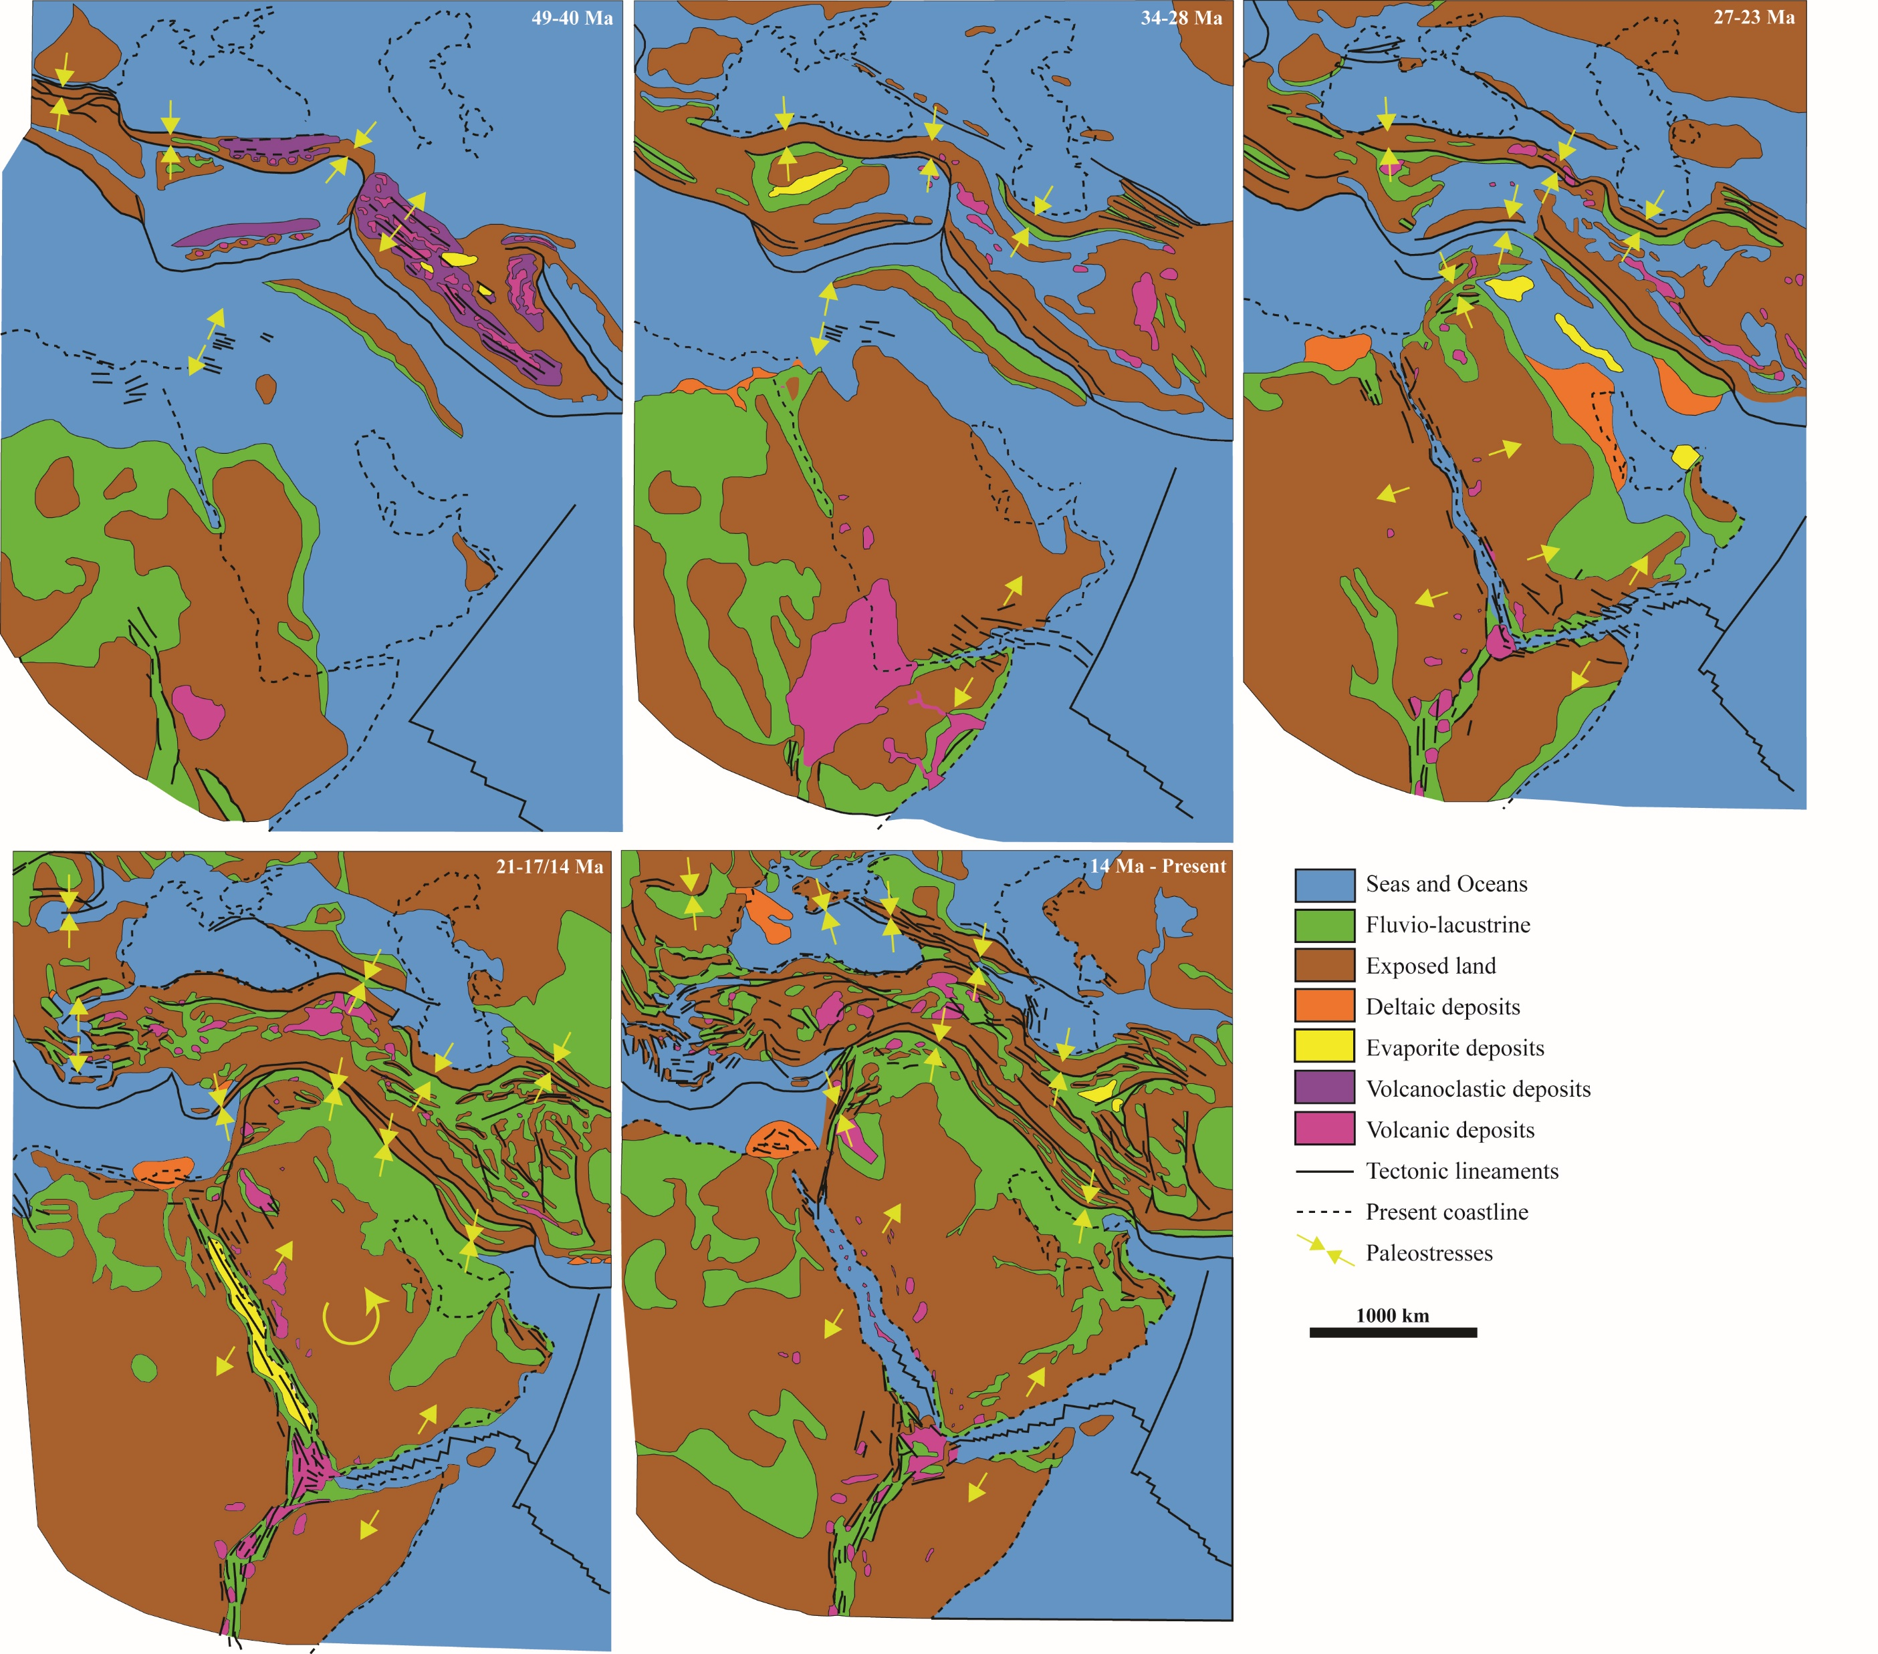
Tectonic evolution of the study area (modified after Barrier and Vrielynck, 2008).

