Slide 1
Green Panel performance testing –
Analysis from one season of monitoring data and implications for urban scale applications
Sean Vrielink (Karina vink), Department of civil engineering & management, Faculty of engineering technology

Slide 2
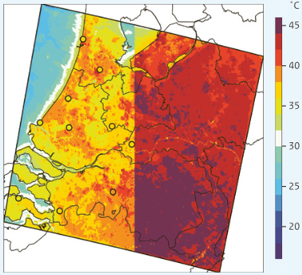
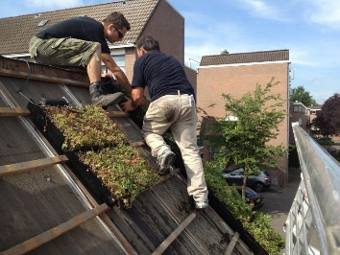
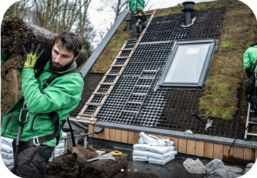
Climate change impacts
How can GI help reduce negative impacts
Impacts for the Netherlands in 2050-2100
Current climate zone: Cfb (Temperate, no dry season, warm summer), 2070: Cfb/Cfa (hot summer)
Temperature average increase of 0,9 - 4,4°C; winter 0,7 - 3,9 °C and summer 1,2 - 5,1 °C
Wetter seasons with winters +4-24% precipitation, spring +1-10%, fall +4-13%
Drier summers with -8 - -12% precipitation, annual average precipitation 851 mm, chances of precipitation shortages >265mm increase with 16-63%
Green roofs can help reduce climate change impacts
Cooling through shade/leaf reflection and water loss to the atmosphere
Water absorption and evapotranspiration in soil and vegetation
Sequestering atmospheric carbon in biomass
Reducing temperature extremes through insulation
Existing types of green roofs
Several types applied on flat roofs, commercially available and financed by insurance companies/municipalities
Few types available for sloped roofs (e.g. ecopan), but none that leave existing roofs intact

Slide 3
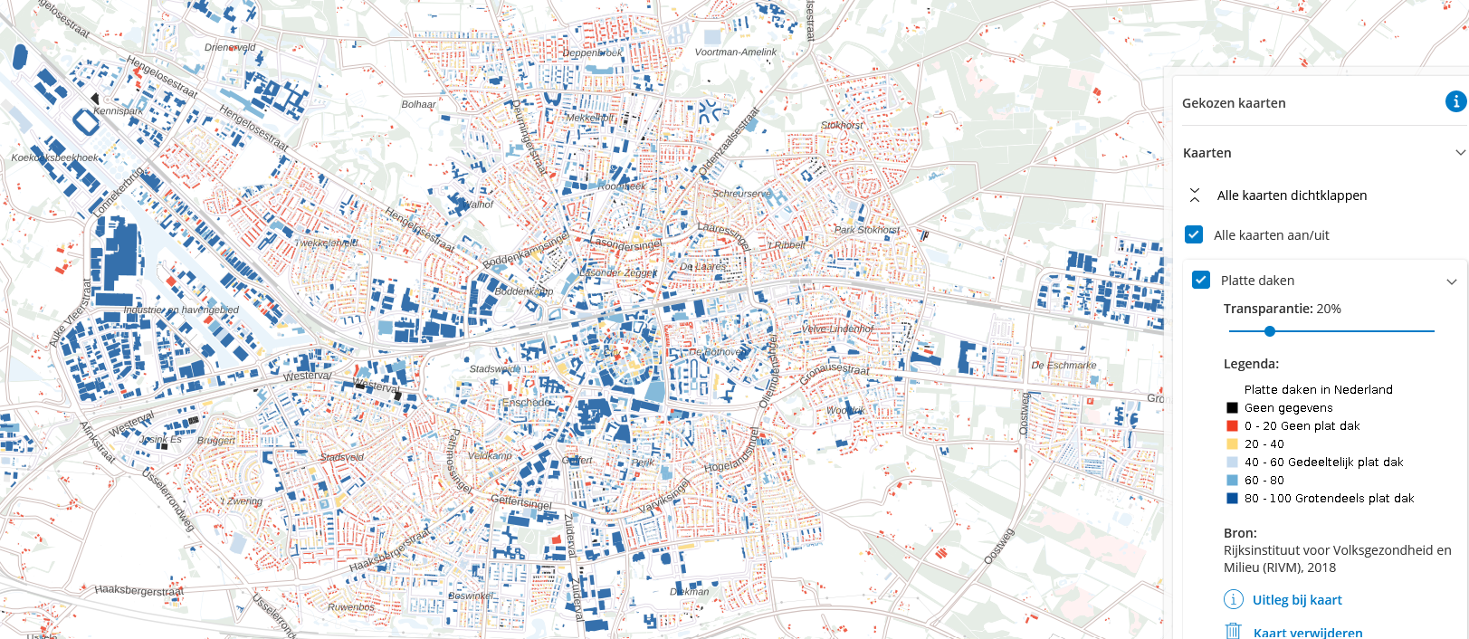
Red-yellow colors show the number of non-flat roofs for the city of Enschede, Netherlands

Slide 4
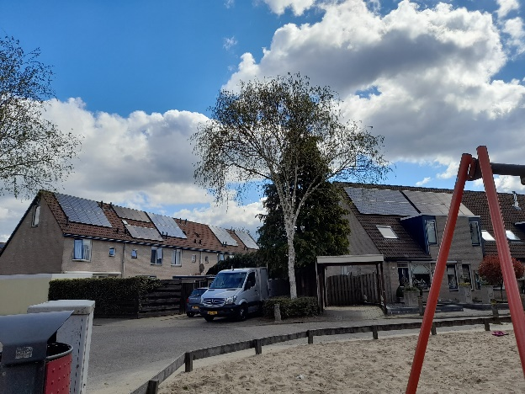
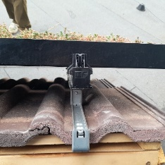
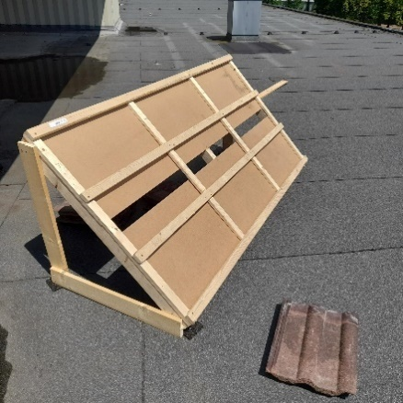
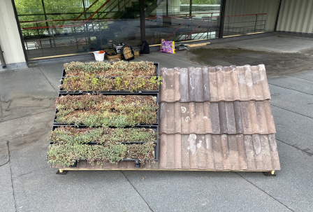
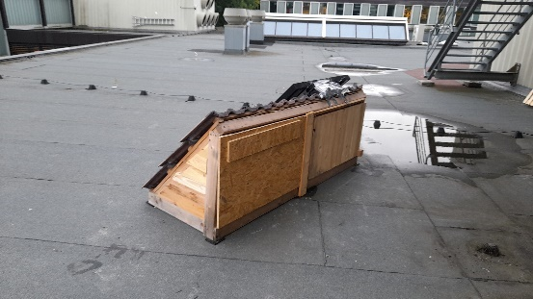
Green panels
Designed for sloped roofs
Design points
Fits on solar panel railings so that one side of the roof can be fitted with solar panels and the other with green panels
Consists of long thin trays that allow for water capture and plant growth
Developed by Aurélio Wijnands (https://lelowijnands.wixsite.com/greenpanels)
Construction
New and recycled wood, recycled roof tiles, nails, labels, plastic covers
Later modifications: recycled wood to enclose the roof, sensebox covers
About 1 m2 of roof for Green Panels and 1 m2 for control roof

Slide 5
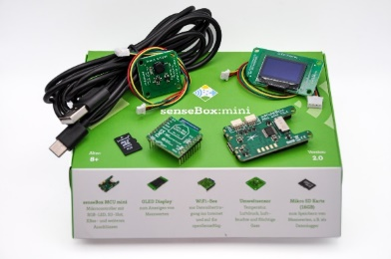
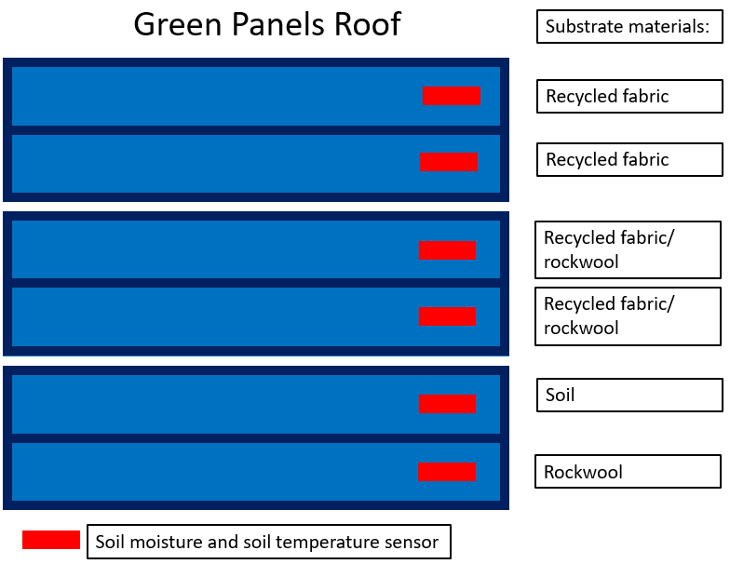
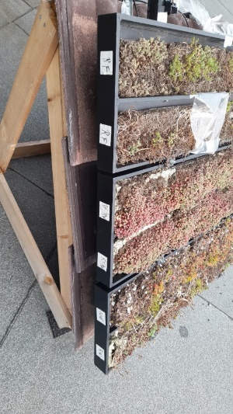
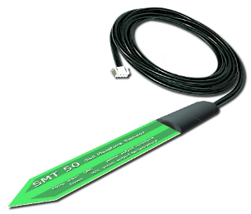
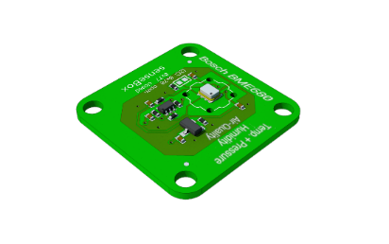
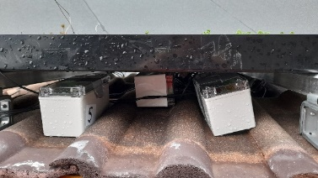
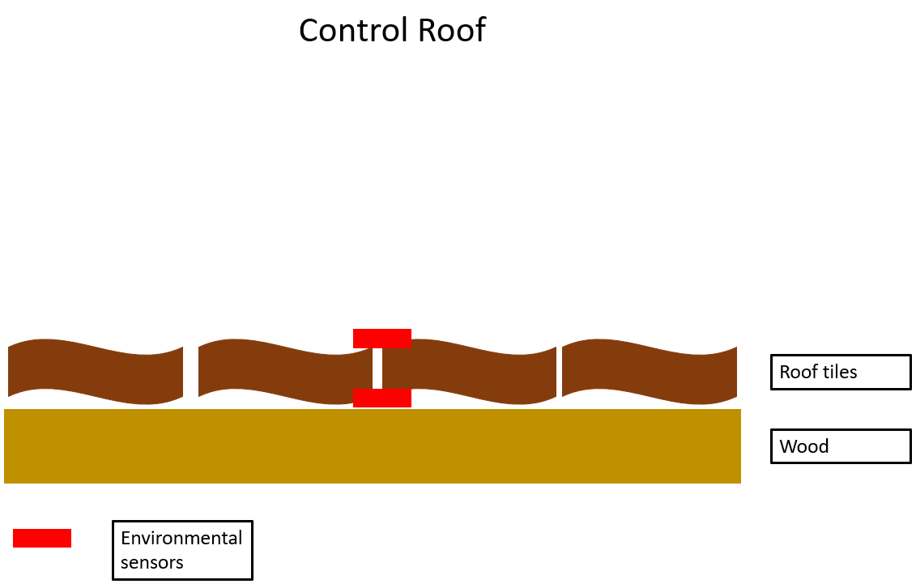
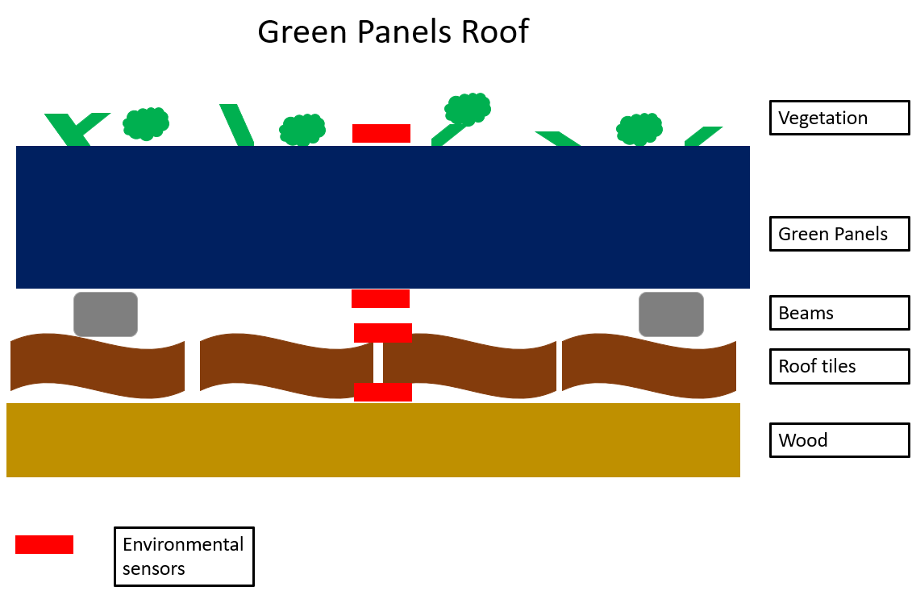
Green panels and sloped roof demonstrator
https://opensensemap.org/
Equipment and sensor network
Sensebox mini data logger
Soil moisture & soil temperature sensors (SMT50)
Environmental Sensors (BME680)
Air pressure, air temperature, Volatile Organic Compounds, and humidity.

Slide 6
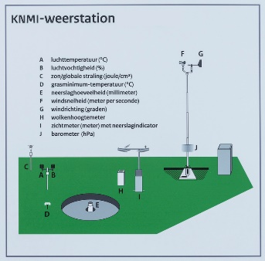
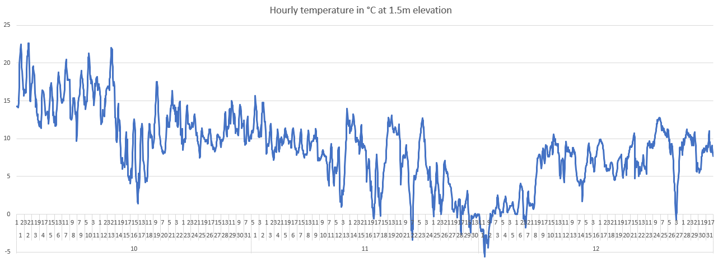
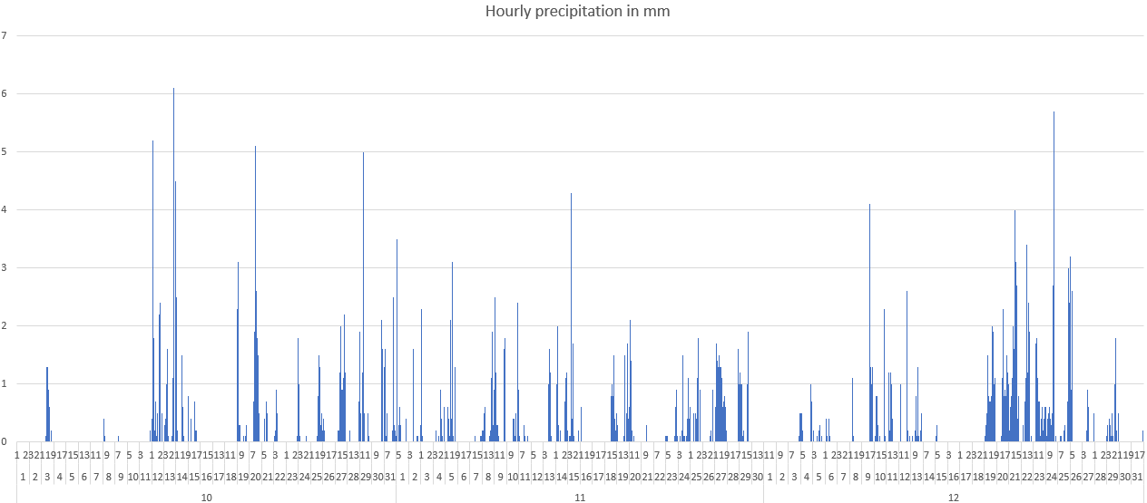
KNMI Provides reliable and consistent measurements, data, and forecasts to alert for extreme weather conditions, climate, and earthquakes, >170 years.
KNMI weather parameters
Validation with royal Dutch meteorological institute data
Hourly data for weather station ~4km
October
First half warm, >20°C
Second half colder, wetter (wettest October since 1906)
November
Storms, day temperature 15-10°C
End of the month frost and several cm of snow
December
Cold start, -10 at night, days >0°C
Later, day temperatures ~10°C
Rain nearly every day, 2-5cm snow during the first week
Only 20h of sun in Twente

Slide 7
Hypotheses and datasets
https://archive.opensensemap.org/
Highest temperature extremes
1 Control roof top of tiles
2 Control roof bottom of tiles
3 Green Panels top of Panels
4/5 Green Panels bottom of Panels
4/5 Green Panels top of tiles
6 Green Panels bottom of tiles
Highest soil moisture capture
Water retention capacity:
  Rockwool – 93%
  Recycled fabric – 80%
  Soil – 53%
Expect that recycled fabric/rockwool has around 87% water retention capacity
1,980 csv files
Data gaps due to intermittent power
Transforming data for comparison
Hourly average
box # | 0 | 1 | 2 | 3 | 4 | 5
Total days data/box | 43 | 58 | 57 | 53 | 53 | 60
% of total days (92) | 47 | 63 | 62 | 58 | 58 | 65

Slide 8
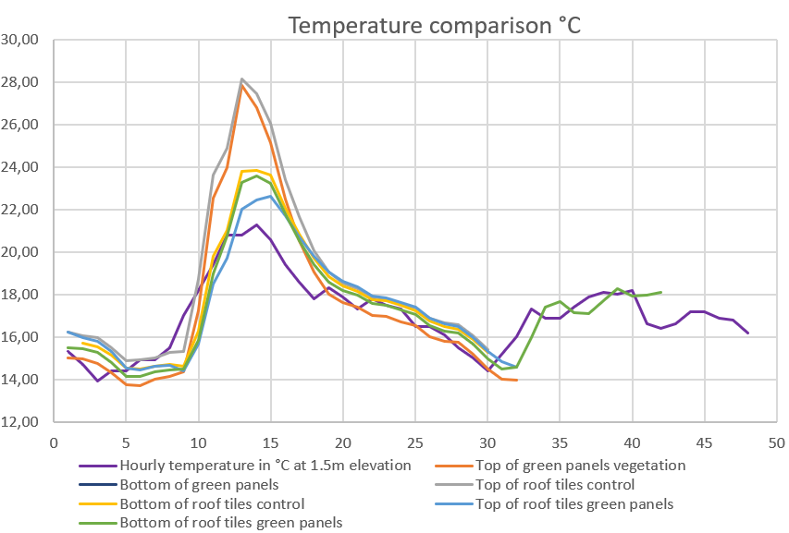
results
Temperature – warm day
Data cleansing and validation
Box 1 had errors for temperature (stuck on -1,00 or 30,65 °C, 67%)
Box 3 had errors for temperature (values over 79 °C, 0.02%)
Typical warm, average, cold day
Warm: 9-11 October
Average: 8-9 November
Cold: 1-2 December
Warm day
All boxes warmer than average – might be due to black flat roof surroundings
Roof not yet enclosed, hot air may affect bottom of roof tiles
1 Control roof top of tiles
3 Green Panels top of Panels
2 Control roof bottom of tiles
6 Green Panels bottom of tiles
4/5 Green Panels top of tiles

Slide 9
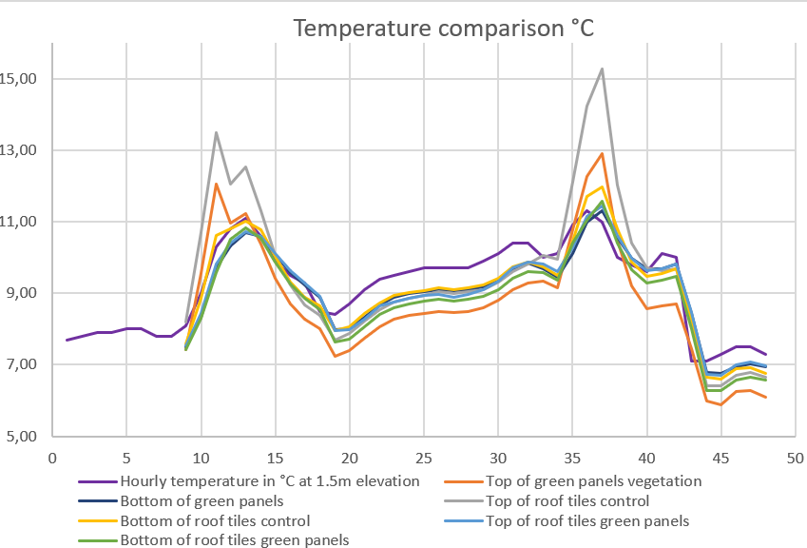
results
Temperature – average day
Data cleansing and validation
Box 1 had errors for temperature (stuck on -1,00 or 30,65 °C, 67%)
Box 3 had errors for temperature (values over 79 °C, 0.02%)
Typical warm, average, cold day
Warm: 9-11 October
Average: 8-9 November
Cold: 1-2 December
Average day
All boxes colder at night, half warmer during the day
Top of green panels cools down more than control roof

Slide 10
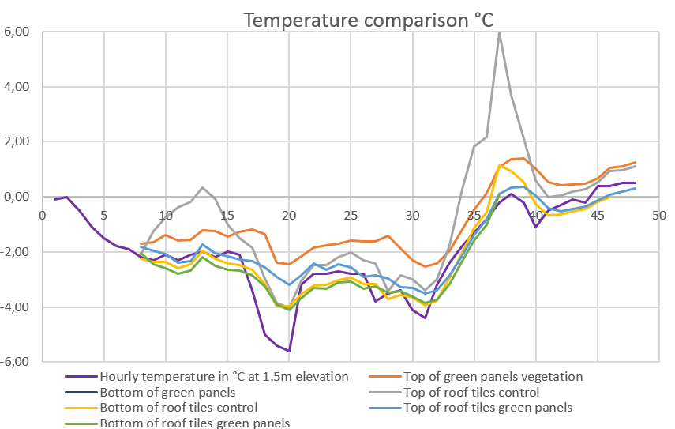
results
Temperature – cold day
Data cleansing and validation
Box 1 had errors for temperature (stuck on -1,00 or 30,65 °C, 67%)
Box 3 had errors for temperature (values over 79 °C, 0.02%)
Typical warm, average, cold day
Warm: 9-11 October
Average: 8-9 November
Cold: 1-2 December
Cold day
Top of roof tiles peaks both hot and cold, whereas top of green panels is more stable

Slide 11
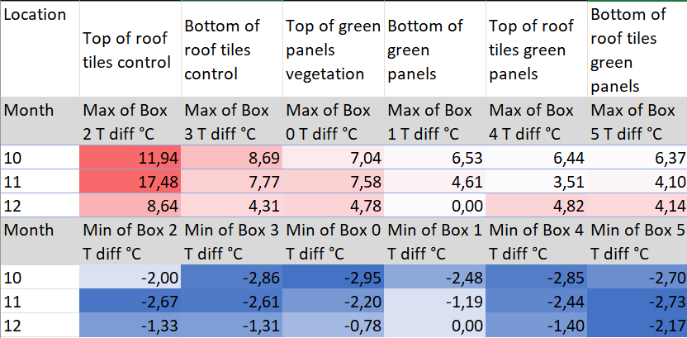
results
Temperature – max/min differences
Max/min differences
Warm
Top of roof tiles the hottest, highest difference 13.4°C
Green panels all cooler especially in warmer months (10-11), same temperature as bottom of tiles for control in December
Cold
Effect not noticeable and even in reverse as bottom of green panel roof tiles is colder than top of roof tiles control
Bottom of green panels has least extremes

Slide 12
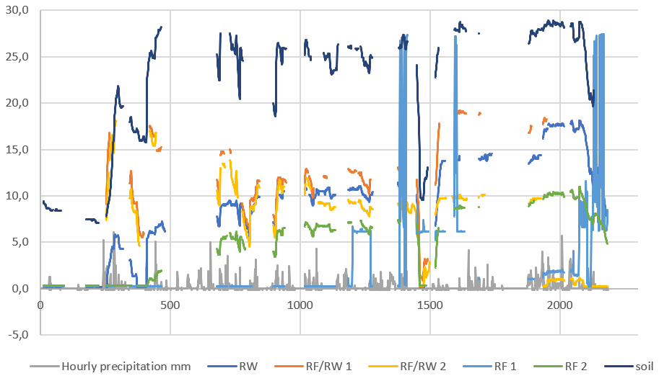
results
Water absorption
Oct-Dec
Data cleansing and validation
Soil moisture measurement only works up to freezing point.
RF1 showed implausible values and was taken out of the comparison.
Precipitation comparison
No relation between substrate moisture content and precipitation
More continuous data needed

Slide 13
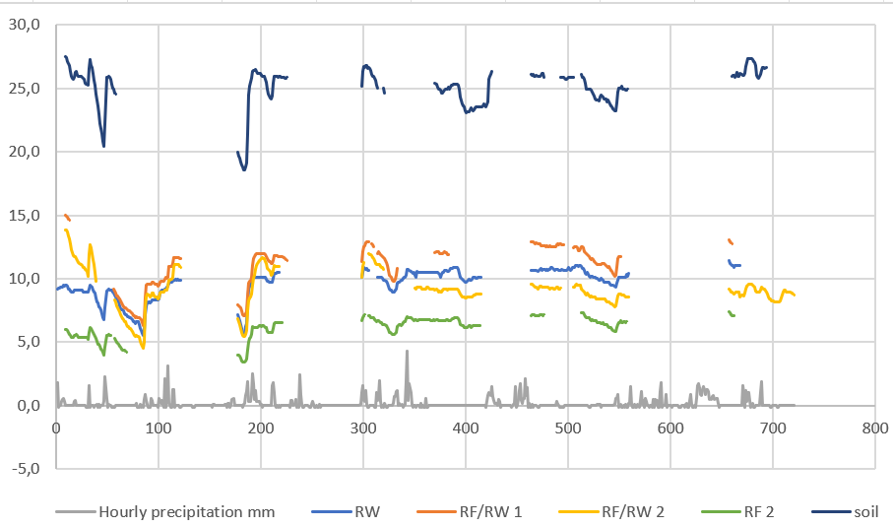
Expected:
1 Rockwool
2 Recycled fabric/rockwool
3 Recycled fabric
4 Soil
Results:
1 Soil
2/3 Recycled fabric/rockwool
2/3 Rockwool
4 Recycled fabric
results
Water absorption
November
Data cleansing and validation
Soil moisture measurement only works up to freezing point.
RF1 showed implausible values and was taken out of the comparison.
Precipitation comparison
No relation between substrate moisture content and precipitation
More continuous data needed

Slide 14
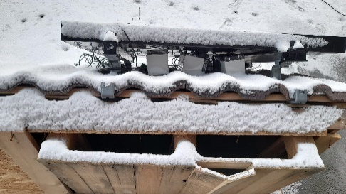
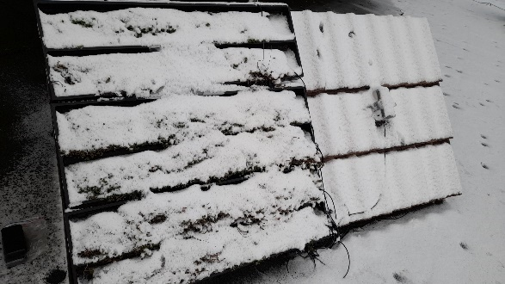
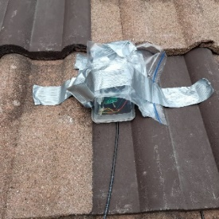
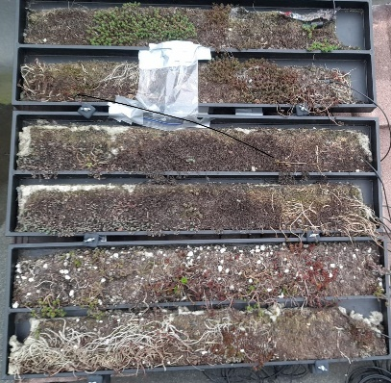
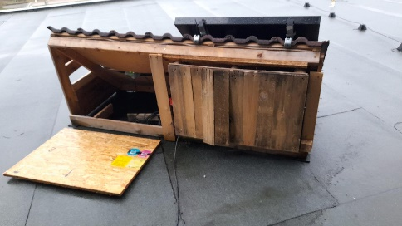
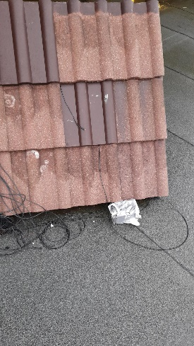
discussion
Implications for future research
Sensor accuracy
-moisture not accurate below 0°C
-placement given weather (wind)
Data quality
-alignment given daylight savings
-temperature hourly/1 moment
-more data after 8am
Impacts of evapotranspiration
-thermal conductivity of materials
-substrate effects on plant growth
-high humidity and soil moisture
-high soil temperature and low soil moisture

Slide 15
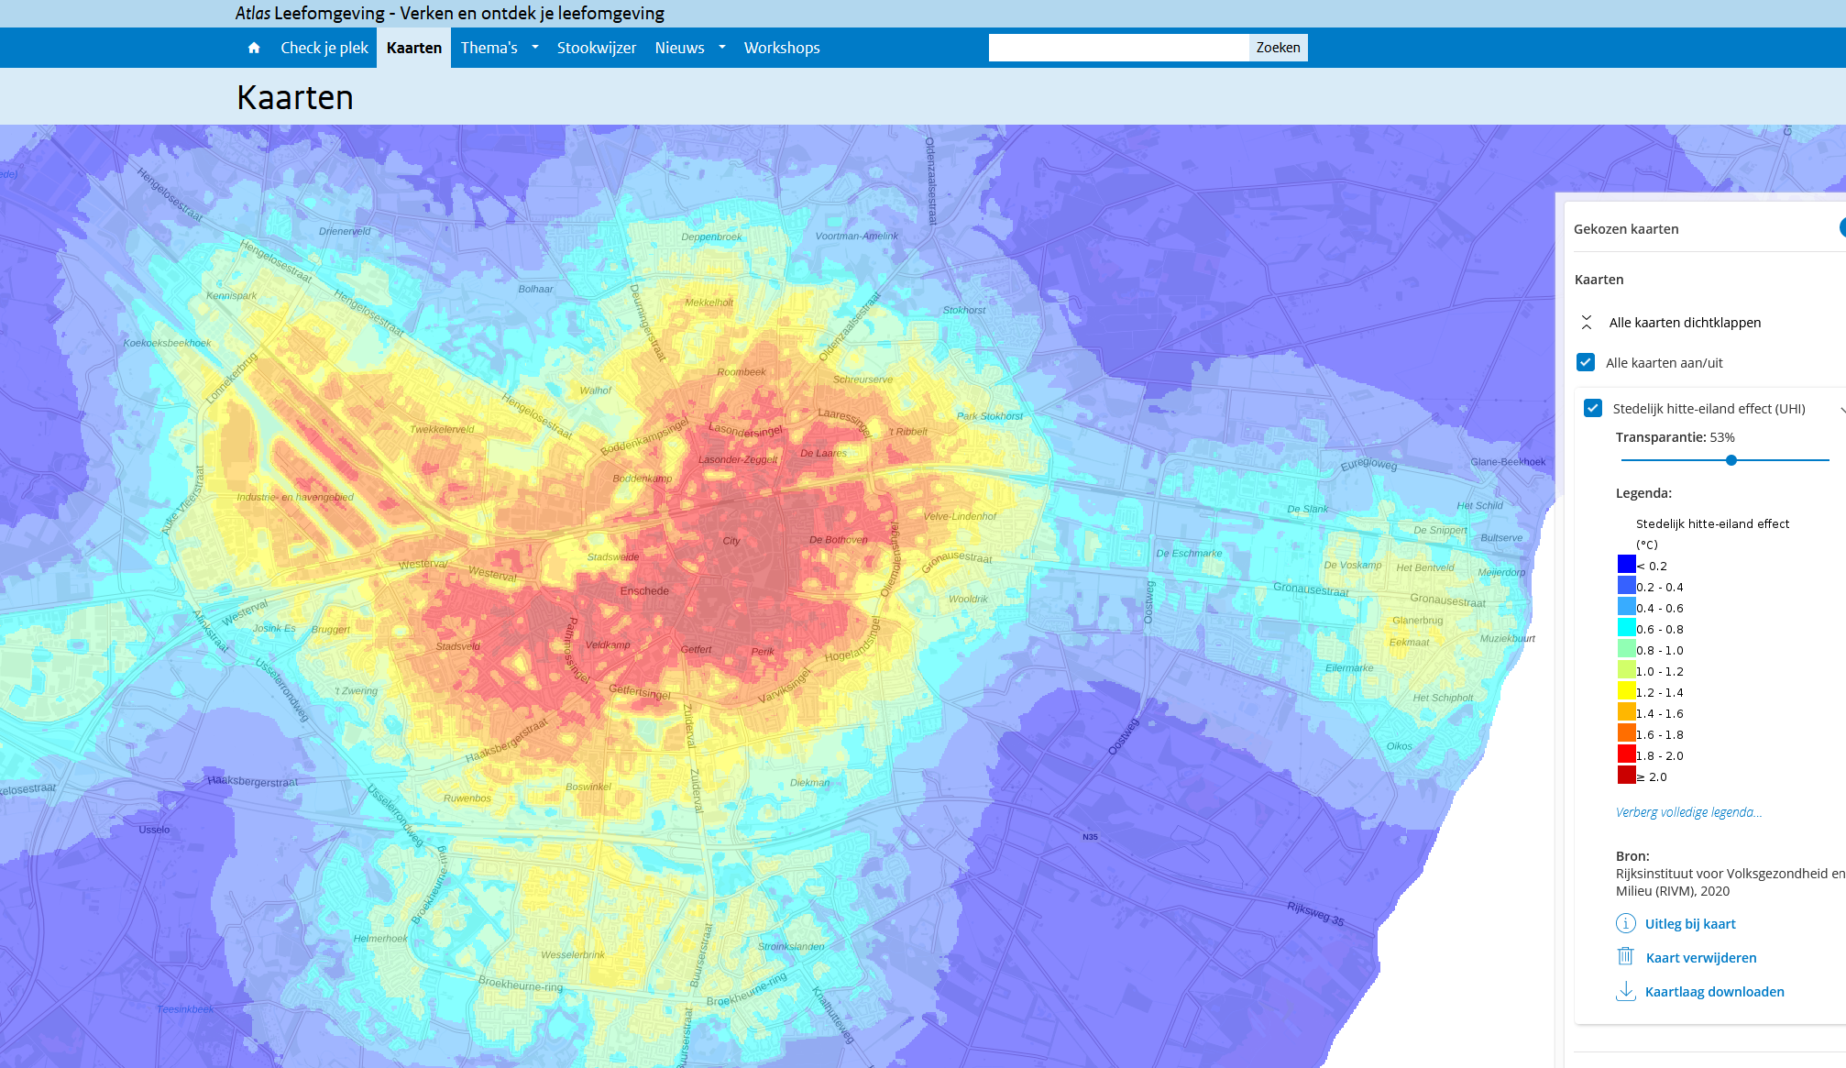
Terraced housing types
conclusions
Implications for urban scale
<1945
1946-1964
1965-1974
1975-1991
1992-2005
Enschede climate ambitions
New construction >55mm/m2
Construction must advance climate label classification
Many other GI implemented
How can we measure the impact of roofs compared to other GI?
Do we need to measure the impact of roofs?
Proposed monitoring scheme
At least one test per house type
Full year of data

Slide 16
Thank you for your kind attention
Sean Vrielink
k.vink@utwente.nl
https://lilagi.blogspot.com/

Slide 17
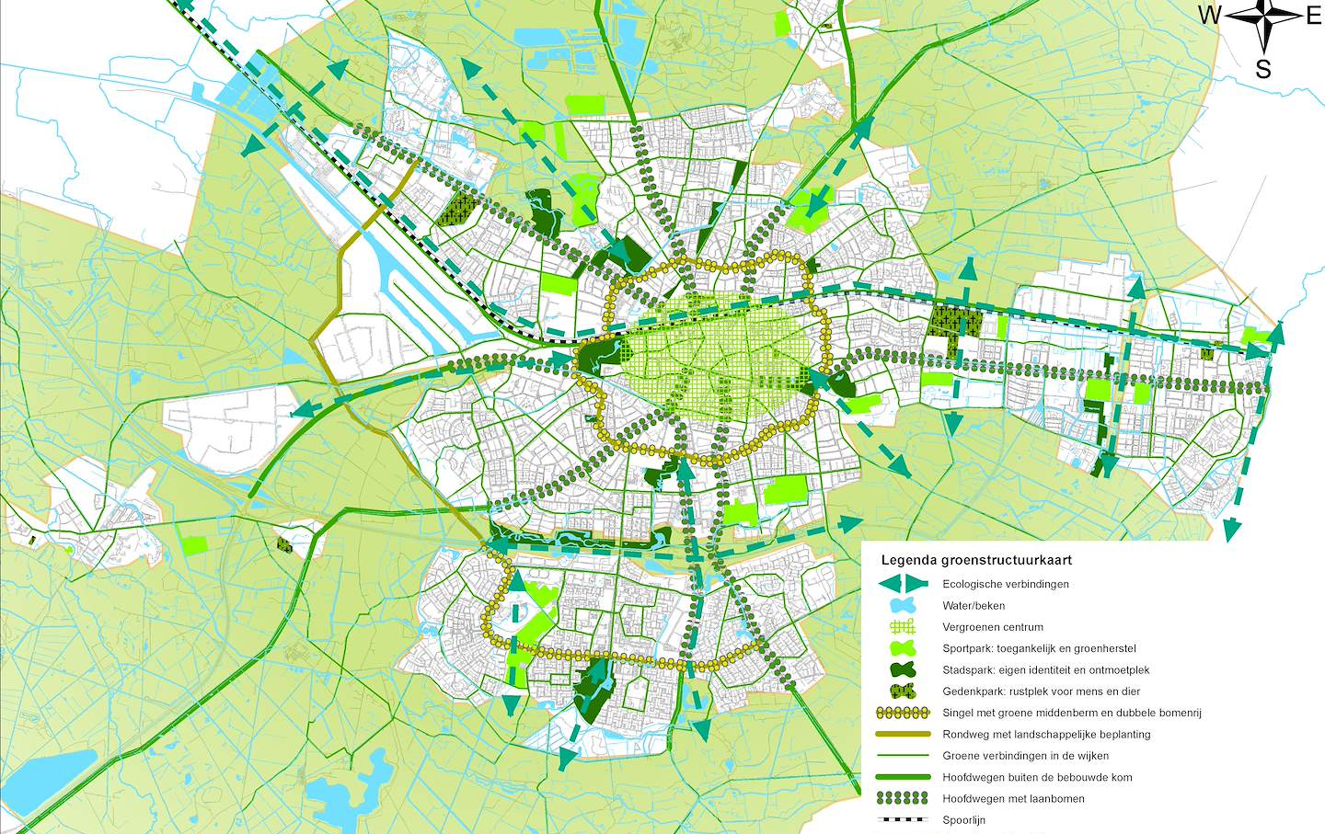
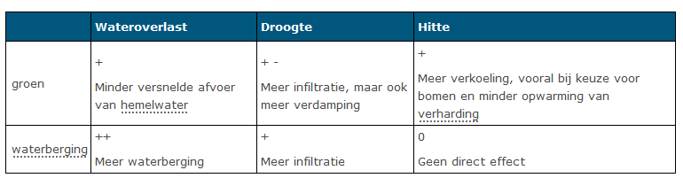
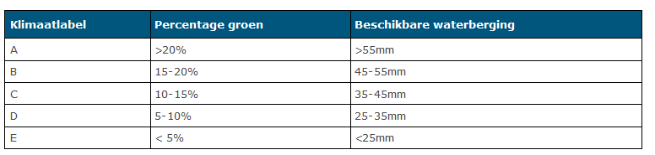
Enschede climate plans
guidelines for redesigning public space
(in Dutch)

Slide 18
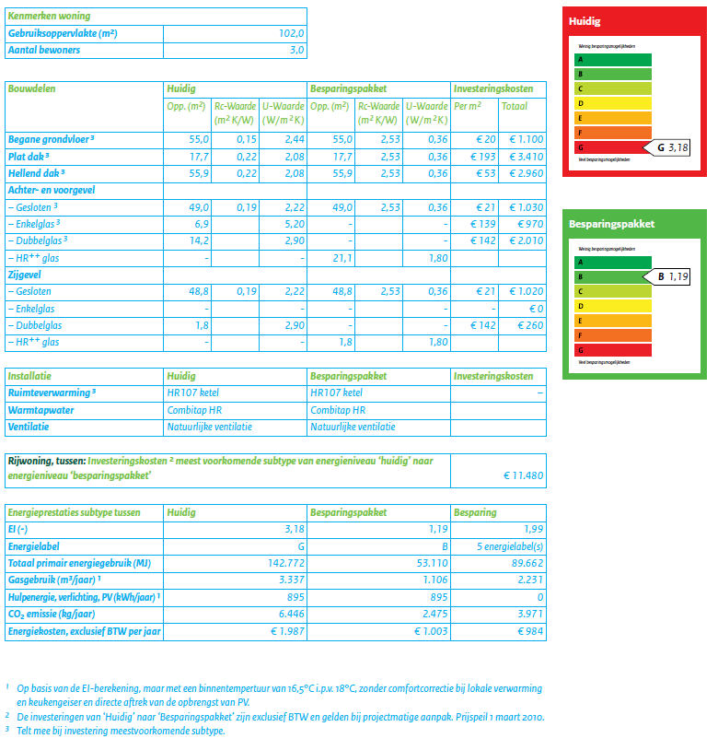
Housing types
Example calculation for terraced housing <1945
Add green panels as energy saving measure
Depends on current climate label
Material costs
Thermal conductivity properties
Orientation towards sun
(In Dutch)

Slide 19
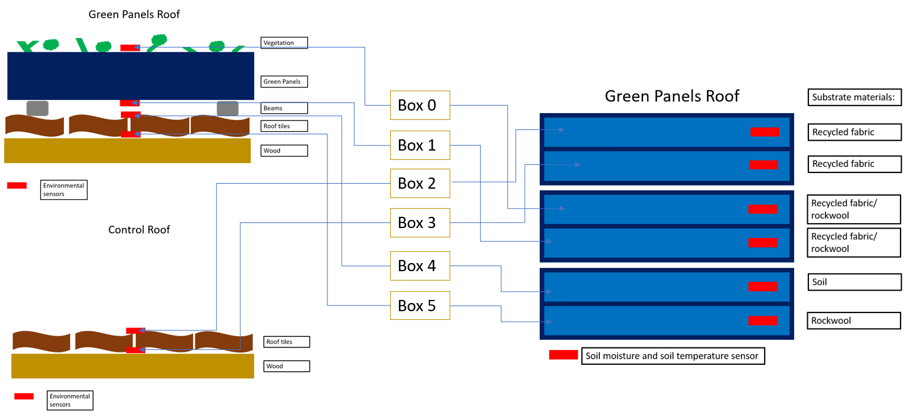
Sensor network connections

