Slide 1
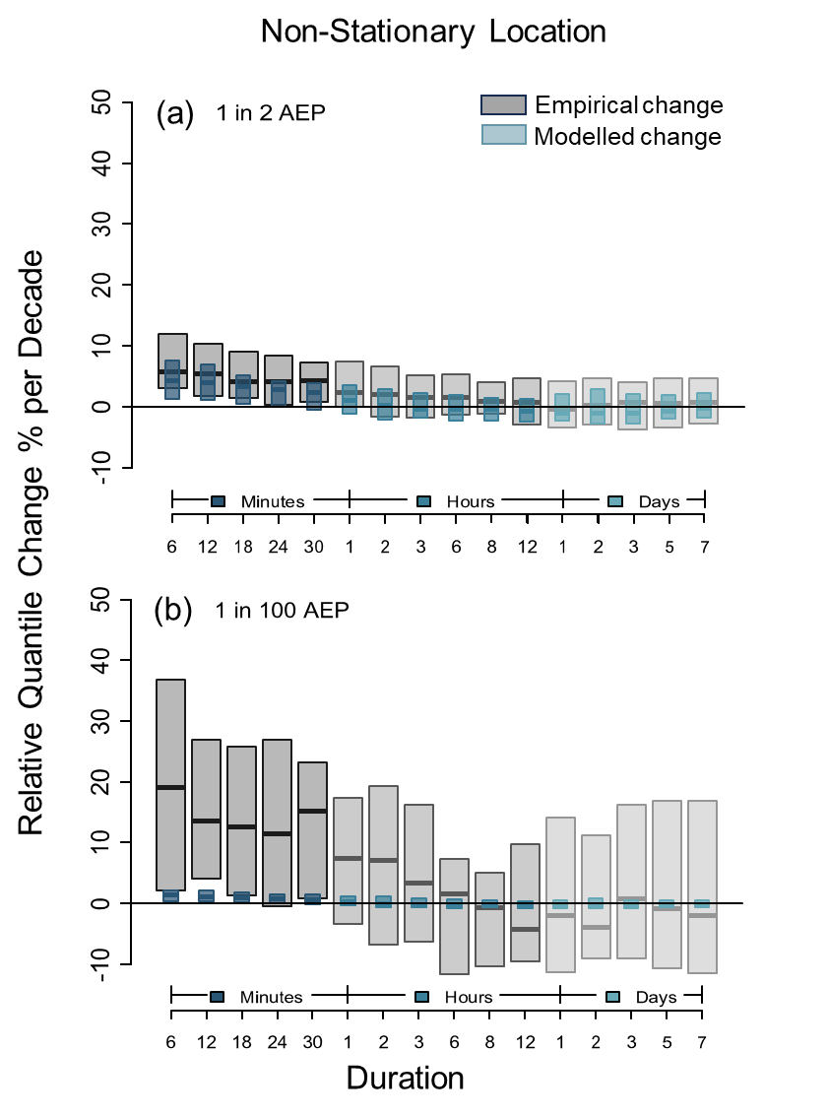
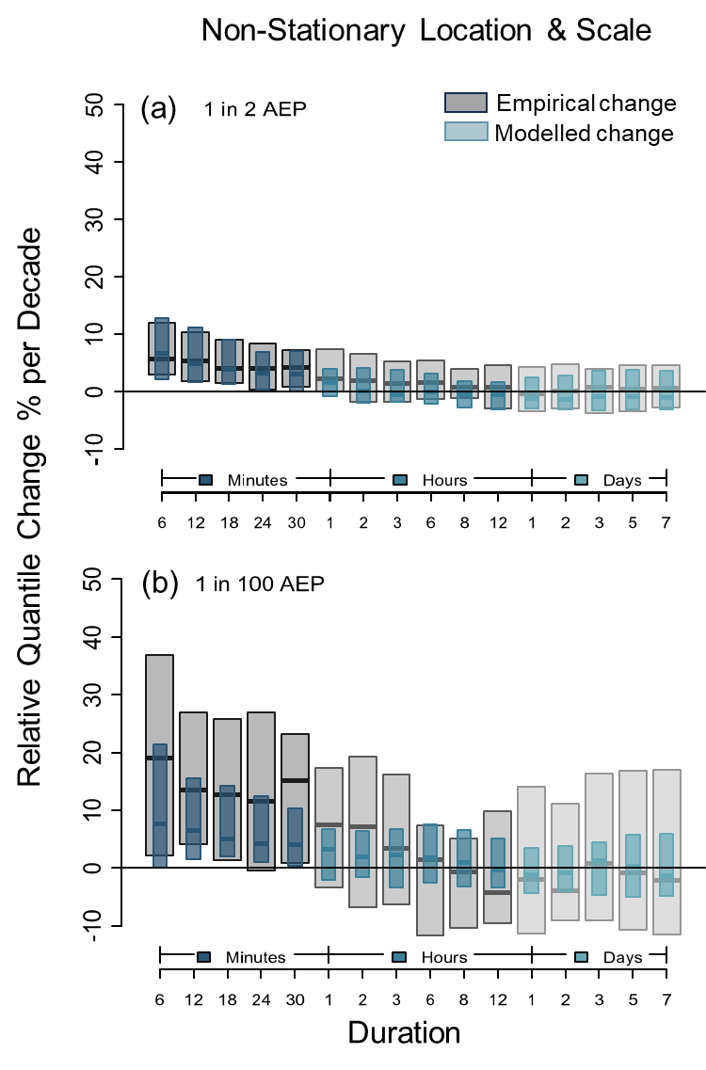
Non-stationary design rainfalls for Australia
Lalani Jayaweera ,Conrad Wasko, Rory Nathan, and Fiona Johnson
ljayaweeramu@student.unimelb.edu.au
Data
42 rainfall stations including pluviometer/tipping buckets and Automatic Weather Stations as shown in the figure (right).
Common record length from 1967 to 2021.
Rainfall stations spread over different rainfall generation mechanism regions from tropical north to temperate south.
Extracted annual maxima for 16 different durations from 6 min to 7 day .
Method
Performed the Mann-Kendall test and calculated the Theil-Sen slope to detect the presence of monotonic trend and to quantify the trend magnitude.
Adopted Fligner-Killeen test to test the homogeneity of variance.
Tested different Generalized Extreme Value models allowing for non-stationarity in only the location parameter, the scale parameter only, and both the location and scale parameters.
(a) 6 min annual maxima
(b) 1 day annual maxima
Results
Figure (right): we find that the short duration (<1hr) annual maxima rainfalls have increased across Australia, but the increases are greater for shorter duration annual maxima ( >1 hr and 1 day).
Results
The boxplots show the empirical (grey) and modelled (blue) rainfall quantile changes for 1 in 2 AEP (Annual Exceedance Probability) and 1 in 100 AEP from the best performing GEV non-stationary models based on the Akaike Information Criteria.
Non-stationary Location
Non-stationary Location and Scale…….
Empirical quantile changes show that events of rarer severity have increased more than frequent events (e.g. median increase for 6 min rainfall is 7% for 1 in 2 AEP and 20% for 1 in 100 AEP).
BUT only non-stationary location and scale GEV model (right) showed best agreement with empirical quantile changes across both durations and AEPs.
Increasing Trend
Decreasing Trend
“Historic rainfall maxima increases are larger for shorter duration and more extreme rainfalls”
Conclusions
Shorter duration (<1 hr) annual maximum rainfalls are increasing across Australia.
Longer durations (>1 h and 1 day) exhibit fewer increasing annual maximum rainfall trends as compared to shorter durations.
The more extreme rainfalls have experienced greater increases than lesser extreme rainfalls.
The change in extreme rainfall across duration and APEs is best described by a non-stationary Generalized Extreme Value model that incorporates changes in both location and scale parameters.
Jayaweera, L., Wasko, C., Nathan, R., Johnson, F., 2023. Non-stationarity in extreme rainfalls across Australia. J. Hydrol. 624, 129872. https://doi.org/10.1016/j.jhydrol.2023.129872
EGU24-18

