Slide 1
Connect to channel flow and Resuspension
Yin-Yen Peng

Slide 2
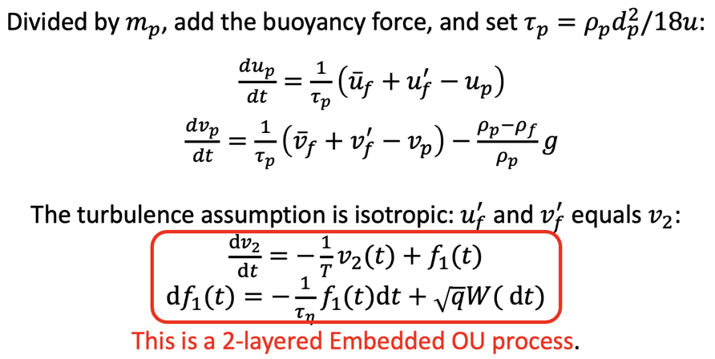
Problem statement
Determine parameters
mean flow velocity
Fluctuation (OU)
DNS (isotropic) calibration
Experimental data
Two-phase flow simulation
DNS (channel)
Properties of particle
Experimental data
Two-phase flow
simulation
We need TKE, Kolmogorov time scale, and Integral time scale
Governing equation:

Slide 3
How do we verify our model?
Determine parameters
mean flow velocity
Fluctuation (OU)
DNS (isotropic) calibration
Experimental data
Two-phase flow simulation
DNS (channel)
Properties of particle
Experimental data
Two-phase flow
simulation
We need TKE, Kolmogorov time scale, and Integral time scale
We can use Experimental data and Two-phase flow simulation
to verify our model, but neither of them has enough information that determine the layer-OU parameters.
I hope we can use another method to determine OU parameters

Slide 4
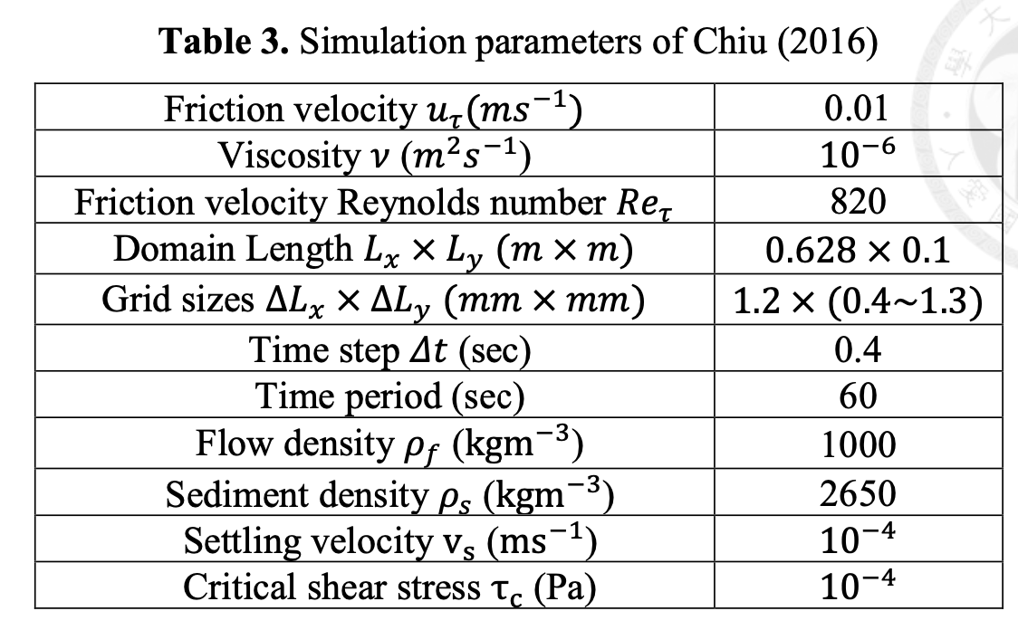
Introduction of Data

Slide 5
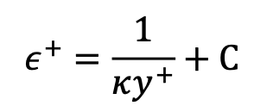
Function of TKE and Dissipation Rate (Shi-Wei Lin)
TKE
Dissipation rate
, for logarithmic region.
Absi (2011)
Regression to get all regions and connect to shear Re
Both of them depend on vertical position and
Notes:
CA1=0.58, CA2=17 c1=0.3012, c2=2.2391
c3=0.0011, c4=-0.0098

Slide 6
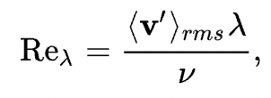
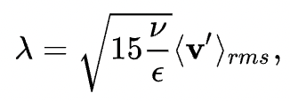
Methodology
Choose one of the data
(Channel Laden-flow)
Certain ${Re}_{τ}$
Certain 〖𝑅𝑒〗_𝜏
TKE/Dissipation profile
Mean velocity profile
Particle properties
Determine 2-layer OU parameters
Assumption: isotropic
For isotropic:

Slide 7
Detail of the 2-layer OU process

Slide 8
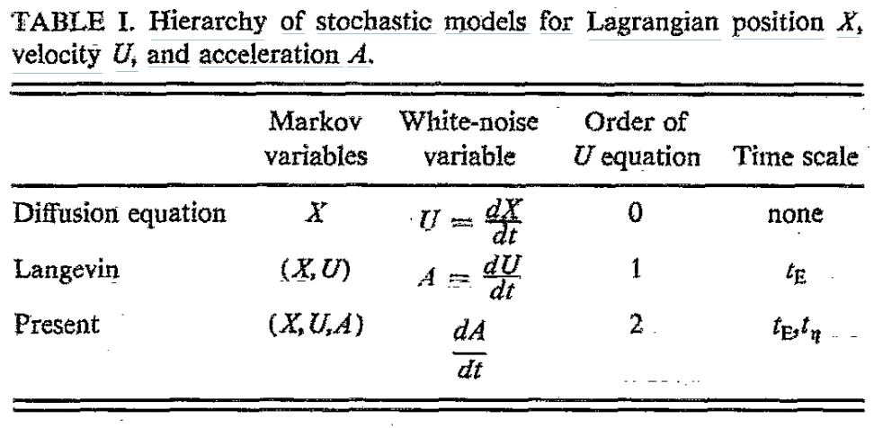
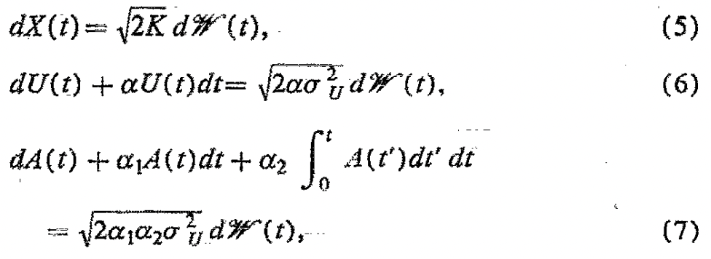
Stochastic models for Lagrangian position X, velocity U, and acceleration A

Slide 9
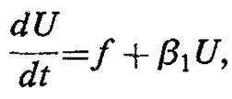
Determine parameters $β_{1} \& β_{2}$ (time scale)
Equivalent to
2-layer OU

Slide 10
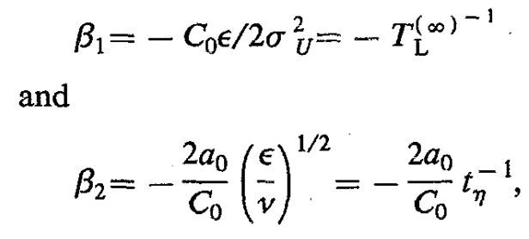
Lagrangian structure function constant: $a_{0}$ and $C_{0}$
We can use TKE and dissipation rate profile to determine $β_{1} \& β_{2}$ but still have two constants.
They solve $β_{1} \& β_{2}$ in Kolmogorov similarity theory to let them have physical meaning.

Slide 11
Lagrangian similarity theory in different regions
For p=2, we can get the famous form (2-order Lagrangian structure function):
Notes:
Turbulent Lagrangian velocity statistics conditioned on extreme values of dissipation

Slide 12
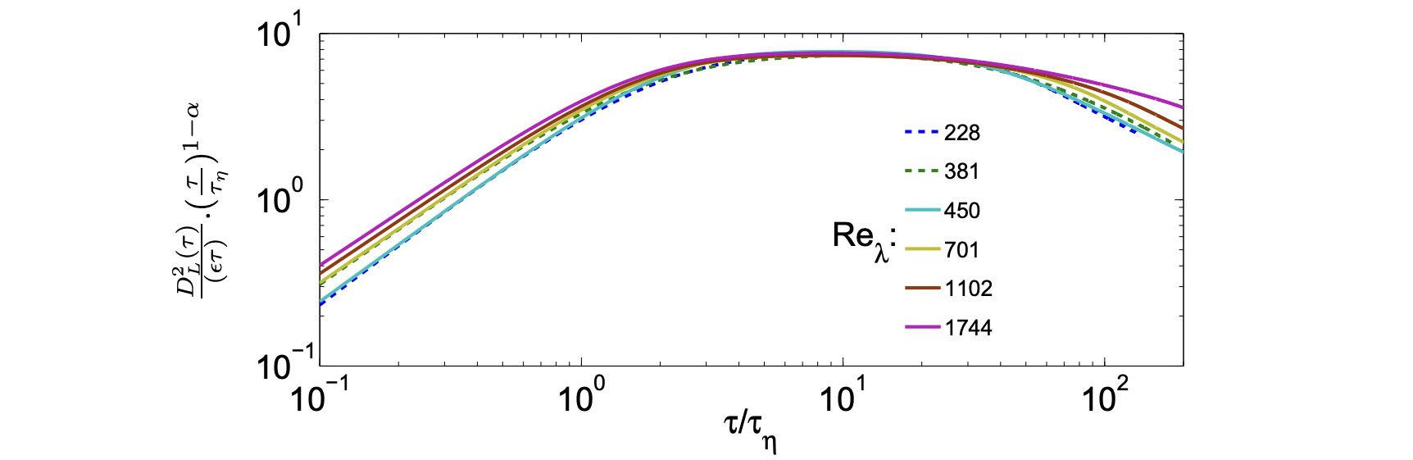
Research about the constant $C_{0}$
According to K41 universality hypotheses, the structure function should be isotropic and $C_{0}$ should have a universal value for all turbulent flows (at least in the limit of high Reynolds number).
Because the Equation is linear in the dissipation rate, it is expected to be independent of intermittency corrections and therefore universal in nature. Sawford (2011)
In this paper, $C_{0}$=7
It has been difficult to settle this important issue because of the lack of available experimental and numerical data with sufficient accuracy at sufficiently high Reynolds numbers. Barjona (2017)
The new procedure is then able to compute the universal constant defined in the LVSF-2, which is obtained with a new degree of confidence, giving $C_{0}$ = 7.4 ± 0.2.

Slide 13
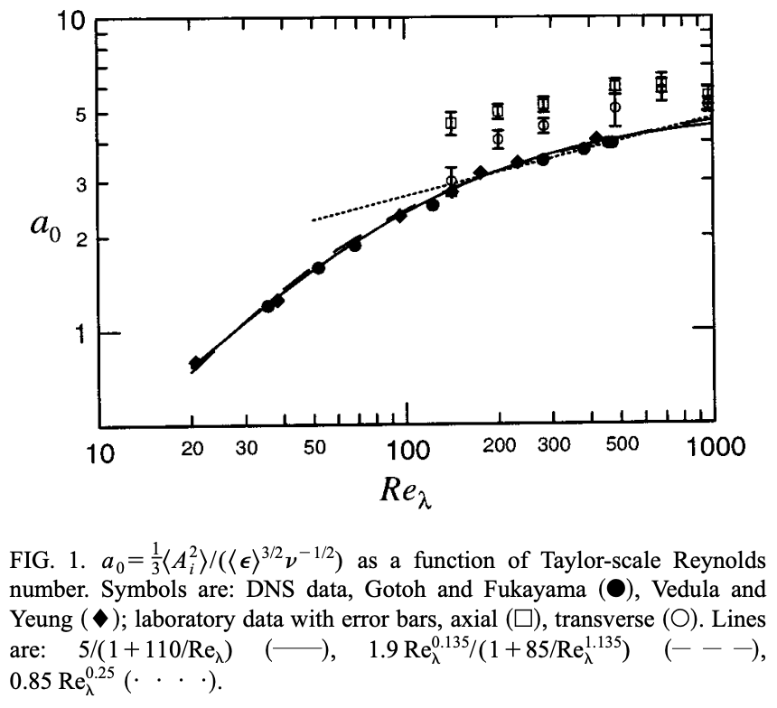
Research about the constant $a_{0}$
uncertainty reflects the difficulty in carrying out such measurements.
where the exponent on the Reynolds number reflects the influence of intermittency

Slide 14
Simulation
Choose one of the channel flow data (${Re}_{τ}$)
Choose one of the channel flow data (〖𝑅𝑒〗_𝜏)
Get the value of mean velocity, TKE, and dissipation rate
(function of y and ${Re}_{τ}$)
Get the value of mean velocity, TKE, and dissipation rate
(function of y and 〖𝑅𝑒〗_𝜏)
Determine OU parameters
$T_{L}$ & $τ_{η}$
(function of TKE & dissipation rate)
Determine OU parameters
𝑇_𝐿 & 𝜏_η
(function of TKE & dissipation rate)
Lagrangian fluid velocity/position/acceleration
Set Initial condition (y)

Slide 15
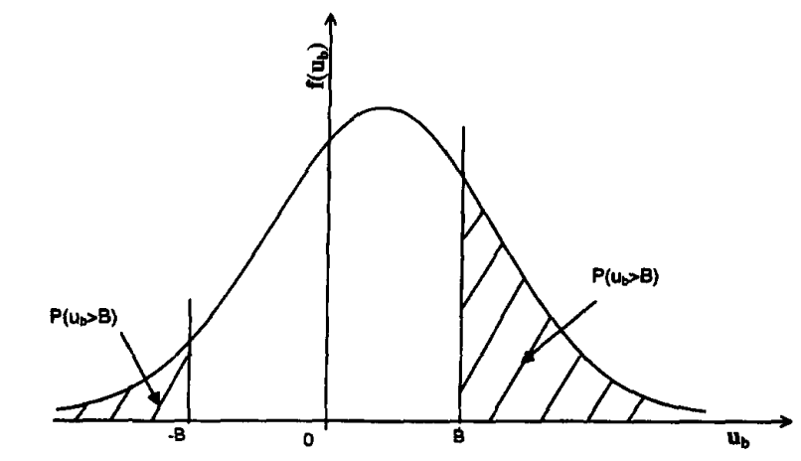
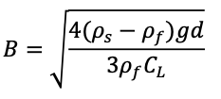
Resuspension
Cheng and Chiew (1998)
Force balance:
Probability:
B is the threshold of resuspension of sediment particles:
Assume velocity is a normal distribution:

Slide 16
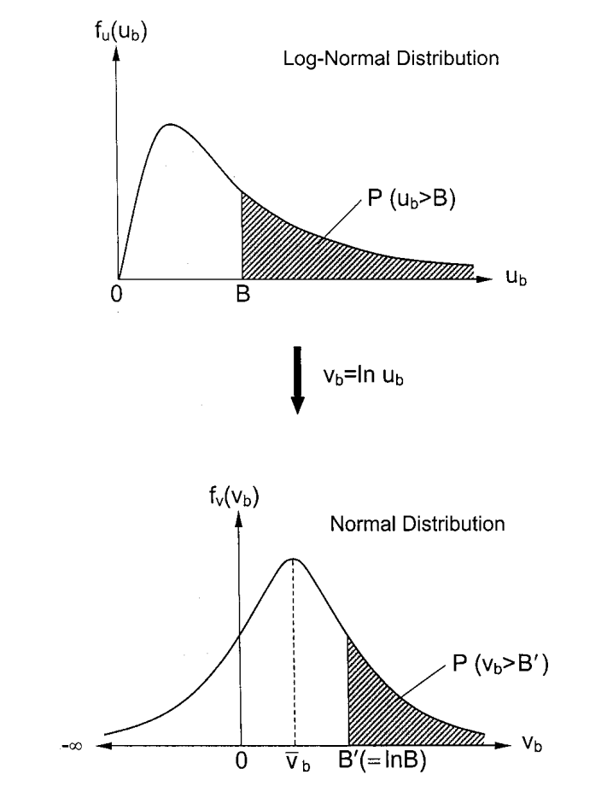
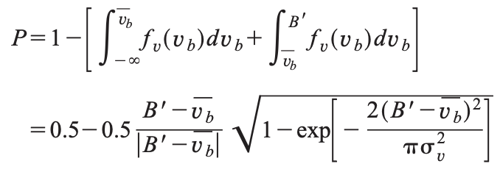
Resuspension
Wu and Lin (2002)

Slide 17
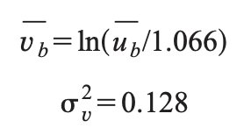
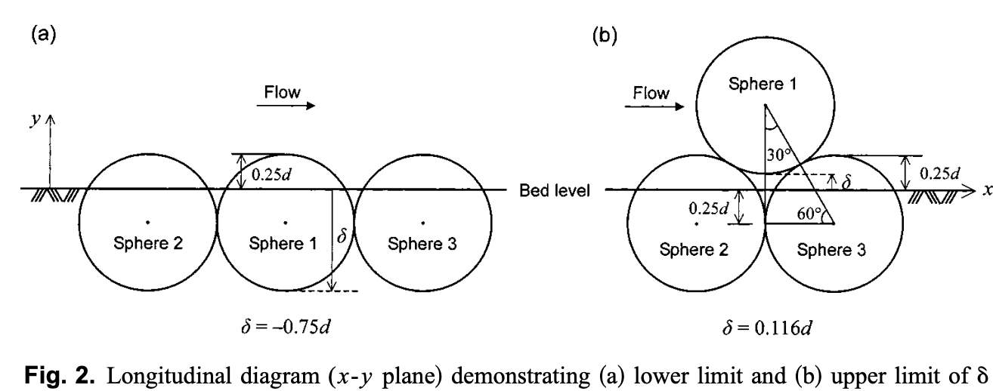
Resuspension
Wu and Chou (2003)
Consider different bed:

Slide 18
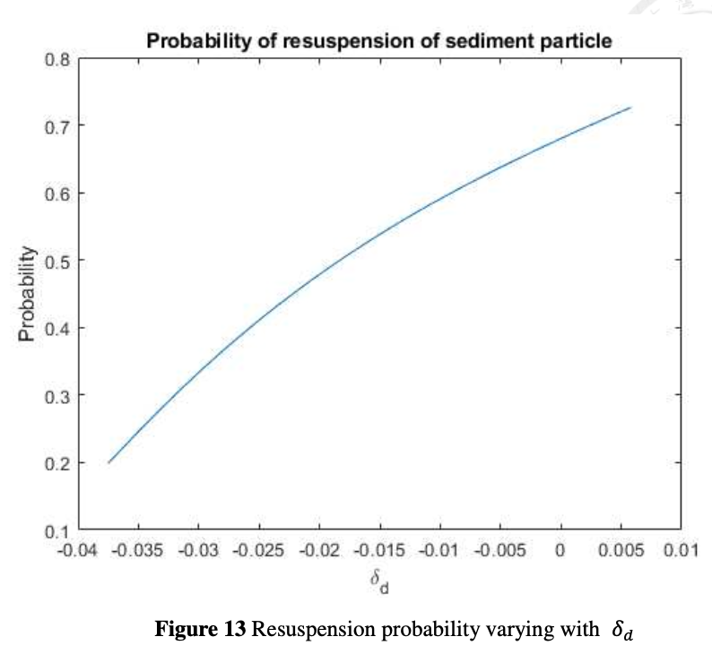
Resuspension
Shi-Wei Lin (2023)
For smooth bed (Nezu & Noguchi 2009):
$δ_{d}=0$
Probability =0.68

Slide 19
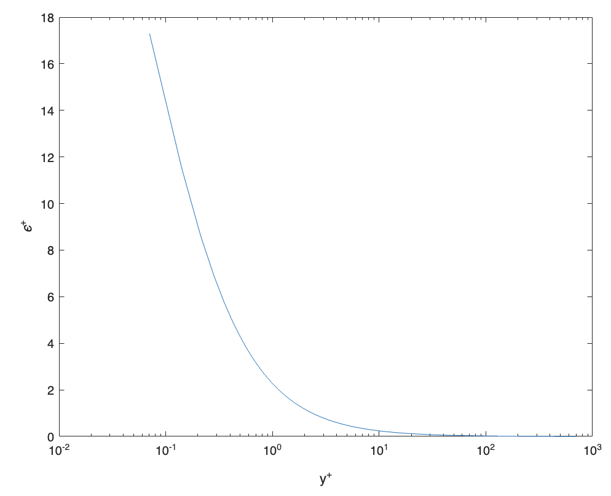
Problem for the dissipation rate function
Shi-Wei Lin (2023)

Slide 20
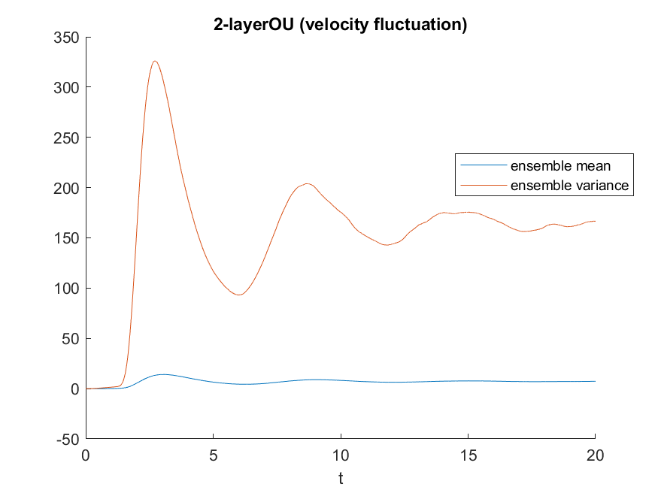
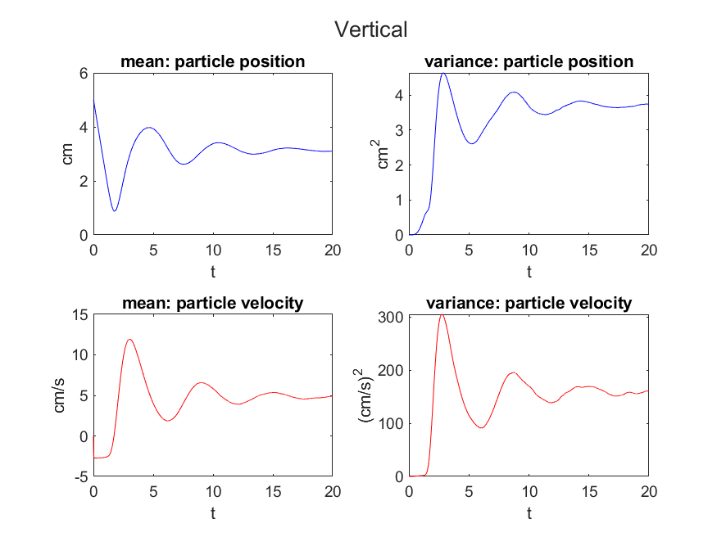
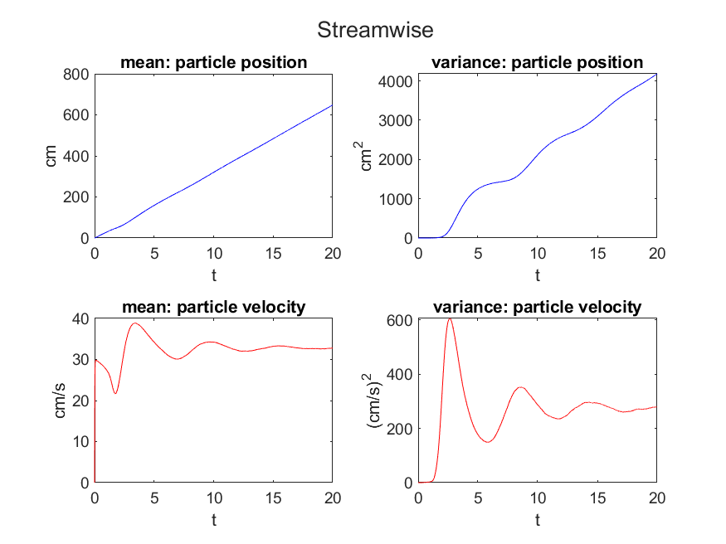
Influence

Slide 21
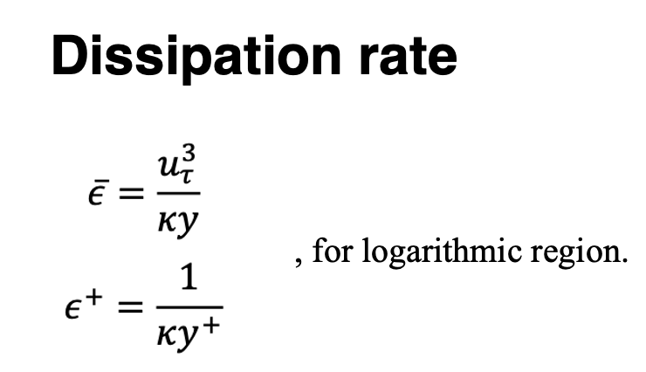
Fix the dissipation rate problem
I use the following formula to avoid overly large values ​​near the bed:
if y*utau/nu <= 30
y = 30*nu/utau;
Based on the original dissipation rate equation:
Shi-Wei Lin (2023)

Slide 22
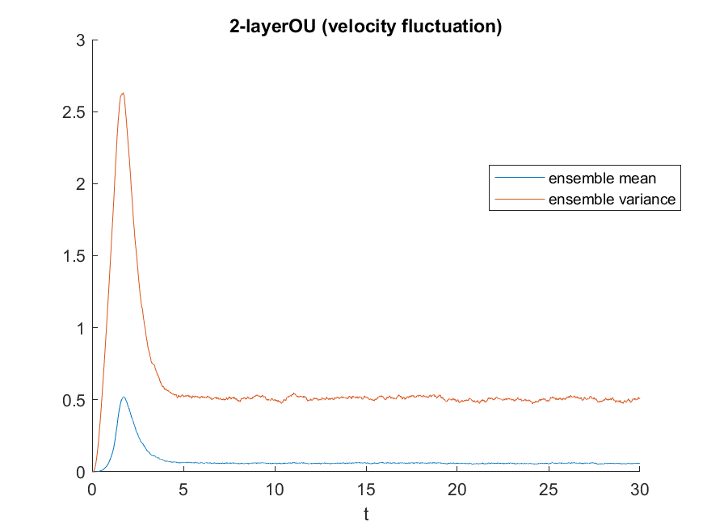
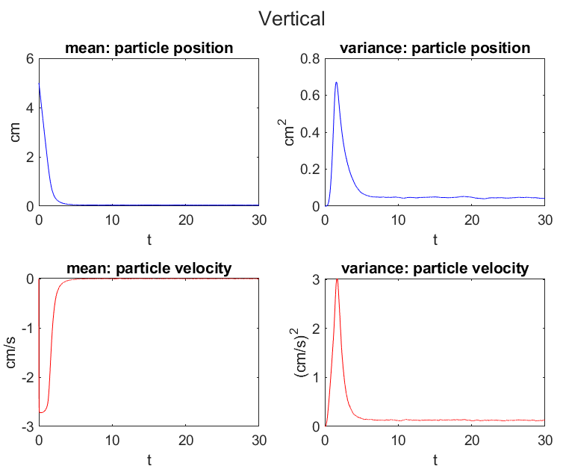
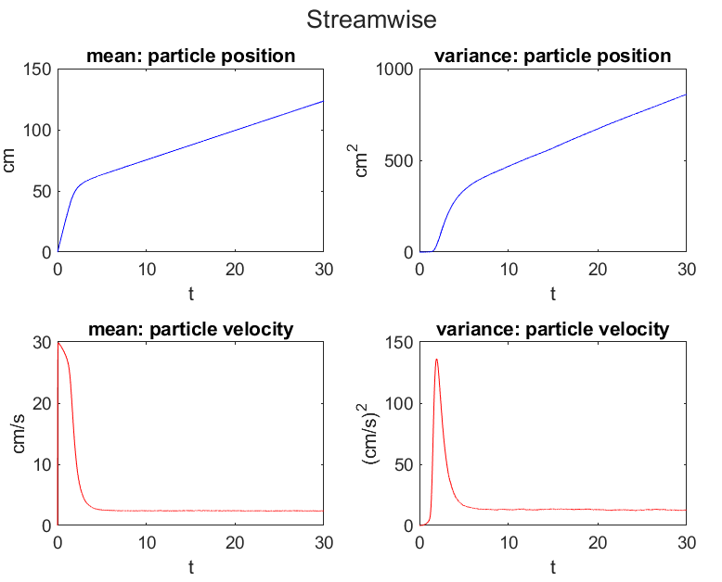
Final result

Slide 23
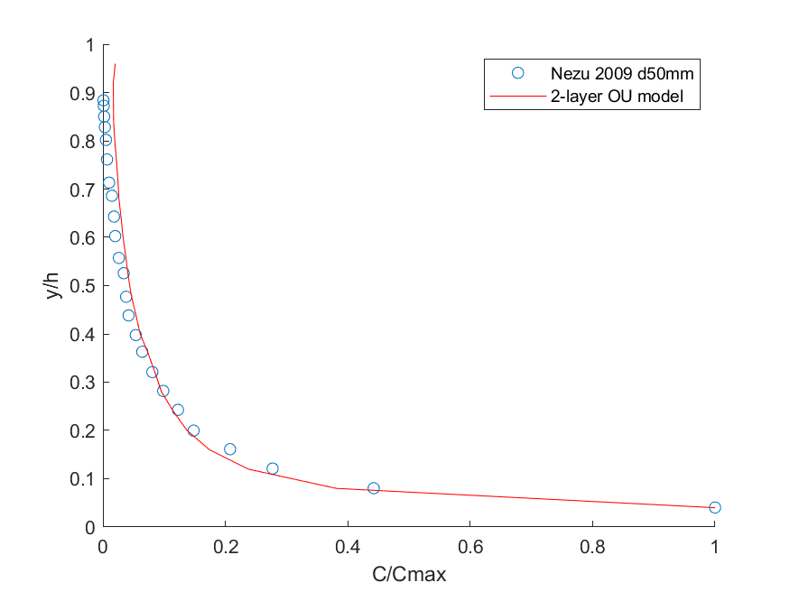
Compare the concentration profile (Nezu 2009)
% NN2009 (suspended load:h~0.05h)
The particle specific density:
$$ρ_{p}=1.2$$
25-layer

Slide 24
Muste (2005)

Slide 25
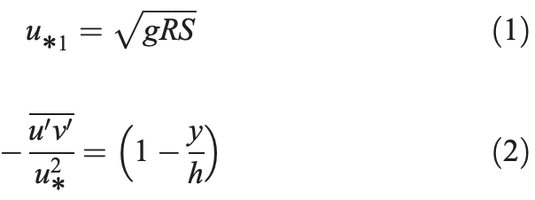
Data
Flow depth was small to have a large channel aspect ratio (i.e., 7.5)

Slide 26
Reference
Barjona, M., & da Silva, C. B. (2017). Kolmogorov’s Lagrangian similarity law revisited. Physics of Fluids, 29(10).
Lattanzi, A. M., Tavanashad, V., Subramaniam, S., & Capecelatro, J. (2020). Stochastic models for capturing dispersion in particle-laden flows. Journal of Fluid Mechanics, 903, A7.
Muste, M., Yu, K., Fujita, I., & Ettema, R. (2005). Two‐phase versus mixed‐flow perspective on suspended sediment transport in turbulent channel flows. Water resources research, 41(10).
Man, C., & Tsai, C. W. (2007). Stochastic partial differential equation-based model for suspended sediment transport in surface water flows. Journal of engineering mechanics, 133(4), 422-430.
Noguchi, K., & Nezu, I. (2009). Particle–turbulence interaction and local particle concentration in sediment-laden open-channel flows. Journal of Hydro-environment Research, 3(2), 54-68.
Pope, S. B. (2001). Turbulent flows. Measurement Science and Technology, 12(11), 2020-2021.
Sawford, B. L. (1991). Reynolds number effects in Lagrangian stochastic models of turbulent dispersion. Physics of Fluids A: Fluid Dynamics, 3(6), 1577-1586.
Sawford, B. L., & Yeung, P. K. (2013). Turbulent Lagrangian velocity statistics conditioned on extreme values of dissipation. Procedia IUTAM, 9, 129-137.
Viggiano, B., Friedrich, J., Volk, R., Bourgoin, M., Cal, R. B., & Chevillard, L. (2020). Modelling Lagrangian velocity and acceleration in turbulent flows as infinitely differentiable stochastic processes. Journal of Fluid Mechanics, 900, A27.

