Slide 1

Frequent Marine Heatwaves Hidden below the Global Sea Surface Highlighted by a Spatio-temporal Framework
Di Sun, Zhao Jing, Furong Li, Shijian Hu, Bohai Zhang, Lixin Wu
19 Apr 2024

Slide 2
01
Why Spatial and Temporal ?
CONTENTS
目录
02
How Spatial and Temporal ?
03
Conclusion and Discussion
2

Slide 3
01 Why Spatial and Temporal ？

Slide 4
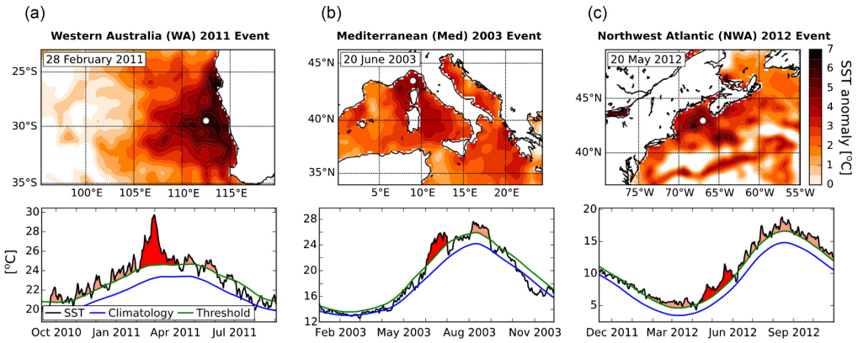
Marine Heatwaves——Extremely warm water events
Hobday et al., 2016
Qualitative definition: prolonged extremely warm water at a single location
Quantitative definition: SST exceeds a seasonal varying threshold at a single location (Hobday et al., 2016)

Slide 5
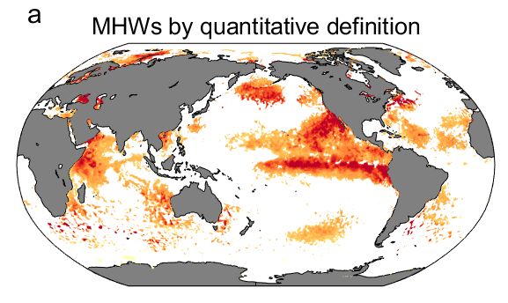
Why Spatial + Temporal ?
time
day 4
50km
day 3
day 2
day 1
u=10cm/s
eddy
east
Cannot depict the spatial structure of MHWs
Cannot describe propagation and deformation
May cause misunderstanding in the dynamics
Cannot study the influence on mobile organisms
Why Spatial + Temporal ?
Significant for both dynamics and biology

Slide 6
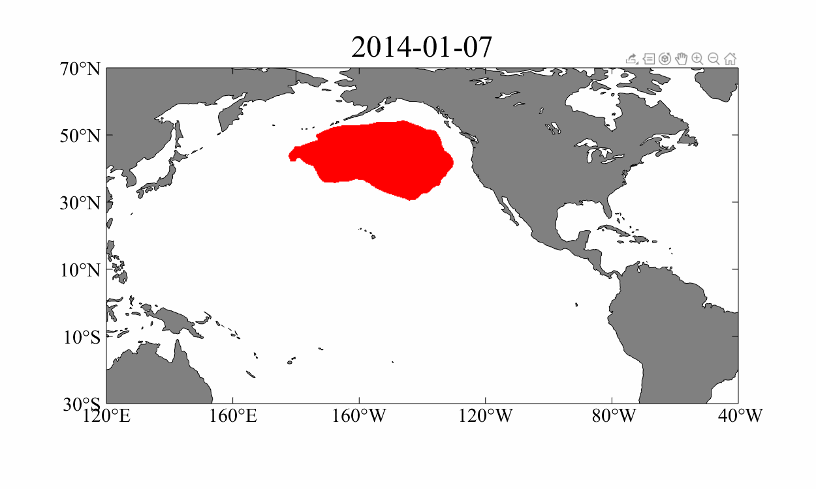
2013-2016 Northeastern Pacific MHW
Spatio-temporal definition：prolonged extremely warm water events with continuously evolving spatial structure
VS
Quantitative definition: SST exceeds a seasonal varying threshold at a single location
Hobday et al., 2016

Slide 7
02 How Spatial and Temporal ？

Slide 8
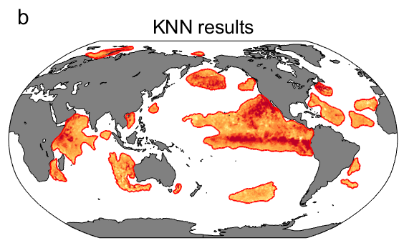
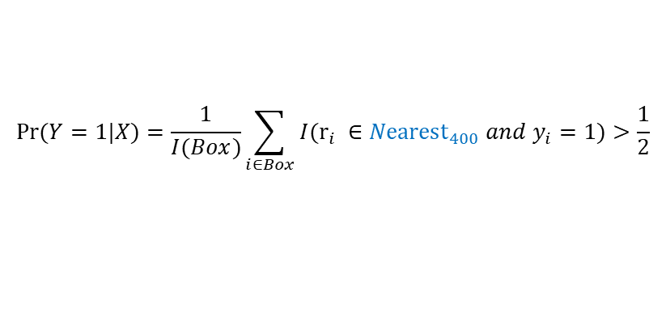

Methodology——KNN cluster and semi-lagrangian method
Step1：pointwise detection of MHWs
Hobday et al. 2016
Step2：cnstruction of spatial structure
K-Nearest Neighbor (KNN)
$$Pr⁡(Y=1|X)=\frac{1}{I(Box)}\sum_{i∈Box}{I({r_{i} ∈{Nearest}_{400} and y}_{i}=1)}>\frac{1}{2}$$
400 grid points ~20×20~5°×5° for 0.25°×0.25° resolution ~500km
Step3：tracking in the time domain
${FOD}_{t,i}^{t+1,j}=\frac{|D_{t,i}∩D_{t+1,j}|}{min\left(\left|D_{t,i}\right|,|D_{t+1,j}|\right)}$ > $α, α=0.5$
简单情况
分裂
融合

Slide 9
New Metrics of MHW events
Metrics：Spatial extent、displacement、deformation
Duration
Spatial extent
Duration
Spatial extent
Intensity
Cumulative intensity
Intensity
Zonal displacement
Displacement
Deformation rate
Meridional displacement
Deformation rate
PDF of MHW metrics
Spatial distribution

Slide 10
Global statistics of MHW events
Count
Duration
Spatial extent
Intensity
Spatial extent evolving with tine
Intensity evolving with tine
Spatial extent and intensity increases and then decreases in MHW lifecycles
Displacement
Deformation rate
MHW events not only become more intense, longer, more frequent, but more bigger, with propagating more fatter and deformation more larger under global warming!

Slide 11

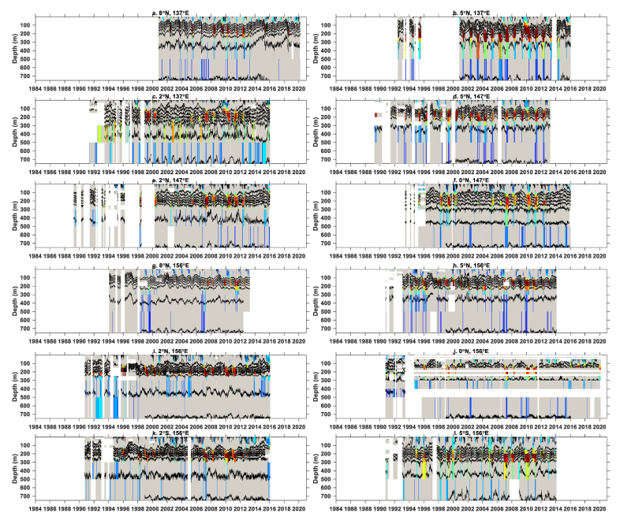

Three structure of marine heatwaves
Viglione et al., 2021, Nature
Hu et al., 2021, ERL

Slide 12
Ocean reanalysis data
Dataset | ECCO2 | GLORYS | HYCOM
Spatial resolution | 0.25°x0.25° | 1/12°x1/12° | 1/12.5°x1/12.5°
Temporal resolution | 3-day mean | daily | 3-hourly
Vertical resolution | Uneven 18 layers to 200m | Uneven 26 layers to 200m | Uneven 23 layers to 200m
Interpolated spatial resolution | 1°x1° | 1°x1° | 1°x1°
Interpolated temporal resolution | daily | daily | daily
Interpolated vertical resolution | 20 layers for 10m per layer | 20 layers for 10m per layer | 20 layers for 10m per layer
Used time range | 1992-2020 | 1993-2020 | 1993-2012
200m：Euphotic zone——home to a massive number of marine organisms

Slide 13
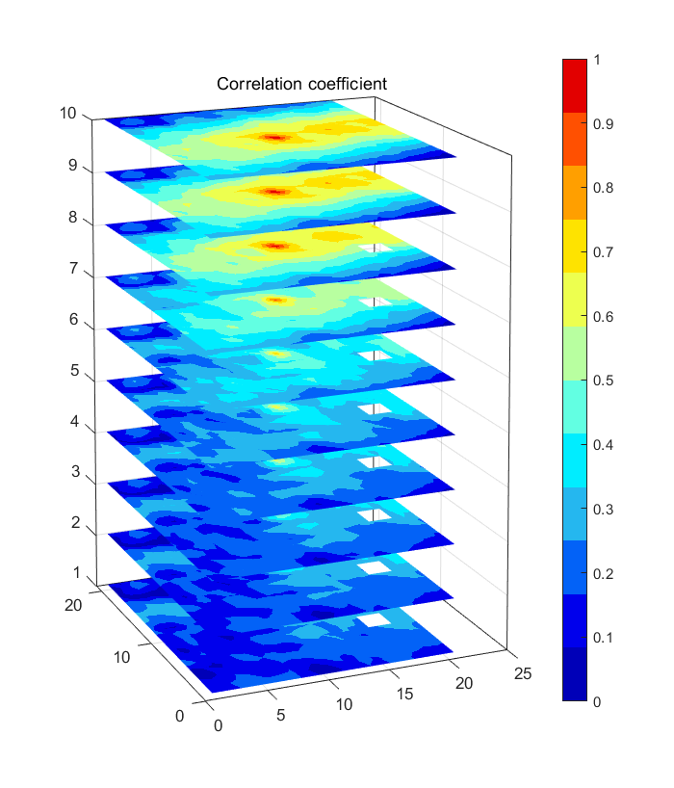
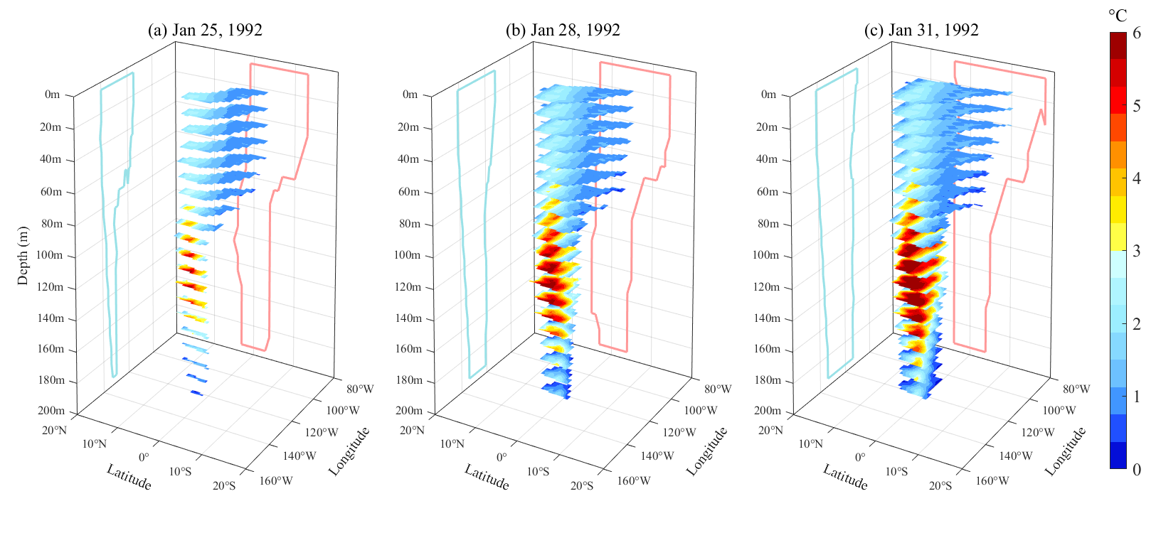
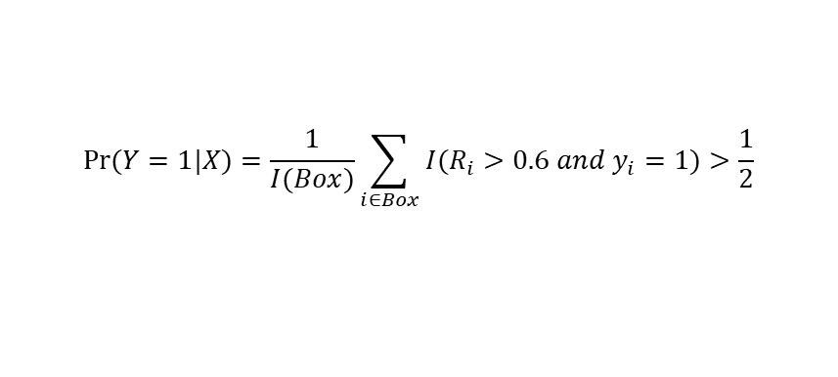
Construction of four-dimensional MHW events
Subsurface MHW definition
0 m
5 m
15 m
25 m
35 m
45 m
55 m
65 m
75 m
85 m
pointwise detection of MHWs
Hobday et al. 2016
Spatial structure construction ——Correlation-based KNN
11x11x20
$$Pr⁡(Y=1|X)=\frac{1}{I(Box)}\sum_{i∈Box}{I({R_{i}>0.6 and y}_{i}=1)}>\frac{1}{2}$$
Tracking in the time domain
Find connected domains in x-y-z and track in x-y-z-t

Slide 14
03 Conclusions and discussions

Slide 15
Classification and proportion of MHW events
Surface MHW events
0-200m
Subsurface MHW events
0-200m
About 1/3 MHW events have no surface signals at all !
~ 1/3
Mixed MHW events
Datasets | GLORYS | HYCOM | ECCO2
Surface | 46.9% | 32.6% | 52.8%
Subsurface | 31.2% | 42.4% | 27.7%
Mixed | 21.9% | 25.0% | 19.5%
0-200m
Life cycle
D=1
D/3
2D/3
D

Slide 16
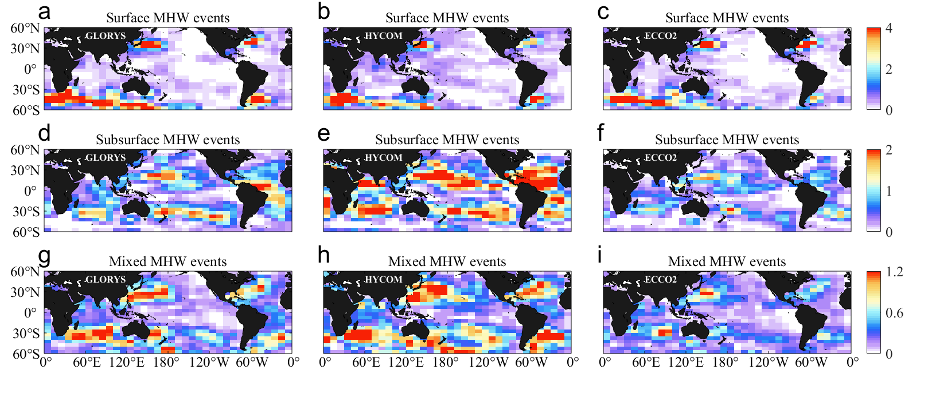
Global distribution of different-type MHW events
Surface
Subsurface
Mixed

Slide 17
Vertical characteristics of MHW events
Surface
Subsurface
Mixed
Area
The peak intensity and area of subsurface MHW events appeared below the surface
It means potentially greater losses to marine ecosystems
Intensity

Slide 18
Response to global warming
The number of subsurface MHW events is increasing under the influence of subsurface ocean warming

Slide 19


Conclusions
Spatio-temporal MHW events
MHW
next day
MHW
Spatial extent
Displacement
Deformation
3D Spatio-temporal MHW events
MHW
Vertical structure→About 1/3 MHW events have no surface signals at all
Vertical properties→The peak intensity and area of subsurface MHW events appeared below the surface
Code and data availability: https://github.com/cindyisok
Sun, D., Li, F.*, Jing, Z., Hu, S., Zhang, B., 2023: Frequent Marine Heatwaves Hidden below the Sea Surface Globally, Nature Geoscience.
Sun, D., Jing, Z.*, Li, F., Wu. L.-X., 2023: Characterizing Global Marine Heatwaves from a Spatio-temporal Perspective, Progress in Oceanography.

Slide 20
Thanks for your attention !
19 Apr 2024

