Slide 1
Quantifying of the ten-year variation in surface velocity of the Svalbard Archipelago glaciers using SAR data
Wojciech Milczarek¹, Anna Kopeć¹, Michał Tympalski¹, and Marek Sompolski¹
Department of Geodesy and Geoinformatics, Wrocław University of Science and Technology, Poland
Area 1 Northwest Spitsbergen
Area 3 Nordaustlandet
Area 4 Eastern Islands
Area 2 Northeast Spitsbergen
Area 5 Southern Spitsbergen
Data and Methods
Validation results

Slide 2
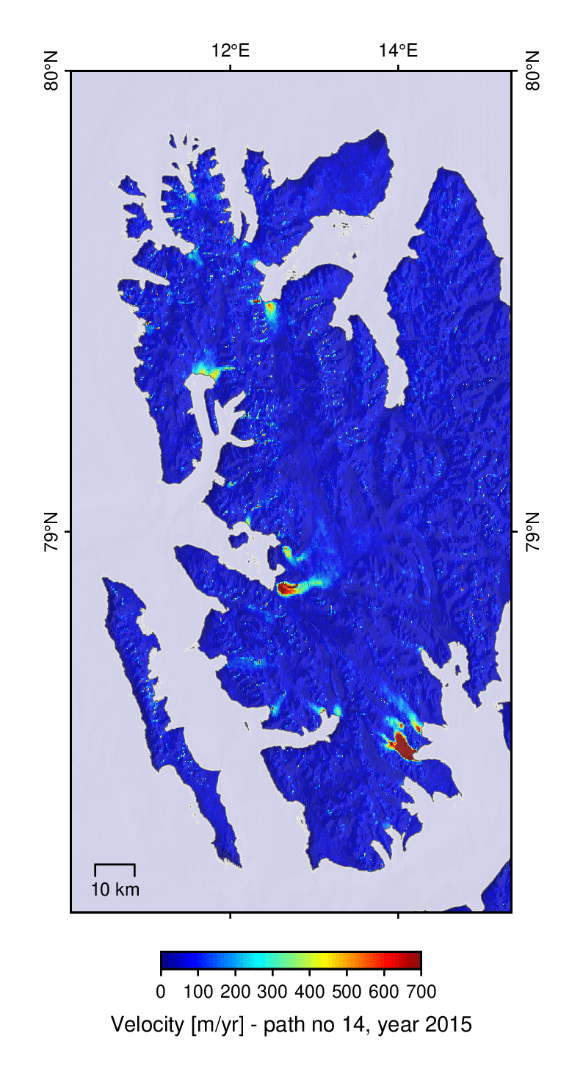
Area 1- Northwest Spitsbergen

Slide 3
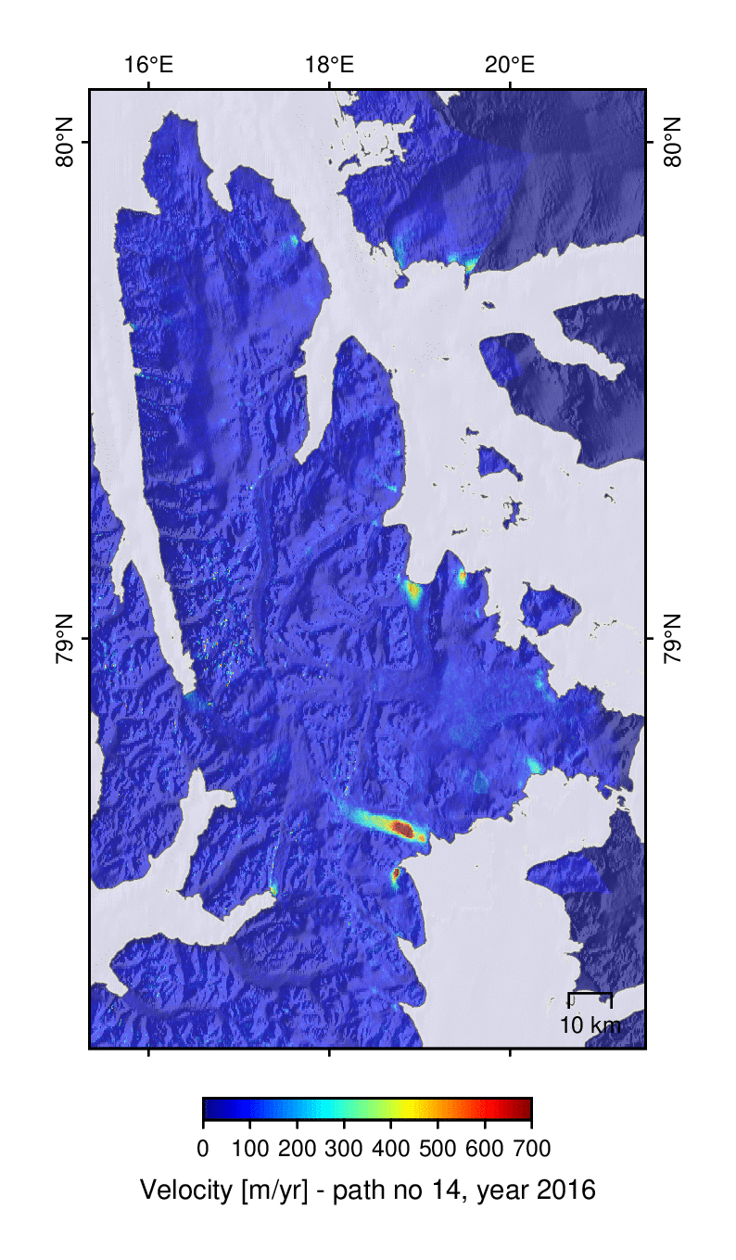
Area 2 - Northeast Spitsbergen

Slide 4
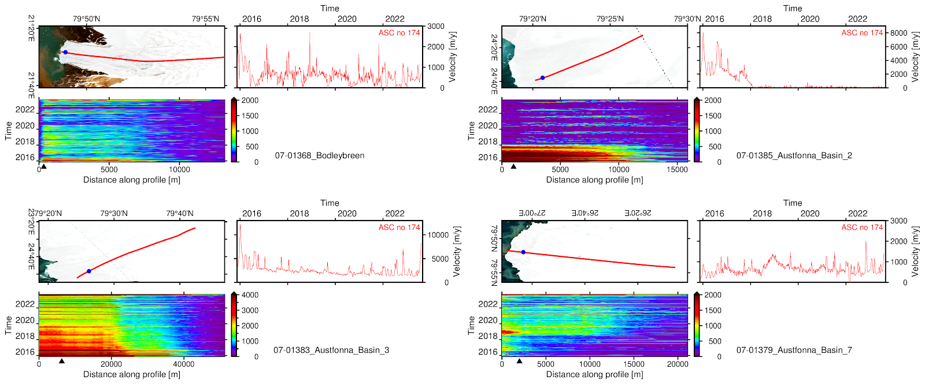
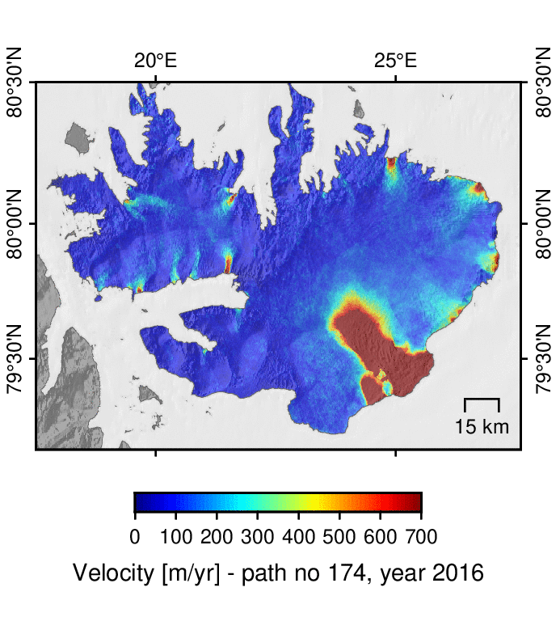
Area 3 - Nordaustlandet

Slide 5
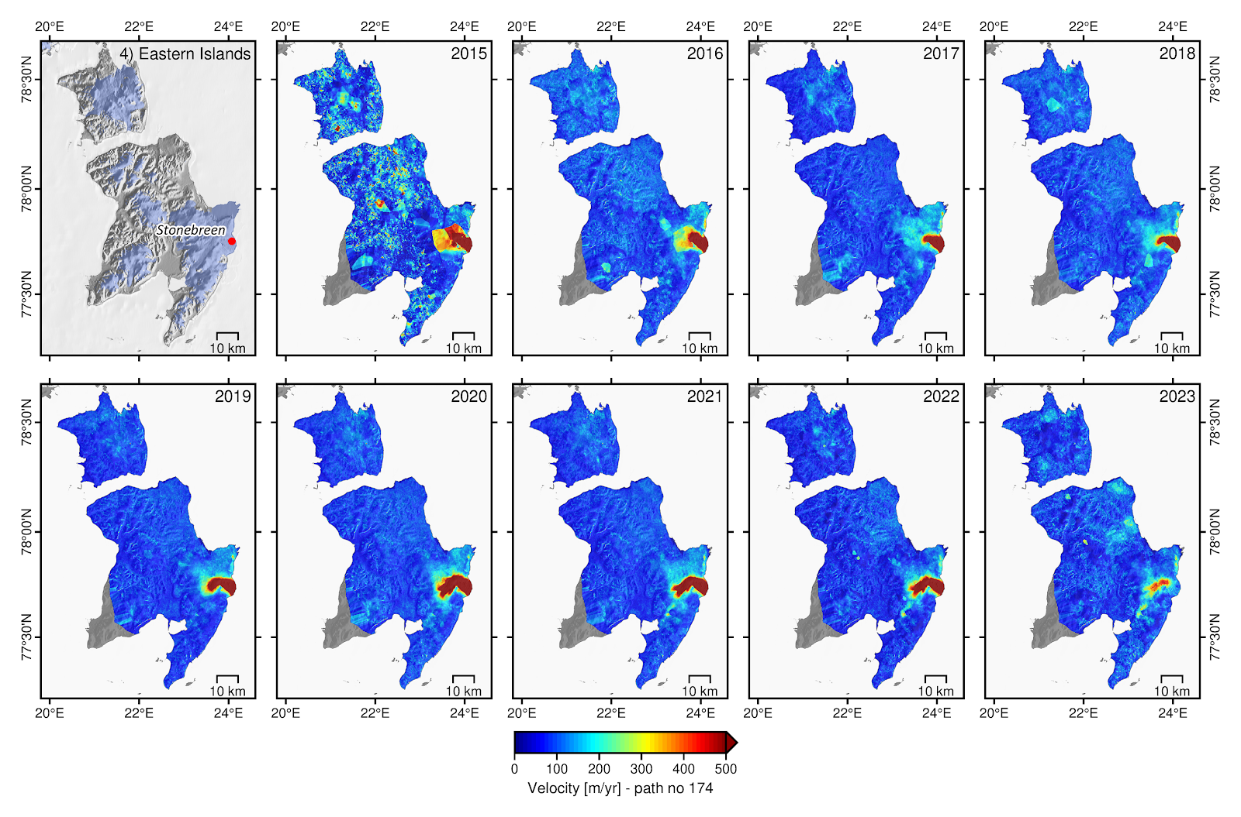
Area 4 - Eastern Islands

Slide 6
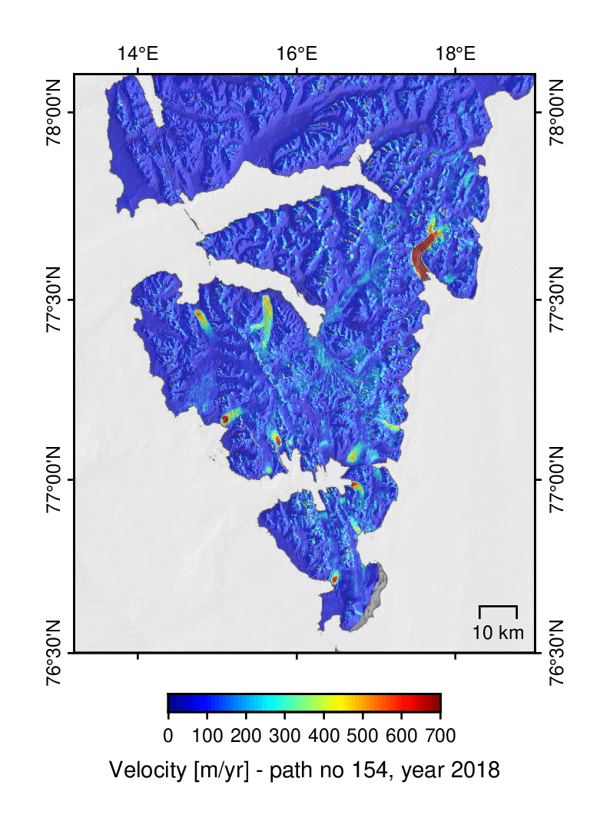
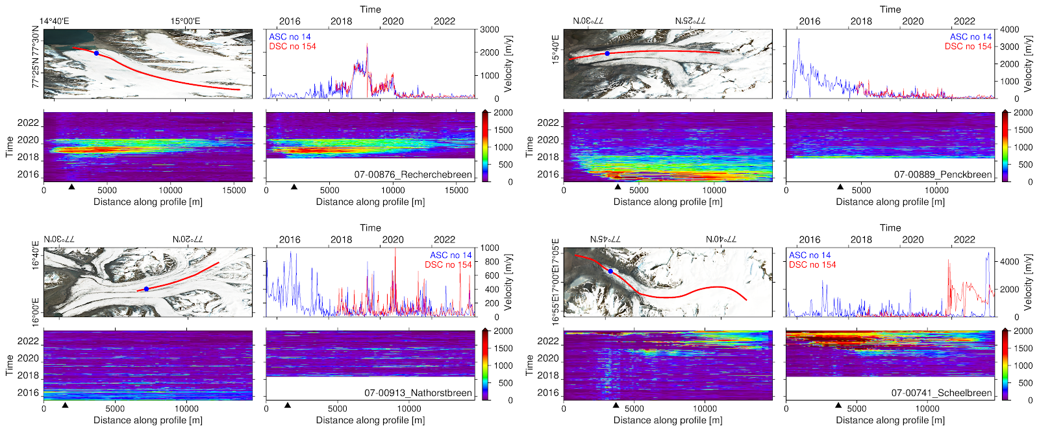
Area 5 – Southern Spitsbergen

Slide 7
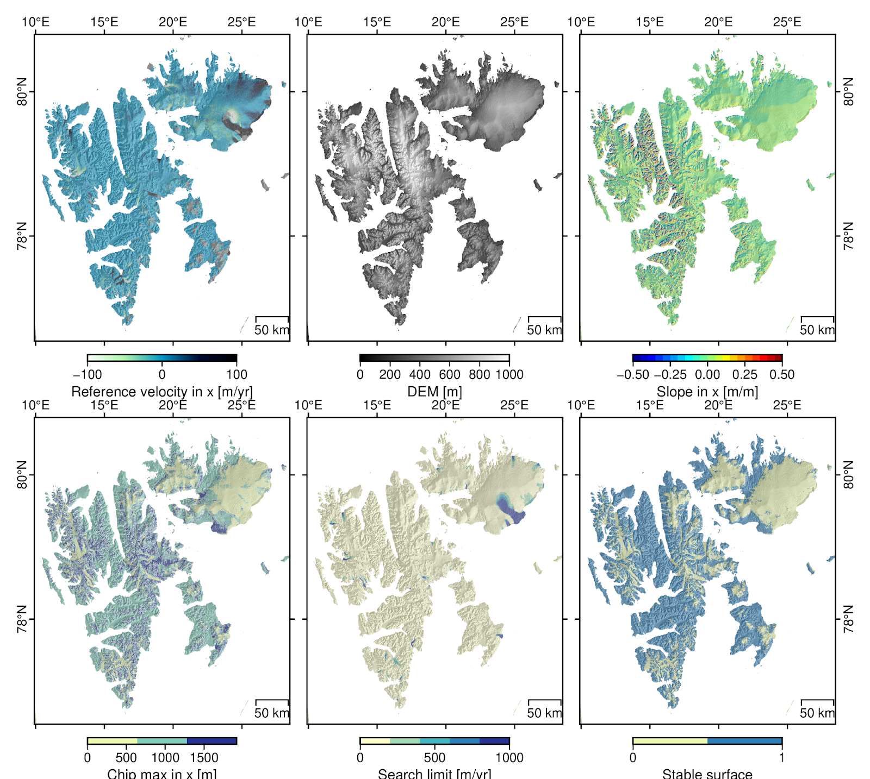
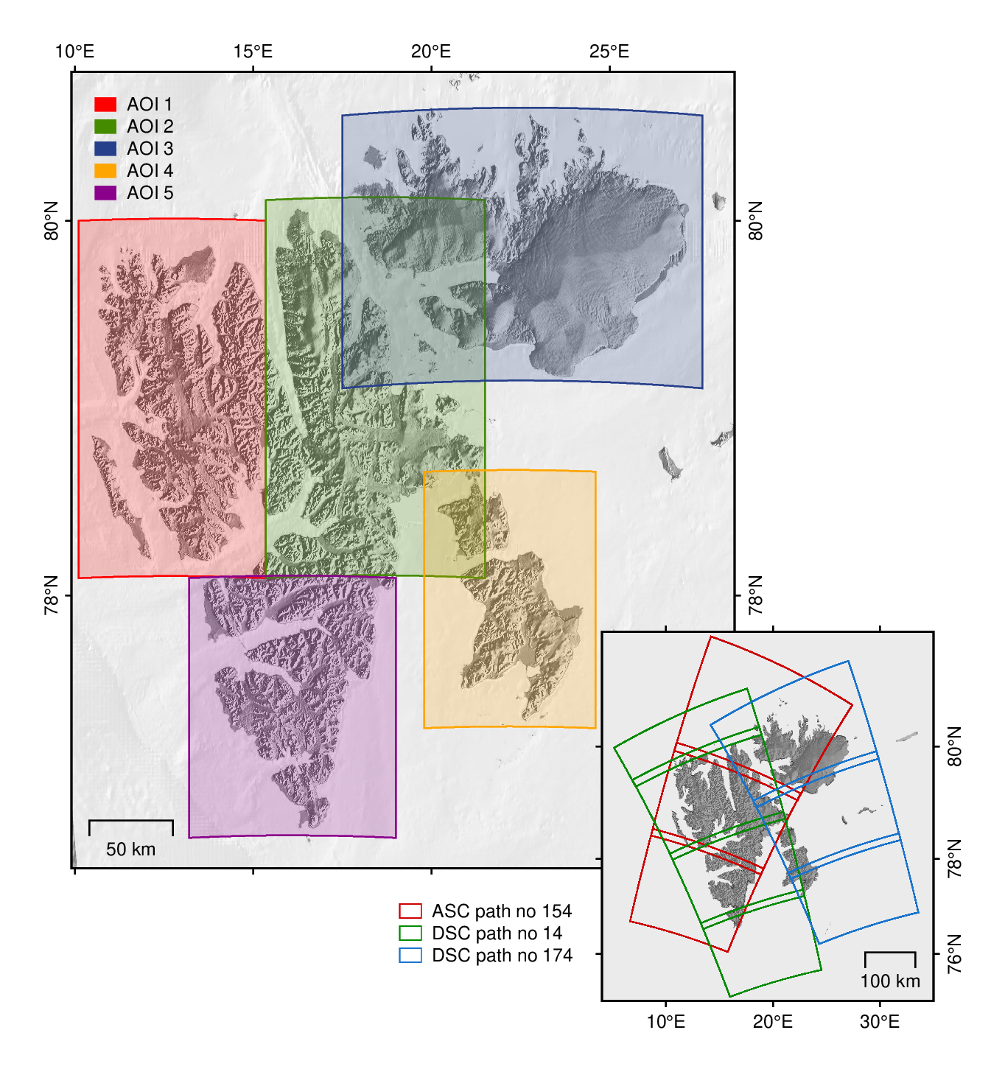
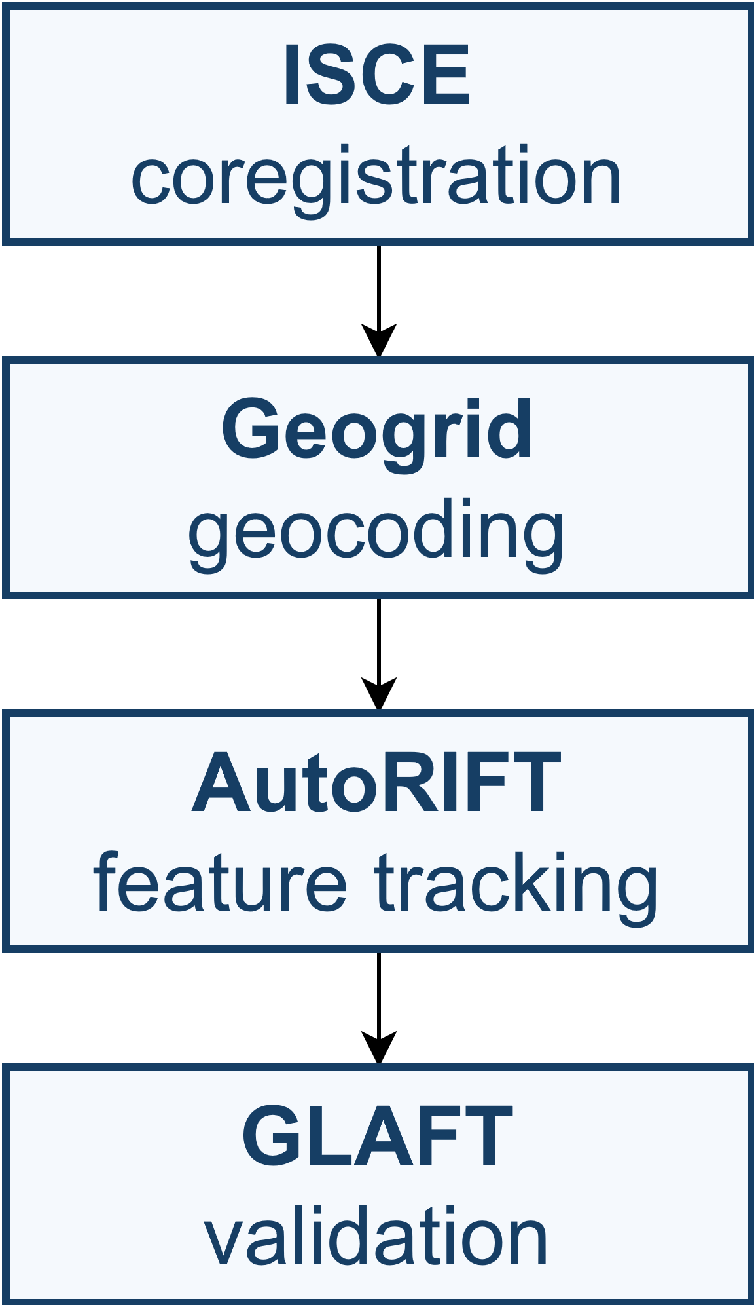
External AutoRIFT input data for Svalbard
Data and methods
Reference velocity (ITS-LIVE data for 2018)
DEM – ArticDEM
Slope in x and y
Chip max in x and y
Search limit
Stable surface
Path no. | 14 | 154 | 174
Polarization/orbit direction | HH/ASC | VV/DSC | VV/ASC
Number of SAR images | 399 | 263 | 386
Time frame | 20150802-20230901 | 20180416-20230911 | 20150813-20230831
based on reference velocity and terrain coverage
Processing workflow

Slide 8
Validation results
Path no 14
Area no. | corr metric 1 | corr metric 2 | mean incorrect match % | mean metric 1 [m/yr] | mean metric 2 [1/yr]
1 | 0.98 | 0.99 | 21.99 | 70.91 | 3.78
2 | 0.97 | 0.97 | 22.32 | 45.10 | 5.42
3 | 0.98 | 0.96 | 20.40 | 58.55 | 7.58
4 | 0.92 | 0.98 | 23.89 | 49.31 | 2.14
Path no 174
5 | 0.99 | 0.96 | 18.29 | 61.13 | 4.37
6 | 0.99 | 0.96 | 19.28 | 94.17 | 2.69
Path no 154
1 | 0.99 | 0.97 | 22.14 | 64.93 | 3.82
2 | 0.97 | 0.98 | 15.83 | 47.83 | 3.46
3 | 0.99 | 0.96 | 19.73 | 62.98 | 5.32
4 | 0.97 | 0.96 | 25.03 | 85.67 | 2.57
5 | 0.91 | 0.95 | 19.09 | 39.67 | 4.13
6 | 0.93 | 0.97 | 21.92 | 78.08 | 3.31
Metric 1 - uncertainty of ice velocity products on the assumption that ice-free areas are static, and non-zero velocity values are measurement errors.
Separation of correct and incorrect feature matches over static terrain has been done with KDE.
Metric 2 - based on the physics of glacier flow.

