Slide 1
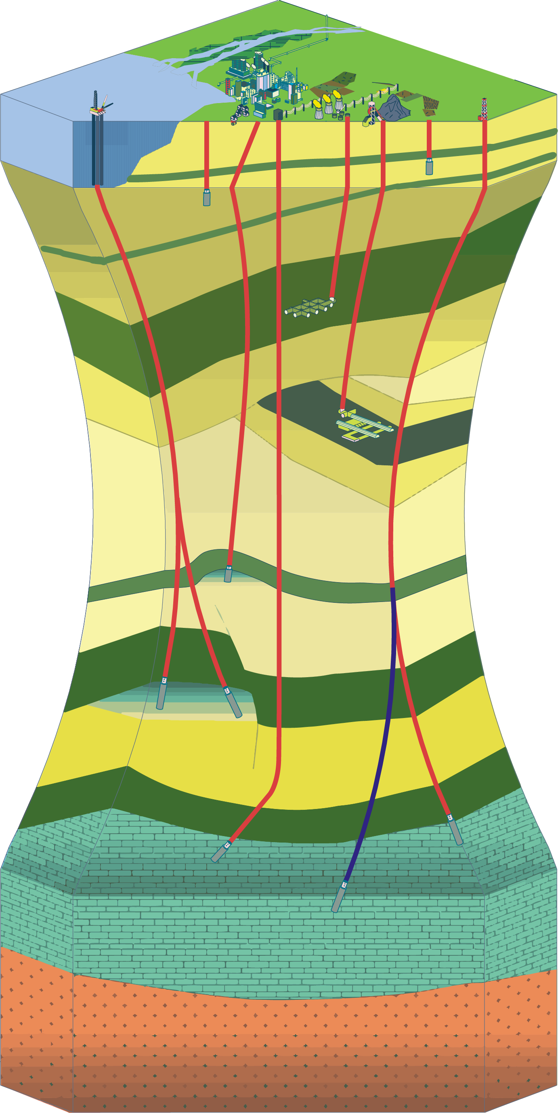
Sustainable Scale for Geosystem Services Use: Addressing the missing link in subsurface management
Adithya Eswaran ^{a*}, Tine Compernolle ^{a,b}, Kris Piessens ^{b}
ª Faculty of Business and Economics, University of Antwerp, Belgium
^{b} Geological Survey of Belgium, Royal Belgian Institute of Natural Sciences, Belgium

Slide 2
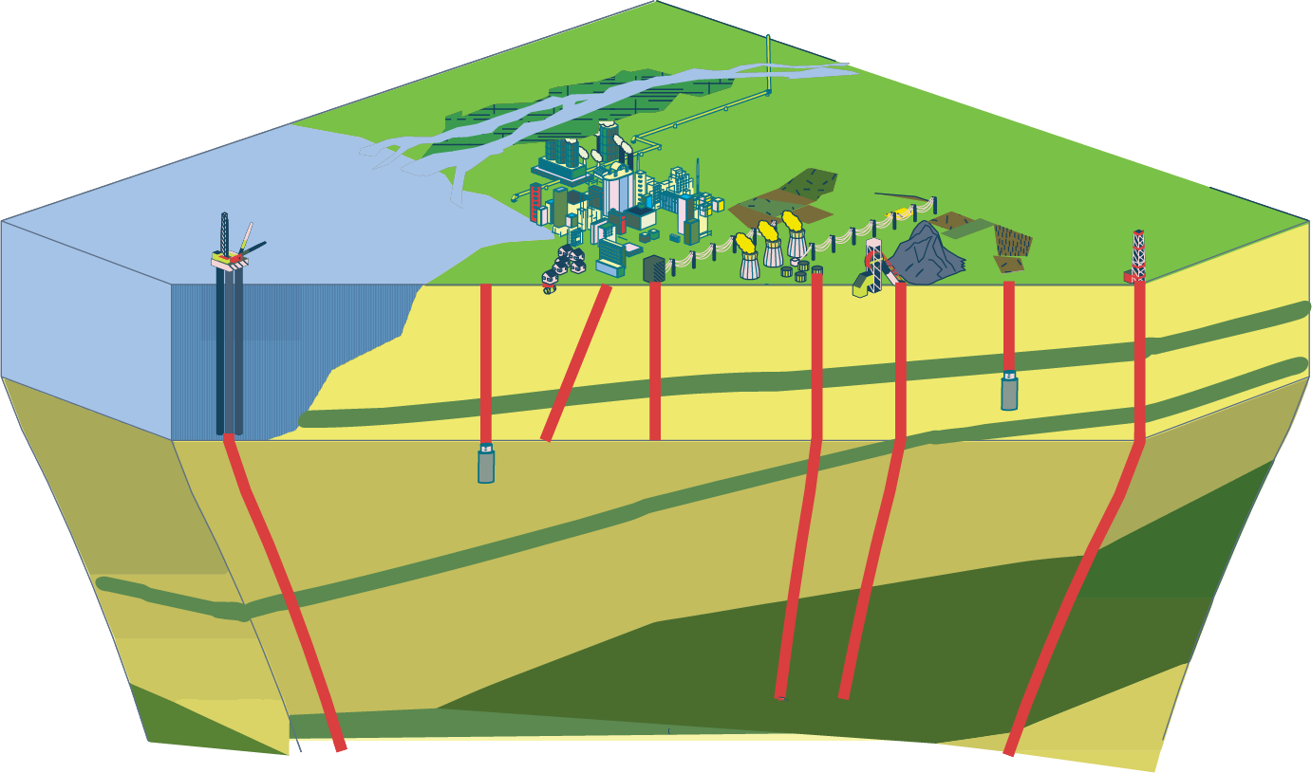
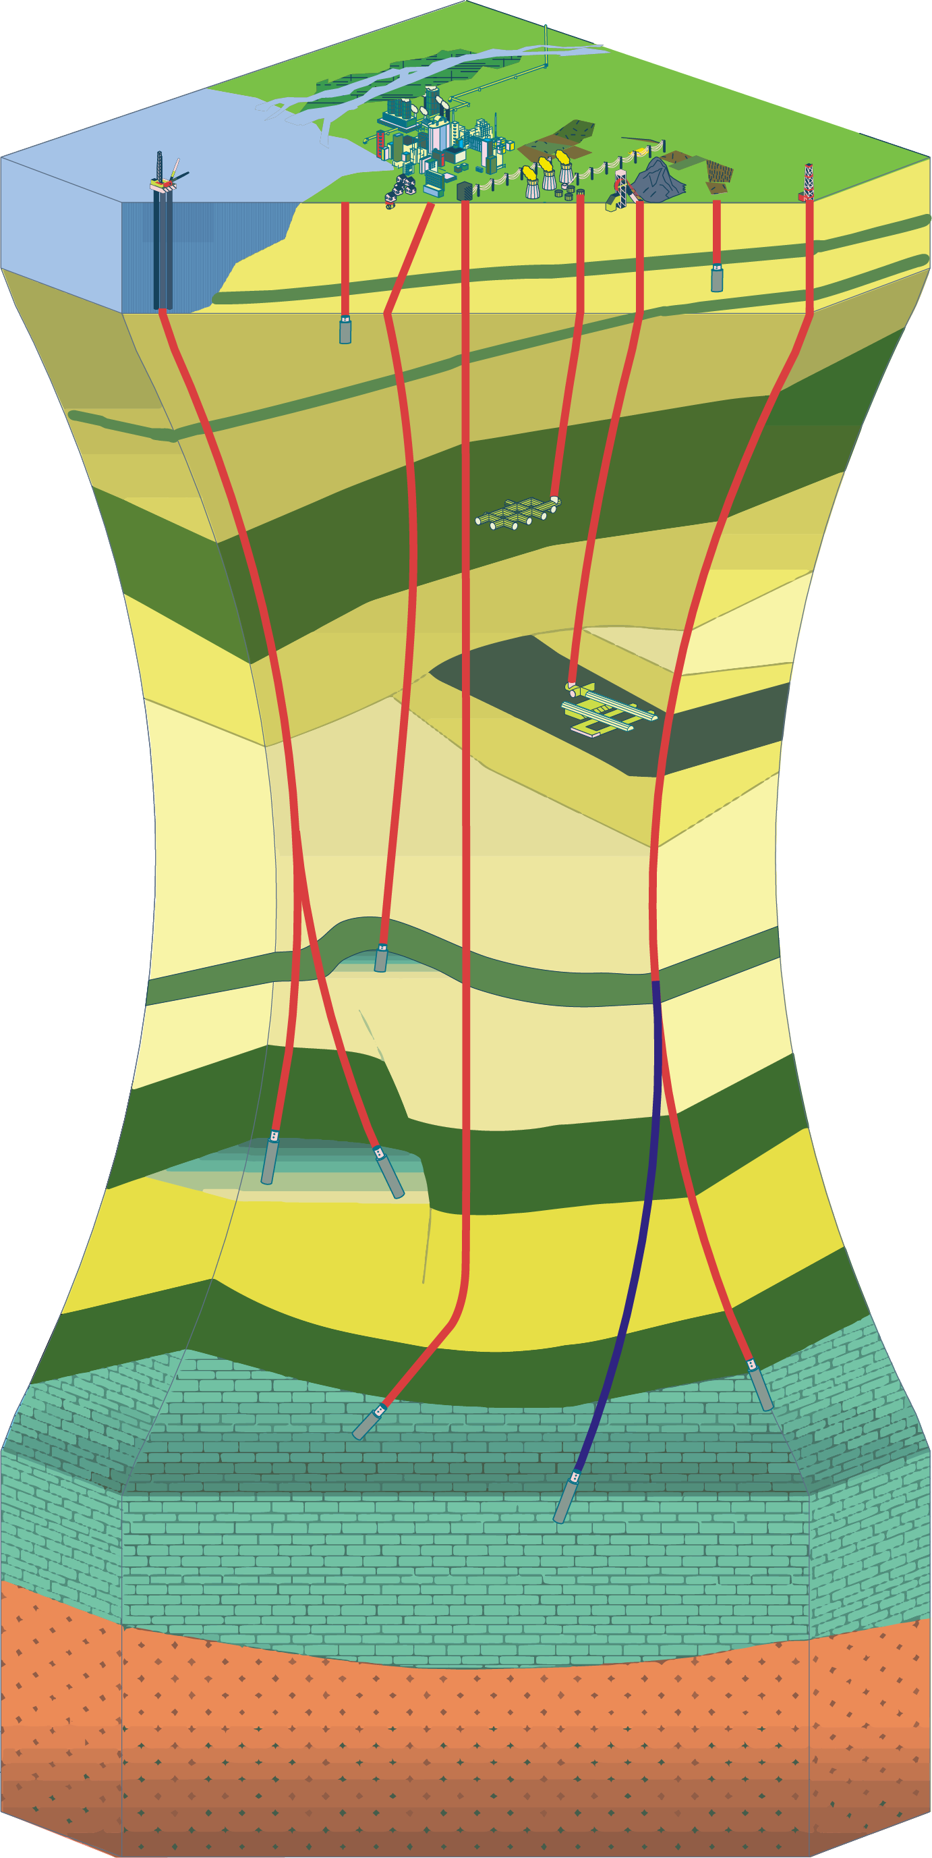
Balancing conservation and exploitation of the subsurface?
Extractive, consumptive, and non-renewable resources contribute to economic growth.
Structures and Processes
Multi-functional goods and services with various regenerative capacities contribute to human well-being.
Utility
Functions
Ecological Economics and Ecosystem Services allow for addressing the plurality of nature, its finiteness and fragility. But they overlook and undervalue the subsurface!
Services
Subsurface
Economy & Society
How do we conceptualize the benefits obtained from the subsurface by tracing natural processes, functions, and utilization?
Can Ecological Economics provide guidance to phase out from growth-obsessed economic models for geosystem service utilization?
Disutility
Finite Natural Capital

Slide 3
The urgency of this research
01
Read the abstract here
A shift from the productivist approach
Objective(s)
Existing literature on managing services
02
Want to get in touch?
Illustrating the dynamics of the subsurface using Ecosystem Services Cascade
03
Contributions of this research
04
Previous slide
Returns to this slide
Next slide
Summary and Conclusion
05
Press to go to the specific sections

Slide 4
Why managing the subsurface sustainably is urgent?
The demands of the uses of the subsurface keep growing. But the supply is not infinite!!
Rapid pace of exploitation to fulfill the growing demands of population and obsession for a growth-based economy.
Yet managing the subsurface is under-represented in mainstream economics literature.
According to mainstream economics – technological progress and resource substitutes will solve resource scarcity
Out-of-sight-out-of-mind
Recipe for resource depletion and impacts on the wider ecosystem
Optimizing for short-term economic gains, competing uses and a first-come-first-served mode of subsurface requires proactive action

Slide 5
Managing the subsurface requires a shift in our perspective
Narrow view of the subsurface
Broad(er) view of the subsurface
Source of goods and services
Contributes to human well-being and intrinsic benefits
Perfect substitutes do not exist
Extractive Resources
Contribution to Economic Growth
Substitutes will solve scarcity
Objective
Bridging the gap between subsurface exploitation and conservation.
Informing policy and decision-making for sustainable resource management.
Advancing understanding of economic approaches that are suitable for managing geosystem services and basins globally?

Slide 6
Operational principles are absent that guide decision-making for services
The existing literature (n=32) on governing and managing geosystem services focuses on the following aspects:
Classifying and tracing the value of geosystem services and geodiversity.
Why to conserve? What to conserve? Significance of conserving?
How to achieve it using economic approaches is absent!
The conservation based approach does not combine geological, environmental, economic, and social considerations that are essential for the sustainable management of geosystem services.

Slide 7
To manage the subsurface we need to understand the dynamics
Sustainable management of the subsurface involves ensuring:
Structures, components and Processes
Marginal disutility (diminishing of services, climate change, biodiversity loss, etc.) does not exceed Marginal utility (human well-being, economic growth, etc.)
Functions
Services
Human well-being
Utility
Disutility
Natural resources

Slide 8
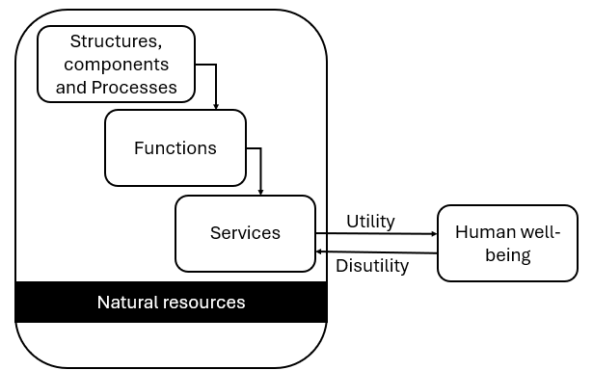
Contribution [1/3] – Conceptual view of geology-environment-economy interactions
Natural resource | Processes and components | Functions | Service Type | Goods and services | Utility
Water | Hydrogeological cycle, the process of infiltration | Production Function | Provisioning Service | Fresh groundwater | Groundwater extraction
Host rock | Different sedimentary, tectonic, and igneous processes (resulting in sediments or rocks with certain properties) | Carrier function: Addition of high- and low-permeability layers to rock sequences forming static or dynamic traps | Reservoir/trap configuration (geological storage complex) | Natural in-situ impermeable barrier | Injection of CO₂ for permanent storage
Consists of a non-exhaustive list of 17 entries covering all the categories of functions as accounted in TEEB(2010) and MEA(2005)

Slide 9
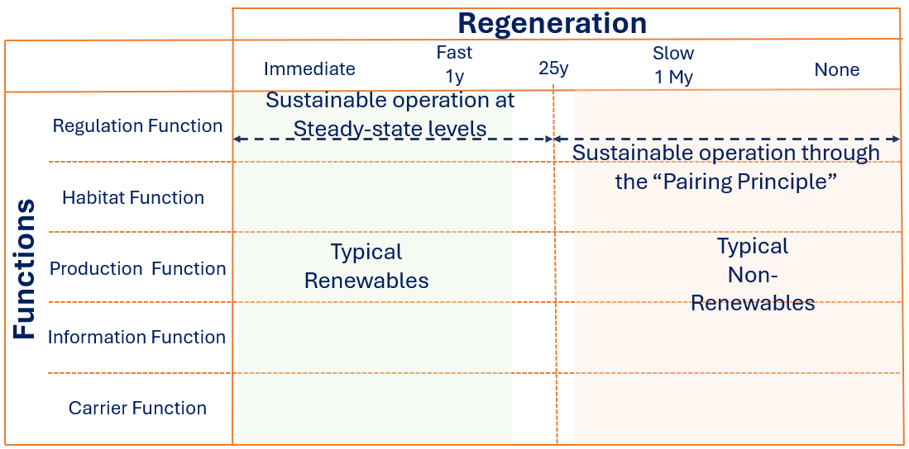
Contribution [2/3] – Sustainable scale of subsurface use based on limits to maximal physical economy
Contextualized version of Sustainable Scale of Daly (1990) from Ecological Economics that focuses on limiting resource use by aligning resource use with regeneration rates (Steady-State Economics) and pairing the use of non-renewables with renewables (Pairing Principle)
This does not mean that we shrink our economy and not develop.

Slide 10
Contribution [2/3] – Sustainable Scale for subsurface based on each activity
Steady-State utilization
Paired utilization

Slide 11
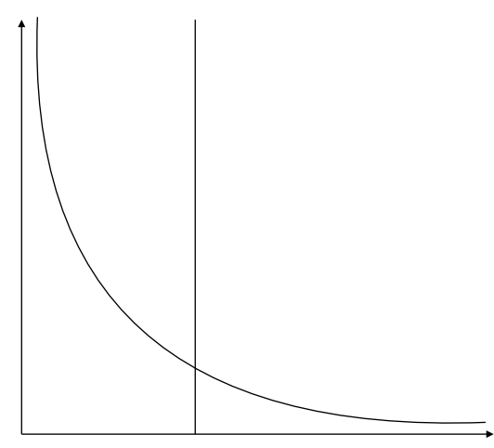
Contribution [3/3] - Control mechanisms to stay within a sustainable scale of utilization
Steady-State utilization
Paired utilization
High
High
Switching from the existing non-renewable resource to a renewable alternative
Exploitation Rate (E)
E > R
Exploitation Rate (E)
E > R
E = R
Minimizing Exploitation rate for achieving Steady State exploitation
Low
E = R
Low
High
Regeneration Rate (R)
Low
High
Regeneration Rate (R)
Low

Slide 12
Summary and Conclusions
Significance our contribution
Based on bio-physical conditions of each service, the policymakers can establish targets for utilization levels based on geological limits determined based on resource properties (its formation and regeneration)
The sustainable scale does not rely on resource substitution or technological progress. Rather it is to understand the rate at which we can utilize the subsurface without diminishing its ability to provide these services.
Implications
Approaches in Ecological Economics have significant potential to address the concerns of the management of the subsurface.
There is a need for transdisciplinary research wherein geologists are actively involved in conceptualizing such economic approaches.
The sustainable scale is one of the many options and not the sole option. It needs to take place along with other efforts such as maximal circular economy and resource efficiency.

Slide 13
Get in touch
Prof. Dr. Tine Compernolle
University of Antwerp, Belgium and Geological Survey of Belgium, Belgium
Dr. Kris Piessens
Geological Survey of Belgium, Belgium
ir. Adithya Eswaran
University of Antwerp, Belgium
adithya.eswaran@uantwerpen.be

Slide 14
Selected References
Barbier, E. B. (2021). The evolution of economic views on natural resource scarcity. Review of Environmental Economics and Policy, 15(1), 24-44.
Brilha, J., Gray, M., Pereira, D. I., & Pereira, P. (2018). Geodiversity: An integrative review as a contribution to the sustainable management of the whole of nature. Environmental Science & Policy, 86, 19-28. https://doi.org/10.1016/j.envsci.2018.05.001
da Silva, M. L. N., & do Nascimento, M. A. L. (2020). Ecosystem Services and Typology of Urban Geodiversity: Qualitative Assessment in Natal Town, Brazilian Northeast. Geoheritage, 12(3). https://doi.org/10.1007/s12371-020-00479-y
Daly, H. E. (1990). Toward some operational principles of sustainable development. Ecological economics, 2(1), 1-6.
Daly, H. E. (1991). Steady-state economics: with new essays. Island press.
Daly, H. E. (1992). Allocation, distribution, and scale: towards an economics that is efficient, just, and sustainable. Ecological economics, 6(3), 185-193. https://doi.org/https://doi.org/10.1016/0921-8009(92)90024-M
de Groot, R., Wilson, M. A., & Boumans, R. M. J. (2002). A typology for the classification, description and valuation of ecosystem functions, goods and services. Ecological economics, 41(3), 393-408. https://doi.org/https://doi.org/10.1016/S0921-8009(02)00089-7
De Groot, R. S. (1992). Functions of nature: evaluation of nature in environmental planning, management and decision making. Wolters-Noordhoff BV.
Fox, N., Graham, L. J., Eigenbrod, F., Bullock, J. M., & Parks, K. E. (2020). Incorporating geodiversity in ecosystem service decisions. Ecosystems and People, 16(1), 151-159. https://doi.org/10.1080/26395916.2020.1758214
Gordon, J. E., Barron, H. F., Hansom, J. D., & Thomas, M. F. (2012). Engaging with geodiversity—why it matters. Proceedings of the Geologists' Association, 123(1), 1-6. https://doi.org/10.1016/j.pgeola.2011.08.002
Gray, M. (2004). Geodiversity: valuing and conserving abiotic nature. John Wiley & Sons.
Gray, M. (2011). Other nature: geodiversity and geosystem services. Environmental Conservation, 38(3), 271-274. https://doi.org/10.1017/s0376892911000117
Gray, M. (2012). Valuing Geodiversity in an ‘Ecosystem Services’ Context. Scottish Geographical Journal, 128(3-4), 177-194. https://doi.org/10.1080/14702541.2012.725858
Haines-Young, R., & Potschin-Young, M. (2018). Common International Classification of Ecosystem Services (CICES) V5.1 and Guidance on the Application of the Revised Structure. www.cices.eu
Haines-Young, R., & Potschin, M. (2013). Common international classification of ecosystem services (CICES): consultation on version 4, August-December 2012. EEA Framework Contract No EEA.
Hjort, J., Gordon, J. E., Gray, M., & Hunter, M. L., Jr. (2015). Why geodiversity matters in valuing nature's stage. Conserv Biol, 29(3), 630-639. https://doi.org/10.1111/cobi.12510
Schrodt, F., Bailey, J. J., Kissling, W. D., Rijsdijk, K. F., Seijmonsbergen, A. C., van Ree, D., Hjort, J., Lawley, R. S., Williams, C. N., Anderson, M. G., Beier, P., van Beukering, P., Boyd, D. S., Brilha, J., Carcavilla, L., Dahlin, K. M., Gill, J. C., Gordon, J. E., Gray, M., . . . Field, R. (2019). Opinion: To advance sustainable stewardship, we must document not only biodiversity but geodiversity. Proc Natl Acad Sci U S A, 116(33), 16155-16158. https://doi.org/10.1073/pnas.1911799116
Solow, R. M. (1974). The Economics of Resources or the Resources of Economics. The American Economic Review, 64(2), 1-14. http://www.jstor.org/stable/1816009
Stiglitz, J. (1974). Growth with Exhaustible Natural Resources: Efficient and Optimal Growth Paths. The Review of Economic Studies, 41, 123-137. https://doi.org/10.2307/2296377
van der Meulen, E. S., Braat, L. C., & Brils, J. M. (2016). Abiotic flows should be inherent part of ecosystem services classification. Ecosystem Services, 19, 1-5. https://doi.org/10.1016/j.ecoser.2016.03.007
van Ree, C. C. D. F., & van Beukering, P. J. H. (2016). Geosystem services: A concept in support of sustainable development of the subsurface. Ecosystem Services, 20, 30-36. https://doi.org/10.1016/j.ecoser.2016.06.004
van Ree, C. C. D. F., van Beukering, P. J. H., & Boekestijn, J. (2017). Geosystem services: A hidden link in ecosystem management. Ecosystem Services, 26, 58-69. https://doi.org/10.1016/j.ecoser.2017.05.013

