Slide 1





Application of a fault identification and fault sealing evaluation method in production and development stage in ZB area of Bohai Bay Basin
Changping Cheng, Xianguo ZHANG
School of Geosciences
China University of Petroleum (East China)
Notes:
1

Slide 2
Outline
1
Geologic background
2
Methods
3
Result and conclusion
Notes:
2

Slide 3
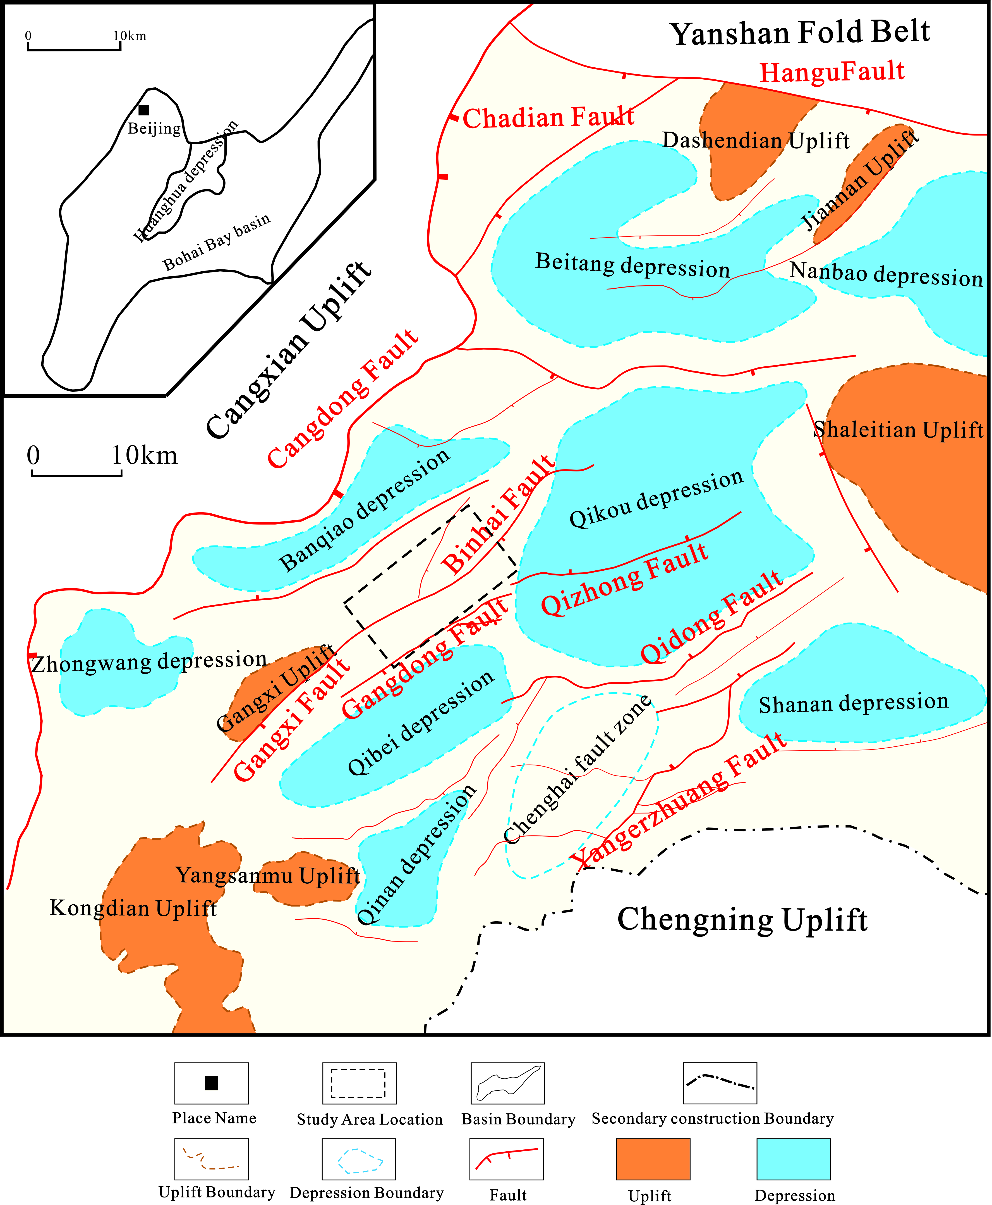
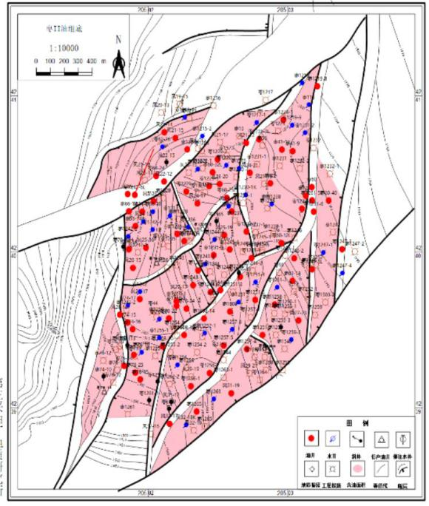
The study area is mainly a shallow water delta sedimentary environment
Kongdian uplift is located in the southern part of the Bohai Bay Basin
ZB area is located in the middle of Qikou depression
It developed a large number of faults affecting oilfield production.

Slide 4
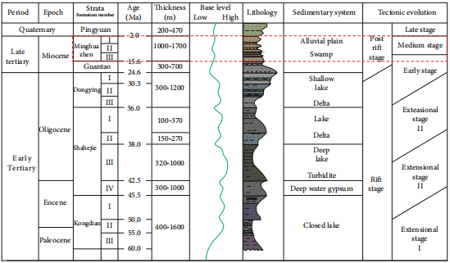
The interested strata is the Paleogene Kongdian Formation
The top and bottom of Kongdian Formation are unconformity
The sedimentary environment is mainly braided river in middle alluvial fan in Kongdian Formation

Slide 5
Outline
1
Geologic background
2
Methods
3
Result and conclusion
Notes:
5

Slide 6
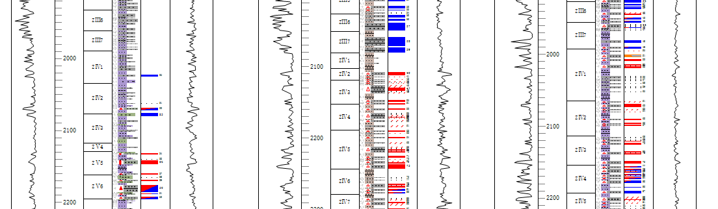
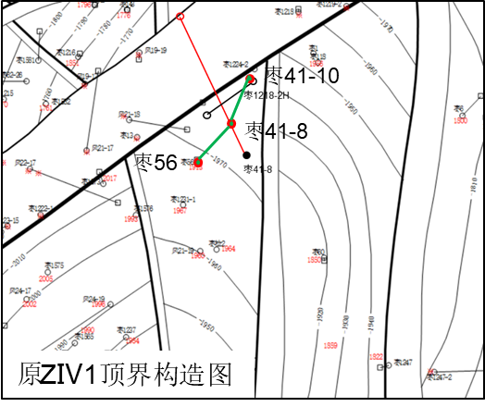
Formation thickness change to identify breakpoints
According to the variation of formation thickness,it indicates that minor faults maybe missed.
168m
198m
Well Z56
Well Z41-8
Well Z41-10
Well 41-10
Well Z56
Well Z41-8
The bottom of ZⅣ sand group

Slide 7
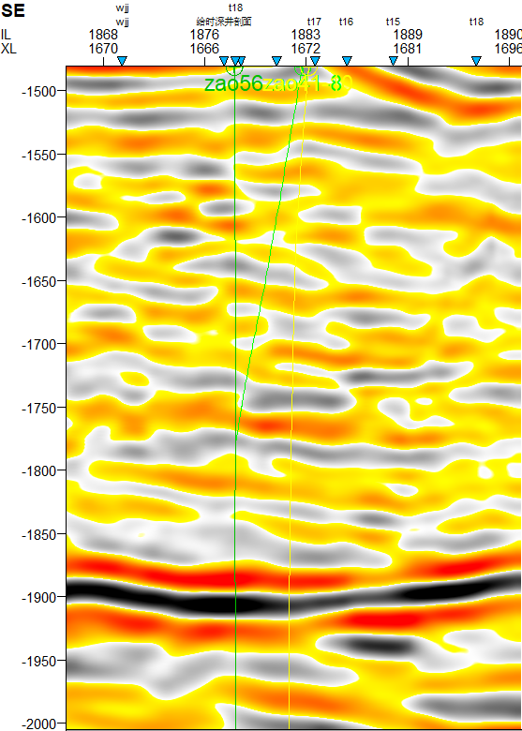
Formation thickness change to identify breakpoints
Combined with thje seismic profile,the top of ZⅣ developed a small fault derived from the Fenghuadian fault,which led to the partial loss of the top.
Well Z56
Well Z41-8
Well 41-10
Z56井
Z41-8井
Z41-10井
ZⅠ sand group
ZⅡ sand group
Well 41-10
Well Z56
Well Z41-8
Well 41-10
F1
Well Z41-8
Well Z56
ZⅣ sand group
ZⅣ sand group
ZⅤ sand group
The bottom of ZⅣ sand group

Slide 8
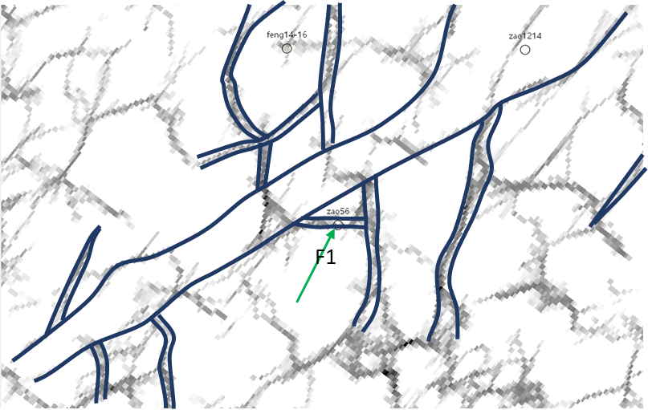
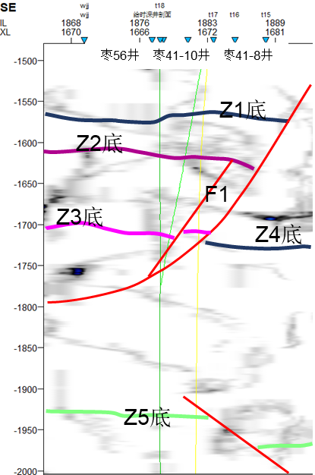
Ant body flat section identification breakpoint
The plane information and profile of seismic data are combined to identify small faults by using the plane and profile information of ants.
WellZ56
Well Z41-8
Well 41-10
Well 41-10
Well Z41-8
Well Z56
Ant body stratigraphic slice to indetify faults

Slide 9
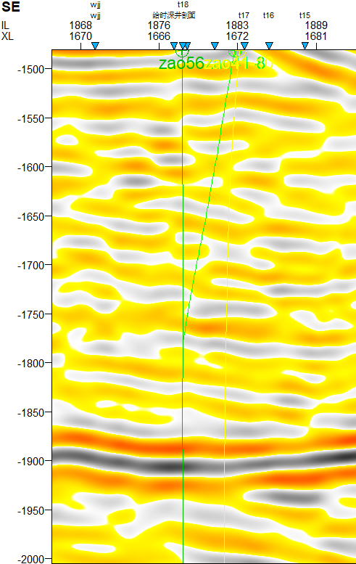
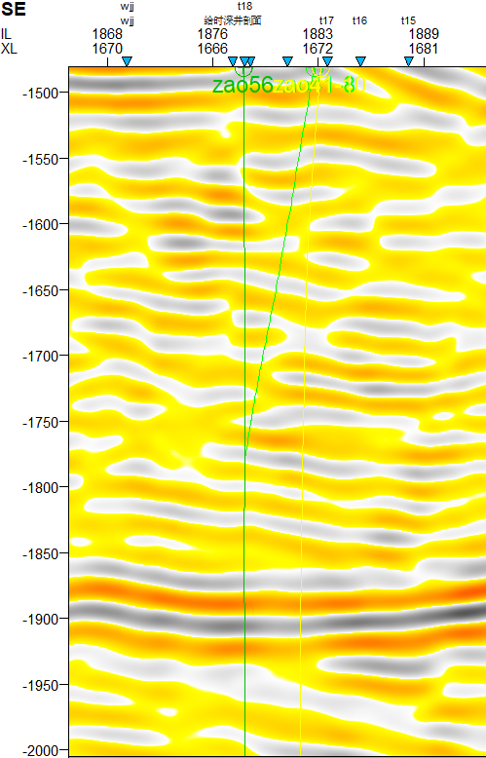
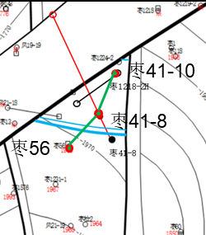
Frequency division profile to identify breakpoints
The frequency division profile analysis can more accurately indetify the breakpoints and explain the small fault 45Hz frequency division profile.
WellZ56
Well Z41-8
Well 41-10
WellZ56
Well Z41-8
Well 41-10
WellZ56
Well Z41-8
Well 41-10
ZⅠ
ZⅠ
ZⅠ
ZⅡ
ZⅡ
ZⅡ
F1
F1
F1
ZⅣ
ZⅢ
ZⅢ
ZⅣ
ZⅢ
ZⅣ
Well Z41-10
Well Z41-8
Well Z56
ZⅤ
ZⅤ
ZⅤ
The original section
35Hz
45Hz

Slide 10
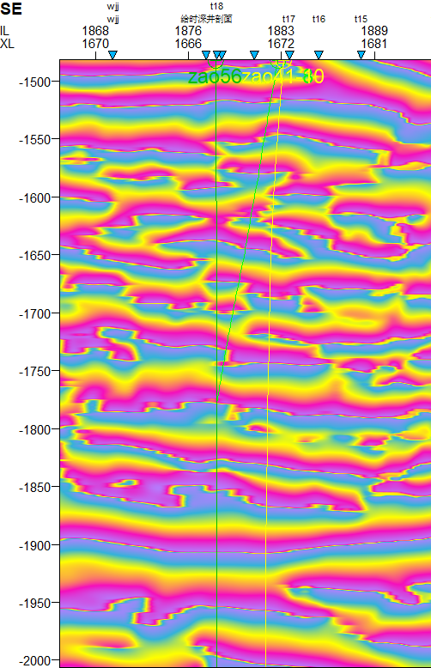
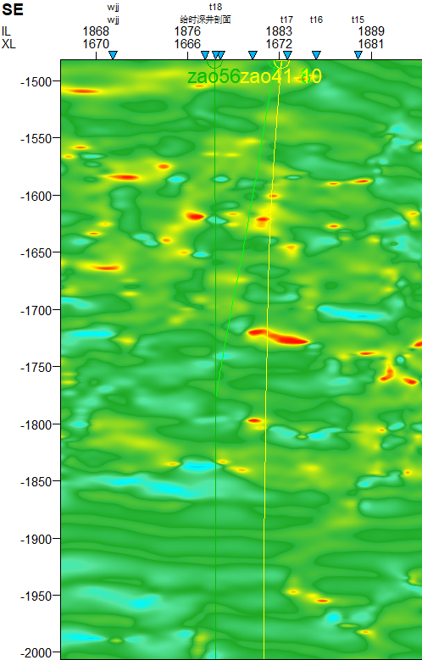
Seismic profile attributes determine breakpoints
The phase interruption at the instantaneous phase profile F1 indicates that there is a layered or anomalous medium.
枣56井
枣41-8井
枣41-10井
WellZ56
Well Z41-8
Well 41-10
枣56井
枣41-8井
枣41-10井
WellZ56
Well Z41-8
Well 41-10
ZⅠ
ZⅠ
ZⅡ
ZⅡ
F1
F1
ZⅢ
ZⅢ
ZⅣ
ZⅣ
ZⅤ
ZⅤ
Instantaneous phase
Instantaneous frequency

Slide 11
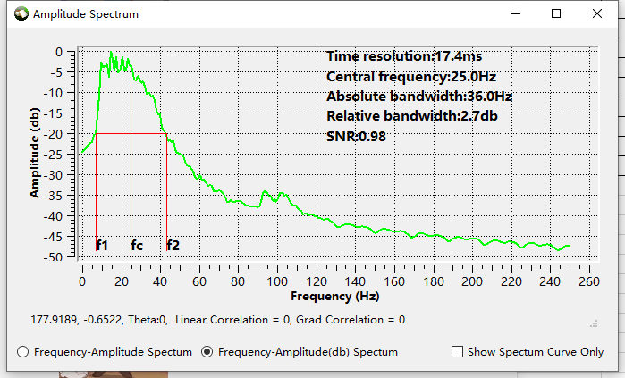
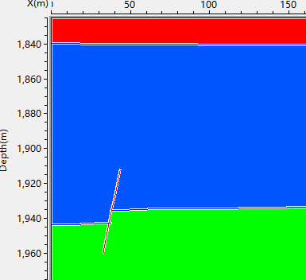






Seismic forward modeling fault response
Seismic forward modeling with different frequencies simulates the seismic reflection characteristics of small faults, and 45 Hz seismic data is selected as the data volume for small fault interpretation.
3250
sand
mud
3400
Main frequency:25Hz
Bandwidth:36Hz
sand
3500
20hz
25hz
25hz
35hz
45hz
45hz

Slide 12
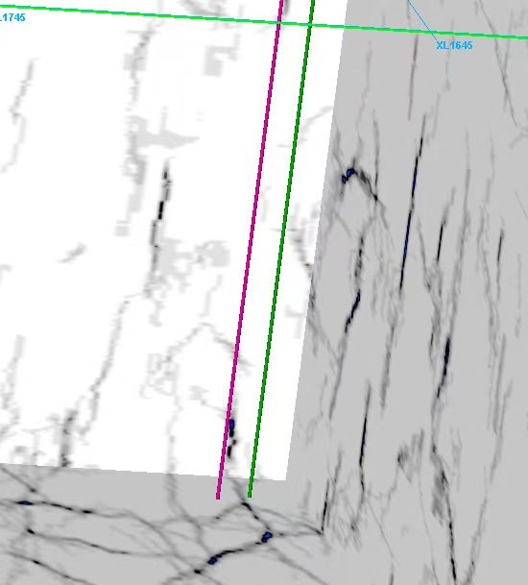
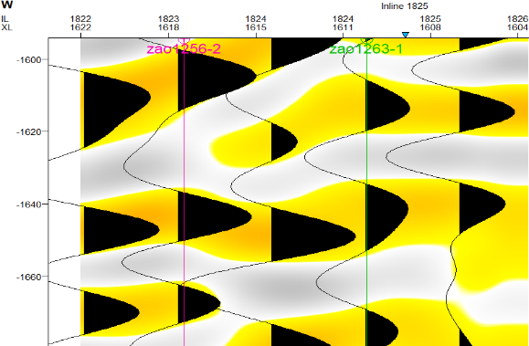
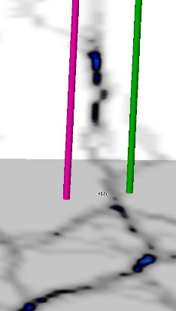
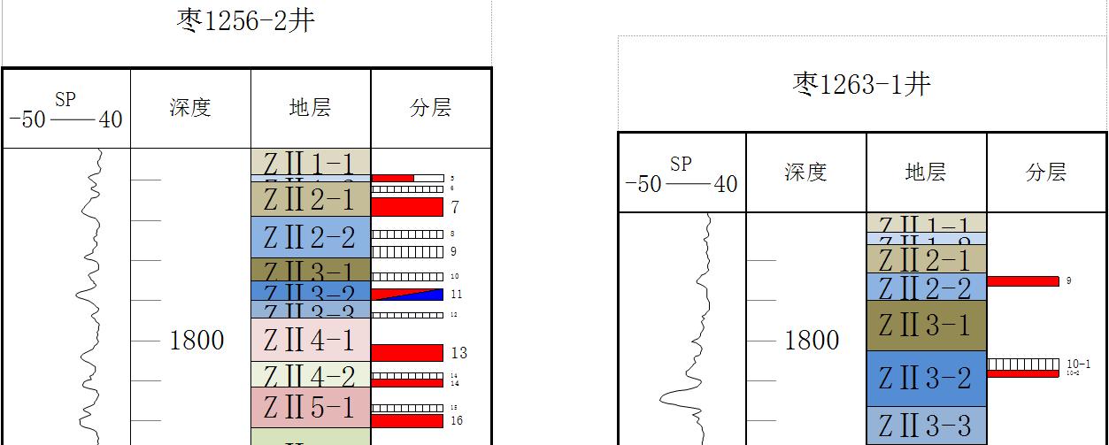
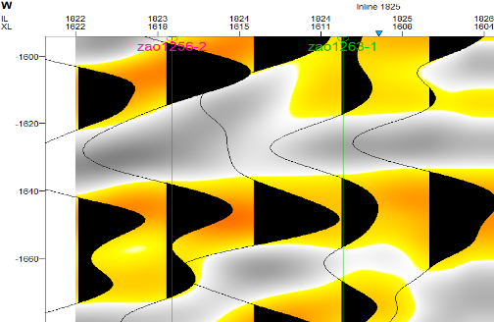
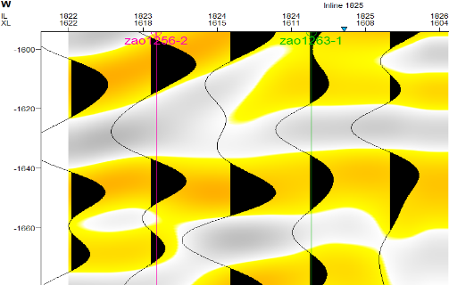
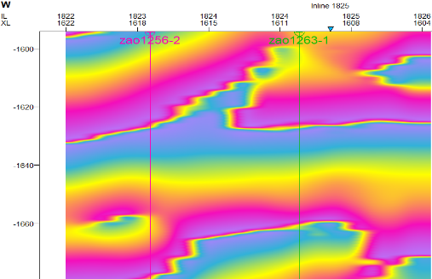
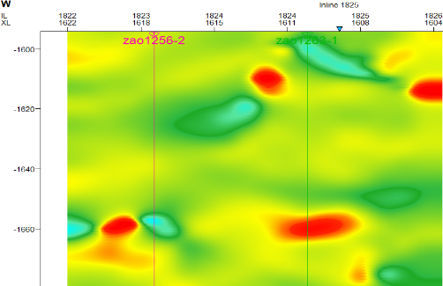
Identifying faults by frequency-division seismic profiles
Well Z1256-2 is close to Well Z1263-1, and the height difference is 15 m. The weak distortion can be identified by using the 45 Hz frequency division profile, which is consistent with the seismic forward modeling. The instantaneous phase response is weak, and the instantaneous frequency can be seen. The ant body plane slice shows that there are obvious fractures here to identify small faults in the study area.
Well Z1256-2
Well Z1263-1
45Hz
The original section
35Hz
Instantaneous phase
Instantaneous frequency

Slide 13
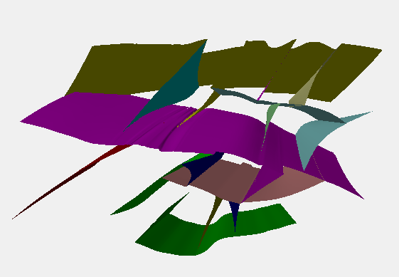
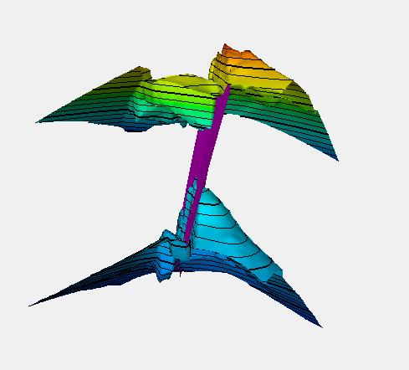
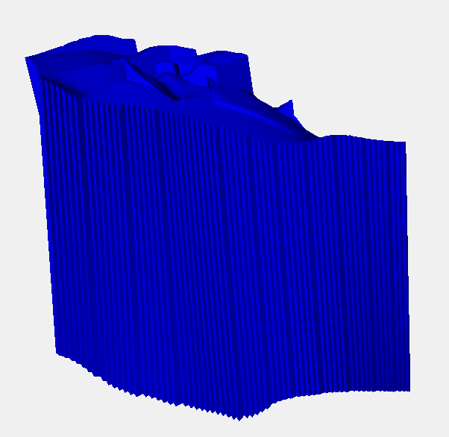
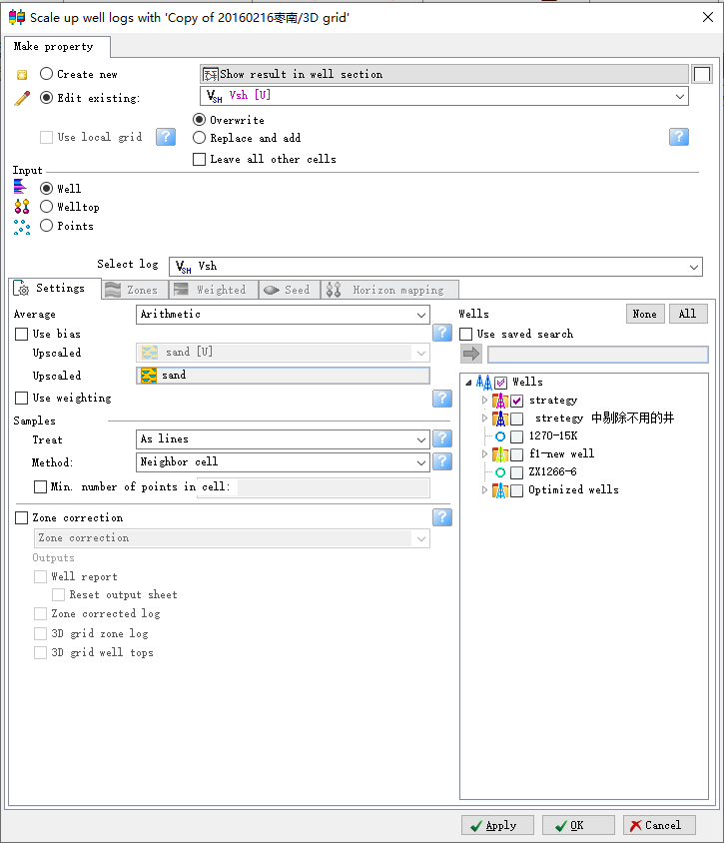
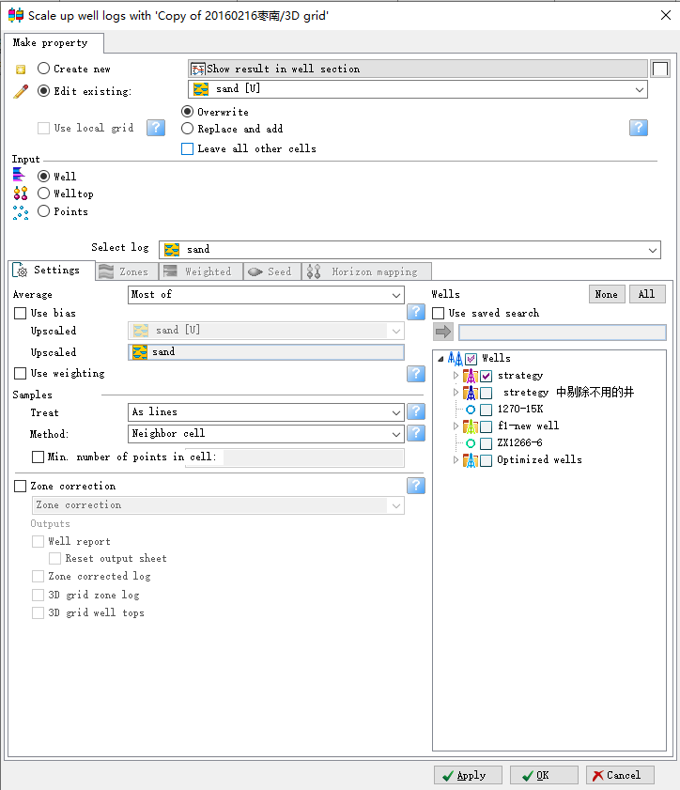
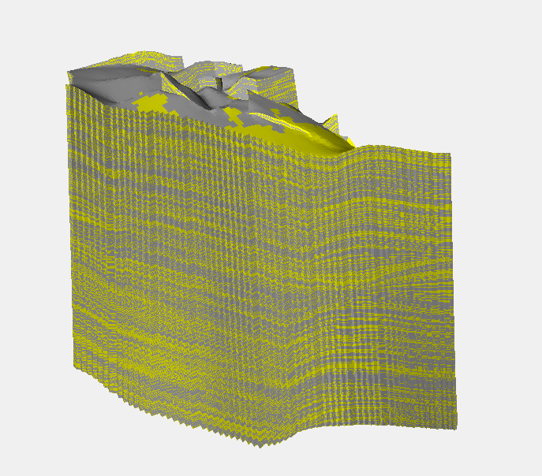
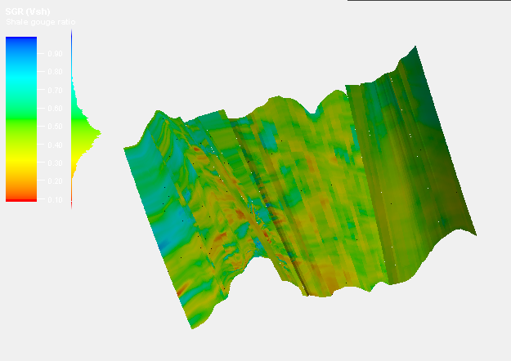
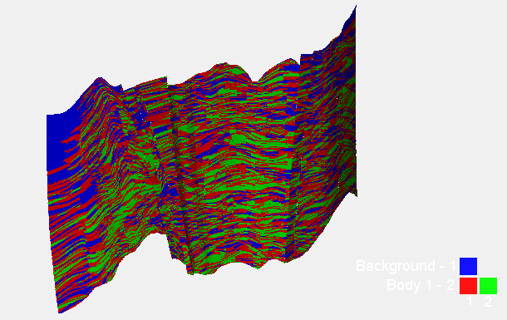
Fault sealing characterization process
Based on the Petrel software platform, a three-dimensional quantitative characterization technique for the SGR value of mudstone smearing on the cross-section of the fault and the lithology of the two sides of the fault is developed.
① Fault model
②stratigraphic model
③Fault block model
④Coarsening mud content and lithology curve
⑤Lithologic model
⑥Lithologic contraposition map
⑦SGR distribution map
sand
mud
Evaluation of closure | Poor | Medium | Good | Better
SGR（%） | <50 | 50-60 | 60-75 | >75
SGR evaluation criteria

Slide 14
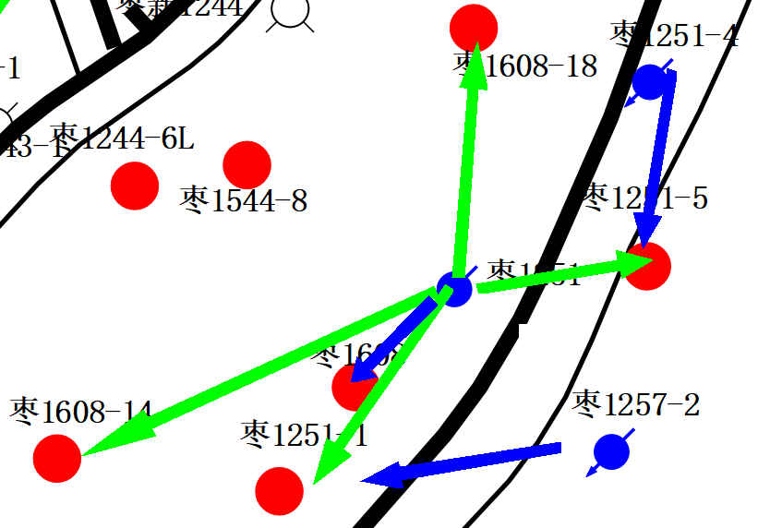
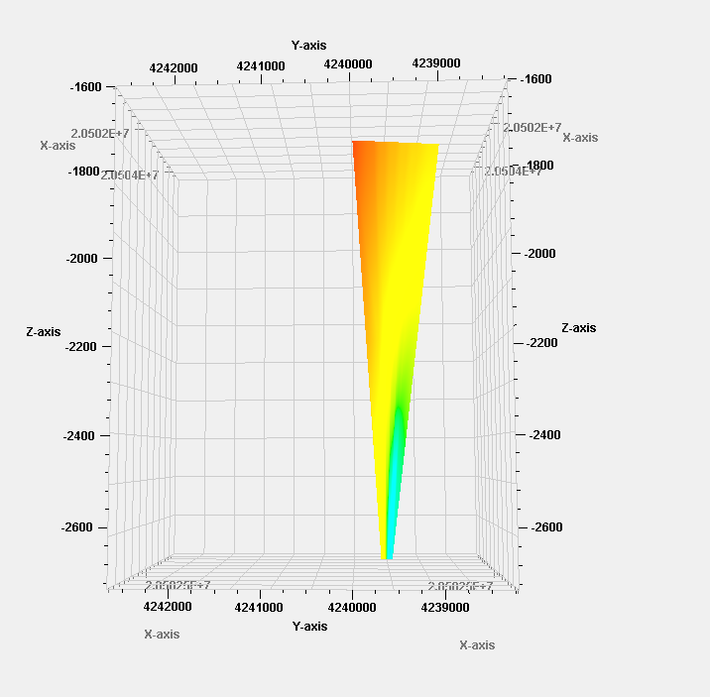
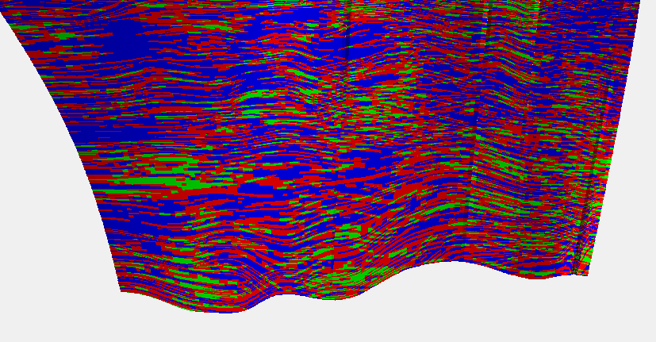



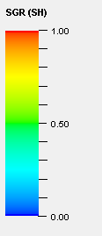
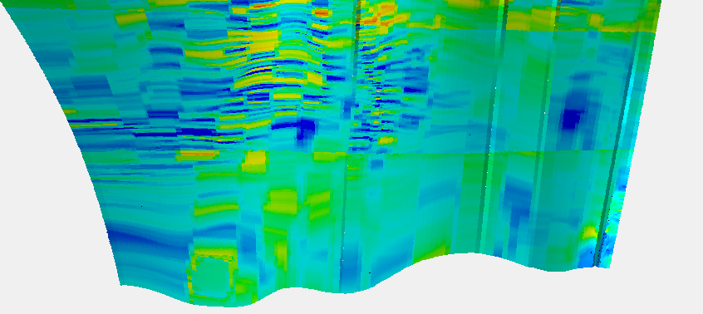
Example test
Most of the small faults in Zaobei area are high dip faults.The shallower the buried depth of the fault is,the worse the sealing property of the fault is.The static analysis are consistent with it.
ZIV
sand-sand
sand-mud
ZIV:sand-sand
ZV:sand-sand、
sand-mud
ZV
mud-mud
Oil well
Water well
 | Crude oil viscosity (mPa.S，50℃） | Crude oil density （g/cm3,50℃）
Well Z1257-2 | 260.98 | 0.9068
Well Z1251 | 269.02 | 0.884
ZIV
ZIV:SGR 30%-40%
ZV:SGR 40%-50%
ZV

Slide 15
The relationship between SGR and seepage velocity
The injection-production relationship is selected to determine the effective well group across the fault, and the SGR relationship of the fault mudstone smear ratio at the intersection of the fault plane section is analyzed. It is found that the seepage velocity is positively correlated with the SGR logarithmically. When the SGR at a certain point of the section is small, the water body flows to the low value direction.
Fault | Well group | Well spacing（m） | Effective time (d) | Seepage velocity(m/d) | SGR(%)
F19 | Z1243-1、Z1243-3 | 163 | 57 | 2.86 | 0.47
F9 | Z1242-4、Z1235-4 | 180 | 71 | 2.54 | 0.34
F11 | Z1255-1、Z76-16 | 160 | 65 | 2.46 | 0.46
F11 | Z76-16、Z1608-10 | 140 | 55 | 2.55 | 0.44
F11 | Z1256、Z1256-2 | 240 | 147 | 1.63 | 0.13
F14 | Z1247-5L、Z1546 | 145 | 71 | 2.04 | 0.26
F17 | Z1546、Z59 | 220 | 88 | 2.50 | 0.43
F19 | Z1243-1、Z1243-3 | 170 | 81 | 2.10 | 0.33
F22 | Z130、Z62-26 | 130 | 49 | 2.65 | 0.49
F11 | Z1256、Z1256-1 | 124 | 57 | 2.18 | 0.39
F13 | Z1257-2、Z1251-1 | 176 | 76 | 2.31 | 0.45

Slide 16
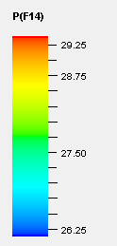
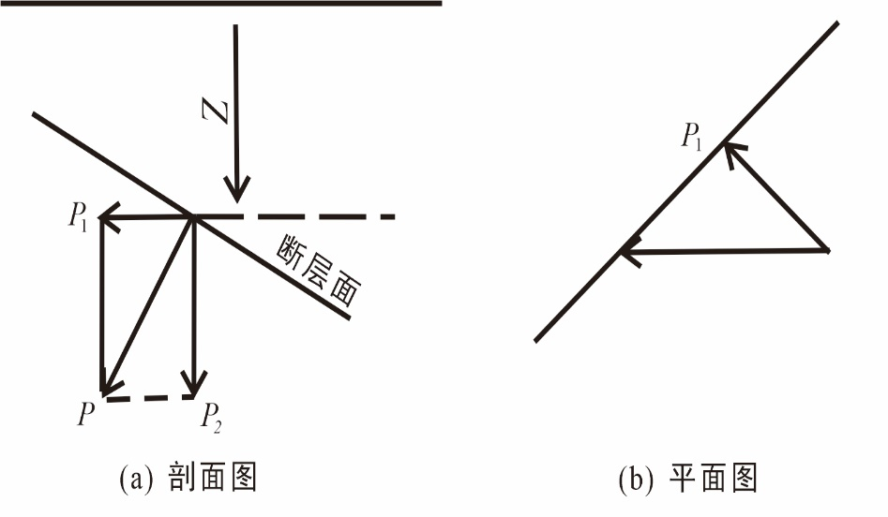
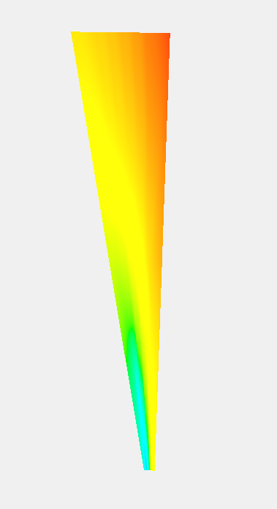
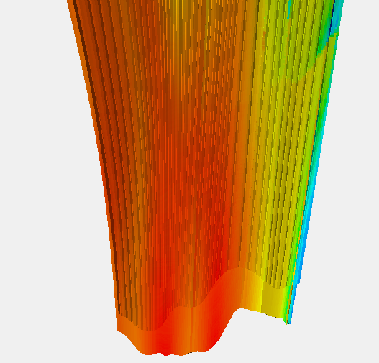
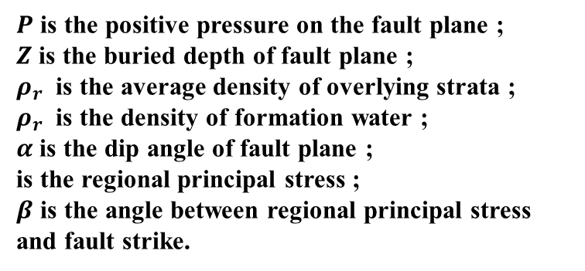

Vertical sealing of fault
The evaluation factors of the vertical sealing of the fault are whether the mudstone in the fault zone can flow plastically and the splitting effect of the bottom hole flowing pressure on the fault surface. The normal pressure of the fault surface can be well characterized.
$P=Z(ρ_{r}$-$ρ_{w}$)$cosα+σsinαsinβ$
ZIV
ZIV
ZV
ZV
Sectional digram
Planar digram
$P$ is the positive pressure on the fault plane ;
$Z$ is the buried depth of fault plane ;
$ρ_{r}$ is the average density of overlying strata ;
$ρ_{r}$ is the density of formation water ;
$α$ is the dip angle of fault plane ;
is the regional principal stress ;
$β$ is the angle between regional principal stress and fault strike.
The positive pressure of F11 fault plane ( 29.49-35MPa ) is much larger than the brittleness limit of mudstone ( 22MPa ) and bottom hole flowing pressure ( 8.61MPa ).

Slide 17
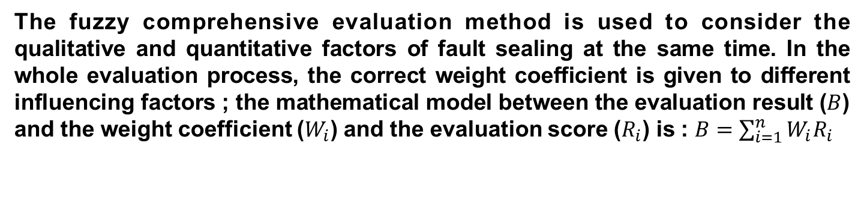
Comprehensive fuzzy discrimination of fault sealing
The fuzzy comprehensive evaluation method is used to consider the qualitative and quantitative factors of fault sealing at the same time. In the whole evaluation process, the correct weight coefficient is given to different influencing factors ; the mathematical model between the evaluation result ($B$) and the weight coefficient ($W_{i}$) and the evaluation score ($R_{i}$) is : $B=\sum_{i=1}^{n}{W_{i}R_{i}}$
Influencing factors | Evaluation mark | Membership | Weight
Background of fault mechanics | Torsion | 0.9
 | tension-torsion | 0.6 | 0.1
 | tension | 0.3
Lithologic contraposition | Sand-mud | 0.9
 | Sand-sand<50% | 0.6 | 0.25
 | Sand-sand>50% | 0.3
SGR | >0.6 | 0.9
 | 0.5-0.6 | 0.6 | 0.4
 | <0.5 | 0.3
Positive pressure on the fault plane | >Brittle mudstone limit | 0.9
 | Bottom hole flowing pressure-brittle mudstone limit | 0.6 | 0.25
 | <Bottom hole flowing pressure | 0.3

Slide 18
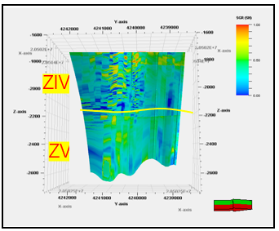
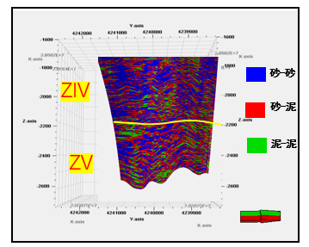
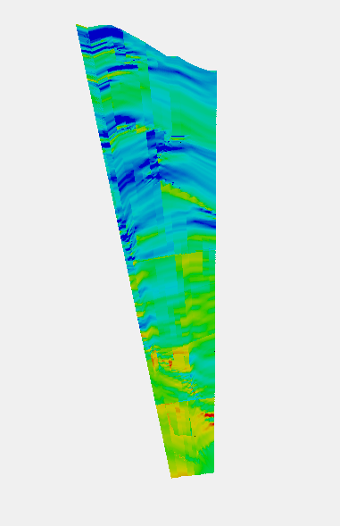
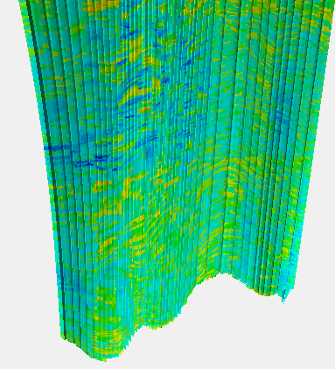
Comprehensive fuzzy discrimination of fault sealing
In view of the previous evaluation results, most of the faults in Zaobei are not closed. According to the verified Zaonan F4 fault, the minimum closure comprehensive index is calculated to be 0.48, which is considered to be the threshold value for the fault closure in the whole area.
ZIV
ZIV
ZIV
ZV
ZV
ZV
Comprehensive fuzzy discrimination
Qualitative and quantitative coupling
ZIV
ZV
F11 fault sealing comprehensive indicator diagram

Slide 19
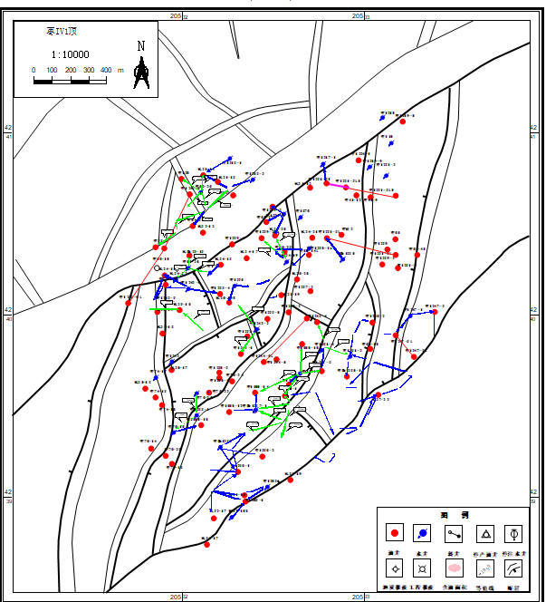
Fault sealing characterization results
From the injection-production correspondence on both sides of the fault to analyze the sealing of the fault in the development processIf the production wells on the opposite side of the fault have effective reactions during the water injection process of the water injection well, it can be inferred that the fault is not sealed.
Fault | Effective water injection wells | Water injection wells | Fault sealing
F8 | Z55-14H | Z1242-5 | Poor
F9 | Z1235-4 | Z1242-4 | Poor
F10 | F26-19K | Z1243-3 | Poor
F13 | Z76-16 | Z1608-10 | Poor
F11 | ZX1256-2 | ZX1256 | Poor
F14 | Z1247-5L | Z1247-1 | Poor
F17 | Z1546 | Z59 | Poor
F19 | Z1243-1 | Z1243-3 | Poor
F22 | Z130 | Z62-26 | Poor
F22
F14
F9
F10
F19
F11
F16
F8
F13

Slide 20
Outline
1
Geologic background
2
Methods
3
Result and conclusion
Notes:
20

Slide 21
3.3 Conclusion
Stratum thickness, frequency division, seismic attribute plane section combination and seismic forward modeling can effectively identify faults.
The three-dimensional evaluation model of fuzzy comprehensive evaluation method has higher accuracy.

Slide 22

Thank You
Question ? Suggestion?
Cheng, Changping
Email: 1801040320@s.upc.edu.cn
Notes:
22

