Slide 1
Field-scale soil moisture predictions using in situ sensor measurements in an inverse modelling framework: SWIM²
Marit Hendrickx^{*1}, Jan Diels¹, Jan Vanderborght^{1,2}, Pieter Janssens^{3,4}
* marit.hendrickx@kuleuven.be
¹ Department of Earth and Environmental Sciences, KU Leuven, Belgium
² Agrosphere Institute (IBG-3), Forschungszentrum Jülich GmbH, Germany
³ Soil Service of Belgium, Belgium
⁴ Department of Biosystems, KU Leuven, Belgium
Notes:
Session HS3.9 – Advances in Diagnostics, Sensitivity Analysis, Bayesian Evaluation, and Hypothesis Testing of Earth and Environmental Systems Models
Chairpersons: Juliane Mai, Thomas Wöhling, Cristina Prieto

Slide 2
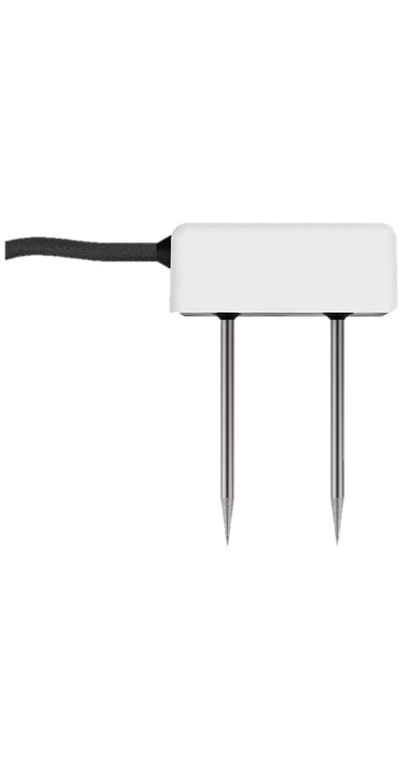
SWIM² Sensor Wielded Inverse Modelling of a Soil Water Irrigation Model
Boundary & initial conditions
Weather data
Crop & soil information
Prior distributions
Soil water balance model
Soil moisture sensor measurements
n = 3
d = 12
In situ soil moisture samples
Posterior parameter distributions
Parameter estimation with Bayesian inverse modelling
(DREAM_{ZS})
Soil moisture simulation & prediction
with uncertainty estimate
Optimal irrigation advice
FEEDBACK
Notes:
I would like to introduce SWIM², a digital twin at field-scale that simulates and predicts soil moisture in real time with the purpose of irrigation scheduling.
In this framework, 12 soil and crop parameters of a simple FAO-based soil water balance are estimated with DREAM.
The Bayesian parameter estimation is driven by daily mean soil moisture sensor measurements from 3 sensors and periodic soil moisture samples, and results in parameter sets leading to soil moisture simulations with an uncertainty estimate. Then we can also predict soil moisture with a realistic uncertainty estimate and decide on optimal irrigation scheduling.

Slide 3
SWIM² Sensor Wielded Inverse Modelling of a Soil Water Irrigation Model
Boundary & initial conditions
Weather data
Crop & soil information
Prior distributions
Soil water balance model
Soil moisture sensor measurements
n = 3
d = 12
In situ soil moisture samples
Posterior parameter distributions
Parameter estimation with Bayesian inverse modelling
(DREAM_{ZS})
Soil moisture simulation & prediction
with uncertainty estimate
Optimal irrigation advice
FEEDBACK
Notes:
Today I will focus on the measurement uncertainty which is key in the parameter & uncertainty estimation.
In DREAM we can consider this measurement uncertainty with the error covariance matrix. The aim is to correctly quantify these errors and evaluate how they are propagated through the model.
To do this, we build a generalized error model because the measurements within one field are limited to only 3 sensors per field and only few samples.
SLIDE 1+1 = 1:30 min

Slide 4
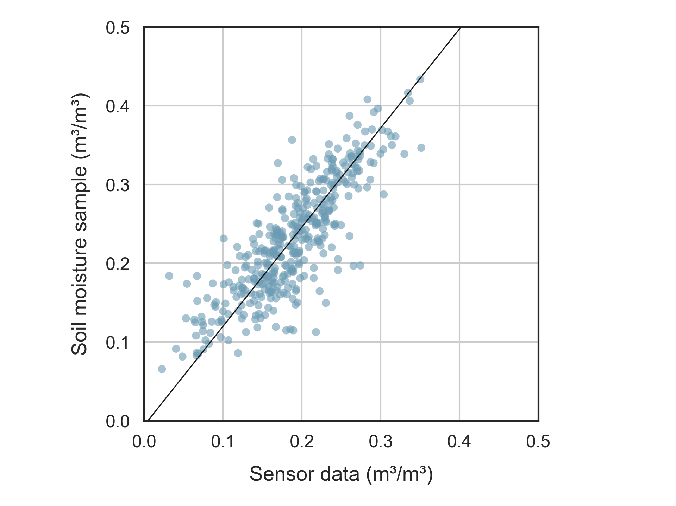
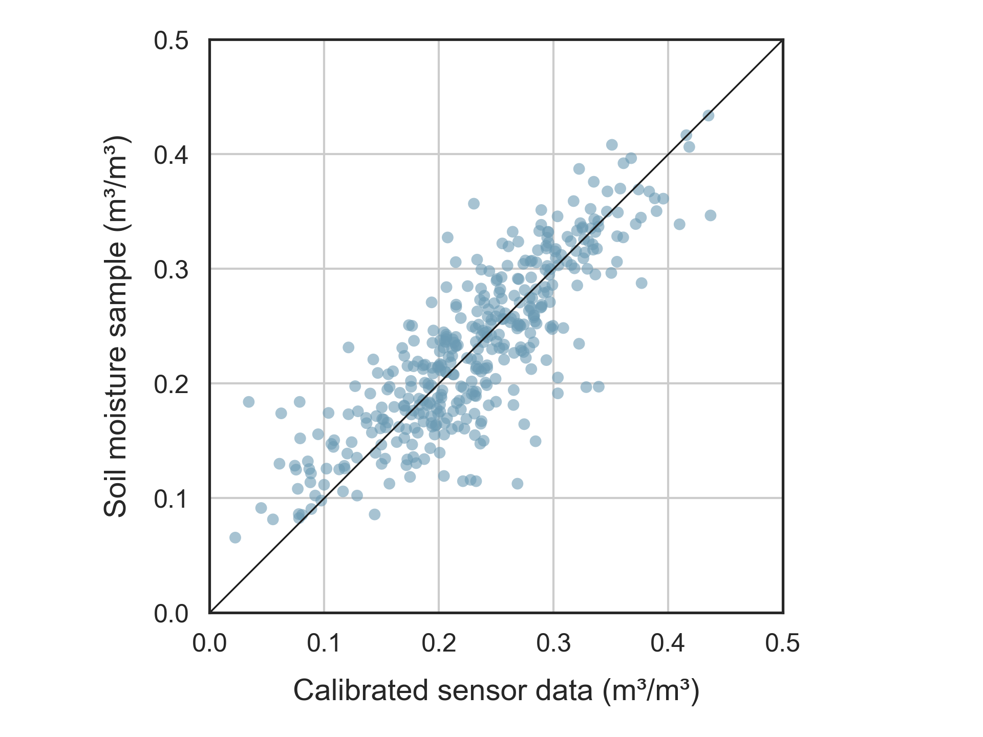
Generalized error model Soil moisture sensor measurement uncertainty
General sensor calibration
2 to 30 cm soil layer
$$θ=−0.006 + 1.26 ×θ_{sensor}$$
15 cm depth
Notes:
Before we dive into the error model, we need to calibrate the sensor data to account for the discrepancy between soil samples throughout the whole 30 cm soil layer and sensor point measurements at 15 cm depth.
This general calibration is based on datapoints from field measurements during 3 growing seasons in about 30 fields per year.
The sensor data are the mean of three sensors in the measurement zone of a field.
After this general calibration is applied, we can further examine the measurement errors.
SLIDE 2 = 0:40 min

Slide 5
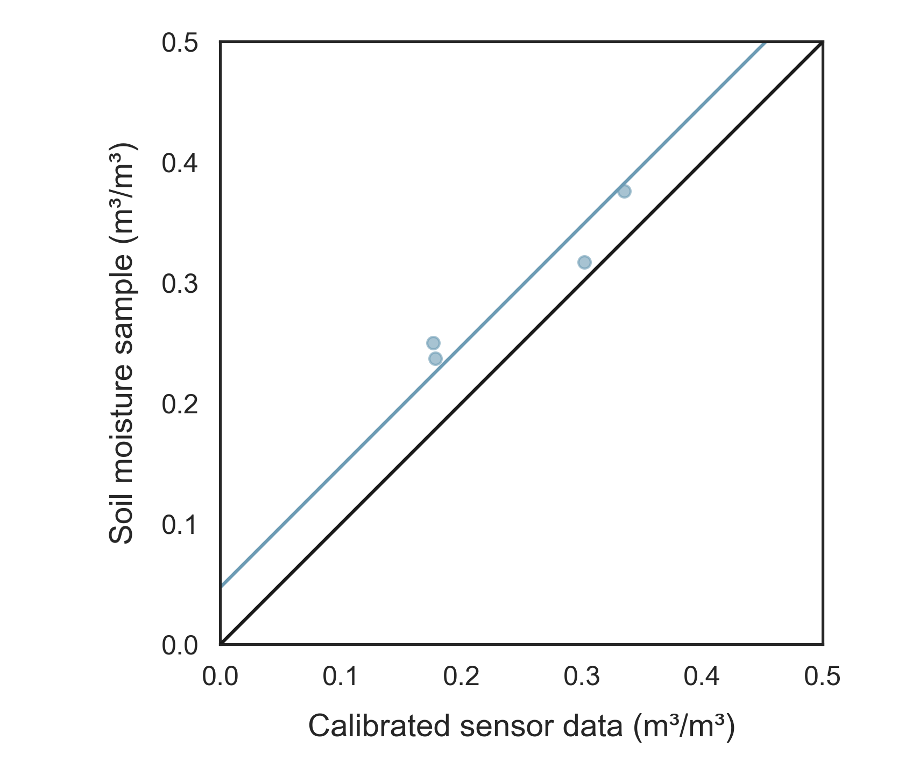
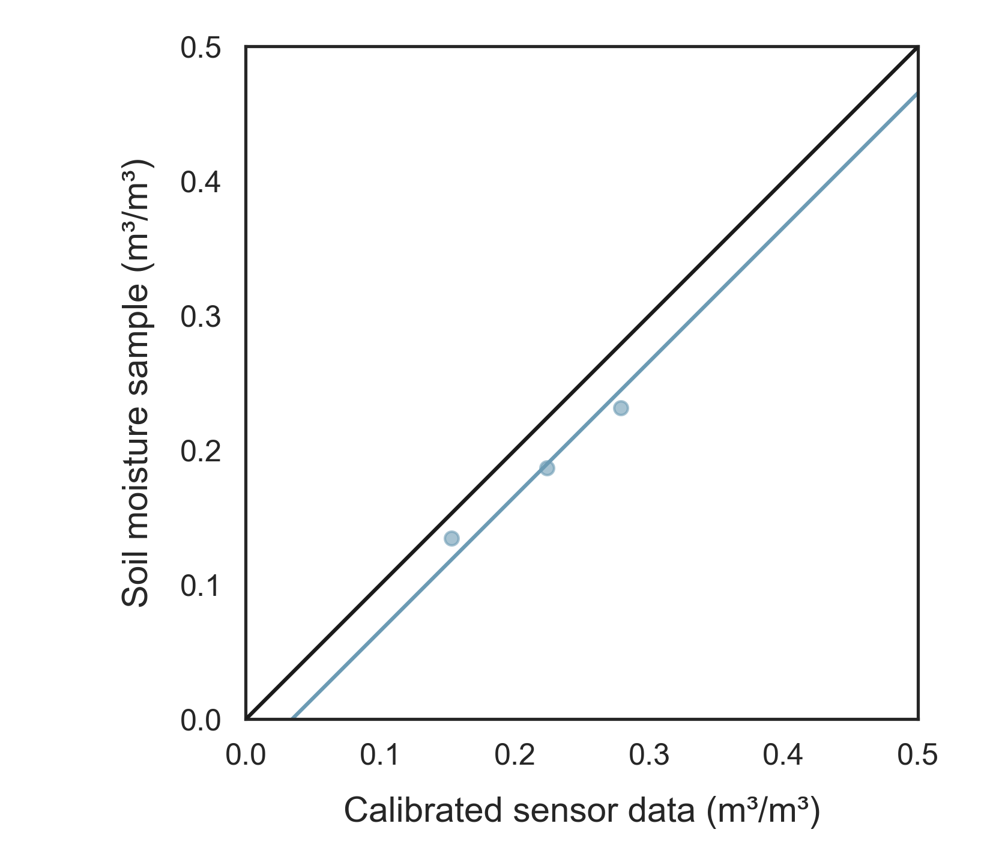
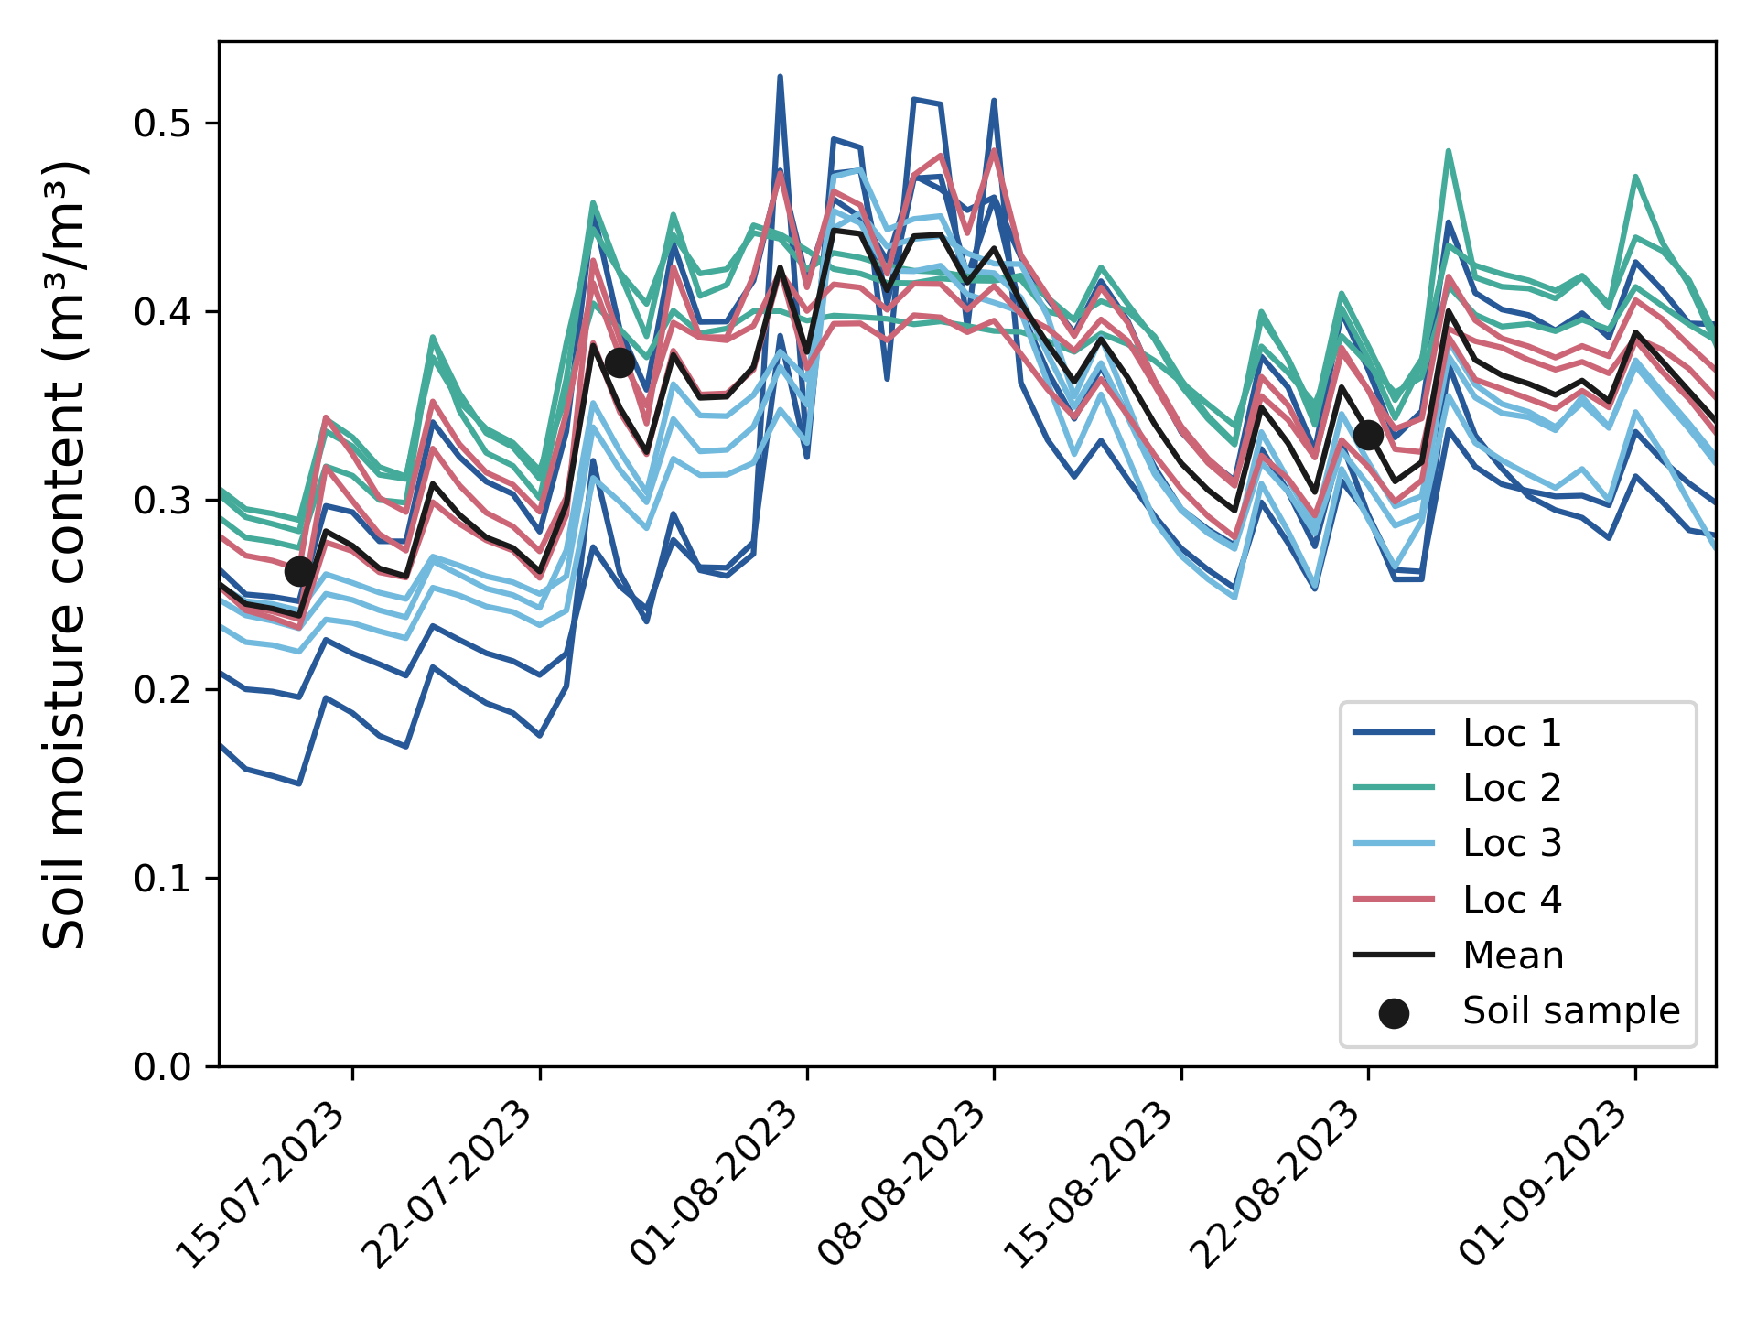
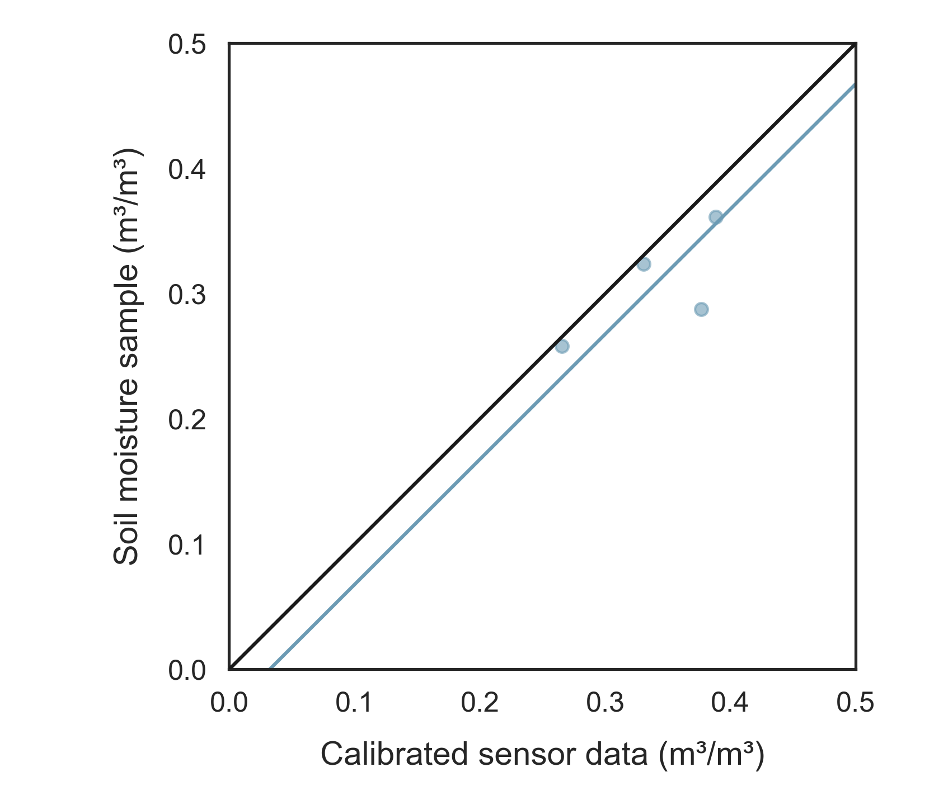
Generalized error model Soil moisture sensor measurement uncertainty
Systematic error
Measurement bias: Sensor measurement errors are strongly correlated
Random error
Errors with respect to their location-specific curve
Notes:
First of all, a systematic error may be present. This is illustrated with a field trial where 4 sensor modules were installed with three sensors each. Here we can clearly see the different sensor measurement biases at the different locations. For instance, the location 2 with the green color always measures a higher soil moisture content compared to the field mean and the samples. Thus, we can say that the sensor measurement errors are strongly correlated in time.
On top of this, there is also a random error. This corresponds to the variance of the sensor measurements with respect to their bias corrected curve.
We quantify the systematic bias, which is the intercept, and the random error for each field.

Slide 6
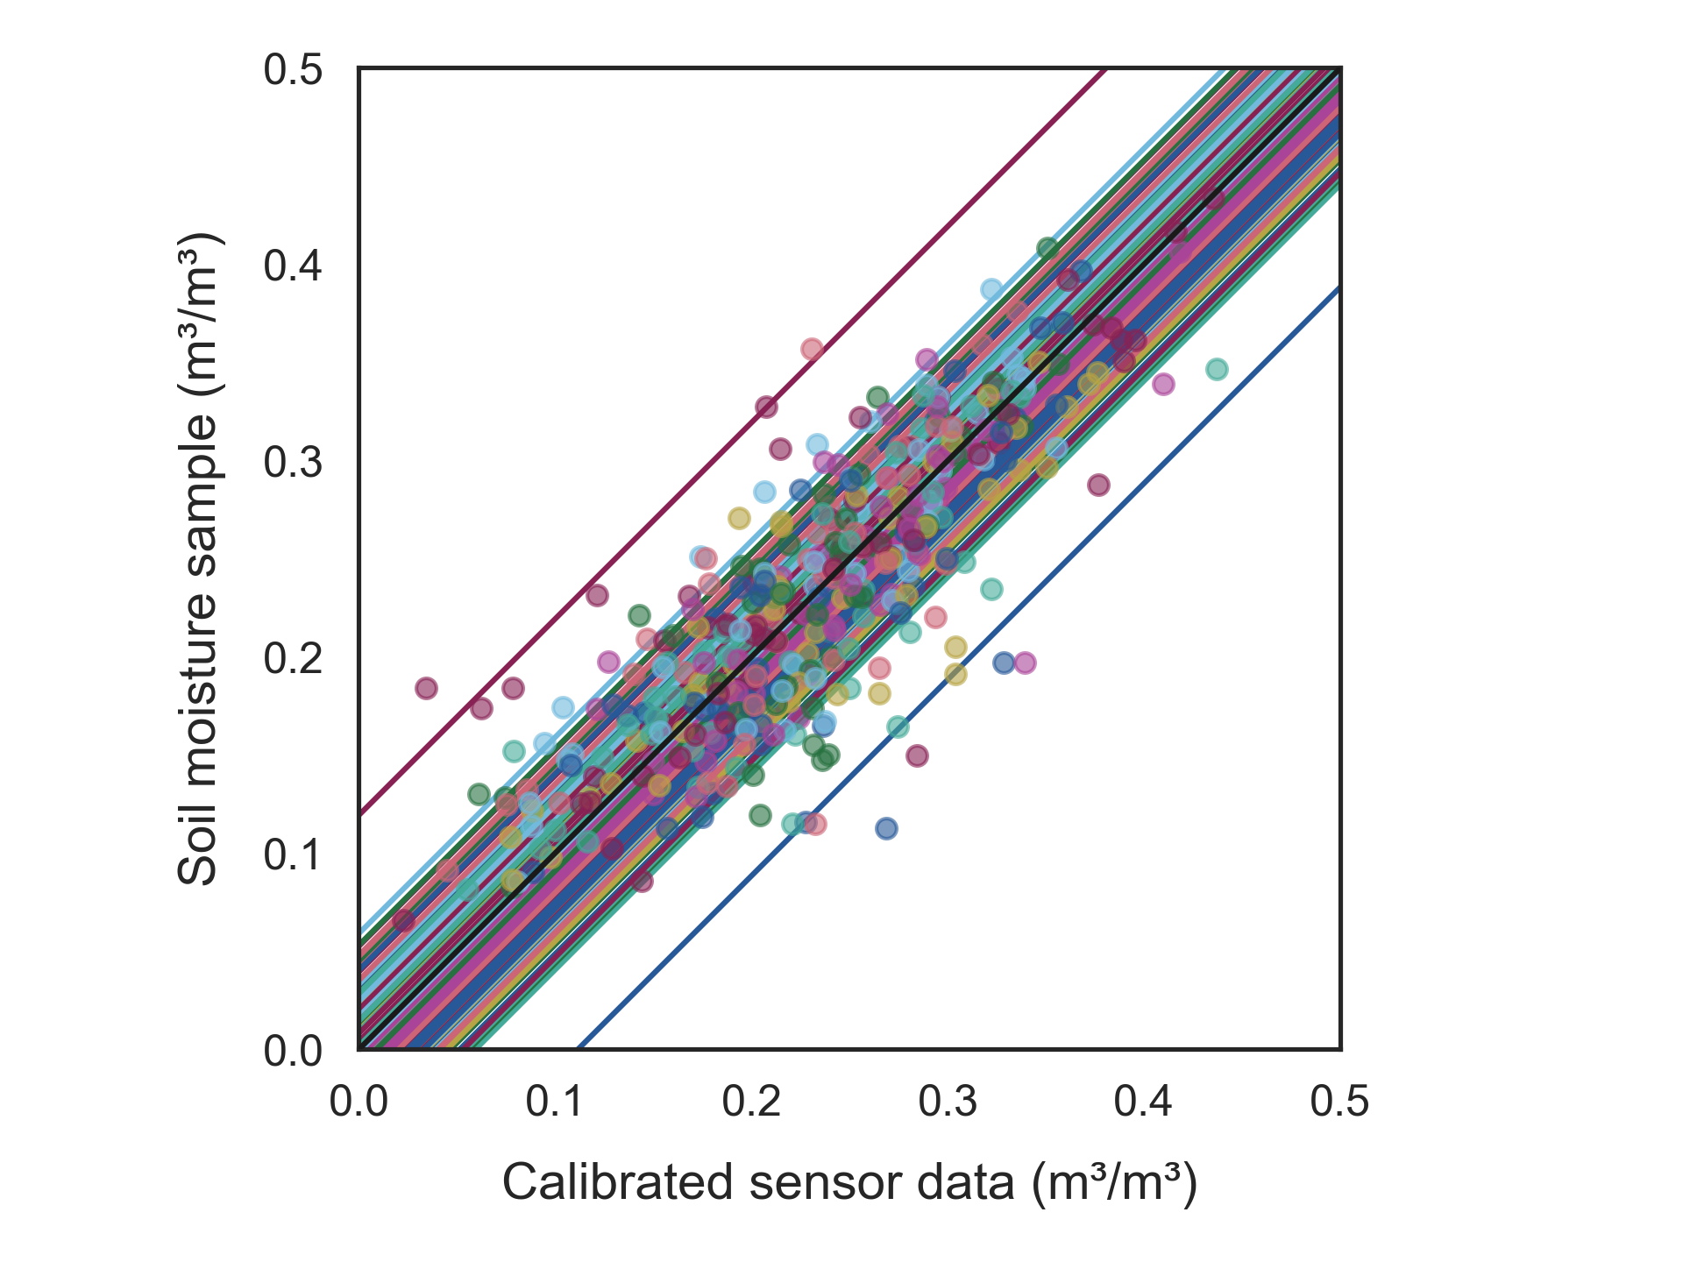
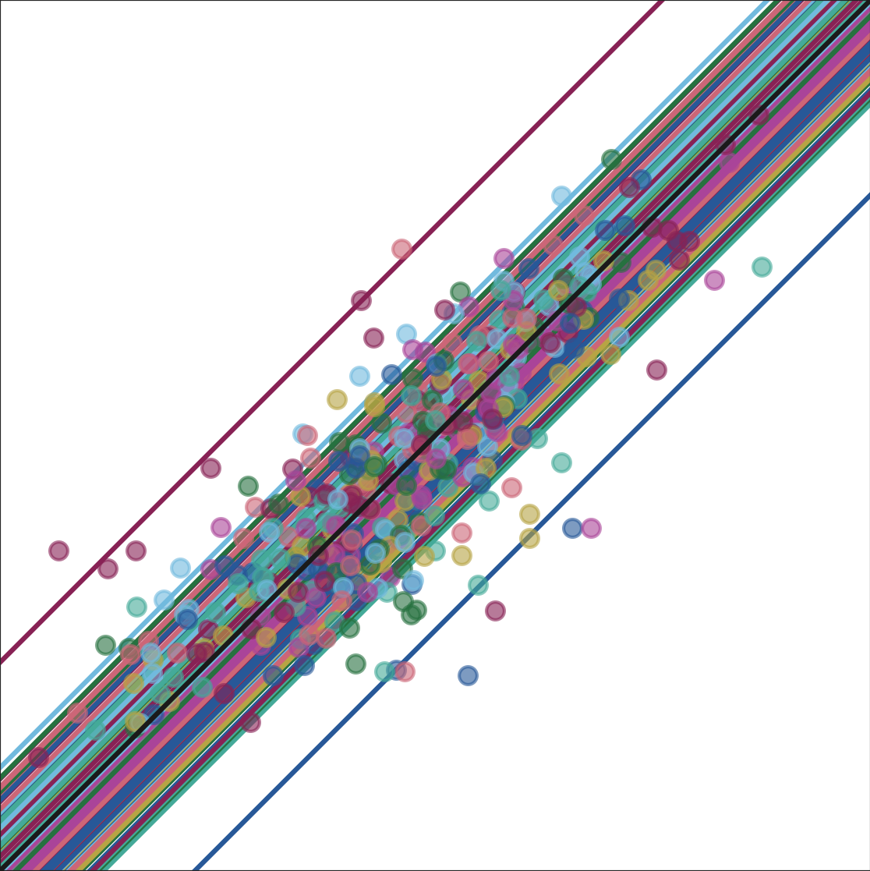
Generalized error model Soil moisture sensor measurement uncertainty
Systematic error
Measurement bias: Sensor measurement errors are strongly correlated
Intercept variance
Random error
Errors with respect to their location-specific curve
Notes:
The generalized systematic error will then be defined by the variance of all intercepts, while the generalized random error is the median observed random error.
SLIDE 3+3 = 1:10 min

Slide 7
Generalized error model Error covariance matrix
1
2
3
…
N
S1
S2
$$σ_{total}^{2}$$ | $$σ_{cov}$$ | $$σ_{cov}$$ | … | $$σ_{cov}$$ | 0 | 0
$$σ_{cov}$$ | $$σ_{total}^{2}$$ | $$σ_{cov}$$ | … | $$σ_{cov}$$ | 0 | 0
$$σ_{cov}$$ | $$σ_{cov}$$ | $$σ_{total}^{2}$$ | … | $$σ_{cov}$$ | 0 | 0
… | … | … | … | $$σ_{cov}$$ | 0 | 0
$$σ_{cov}$$ | $$σ_{cov}$$ | $$σ_{cov}$$ | $$σ_{cov}$$ | $$σ_{total}^{2}$$ | 0 | 0
0 | 0 | 0 | 0 | 0 | $$σ_{samp}^{2}$$ | 0
0 | 0 | 0 | 0 | 0 | 0 | $$σ_{samp}^{2}$$
Systematic error $(σ_{cov})$ = (0.0345 m³/m³)²
Random error $(σ^{2})$ = (0.0202 m³/m³)²
$σ_{cov}=0.00119$
$σ_{total}^{2}=σ_{cov}+σ^{2}=0.00160$
► Correlation of 0.744
Uncorrelated samples:
$σ_{samp}^{2}={0.004}^{2}=0.000016$
1
2
3
…
N
S1
S2
* For N sensor measurements and 2 samples
Notes:
The resulting systematic error was about 3.5 volumetric percent, while the random error was only 2 volumetric percent.
With these values, we can build our error covariance matrix, with the covariance corresponding to the systematic error and the total error on the diagonal being the sum of the systematic and random error.
This results in a high correlation of 74%, as was to be expected.
Aside from the sensor measurement errors, we also need to include the independent soil moisture samples, but it’s important to note that these errors are uncorrelated to the sensor errors and each other. This sample error was quantified in field trials with repeated sampling and was about 0.4 volumetric percent.
SLIDE 4 = 0:50 min
--------------- > 4:10 min

Slide 8
SWIM² Temporal evaluation: Similar to real-time application
Start of growing season
End of growing season
Sensor measurements
Soil moisture samples
10 days
20 days
30 days
…
100 days
CALIBRATION
VALIDATION
Notes:
We’ll perform a temporal evaluation that is in line with the real-time application of the model. Hence, we evaluate model performance in function of data availability throughout the growing season. For example, after 10 days, we have 10 days of sensor measurements and 1 soil moisture sample. These 10 days are the calibration period. From here on, we predict the soil moisture for the next 10 days, which is the validation period. We do this again for 20 days of calibration with another 10 days of validation and continue like this to the end of the growing season.
In reality, we’ll make soil moisture predictions with weather forecast ensembles, but for now, we’ll use weather observations to exclude this additional prediction uncertainty.
SLIDE 5 = 1:00 min

Slide 9
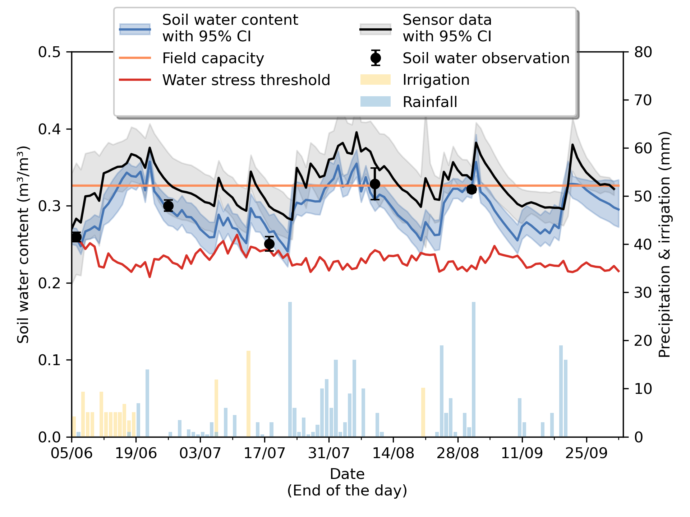
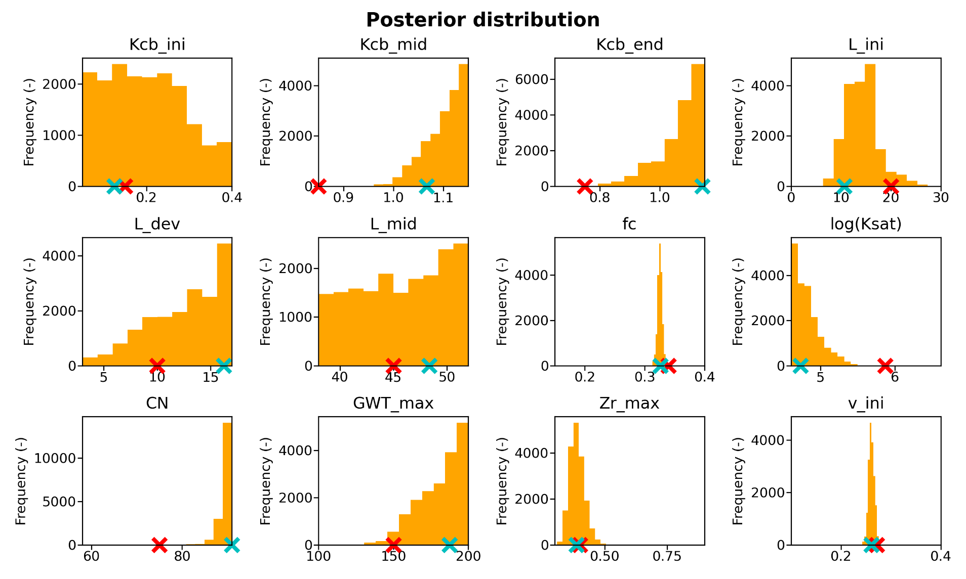
SWIM² Temporal evaluation: Similar to real-time application
Field trial 2023
Chicory in Herent (Belgium)
Highest likelihood
Theoretical initial value
Notes:
I will illustrate this by means of a field trial in 2023.
On the left we see the soil water balance for a full growing season of chicory in a field in Belgium. Precipitation and irrigation are shown by the bars, and on the left axis, we see soil moisture content. The black curve with the grey uncertainty band is the mean soil moisture measured by three sensors, while the black dots are the soil moisture samples. Then we have the blue curve with the blue uncertainty band, which is the simulated soil moisture content. Field capacity is shown by the orange line and the critical soil moisture content is shown by the red line.
On the right we see the posterior parameter distributions at the end of the growing season, while all prior distributions were defined as non-informative uniform priors within the shown boundaries.
SLIDE 6 = 1:00 min

Slide 10
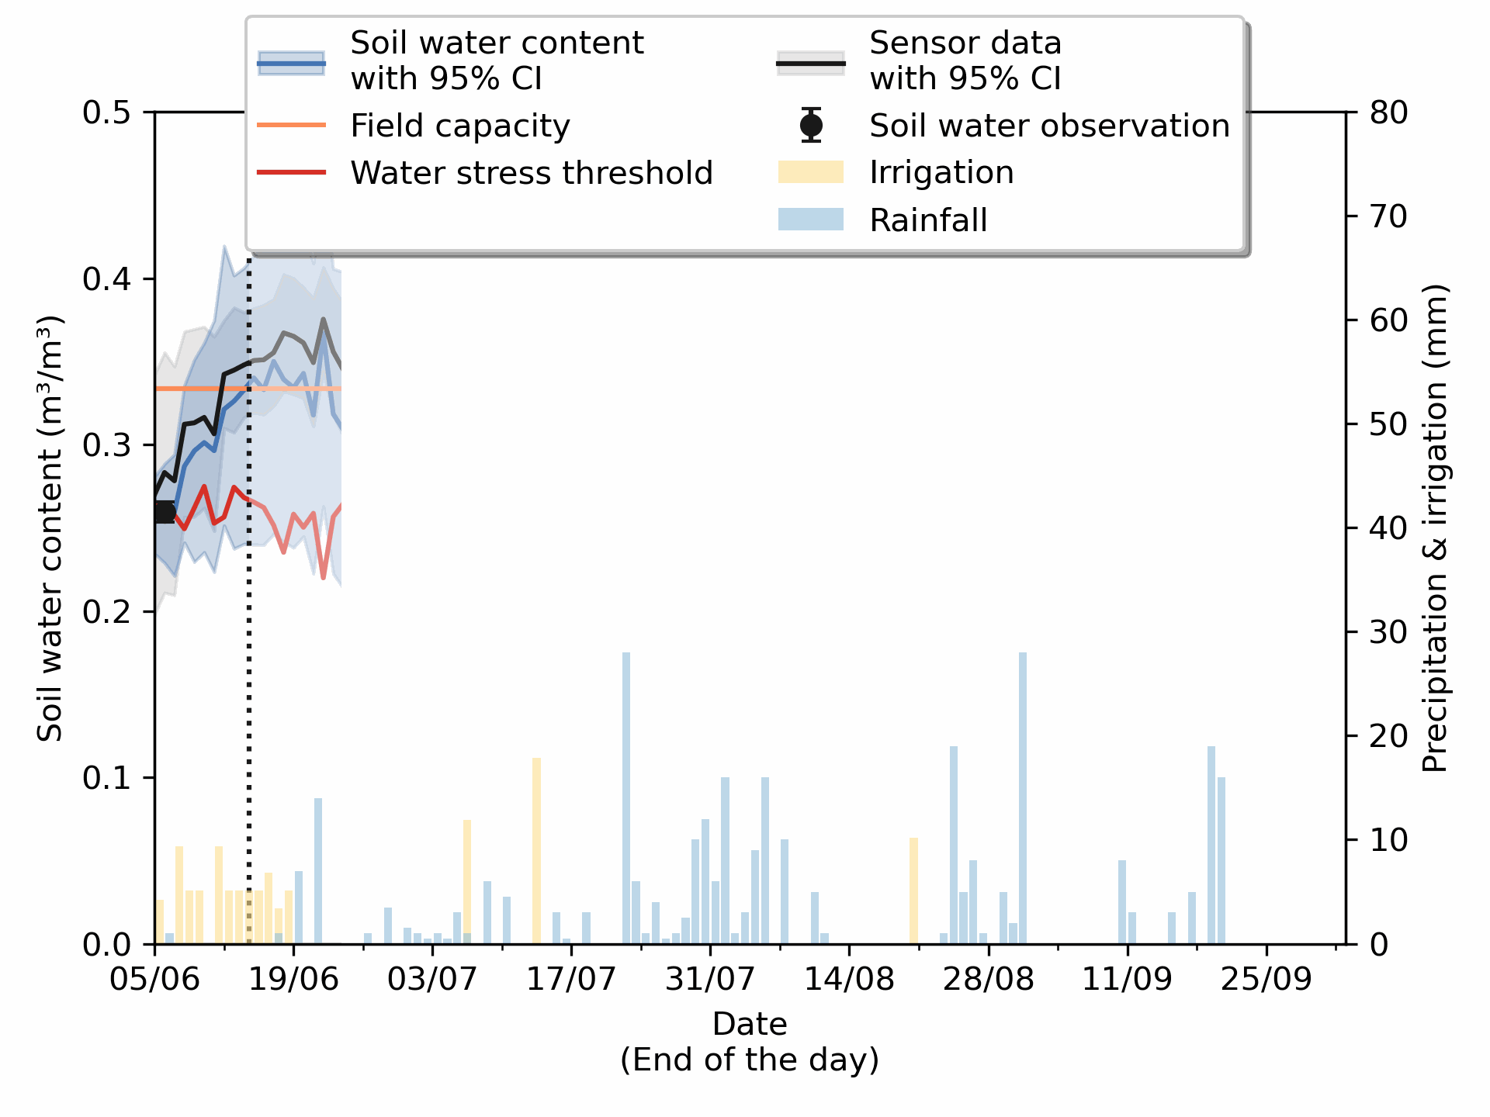
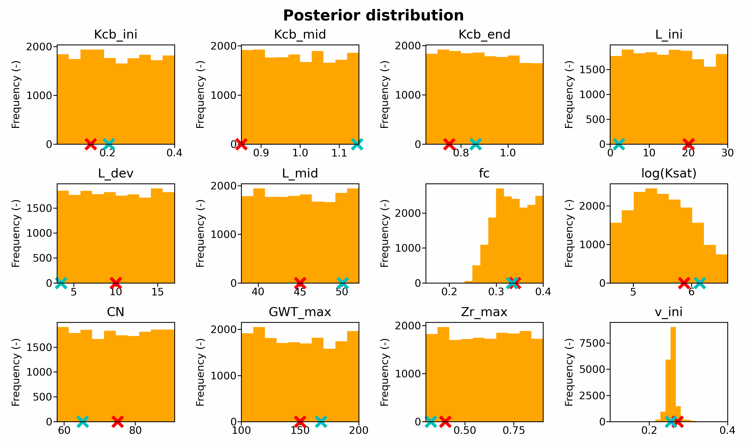
SWIM² Temporal evaluation: Similar to real-time application
Field trial 2023
Chicory in Herent (Belgium)
Highest likelihood
Theoretical initial value
Notes:
Now we can go to the real-time application of the model. Left of the dashed line is the calibration period, with the amount of data days indicated in the bar below, while the validation period is the 10-day prediction on the right side of the line. At the same time, on the right, we see how our posterior parameter distributions evolve as we have an increasing amount of data available for parameter estimation.
First of all, we see a decrease in uncertainty with increasing data availability, which can be seen by the shrinking blue band. Additionally, there is a sensor bias that is not in the model simulation, as the simulation is pulled towards the samples instead of the sensor data. Even if our sensor measurements are biased, as we have only few sensors, we are still able to correct this bias with uncorrelated samples by applying the generalized error model, as the sensor measurement errors are highly correlated.
Performance of the model during the calibration period slightly decreases with increasing data availability, as it becomes more difficult to fit the model to all this data. Still, performance is very good with
a correlation of 0.99 to 0.90 and a bias-corrected RMSE of 0.0182 to 0.0391
SLIDE 7 = 1:30 min

Slide 11
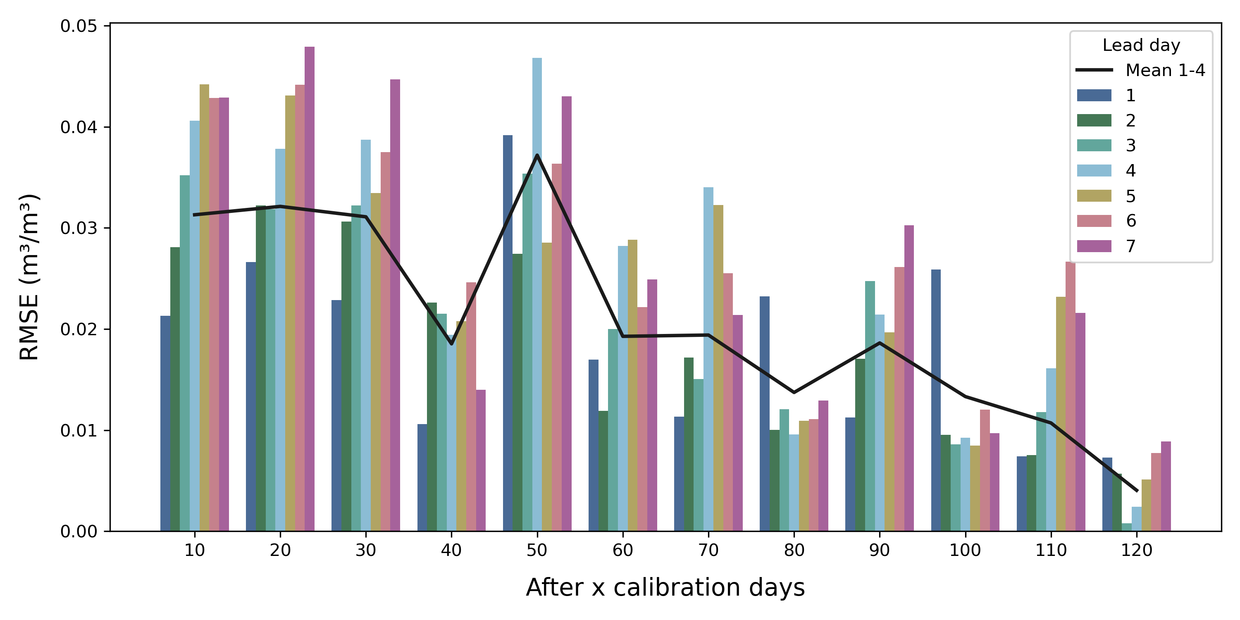
SWIM² Temporal evaluation: Validation results
Error during validation period
After x calibration days, on different lead days
Notes:
For the validation period, I summarized our 4 field trials of 2023 into bias-corrected RMSEs in function of amount of calibration data, broken down in prediction lead days.
Generally, the accuracy of the soil moisture predictions is very good.
The error increases with lead days, which is to be expected as prediction errors propagate with time. In practice, we will never look beyond the 7-day prediction, and we’ll even focus on the first 4 lead days, as the parameter estimation is executed twice a week. We also see that the model prediction generally becomes more accurate as more data is used for calibration.
SLIDE 8 = 1:00 min

Slide 12
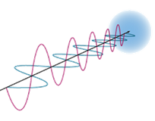
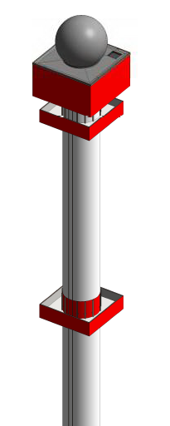
SWIM² - Future work Sensor Wielded Inverse Modelling of a Soil Water Irrigation Model
Boundary & initial conditions
Weather data
Crop & soil information
Prior distributions
Soil water balance model
Soil moisture sensor measurements
n = 3
d = 12
In situ soil moisture samples
Posterior parameter distributions
Parameter estimation with Bayesian inverse modelling
(DREAM_{ZS})
Soil moisture simulation & prediction
with uncertainty estimate
Optimal irrigation advice
FEEDBACK
Notes:
Today I only talked about measurement uncertainty, but weather input data is also an important source of uncertainty in farmers fields where we use uncertain precipitation radar data instead of rain gauge data. We are currently working on the implementation of rainfall multipliers with an observation-based probability distribution, aiming for a better uncertainty estimate, though there's a risk of overfitting, potentially reducing predictive power.
SLIDE 9 = 0:30
--------------- > 4:10 min + 5:00 min = 9:10 min

Slide 13
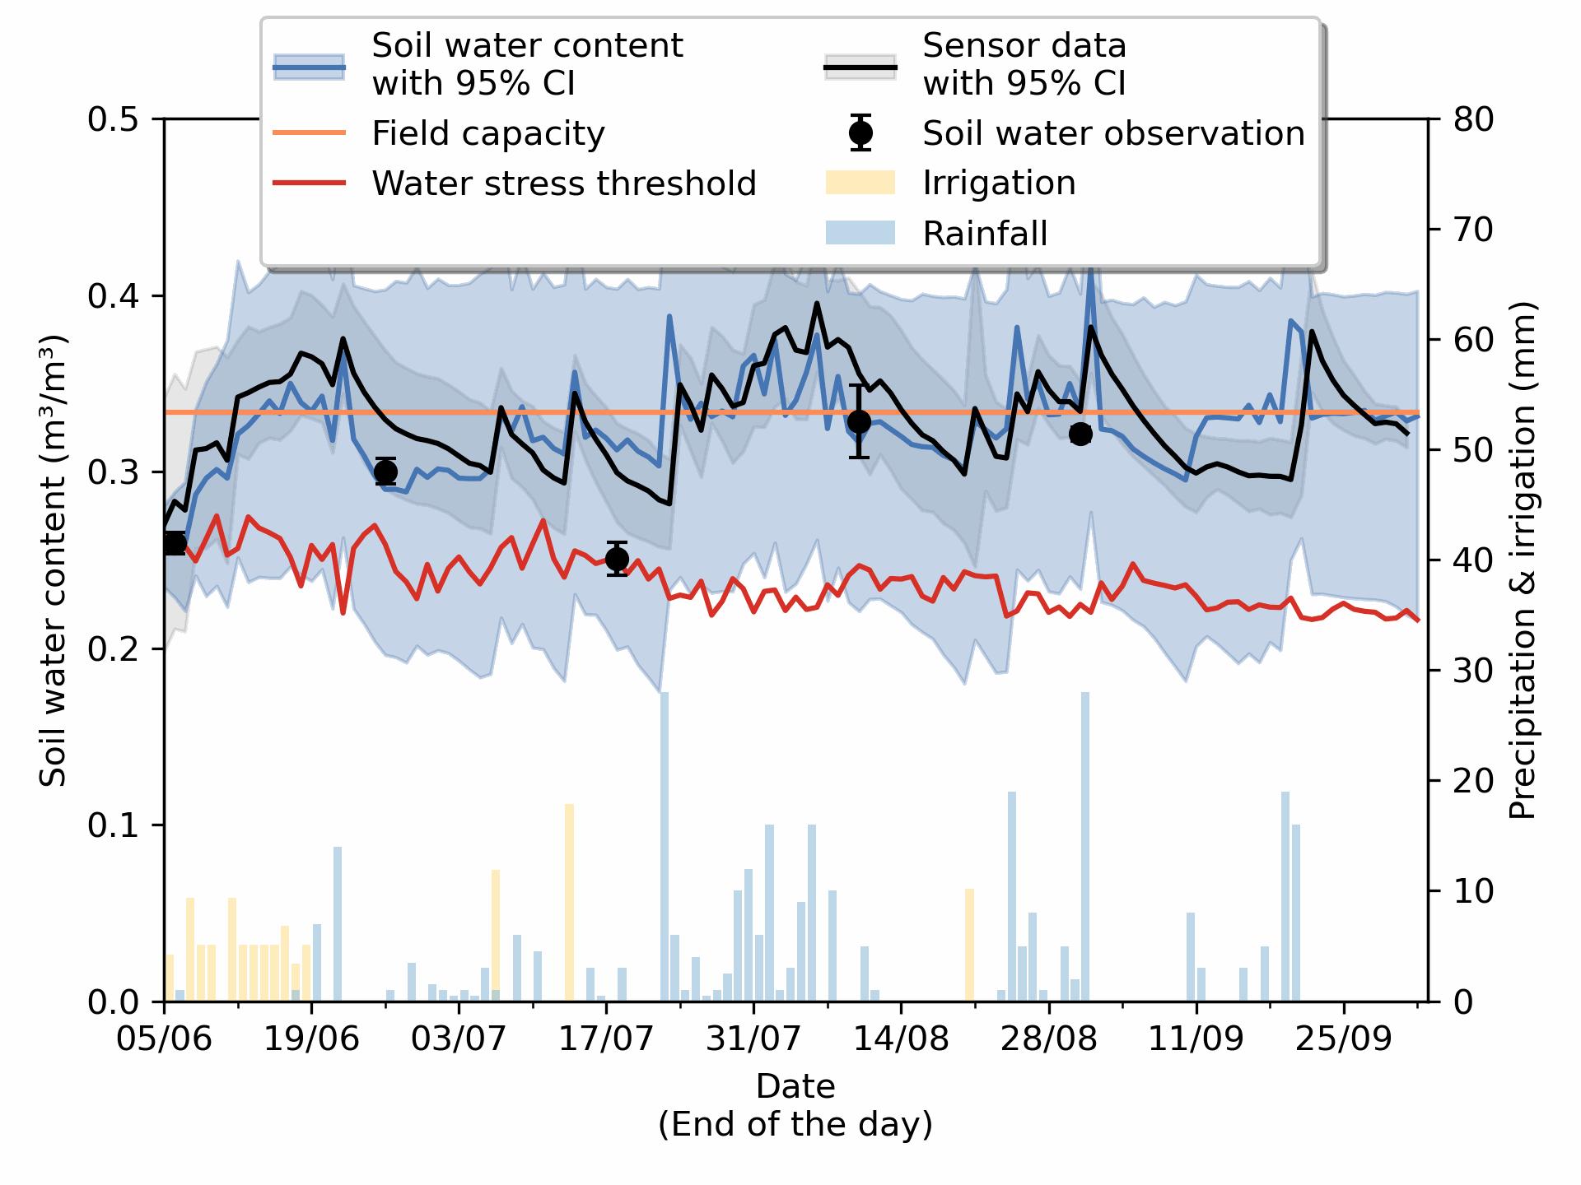
Take-home messages
SWIM²
Digital twin: Root zone soil moisture at field scale for irrigation scheduling
Considers measurement uncertainty and error covariance ► high correlation of sensor measurement errors ► sensor bias can be eliminated by few uncorrelated soil samples
Increasing data availability ► increasing information gain ► increasing accuracy & decreasing uncertainty ► higher predictive power
Future work: Accounting for precipitation forcing error by applying rainfall multipliers
► more realistic uncertainty estimate ► overfitting & lower predictive power

Slide 14
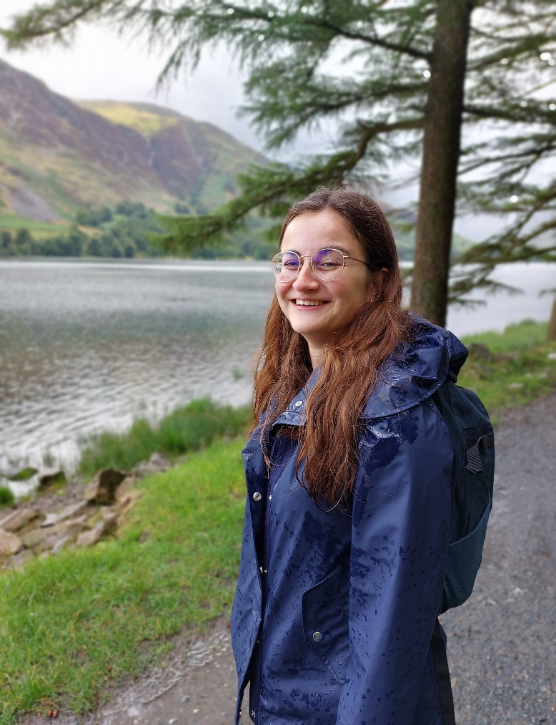
Thank you!
marit.hendrickx@kuleuven.be
Soil & Water Management,
KU Leuven (Arenberg)
Celestijnenlaan 200e - box 2411
3001 Leuven
Acknowledgements: prof. Jan Diels, prof. Jan Vanderborght, dr. ir. Pieter Janssens
Notes:
8 min + 2 min for questions and discussions

