Slide 1
Integrated Water Planning Portal: Feasibility study for a development-oriented digital twin to facilitate integrated water management Eduardo Rico Carranza¹, Ziyan Zhang¹, Ana Mijic¹
¹ Environment and Water Resources Section, Department of Civil and Environmental Engineering, Imperial College London

Slide 2
Motivation

Slide 3
Motivation
Based on a no-document workflow
Allows evidence-based decisions
Centralise data ready for sharing and processing

Slide 4
Proposal
INTEGRATED WATER PLANNING PORTAL

Slide 5
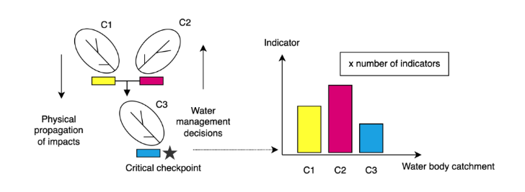
Study framework
INTEGRATED WATER PLANNING PORTAL
INTEGRATED WATER PLANNING PORTAL
INSTITUTION FEEDBACK
Checks
Submits
DEVELOPER
INTEGRATED WATER PLANING MODEL AND REGULATIONS
DATA COLLECTION
Checks Submission
PLANNING AUTHORITY
PROPOSED FRAMEWORK

Slide 6
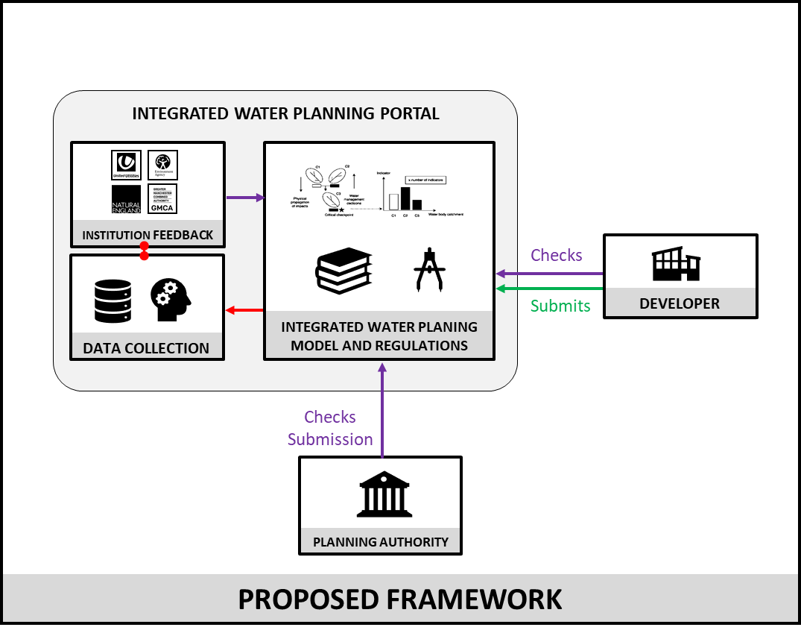
Study framework: Integrated model
Zhang, Ziyan
Novel Use of Integrated Water System Model for Decision-Making Processes at Different Scales
HS5.1.1

Slide 7
Study framework: Digital Twin
This is what this talk is all about

Slide 8
Research Questions
What is the feasibility of such no-document, evidence-based approach to planning water systems?
What are the variables that influence it?

Slide 9
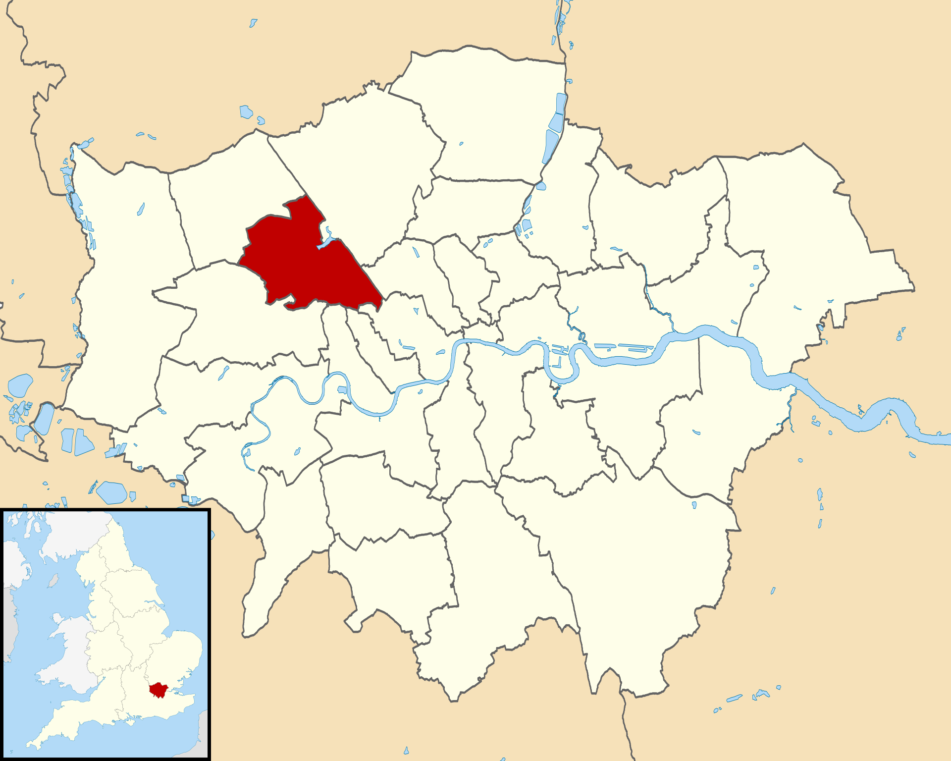
Prototype development / testing for London borough of Brent
Brent borough
Catchment
River

Slide 10
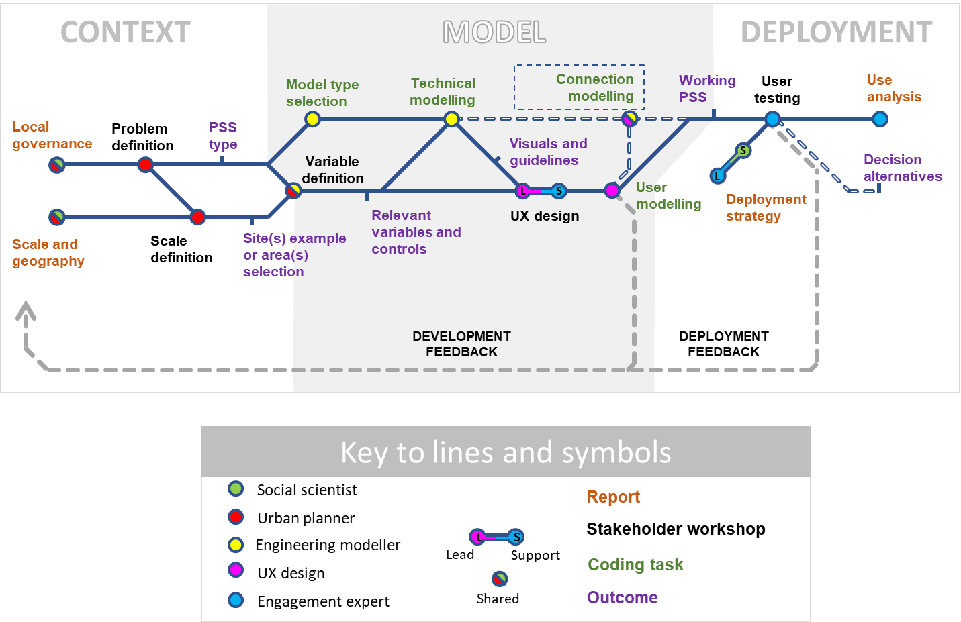
Existing planning support system development framework

Slide 11
Current challenges for DTs
(Bordeleau et al., 2020)
Managing heterogeneous models from different disciplines
Bi-directional synchronization
Support for collaborative development through the life cycle of the twin.
MODEL DEFINITION
(Weil et al., 2023)
interoperability and semantics;
infrastructure, including storage, computation, network;
data acquisition and actuation;
data quality and harmonization;
modelling, simulation and decision-support;
data visualization and information display;
human and capital resources;
governance, organizational and social issues.
MODEL / DATA SHARING
GOVERNANCE AND SOCIAL

Slide 12
Semi structured interviews
(Bordeleau et al., 2020)
Managing heterogeneous models from different disciplines
Bi-directional synchronization
Support for collaborative development through the life cycle of the twin.
What processes you need to model
Which variables and scales
Who will be using this tool
What is the meaning of water and nutrient neutrality in your organisation
MODEL DEFINITION
(Weil et al., 2023)
interoperability and semantics;
infrastructure, including storage, computation, network;
data acquisition and actuation;
data quality and harmonization;
modelling, simulation and decision-support;
data visualization and information display;
human and capital resources;
governance, organizational and social issues.
MODEL / DATA SHARING
GOVERNANCE AND SOCIAL

Slide 13
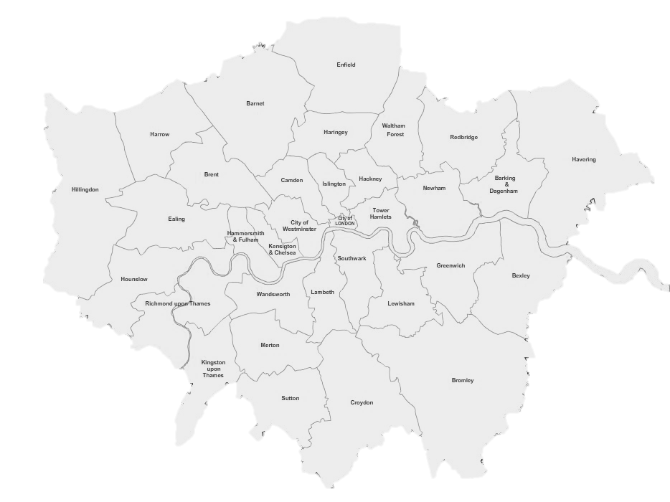
Semi structured interviews
Thames Water
United Utilities
Ramboll
Atkins
(Bordeleau et al., 2020)
Managing heterogeneous models from different disciplines
Bi-directional synchronization
Support for collaborative development through the life cycle of the twin.
MODEL DEFINITION
DEVELOPER
(consultants)
(Weil et al., 2023)
interoperability and semantics;
infrastructure, including storage, computation, network;
data acquisition and actuation;
data quality and harmonization;
modelling, simulation and decision-support;
data visualization and information display;
human and capital resources;
governance, organizational and social issues.
MODEL / DATA SHARING
WATER COMPANIES
GOVERNANCE AND SOCIAL
Horesham
GLA
Environment Agency
Natural England
LOCAL PLANNING AUTHORITIES
GOVERNMENT BODIES

Slide 14
Key learning points for prototyping
Company/stakeholder models are patchy, likely to be in a permanent state of development, partial, and constantly updating.
For the purposes of sharing, the cost, maintenance and reliability of the model are likely to be a stronger impediment than data protection.
Middle precision models focusing on early warning may give enough information for planning.
Centralising information and keeping track may be the most valuable aspect.

Slide 15
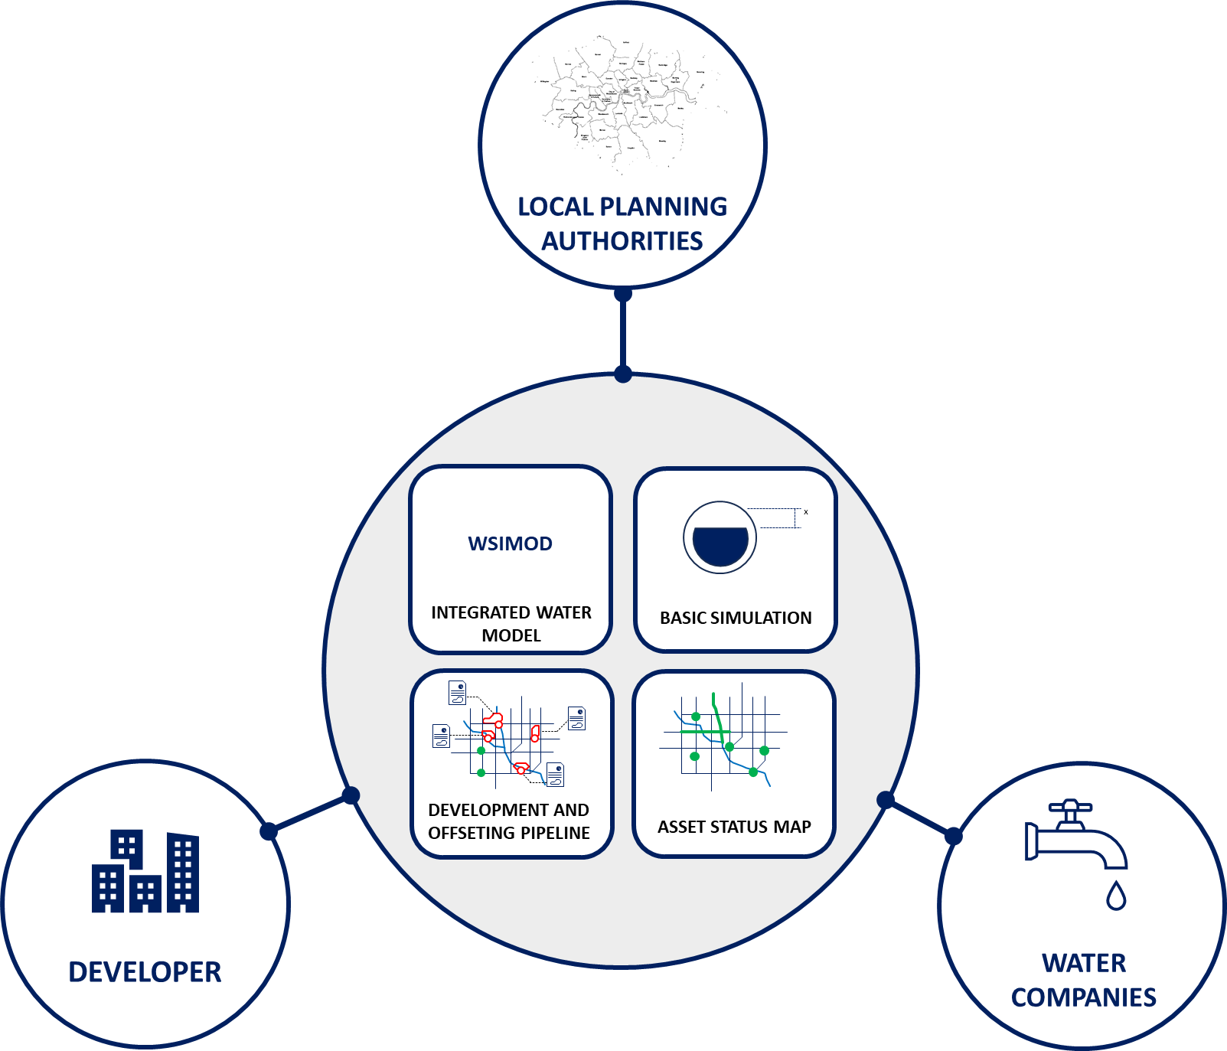
Data and modelling architecture
IWPP

Slide 16
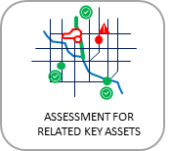
Asymmetrical data sharing
Your development seems to impact negatively a Water Company asset located in “X” area
Full access
Partial access

Slide 17
IWPP at work

Slide 18
Next steps
PART OF IMPACT ACCELERATION FUND IMPERIAL
Incorporating stakeholder feedback
Workshop with Legal teams
Linking WSIMOD and local models live

Slide 19
Thank you
Eduardo Rico Carranza¹, Ziyan Zhang¹, Ana Mijic¹
¹ Environment and Water Resources Section, Department of Civil and Environmental Engineering, Imperial College London

