Slide 1
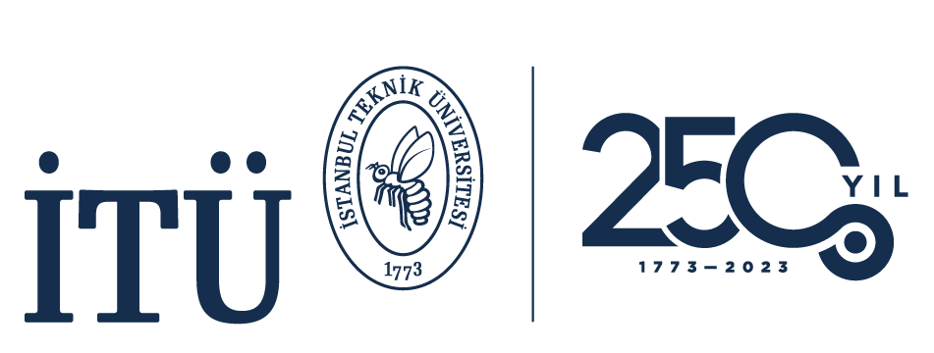

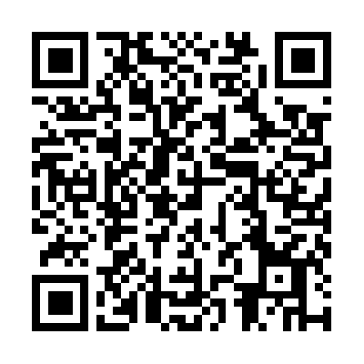




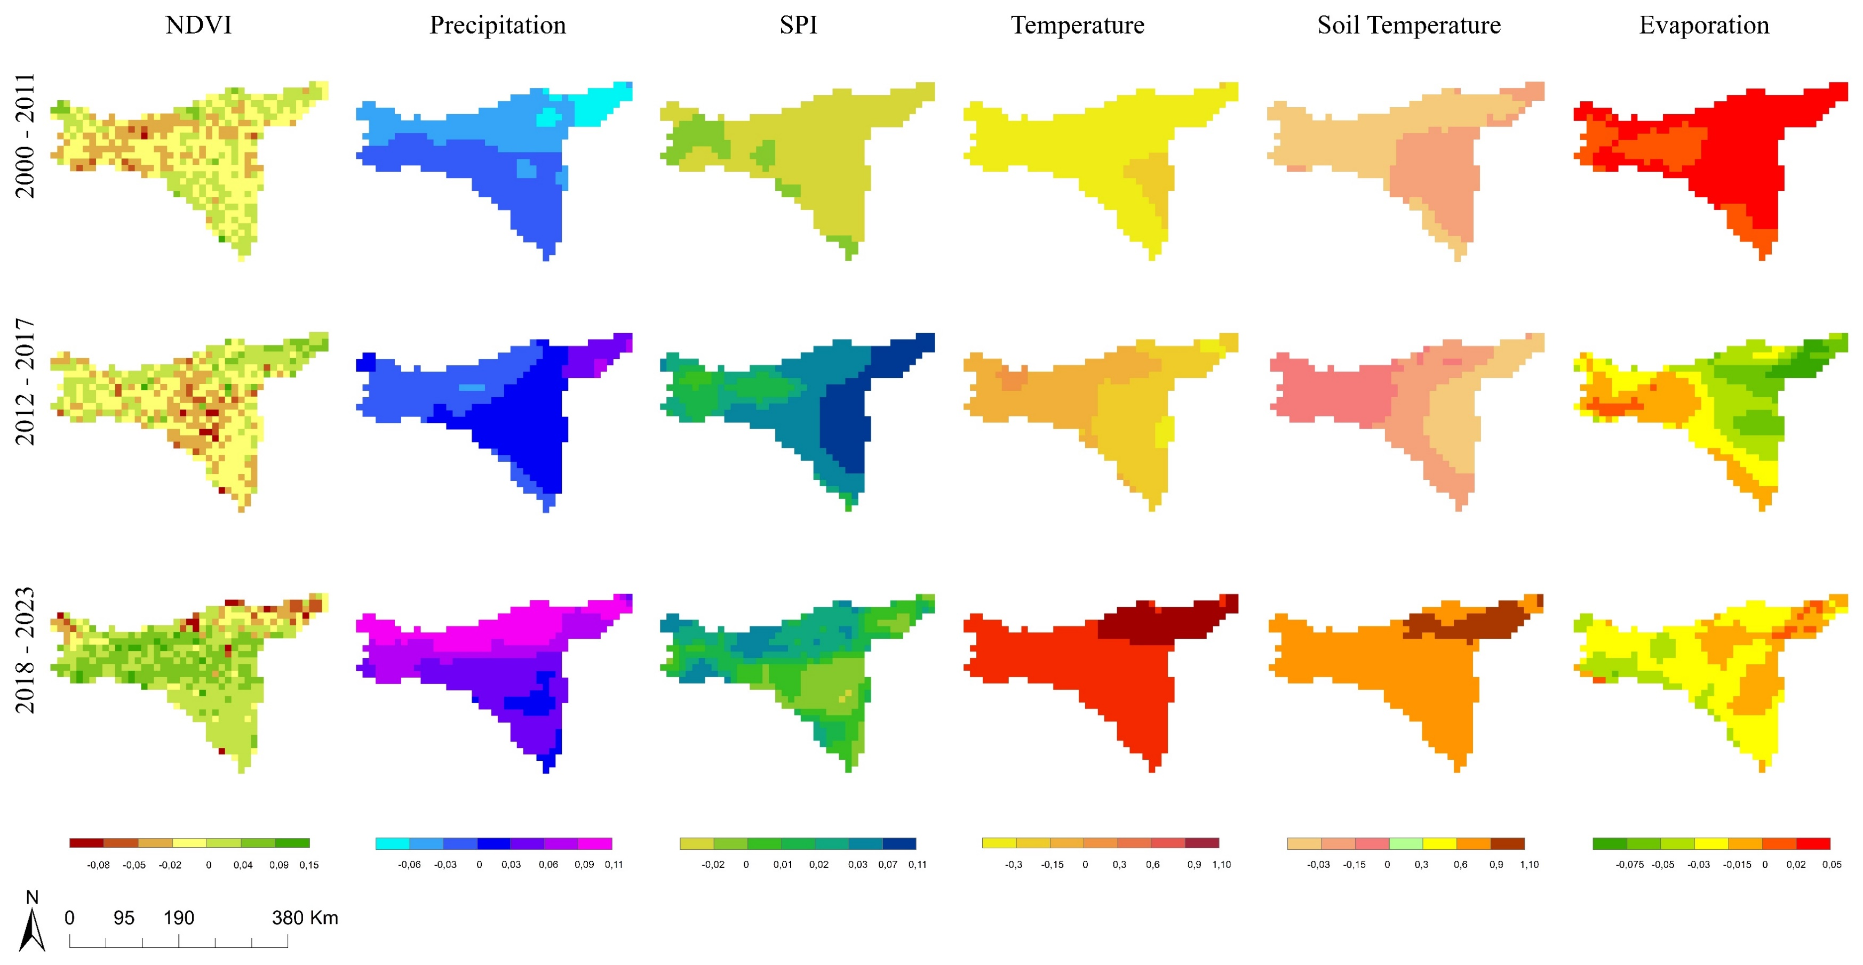
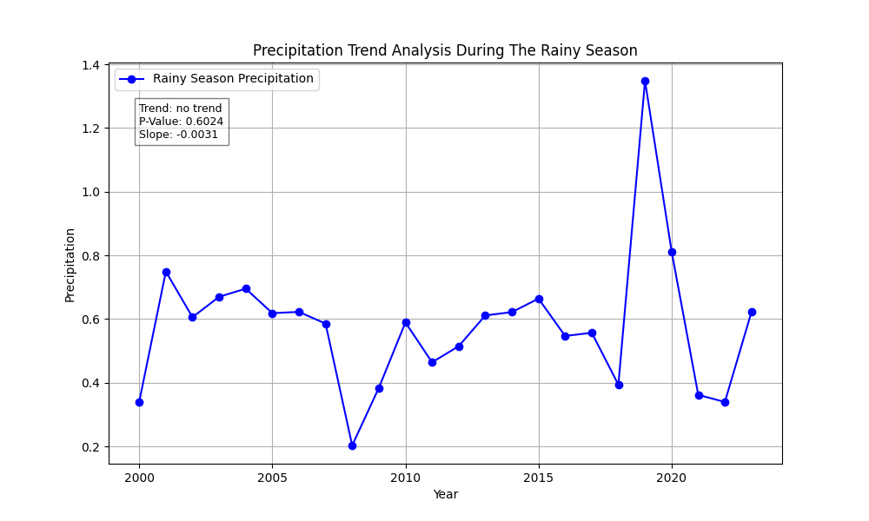
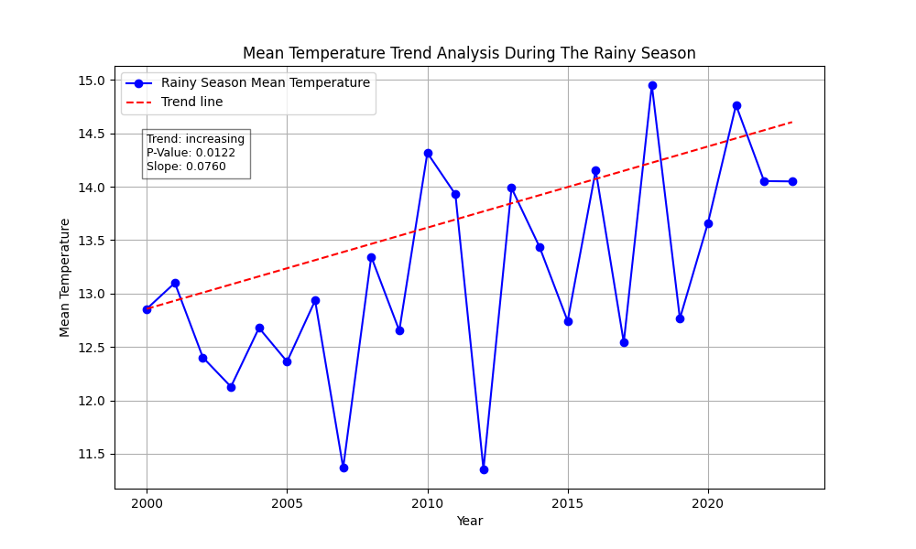
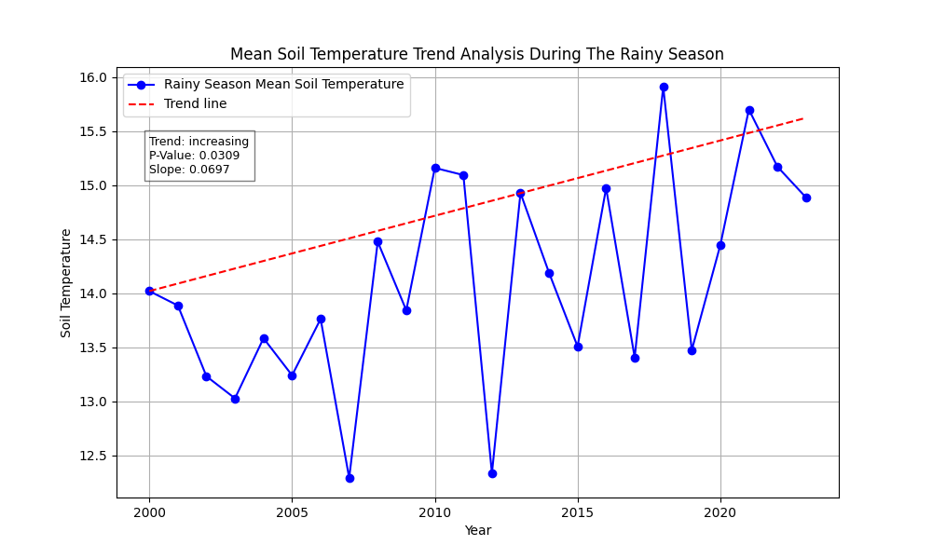
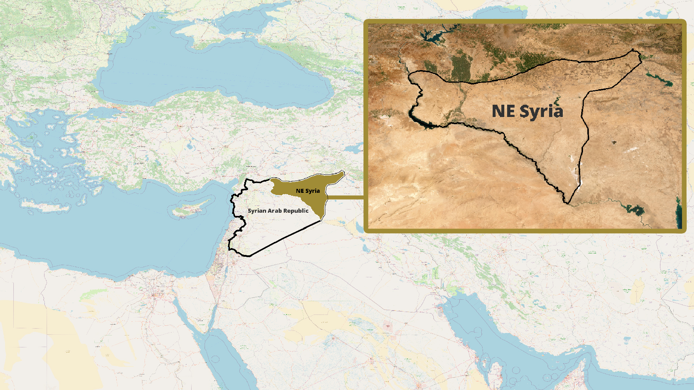
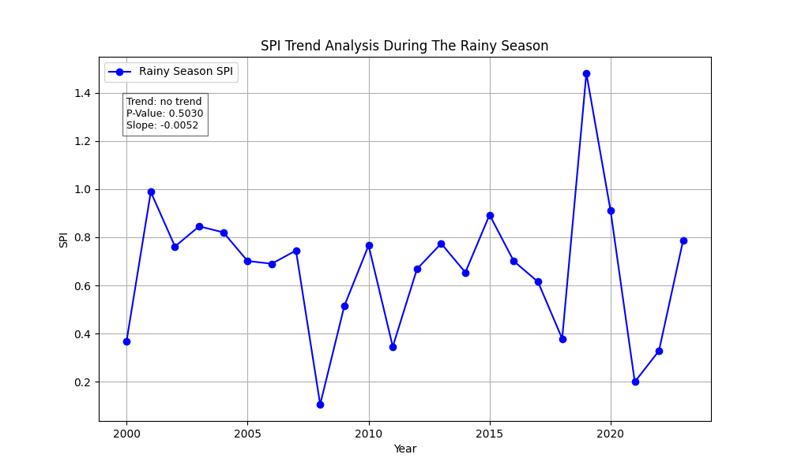
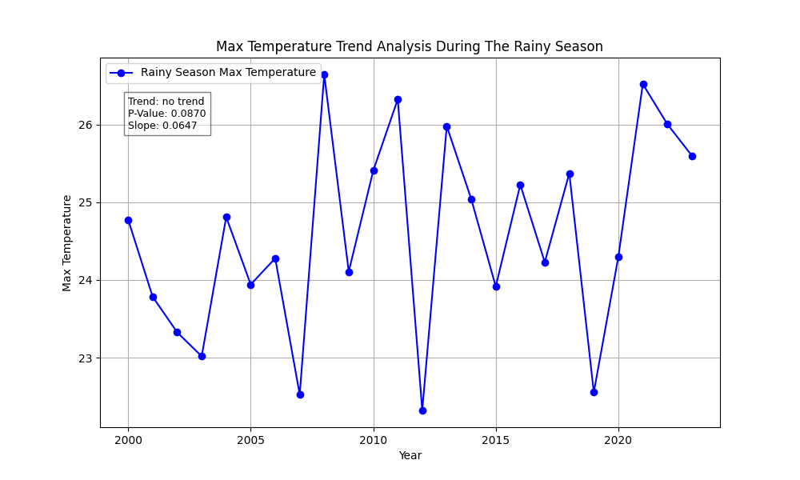
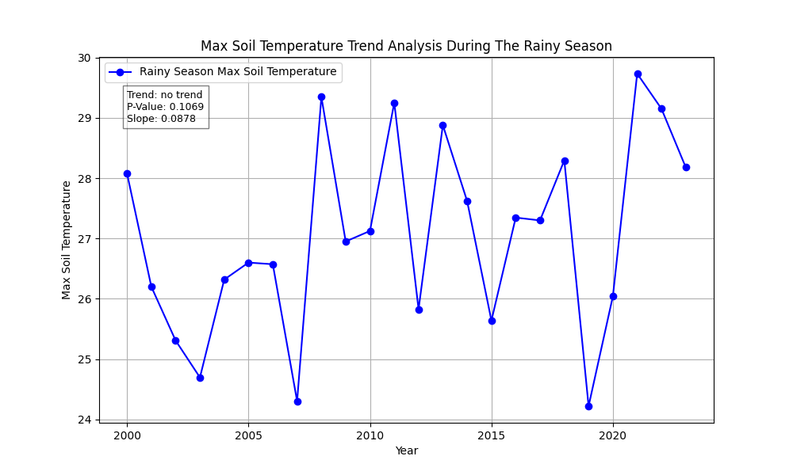
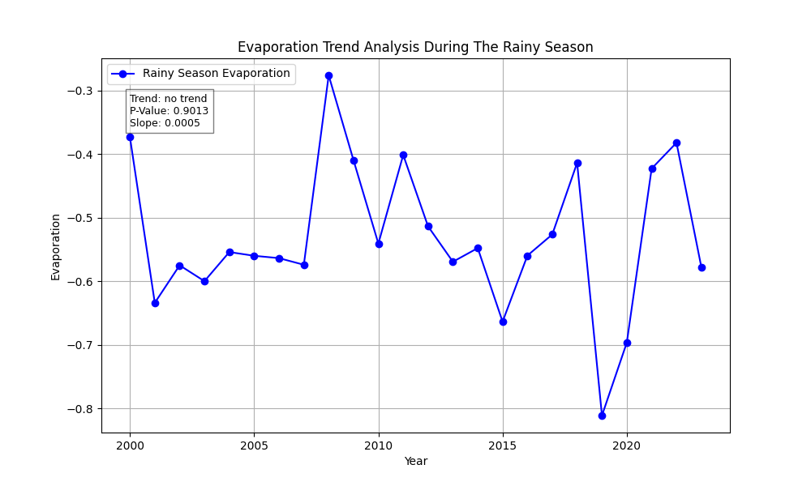
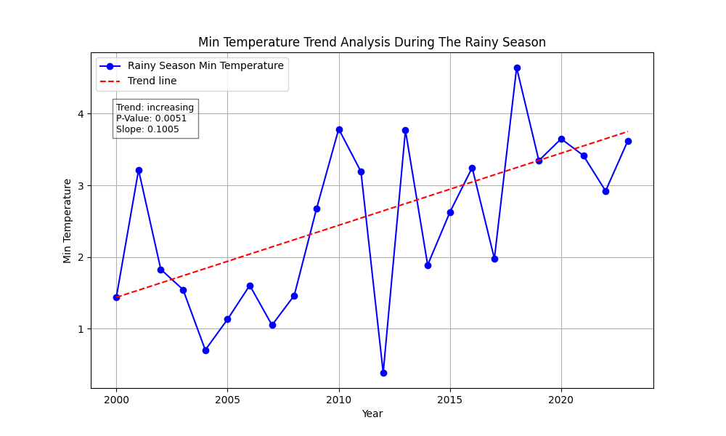
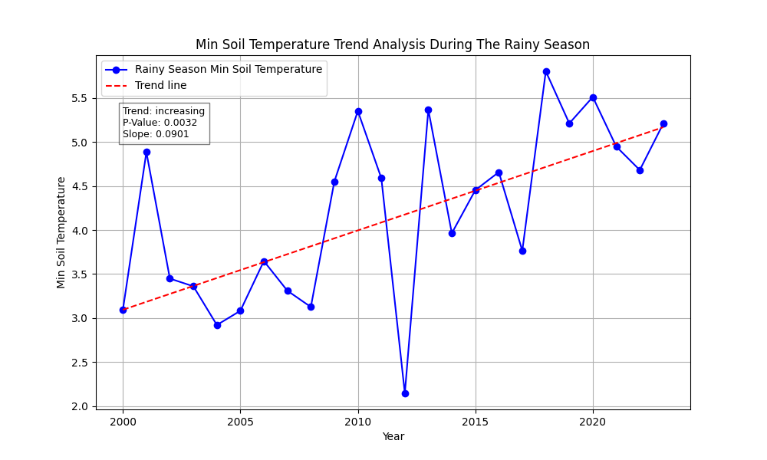
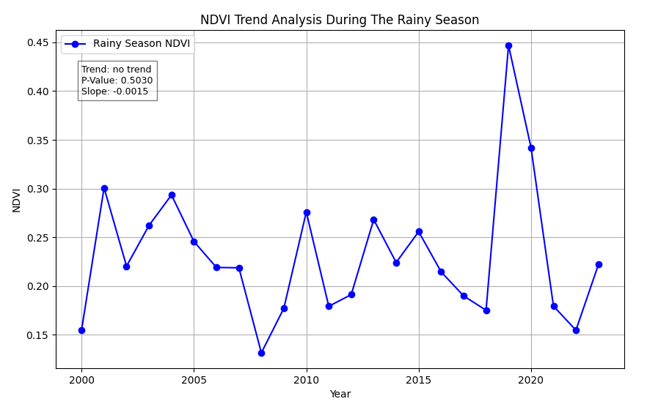
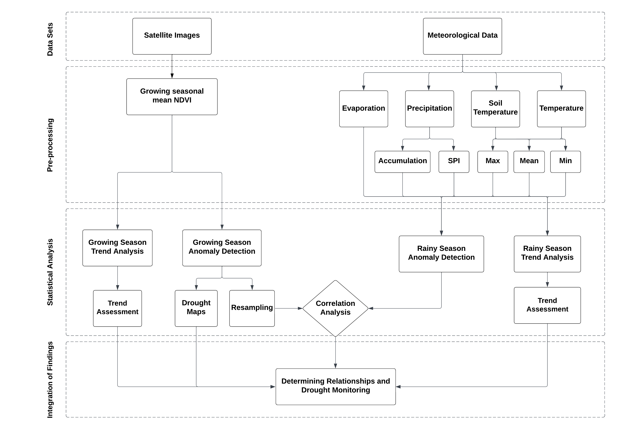
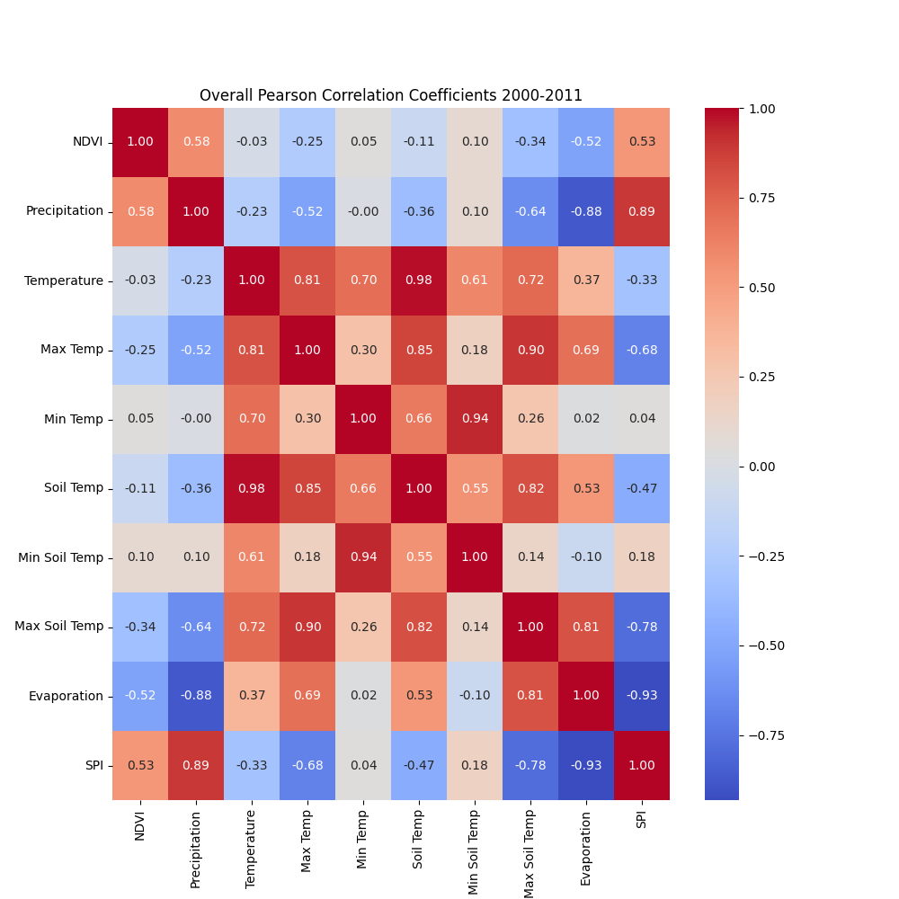
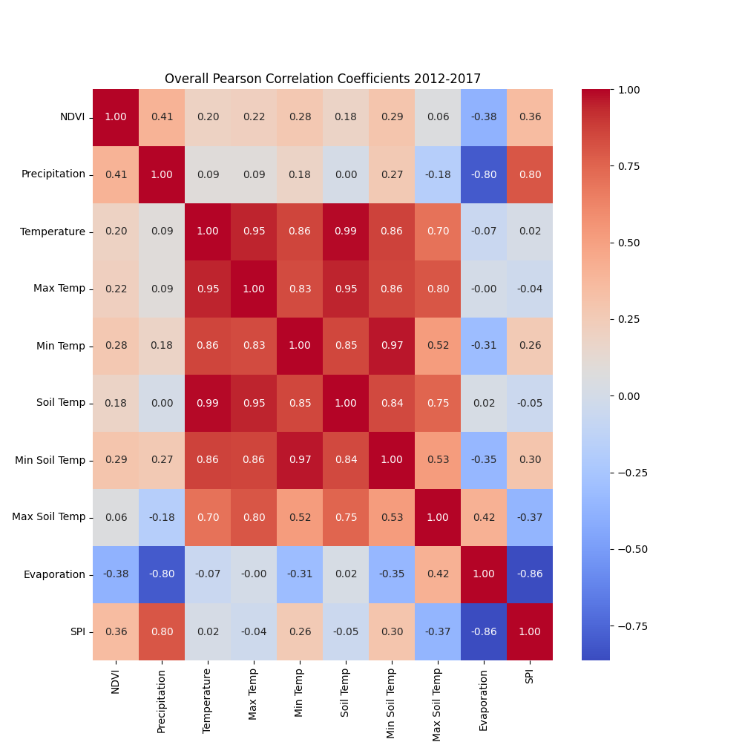
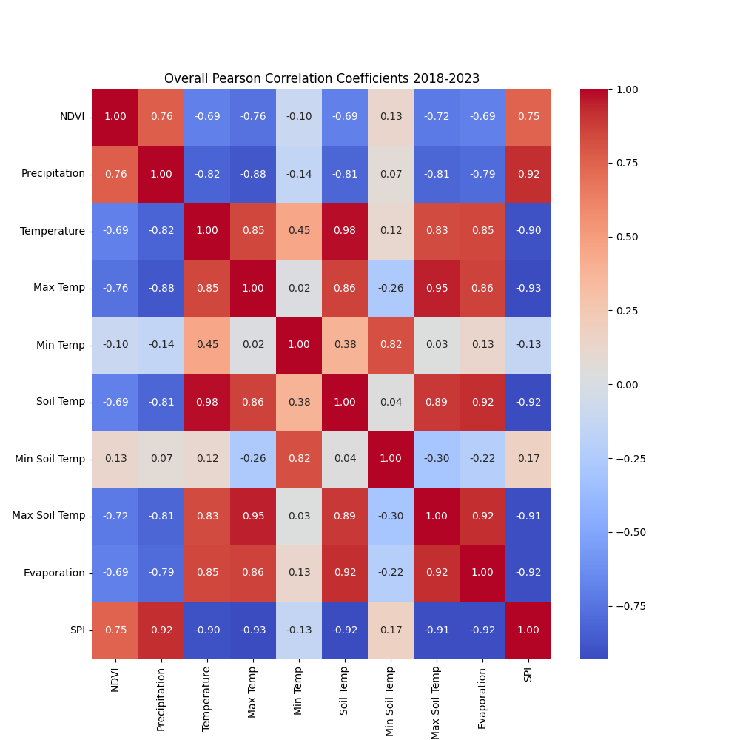
Investigating Impacts of Climate Change and War on the Green Cover Area in Northeast Syria Between 2000 and 2023
EGU24-20528
Abdullah Sukkar¹, Sara Essoussi², Omar Alqaysi¹, Enes Hisam¹, Dursun Zafer Seker³
¹ ITU, Istanbul Technical University, Graduate School, Geomatics Engineering Program, Maslak 34469, Istanbul, Türkiye (sukkar20@itu.edu.tr)
² Laboratory of Geo-Bio-Environment Engineering and Innovation (2GBEI), Polydisciplinary Faculty of Taroudant, Ibnou Zohr University, Taroudant, Morocco
³ ITU, Istanbul Technical University, Department of Geomatics Engineering, Maslak 34469, Istanbul, Türkiye
Want to talk?
sukkar20@itu.edu.tr
LinkedIn
Objectives and Background
Results
Syria, located at the intersection of Asia and the Mediterranean, is an area with a high level of water scarcity and is susceptible to extreme droughts, especially in the northeastern region, where temperature and evaporation have significant impacts. The land cover in the northeastern region has undergone significant alterations in recent years due to the armed conflict, and its effects on land use and land cover (LULC) are neither unidirectional nor spatially uniform. Research and policy alike have carefully considered the relationship between conflict and climate change. The study highlights how climate change and war have affected the vegetation areas in the northeastern region of Syria. The results emphasize different drought events and map the change in the LULC through the period of the study.
Investigation of the Mann-Kendall (MK) test indicates an increasing trend in both air and soil temperatures. While a significant increasing trend is evident in the minimum temperatures, no trend is observed in the maximum temperature readings,
Spatial distribution of anomalies for the NDVI, Precipitation, SPI, Temperature, Soil Temperature, and Evaporation parameters for three different periods: before the conflict 2000/2011, from 2012 to 2017, and from 2018 to 2023
Before the conflict, agricultural areas in the northwest, northeast, and southeast of the study region showed a positive anomaly in the NDVI, despite experiencing low precipitation anomalies. This indicated that these regions maintained relatively robust vegetation health, even under potentially less favorable weather conditions. Conversely, the central region exhibited a negative NDVI anomaly. From 2012 to 2017, the southeast experienced a slight decline in NDVI anomaly, while the northeast recorded a higher positive anomaly, and the central area saw a modest improvement in NDVI anomaly. The period also noted negative anomalies in the central and northwest regions. However, from 2018 to 2023, the central and southeast regions displayed significantly positive NDVI anomalies, whereas the northwest and northeast regions faced unexpected negative anomalies, despite relatively high positive precipitation anomalies. These negative trends may be linked to the detrimental effects of conflict on agriculture and the environment. In essence, the conflict likely interrupted farming activities, leading to a decline in vegetation vitality. This deterioration may have resulted from the destruction of farmland, disruption of irrigation systems, or the displacement of farming communities.
Location of the study area
The Mann-Kendall test for analyzing the trend, p-value, and Sen's slope over the rainy season for precipitation, SPI, evaporation, temperature, minimum temperature, maximum temperature, soil temperature, minimum soil temperature, maximum soil temperature, and NDVI.
Data and Methodology
The ERA5-Land reanalysis datasets, encompassing temperature, soil temperature, precipitation, and evaporation at an hourly scale, have been utilized to analyze climatic conditions in northeast Syria from 2000 to 2023. Additionally, Landsat 5, 7, and 8 satellite images have been employed to generate NDVI maps. Below is a diagram illustrating the methodological process, with each step detailed as follows: Initially, the monthly mean, maximum, and minimum temperatures and soil temperatures were calculated, alongside precipitation accumulation and the Standardized Precipitation Index (SPI), using the hourly measurements from the ERA5-Land dataset. Subsequently, seasonal mean values were derived from these monthly averages for both NDVI and the assessed meteorological variables. The Mann-Kendall (MK) test was then applied to determine the trend direction, p-value, and Sen's slope estimate. Anomalies for the NDVI and meteorological parameters were identified and spatially distributed. Finally, the Pearson correlation coefficient was calculated to elucidate the relationships among the various variables.
When calculating the correlation between the Normalized Difference Vegetation Index (NDVI) and various climatic parameters, a weak correlation is noted between NDVI and the mean, minimum, and maximum air and soil temperatures. Additionally, a rise in the negative correlation was observed during the post-conflict period. The correlation between precipitation and NDVI was 0.58 for the period from 2000 to 2011, 0.41 for the period from 2012 to 2017, and 0.76 for the period from 2018 to 2023. This suggests that between 2000 and 2017, there was not a strong positive correlation between precipitation and NDVI, indicating that NDVI during this period was more influenced by agricultural practices than by climatic conditions alone. The more pronounced increase in the correlation values between NDVI and precipitation in the period from 2018 to 2023 suggests that vegetation has become more sensitive to variations in precipitation. Furthermore, a strong negative correlation (-0.69) between NDVI and evaporation, NDVI and temperature, and NDVI and soil temperature for the period from 2018 to 2023.
By examining the drought classes and the annual drought classification, it becomes evident that Northeast Syria has experienced an increase in drought events, particularly moderate and severe droughts, after 2011.
Conclusions
In this study, we investigated the drought phenomenon in northeast Syria, a region characterized by extreme water stress and ongoing armed conflict for over a decade. We utilized hourly ERA5-Land meteorological datasets, including precipitation, temperature, soil temperature at level 1, and evaporation, along with the Standardized Precipitation Index (SPI). NDVI images were generated using the Landsat satellite imagery. Our analysis included anomaly detection to spatially represent drought behavior before and after the onset of armed conflict. Additionally, we applied the Mann-Kendall test to assess trend direction, significance (p-value), and magnitude (Sen's slope) for each parameter. The Pearson correlation coefficient was used to analyze overall parameter relationships for three periods: 2000/2011, 2012/2017, and 2018/2023. Furthermore, we conducted a drought classification on the NDVI anomaly maps, categorizing changes into different classes from normal to very severe drought. The significance of this study is multifaceted: (i) It addresses the scarcity of comprehensive geospatial and climatic studies in Syria, particularly post-conflict. (ii) The methodology, proven applicable in northeast Syria, can be extended nationwide and even to similar regions, such as the marshlands in Iraq or southeastern Anatolia in Türkiye. (iii) This research could underpin future international aid and projects, potentially contributing to a roadmap for resolving the conflict in Syria.
The overall Pearson correlation between the parameters over three different periods: 2000/2011, 2012/2017, and 2018/2023
Flowchart of methodology

