Slide 1
Assessing Multidimensional Climate Extremes and Associated Vulnerabilities Across the United States
Saurav Bhattarai^{1,} Sanjib Sharma², Rocky Talchabhadel¹
04/19/2024

Slide 2
Background
Climate change is intensifying the occurrence of various extreme weather events globally
Existing research often focuses on individual extremes (e.g. heatwaves, droughts, floods)
Limited exploration into how multiple, diverse extremes interact and compound social vulnerability
This study analyzes the overlapping spatial and temporal impact of temperature, precipitation, and hydroclimatic extremes across the U.S.

Slide 3
Research Objectives
Compute indices of different climate extremes (related to heatwaves, floods, droughts) using climate model data and predictions
1
Categorize regions (states, counties) based on exposure to simultaneous climate extremes
2
Incorporate social vulnerability and socioeconomic factors into the analysis
3
Identify areas facing the highest risks from the convergence of climate hazards and social vulnerability
4

Slide 4
Case Study 1: Heatwave

Slide 5
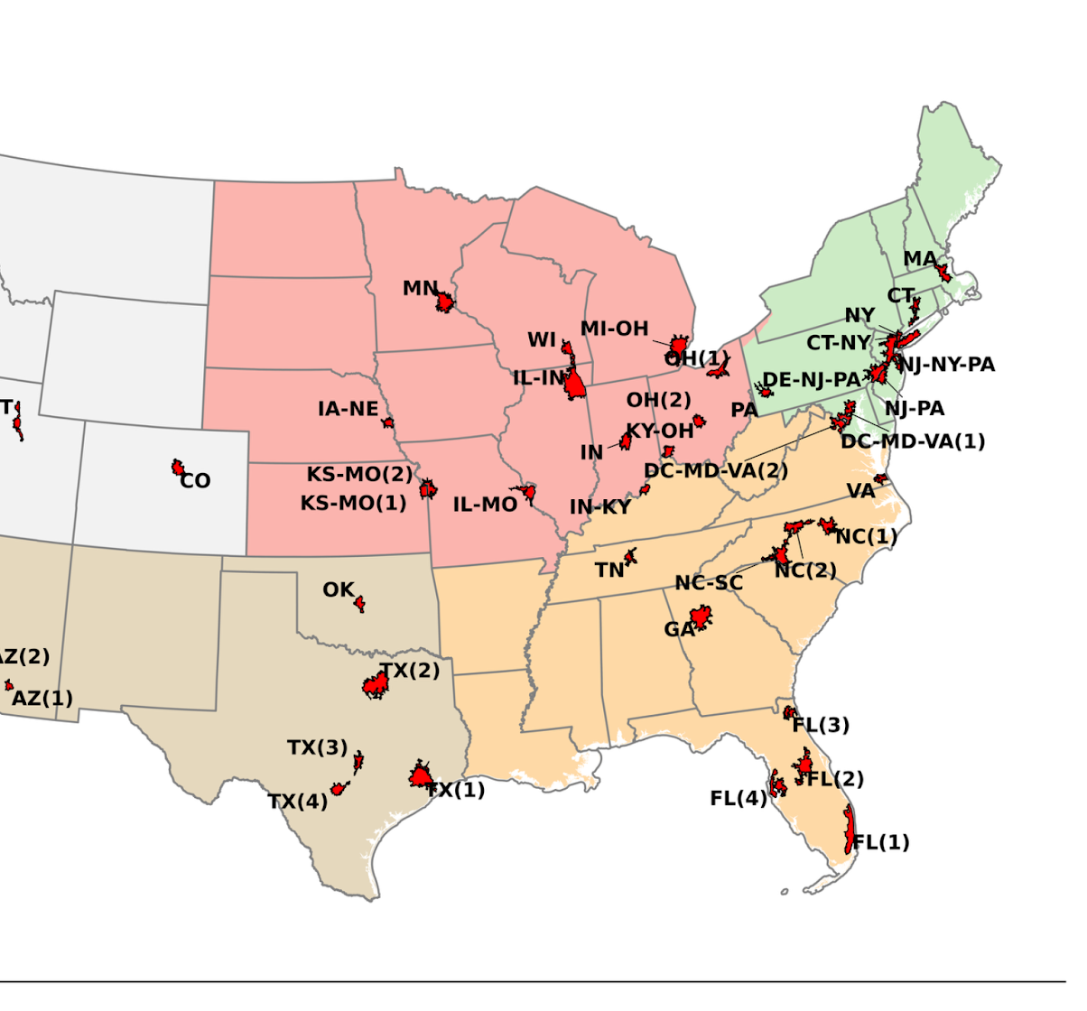
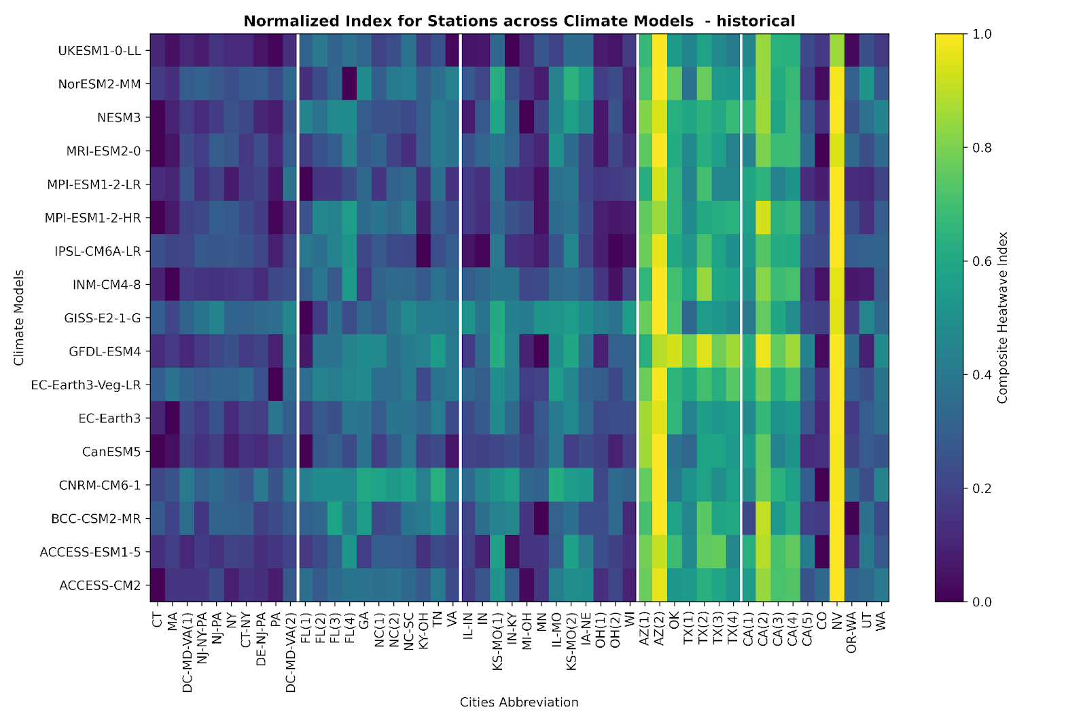
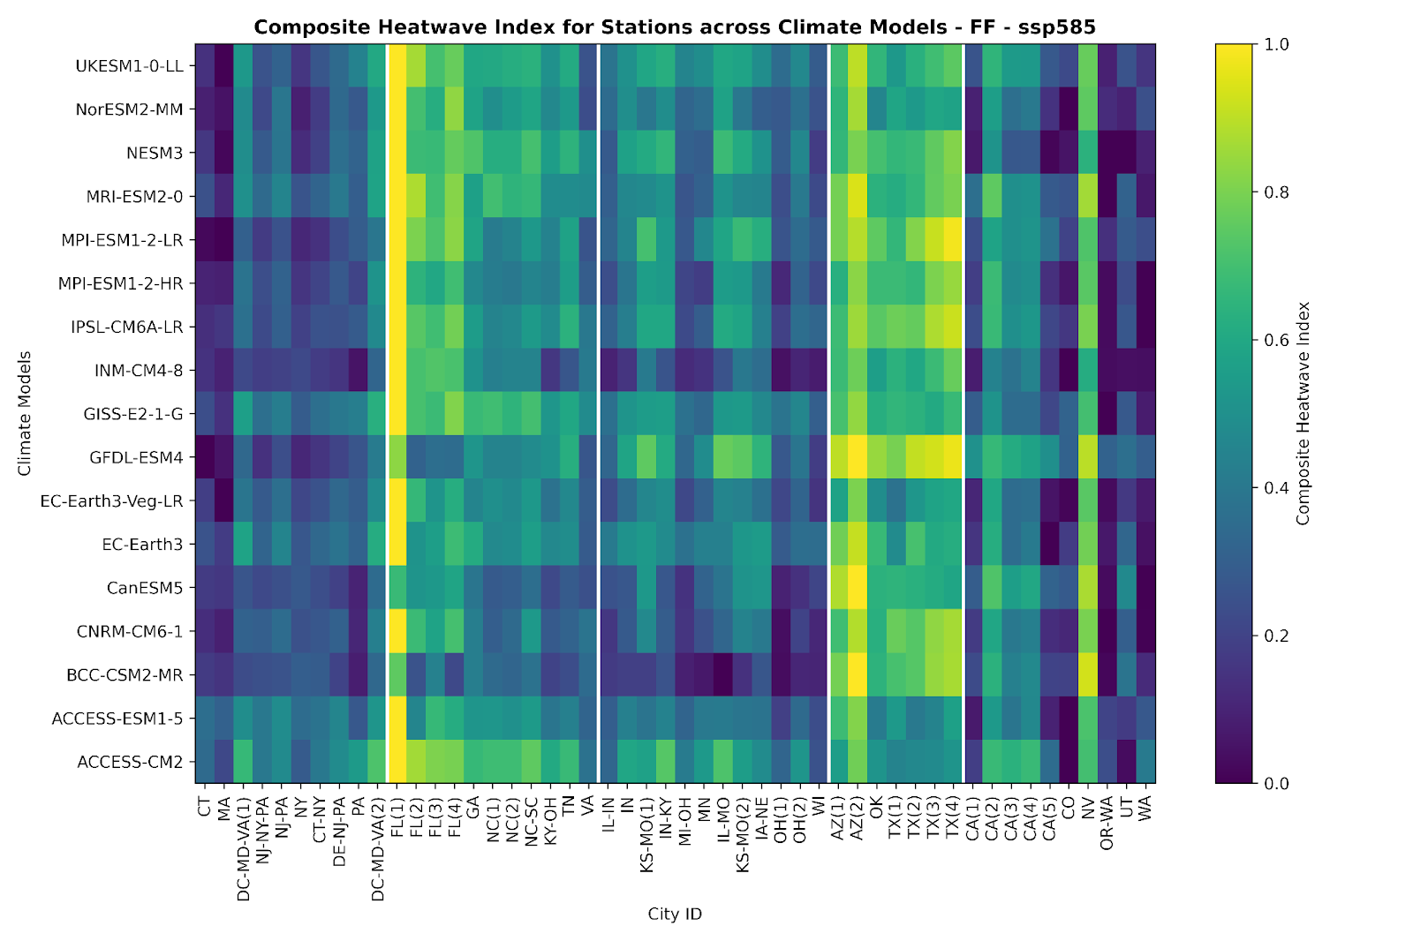

Slide 6
Heatwave: Spatial Representation

Slide 7
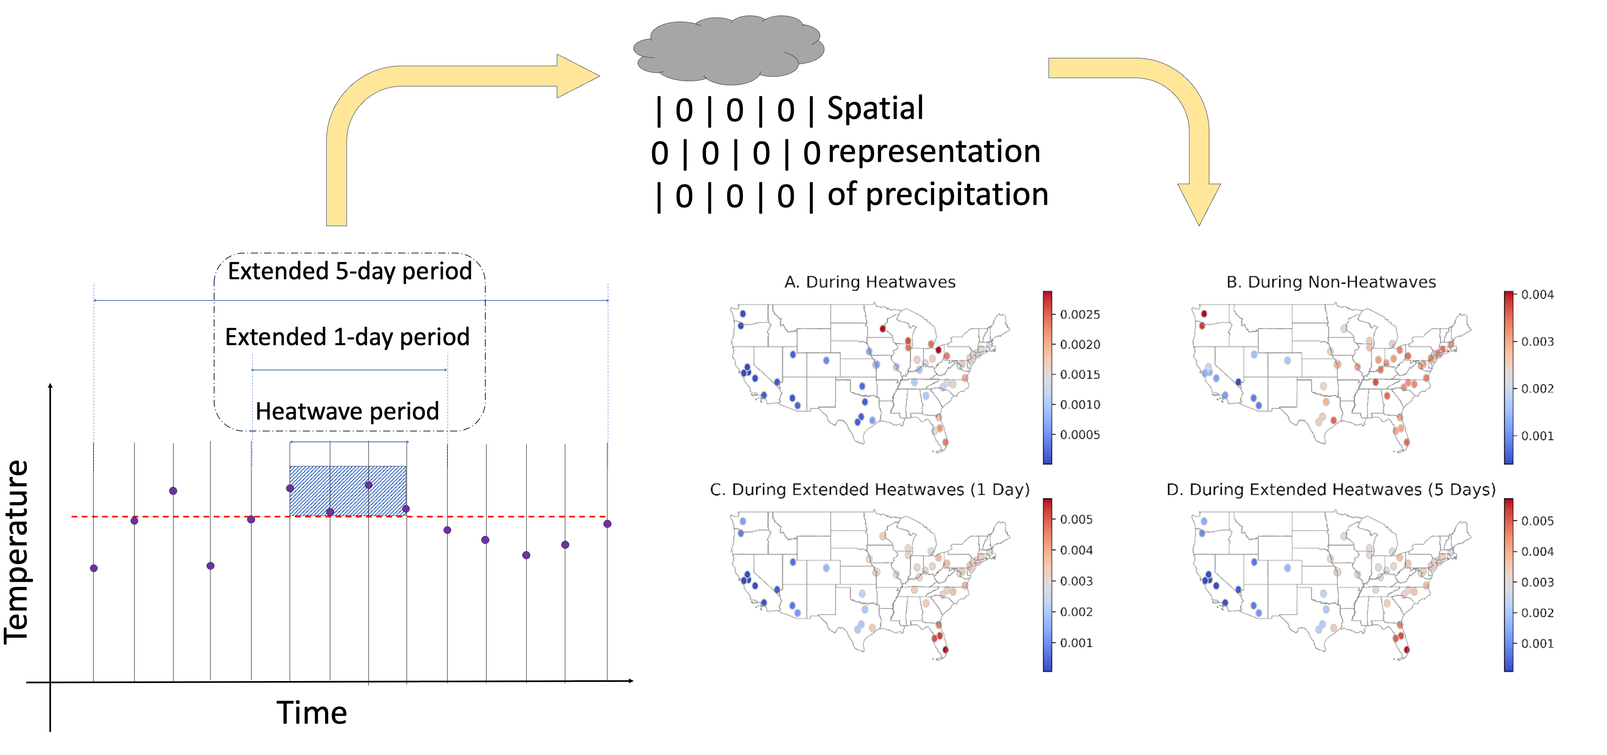
Heatwaves and Precipitation

Slide 8
Precipitation during ‘x’ days prior/after heatwave x = 1

Slide 9
Precipitation during ‘x’ days prior/after heatwave x = 3

Slide 10
Precipitation during ‘x’ days prior/after heatwave x = 5

Slide 11
Precipitation during ‘x’ days prior/after heatwave x = 7

Slide 12
Humidity during heatwave
100
90
80
70
60

Slide 13
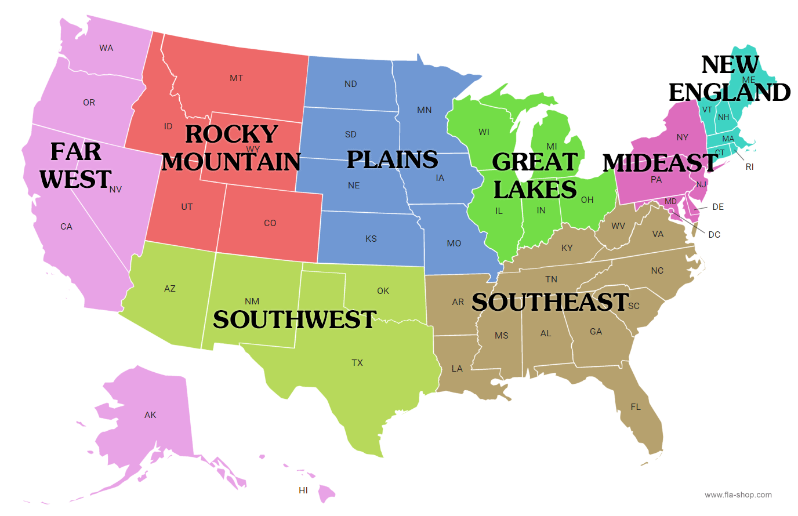
Precipitation during ‘x’ days prior/after heatwave

Slide 14
Takeaway for Case 1
Our analysis uncovered some connections between extreme heatwaves and precipitation patterns. Places that experienced more intense and frequent heatwaves saw less total precipitation.
Additionally, we found places with lower heatwave intensity did often receive rainfall soon after heatwaves. This precipitation could provide a cooling relief. This looks like the good news, BUT..
However, precipitation also raises humidity levels which may heighten heat discomfort.
HEATWAVE only is severe at one region (in this case mostly west and florida region)
However, HEATWAVE + HUMIDITY (as a result of precipitation) is at eastern region.

Slide 15
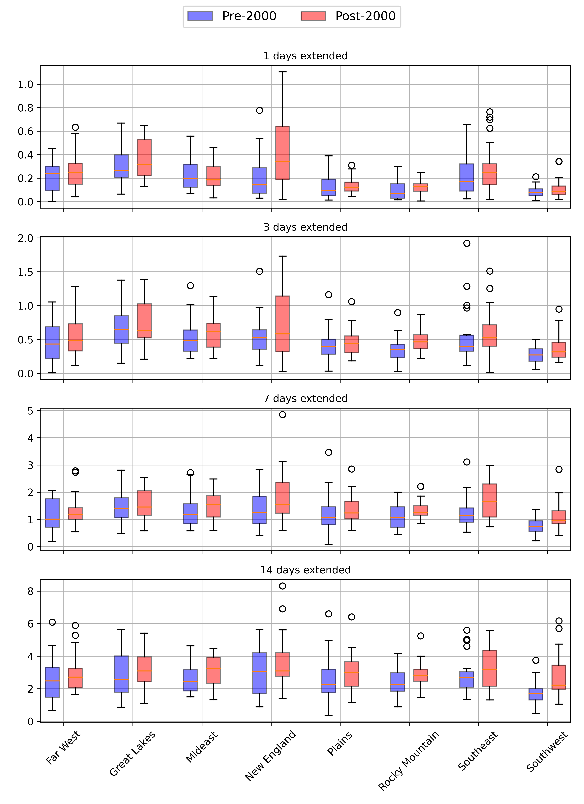
Case Study-2: Higher precipitation extreme with days above 90th percentile at extended period

Slide 16
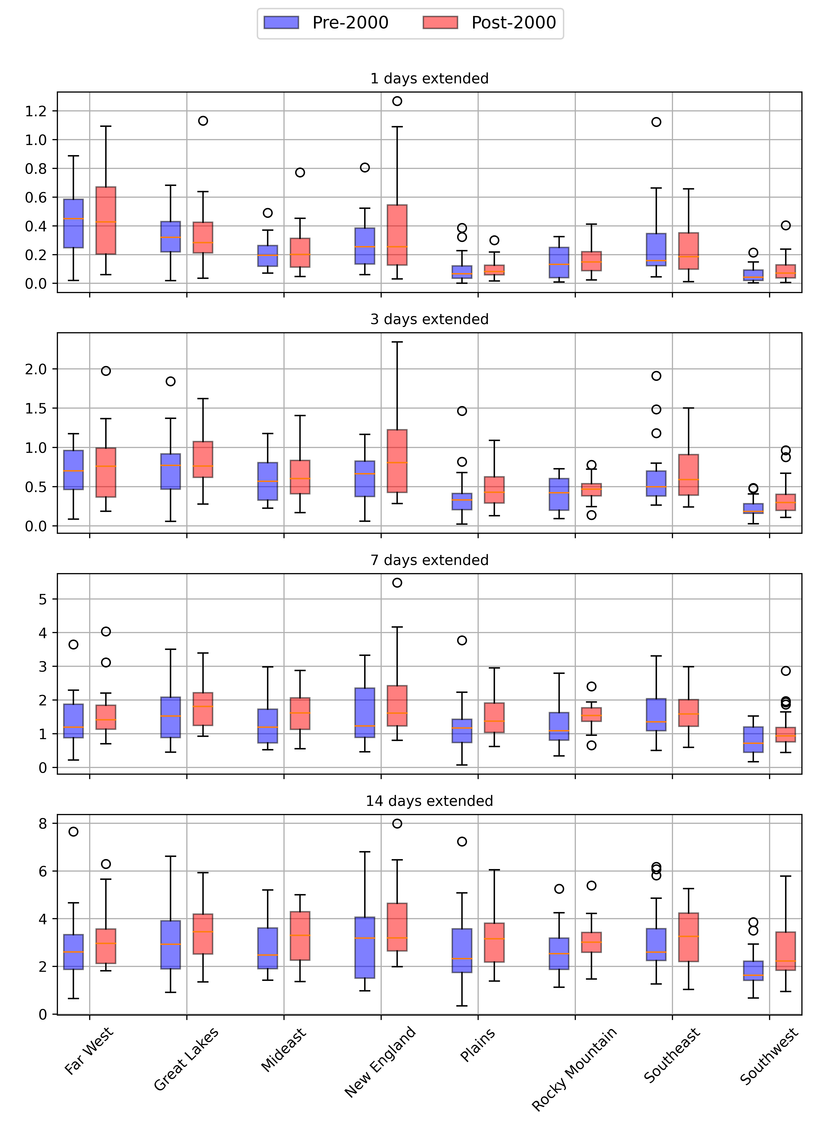
Case Study-2: Higher precipitation extreme with days above 90th percentile at extended period

Slide 17
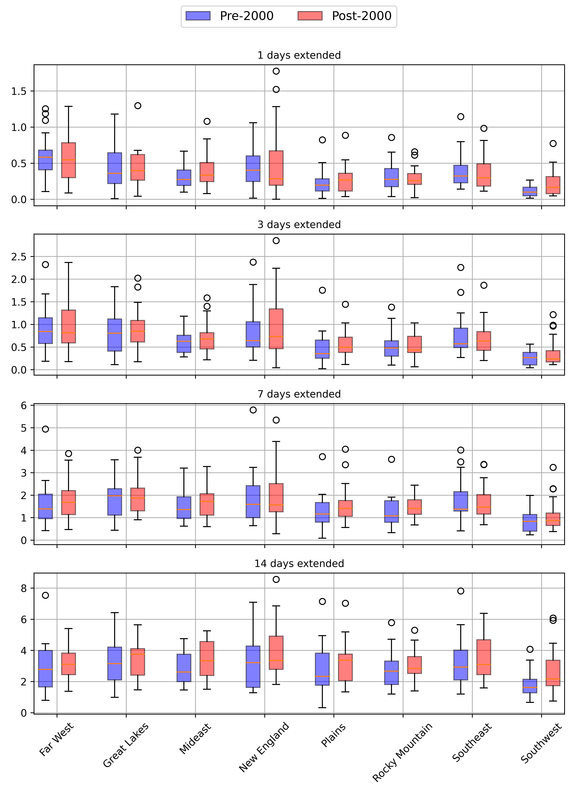
Case Study-2: Higher precipitation extreme with days above 90th percentile at extended period

Slide 18
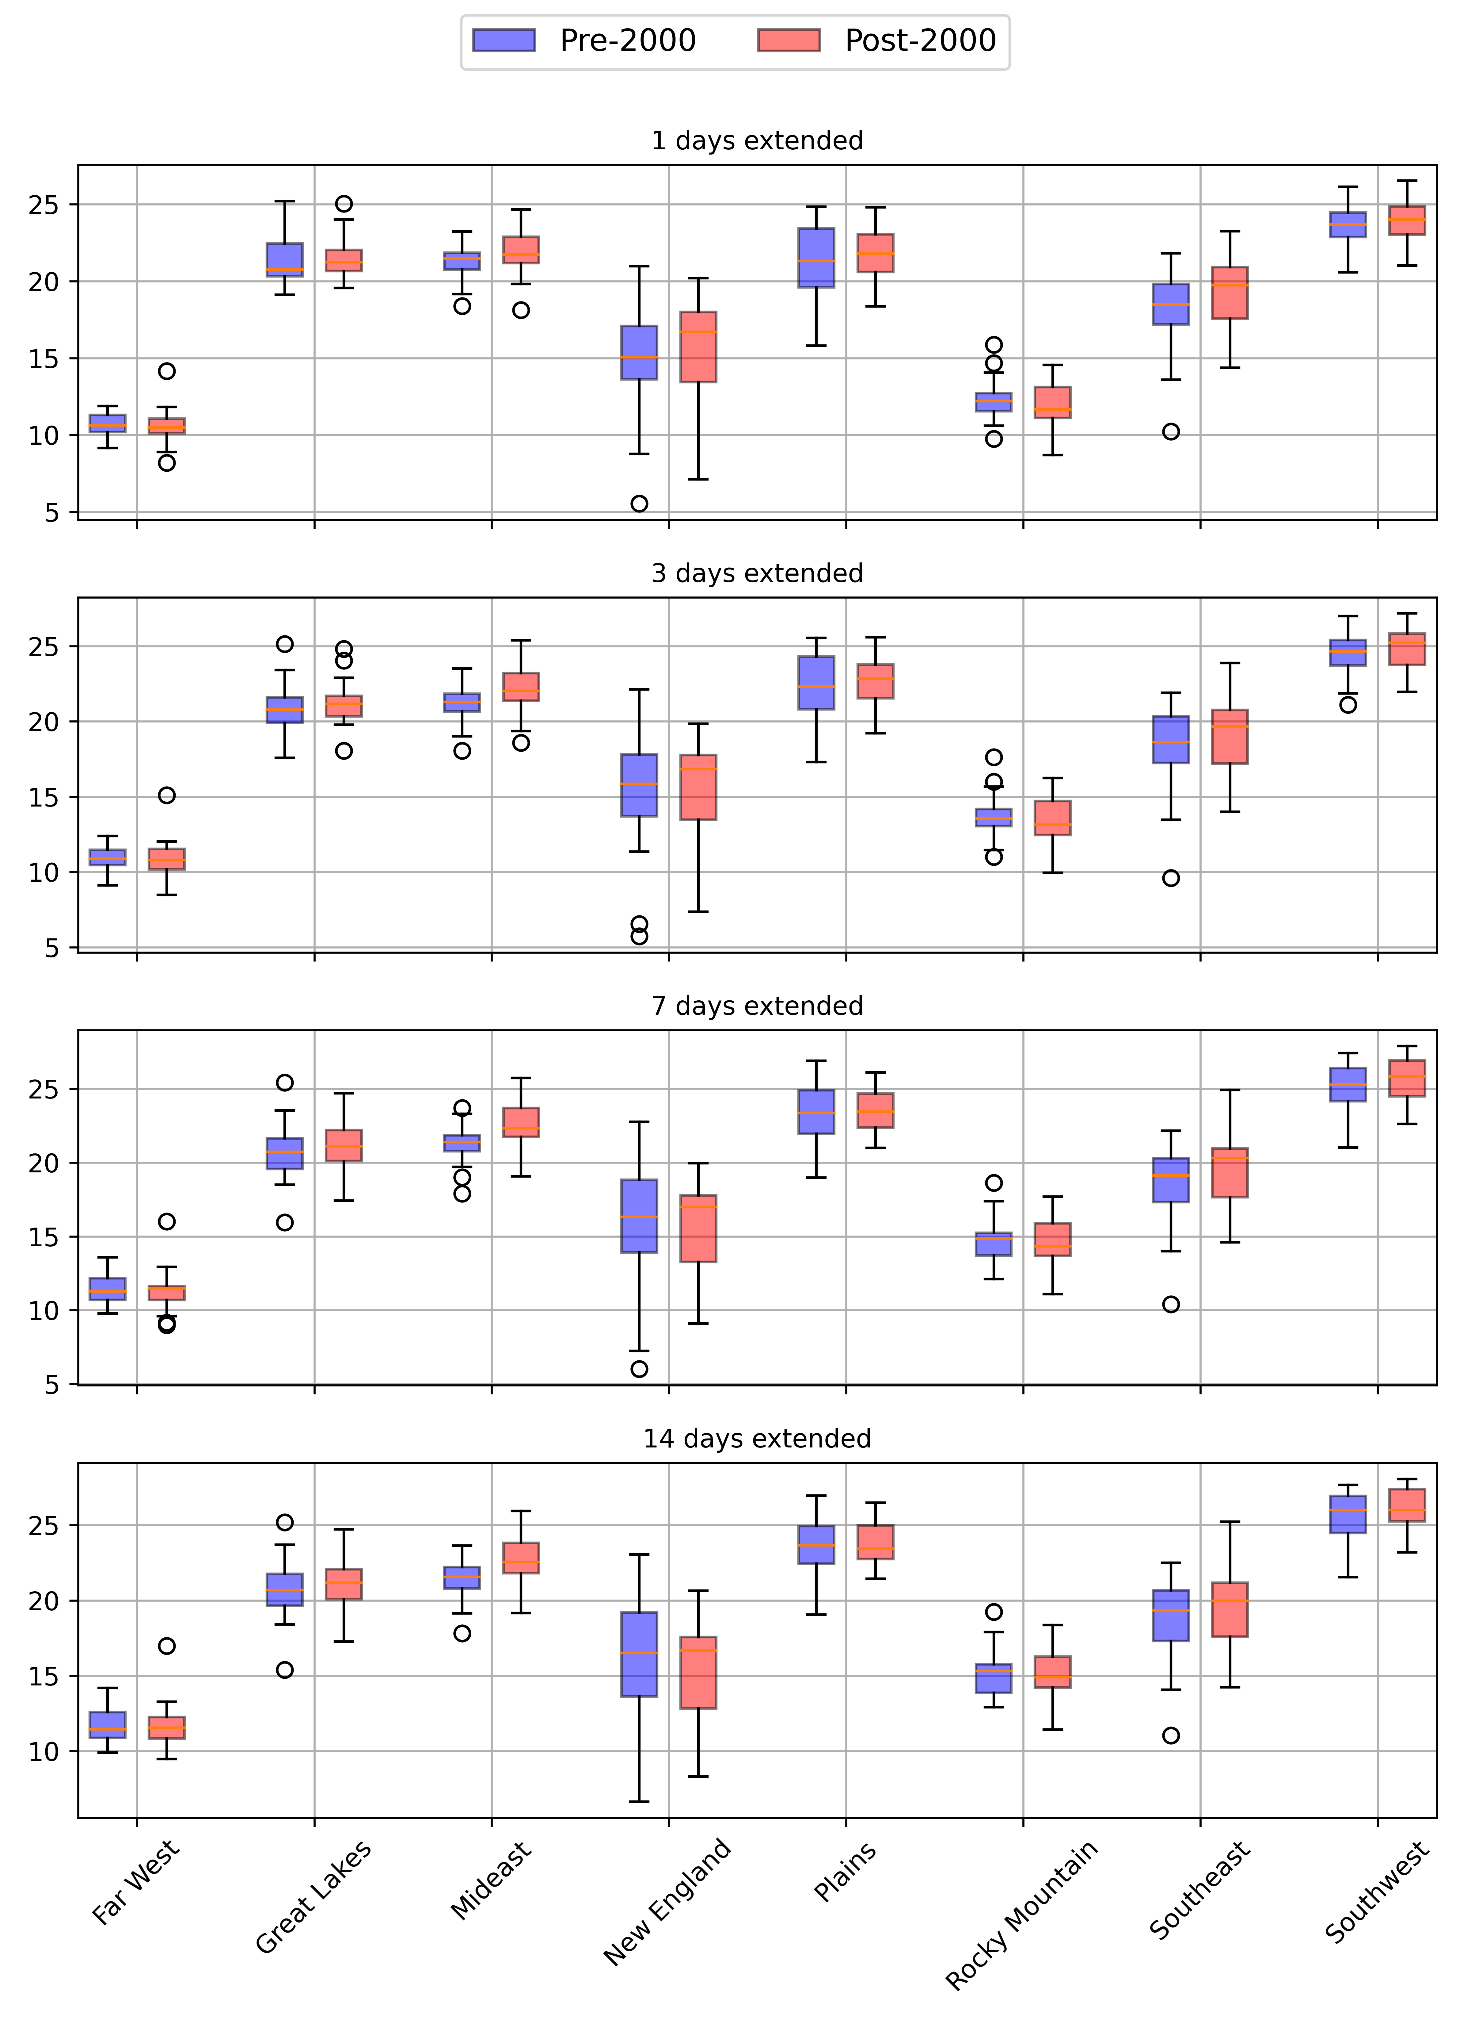
Case Study-2: Higher precipitation extreme with average temperature at extended period

Slide 19
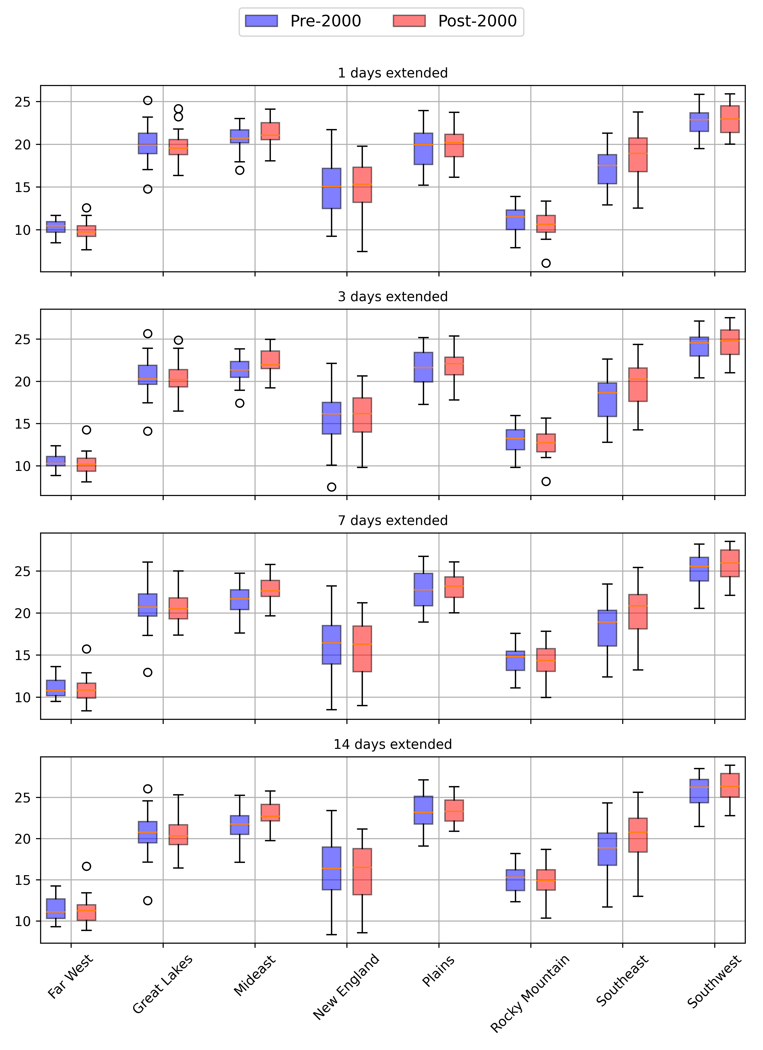
Case Study-2: Higher precipitation extreme with average temperature at extended period

Slide 20
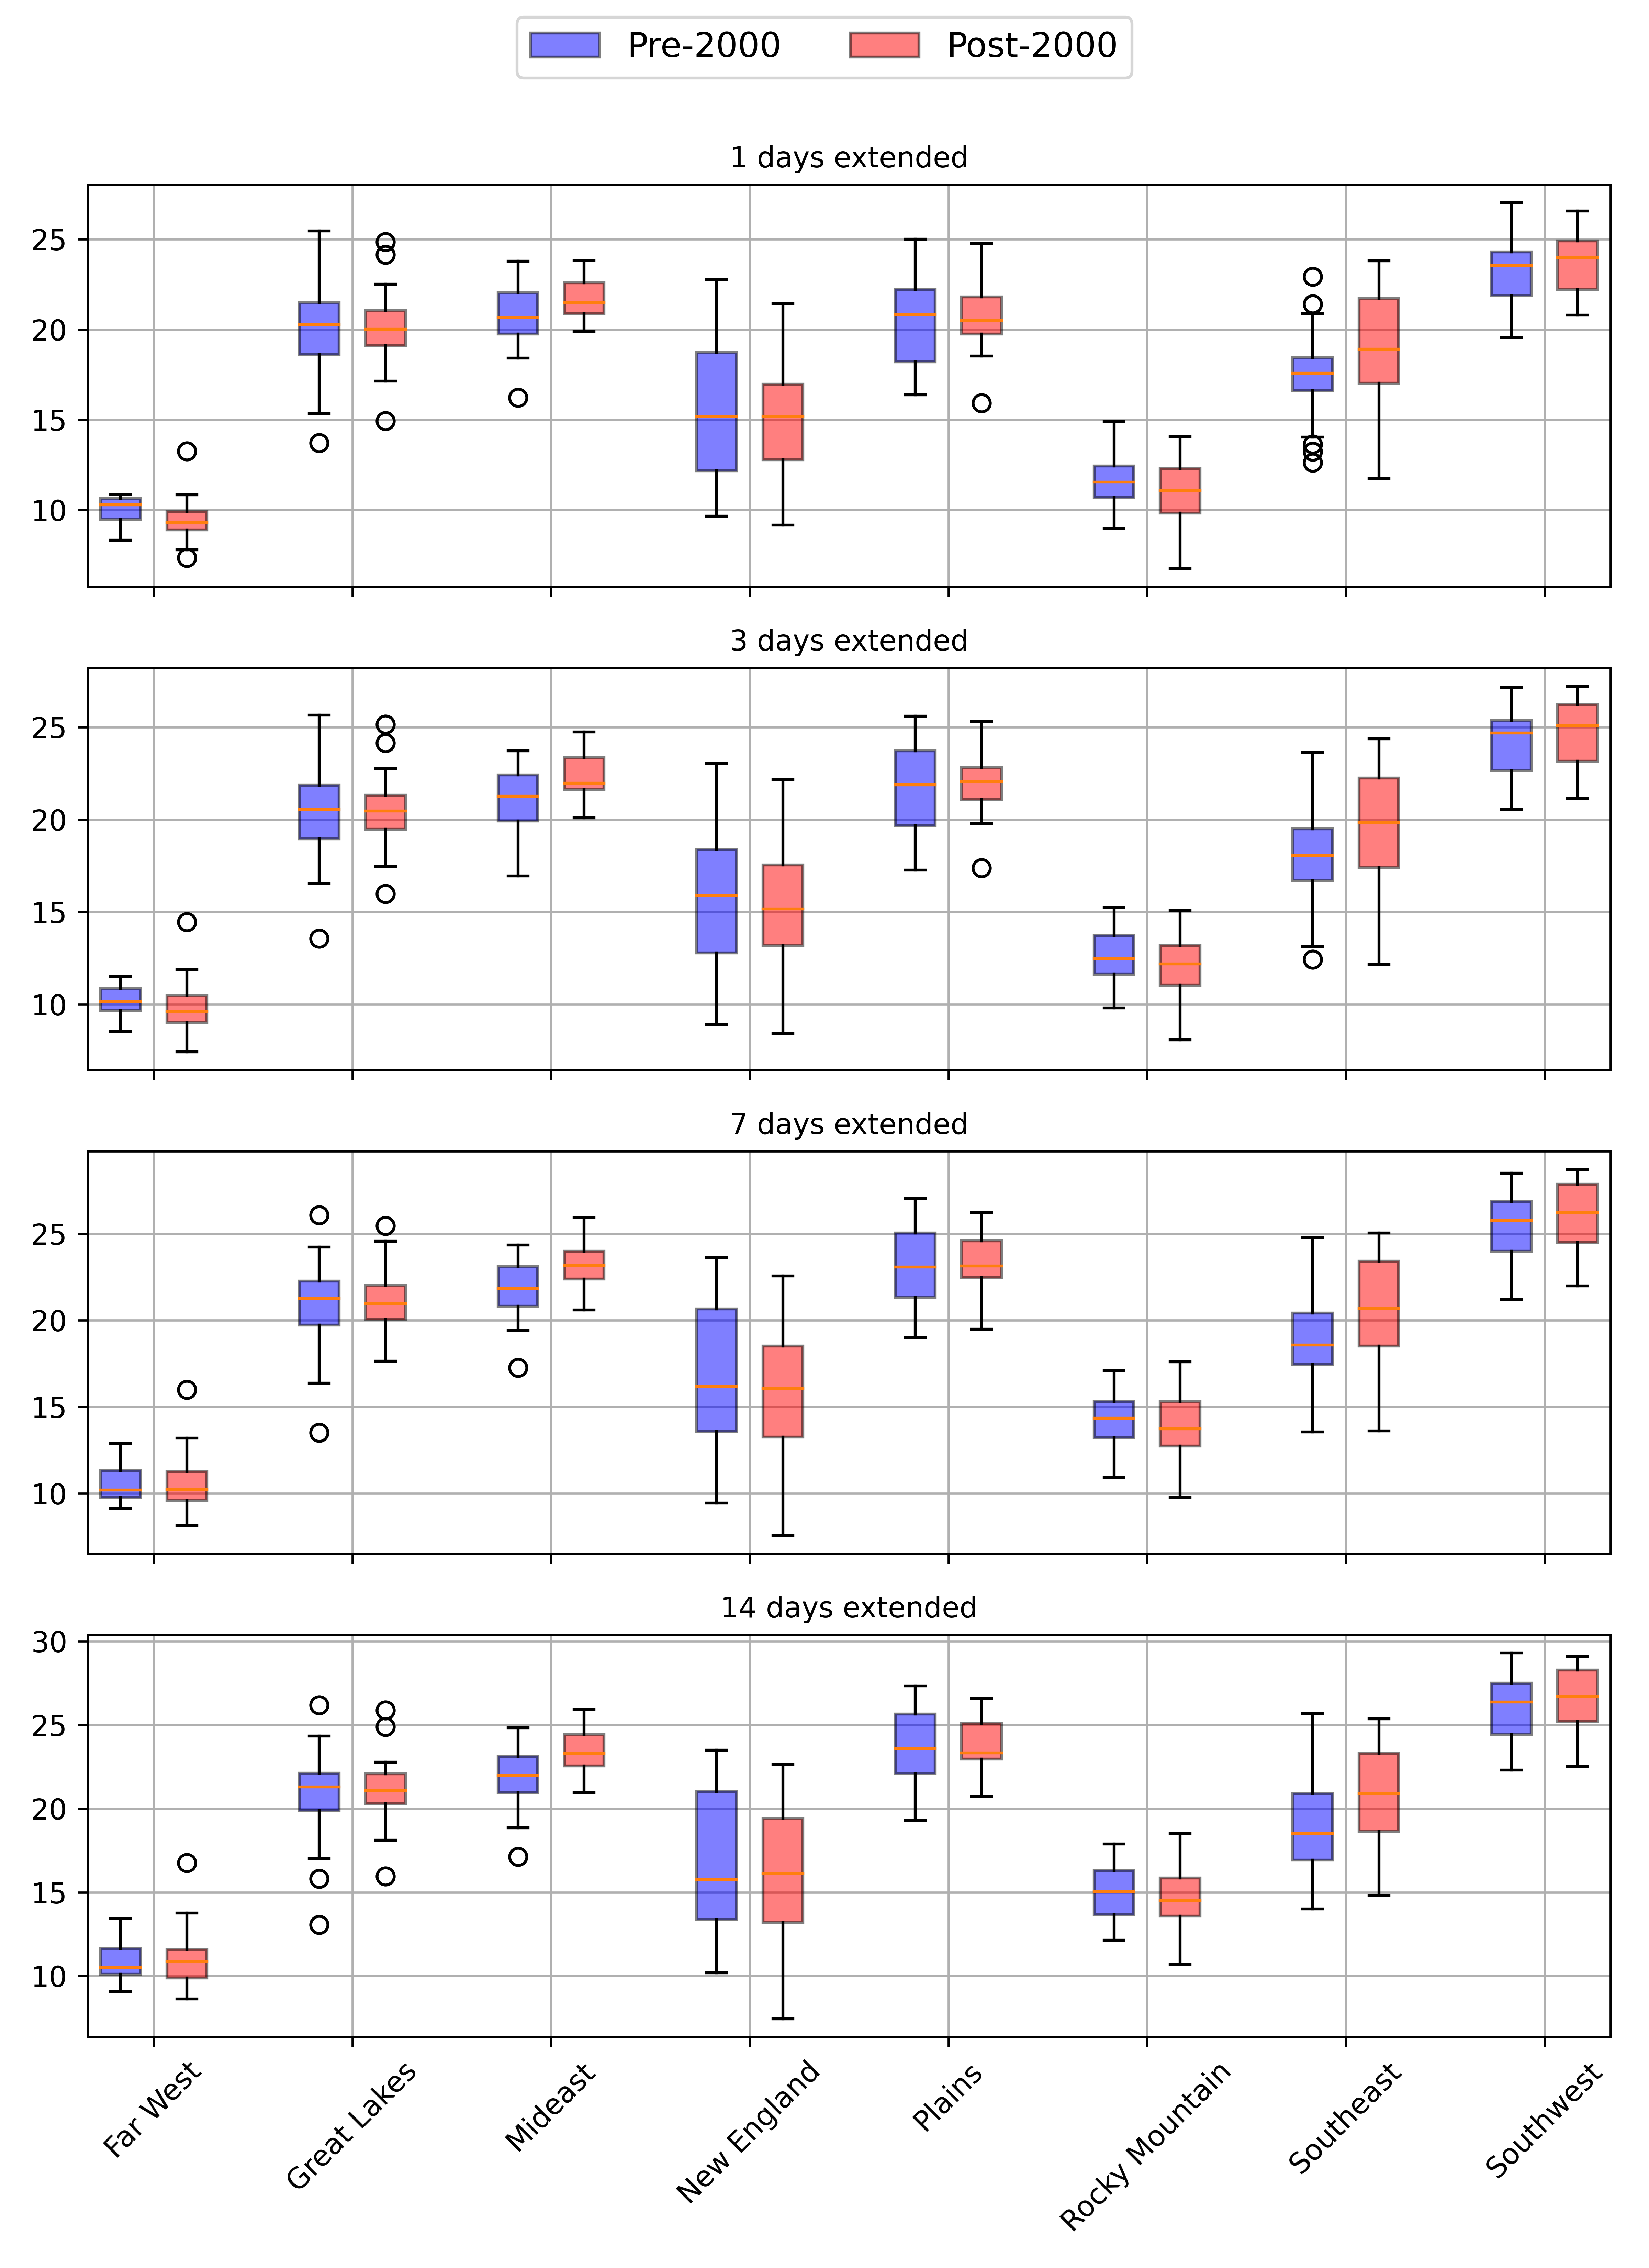
Case Study-2: Higher precipitation extreme with average temperature at extended period

Slide 21
Takeaway for Case 2
Frequency and severity of precipitation-related extremes are increasing across the U.S.
Temperature extremes are also increasing near the dates and locations of precipitation extremes
Temporal analysis shows clear upward trends in temperature extremes around precipitation extremes
Spatial patterns reveal growing geographic extent of high temperature extremes coinciding with precipitation extremes
The convergence of intensifying precipitation and temperature extremes poses compounded risks
Regions facing the simultaneous increase in diverse climate hazards are emerging
Understanding these compound climate risks is critical for targeted adaptation planning

Slide 22
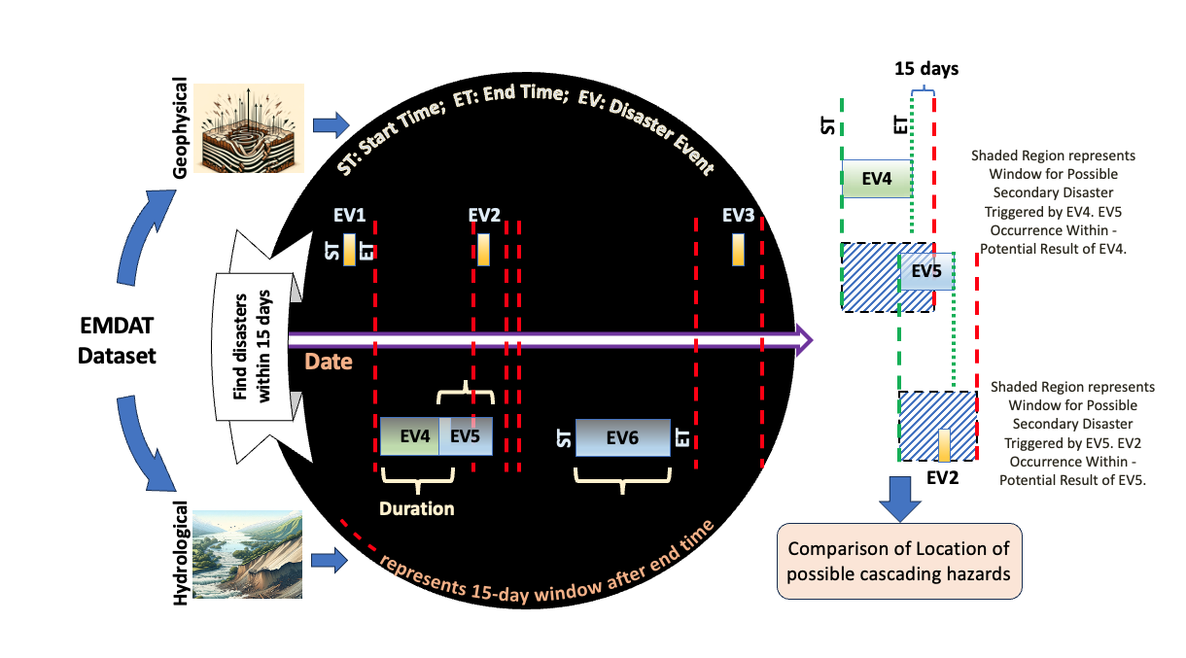
Future Direction: Other Indices & Using Real Disaster Dataset?

Slide 23
THANK YOU! Thank you for listening Any suggestions and comments are appreciated. Contact Information: Saurav.Bhattarai@students.jsums.edu Saurav.Bhattarai.1999@gmail.com

