Slide 1
Current status of the
Urban Geo-climate Footprint (UGF) project
Azzurra Lentini
University of Granada, Spain
Joint Research Centre of European Commission (EC-JRC)
azzurra.lentini@ec.europa.eu
Working group: Azzurra Lentini^{3,4}, Jorge P. Galve⁴, Beatriz Benjumea-Moreno^{5, 2},, Stephanie H. Bricker^{6,2}, Xavier Devleeschouwer^{7,2},Paolo Maria Guarino^{1,2}, Timothy Kearsey^{6,2}, Gabriele Leoni^{1,2}, Saverio Romeo^{1,2}, Guri Venvik^{8,2}, Francesco La Vigna^{1,2}
¹ISPRA - Geological Survey of Italy, Italy; ²Urban Geology Expert Group, EuroGeoSurveys; ³Joint Research Centre of European Commission, Italy; ⁴University of Granada, Spain; ⁵Geological Survey of Spain - CN IGME CSIC, Spain; ⁶British Geological Survey, United Kingdom; ⁷Geological Survey of Belgium, Belgium; ⁸Geological Survey of Norway, Norway
In collaboration with:
University of Granada
(Spain)
British Geological Survey
Instituto Geológico y Minero de España
Geological Survey of Belgium
Geological Survey of Norway
Urban Geology Expert Group of EuroGeo Surveys

Slide 2
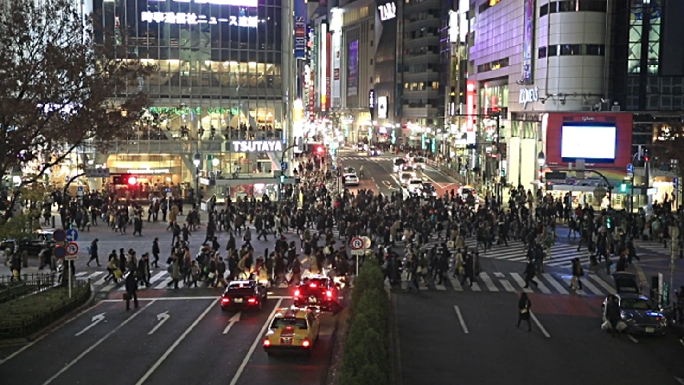
SCOPE: cities’ classification (European, Globally). Considering urban area as complex systems defined by GEOLOGICAL, SUBsubsoil-related climate impact, environmental and anthropic factors
APPROACH: creating a tool for concurrently analyzing all these factors and to cluster the cities.
BASIC ASSUMPTION: cities with similar geological-geographical settings should have similar challenges to manage, due to both common geological issues and climate change subsoil-related effects.

Slide 3
Final goals: UGF tool to classify cities could be a starting point for city resilience development, increasing citizens’ awareness, enhancing city management, exchanging best practices, adapting to climate change, and supporting policy and cooperative geoscience (Hollis et al., 2023) both at European level (Bricker et al., 2023), and worldwide

Slide 4
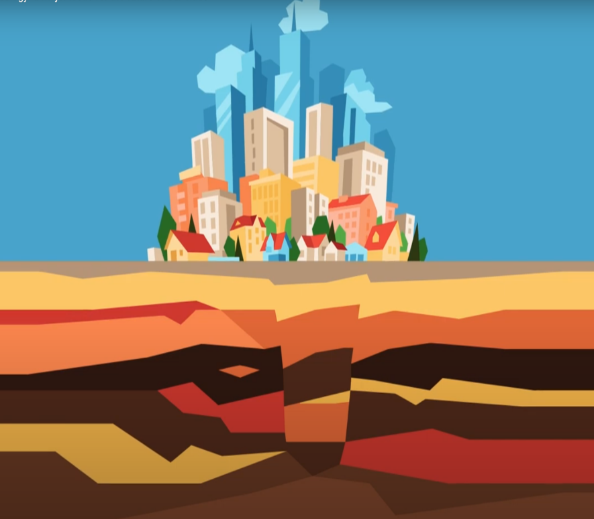
METHODOLOGY
The Urban Geo-Climate Footprint (UGF): semi quantitative measure of how much the mentioned factors affect the urban area
Every parameter “negative” meaning: higher the parameter value of the UGF, greater is the influence caused by its geological complexity, subsoil-related climate impact, anthropic factors.
The selected parameters and data must be available for all the cities and should be homogeneous
Notes:
Normally the “footprints” related to human activities (as for sustainability, carbon consumption, water use etc.) are intended to be a factor affecting the natural system and resources.

Slide 5
We can thus imagine a footprint composed by the combination of these factors “Drivers”:
Deep processes pressure
Subsoil anthropic pressure (SAP)
Exogenous processes pressure
Geological pressure
Superficial processes pressure
Geology
Exogenous processes
Urban Geo-climate Footprint (UGF) INDEX
Deep processes
=
Superficial processes
Subsoil anthropic pressure
The UGF INDEX corresponds to the sum of Drivers’ scores obtained in an urban area, and it represents the value of its geological complexity:
it is the geo-climate footprint (UGF) of the city

Slide 6
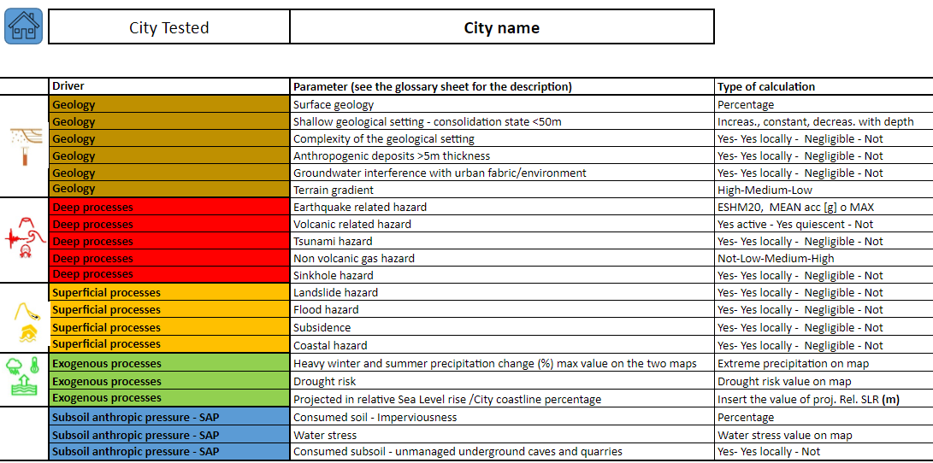

Slide 7
PARAMETERS CALCULATION
POSSIBLE OPTIONS
Type 1: Percentages
Type 2: Multiple answers e.g. “YES, YES LOCALLY, NOT” OR “HIGH, MEDIUM, LOW” with a clear guidance for the assignments
Type 3: Values directly gathered from a specific map e.g. Seismic Hazard Map
SCORE: value from 0 to 100
SCORE WEIGHTING
based on:
Evaluation 1: if it is AREAL (x1) or POINT (x0.5)
Evaluation 2: if it is a SHOCK (x1) or STRESS (x0.5)
Evaluation 3 : in case of documented historical event about a parameter YES (x2) NOT (x1)
SCORE (W): also grater than 100

Slide 8
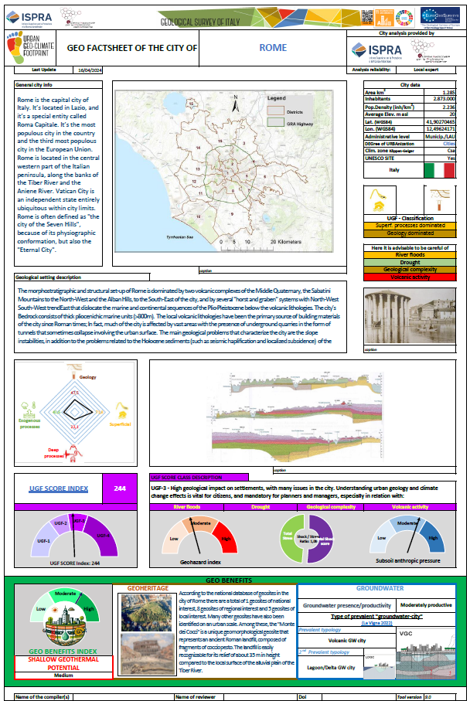
By means of a user-friendly spreadsheet (with self-calculating scores routines) the UGF tool produces:
The City Geo Factsheet
It automatically provides for the city:
The UGF SCORE INDEX and UGF SCORE CLASS
The UGF CITY CLASSIFICATION
The GEOHAZARD INDEX
The SHOCK/STRESS RATIO
The SUBSOIL ANTHROPIC PRESSURE

Slide 9
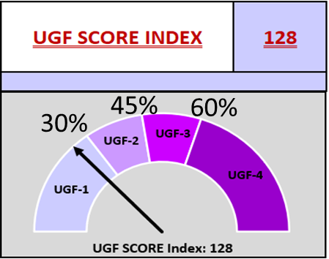
UGF SCORE INDEX and UGF SCORE CLASS
UGF INDEX: Dimensionless value representative of the geological complexity. The main ground-related factors that can interfere with human settlements are divided in 5 drivers: GEOLOGY, DEEP PROCESSES, SUPERFICIAL PROCESSES, EXOGENOUS PROCESSES, and SUBSOIL ANTHROPIC PRESSURE (SAP). The index is obtained by summing the scores of the parameters of each driver.
UGF SCORE CLASSES
UGF -1 | < 150 | Low geological impact on settlements, but some areas may have issues for which citizens should be aware. Some knowledge of the urban geology and climate change effects by urban planners can help in the city management.
UGF -2 | 150-225 | Moderate geological impact on settlements, with several areas facing challenges. Planners and managers must understand urban geology and climate change effects, and citizens must be aware.
UGF -3 | 225-300 | High geological impact on settlements, with many issues in the city. Understanding urban geology and climate change effects is vital for citizens, and mandatory for planners and managers.
UGF -4 | > 300 | Potential catastrophic geological impact on settlements. Knowledge of urban geology and climate change effects, along with citizens and planners' awareness, is crucial.
Depending on the reached value: UGF score class of the city
The maximum value of UGF Score is the maximum obtainable by the sum of parameters.

Slide 10
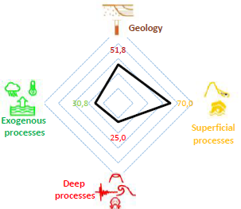
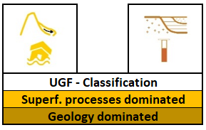
The UGF CITY CLASSIFICATION
For showing the impacts from every driver their values are plotted in a radar graph
The magnitude of the four drivers is compared
The two drivers with the highest scores define a clustering of cities by type of dominant processes.
UGF- CITY analysis |  | DESCRIPTION
 | Geology dominated | The complexity of the geological setting of the city is the main factor influencing city subsoil-related issues.
 | Deep processes dominated | The city is located in a place geo-dynamically active or very close to. It can experience very shocking phenomena.
 | Superf. processes dominated | In the city the most important geological-related issues are due to surface processes caused by gravity and presence of water.
 | Exog. processes dominated | The city is strongly influenced by extreme meteorological and climate-dependent phenomena.
1°
2°

Slide 11
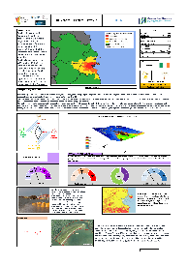
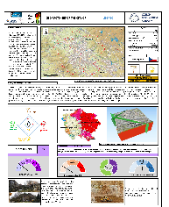
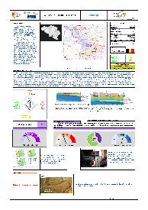
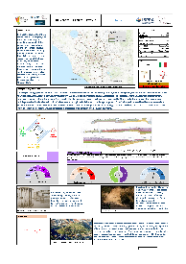
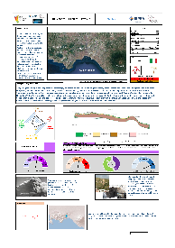
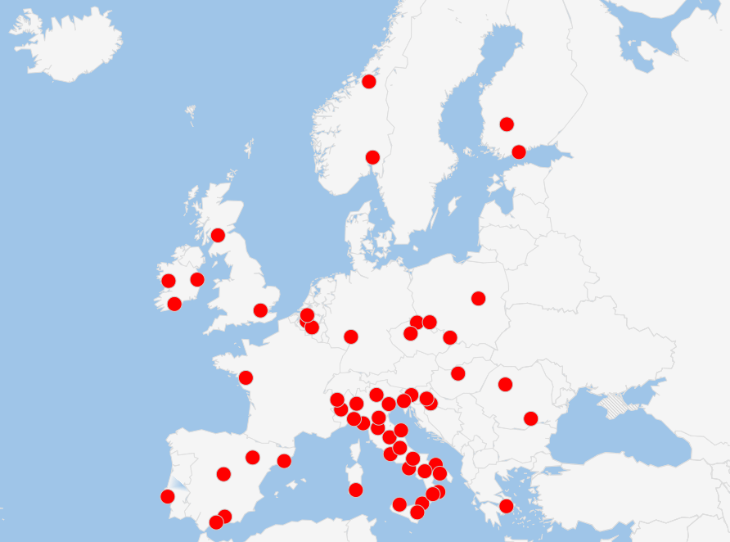
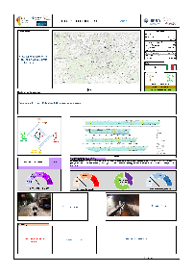
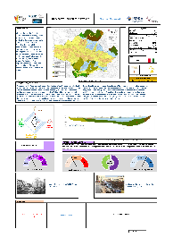
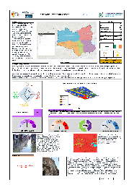
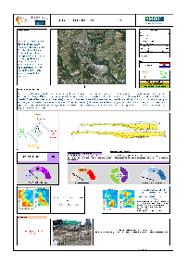
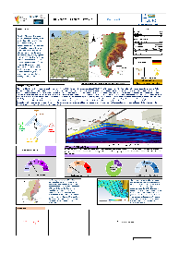
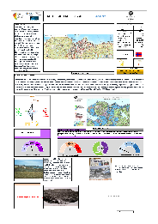
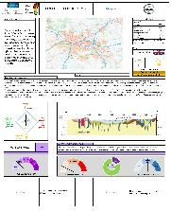
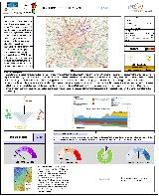
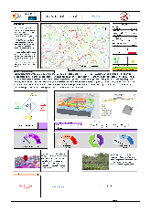
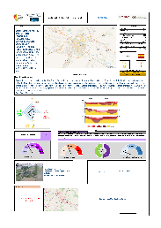
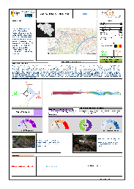
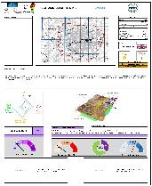
60 TESTED cities

Slide 12
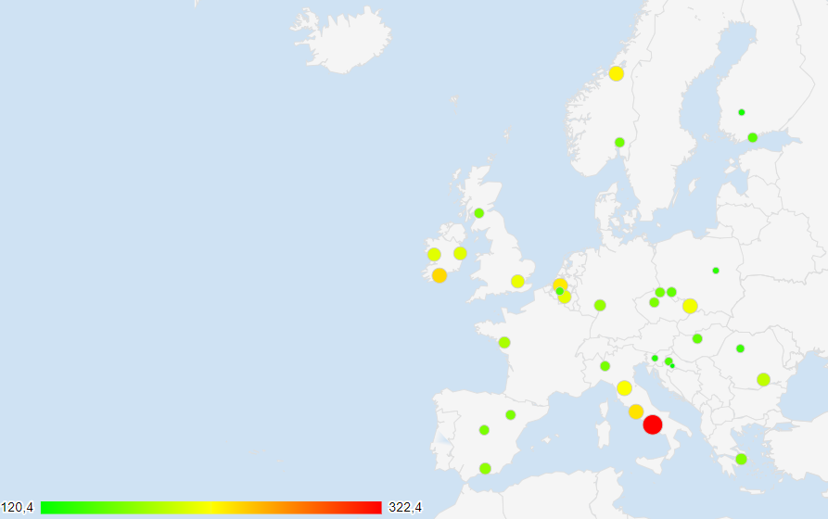
UGF INDEX variation in EUROPE
UGF Score Index range is from 120 of Sisak (Croatia) to 322 of Naples (Italy)

Slide 13
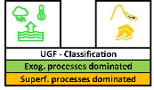
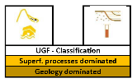
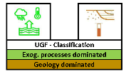
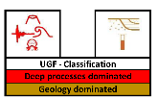
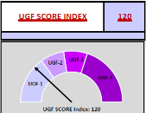
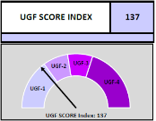
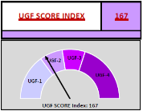
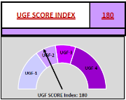
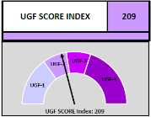
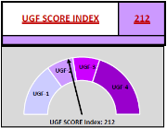
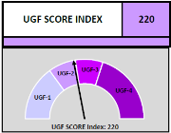
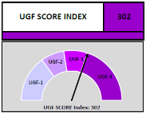
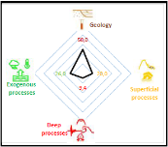
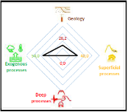
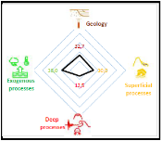
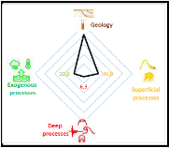
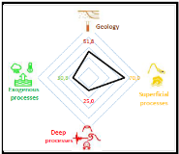
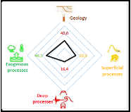
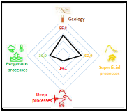
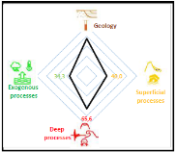
UGF CLASSIFICATION, UGF SCORE INDEX, UGF RADAR GRAPH COMPARISON
SISAK | WARSAW | LIBEREC | DARMSTADT | DUBLIN | NAMUR | FLORENCE | NAPLES
120 | 137 | 167 | 180 | 209 | 212 | 220 | 322

Slide 14
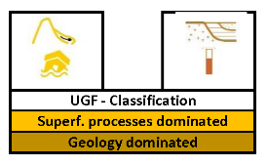
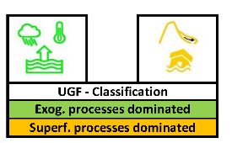
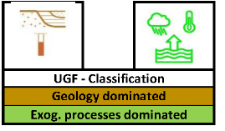
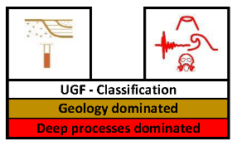
UGF CLASSIFICATION – CITY CLUSTERING

Slide 15
NEWS of the latest tool version 9.0!
GEO-BENEFITS section
GEO-BENEFITS section with three elements that have positive impact:
Presence of local groundwater resources (for water supply and different urban uses).
Geothermal potential resources
Geo-heritage (geo-sites, geological museums)

Slide 16
STRENGTHS:
Open project with shared and homogenous data. The participation is open.
Tool easy to use and understand.
The results are also easily comprehensible for non-expert.
Tool and results can be easily disseminated at European level
WEAKNESSES
Possible variability of the results based on the areal extension of the cities considered and continuing changing of some factors (e.g. climate, urban pressure)
Absence of dedicated funding.
THREATS Risk of identifying «Class A» and «Class B» cities based on geological factors and resistance of local governments to confronting this type of categorization
OPPORTUNITIES
Possible use as new standard index
Possible global spread
Possible automation of UGF Index calculation on a global scale
Possible official diffusion at European scale and at the EU (integration in the RDH of the EC-JRC)

Slide 17
https://drmkc.jrc.ec.europa.eu/risk-data-hub#/

Slide 18
BE AWARE,
BE PREPARED,
THANKS A LOT !
BE SAFE!
AZZURRA LENTINI
Joint Research Center of European Commission
University of Granada, Spain
azzurra.lentini@ec.europa.eu
ugf@isprambiente.it http://ugf.isprambiente.it/

