Slide 1
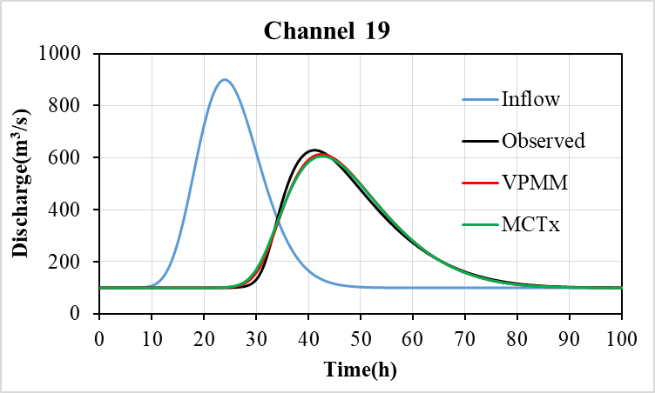


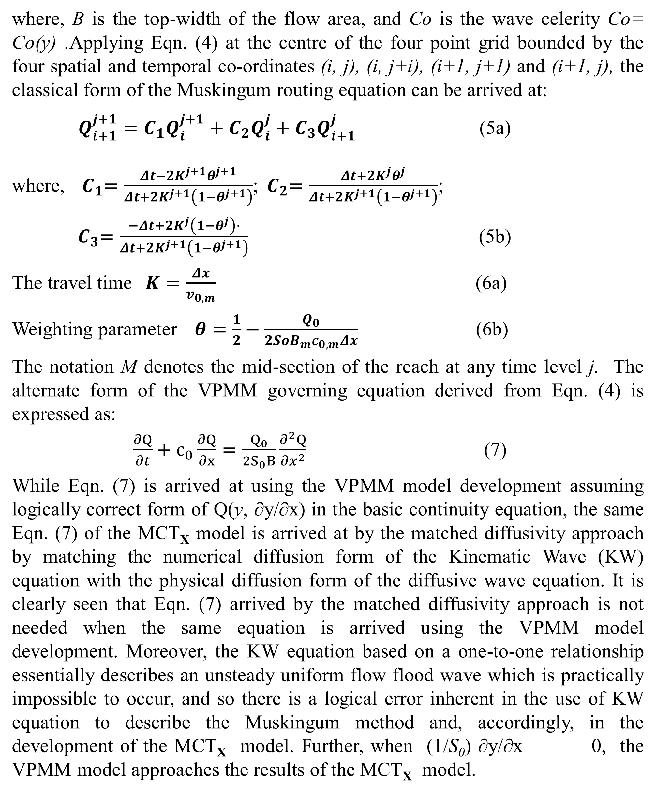
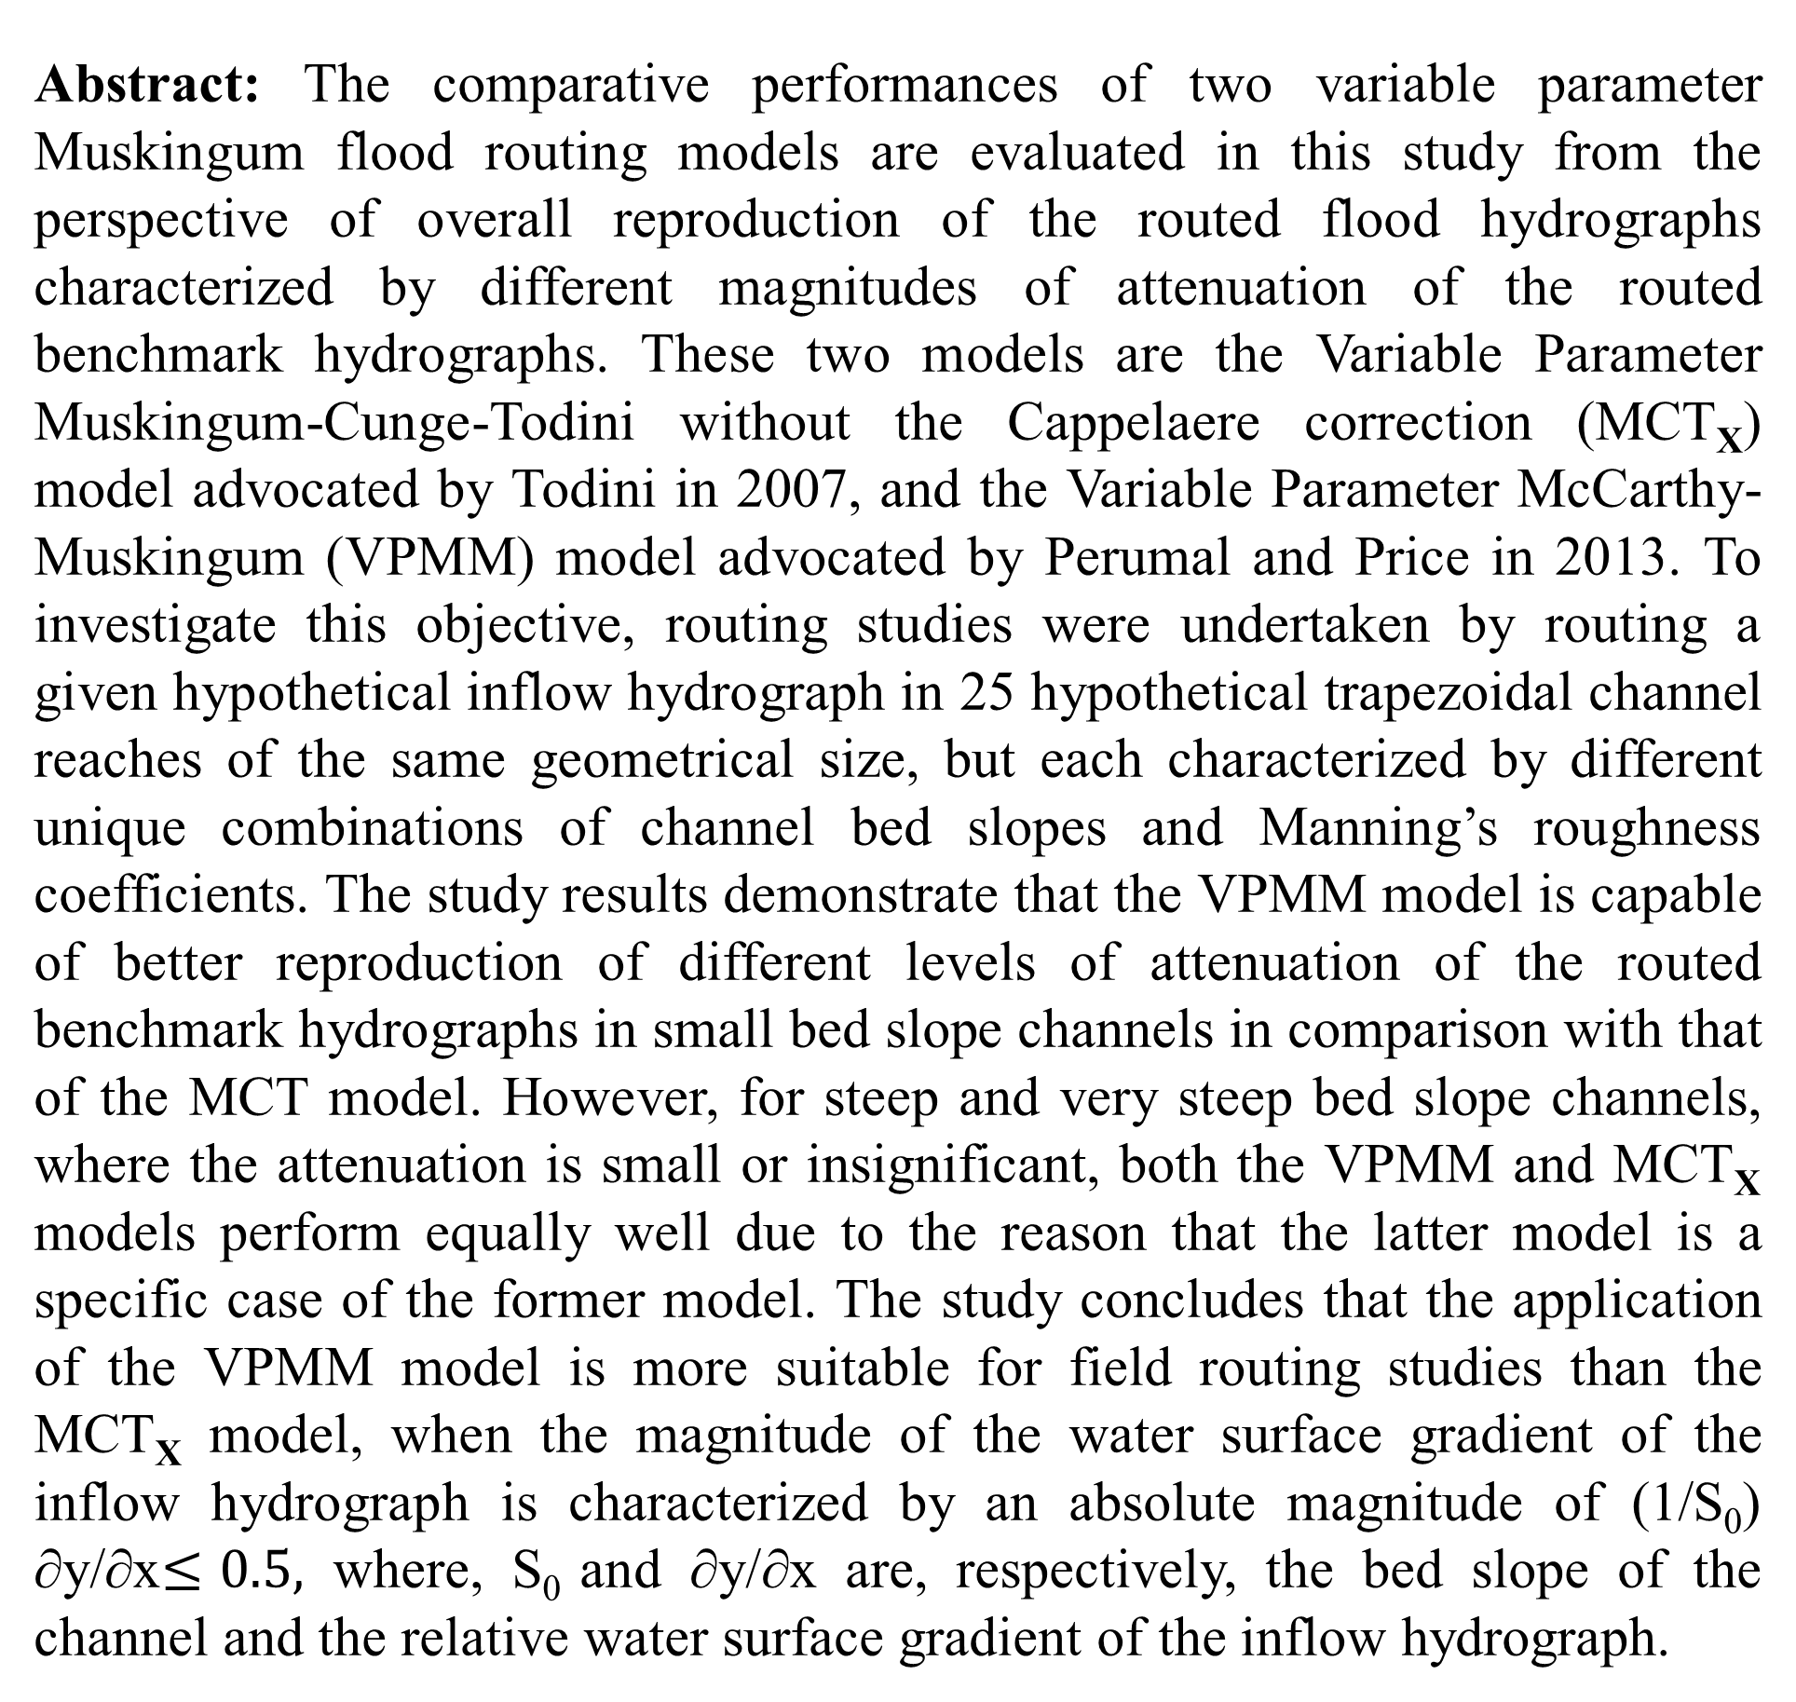
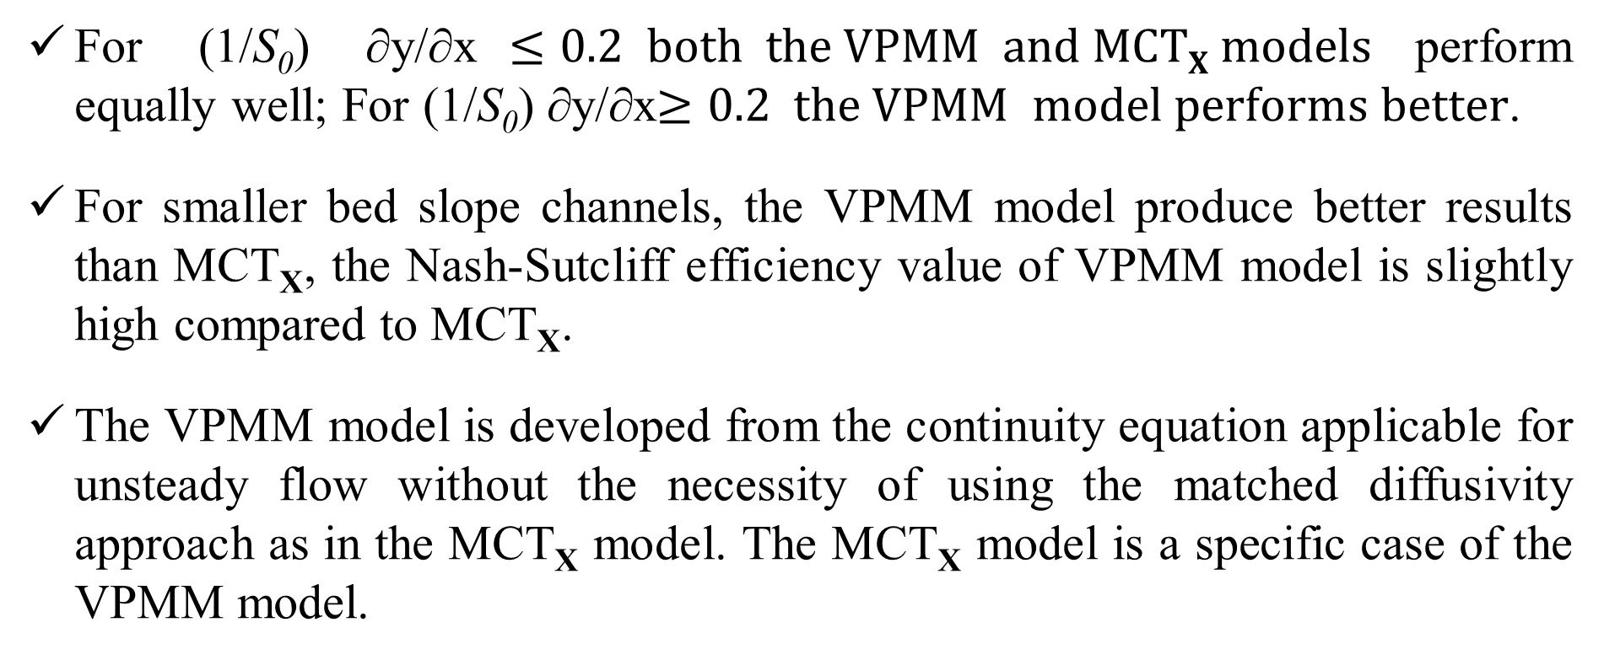
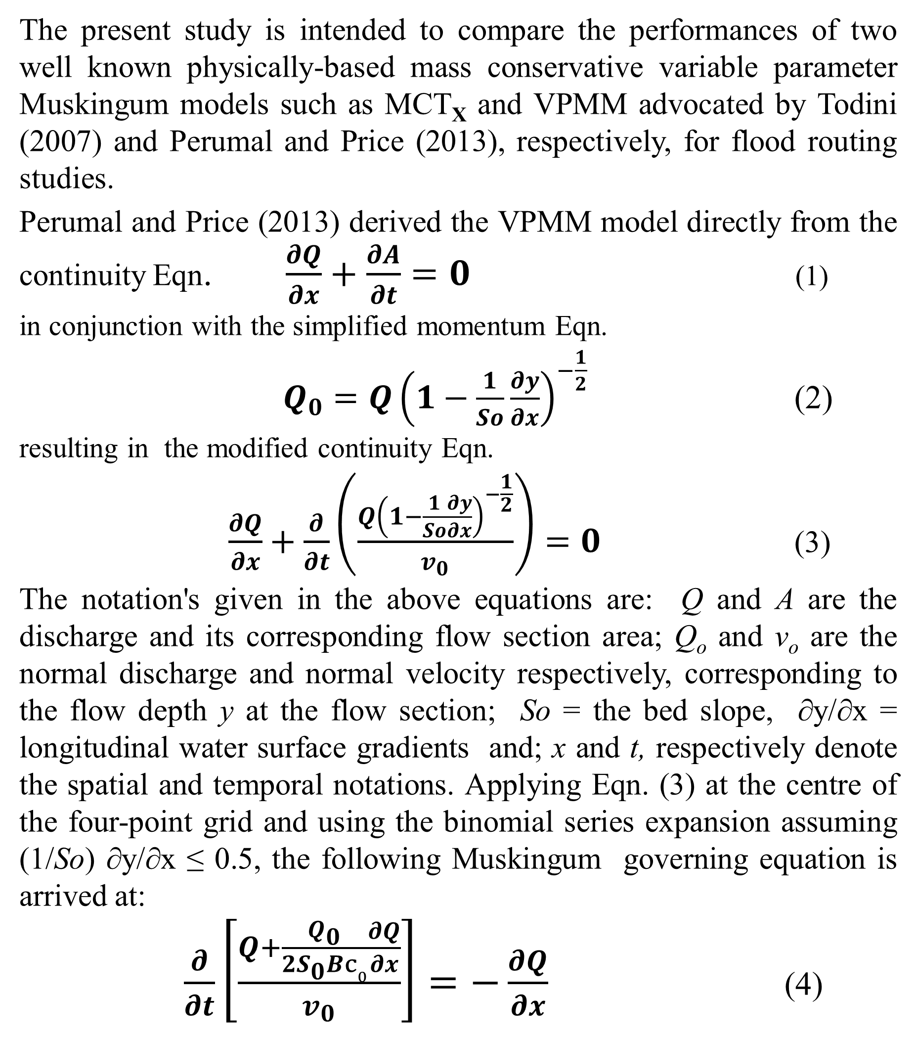
Comparative evaluation of two physically-based mass conservative variable parameter Muskingum models
Muthiah Perumal^{1*}, C. Madhusudana Rao²
EGU General Assembly 2024, Vienna, Austria
Abstract
where, B is the top-width of the flow area, and Co is the wave celerity Co= Co(y) .Applying Eqn. (4) at the centre of the four point grid bounded by the four spatial and temporal co-ordinates (i, j), (i, j+i), (i+1, j+1) and (i+1, j), the classical form of the Muskingum routing equation can be arrived at:
$Q_{ⅈ+1}^{j+1}=C_{1}Q_{i}^{j+1}+C_{2}Q_{i}^{j}+C_{3}Q_{ⅈ+1}^{j}$ (5a)
where,${ C}_{1}=\frac{Δt−2K^{j+1}θ^{j+1}}{Δt+2K^{j+1}\left(1−θ^{j+1}\right)}$;${ C}_{2}=\frac{Δt+2K^{j}θ^{j}}{Δt+2K^{j+1}\left(1−θ^{j+1}\right)}$;
${ C}_{3}=\frac{−Δt+2K^{j}\left(1−θ^{j}\right)⋅}{Δt+2K^{j+1}\left(1−θ^{j+1}\right)}$ (5b)
The travel time$K=\frac{Δx}{v_{0,m}}$(6a)
Weighting parameter$θ=\frac{1}{2}−\frac{Q_{0}}{2SoB_{m}c_{0,m}Δx}$ (6b)
The notation M denotes the mid-section of the reach at any time level j. The alternate form of the VPMM governing equation derived from Eqn. (4) is expressed as:
$\frac{∂Q}{∂t}+c_{0}\frac{∂Q}{∂x}=\frac{Q_{0}}{2S_{0}B}\frac{∂^{2}Q}{{∂x}^{2}}$ (7)
While Eqn. (7) is arrived at using the VPMM model development assuming logically correct form of Q(y, ∂y/∂x) in the basic continuity equation, the same Eqn. (7) of the MCT_{X} model is arrived at by the matched diffusivity approach by matching the numerical diffusion form of the Kinematic Wave (KW) equation with the physical diffusion form of the diffusive wave equation. It is clearly seen that Eqn. (7) arrived by the matched diffusivity approach is not needed when the same equation is arrived using the VPMM model development. Moreover, the KW equation based on a one-to-one relationship essentially describes an unsteady uniform flow flood wave which is practically impossible to occur, and so there is a logical error inherent in the use of KW equation to describe the Muskingum method and, accordingly, in the development of the MCT_{X} model. Further, when (1/S₀) ∂y/∂x 0, the VPMM model approaches the results of the MCT_{X} model.
Inflow hypothetical hydrograph
Abstract: The comparative performances of two variable parameter Muskingum flood routing models are evaluated in this study from the perspective of overall reproduction of the routed flood hydrographs characterized by different magnitudes of attenuation of the routed benchmark hydrographs. These two models are the Variable Parameter Muskingum-Cunge-Todini without the Cappelaere correction (MCT_{X}) model advocated by Todini in 2007, and the Variable Parameter McCarthy-Muskingum (VPMM) model advocated by Perumal and Price in 2013. To investigate this objective, routing studies were undertaken by routing a given hypothetical inflow hydrograph in 25 hypothetical trapezoidal channel reaches of the same geometrical size, but each characterized by different unique combinations of channel bed slopes and Manning’s roughness coefficients. The study results demonstrate that the VPMM model is capable of better reproduction of different levels of attenuation of the routed benchmark hydrographs in small bed slope channels in comparison with that of the MCT model. However, for steep and very steep bed slope channels, where the attenuation is small or insignificant, both the VPMM and MCT_{X} models perform equally well due to the reason that the latter model is a specific case of the former model. The study concludes that the application of the VPMM model is more suitable for field routing studies than the MCT_{X} model, when the magnitude of the water surface gradient of the inflow hydrograph is characterized by an absolute magnitude of (1/S₀) ∂y/∂x$≤0.5,$ where, S₀ and ∂y/∂x are, respectively, the bed slope of the channel and the relative water surface gradient of the inflow hydrograph.
where, I_{b} = initial steady flow (100 m³ s⁻¹ ); I_{p} = peak inflow (900 m³ s⁻¹); t_{p} = time to peak (24 h), and β (shape factor) = 16.
Results
Conclusions
Table 2 Summary of Performances in Discharge reproduction
For (1/S₀) ∂y/∂x$≤0.2 both the VPMM and MCTX models$perform equally well; For (1/S₀) ∂y/∂x$≥0.2 the VPMM model performs better$.
For smaller bed slope channels, the VPMM model produce better results than MCT_{X}, the Nash-Sutcliff efficiency value of VPMM model is slightly high compared to MCT_{X}.
The VPMM model is developed from the continuity equation applicable for unsteady flow without the necessity of using the matched diffusivity approach as in the MCT_{X} model. The MCT_{X} model is a specific case of the VPMM model.
Background
The present study is intended to compare the performances of two well known physically-based mass conservative variable parameter Muskingum models such as MCT_{X} and VPMM advocated by Todini (2007) and Perumal and Price (2013), respectively, for flood routing studies.
Perumal and Price (2013) derived the VPMM model directly from the continuity Eqn. $\frac{∂Q}{∂x}+\frac{∂A}{∂t}=0$ (1)
in conjunction with the simplified momentum Eqn.
$Q_{0}=Q{\left(1−\frac{1}{So}\frac{∂y}{∂x}\right)}^{−\frac{1}{2}}$ (2)
resulting in the modified continuity Eqn.
$\frac{∂Q}{∂x}+\frac{∂}{∂t}\left(\frac{Q{\left(1−\frac{1}{So}\frac{∂y}{∂x}\right)}^{−\frac{1}{2}}}{v_{0}}\right)=0$ (3)
The notation's given in the above equations are: Q and A are the discharge and its corresponding flow section area; Q_{o} and v_{o} are the normal discharge and normal velocity respectively, corresponding to the flow depth y at the flow section; So = the bed slope, ∂y/∂x = longitudinal water surface gradients and; x and t, respectively denote the spatial and temporal notations. Applying Eqn. (3) at the centre of the four-point grid and using the binomial series expansion assuming (1/So) ∂y/∂x ≤ 0.5, the following Muskingum governing equation is arrived at:
$\frac{∂}{∂t}\left[\frac{Q+\frac{Q_{0}}{2S_{0}Bc0}\frac{∂Q}{∂x}}{v_{0}}\right]=−\frac{∂Q}{∂x}$ (4)
Authors
¹Professor (Retd.), Department of Hydrology, Indian Institute of Technology Roorkee, Roorkee, India, p_erumal@yahoo.com.
²Associate Professor, Department of Civil Engineering, National Institute of Technology Jamshedpur, Jamshedpur, India cmrao.civil@nitjsr.ac.in.
Numerical Experiments
25 hypothetical trapezoidal channel reaches of the same geometrical size, but each characterized by different unique combinations of channel bed slopes and Manning’s roughness coefficients have been used.
Table 1. Cannel configurations used in this study
References
Cappelaere, B., 1997. Accurate diffusive wave routing. J. Hydraulic Eng. 123 (3), 174–181.
Cunge, J.A., 1969. On the subject of a flood propagation computation method (Muskingum method). J. Hydraulic Res. 7 (2), 205–230.
Perumal, M., Price, R.K., 2013. A fully mass conservative variable parameter McCarthy-Muskingum method: Theory and verification. J. Hydrol. 502, 89–102.
Todini, E., 2007. A mass conservative and water storage consistent variable parameter Muskingum-Cunge approach. Hydrol. Earth Syst. Sci. 11 (5), 1645–1659.
Fig. 1 Trapezoidal Channel reach (prismatic cross-sectional shape)

