Slide 1
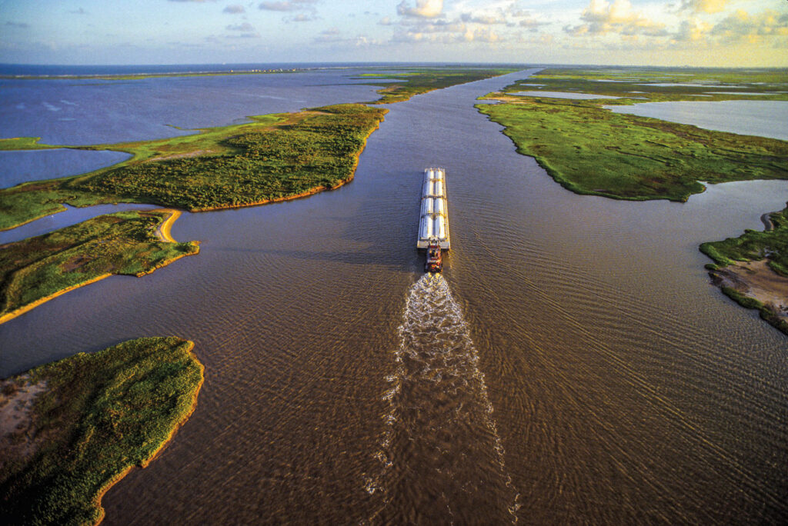
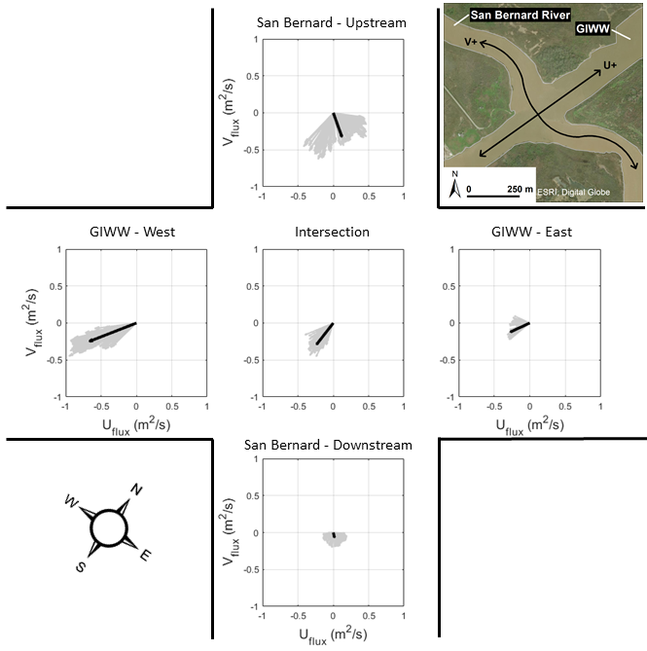
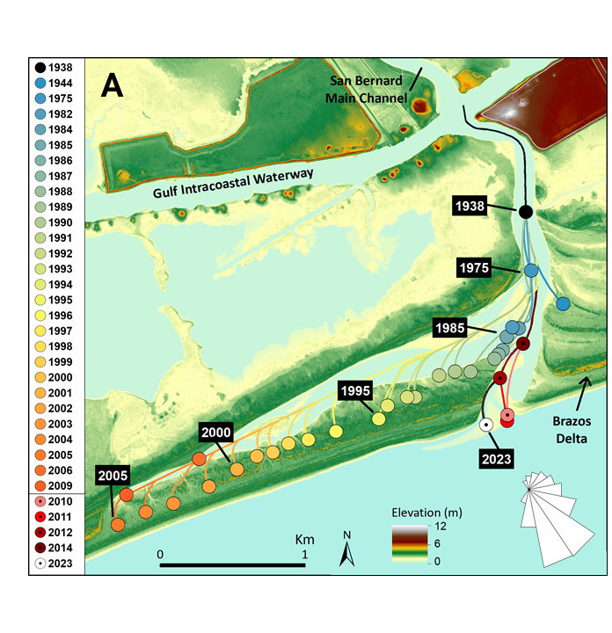
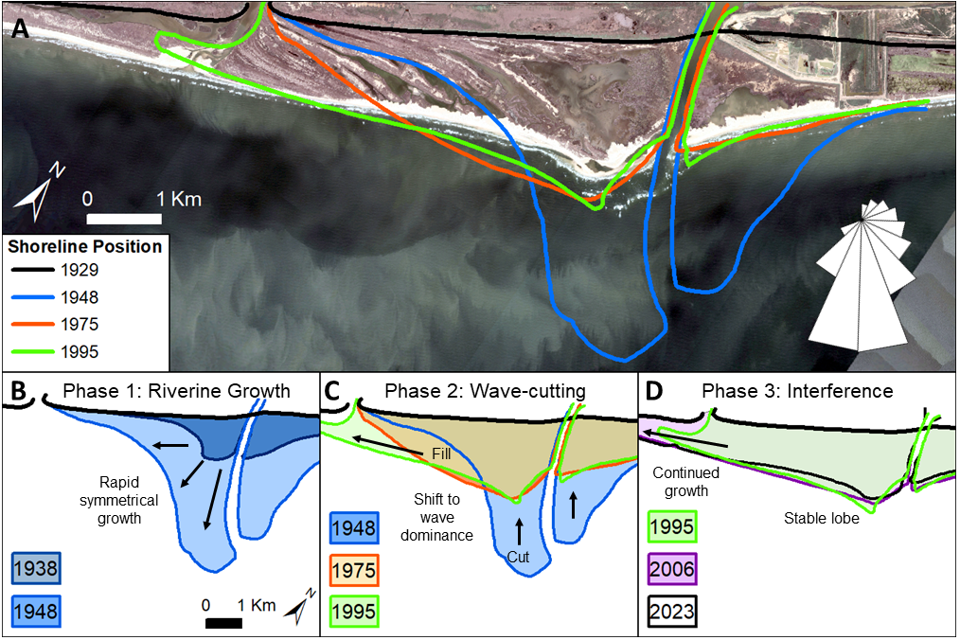
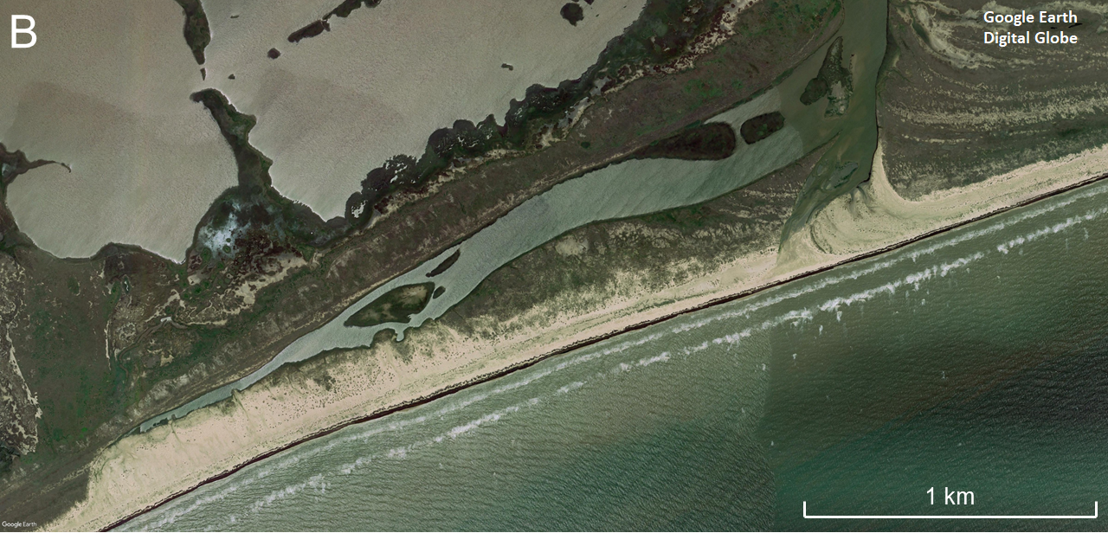
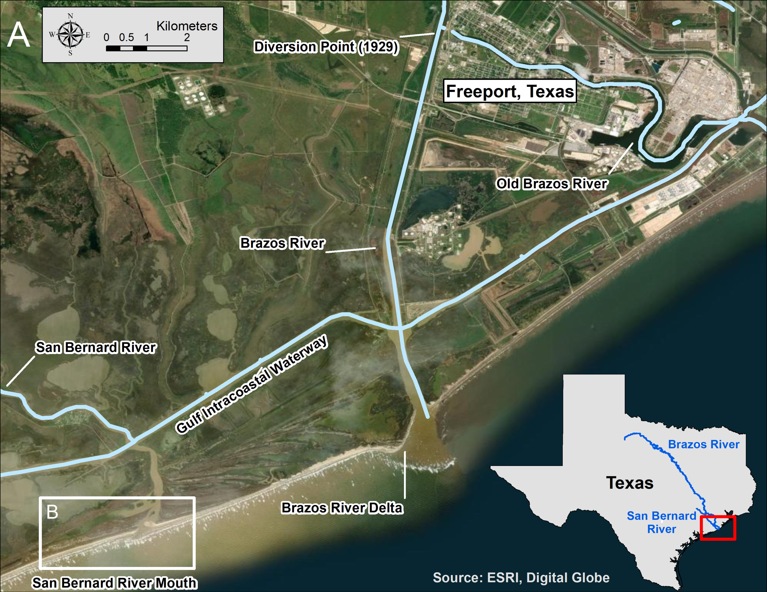
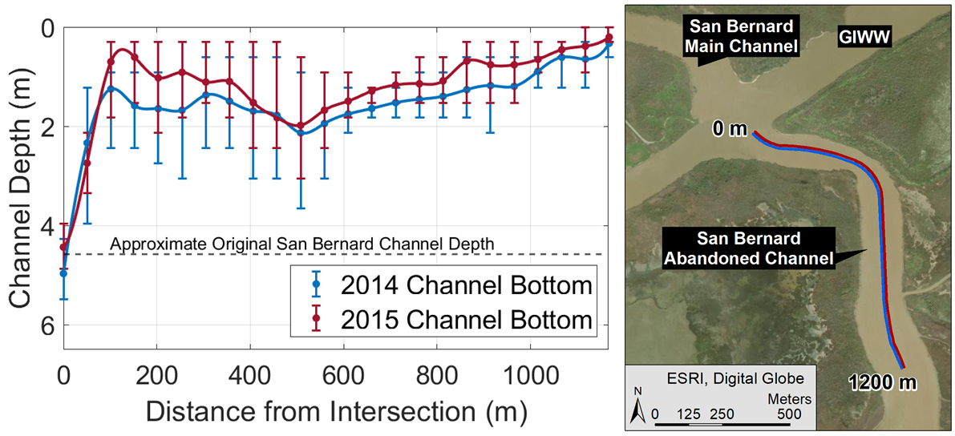
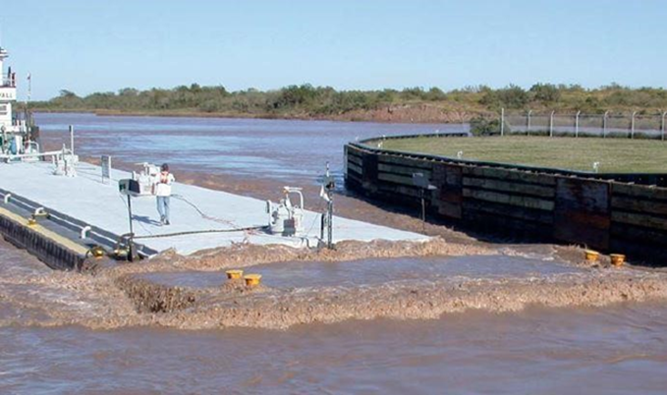
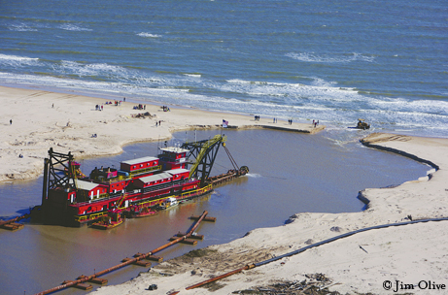
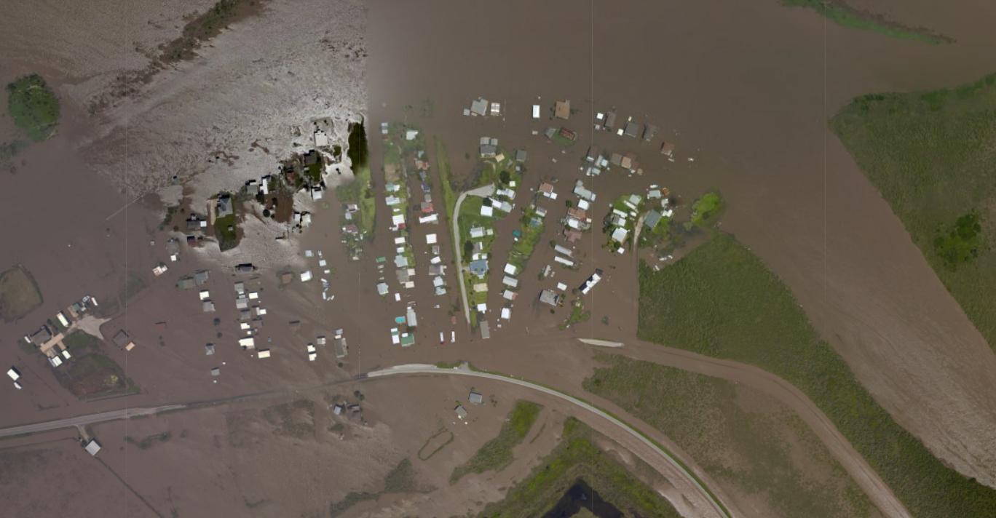
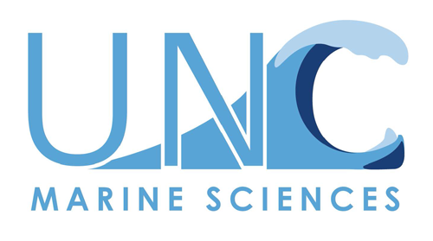
Intended vs unintended consequences of modifying coastal river channels
John Malito^{1,2} and David Mohrig³ ¹University of Texas at Austin, Bureau of Economic Geology, Jackson School of Geosciences; ²University of North Carolina at Chapel Hill, Department of Earth, Marine, and Environmental Sciences; ³University of Texas at Austin, Jackson School of Geosciences
SAN BERNARD RIVER CLOSURE
Delayed responses to channel modifications can lead to costly hazards decades later.
SAN BERNARD – BRAZOS DELTA COUPLING
Coastal infrastructure projects are becoming increasingly significant to economic activities worldwide due to climate-driven changes and urbanization.
UNINTENDED FLOW & SEDIMENT PATHWAYS
Beginning in 1929 the Brazos delta developed quickly in its new location
By 1975, the delta began to encroach on the San Bernard River mouth
The San Bernard channel was steered and tapered alongshore by wave-reworking of beach sediments before closing in the late 1990’s
What happens at the intersection with the Gulf Intracoastal Waterway (GIWW)?
Water flux measurements taken during calm-weather show that the GIWW is the main conduit for San Bernard River flow
However, the altered movement of sediments in the river channel can lead to harmful and costly morphologic changes decades later that were not initially considered.
Jim Olive
As a result, reduced discharge in the terminal limb of the San Bernard led to sedimentation and lack of erosive ability at its river mouth
The San Bernard River mouth is presently clogged with sediments due to engineering projects* in the mid-20th century.
Bathymetric transects in the terminal limb show rapid accumulation of sediments between 2014 and 2015
*
The San Bernard river mouth is controlled by coastal processes rather than river flow
Hurricane Harvey re-opened the river mouth in 2017
Today, the mouth remains open but is shallow and dynamic, behaving more like a tidal inlet than a river mouth
*
1930
1940
1950
1960
1970
1980
1990
2000
2010
2020
Goal: The objective of this study was to a) document the delayed geomorphic responses to these projects and b) provide a snapshot of the sediment transport field between engineered channels using measurements collected in situ.
* 1929: Brazos River channel diverted from it’s natural pathway to within 6 km of the San Bernard
* 1941: Gulf Intracoastal Waterway (GIWW) constructed 2 km inland of the coast, bisecting the San Bernard
River mouth closed
A dredging project in 2010 ($2.4 million) was futile, and an improved project began in 2022 ($10 million +) in an attempt to reopen the river mouth permanently
1975
1989
2014
1938
1995
RESULTANT HAZARDS
CONSEQUENCES OF CHANNEL MODIFICATION
ACKNOWLEDGEMENTS
The river mouth closure has led to:
Unpredictable currents & sediment deposition in the Gulf Intracoastal Waterway (GIWW)
Enhanced backwater flooding, as shown in the nearby community of Rivers End
Freshening of the nearby estuary
Since the San Bernard is unable to maintain it’s own mouth, consistent dredging has been required to connect the river to the sea
Over $12 million has been spent correcting this problem, with more maintenance projects funded into the future
To optimize the cost-benefit framework of coastal projects, the long-term impact of hydrodynamic changes to sediment-transport fields must be considered!
We thank Jasmine Mason, Jim Buttles, and Brandon Minton for their assistance with field data collection and logistics.
Thanks to David Mohrig for his support and enthusiasm throughout the research process, including while driving the boat.
This research project was funded by the Jackson School of Geosciences at the University of Texas at Austin.
TXDOT
NOAA
@JMalito_GeoSci
Feel free to reach out! john.malito@beg.utexas.edu

