Slide 1
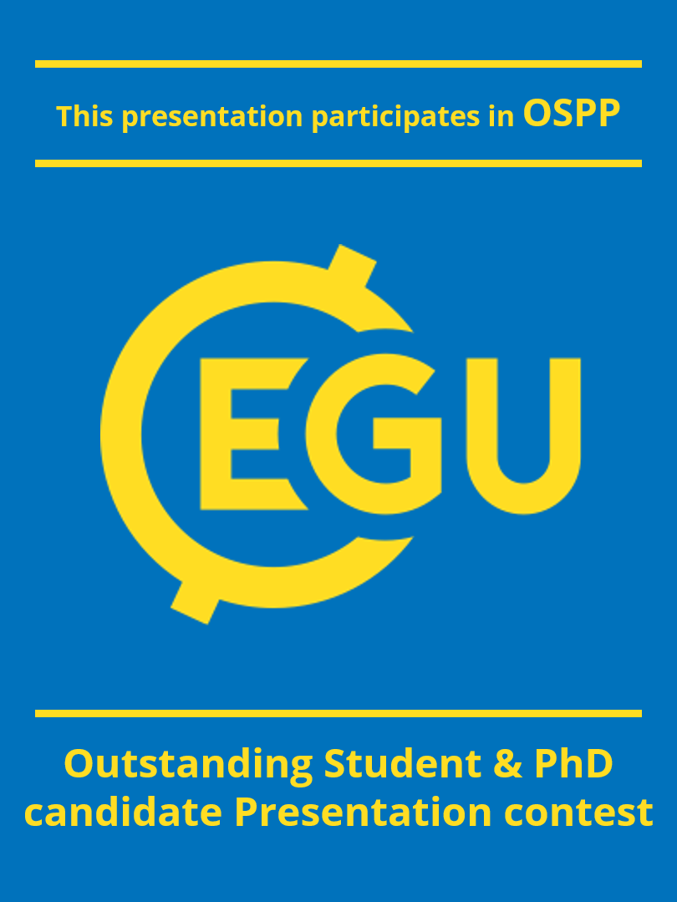
A novel modeling approaches to understand the fate and transport of microplastics in aquatic environment
Sadashiv Chaturvedi, Prof. Liu Min, Dr. Amit Kumar, and Zeng Wenfan
Nanjing University of Information Science and Technology (NUIST), School of Hydro-meteorology and Water resources, China
(202351600001@nuist.edu.cn)

Slide 2
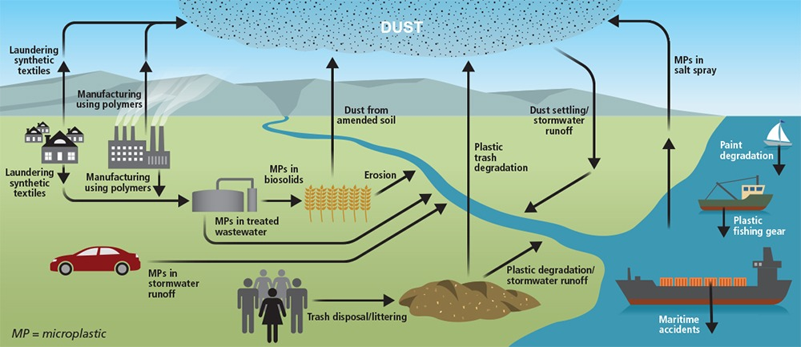
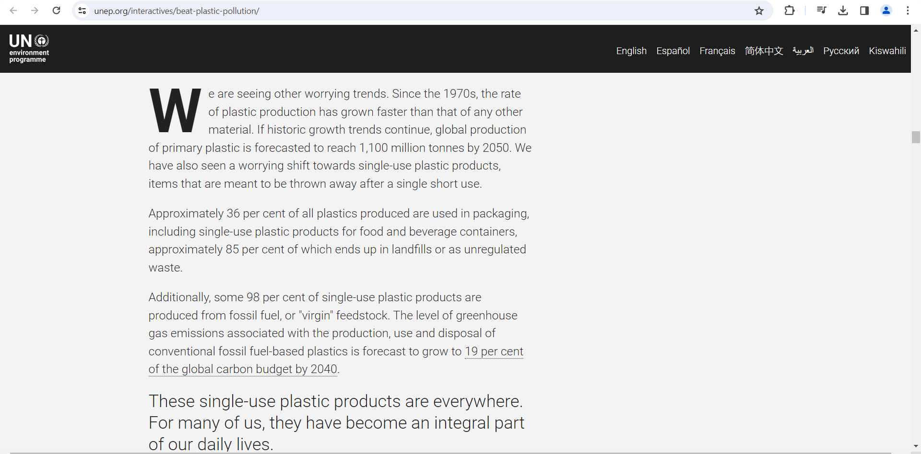
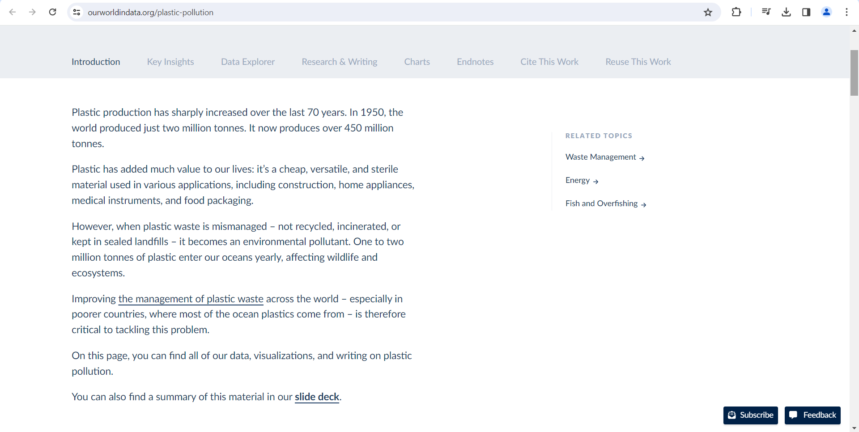
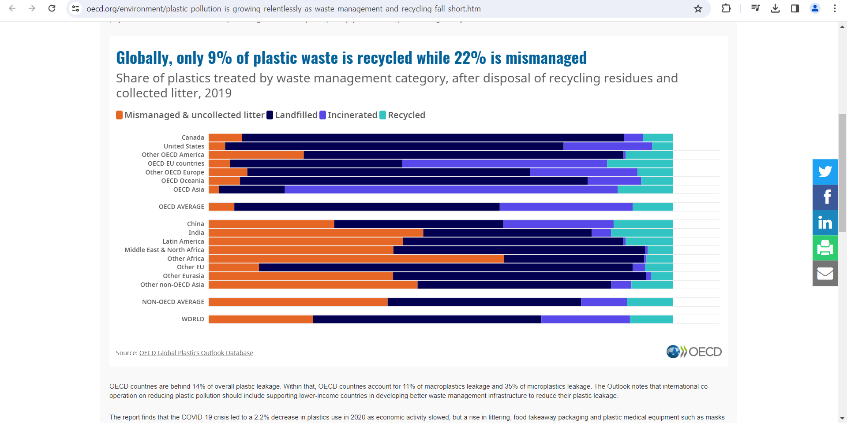
Microplastics
Less than 5mm in size
Every corner of the planet, from the deepest ocean trenches to remote polar regions
Disrupting food webs and endangering aquatic life
Transport harmful pathogens and invasive species, worsening ecological imbalances
Detected microplastic contamination in drinking water, seafood, and salt
Adverse health outcomes inflammation, oxidative stress, transfer of chemical pollutants; research is going on..

Slide 3
Current Challenges in Modeling Microplastics
Limited Availability of Datasets
Methodological Inadequacies
Focus on Field Monitoring Rather Than Modeling
Incorporating Biological Interactions
Scaling from Laboratory to Field Conditions
Assessing Long-Term Impacts

Slide 4
Need for Hybrid Models
Integration of Multiple Models
Hybrid Modeling Frameworks
Coupled Environmental Models
Data Assimilation Techniques
Interdisciplinary Collaboration
Standardization and Benchmarking

Slide 5
Coupling CaMPSim-3D and DuMuX
CaMPSim-3D uses a Lagrangian approach to track individual microplastic particles in 3D space.
It can consider spatially and temporally varying diffusivity of microplastics.
DuMuX includes pre-implemented models for a wide range of applications, including multi-phase multi-component flow, reactive transport, solid mechanics, and shallow water equations.
Possible to incorporate additional physical processes, such as hydrodynamics, sediment transport, and biogeochemical interactions, to more accurately model the fate and behavior of microplastics in aquatic systems.

Slide 6
Mitigation Strategies and Future Prospect
Data Data Data
More hit and trails in modeling and large scale integration
Technical development in biological degradation
Replacing plastic with more sustainable products such as Hemp fiber bag and other sustainable materials.
Focusing more on NBS.
https://www.tno.nl/en/sustainable/circular-plastics/microplastics-unknown-risks/reducing-microplastics/

Slide 7
Reference
https://www.tno.nl/en/sustainable/circular-plastics/microplastics-unknown-risks/reducing-microplastics/
https://www.statista.com/topics/5401/global-plastic-waste/#:~:text=Plastic%20waste%20generation%20and%20treatment,staggering%20one%20billion%20metric%20tons.
https://www.unep.org/interactives/beat-plastic-pollution/
https://www.oecd.org/environment/plastic-pollution-is-growing-relentlessly-as-waste-management-and-recycling-fall-short.htm
Pilechi A., Abdolmajid M., Murphy E., A numerical framework for modeling fate and transport of microplastics in inland and coastal waters, Marine Pollution Bulletin, Volume 184,2022, https://doi.org/10.1016/j.marpolbul.2022.114119.
Timo K., Dennis G., Kilian W., et al., DuMux 3 – an open-source simulator for solving flow and transport problems in porous media with a focus on model coupling, Computers & Mathematics with Applications, Volume 81, 2021, https://doi.org/10.1016/j.camwa.2020.02.012.
Jingyi L., Huihui L., Paul C.J., 2018, Microplastics in freshwater systems: A review on occurrence, environmental effects, and methods for microplastics detection, Water Research, https://doi.org/10.1016/j.watres.2017.12.056
Kumar A., Krishnan G., Microplastic Pollutants in Aquatic Ecosystems: Present and Future Challenges, 2023, Water 16(102) https://doi.org/10.3390/w16010102
Kumar A., Upadhyay P., Prajapati S.K, 2022, Impact of microplastics on riverine greenhouse gas emissions: a view point, Environmental Science and Pollution Research, https://doi.org/10.1007/s11356-022-23929-2

