Slide 1
Supplementary Materials
Replicated stalagmite records revealed orbital and millennial-scale hydroclimate changes in arid central Asia across the MIS 5 stadial-interstadial transition
Xiaokang Liu, Xianfeng Wang, Chuan-Chou Shen, Hanying Li, Jiaoyang Ruan, Guangxin Liu, Yan Yang, and Fahu Chen

Slide 2
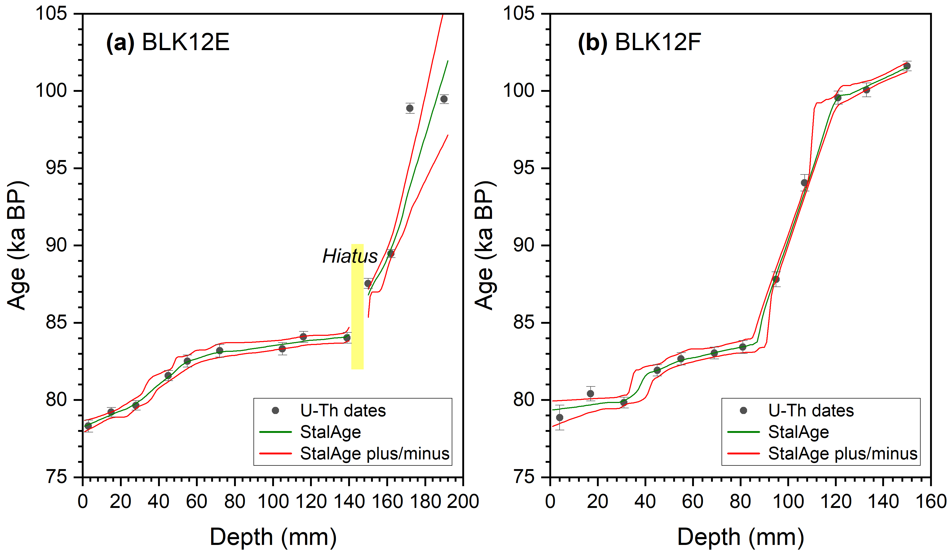
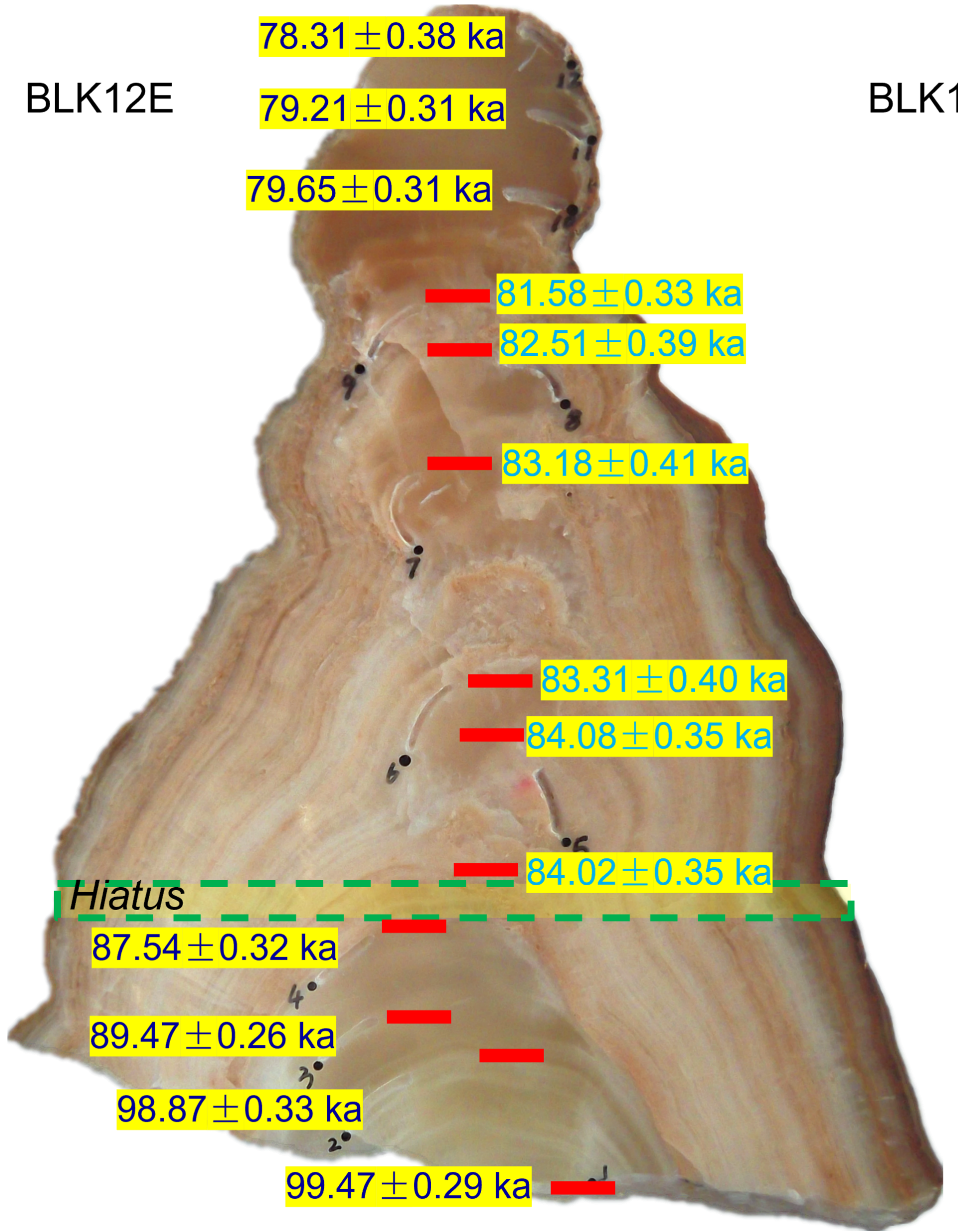

Materials and methods —— sample and age model
U-Th dates for stalagmites: 13 (BLK12E) and 12 (BLK12F) , StalAge age
Two replicated stalagmites spanning 101.9 -78.3 ka BP
BLK12E
BLK12F

Slide 3
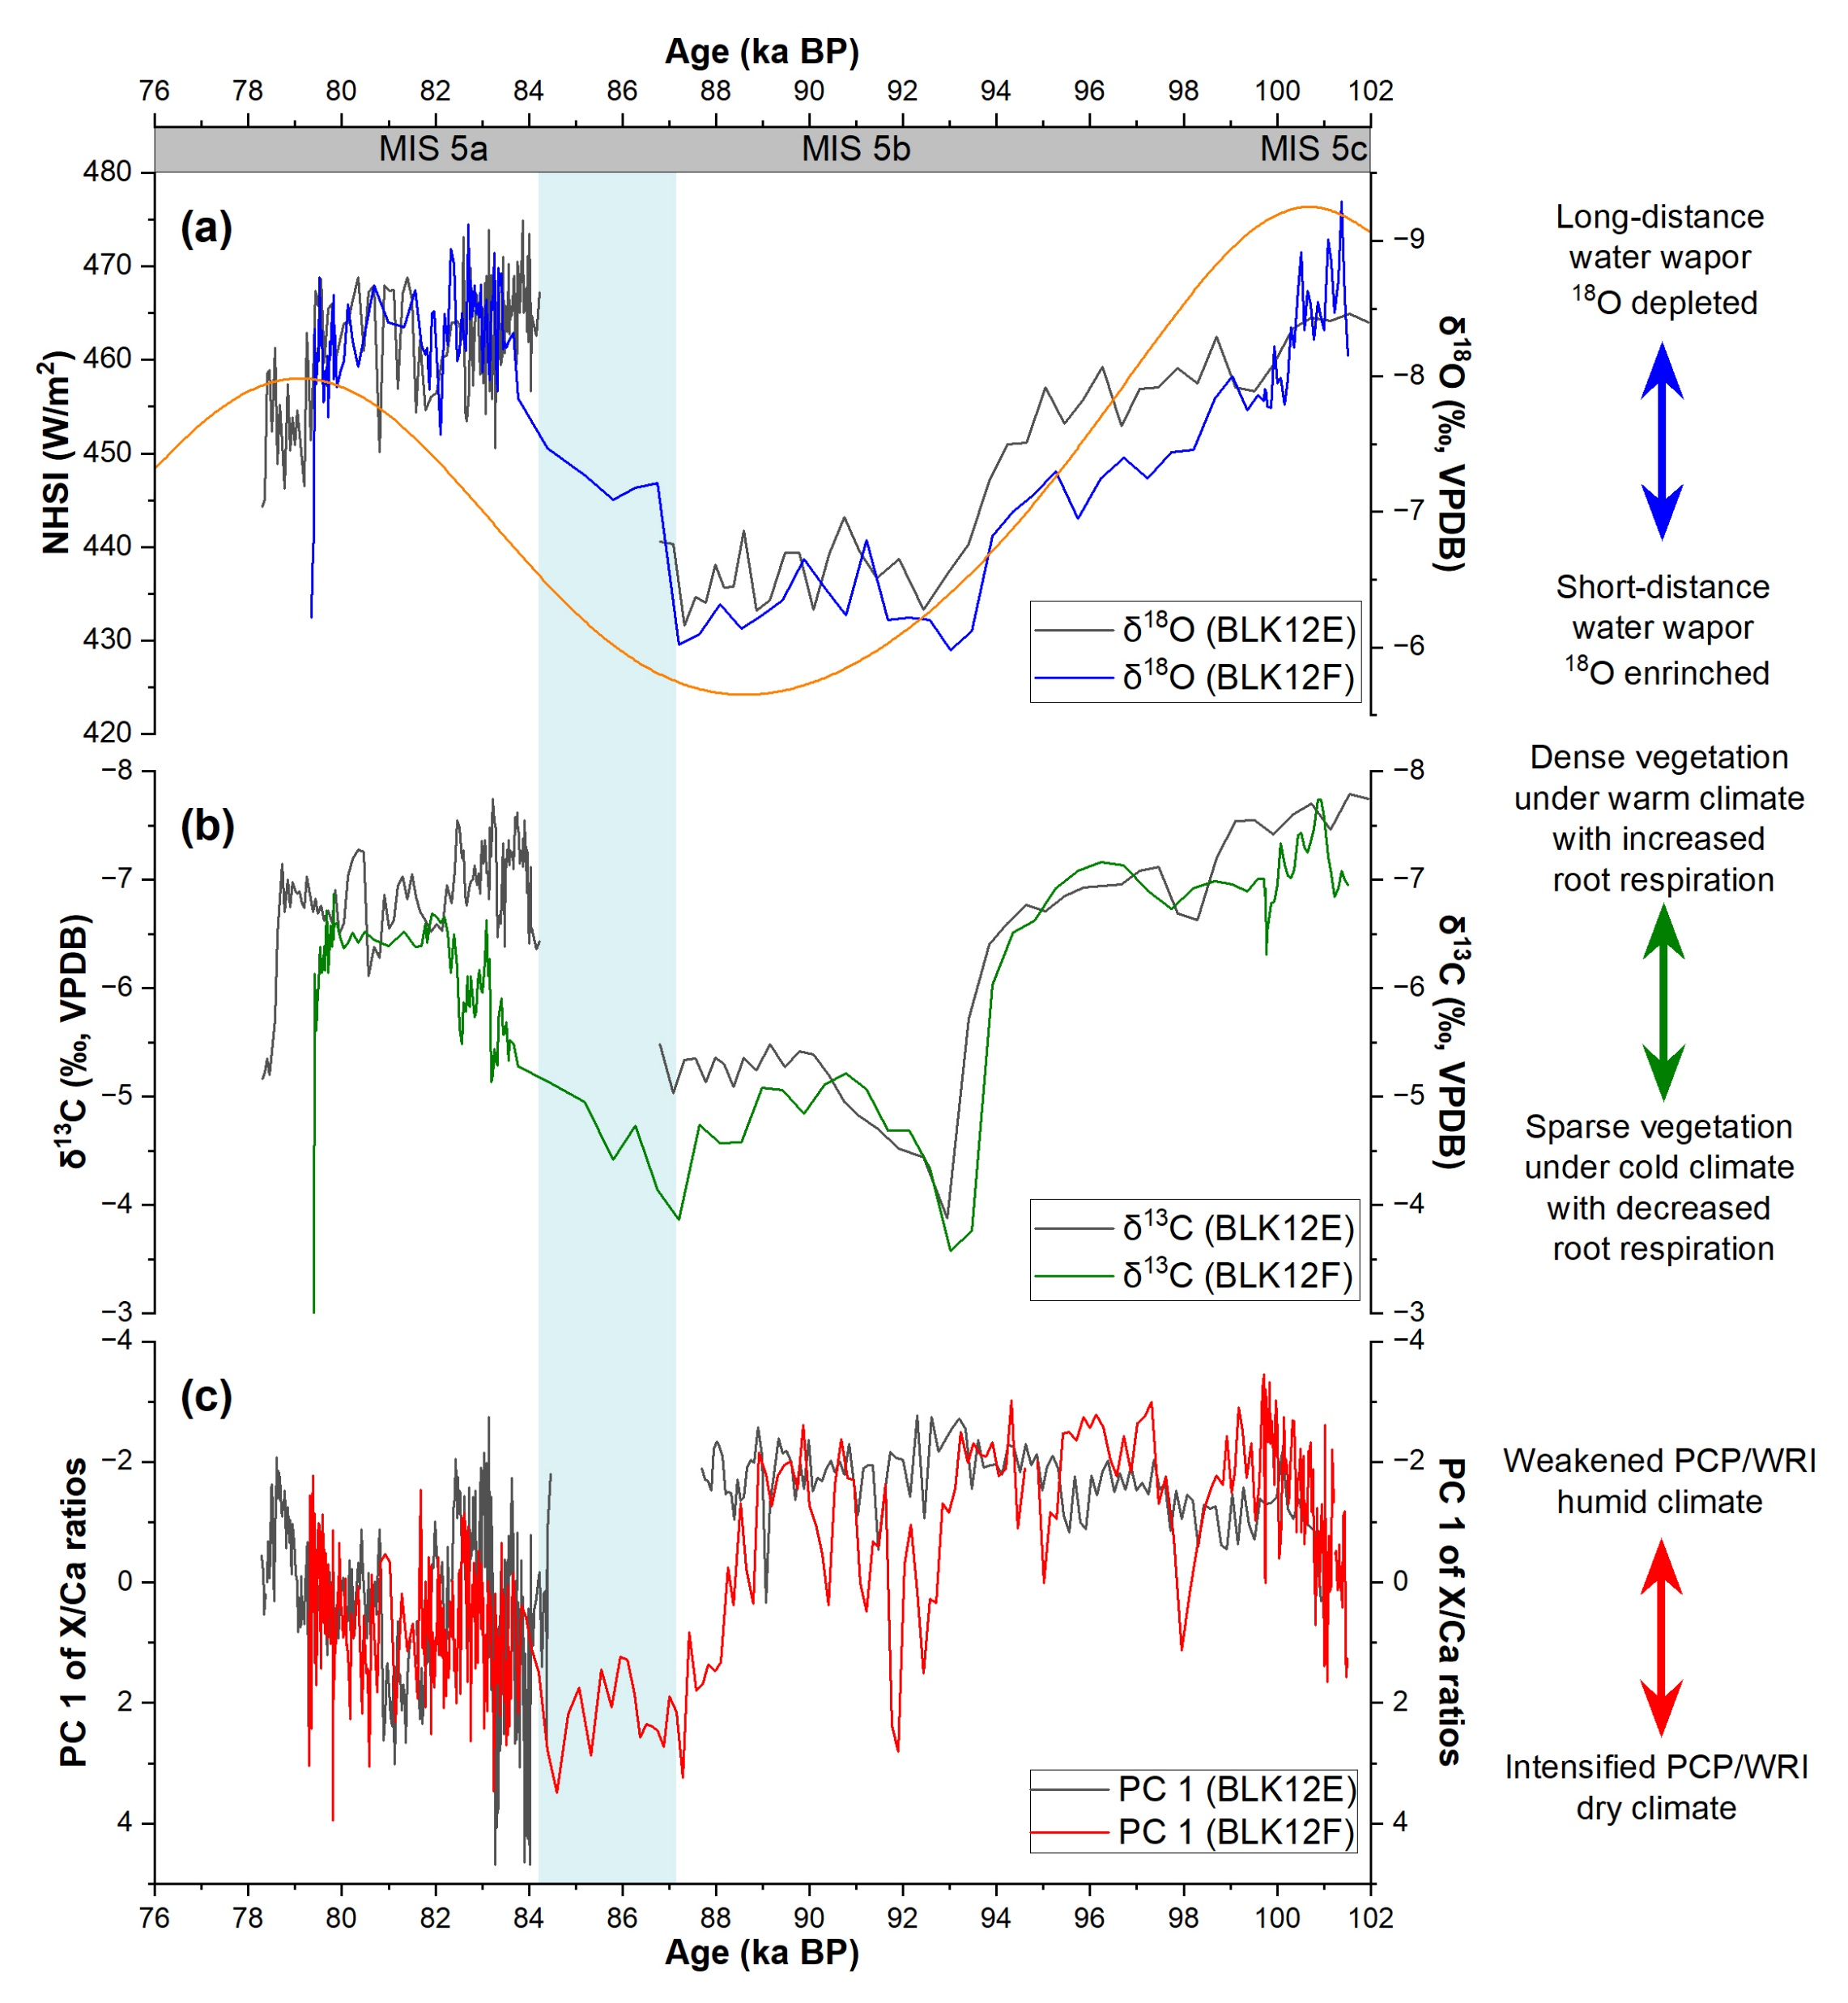
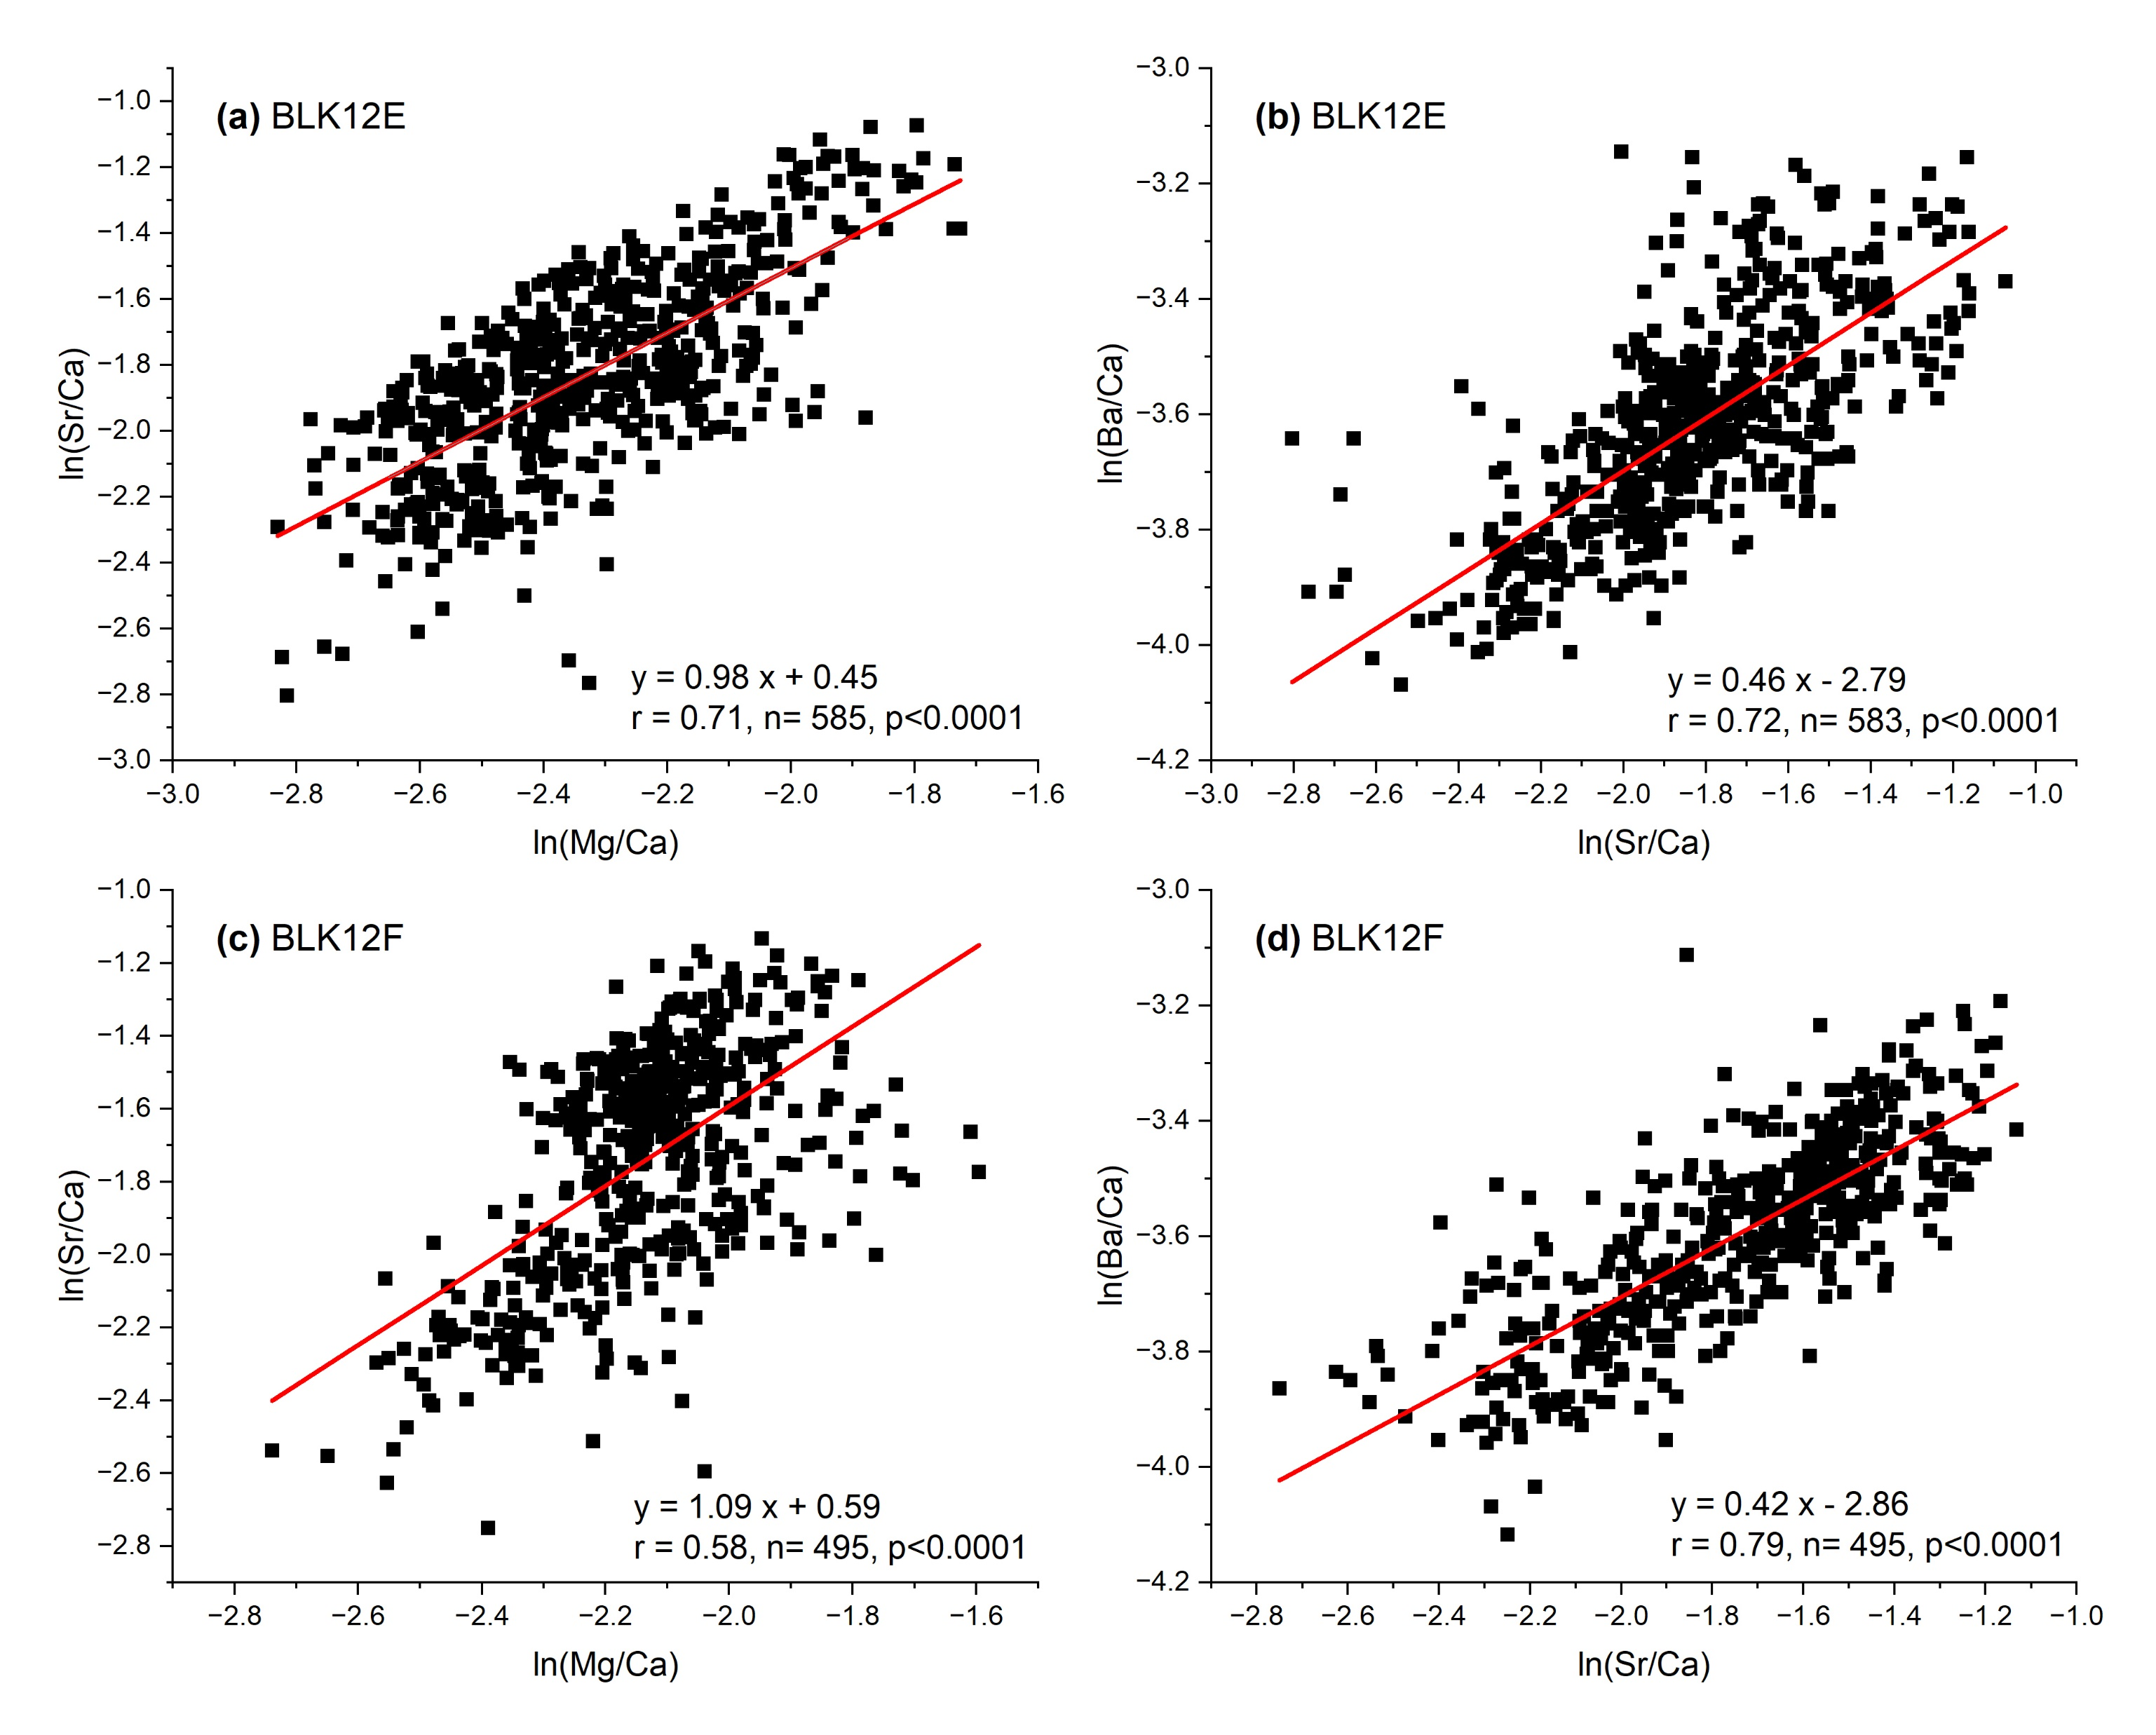
Proxy interpretations —— stable isotopes and trace element ratios

Slide 4
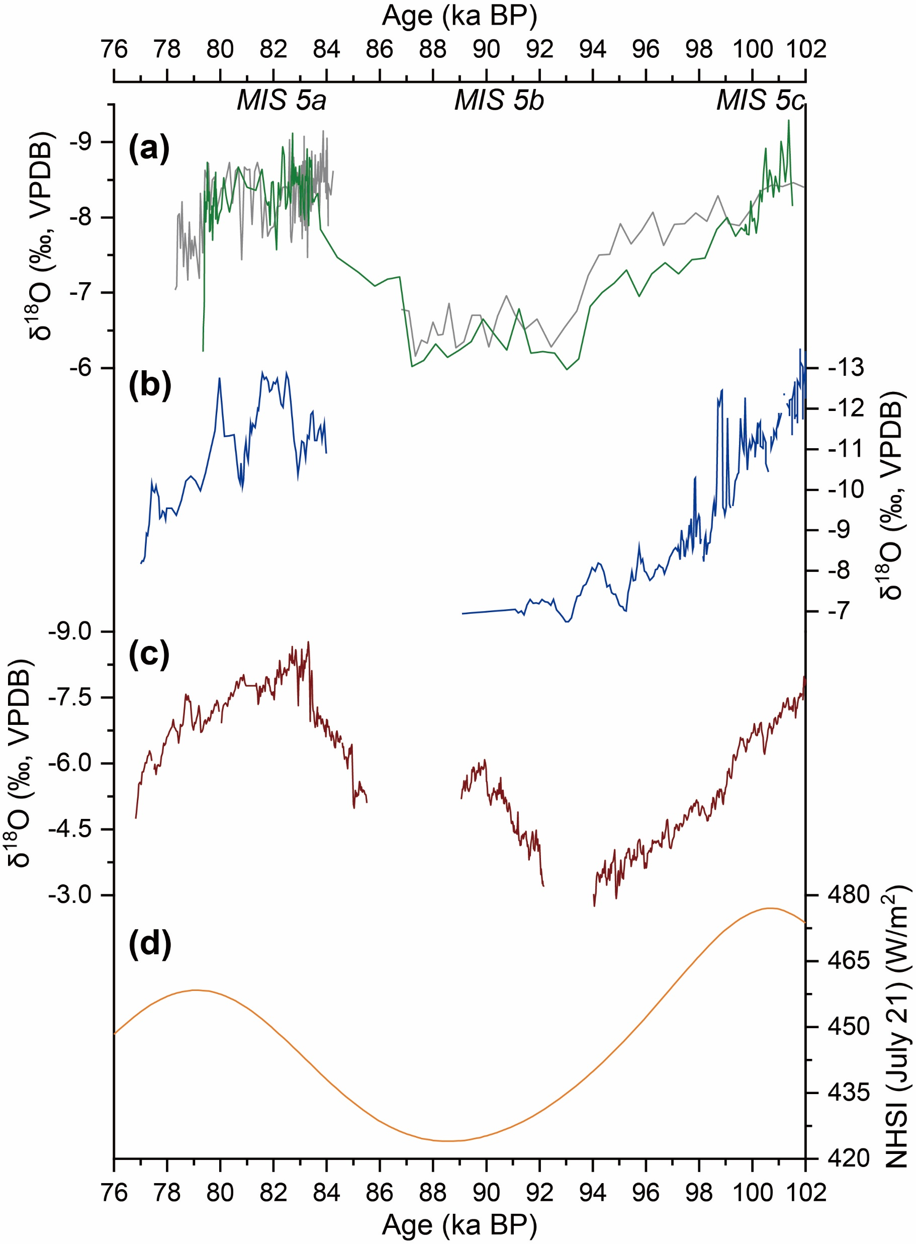
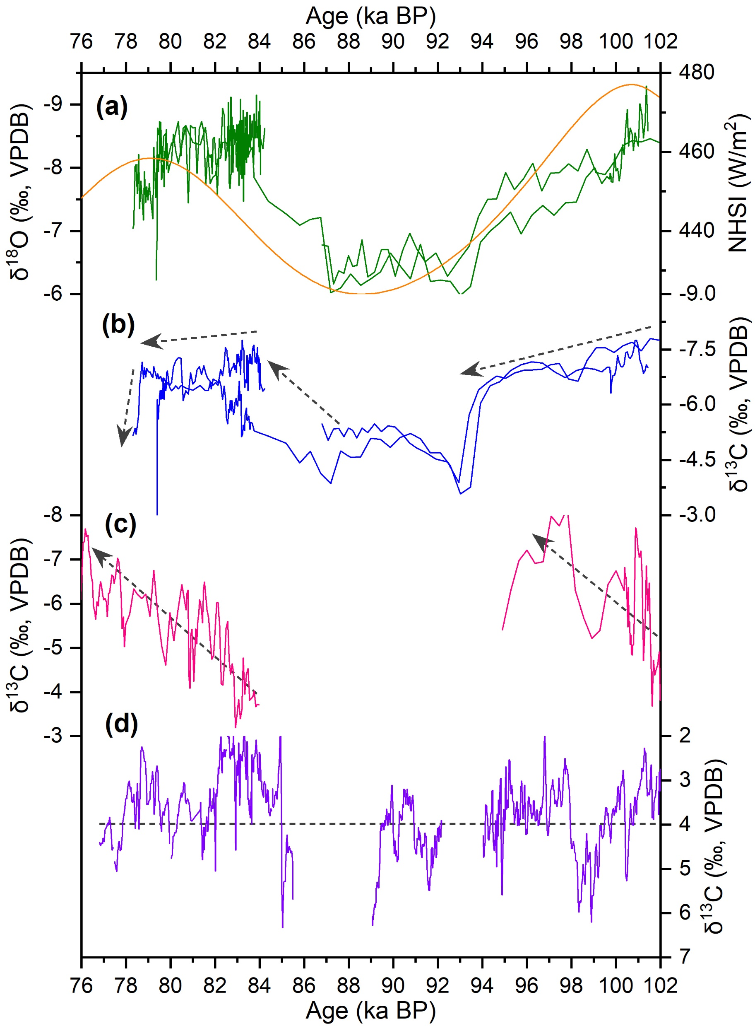
Regional record comparison —— speleothems from arid central Asia

Slide 5
Regional record comparison —— loess sections from Xinjiang
Li et al., 2020, EPSL

Slide 6
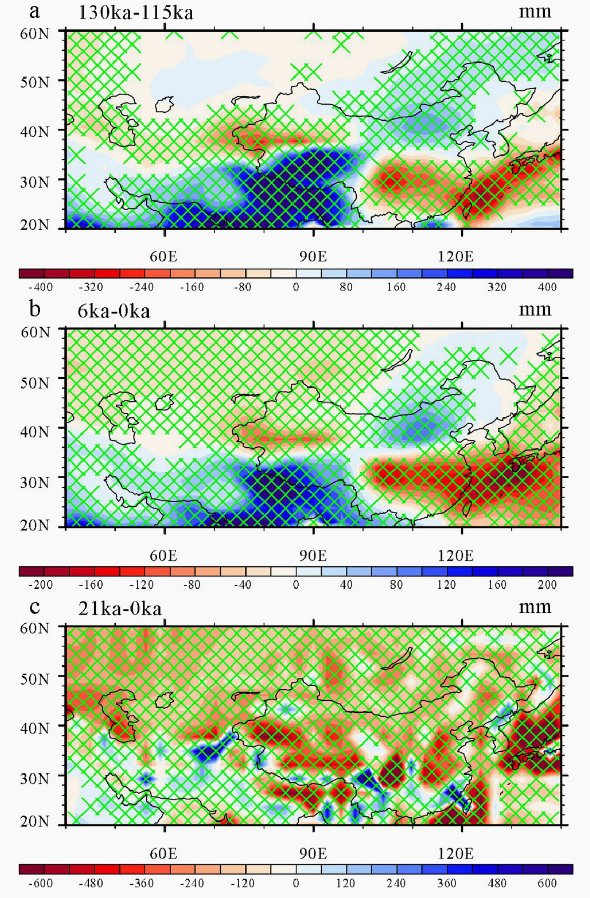
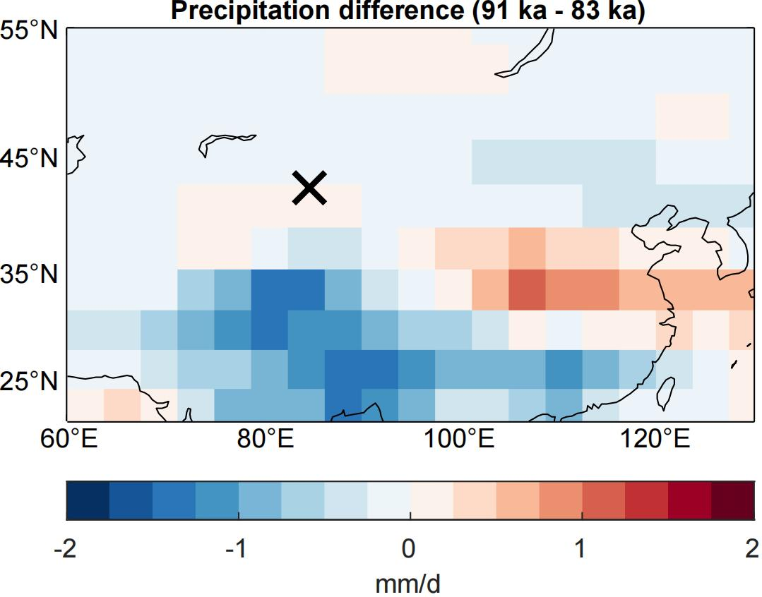
Forcing mechanisms —— modelling results
Fig. 10. Changes in annual mean precipitation (mm) between a) 130 ka and 115 ka, b) between 6 ka and PI, and c) between 21 ka and PI, simulated by the FGOALS-g2 model. Gridded regions indicate changes that are significant at the 99% confidence level.
CESM simulation
by Dr. J. Ruan (unpublished)
Li et al., 2020, EPSL

