Slide 1
EGU24-21572
Carbon stock projection for four major forest plantation species in Japan
Tomohiro Egusa^{1*}, Ryo Nakahata², Mathias Neumann³, and Tomo’omi Kumagai^{2,4,5}
1, Faculty of Agriculture, Shizuoka University, Shizuoka, Japan
2, Graduate School of Agricultural and Life Sciences, The University of Tokyo, Tokyo, Japan
3, Institute of Silviculture, Department of Forest and Soil Sciences, University of Natural Resources and Life Sciences Vienna, Vienna, Austria
4, Institute for Space-Earth Environmental Research, Nagoya University, Nagoya, Japan
5, Water Resources Research Center, University of Hawaiʻi at Mānoa, Honolulu, USA

Slide 2
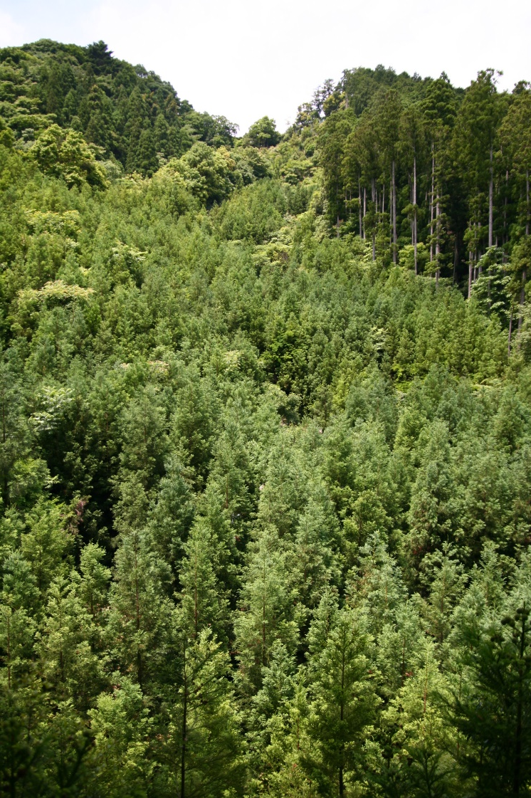
Introduction: Forests can store large amounts of carbon, which has a significant impact on the global warming
Forest carbon stock: 861±66 PgC
Soil (to 1m depth): 383±30 PgC
Biomass: 363±28 PgC
Dead wood: 73±6 PgC
Litter: 43±3 PgC
2.3±0.5 PgC y⁻¹ was absorped in 2000-2007 (excluding tropical land-use changes)
Pan et al., 2011 Science
It is important to accurately assess and to predict the amount of carbon stocks in forests

Slide 3
Introduction: There are two groups of studies in predictions of forest carbon stocks
(1) Complex process-based models
Future changes in environmental factors can be expressed in detail (e.g., Eggers et al., 2008 Glob. Change Biol.), but require many computational resources
Sato et al., 2007 Ecol. Modell.
http://seib-dgvm.com/

Slide 4
Introduction: There are two groups of studies in predictions of forest carbon stocks
(2) Simple empirical models
This type of models cannot fully consider changes in environmental factors (e.g., de Vries et al., 2017 Sci. Total Environ. )
But, they require low computational power and are suitable for practical assessments of the effects of forest management and forestry practices, climate change, and pest and insect damage on forest growth (e.g., Kurz et al., 2008 Nature; Foley et al., 2009 For. Ecol. Manag.)
Carbon density
Forest age

Slide 5
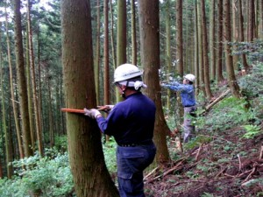
Introduction: How to know the forest carbon?
On-site measurement is the most accurate and reliable
NFI:
National Forest Inventory

Slide 6
Introduction: Two types of NFI in Japan
p-NFI: NFI predicted using a simple model called a yield table that uses forest age as a variable (mostly based on the measurements in the 1960s)
m-NFI: NFI actually measured by the Forestry Agency in Japan

Slide 7
Introduction: Two types of NFI in Japan
Outdated
Current system
Past system
The data we used
Previous studies estimated forest C accumulation rates using p-NFI rather than m-NFI

Slide 8
Objective
To accurately understand the carbon accumulation rate with increasing forest age in planted Japanese forests and to examine forest management and operation strategies that maximize future carbon sequestration
To achieve this, we targeted four major forest plantation species in Japan: Cr. japonica, Ch. obtusa, Pinus spp., and L. kaempferi.

Slide 9
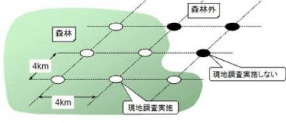
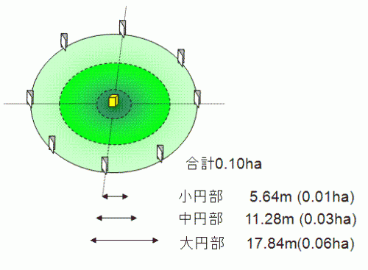
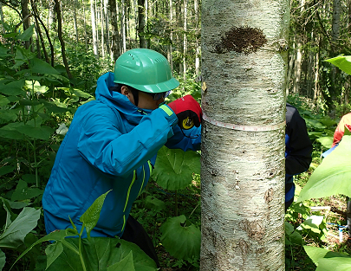
Methods: m-NFI
Surveys conducted at 4km intervals throughout Japan (12,457 plots)
The size of the tree to be measured Small circle: DBH 1 cm or more Middle circle: DBH 5 cm or more Large circle: DBH 18 cm or more
Totally 0.1 ha of area
Forestry Agency (https://www.rinya.maff.go.jp/j/keikaku/tayouseichousa/index.html)

Slide 10
Methods: Chapman-Richards equation
$$C_{d}=C_{d_max}{\left\{1−exp⁡(−kx)\right\}}^{\frac{1}{1−m}}$$
$$C_{d}$$
Carbon density(MgC/ha)
$$C_{d_max}$$
Maximum carbon density(MgC/ha)
$$k, m(0≤m<1)$$
Fitting Parameters
Assuming that the most important parameter, $C_{d_max}$ is affected by region and air temperature, a hierarchical Bayesian framework was used
Expresses a variety of shapes

Slide 11
Results: forest age–carbon density functions
Carbon density increased until about 50 years of age for all tree species and after that the rate of increase slowed
Carbon density values were highest for Cr. japonica, followed by Ch. obtusa, L. kaempferi, and Pinus spp.
Median values and 95% intervals of repeated calculations

Slide 12
Results: Carbon sequestration potentials in Japan’s plantation trees
Case 0: without any forestry practices
Case 1-1: current forestry practices
Case 1-2: current forestry practices (from a different statistical info)
Case 2-1: doubled harvest rate & current reforestation rate
Case 2-2: doubled harvest rate &
100% reforestation rate
Sequestered carbon is minimum without forestry practices, and is maximum under the doubled harvest rate and 100% reforestation rate

Slide 13
Conclusion
Without forestry practices,
forest carbon stock is saturated
More information is in
More carbon can be sequestered
Egusa et al., (2024) Carbon stock projection for four major forest plantation species in Japan. Sci. Total Environ. (accepted)
With active forestry practices, carbon is stored in planted trees and harvested, including stems, leaves, and roots

