Slide 1
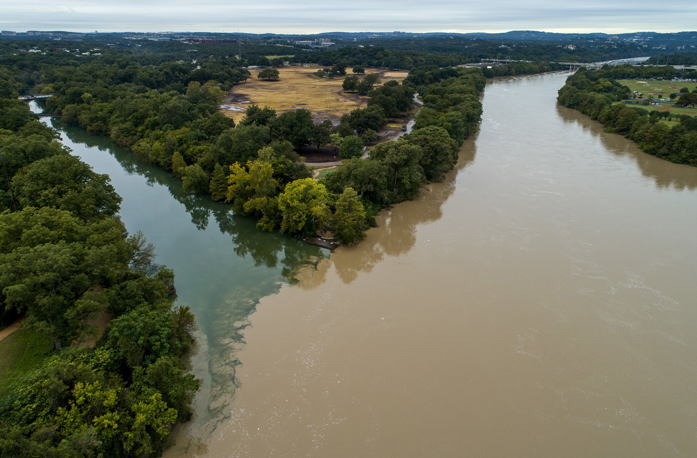
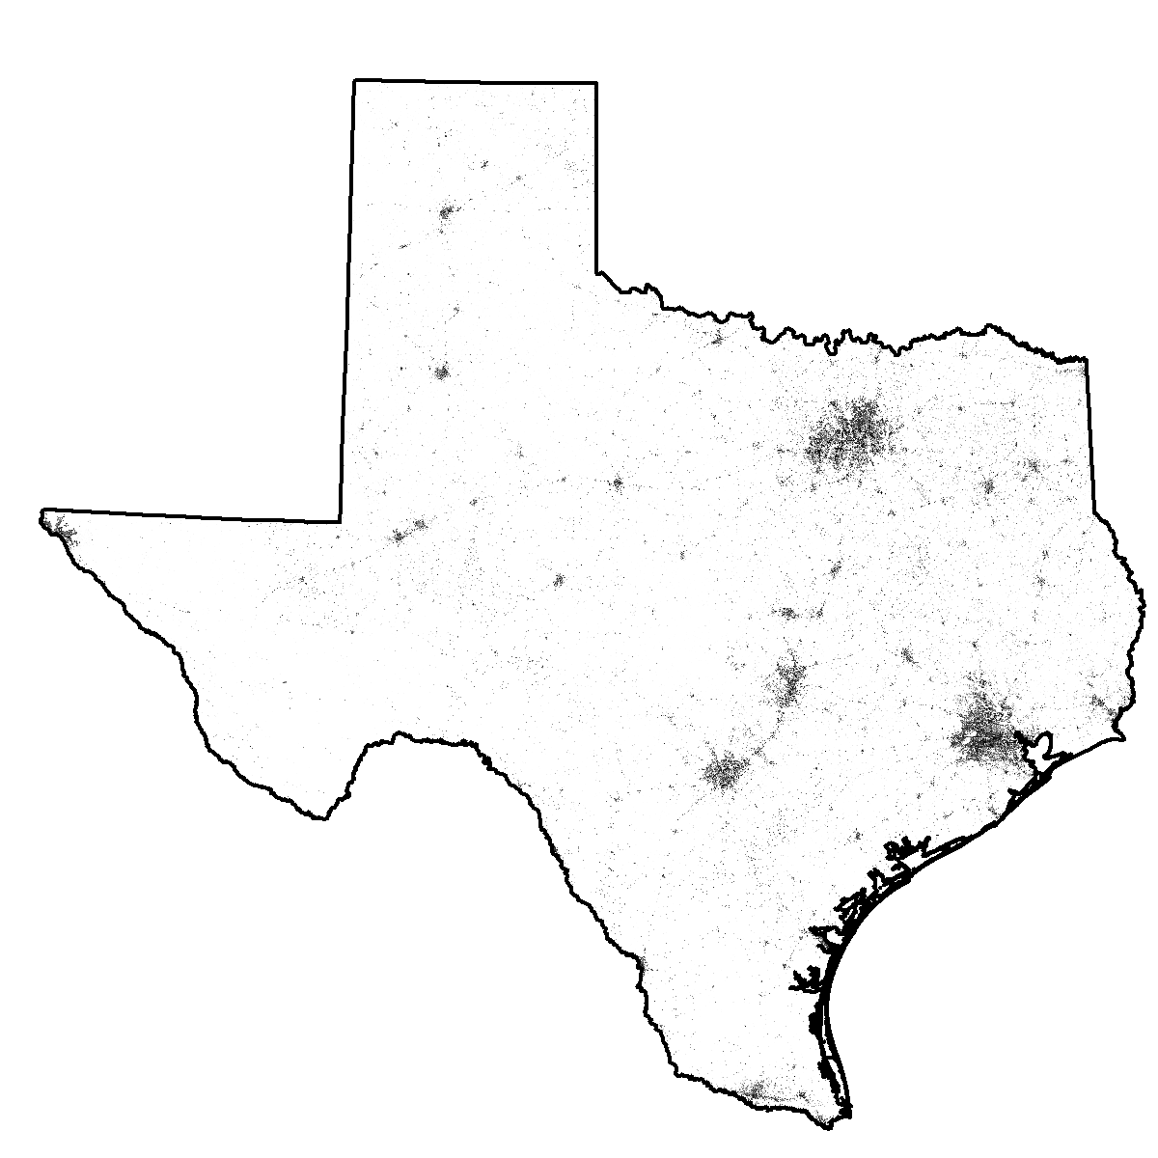
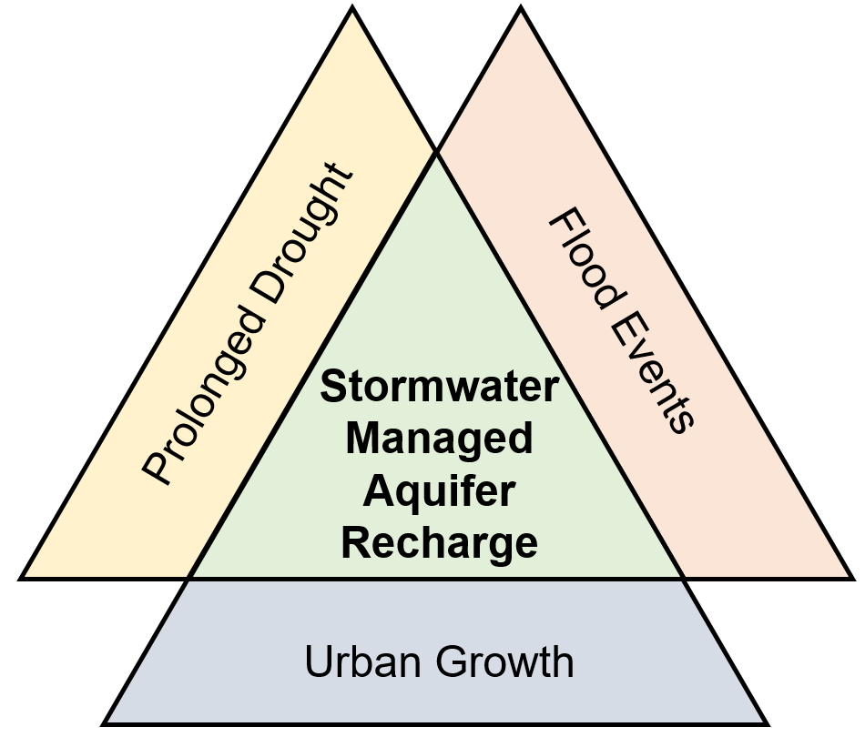
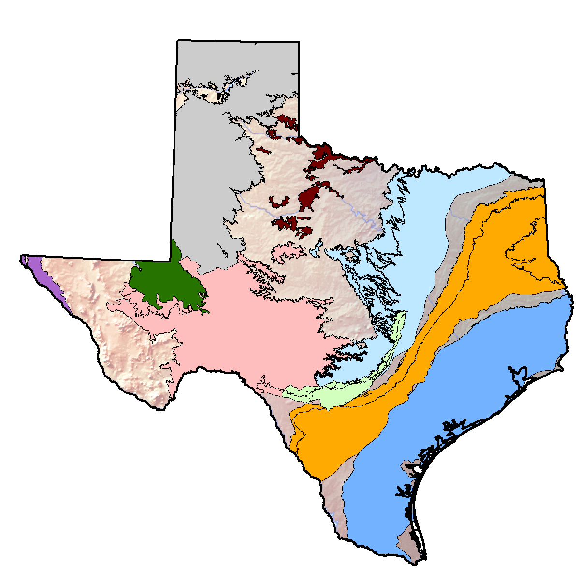
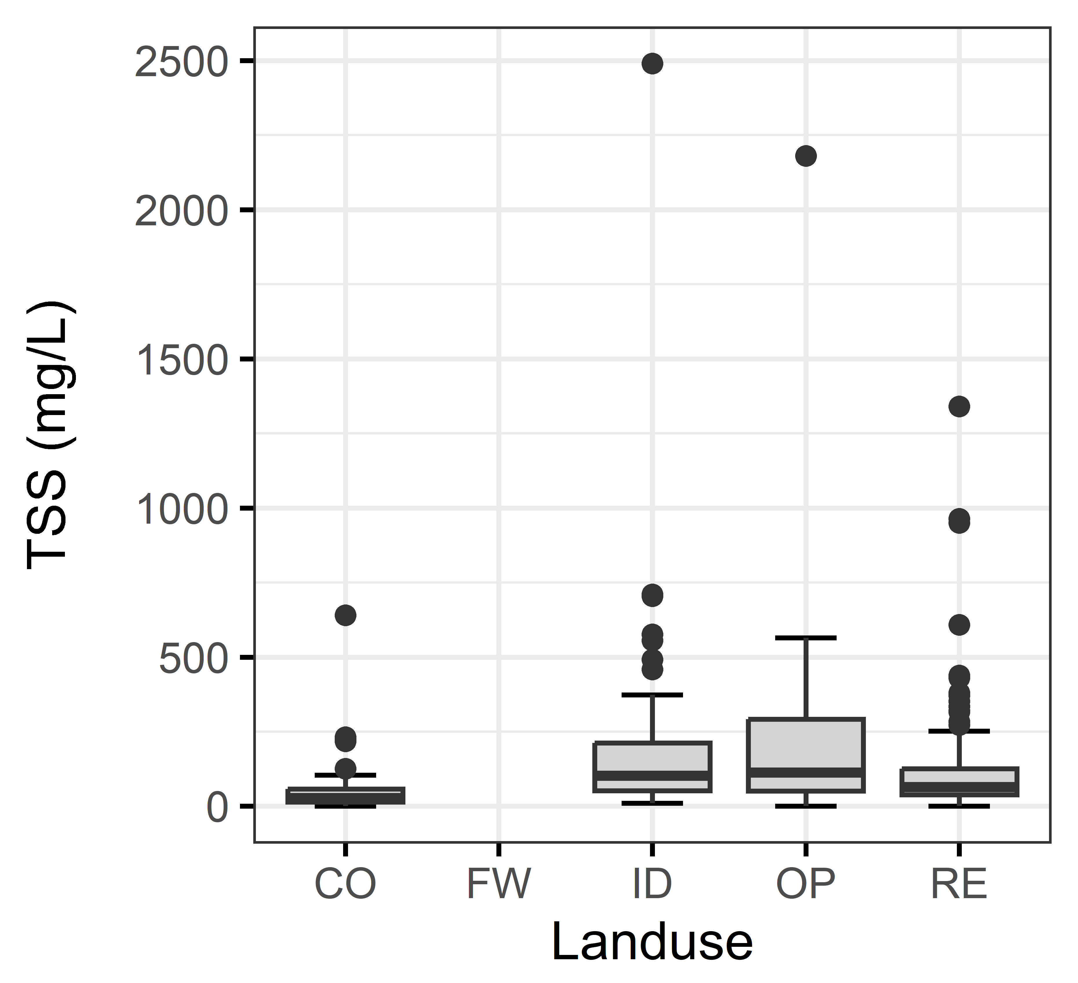
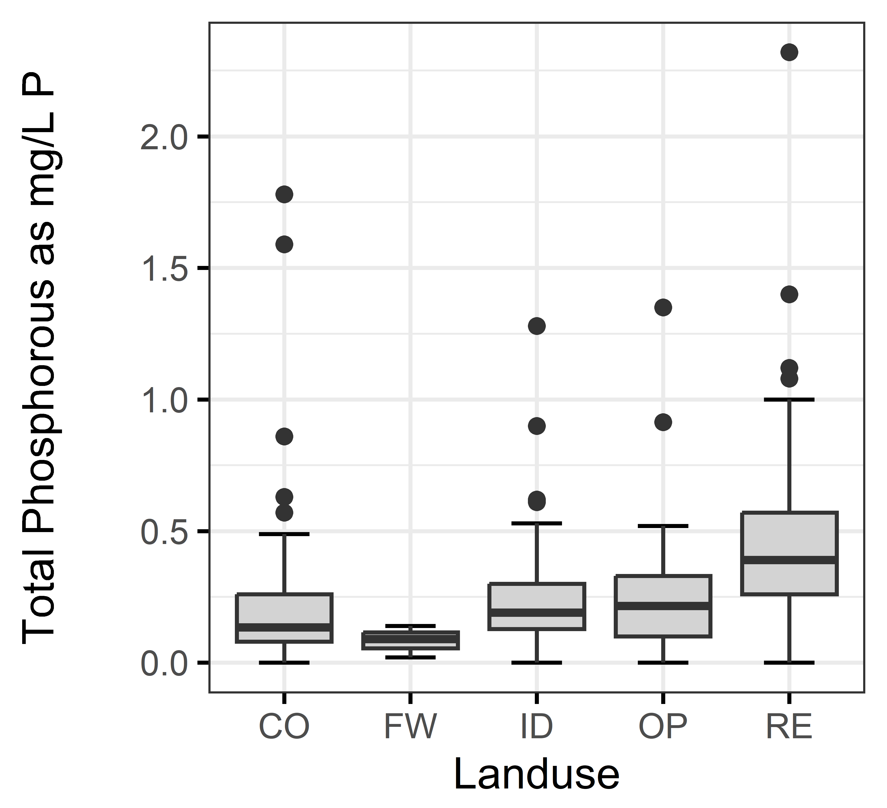
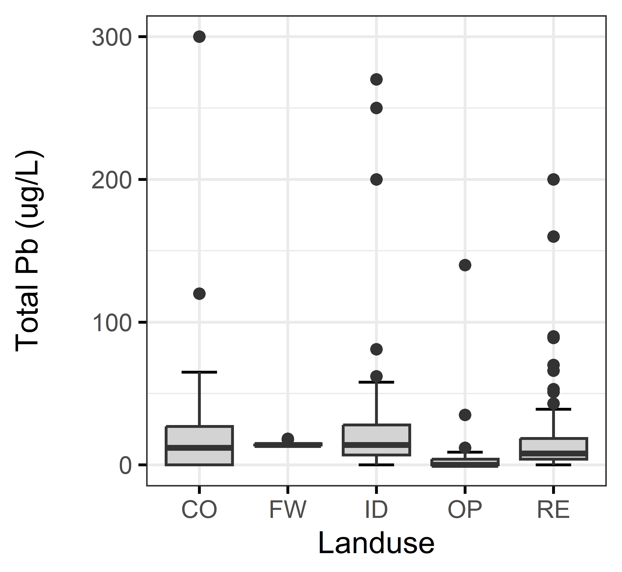
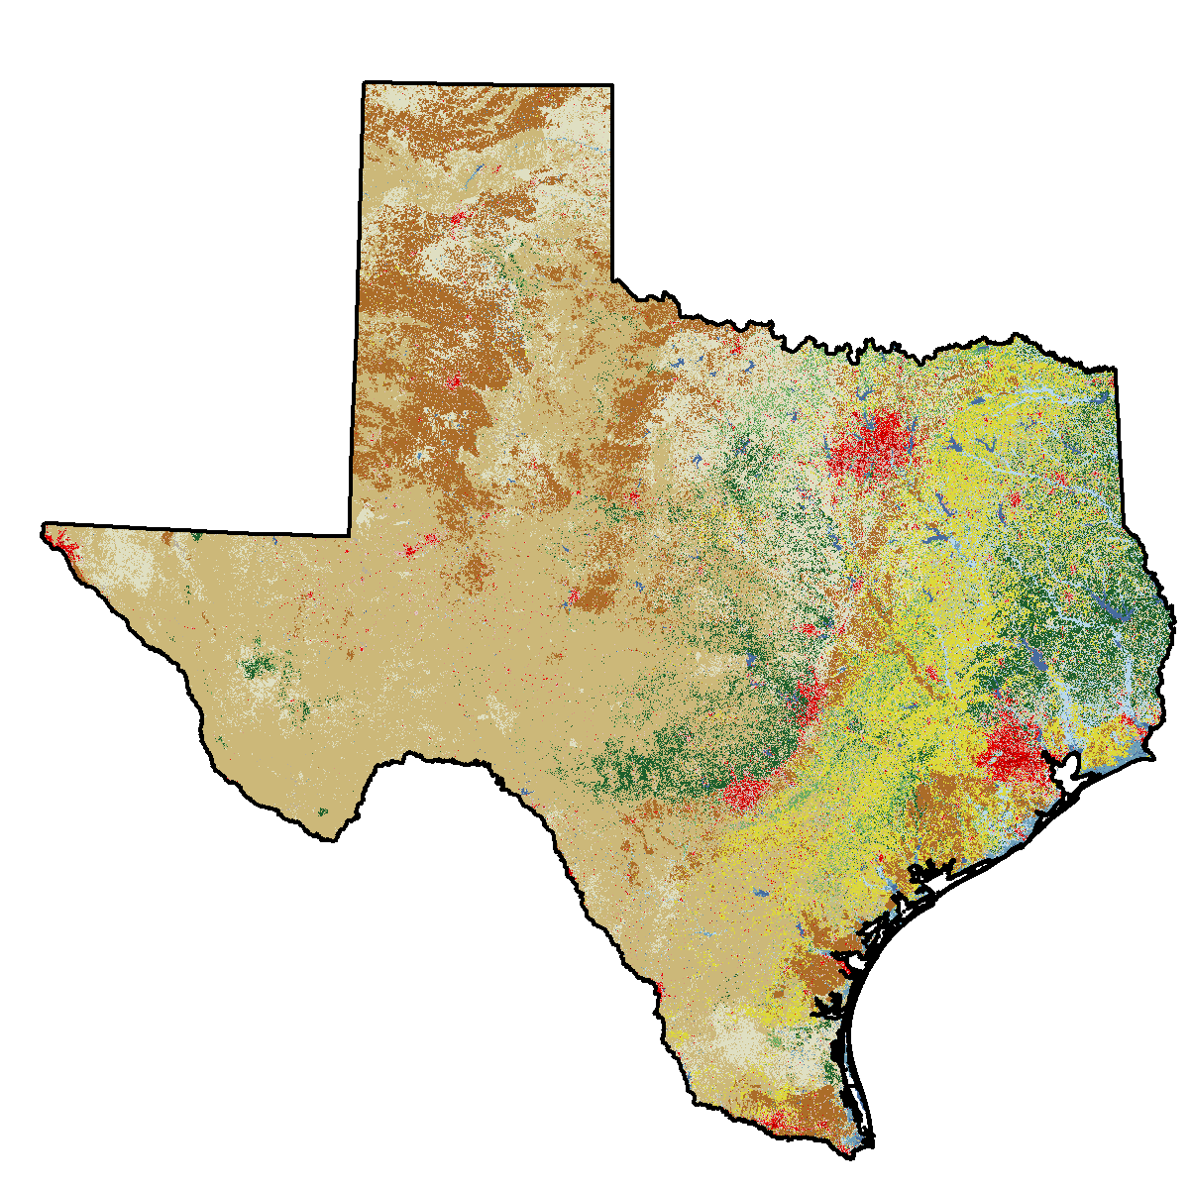
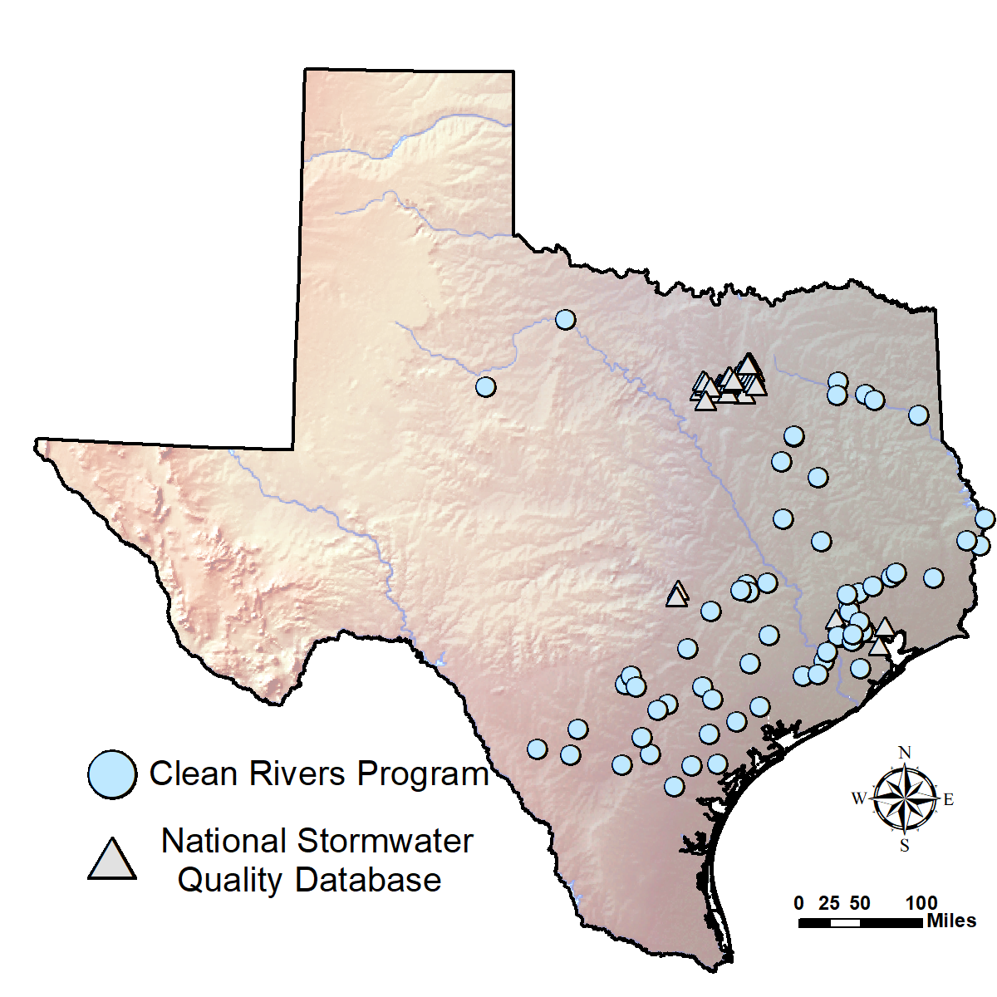
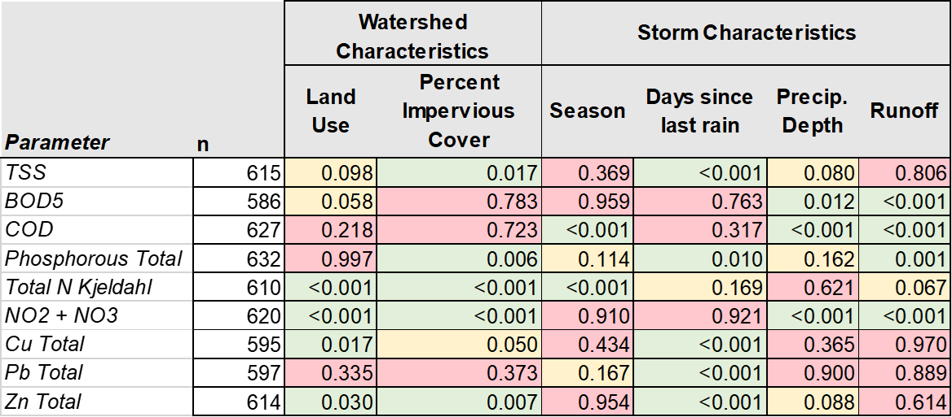
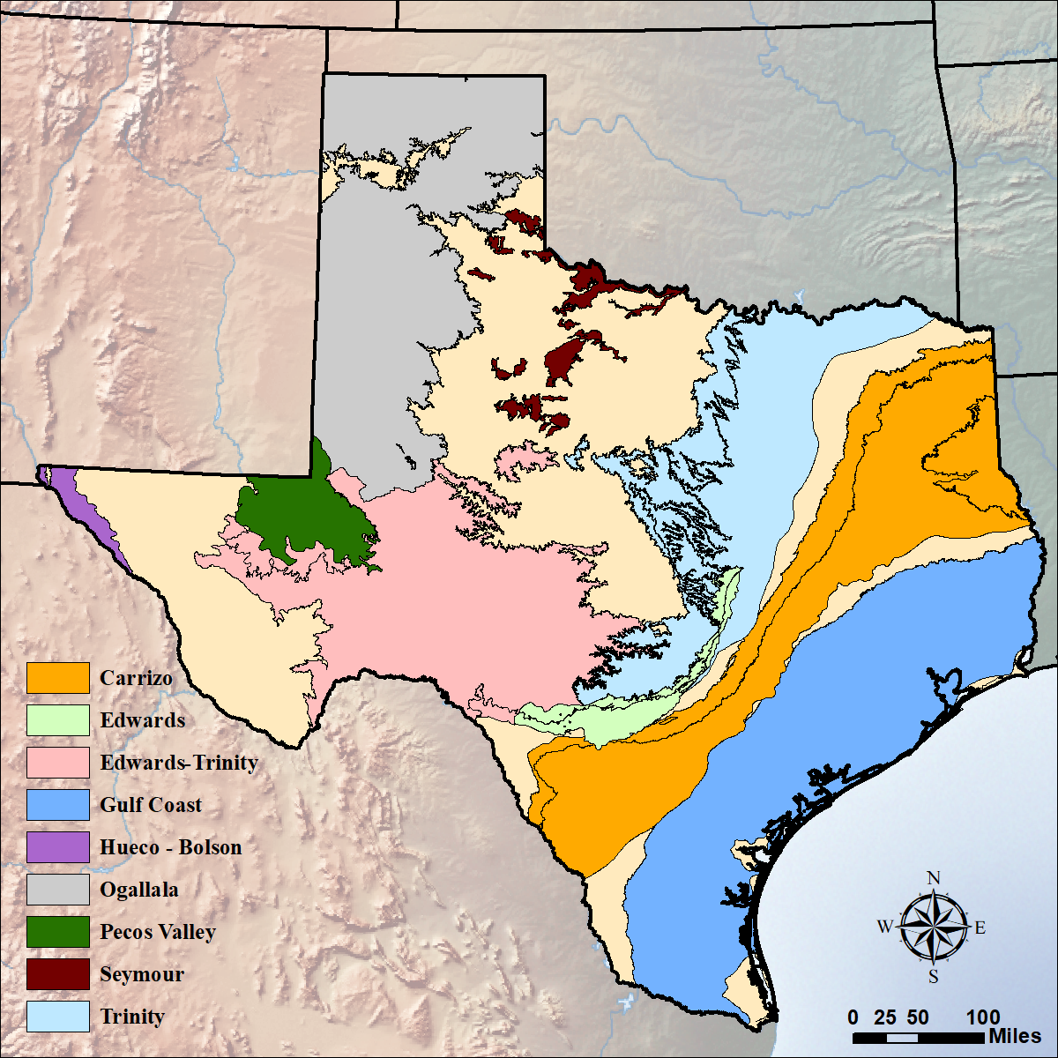
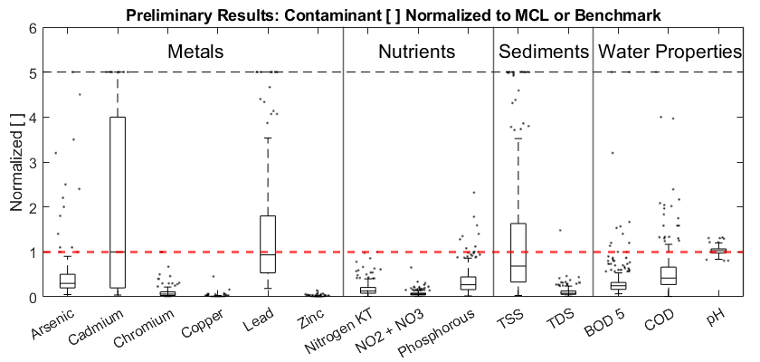
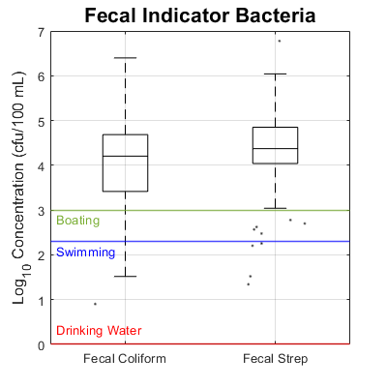
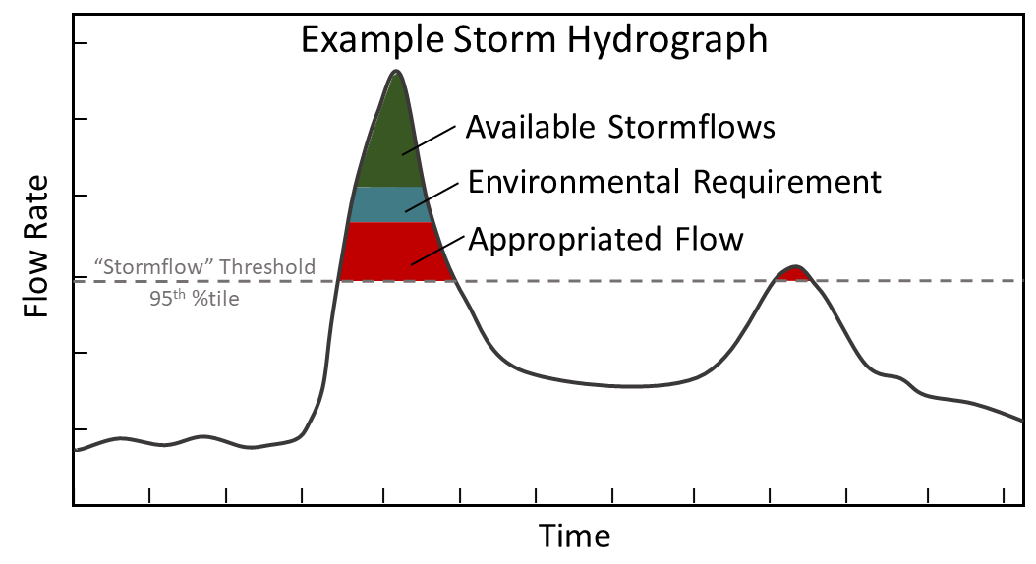
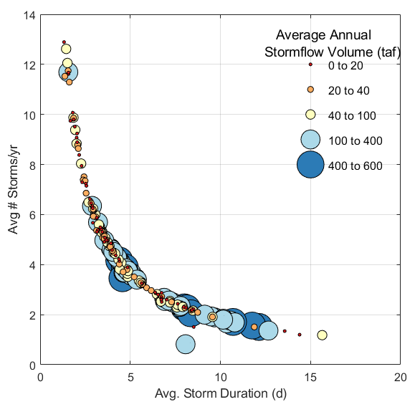
Enhanced Stormwater Recharge in Texas: Considerations for Water Quality and Quantity
John Malito, Bridget Scanlon, Sarah Fakhreddine
Bureau of Economic Geology, Jackson School of Geosciences, University of Texas at Austin
Solvay
Jay Janner, Austin-American Statesman
The quality and volume of Texas stormwater appear adequate for enhanced aquifer recharge, with simple pretreatment.
Stormwater recharge as innovative water solution
Texas needs more water. As water demands grow, using stormwater for enhanced recharge has emerged as a potential solution for water scarcity.
Total Suspended Solids (TSS)
Total Phosphorous
Lead
What are the key factors driving contaminant concentrations in stormwater?
Different contaminants appear sensitive to different watershed and storm characteristics.
Suspended solids: impervious cover and non-residential land use.
Nutrients: % impervious cover and residential use
Metals: extended dry periods between storms and industrial land use
The problem?
Limited information is available on stormwater contaminants and volumes of excess stormwater.
The idea?
Using publicly available data, we can provide a general overview of stormwater quality and availability for enhanced aquifer recharge.
Commercial, Freeway, Industrial, Open space, Residential
Box plots of stormwater quality by land use from NSQD
Analytical approaches
P-values from statistical tests for key water quality parameters and potential explanatory variables, including site and event characteristics.
Does Texas stormwater have elevated contaminant concentrations? If so, where?
Statewide Stormwater Quality Analysis
National Stormwater Quality Database
Data Analysis
Geospatial datasets used in this study 1) stormwater quality point data, 2) land cover, 3) major + minor aquifers, and 4) impervious cover
Green: 95% confidence that there is a relationship between nutrient concentration and explanatory variable; Yellow: ~80% to 95% confidence; Red: < 80% confidence
Atop Major & Minor Aquifers
Urban areas (Dallas, Austin, Houston)
Storm events only, 1981 - 2001
Land cover data included
Storm characteristics
674 total storm-runoff events
Summary statistics for stormwater contaminant concentrations
How much stormwater is truly available?
Statistical relationships between contaminant concentrations and:
Storm characteristics
Land Use
Impervious Cover
Next, consider environmental flow requirements
Clean Rivers Program
First, consider water appropriations
Surface water quality time series
1991 - 2021
Storms selected from 95th %-tile of streamflow from USGS stations
Stations paired with land cover data
USGS Streamflow
Mean concentration maps for each major contaminant
National Land Cover Database
Which stormwater contaminants may require pretreatment?
Generally, median concentrations are below the EPA maximum contaminant level (MCL) or similar health-based standards.
Fecal indicator bacteria (Coliform and Streptococcus) have high concentrations in stormwater and stringent health-based thresholds.
These data can help guide which pretreatment techniques, such as sediment settling and biofiltration, will be needed before injection/infiltration
How much water can be captured from flood flows to store in depleted aquifers without negatively impacting:
Appropriated flows?
Environmental flows?
USGS Streamflow
Average annual “available” stormflows estimated by subtracting appropriated flows from stormflows
Available stormflows considering appropriated flows and environmental flow requirements
Final thoughts and next steps
Water Availability Models
Texas Instream Flow Program
What are the “ideal” storms for MAR?
Contact us
Long (multi-day), infrequent storms produce the highest volumes of stormflow.
Available stormflows decrease westward along the precipitation gradient, and with position in the watershed
Average annual available stormflows range from ~100’s of acre-feet (123,000 m³) in the upper basins to >100,000 ac-ft (0.12 km³) near the basin outlets
Texas generally has suitable volumes of stormwater for managed aquifer recharge
However, stormwater contaminant concentrations depend on watershed and storm characteristics, but generally below maximum contaminant levels, with the exception of fecal indicator bacteria.
With proper pretreatment strategies, stormwater MAR can provide an innovative solution to replenish depleted aquifers.
Feel free to reach out!
john.malito@beg.utexas.edu
@JMalito_GeoSci
Associated paper on stormflow volumes here!
The Nature Conservancy

