Slide 1
Important drivers of October to December rainfall season in eastern Africa and relevant mechanisms
Indrani Roy ( UCL, Indrani.roy@ucl.ac.uk)
and Alberto Troccoli (WEMC)
EGU 2024

Slide 2
Outline
Choosing Station and Data
Comparing station data with observations and reanalyses
East African Monsoon rain (OND) and Drivers
Precipitation (OND): ENSO, IOD correlation
Precipitation (OND): Compositing technique
Mechanism: Walker circulation plays a major role
Rainy season Onset (OND): Various data and different technique
Outlook one season ahead possible and verification
Analyses based on Station data
Cumulative rain and Onset date
Summary and Discussion
Compared to other African countries, East African countries are more prone to floods and droughts
Notes:
AMO is area average over the entire N Atlantic of the low pass filtered annual mean SST anomalies after removing linear trend. The time scale of the AMO is ~ 20-40 years.

Slide 3
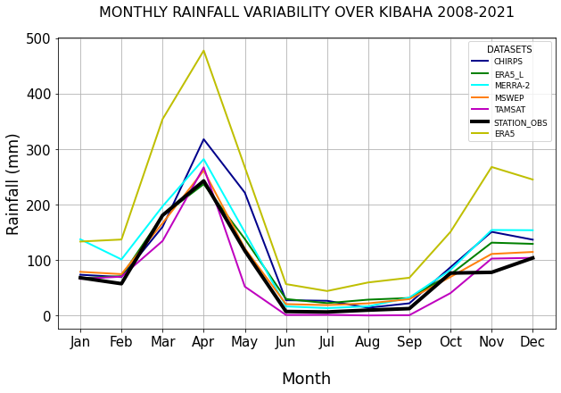
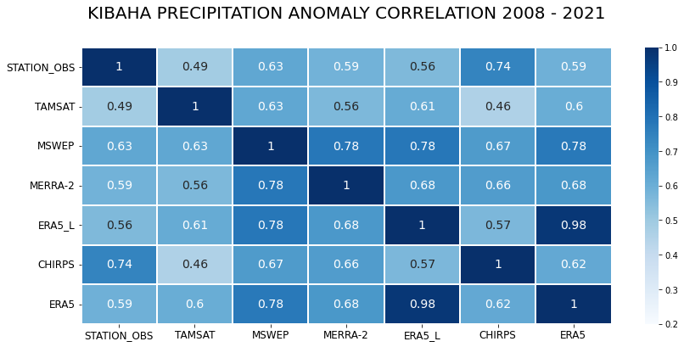
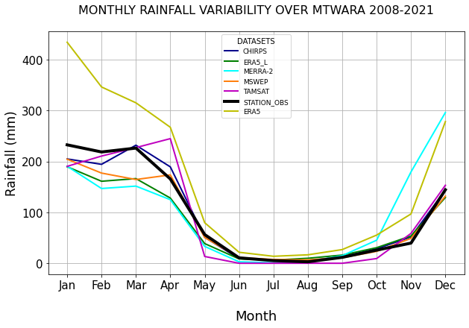
Comparison of various Precipitation Datasets against Local Observations
Various data are consistent in identifying Bimodal (Top-left, shown for Kibaha) and Unimodal (bottom-left, Mtwara) rainfall patterns. Both have station data to compare with.
High-resolution CHIRPS data has stronger correspondence with station data (c.c. 0.74).

Slide 4
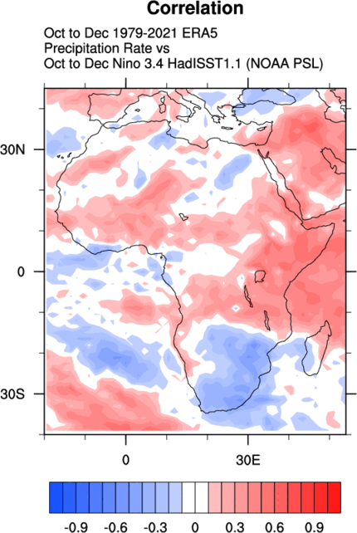
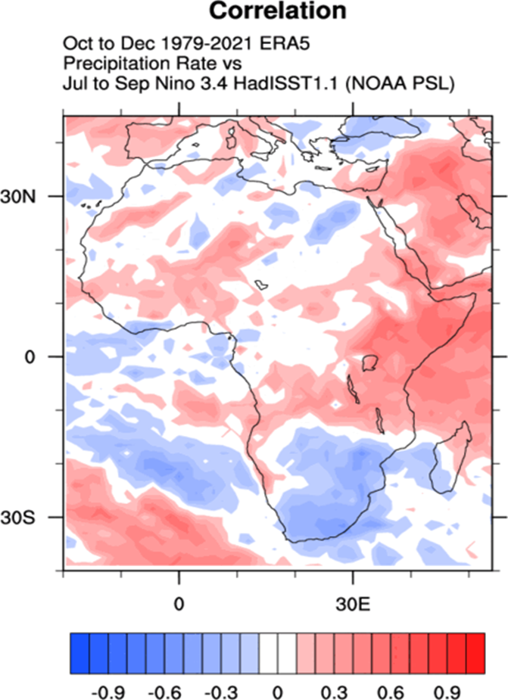
Precipitation (OND): ENSO, IOD Correlation
Precipitation, ENSO (ERA5: 1979-2021)
Positive Correlation: Strong Positive correlation (OND) without lag (left).
One Season Ahead: Correlation 95% significant (c.c>.23), not only one season ahead (right), but one season one month ahead too. Even similar signal for Nino3.4 (June) and Ppt (Oct).
Signal is similar for IOD too!
Compositing Technique applied:
Why? To eliminate effects of confounding factors of ENSO and IOD when those are in the opposite phase.
Ppt (OND) vs.
Nino3.4 (OND)
Ppt (OND) vs.
Nino3.4 (JAS)
[Roy et al. 2024]

Slide 5
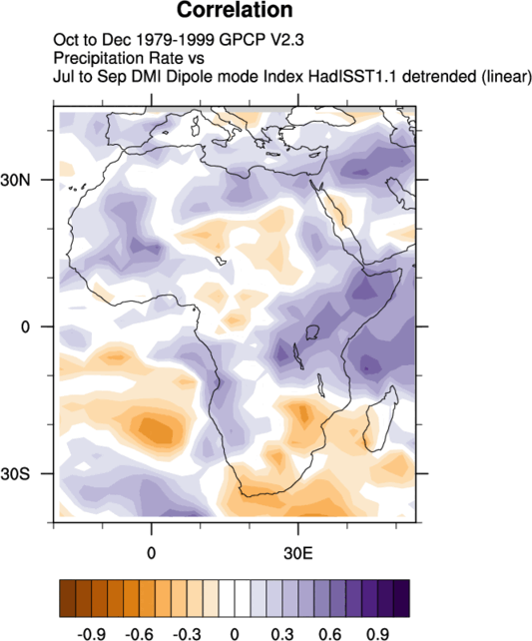
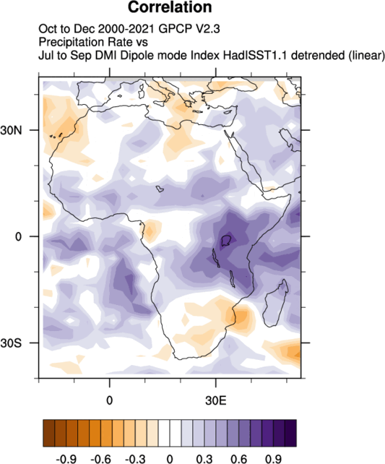
Precipitation (OND) and IOD (JAS) Correlation
Earlier (1979-1999) vs. later period (2000-2021)
Earlier Period (1979-1999)
Later Period (2000-2021)
[Roy et al. 2024]
Significant signal around East Africa.
ENSO instead of IOD indicates similarly.
Earlier period vs. Later showed a similar pattern.
Detrended data: Results same without detrending too.
Similar results using various data; GPCP is shown.
Regression Analyses also give similar results.

Slide 6
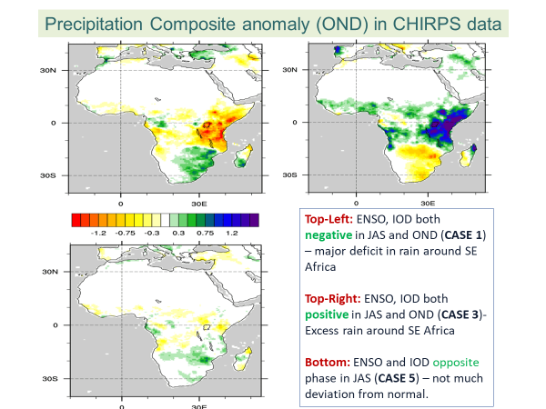
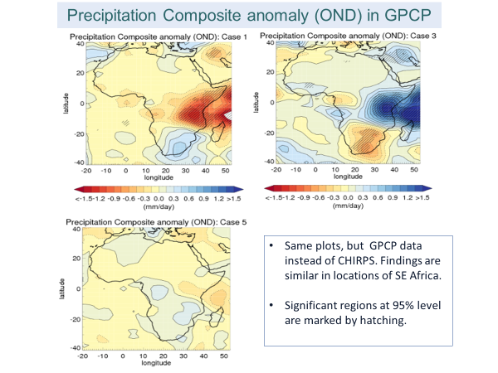
Precipitation Composites
(Left: CHIRPS data; Right GPCP)
Case 1: ENSO, IOD negative in JAS and OND; Case 2: ENSO, IOD negative in JAS
Case 3: ENSO, IOD positive in JAS and OND ; Case 4: ENSO, IOD positive in JAS
Case 5: ENSO, IOD opposite in JAS ; Case 6: All years (1993-2021) together
In 2022, we were in Case 1 and it was 2nd consecutive year. Deficit of rain in SE African countries.
News Bulletin was issued to relevant authorities (e.g., WMO,TMA etc.) and a blog was written in Sept 2022.
Validated at the beginning of 2023 and that outlook indeed matched!
[Roy et al. 2024]

Slide 7
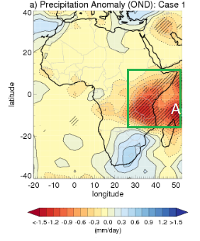
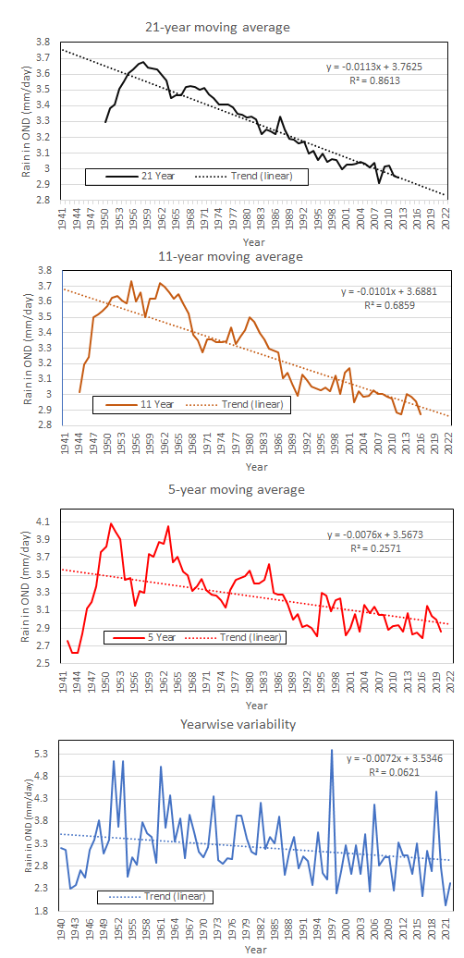
Analyses on Intra-decadal, Decadal and Multi-decadal signal
d) Multi-Decadal:
21 yr Moving Average
c) Decadal:
11 yr Moving Average
[Roy et al. 2024]
b) Intra-Decadal:
5 yr Moving Average
A box region, where strong signal by green box (‘A’) with a boundary of 18˚S -12˚N to 25˚E - 52˚E.
a) No significant trend. b,c) Peaks and troughs were identified. d) A shift around 1958 identified where trend changed from increasing to decreasing.
a) Yearwise variability

Slide 8
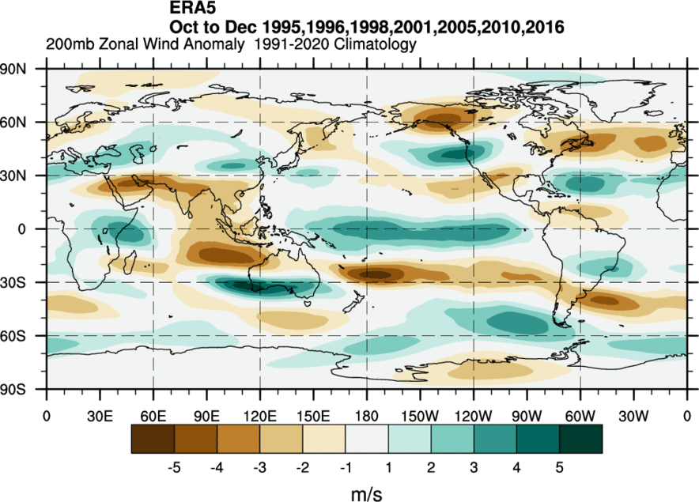
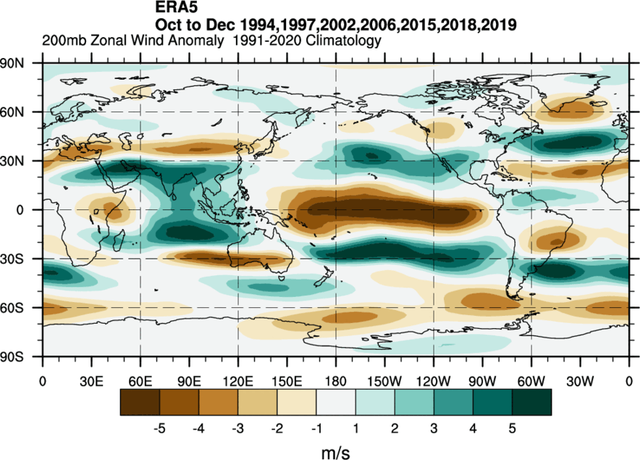
Mechanism: Zonal wind anomaly at 200 mb level in ERA5 data
a) Case 1
b) Case 3
Composites for Cases when IOD and ENSO are both negative in JAS and OND (a-Case 1, left) and when both are positive (b-Case 3, right):
It is reversed around regions of East Africa marked earlier by ‘A’!

Slide 9
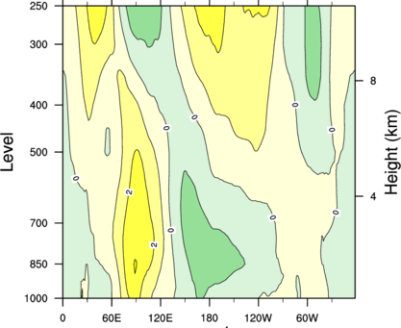
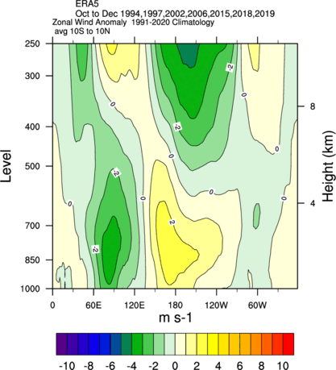
Mechanism: Longitude- Height plot
Composites of Zonal winds anomaly (m/s) in ERA5 data.
a) Case 1
b) Case 3
[Roy et al. 2024]
Zonal winds reversed for Case 1 (a, Left) to that from Case 3 (b, right). Walker circulation plays an important role.

Slide 10
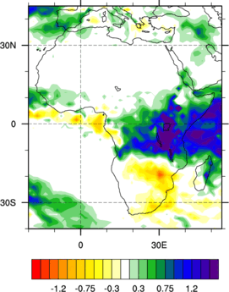
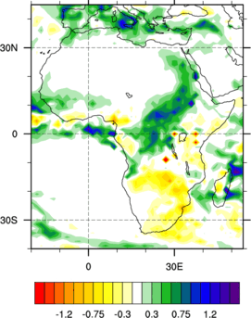
Anomaly of precipitation (OND) for Case 4
based on Threshold using longer data of ERA5 (1940-2021)
Classification on Threshold:
Further classification of drivers, based on a threshold value (+0.4) is tested for Case 4 as recent yr 2023, JAS fell that category, left plot.
One driver weak (0 to +0.4):
Signal in region ‘A’ weakens substantially on eastern side of box
Both drivers IOD, ENSO weak:
Strongest weakening happens when both drivers are of low magnitude in JAS (i.e., between 0 to +0.4), right plot.
ENSO, IOD both >+0.4
ENSO,IOD in (0 to +0.4)
[Roy et al. 2024]

Slide 11
Rainy Season Onset
Criteria for Rainy Season Onset in Tanzania using Official Standard Technique (ST) by Tanzanian Meteorological Authority (TMA)
Onset day: First occasion during MAM or OND when a) more than 20 mm rainfall in four days, b) with at least two wet days, and c) no dry spell of 10 days or more within the following 30 days.
Wet day: when 1 mm or more rainfall in a day.
Importance of a new algorithm: An algorithm that can correctly identify actual onset with
no Conditional statements nor Arbitrary thresholds

Slide 12
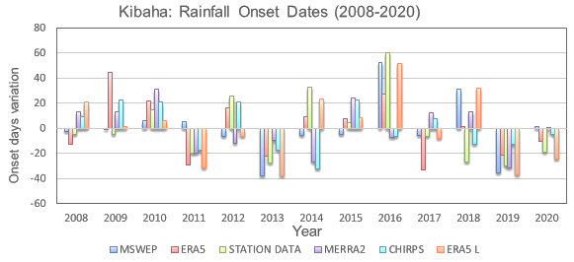
Onset Date Definition has some role: Standard Technique (ST)
[Roy et al. 2023]
No consistency among various data sources.
In the same year, some data suggest early onset, while some late onset.
Sometimes even 60 days difference (say, 2016)

Slide 13
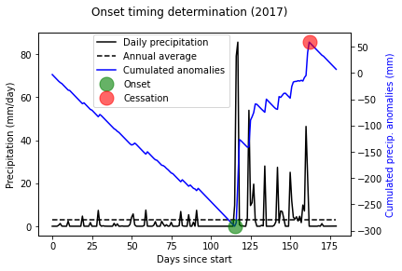
Onset, Duration and Cessation Date: 2017
CHIRPS data for Kibaha (38.96,-6.83), Tanzania
Exploring an Alternate Technique (AT) based on Cumulative Precipitation Anomaly (without any arbitrary threshold or condition)
[Zampieri et al. 2023]
Onset (23rd Oct), Cessation (9th Dec) and Duration (47 days).
Normal rainfall year, IOD and ENSO were opposite in JAS.
Onset in ST and AT matched

Slide 14
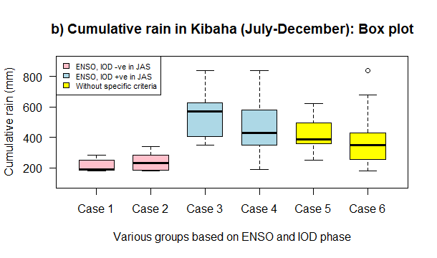
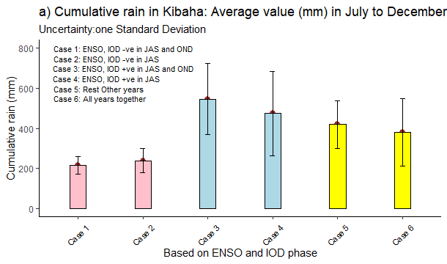
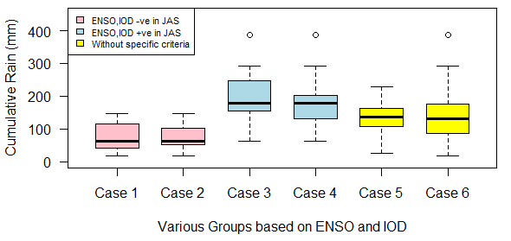
Cumulative Rains based on Drivers
(1993-2021), CHIRPS data
b) Kibaha (Box plot)
a) Kibaha (Averaging)
c) Mtera (Box plot)
Deficit/Excess: Rainfall deficit in Case 1, 2 (pink); while excess rain for Case 3, 4 (blue).
Uncertainty: smallest in Case 1 and 2 (Pink) than Case 6. Similar for other stations too
Boxplot better than Averaging: outliers can be removed.
Two stations chosen from Tanzania where station data available.

Slide 15
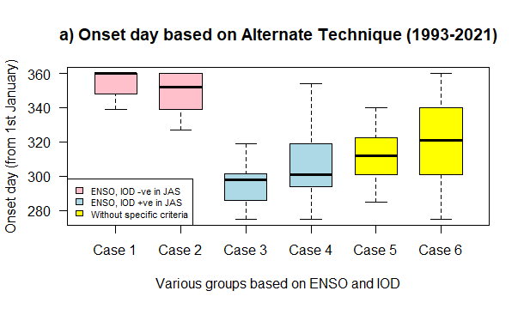
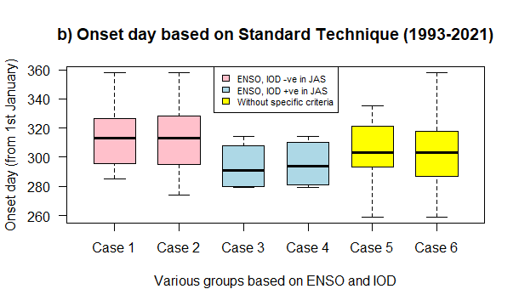
Rainy season Onset (OND) based on drivers in JAS: two Techniques using CHIRPS data in Kibaha
a) Alternate Technique (AT)
b) Official Standard Technique (ST)
Late/Early Onset: Late onset in Case 1, 2 (pink), while early onset for Case 3,4 (blue) in both techniques.
Uncertainty: Reduced compared to Case 6.
Importance: Statistical methodology presented here constitutes a valuable complement to methods applied in dynamic forecasting of monsoon circulation which are currently still not very reliable for simultaneous season, let alone a season ahead.

Slide 16
Summary and Discussion
Two important drivers of monsoon (OND) in East Africa with affected regions identified.
Positive significant correlation between rain (OND) and ENSO or IOD, a season ahead.
Results are confirmed by various data, earlier/later years, detrending data before.
Compositing: significant rain (OND) deficit (excess), if both drivers –ve (+ve) in JAS.
Walker circulation plays important role.
Outlook of 2022, 2023 rainy season (OND) matched in the identified regions of E. Africa.
An Alternate Technique (AT) for ‘Onset’ is tested which is based on cumulative precipitation
anomaly and offers fair results and comparable to official Standard Technique (ST).
Late (Early) OND rainy season Onset, if both drivers –ve (+ve) in JAS; for both techniques.
Future outlook of cumulative rain and Onset date possible a season ahead using box
plots for any station or average over a region of East Africa.

Slide 17
East African Monsoon (OND): Interested in Details
Roy, I and Troccoli, A (2024) Identifying Important drivers of East African October to December rainfall season. Science of the Total Environment (STOTEN), Elsevier, [https://doi.org/10.1016/j.scitotenv.2023.169615].
Roy I, Mliwa M, Troccoli A (2023), ‘Important drivers of East African Monsoon variability and improving rainy season onset prediction’. Natural Hazards, Springer, [https://doi.org/10.1007/s11069-023-06223-3].
Zampieri, M, … Troccoli A ,.., Roy, I,.(2023). Seasonal forecasts of the rainy season onset over Africa: preliminary results from the FOCUS-Africa project, Climate Services, Elsevier, [https://doi.org/10.1016/j.cliser.2023.100417].
Note: Some results were presented in EGU 2023 on 25th April. IOD data was changed on 26th April 2023! [ https://psl.noaa.gov/gcos_wgsp/Timeseries/Data/dmi.had.long.data].
IOD data keeps on changing and hence careful while using it. We are publishing the old IOD data used for our analysis soon: https://doi.org/10.1007/s11069-024-06551-y
Project Focus Africa, Horizon 2020, collaboration with African partners

Slide 18
Thank You

