Slide 1
Effects of Cloud Seeding on Hydrological Processes, Air Quality and Particulate Matter Dynamics: A Case Study in San Angelo, TX, United states
Marya Al Homoud
Master of Art in The Environmental Sciences, University of Virginia, 2024
Department of Environmental Sciences
University of Virginia
Committee Members
Dr. Stephan Macko
Dr. Robert Davis
Dr. Ashraf Farahat
Notes:
Title page

Slide 2
Acknowledgement
- Dr. Stephan Macko
- Dr. Robert Davis
- Dr. Ashraf Farahat
- My family
Notes:
Acknowledgement

Slide 3
Introduction
Topic area investigating
The Impact of Cloud Seeding on Hydrological Processes, Air Quality, and Particulate Matter Dynamics
Research question
How does cloud seeding affect hydrological processes, Aerosol Optical Depth (AOD), air quality, and particulate matter in the atmosphere?
Why this question is important ?
Notes:
Importance of the Research Question:
- There are critical gaps in our understanding of the relationship between cloud seeding and air quality, particularly its impact on particulate matter concentrations.
- The effects of cloud seeding on Aerosol Optical Depth (AOD) and the ecological impacts on watershed ecosystems and water availability require further investigation.
- Understanding the socioeconomic impacts of cloud seeding, including public perception and regulatory aspects, is essential for evaluating the sustainability and environmental consequences of weather modification strategies.

Slide 4
Purpose of the Research
To comprehensively understand the impacts of cloud seeding on hydrological processes, air quality, and particulate matter dynamics, focusing on a case study in San Angelo, Texas.
Objective of the Research
1. Investigating the impact of cloud seeding on precipitation enhancement through a case study in San Angelo, TX.
2. Analyzing the relationship between cloud seeding, Aerosol Optical Depth (AOD), and Particulate Matter Dynamics before and after cloud seeding operations.
3. Assessing the impact of cloud seeding on hydrological processes and watersheds, focusing on water availability and watershed health.
4. Examining the factors influencing the dynamics of aerosols and particulate matter in relation to cloud seeding, considering geographical location, meteorological conditions, air pollution levels, and cloud seeding techniques.
Notes:
Objective of the Research
To explore the ethical and scientific considerations surrounding cloud seeding, address ethical dilemmas and scientific skepticism, and provide a nuanced understanding of cloud seeding's role in weather modification.
This research aims to provide a comprehensive understanding of cloud seeding's effects and contribute to informed decision-making in environmental management and policy.

Slide 5
CHAPTER 1. CLOUD SEEDING OVERVIEW
CHAPTER 2. ENHANCEMENT OF PRECIPITATION BY CLOUD SEEDING METHODS.
CHAPTER 3: LONG-TERM STATISTICAL ANALYSIS.
CHAPTER 4 : IMPACT OF CLOUD SEEDING ON HYDROLOGICAL PROCESSES.
CHAPTER 5 : EVALUATING CLOUD SEEDING’S ROLE IN ATMOSPHERIC AEROSOLS AND AIR QUALITY DYNAMICS

Slide 6
CHAPTER 1. CLOUD SEEDING OVERVIEW
Where ?
What are the techniques used ?
Scientific and ethical considerations
Weather modification history
What is cloud seeding ?
Notes:
- Cloud seeding how it works
- locations
- precipitation enhancement numbers
- validation techniques
- ethical concedirations

Slide 7
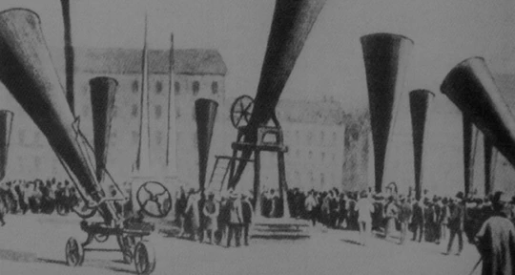
Weather modification history Intentional alteration of weather patterns
Ancient civilizations used rituals to control weather for agriculture and survival, not scientifically based, but reflect humanity's desire for weather control
Ancient Practices
James Pollard Espy's contribution : proposing theories on influencing rainfall and altering landscape for weather modification
19th century
Discovery of cloud seeding by Vonnegut, Langmuir, and Schaefer using silver iodide and Operation Popeye
In 1946
Prohibiting hostile use of weather modification by Environmental Modification Convention (ENMOD)
In 1978
Notes:
- Weather modification defined as intentional alteration of weather patterns
- Ancient Practices
Ancient civilizations used rituals to control weather for agriculture and survival
Practices not scientifically based, but reflect humanity's desire for weather control
- Early Scientific Endeavors
James Pollard Espy's contribution in 19th century proposing theories on influencing rainfall
Discussions on altering landscape for weather modification
- Modern Era Developments
1946: Discovery of cloud seeding by Vonnegut, Langmuir, and Schaefer
Birth of operational cloud seeding using silver iodide - Cloud seeding applications in research, commercial purposes, and military settings (Operation Popeye)
- Ethical and Environmental Debates
1978 Environmental Modification Convention (ENMOD) prohibiting hostile use of weather modification

Slide 8
Notes:
what is cloud seeding ?
- Cloud seeding is a technique aiming to enhance precipitation by introducing substances acting as ice nuclei or cloud condensation nuclei into clouds.
- Materials like silver iodide or dry ice are dispersed to stimulate ice crystal or water droplet formation, ultimately increasing rainfall or snowfall.

Slide 10
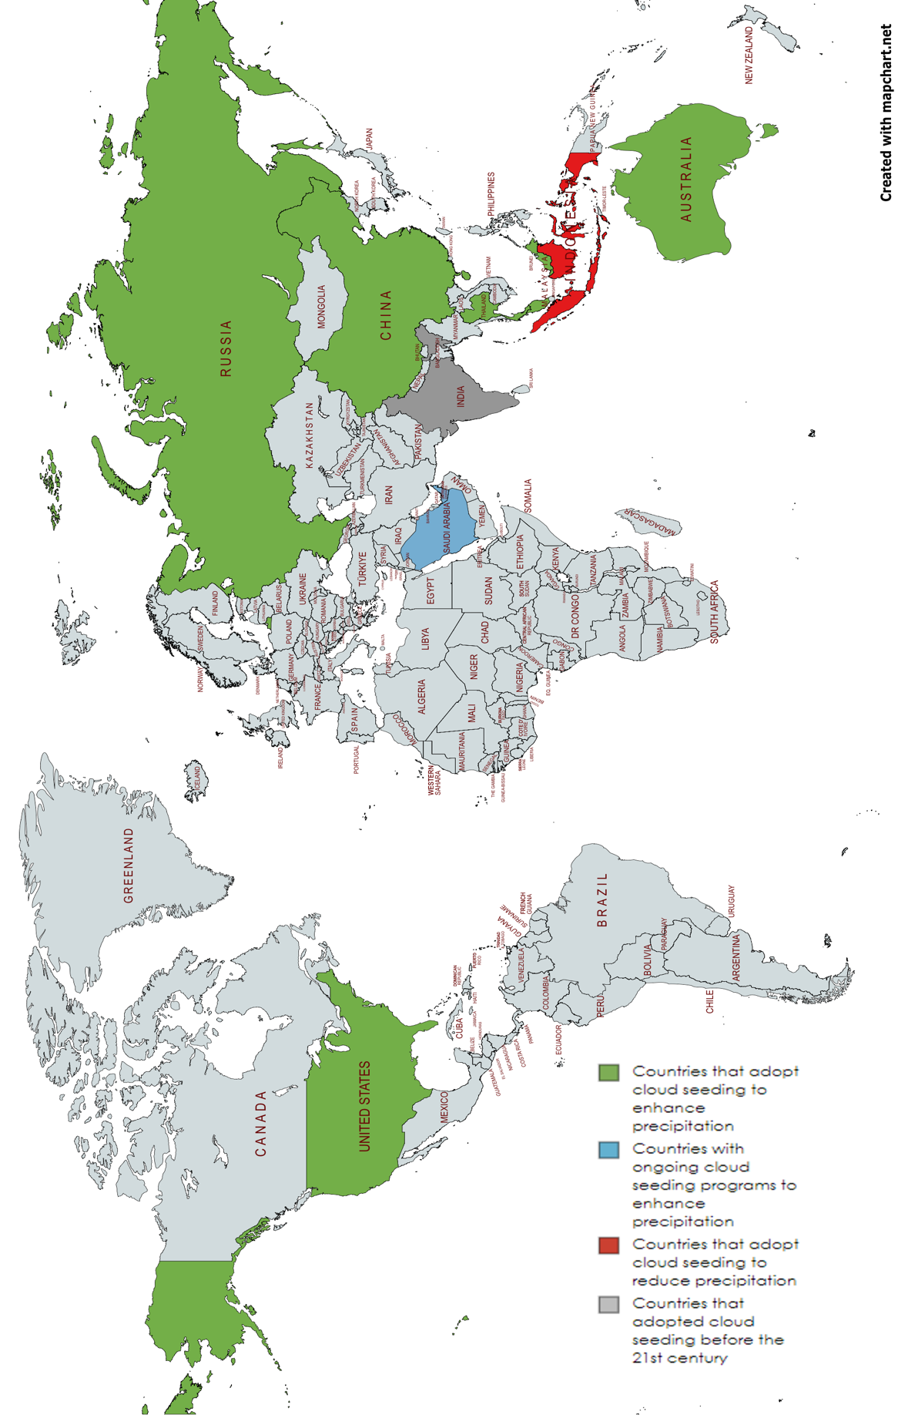

Slide 11
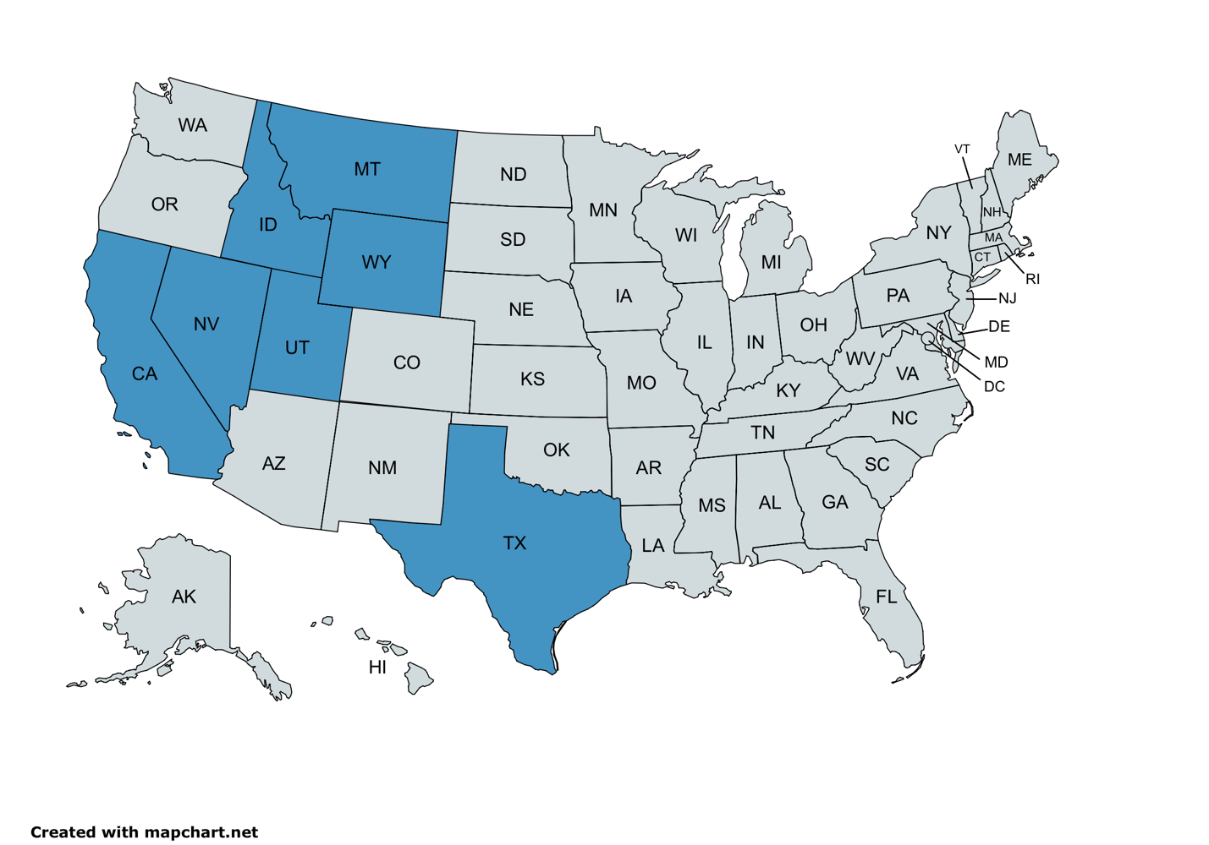

Slide 12
Valid techniques
1. Using Silver Iodide
Commonly used technique in cloud seeding for weather modification. Dispersed into clouds via ground-based generators or aircraft to serve as ice nuclei. Facilitates ice crystal formation, enhancing rainfall or snowfall.
2. Using Hygroscopic Flares
Involves flares containing hygroscopic materials like potassium chloride or sodium chloride. Flares ignited in clouds to release hygroscopic particles, absorbing moisture and potentially increasing rainfall
Notes:
1. Using Silver Iodide
- Commonly used technique in cloud seeding for weather modification
- Dispersed into clouds via ground-based generators or aircraft to serve as ice nuclei
- Facilitates ice crystal formation, enhancing rainfall or snowfall
- Scientific debate on effectiveness, with studies reporting positive effects in targeted areas
- Flaws and limitations include environmental impact, uncertainty about long-term effects, and potential unintended consequences
- Concerns about silver iodide impact on ecosystems and water quality, potential changes in precipitation patterns
2. Using Hygroscopic Flares
- Involves flares containing hygroscopic materials like potassium chloride or sodium chloride
- Flares ignited in clouds to release hygroscopic particles, absorbing moisture and potentially increasing rainfall
- Effectiveness subject to active research and debate, with mixed results in studies
- Evidence suggesting cloud seeding can enhance precipitation under specific meteorological conditions
- Notable advancements in cloud seeding techniques and materials, including the use of silver iodide and hygroscopic materials Slide

Slide 13
Scientific considerations
Ethical considerations
- Comprehensive reviews and studies casting doubt on the efficacy of cloud seeding in enhancing precipitation
- Challenges in proving effectiveness due to methodological issues and natural variability in weather patterns
- Lack of consistent scientific proof regarding the direct impact of cloud seeding on inducing rainfall
- Concerns about the statistical significance of many cloud-seeding experiments
- Environmental impact of seeding agents like silver iodide, and economic feasibility as key considerations
- Risks of unforeseen consequences, impacts on neighboring regions, and ecosystems not fully understood
- Potential for unpredictable outcomes affecting ecosystems, agriculture, and water resources
- Questions of fairness, equity, and lack of consent from communities affected by weather modification decisions
- Case studies highlighting negative impacts of weather modification experiments, such as snow blizzards in China Slide
Notes:
- Discuss the skepticism surrounding cloud seeding's effectiveness based on scientific literature and research findings
- Explain the methodological challenges in proving cloud seeding efficacy and the difficulty in attributing changes in precipitation to seeding efforts
- Highlight the environmental, ethical, and economic considerations associated with cloud seeding, including concerns about sustainability and impact on neighboring regions
- Emphasize the need for further research and controlled experiments to better understand the potential and limitations of cloud seeding

Slide 14
CHAPTER 2. ENHANCEMENT OF PRECIPITATION BY CLOUD SEEDING METHODS.
Global Precipitation Measurement mission
Precipitation enhancement by cloud seeding
Study area
Data analysis

Slide 15
Cloud Seeding Operations in Different Regions
Location | Year | Percent (%)
Wyoming | 2007 – 2011 | 5 – 15
Idaho | 2003 – 2022 | 4 – 7.1
Utah | 2021 - 2022 | 3 – 21
Texas | 2015 - 2022 | 9 – 20
Tasmania, Australia | Since 1960 | 5 – 14
Henan , China |  | 12.8 – 13.8
Fujian Gutianin , China |  | 24.16
UAE |  | 5 – 30
Notes:
- Discuss Tasmania's long-standing cloud seeding efforts and the challenges faced during the Snowy Mountains region operation in 2020
- Highlight China's extensive cloud seeding programs and the significant increases in rainfall recorded in various regions
- Explain the importance of cloud seeding in the Middle East to address water scarcity challenges and the positive outcomes observed in terms of increased rainfall
- Describe the UAE's advanced cloud seeding techniques and the promising results in enhancing precipitation and addressing water scarcity
- Summarize the cloud modification operations in Saudi Arabia and the significant findings on reflectivity and precipitation flux compared to natural clouds

Slide 16
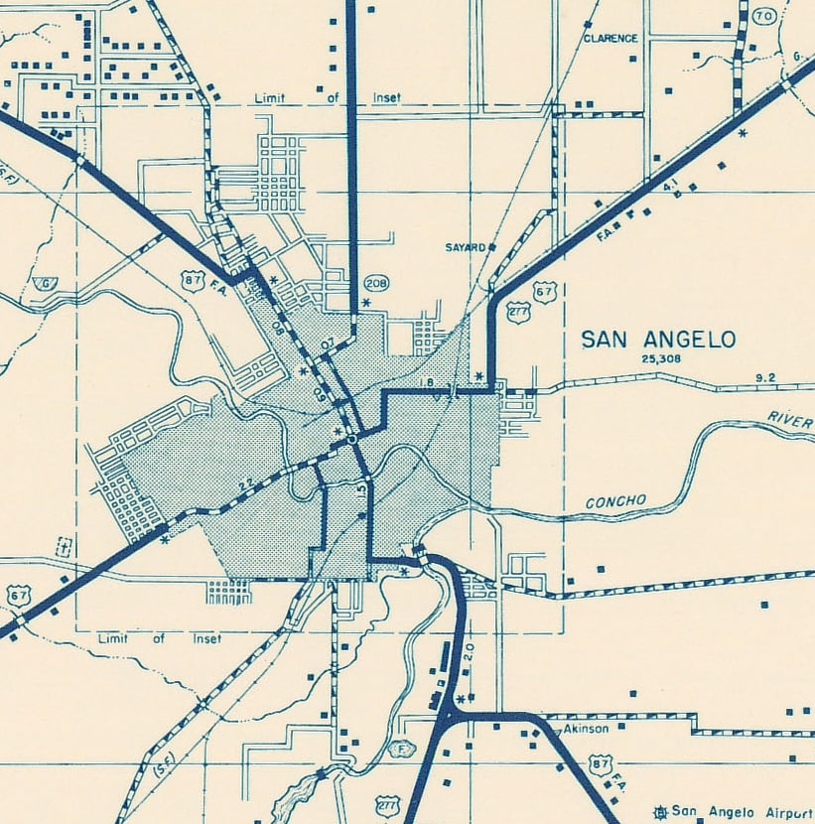
San Angelo, TX
- Overview of San Angelo
- Cloud Seeding Campaigns by WTWM
- Aim of cloud seeding
Year | # of seeded clouds | Percent (%)
2015 | 88 | 89 – 135%
2016 | 111 | 85 – 125%
2017 | 73 | 8 – 115%
2018 | 54 | 19 – 150%
2019 | 61 | 7 – 105%
2020 | 56 | 15 – 120%
Notes:
- Study Area: Overview of San Angelo, TX, USA and Tom Green County's diverse landscape
- Cloud Seeding Campaigns: Description of cloud seeding operations in Tom Green County to enhance precipitation and mitigate drought impact
- Objectives: Aim of cloud seeding to stimulate rainfall, bolster local water supply, and support agriculture
- Community Engagement:
Proactive approach of the community in managing water resources and promoting environmental sustainability
- Evaluation Reports: Summary of cloud seeding campaigns in Tom Green County from 2015-2020
- Effectiveness: Positive outcomes and impact of cloud seeding operations on increasing precipitation and cloud mass in the San Angelo area

Slide 17
- Overview of GPM Mission:
International initiative to improve understanding of global precipitation patterns and water cycle impact
- Launch Date:
GPM mission launched on February 27, 2014, through collaboration between NASA, JAXA, and other international partners
- Instruments:
Dual-frequency precipitation radar (DPR) and microwave imager (GMI) aboard the GPM Core Observatory satellite for precise precipitation measurements
- Applications and Benefits:
Role of GPM data in weather forecasting, hydrological studies, and climate research
- Weather Forecasting:
Enhancing precipitation estimates, improving weather models, and enabling reliable early warning systems for severe weather events
- Hydrological and Climate Studies:
Contribution to understanding the water cycle, assessing changes in rainfall distribution, and studying climate variability and trends Slide
Notes:
- Introduce the Global Precipitation Measurement (GPM) mission as an international collaboration to enhance global precipitation understanding and water cycle impact
- Explain the launch date of the GPM mission and the key instruments, such as the dual-frequency precipitation radar (DPR) and microwave imager (GMI) for precise precipitation measurements
- Discuss the applications and benefits of GPM data in weather forecasting, highlighting its role in improving precipitation estimates and enhancing weather models
- Emphasize the significance of GPM data in hydrological and climate studies, contributing to a better understanding of the water cycle and climate variability
- Present the role of GPM data in utilizing aerosol analysis for cloud seeding operations, detailing how GPM data provides insights into cloud behavior and characteristics

Slide 18
Data Analysis
Average precipitation during seeding seasons for the estimated precipitation before seeding scenario and the resulted precipitation after seeding for the three clouds types in Tom Green, TX during 2015 – 2020.
rates are 0.49 and 0.55.

Slide 19
CHAPTER 3: LONG-TERM STATISTICAL ANALYSIS.
AOD
analysis in
San Angelo TX
Ångström exponent concept
Terra/Aqua
MODIS
Ångström exponent analysis in San Angelo TX
Data analysis in last season
UAE case study
Cloud seeding impact in China

Slide 20
- Terra and Aqua Satellites:
Terra launched in 1999, Aqua in 2002 by NASA; instrumental in Earth observation
- MODIS Instrument:
Moderate Resolution Imaging Spectroradiometer on Terra and Aqua satellites
- Data Capture:
Captures images in 36 spectral bands, moderate spatial resolutions (250m to 1km), daily global coverage
- Applications of Terra/Aqua-MODIS:
Monitoring climate change indicators, land cover mapping, vegetation dynamics, air quality assessment
- Advantages:
Global coverage, spectral capabilities, regular revisit times for large-scale environmental monitoring
- Limitations:
Spatial resolution constraints, cloud cover interference, data processing challenges
Notes:
- The Terra and Aqua satellites, launched by NASA in 1999 and 2002, respectively, have been pivotal in Earth observation, providing valuable data for monitoring the Earth's surface and atmosphere.
- The MODIS instrument onboard Terra and Aqua satellites captures images in 36 spectral bands, offering detailed information on land, ocean, and atmospheric parameters at moderate spatial resolutions.
- Terra/Aqua-MODIS data have been extensively used to monitor climate change indicators, map land cover, analyze vegetation dynamics, and assess air quality, contributing to a better understanding of environmental processes.
- The advantages of Terra/Aqua-MODIS data include global coverage, spectral capabilities, and regular revisit times, enabling researchers and policymakers to make informed decisions based on comprehensive environmental data.
- Despite its advantages, Terra/Aqua-MODIS data have limitations, such as spatial resolution constraints, cloud cover interference, and challenges related to data processing that need to be considered when utilizing the data for analysis.
- The contributions of Terra/Aqua-MODIS data in advancing our understanding of Earth's dynamic processes are significant, and ongoing advancements in satellite technology and data analysis techniques hold promise for enhancing Earth observation capabilities in the future.

Slide 21
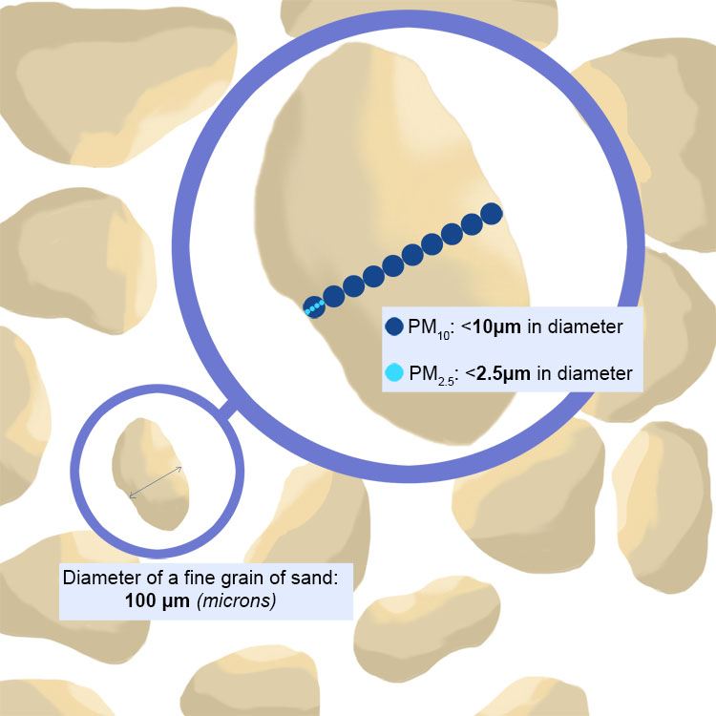
- Definition of Ångström exponent:
Parameter used in atmospheric science to describe aerosol particle size distribution
- Symbol and measurement:
Denoted by "α" and derived from light attenuation measurements at different wavelengths
- Relationship to aerosol particle size:
High α indicates small particles (<0.1 micrometers), low α indicates large particles (>1 micrometer)
-Properties of aerosols:
Small particles associated with combustion byproducts, large particles with natural sources
- Impacts of Ångström exponent:
High α leads to increased atmospheric haziness, reduced visibility, and formation of haze/smog
- Role in climate:
Low α can lead to localized heating effects, alter atmospheric temperature profile, and influence Earth's radiative balance
Notes:
- The Ångström exponent, represented by the symbol "α", is a parameter used in atmospheric science to characterize the size distribution of aerosol particles based on light attenuation measurements.
- High α values indicate the prevalence of small aerosol particles (<0.1 micrometers) in the atmosphere, often associated with combustion byproducts like smoke and exhaust emissions.
- Conversely, low α values suggest the presence of larger aerosol particles (>1 micrometer) from natural sources such as sea spray, dust, or pollen.
- The Ångström exponent provides insights into the properties and behavior of aerosols, with high α values leading to increased scattering of light and atmospheric haziness.
- This haziness can impact air quality, visibility, and contribute to the formation of haze or smog, affecting human health.
- On the other hand, low α values indicate aerosol particles that are more efficient at absorbing sunlight, potentially leading to localized heating effects, altering the atmosphere's temperature profile, and influencing Earth's radiative balance.

Slide 22
Higher temperatures can increase AOD levels by intensifying emissions from sources like industrial facilities and vehicular traffic, impacting regional air quality and climate change.
AOD exhibits complex behavior during rainstorms, with studies indicating a decrease in AOD during precipitation events due to aerosol scavenging.
The presence of silver iodide (AgI) in the air, particularly from cloud seeding operations, can influence AOD levels through complex chemical interactions and reactions.
Notes:
- Aerosol Optical Depth (AOD) serves as a crucial indicator of aerosol presence in the atmosphere, influenced by various factors like temperature and precipitation dynamics.
- Understanding the relationship between AOD and environmental variables is essential for addressing air quality, climate change, and broader environmental challenges.

Slide 23
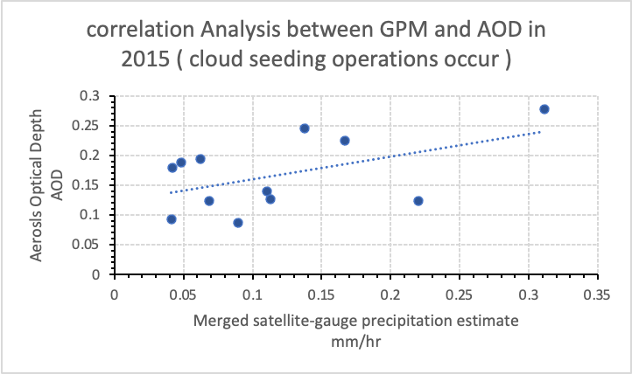
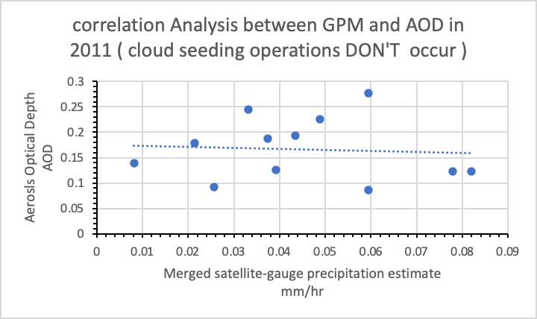
R = 0.50816871
R = -0.0755305
The correlation values are NOT significant
Notes:
- Precipitation measurement is crucial in understanding the relationship between rain and aerosols, as it influences aerosol concentrations through processes like wet deposition, scavenging, and coagulation.
- Intense precipitation events can lead to precipitation-induced washout, temporarily reducing aerosol concentrations in the atmosphere and impacting local air quality and climate.
- This study sheds light on the relationship between rainfall precipitation and aerosols in cloud seeding scenarios, emphasizing the complex interactions between cloud physics, rainfall, and aerosols.

Slide 24
On 6 out of 22 seeding days, AOD values were higher post-seeding, suggesting an increase in aerosol particles, possibly due to seeding agents like silver iodide (AgI).
AE values decreased on 11 out of 22 seeding days, indicating a shift towards larger aerosol particles, potentially influenced by aggregation around seeding agents.
Return of AE and AOD levels to baseline values post-seeding indicates transient effects of cloud seeding on atmospheric aerosol properties.
Notes:
- This study focuses on analyzing variations in AOD and AE during cloud seeding operations in 2023 to understand the immediate atmospheric consequences of seeding activities.
- Data collected from satellite observations and ground-based monitoring stations during a 22-day period in 2023 were analyzed to compare AOD and AE values on seeding days versus non-seeding days.

Slide 25
This review explores the relationship between cloud seeding and particulate matter dynamics in the UAE.
- Study Findings:
A study in the UAE analyzed cloud seeding missions' impact on air quality. The research focused on PM10 and PM2.5 concentrations during and after the cloud seeding missions.
- Aerosol Optical Depth (AOD) Trends:
AOD trends varied seasonally, affecting aerosol loadings in the atmosphere. The study observed higher AOD values during summer due to factors like dry soil and anthropogenic aerosol loadings.
- Impact on Precipitation:
Cloud seeding increased precipitation rates, washing out aerosol particles. The study showed that the 2017 cloud seeding project contributed to lower AOD during the spring.
- Air Quality Monitoring:
Data from air quality stations revealed an increase in PM10 concentrations compared to PM2.5 during cloud seeding missions. The research highlighted the formation of PMs due to silver iodine crystals used in cloud seeding.

Slide 26
China
- Aim of cloud seeding in China: Increase precipitation and potentially reduce air pollution.
- Concerns: Introduction of additional particles into the air through seeding process.
- Studies examining effects of cloud seeding on air quality and particulate matter in China. Positive and negative impacts observed based on factors such as seeding methods and meteorological conditions.
- Impact of cloud seeding on aerosol concentrations and air quality in Beijing. Changes in aerosol properties and concentrations observed.
Notes:
China has been actively engaged in cloud seeding operations as a means to augment precipitation, particularly in regions facing water scarcity.
The relationship between cloud seeding and air quality in China is multifaceted. While cloud seeding aims to enhance precipitation, which can potentially reduce air pollution by removing particles from the atmosphere through rainout, there are concerns regarding the introduction of additional particles into the air during the seeding process.
Various studies have been conducted to understand the impact of cloud seeding on air quality and particulate matter dynamics in China. These studies have revealed that the effects of cloud seeding can vary, with both positive and negative impacts observed depending on factors such as seeding methods, meteorological conditions, and the type of aerosols used for seeding.
For instance, a study conducted in Beijing investigated the impact of cloud seeding on aerosol concentrations and air quality. The findings indicated that cloud seeding resulted in changes in aerosol properties and concentrations, which influenced air quality in the region.
Another study focused on a specific region of China and analyzed the influence of cloud seeding activities on particulate matter levels. This study emphasized the importance of considering the environmental consequences of cloud seeding on air quality and particulate matter concentrations.

Slide 27
CHAPTER 4. IMPACT OF CLOUD SEEDING ON HYDROLOGYCAL PROCESSES
Methods
Results
Discussion

Slide 28
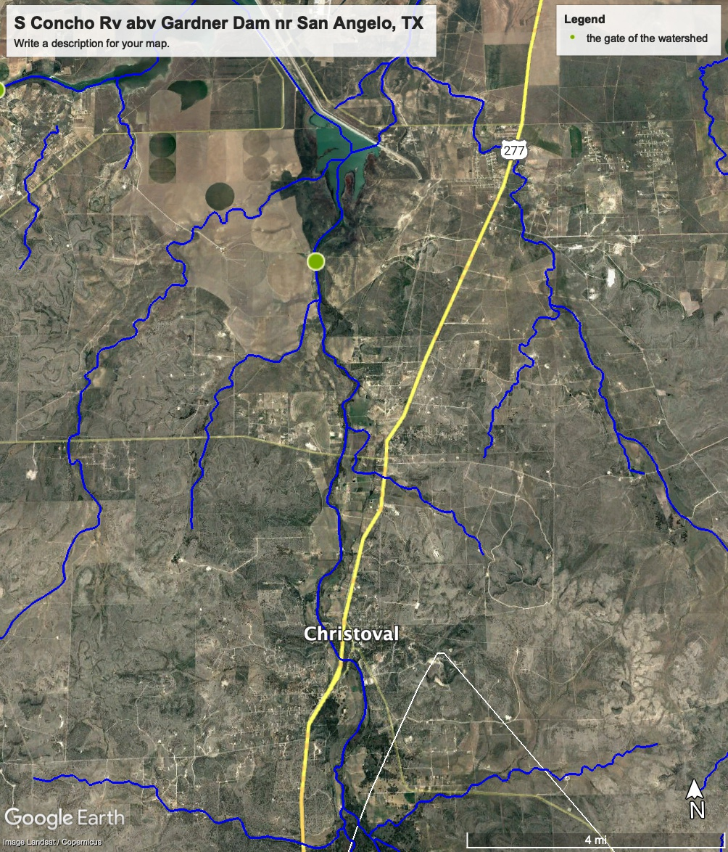
Assessing the impact of cloud seeding on hydrological processes in San Angelo TX
Data Collection
Analysis of annual reports from WTWMA to calculate estimated precipitation before and after seeding in Tom Green County.
Selection of S Concho Rv at Christoval, TX gauge for river flow data, considering its location within the seeding area.
River Flow Data Analysis
Daily discharge data obtained from USGS for S Concho Rv at Christoval, TX gauge.
Hydrological Process Understanding
Collection of DEM, land cover, and soil data for South Concho River at Christoval, TX watershed area. Generation of stream runoff using QGIS software. Utilization of curve number method to estimate stormwater runoff potential.
Equation for Runoff Calculation
$Q=\frac{{\left(P−0.2S\right)}^{2}}{P+0.8S}$ (1)
$S=\frac{1000}{CN}−10$ (2)
Notes:
Slide Notes:
The methodology employed in this study involved multiple steps to analyze the impact of cloud seeding on precipitation and hydrological processes in the study area.Annual reports from the West Texas Weather Modification Association were scrutinized to assess the effect of seeding on precipitation patterns before and after seeding in Tom Green County.Seeding days during the last season (2023) were determined using MODIS satellite data from the GIOVANNI platform, aiding in understanding the temporal distribution of seeding activities.River flow data, crucial for evaluating the impact of seeding on water resources, were obtained from the USGS for the selected gauge at S Concho Rv at Christoval, TX, and compared with a gauge outside the seeding area.To delve deeper into the hydrological processes, detailed data on DEM, land cover, and soil were collected for the watershed area. This information facilitated the generation of stream runoff using Geographic Information System (GIS) software, particularly QGIS.The curve number method, a widely used technique for estimating stormwater runoff, was applied. This method involves equations (1) and (2) to calculate runoff based on precipitation, potential maximum retention (S), and curve number (CN) values derived from the collected data and analysis.

Slide 29
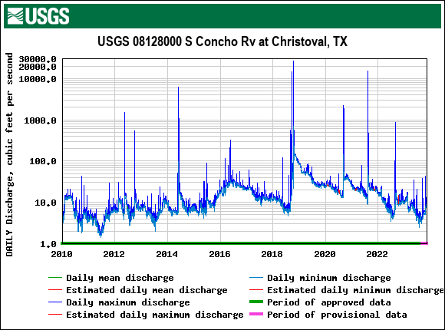

Slide 30
Pre-Cloud Seeding Conditions
Water quality and ecosystem influenced by natural factors and human activities like agricultural runoff and urban development.
Watershed ecosystems adapted to natural precipitation variability.
Outcomes of Cloud Seeding
Increased precipitation leading to higher runoff levels and potentially enhanced water flow through the watershed.
Potential benefits for ecosystems, especially in drought-prone areas, by supporting diverse plant and animal life and improving aquatic ecosystem health.
Impact on Water Quality
Debate on the impact of cloud seeding on water quality.
Silver iodide considered relatively insoluble and low in toxicity, but long-term or large-scale operations could pose risks.
Ecosystem Changes
Alteration of precipitation patterns can shift vegetation patterns and habitat structures.
Positive changes like increased plant growth balanced with potential negative impacts such as favoring invasive species or altering fire regimes.
Concerns and Research
Discussions about accumulation of AgI and potential impacts on soil and water ecosystems.
Research indicates concentrations from cloud seeding are generally below levels harmful to the environment, but continuous monitoring is crucial.
Notes:
Before the implementation of cloud seeding, the water quality and ecosystem dynamics in the San Angelo area were predominantly influenced by natural factors such as weather patterns, alongside human activities like agriculture and urban development. Ecosystems were adapted to the variability of precipitation and runoff, with species compositions reflecting these natural conditions.Cloud seeding operations, primarily aimed at increasing precipitation, could lead to changes in runoff patterns, potentially increasing water flow through the watershed. This increased water availability might positively impact ecosystems, particularly in areas susceptible to drought, by fostering a broader range of plant and animal life and enhancing the health of aquatic ecosystems.The impact of cloud seeding on water quality remains a topic of discussion. While silver iodide, the commonly used seeding agent, is deemed relatively insoluble and low in toxicity, concerns arise regarding potential risks from long-term or large-scale operations. Scientific studies specifically examining these effects are necessary to draw definitive conclusions.Changes in precipitation patterns resulting from cloud seeding could trigger shifts in ecosystems, affecting vegetation patterns and habitat structures. While some changes may be beneficial, such as increased vegetation growth, there could also be negative consequences such as the proliferation of invasive species or alterations in natural fire regimes.Concerns about the accumulation of silver iodide and its potential environmental impacts are often raised. However, research suggests that concentrations resulting from cloud seeding are typically below levels that would cause harm. Nonetheless, ongoing monitoring is essential to ensure that cumulative effects do not pose risks to the environment.

Slide 31
CHAPTER 5 : EVALUATING CLOUD SEEDING’S ROLE IN ATMOSPHERIC AEROSOLS AND AIR QUALITY DYNAMICS
Factors impacting on cloud seeding efficiency
Cloud seeding failure on aerosols
Failure of cloud seeding events identification
This Photo by Unknown Author is licensed under CC BY

Slide 32
Geographical Location
Existing Air Pollution Levels
Type of Cloud Seeding Techniques
Local Topography
Meteorological Conditions
Variations in meteorological conditions, atmospheric composition, and local environmental factors influence cloud seeding outcomes.
Unique atmospheric conditions like humidity, temperature, and wind patterns impact aerosol dispersion and cloud interaction.
Topography affects cloud dynamics, precipitation patterns, and aerosol distribution.
Cloud type, base height, and vertical motion influence cloud seeding success and subsequent air quality effects.
Atmospheric stability, wind speed, and direction affect seeding agent dispersion and air pollutant transport.
Temperature and humidity levels influence cloud properties and precipitation processes, shaping aerosol behavior.
Interaction between cloud seeding and air pollution alters aerosol composition and air quality.
Polluted air masses affect cloud microphysics and precipitation processes, impacting air quality outcomes.
Cloud seeding may remove pollutants through precipitation or introduce additional particles, influencing pollution levels.
Choice of seeding agent and method impacts aerosol formation and dispersion.
Different techniques target specific cloud types, affecting precipitation efficiency and air quality.
Environmental implications, including agent persistence and interaction with existing aerosols, should be considered.
Topographic features influence cloud dynamics, precipitation patterns, and aerosol dispersion.
Orographic lifting and wind patterns affect cloud seeding outcomes and air quality impacts.
Elevation changes and terrain barriers lead to localized air quality effects in different microclimates.

Slide 33
Introduction:
Cloud seeding, aimed at enhancing precipitation, introduces particles like silver iodide or salt into clouds.
Failed cloud seeding operations may lead to unintended consequences for atmospheric aerosols.
Alteration of Aerosol Composition:
Failed cloud seeding may alter aerosol size distribution and composition in the atmosphere.
Changes in aerosol composition can impact cloud microphysics and precipitation processes.
Persistence of seeding agents like silver iodide may influence nucleation processes.
Influence on Atmospheric Processes:
Altered aerosol composition could have broader environmental and climatic implications.
Unintended aerosol effects may impact Earth's radiative balance and modify local weather patterns.
Research Gaps and Future Directions:
Limited research specifically addresses the effects of failed cloud seeding on atmospheric aerosols.
Empirical studies are needed to assess real-world consequences of seeding agent dispersion.
Quantifying persistence and behavior of seeding materials under various conditions is essential.
Future studies should aim to understand implications for aerosol-cloud interactions, weather patterns, and climate.

Slide 34
Factors Contributing to Cloud Seeding Failures:
Unsuitable meteorological conditions and inadequate seeding materials or techniques
Notable Failure Events:
Wyoming Weather Modification Pilot Project
Queensland Cloud Seeding Research Program
Long-term cloud seeding experiment in the Middle East
Notes:
Factors Contributing to Cloud Seeding Failures:
Mention various factors contributing to cloud seeding failures, such as unsuitable meteorological conditions and inadequate seeding materials or techniques.
Explain how the effectiveness of cloud seeding can vary significantly with the type of clouds targeted and the atmospheric conditions present during seeding operations.
Stress the importance of utilizing control areas and advanced statistical methods for accurate assessment of outcomes.
Notable Failure Events:
Highlight notable examples of cloud seeding failure events, including:
Wyoming Weather Modification Pilot Project
Queensland Cloud Seeding Research Program
Long-term cloud seeding experiment in the Middle East

Slide 35
Conclusion
- Review of Impact of Cloud Seeding on Air Quality and Particulate Matter Dynamics
- Factors Influencing Cloud Seeding Effects in Different Geographical Regions
- UAE: Local weather conditions contributing to coarse particle formation
- China: Influence of meteorological conditions on effectiveness and environmental impact
- San Angelo, TX: Transient impact of cloud seeding on atmospheric aerosol properties
- Importance of Existing Air Pollution Levels
- Nuanced Understanding of Cloud Seeding Interactions with Atmospheric Conditions
- Implications for Particulate Matter Concentrations in the Atmosphere
- Complex and Multifaceted Environmental Impacts of Cloud Seeding
- Need for Further Research on Long-Term Impacts and Sustainability of Cloud Seeding
Notes:
- Summarize the findings on cloud seeding effects in UAE, China, and San Angelo, TX
- Emphasize the importance of considering various factors in assessing environmental implications
- Discuss the influence of meteorological conditions, air pollution levels, and seeding techniques on particulate matter dynamics
- Highlight the nuanced understanding of cloud seeding interactions with atmospheric conditions
- Point out the need for further research to understand long-term impacts and ensure environmental sustainability
- Conclude by stressing the importance of balancing benefits of cloud seeding with environmental costs and the need for responsible cloud seeding strategies.

Slide 36
References
(1)Fleming, J. R. Meteorology in America, 1800-1870; John Hopkins Univ. Press: Baltimore, Md., 1990.
(2)Langmuir, I. THE PRODUCTION OF RAIN BY A CHAIN REACTION IN CUMULUS CLOUDS AT TEMPERATURES ABOVE FREEZING. J. Meteor. 1948, 5 (5), 175–192. https://doi.org/10.1175/1520-0469(1948)005<0175:TPORBA>2.0.CO;2.
(3)WEATHER MODIFICATION : PROGRAMS, PROBLEMS, POLICY, AND POTENTIAL. U.S. Govt. Print. Off. 1978.
(4)Latham, J.; Bower, K.; Choularton, T.; Coe, H.; Connolly, P.; Cooper, G.; Craft, T.; Foster, J.; Gadian, A.; Galbraith, L.; Iacovides, H.; Johnston, D.; Launder, B.; Leslie, B.; Meyer, J.; Neukermans, A.; Ormond, B.; Parkes, B.; Rasch, P.; Rush, J.; Salter, S.; Stevenson, T.; Wang, H.; Wang, Q.; Wood, R. Marine Cloud Brightening. Phil. Trans. R. Soc. A. 2012, 370 (1974), 4217–4262. https://doi.org/10.1098/rsta.2012.0086.
(5)Roelof T, B.; Vidal, S.; Trudi A, S.; Peter, B.; Daniel W, B.; Jim, G. Evaluation of Hygroscopic Cloud Seeding Flares. No. Vol. 44 No. 1 (2012). https://doi.org/10.54782/jwm.v44i1.85.
(6)Mandous, A.; Abshaev, M.; Abshaev, A.; Mazroui, A.; Muhairi, M.; Bojkov, R. Achievements In Weather Modification - Uae Prize For Weather Modification, Article: Development of Rocket and Artillery Technology for Hail Suppression, Copyrights © Department Atmospheric Studies, Ministry for Presidential Affairs, p.o.Box 4815, Abu Dhabi, UAE, Fax +9712 642-7711; 2006.
(7)Wan, X.; Zhou, S.; Fan, Z. Comprehensive Efficiency Evaluation of Aircraft Artificial Cloud Seeding in Hunan Province, China, Based on Numerical Simulation Catalytic Method. Atmosphere 2023, 14 (7), 1187. https://doi.org/10.3390/atmos14071187.
(8)Don A, G.; Mark E, S.; David P, Y. 30+ Winter Seasons Of Operational Cloud Seeding In Utah. No. Vol. 41 No. 1 (2009). https://doi.org/10.54782/jwm.v41i1.175.
(9)Breed, D.; Rasmussen, R.; Weeks, C.; Boe, B.; Deshler, T. Evaluating Winter Orographic Cloud Seeding: Design of the Wyoming Weather Modification Pilot Project (WWMPP). Journal of Applied Meteorology and Climatology 2014, 53 (2), 282–299. https://doi.org/10.1175/JAMC-D-13-0128.1.
(10)Arquímedes, R.-C. West Texas Weather Modification Association; San Angelo, TX. https://westtxwxmod.com/?page_id=24.
(11)Zheng, W.; Ma, H.; Zhang, M.; Xue, F.; Yu, K.; Yang, Y.; Ma, S.; Wang, C.; Pan, Y.; Shu, Z.; Mu, J.; Yang, W.; Yin, X. Evaluation of the First Negative Ion-Based Cloud Seeding and Rain Enhancement Trial in China. Water 2021, 13 (18), 2473. https://doi.org/10.3390/w13182473.
(12)Murty, B.; Biswas, R. Weather Modification in India. Journal of the Meteorological Society of Japan. Ser. II 1968, 46, 160–165. https://doi.org/10.2151/jmsj1965.46.3_160.
(13)Almheiri, K. B.; Rustum, R.; Wright, G.; Adeloye, A. J. Study of Impact of Cloud-Seeding on Intensity-Duration-Frequency (IDF) Curves of Sharjah City, the United Arab Emirates. Water 2021, 13 (23), 3363. https://doi.org/10.3390/w13233363.
(14)Fonseca, R.; Francis, D.; Nelli, N.; Farrah, S.; Wehbe, Y.; Al Hosari, T.; Al Mazroui, A. Assessment of the WRF Model as a Guidance Tool Into Cloud Seeding Operations in the United Arab Emirates. Earth and Space Science 2022, 9 (5), e2022EA002269. https://doi.org/10.1029/2022EA002269.
(15)Benjamini, Y.; Givati, A.; Khain, P.; Levi, Y.; Rosenfeld, D.; Shamir, U.; Siegel, A.; Zipori, A.; Ziv, B.; Steinberg, D. M. The Israel 4 Cloud Seeding Experiment: Primary Results. Journal of Applied Meteorology and Climatology 2023, 62 (3), 317–327. https://doi.org/10.1175/JAMC-D-22-0077.1.
(16)Paul, K.; Duncan, A.; Roelof P, B.; Don R, C.; Runjun, L.; Michael, C.; Rafael, P.; Terry W, K.; Ayman S, G. Features of the Weather Modification Assesment Project in Southwest Region of Saudi Arabia. No. Vol. 42 No. 1 (2010). https://doi.org/10.54782/jwm.v42i1.162.
(17)Sinkevich, A. A.; Crauss, T. W. Cloud Modification in Saudi Arabia: Statistical Estimation of the Results. Russ. Meteorol. Hydrol. 2010, 35 (6), 378–385. https://doi.org/10.3103/S1068373910060038.
(18)Wehbe, Y. The Growing Interest in Cloud Seeding Technology in the Gulf. June 13, 2022. https://www.mei.edu/publications/looking-skies-growing-interest-cloud-seeding-technology-gulf.
(19)Wu, X.; Yan, N.; Yu, H.; Niu, S.; Meng, F.; Liu, W.; Sun, H. Advances in the Evaluation of Cloud Seeding: Statistical Evidence for the Enhancement of Precipitation. Earth and Space Science 2018, 5 (9), 425–439. https://doi.org/10.1029/2018EA000424.
(20)Cooper, C. F.; Jolly, W. C. Ecological Effects of Silver Iodide and Other Weather Modification Agents: A Review. Water Resources Research 1970, 6 (1), 88–98. https://doi.org/10.1029/WR006i001p00088.
(21)Rosenfeld, D.; Axisa, D.; Woodley, W. L.; Lahav, R. A Quest for Effective Hygroscopic Cloud Seeding. Journal of Applied Meteorology and Climatology 2010, 49 (7), 1548–1562.
(22)Bruintjes, R. T. A Review of Cloud Seeding Experiments to Enhance Precipitation and Some New Prospects. Bull. Amer. Meteor. Soc. 1999, 80 (5), 805–820. https://doi.org/10.1175/1520-0477(1999)080<0805:AROCSE>2.0.CO;2.
(23)Garstang, M.; Bruintjes, R.; Serafin, R.; Orville, H.; Boe, B.; Cotton, W.; Warburton, J. Weather Modification: Finding Common Ground. Bull. Amer. Meteor. Soc. 2005, 86 (5), 647–656. https://doi.org/10.1175/BAMS-86-5-647.
(24)Huynh, H. N.; McNeill, V. F. The Potential Environmental and Climate Impacts of Stratospheric Aerosol Injection: A Review. Environ. Sci.: Atmos. 2024, 4 (2), 114–143. https://doi.org/10.1039/D3EA00134B.
(25)Critical Issues in Weather Modification Research; National Academies Press: Washington, D.C., 2003; p 10829. https://doi.org/10.17226/10829.
(26)Brownlee, K. A. Statistical Evaluation of Cloud Seeding Operations. Journal of the American Statistical Association 1960, 55 (291), 446–453. https://doi.org/10.1080/01621459.1960.10482074.
(27)Bangsund, D. Economic Impacts of Cloud Seeding on Agricultural Crops. Agribusiness & Applied Economics Report No. 791 2019.
(28)Palmer, T.; Stevens, B. The Scientific Challenge of Understanding and Estimating Climate Change. Proc. Natl. Acad. Sci. U.S.A. 2019, 116 (49), 24390–24395. https://doi.org/10.1073/pnas.1906691116.
(29)Planned Weather Modification through Cloud Seeding. American Meteorological Society. https://www.ametsoc.org/index.cfm/ams/about-ams/ams-statements/archive-statements-of-the-ams/planned-weather-modification-through-cloud-seeding/.
(30)Simms, V. Making the Rain: Cloud Seeding, the Imminent Freshwater Crisis, and International Law. 2010.
(31)Birnbaum, M. A ‘Climate Solution’ That Spies Worry Could Trigger War. February 27, 2023. https://www.washingtonpost.com/climate-environment/2023/02/27/geoengineering-security-war/.
(32)Golden, K. Cloud Seeding as a Water Management Tool–The Idaho Approach; IWRB Cloud Seeding Program: Central Oregon Farm Fair, 2023. https://olis.oregonlegislature.gov/liz/2023R1/Downloads/PublicTestimonyDocument/63133.
(33)Morrison, A. E.; Siems, S. T.; Manton, M. J.; Nazarov, A. On the Analysis of a Cloud Seeding Dataset over Tasmania. Journal of Applied Meteorology and Climatology 2009, 48 (6), 1267–1280. https://doi.org/10.1175/2008JAMC2068.1.
(34)Novo, C. Cloud-Seeding Will Be Used to Increase Rainfall in Saudi Arabia. February 26, 2020.

Slide 37
(35)RADWAN, R. How Artificial Rain Can Make a Difference to Saudi Arabia and Gulf Region’s Water Situation. June 13, 2022. https://www.arabnews.com/node/2091101/middle-east.
(36)Kawara, A. Q.; Elsebaie, I. H. Development of Rainfall Intensity, Duration and Frequency Relationship on a Daily and Sub-Daily Basis (Case Study: Yalamlam Area, Saudi Arabia). Water 2022, 14 (6), 897. https://doi.org/10.3390/w14060897.
(37)Cotton, W. R.; Yuter, S. Principles of Cloud and Precipitation Formation. In Aerosol Pollution Impact on Precipitation; Levin, Z., Cotton, W. R., Eds.; Springer Netherlands: Dordrecht, 2009; pp 13–43. https://doi.org/10.1007/978-1-4020-8690-8_2.
(38)DeMott, P. J.; Prenni, A. J.; Liu, X.; Kreidenweis, S. M.; Petters, M. D.; Twohy, C. H.; Richardson, M. S.; Eidhammer, T.; Rogers, D. C. Predicting Global Atmospheric Ice Nuclei Distributions and Their Impacts on Climate. Proc. Natl. Acad. Sci. U.S.A. 2010, 107 (25), 11217–11222. https://doi.org/10.1073/pnas.0910818107.
(39)Skofronick-Jackson, G.; Petersen, W. A.; Berg, W.; Kidd, C.; Stocker, E. F.; Kirschbaum, D. B.; Kakar, R.; Braun, S. A.; Huffman, G. J.; Iguchi, T.; Kirstetter, P. E.; Kummerow, C.; Meneghini, R.; Oki, R.; Olson, W. S.; Takayabu, Y. N.; Furukawa, K.; Wilheit, T. The Global Precipitation Measurement (GPM) Mission for Science and Society. Bulletin of the American Meteorological Society 2017, 98 (8), 1679–1695. https://doi.org/10.1175/BAMS-D-15-00306.1.
(40)Wu, Y.; Wang, Y.; Zhou, Y.; Liu, X.; Tang, Y.; Wang, Y.; Zhang, R.; Li, Z. The Wet Scavenging of Air Pollutants through Artificial Precipitation Enhancement: A Case Study in the Yangtze River Delta. Front. Environ. Sci. 2022, 10, 1027902. https://doi.org/10.3389/fenvs.2022.1027902.
(41)NASA EarthData : GIOVANNI. https://giovanni.gsfc.nasa.gov/giovanni/.
(42)Jiang, M.; Li, Z.; Wan, B.; Cribb, M. Impact of Aerosols on Precipitation from Deep Convective Clouds in Eastern China. JGR Atmospheres 2016, 121 (16), 9607–9620. https://doi.org/10.1002/2015JD024246.
(43)Moderate Resolution Imaging Spectroradiometer Official Website. https://modis.gsfc.nasa.gov/.
(44)Helin, A.; Virkkula, A.; Backman, J.; Pirjola, L.; Sippula, O.; Aakko‐Saksa, P.; Väätäinen, S.; Mylläri, F.; Järvinen, A.; Bloss, M.; Aurela, M.; Jakobi, G.; Karjalainen, P.; Zimmermann, R.; Jokiniemi, J.; Saarikoski, S.; Tissari, J.; Rönkkö, T.; Niemi, J. V.; Timonen, H. Variation of Absorption Ångström Exponent in Aerosols From Different Emission Sources. JGR Atmospheres 2021, 126 (10), e2020JD034094. https://doi.org/10.1029/2020JD034094.
(45)Randles, C. A.; Da Silva, A. M.; Buchard, V.; Colarco, P. R.; Darmenov, A.; Govindaraju, R.; Smirnov, A.; Holben, B.; Ferrare, R.; Hair, J.; Shinozuka, Y.; Flynn, C. J. The MERRA-2 Aerosol Reanalysis, 1980 Onward. Part I: System Description and Data Assimilation Evaluation. J. Climate 2017, 30 (17), 6823–6850. https://doi.org/10.1175/JCLI-D-16-0609.1.
(46)National Center for Biotechnology Information. Silver Iodide. In PubChem Compound Summary for CID 24563.
(47)Fajardo, C.; Costa, G.; Ortiz, L. T.; Nande, M.; Rodríguez-Membibre, M. L.; Martín, M.; Sánchez-Fortún, S. Potential Risk of Acute Toxicity Induced by AgI Cloud Seeding on Soil and Freshwater Biota. Ecotoxicology and Environmental Safety 2016, 133, 433–441. https://doi.org/10.1016/j.ecoenv.2016.06.028.
(48)Sotoudeheian, S.; Arhami, M. Estimating Ground-Level PM10 Using Satellite Remote Sensing and Ground-Based Meteorological Measurements over Tehran. J Environ Health Sci Engineer 2014, 12 (1), 122. https://doi.org/10.1186/s40201-014-0122-6.
(49)Kim, K. D.; Lee, S.; Kim, J.-J.; Lee, S.-H.; Lee, D.; Lee, J.-B.; Choi, J.-Y.; Kim, M. J. Effect of Wet Deposition on Secondary Inorganic Aerosols Using an Urban-Scale Air Quality Model. Atmosphere 2021, 12 (2), 168. https://doi.org/10.3390/atmos12020168.
(50)Nishikawa, T.; Okabe, S.; Aoki, M. Monte Carlo Calculation of Gamma-Ray Flux Density Due to Atmospheric Radon Daughters. Journal of Nuclear Science and Technology 1989, 26 (5), 525–529. https://doi.org/10.1080/18811248.1989.9734342.
(51)Farahat, A.; Abuelgasim, A. Effect of Cloud Seeding on Aerosol Properties and Particulate Matter Variability in the United Arab Emirates. Int. J. Environ. Sci. Technol. 2022, 19 (2), 951–968. https://doi.org/10.1007/s13762-020-03057-5.
(52)Ku, J. M.; Chang, K.-H.; Chae, S.; Ko, A.-R.; Ro, Y.; Jung, W.; Lee, C. Preliminary Results of Cloud Seeding Experiments for Air Pollution Reduction in 2020. Asia-Pac J Atmos Sci 2023. https://doi.org/10.1007/s13143-023-00315-7.
(53)Maboa, R.; Yessoufou, K.; Tesfamichael, S.; Shiferaw, Y. A. Sizes of Atmospheric Particulate Matters Determine the Outcomes of Their Interactions with Rainfall Processes. Sci Rep 2022, 12 (1), 17467. https://doi.org/10.1038/s41598-022-22558-6.
(54)Che, Y.; Zhang, J.; Zhao, C.; Fang, W.; Xue, W.; Yang, W.; Ji, D.; Dang, J.; Duan, J.; Sun, J.; Shen, X.; Zhou, X. A Study on the Characteristics of Ice Nucleating Particles Concentration and Aerosols and Their Relationship in Spring in Beijing. Atmospheric Research 2021, 247, 105196. https://doi.org/10.1016/j.atmosres.2020.105196.
(55)Wang, F.; Li, Z.; Jiang, Q.; Wang, G.; Jia, S.; Duan, J.; Zhou, Y. Evaluation of Hygroscopic Cloud Seeding in Liquid-Water Clouds: A Feasibility Study. Atmos. Chem. Phys. 2019, 19 (23), 14967–14977. https://doi.org/10.5194/acp-19-14967-2019.
(56)Novo, A.; Garrido, I.; Lorenzo, H.; Arias, P. Use of Geographic Information Systems (GIS) in Higher Education: Practical Geomatics Applications with Quantum GIS Software. In 2022 International Symposium on Computers in Education (SIIE); IEEE: Coimbra, Portugal, 2022; pp 1–6. https://doi.org/10.1109/SIIE56031.2022.9982364.
(57)Geographical Information Systems and Science, 2nd ed.; Longley, P., Ed.; Wiley: Chichester ; Hoboken, NJ, 2005.
(58)S CONCHO RV AT CHRISTOVAL FLOW REPORT; 2024. https://snoflo.org/report/flow/texas/s-concho-rv-at-christoval/.
(59)USGS Water Data for USA. https://waterdata.usgs.gov/nwis.
(60)CONCHO RV AT PAINT ROCK FLOW REPORT; 2024. https://snoflo.org/report/flow/texas/concho-rv-at-paint-rock/#:~:text=The%20Concho%20RV%20at%20Paint,also%20contribute%20to%20the%20flow.
(61)Lee, K. K. F.; Ling, L.; Yusop, Z. The Revised Curve Number Rainfall–Runoff Methodology for an Improved Runoff Prediction. Water 2023, 15 (3), 491. https://doi.org/10.3390/w15030491.
(62)Salimi, S.; Almuktar, S. A. A. A. N.; Scholz, M. Impact of Climate Change on Wetland Ecosystems: A Critical Review of Experimental Wetlands. Journal of Environmental Management 2021, 286, 112160. https://doi.org/10.1016/j.jenvman.2021.112160.
(63)Wood, R.; Ackerman, T. P. Defining Success and Limits of Field Experiments to Test Geoengineering by Marine Cloud Brightening. Climatic Change 2013, 121 (3), 459–472. https://doi.org/10.1007/s10584-013-0932-z.
(64)Rosenfeld, D.; Andreae, M. O.; Asmi, A.; Chin, M.; De Leeuw, G.; Donovan, D. P.; Kahn, R.; Kinne, S.; Kivekäs, N.; Kulmala, M.; Lau, W.; Schmidt, K. S.; Suni, T.; Wagner, T.; Wild, M.; Quaas, J. Global Observations of Aerosol-Cloud-Precipitation-Climate Interactions: Aerosol-Cloud-Climate Interactions. Rev. Geophys. 2014, 52 (4), 750–808. https://doi.org/10.1002/2013RG000441.
(65)Flossmann, A. I.; Manton, M.; Abshaev, A.; Bruintjes, R.; Murakami, M.; Prabhakaran, T.; Yao, Z. Review of Advances in Precipitation Enhancement Research. Bulletin of the American Meteorological Society 2019, 100 (8), 1465–1480. https://doi.org/10.1175/BAMS-D-18-0160.1.
(66)Jung, W.; Chang, K.-H.; Ko, A.-R.; Ku, J. M.; Ro, Y.; Chae, S.; Cha, J. W.; Lee, C. Meteorological Conditions for the Cloud Seeding Experiment by Aircraft in Korea. J. Environ. Sci. Int. 2021, 30 (12), 1027–1039. https://doi.org/10.5322/JESI.2021.30.12.1027.
(67)Andronache, C. Characterization of Mixed-Phase Clouds: Contributions From the Field Campaigns and Ground Based Networks. In Mixed-Phase Clouds; Elsevier, 2018; pp 97–120. https://doi.org/10.1016/B978-0-12-810549-8.00005-2.
(68)Tao, W.; Chen, J.; Li, Z.; Wang, C.; Zhang, C. Impact of Aerosols on Convective Clouds and Precipitation. Reviews of Geophysics 2012, 50 (2), 2011RG000369. https://doi.org/10.1029/2011RG000369.
(69)Strosnider, H.; Kennedy, C.; Monti, M.; Yip, F. Rural and Urban Differences in Air Quality, 2008–2012, and Community Drinking Water Quality, 2010–2015 — United States. MMWR Surveill. Summ. 2017, 66 (13), 1–10. https://doi.org/10.15585/mmwr.ss6613a1.
(70)Haleem, N.; Kumar, P.; Uguz, S.; Jamal, Y.; McMaine, J.; Yang, X. Viability of Artificial Rain for Air Pollution Control: Insights from Natural Rains and Roadside Sprinkling. Atmosphere 2023, 14 (12), 1714. https://doi.org/10.3390/atmos14121714.
(71)Rosenfeld, D. Cloud-Aerosol-Precipitation Interactions Based of Satellite Retrieved Vertical Profiles of Cloud Microstructure. In Remote Sensing of Aerosols, Clouds, and Precipitation; Elsevier, 2018; pp 129–152. https://doi.org/10.1016/B978-0-12-810437-8.00006-2.
(72)Valjarević, A.; Morar, C.; Živković, J.; Niemets, L.; Kićović, D.; Golijanin, J.; Gocić, M.; Bursać, N. M.; Stričević, L.; Žiberna, I.; Bačević, N.; Milevski, I.; Durlević, U.; Lukić, T. Long Term Monitoring and Connection between Topography and Cloud Cover Distribution in Serbia. Atmosphere 2021, 12 (8), 964. https://doi.org/10.3390/atmos12080964.
(73)Ladino, L. A.; Korolev, A.; Heckman, I.; Wolde, M.; Fridlind, A. M.; Ackerman, A. S. On the Role of Ice‐nucleating Aerosol in the Formation of Ice Particles in Tropical Mesoscale Convective Systems. Geophysical Research Letters 2017, 44 (3), 1574–1582. https://doi.org/10.1002/2016GL072455.
(74)Twomey, S. The Influence of Pollution on the Shortwave Albedo of Clouds. J. Atmos. Sci. 1977, 34 (7), 1149–1152. https://doi.org/10.1175/1520-0469(1977)034<1149:TIOPOT>2.0.CO;2.
(75)Fan, J.; Wang, Y.; Rosenfeld, D.; Liu, X. Review of Aerosol–Cloud Interactions: Mechanisms, Significance, and Challenges. Journal of the Atmospheric Sciences 2016, 73 (11), 4221–4252. https://doi.org/10.1175/JAS-D-16-0037.1.
(76)Intergovernmental Panel On Climate Change. Climate Change 2021 – The Physical Science Basis: Working Group I Contribution to the Sixth Assessment Report of the Intergovernmental Panel on Climate Change, 1st ed.; Cambridge University Press, 2023. https://doi.org/10.1017/9781009157896.
(77)Givati, A.; Rosenfeld, D. Quantifying Precipitation Suppression Due to Air Pollution. J. Appl. Meteor. 2004, 43 (7), 1038–1056. https://doi.org/10.1175/1520-0450(2004)043<1038:QPSDTA>2.0.CO;2.

