Slide 1
Long-term Effects of Coastal Protection Measures on Sedimentology in a Dynamic Tidal Inlet: Spiekeroog, East Frisian Islands
Anna-Lena Geßner; Jochen Wollschläger, Helge A. Giebel, Thomas H. Badewien
Next
Question
Sampling
Results
Discussion

Slide 2
Long-term Effects of Coastal Protection Measures on Sedimentology in a Dynamic Tidal Inlet: Spiekeroog, East Frisian Islands
Anna-Lena Geßner, Jochen Wollschläger, Helge A. Giebel, Thomas H. Badewien
2 min MADNESS
North Sea
Groyne H
Wangerooge
Spiekeroog
Harle
Dove Harle
Currents
Facies map
Next
Back
Question
Sampling
Results
Discussion

Slide 3
Long-term Effects of Coastal Protection Measures on Sedimentology in a Dynamic Tidal Inlet: Spiekeroog, East Frisian Islands
Anna-Lena Geßner, Jochen Wollschläger, Helge A. Giebel, Thomas H. Badewien
2 min MADNESS
North Sea
Groyne H
Wangerooge
Setting
Spiekeroog
Facies map
Next
Back
Question
Sampling
Results
Discussion

Slide 4
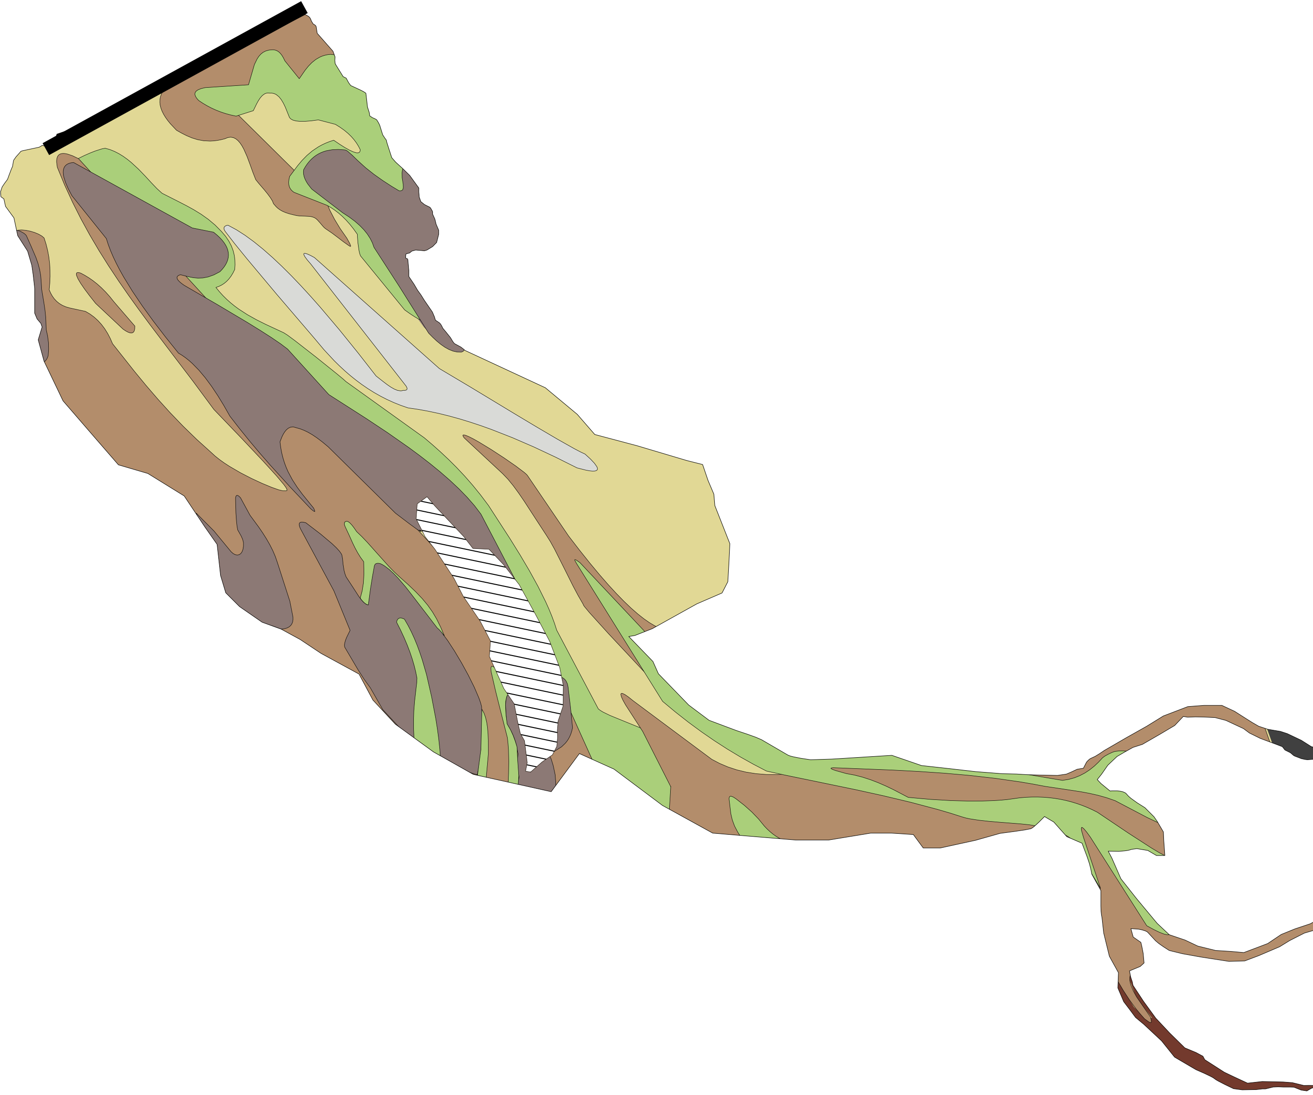
Long-term Effects of Coastal Protection Measures on Sedimentology in a Dynamic Tidal Inlet: Spiekeroog, East Frisian Islands
Anna-Lena Geßner, Jochen Wollschläger, Helge A. Giebel, Thomas H. Badewien
2 min MADNESS
North Sea
Groyne H
Wangerooge
Setting
Spiekeroog
Currents
Next
Back
Question
Sampling
Results
Discussion

Slide 5
Thank you for you time and attention.
Working group
Marine Sensor Systems:
Gute Küste Website:
ICBM:
Back
Question
Sampling
Results
Discussion

