Slide 1
Tkalich, P. and Luu, Q.-H. Recent Sea Level Rise and Variability in Singapore Region Derived from Tide Gauges and Satellite Altimetry EGU General Assembly 2024, Vienna, Austria, 14–19 Apr 2024, EGU24-2288, https://doi.org/10.5194/egusphere-egu24-2288, 2024.
Abstract EGU24-2288
Poster | Thursday, 18 Apr, 16:15–18:00 (CEST), Display time Thursday, 18 Apr, 14:00–18:00Hall X5, X5.172
Quang-Hung Luu¹, Pavel Tkalich^{2,3}
¹ Monash University (Australia),
² National University of Singapore,
³ Technology Centre for Offshore and Marine, Singapore

Slide 2
ABSTRACT
Sea level in the Southeast Asia (SEA) seas is driven by various phenomena at global, regional and local scales. The latest tide gauge and satellite data revealed its most recent spatial and temporal patterns. The trend of global sea level rise in Singapore region is hindered by dominant variability of El Niño-Southern Oscillation (ENSO), Pacific Decadal Oscillation (PDO), and Indian Ocean Dipole (IOD), as well as associated modulation of Asian Monsoon. It was confirmed that positive sea-level anomalies in the southern and western areas of Southeast Asia seas were significantly high (~10 cm) during the northeast monsoon, especially in the Gulf of Thailand (~25 cm). The sea level trends for these regions were basically reversed during the southwest monsoon but with a smaller magnitude of negative sea-level anomalies. The regional sea-level trend in the Sunda Shelf differed from region to region, with the rates varied greatly from 1.4 to more than 4.8 mm/year. Interestingly, the rates on the east-western side of the region were roughly 3.0-4.5 mm/year, which were higher than the ones at other regions, being 2.5-3.5 mm/year. The presentation discuss the causes and consequences of sea level rise and variability in SEA and Singapore region in particular.
This Research is supported by Singapore’s National Research Foundation and National Environment Agency under the National Sea Level Programme Funding Initiative (Award No. USS-IF-2020-4).

Slide 3
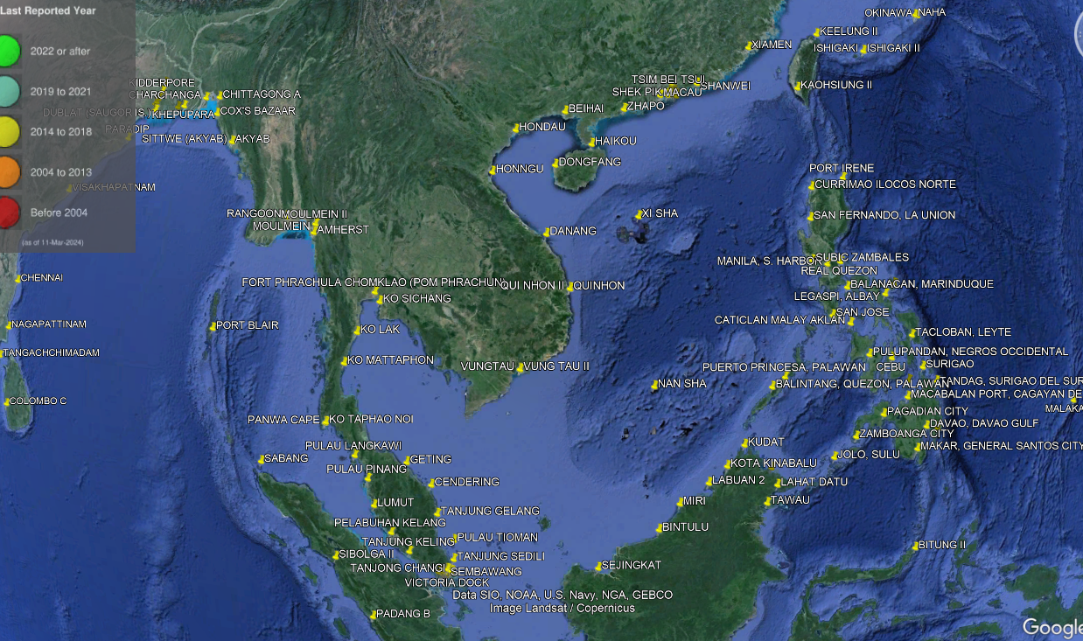
TIDE GAUGES

Slide 4
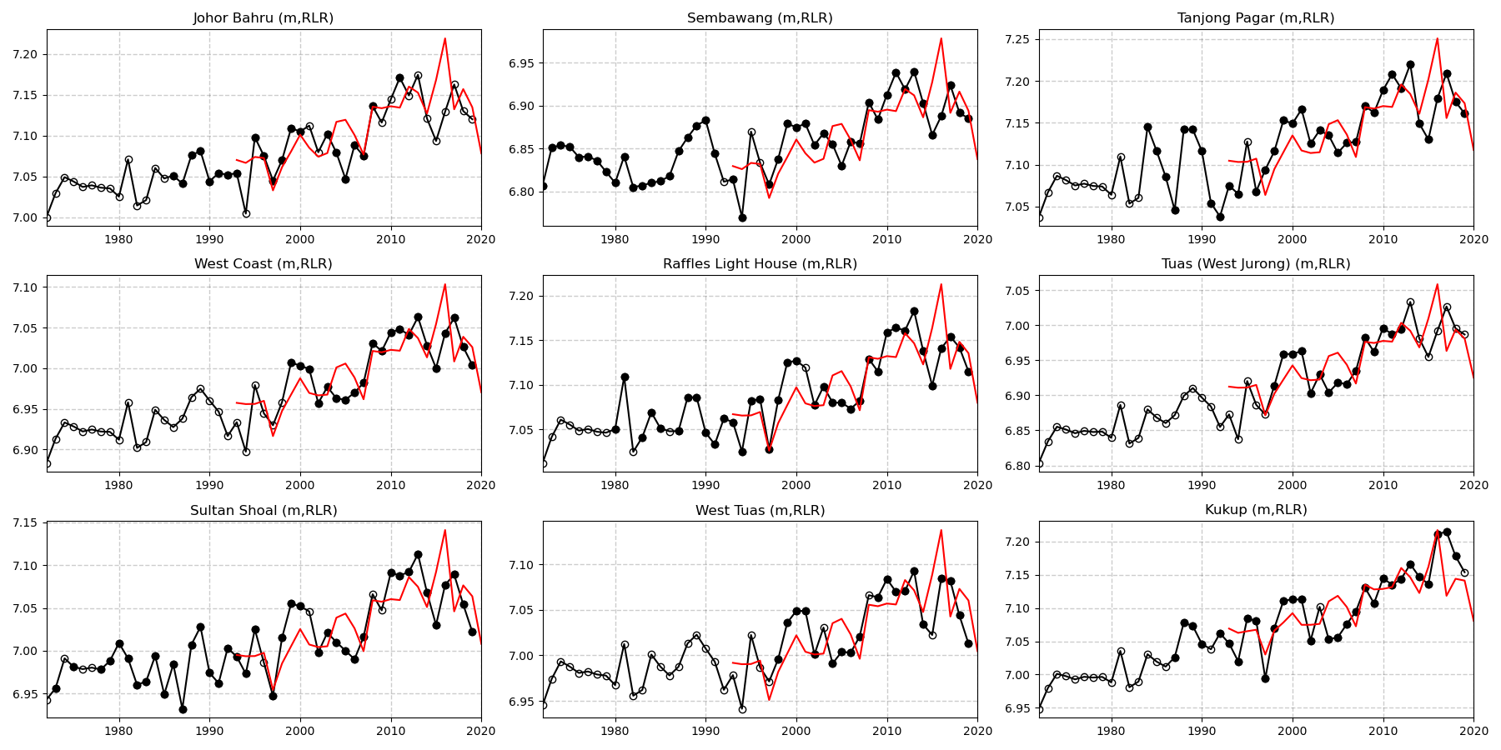
Sea level in the Singapore Strait from tide gauges and satellite altimetry (1972-2019)
tide records (black) and satellite (red). Solid black circle indicates the raw data, open black circle is reconstructed data.

Slide 5
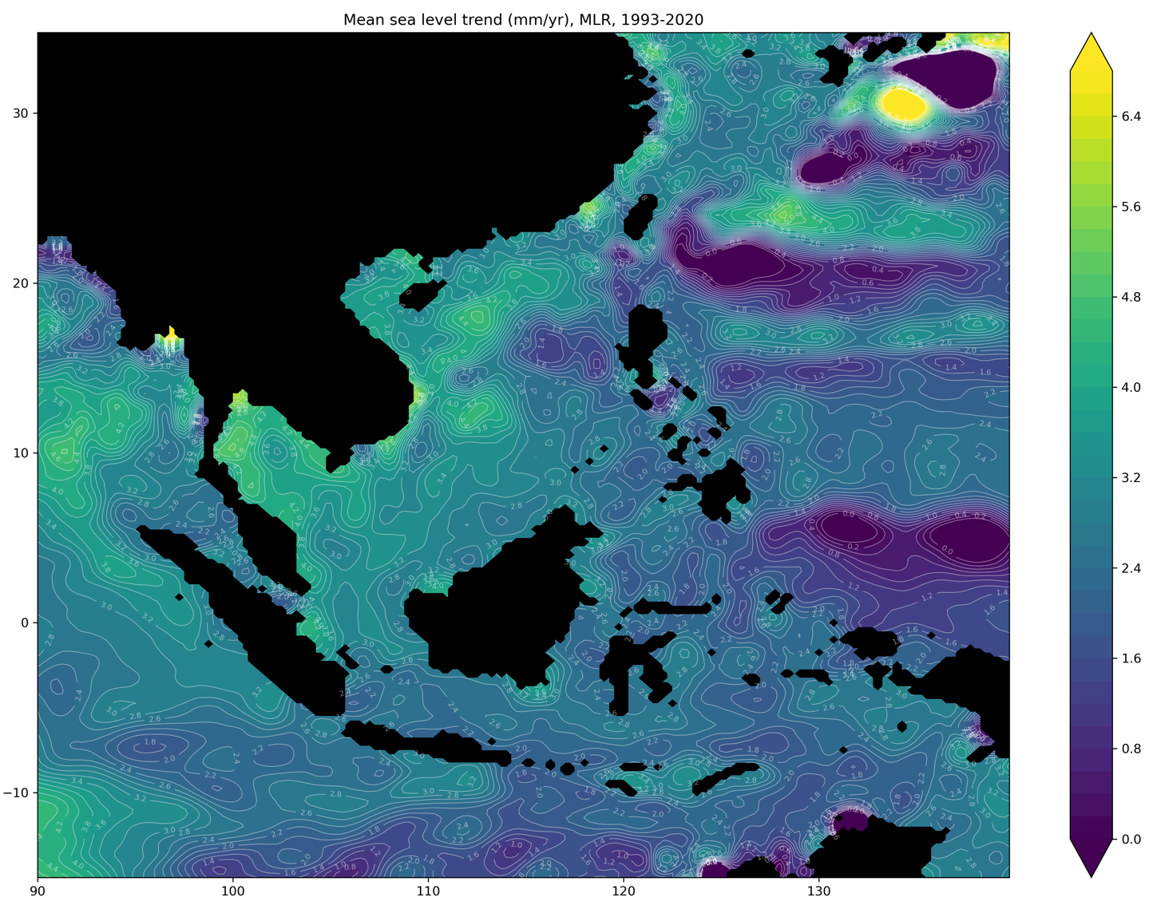
SATELLITE ALTIMETRY TREND (1993–2020)

Slide 6
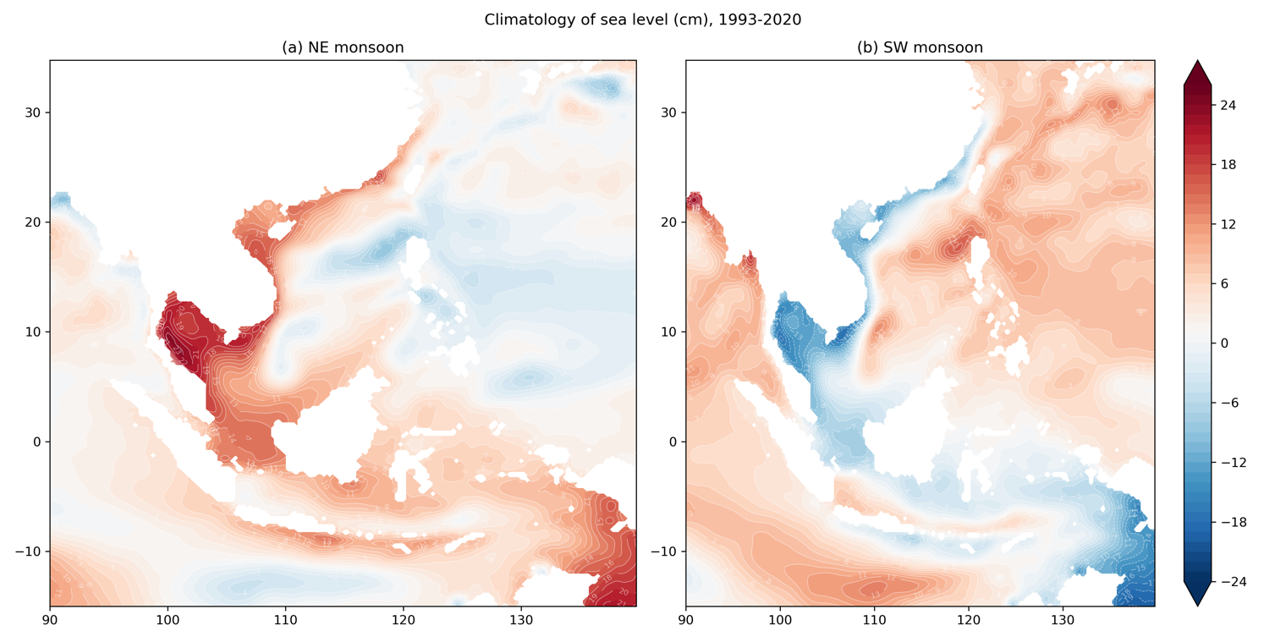
AVISO satellite altimetry (1993–2020)
(a) NE monsoon (November–February), (b) SW Monsoon (June–August)

Slide 7
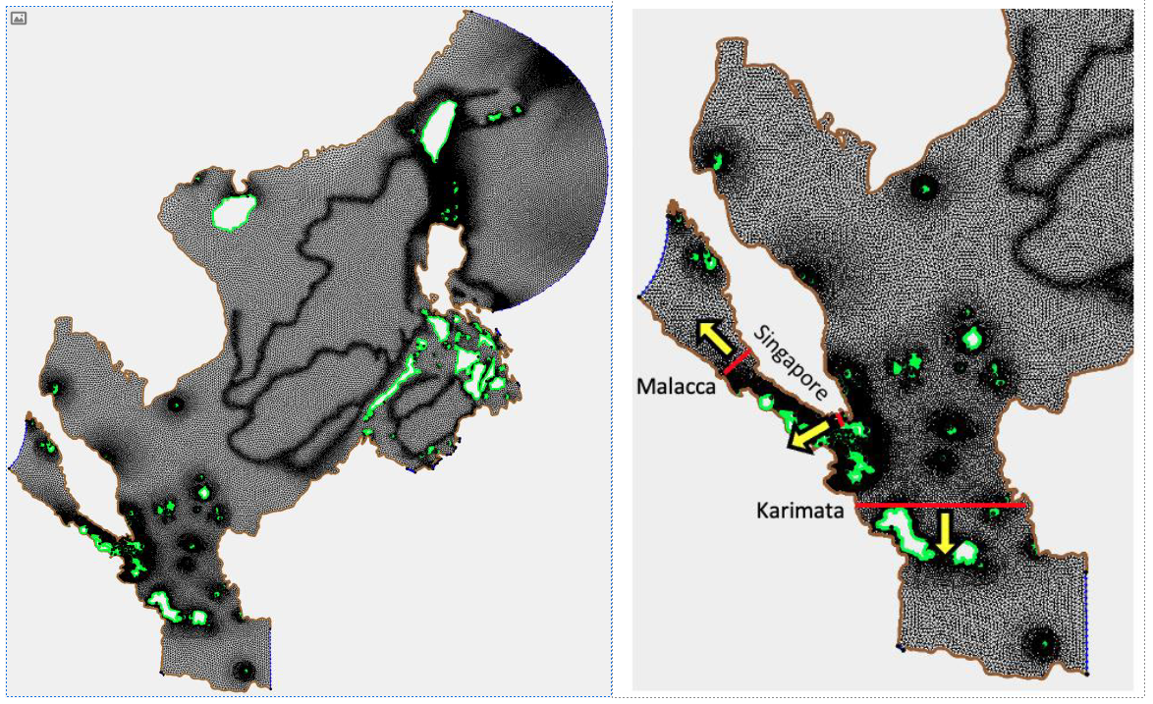
SELFE mesh, cross-sections where volume transport is estimated.

Slide 8
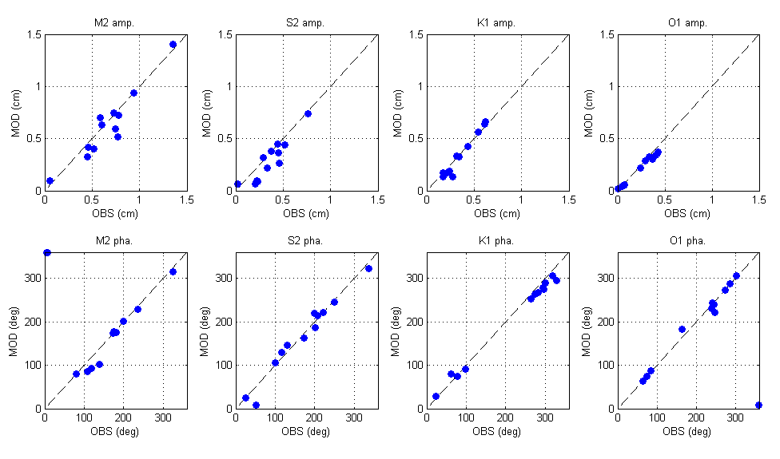
MODEL VALIDATION: Tide Gauge Data

Slide 9
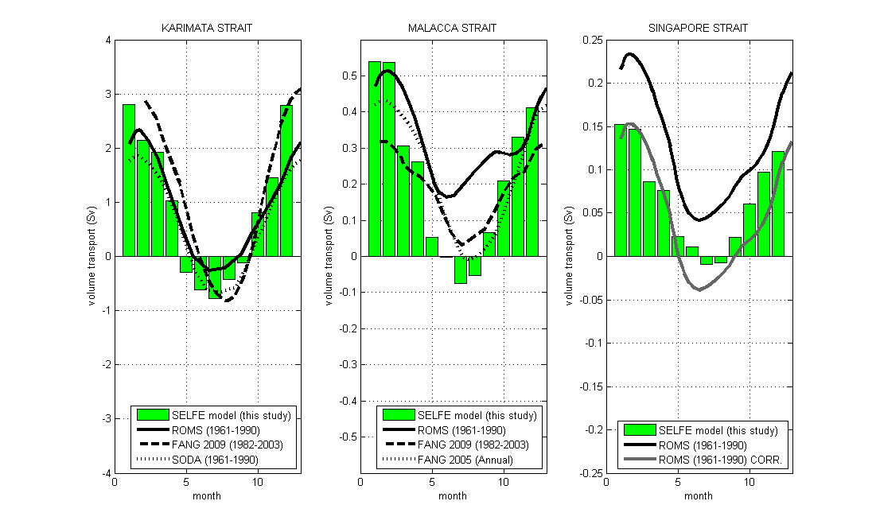
MODEL VALIDATION: Volume Fluxes

Slide 10
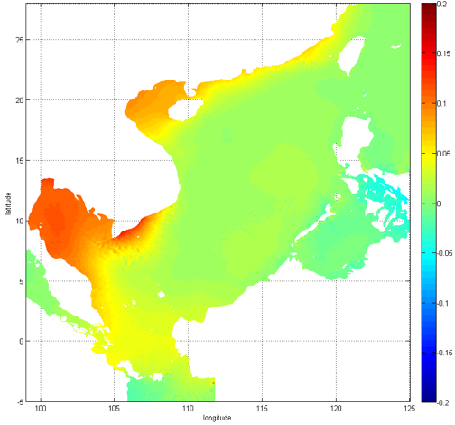
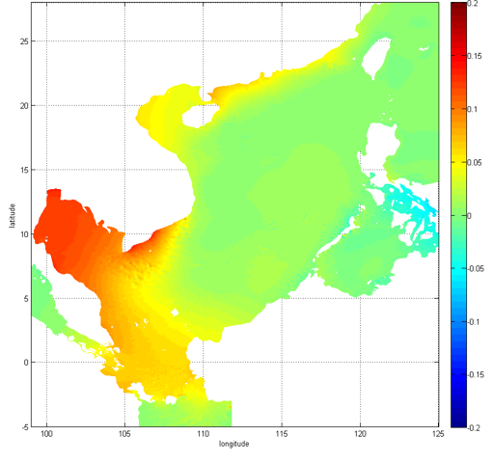
Northeast monsoon sea level computed using SELFE model

Slide 11
Sea level rise rate (mm/year) in Singapore Strait, 1972-2019
Station | Location |  | Record | Tide gauge |  |  | Satellite
Name | Latitude | Longitude | Period | Entire period | 1993 - 2019 | 1984 - 2019 | 1993 - 2019
Johor Bahru | 1º28’N | 103º48’E | 1985 - 2011 | 3.54 ± 0.67 |  |  | 4.40 ± 0.58
Sembawang | 1º28’N | 103º50’E | 1972 - 2019 | 1.83 ± 0.30 | 3.49 ± 0.72 | 2.49 ± 0.46 | 4.40 ± 0.58
Tanjong Pagar | 1º16’N | 103º51’E | 1984 - 2019 | 4.24 ± 0.55 | 4.00 ± 0.69 | 3.02 ± 0.55 | 4.37 ± 0.57
West Coast | 1º18’N | 103º46’E | 1999 - 2019 | 3.26 ± 0.99 |  |  | 4.37 ± 0.57
Raffles Light House | 1º10’N | 103º45’E | 1976 - 2019 | 2.91 ± 0.33 | 3.59 ± 0.73 | 3.09 ± 0.45 | 4.37 ± 0.57
Tuas (West Jurong) | 1º17’N | 103º40’E | 1998 - 2012 | 4.17 ± 1.69 |  |  | 4.37 ± 0.57
Sultan Shoal | 1º24’N | 103º39’E | 1973 - 2019 | 2.67 ± 0.32 | 3.35 ± 0.81 | 3.18 ± 0.51 | 4.37 ± 0.57
West Tuas | 1º21’N | 103º38’E | 1998 - 2019 | 2.20 ± 1.00 |  |  | 4.37 ± 0.57
Kukup | 1º20’N | 103º27’E | 1987 - 2018 | 4.70 ± 0.61 |  |  | 4.37 ± 0.57
Singapore Strait average |  |  |  |  | 3.61 ± 1.48 | 2.95 ± 0.99 | 4.38 ± 1.71

Slide 12
REFERENCES
Luu QH, Tkalich P. (2023) Sea Level Change in the Southeast Asia Seas: From Satellite Observations to Numerical Modelling, Chapter in Book: Coastal Altimetry: Selected Case Studies from Asian Shelf Seas, Eds. Stefano Vignudelli N., Idris N.H., Elsevier, 2023, ISBN: 978-0-323-91708-7, https://doi.org/10.1016/B978-0-323-91708-7.00007-9 .
Luu, Q. H., P. Tkalich, and T. W. Tay. (2015). “Sea Level Trend and Variability around Peninsular Malaysia.” Ocean Science 11: 617–628. doi:10.5194/os-11-617-2015.
Luu, Q. H., Q. Wu, P. Tkalich and G. Chen (2018) “Global mean sea level rise during the recent warming hiatus from satellite-based data”, Remote Sensing Letters, 9:5, 497-506, doi: 10.1080/2150704X.2018.1437291.
Luu, Q.-H., Wu Q, Tkalich P, Chen G. (2019) “Long-term regional trend and variability of mean sea level during the satellite altimetry era”. Scientia Marina, 83(2), doi:/10.3989/scimar.04691.05A.
Tkalich, P., Vethamony, P., Babu, M. T., and Malanotte-Rizzoli, P. (2012) “Storm surges in the Singapore Strait due to winds in the South China Sea”, Natural Hazards, doi:10.1007/s11069-012-0211-8, 2012.
Tkalich, P., Vethamony, P., Luu, Q.-H., and Babu, M. T. (2013) “Sea level trend and variability in the Singapore Strait”, Ocean Science, 9, 293–300, https://doi.org/10.5194/os-9-293-2013.

