Slide 1
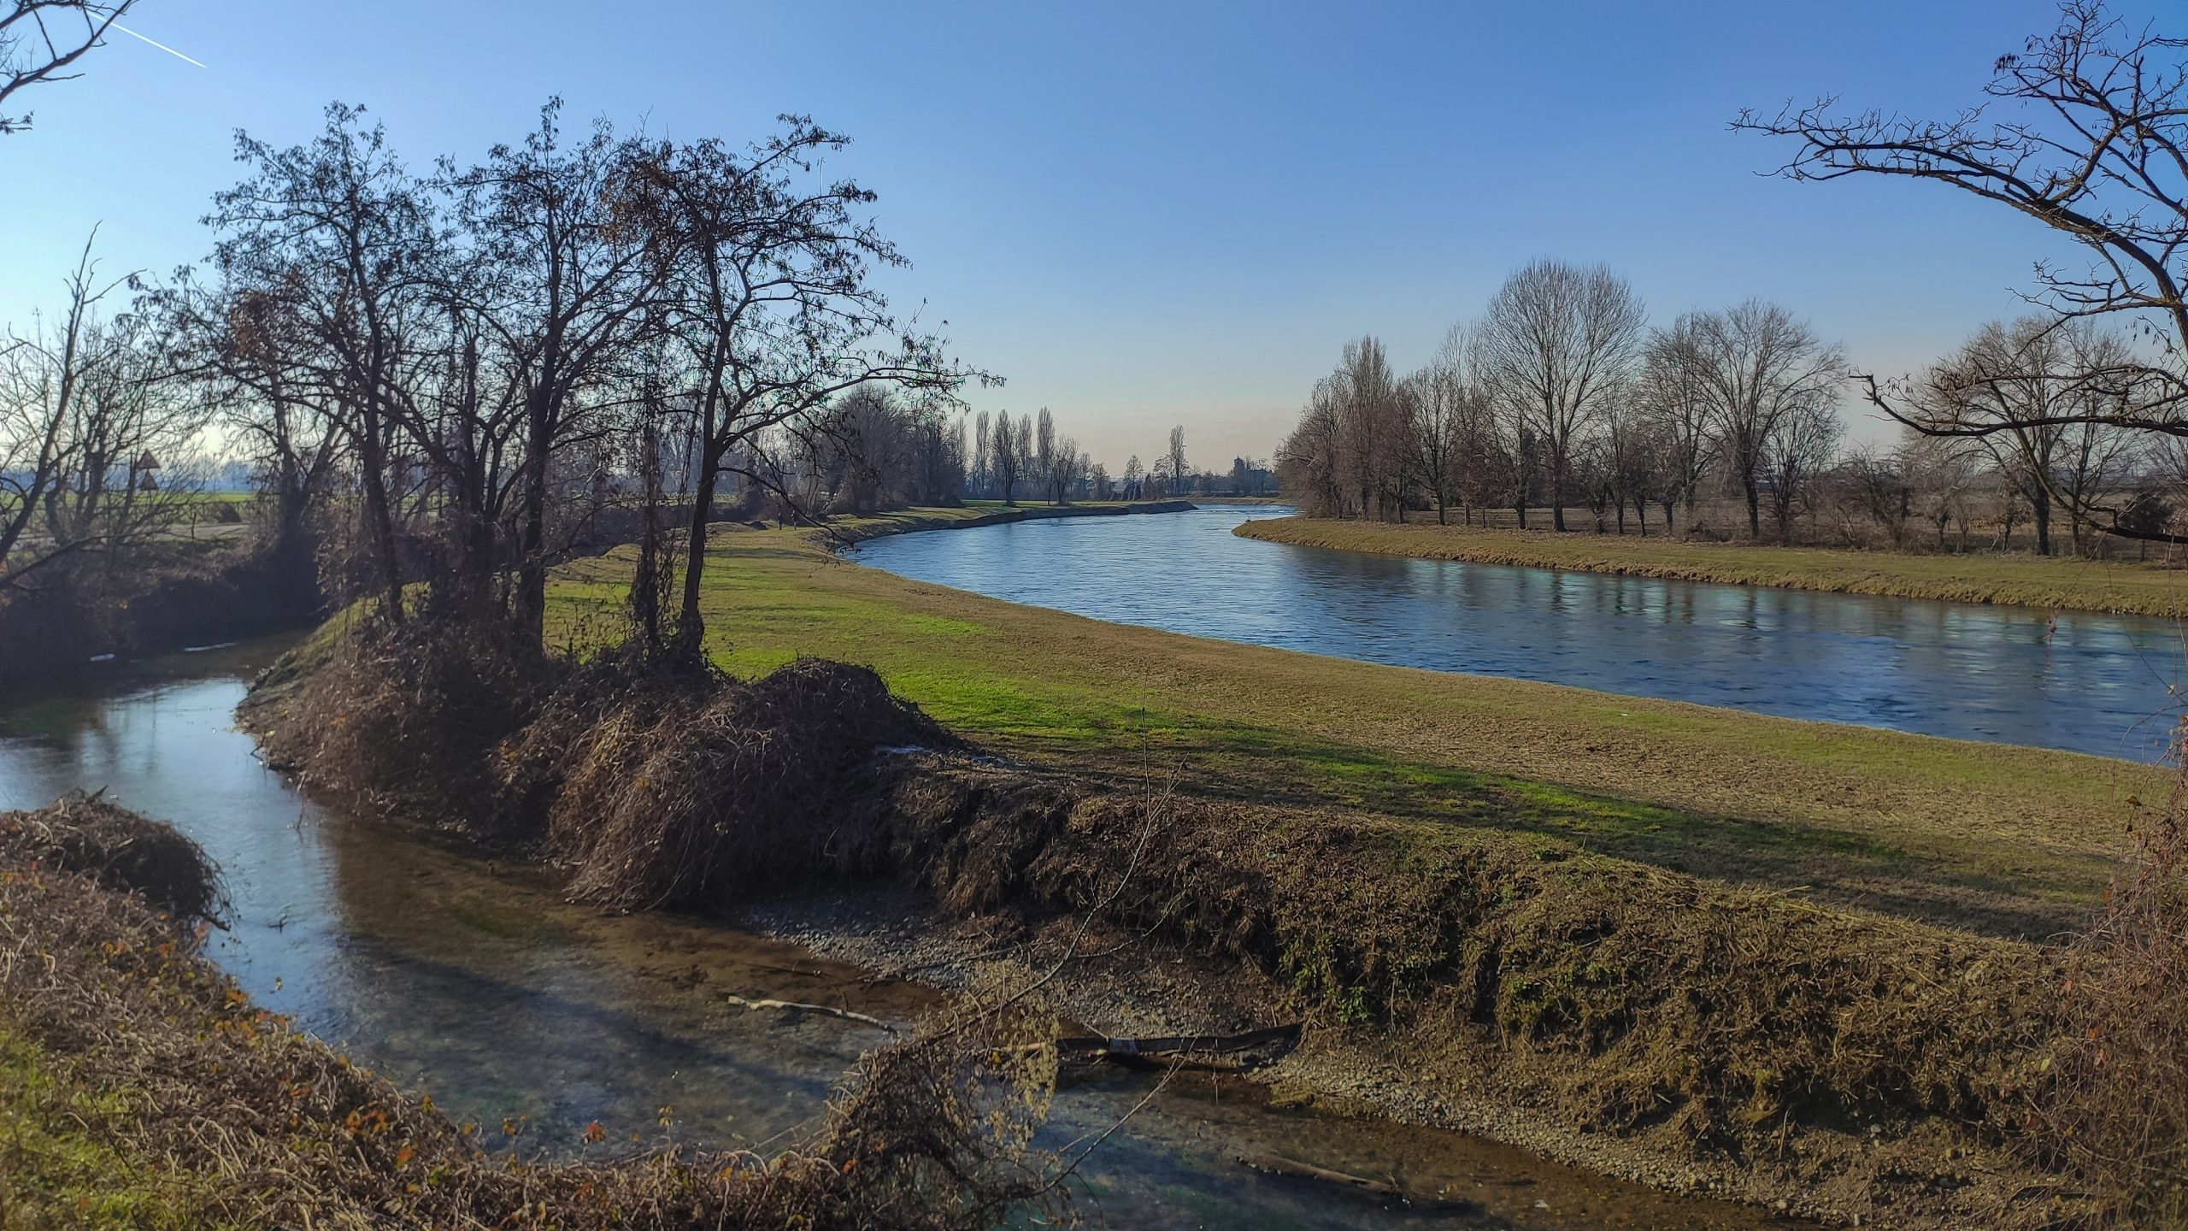
HS5.3.1
Merging social learning and behavior modelling to reinforce farmers adaptation to climate change
Sandra Ricart, Paolo Gazzotti, Claudio Gandolfi, Andrea Castelletti
April 19, 2024

Slide 2
1. INTRODUCTION
DIRECT IMPACTS ON CROPS & LIVESTOCK
ADAPTATION PATHWAYS & LOCAL strategies
extreme EVENTS frequency & intensity
FARMERS’ ACTIONS & DECISIONS
Farmers develop their activity under uncertainty/risk scenarios
Farmers are not ‘blank slates’, they socially construct risk:
Experiences
Knowledge exchange
Cognitive factors
risk averse
risk neutral
risk prone
Risk preferences

Slide 3
2. RESEARCH QUESTIONS
Can farmers’ behavior be used to identify different rationalities and risk preferences?
How agent-based modelling can anticipate and support farmers’ decisions at the farm scale?
cropping
irrigation system
GOAL
to reinforce
farmers’ decisions

Slide 4
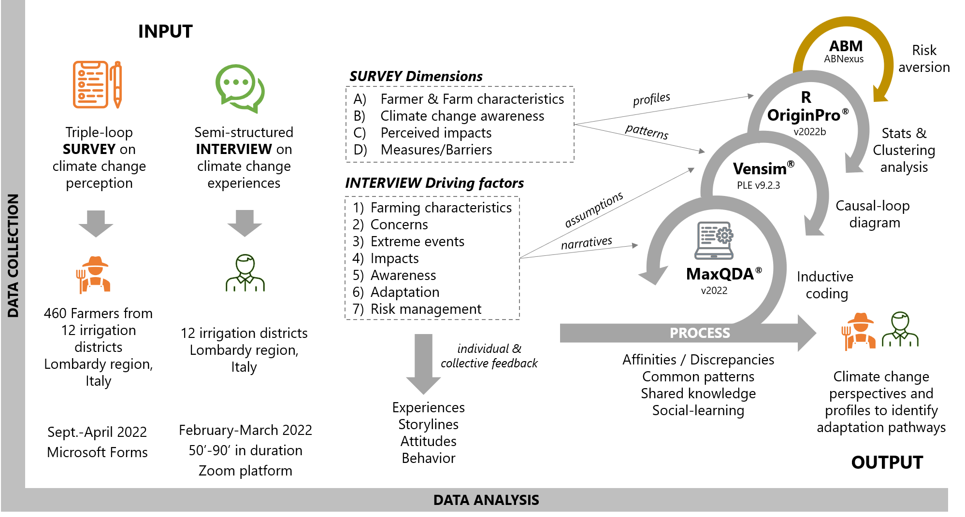
3. DATA & METHODS

Slide 5
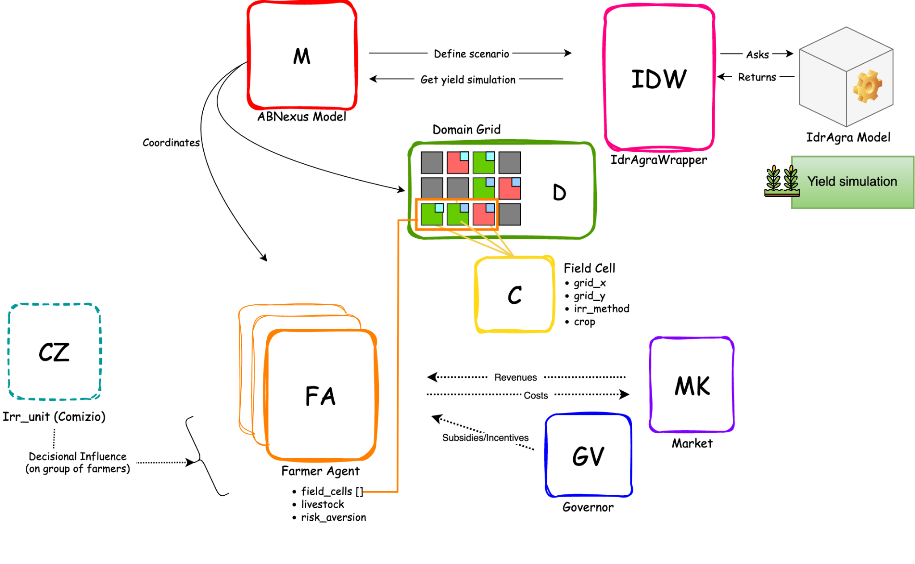
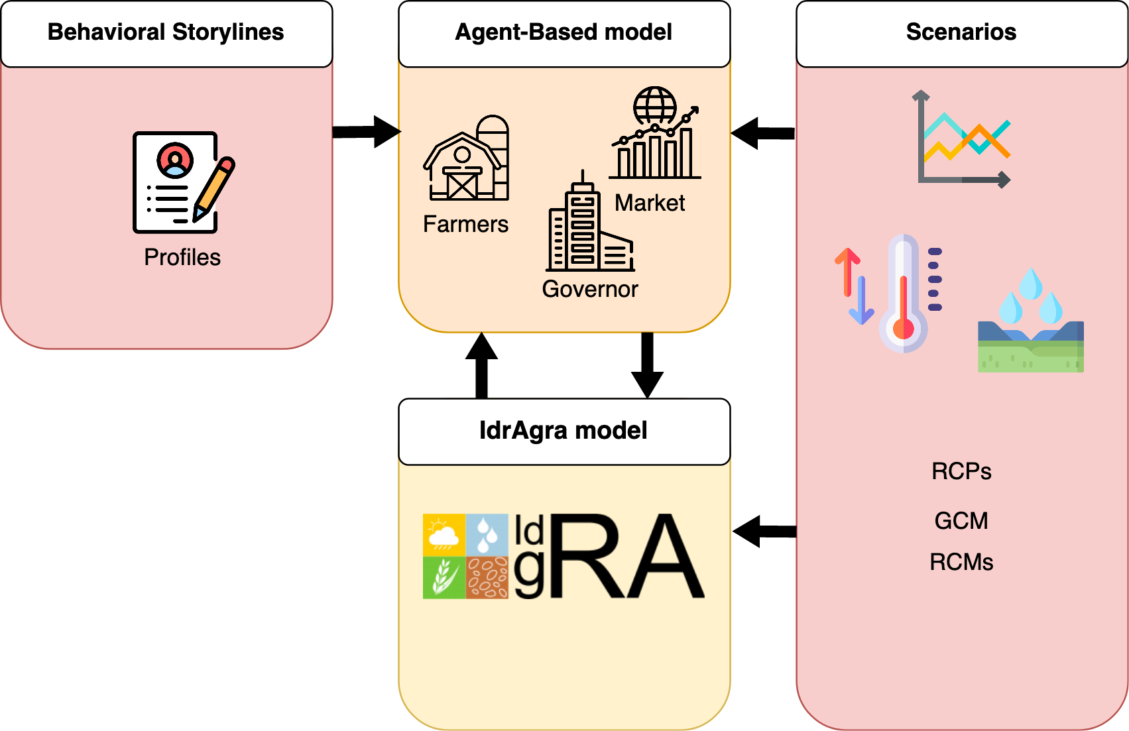
3. DATA & METHODS

Slide 6
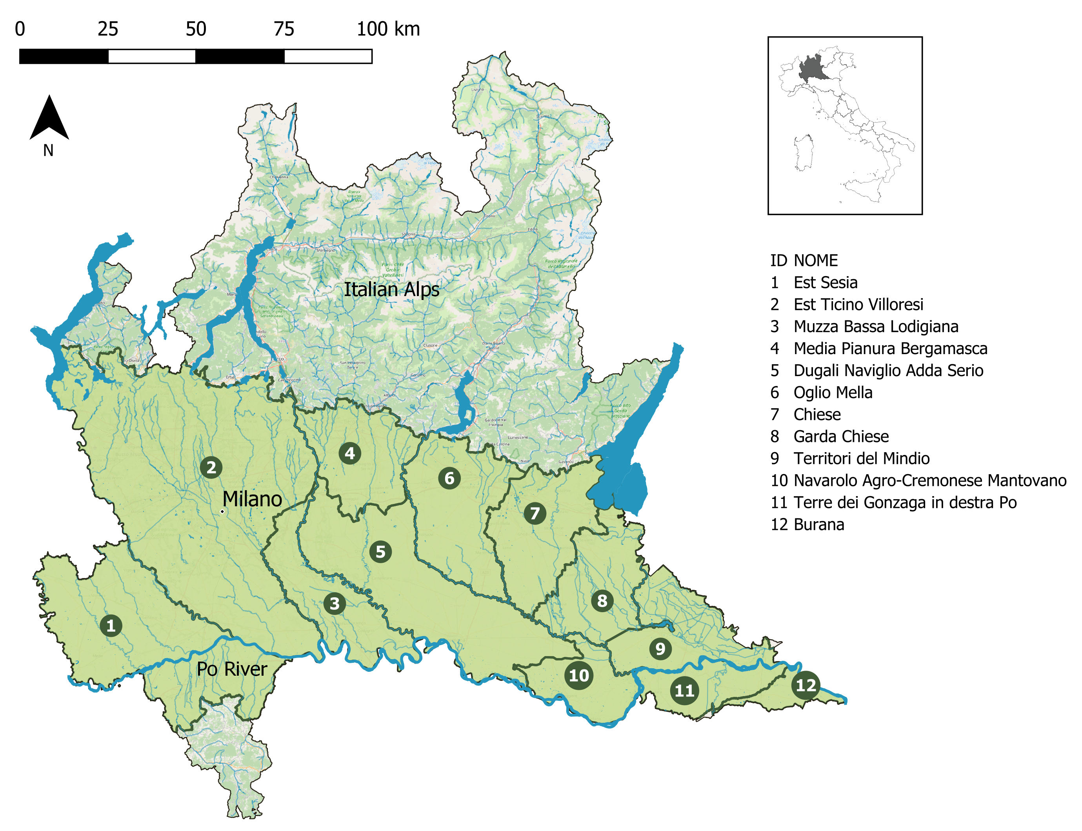
4. CASE STUDY: LOMBARDY PLAIN, IT
MULTI-OBJECTIVE WATER NEEDS
Densely populated
Agriculture and industry clusters
Complex water management: stakeholders
Peak of water need in summer season
A ROBUST AGRICULTURAL SYSTEM
52,000 farms, 40% of the area
Water managed through yearly concessions based on historical use
Surface irrigation as the most adopted technique
CLIMATE IS CHANGING
Frequency & intensity extreme events
Change in rainfall peaks timings
Increased temperature change sowing window

Slide 7
5. RESULTS: DOMINANT PROFILE
Farmer
Man, 45-64 years, higher education, experience >30 years, union farm & consortia membership, non off-farm activity, no succession intention
Farming
Size >20ha, irrigated, conventional crops (maize), livestock, use of fertilizers, irrigation canal as main water source, non renewable energy use
Variable | Profile
Age | 45-64 years (56%)
Gender | Male (80%)
Education | Professional/High education (38%)
Experience | >30 years (50%)
Labor force | Family members (49%)
Irrigation Consortium membership | Yes (74%) Oglio Mella, Chiese, Muzza
Off-farm activity | No (69%)
Succession intention | No (55%)
Variable | Profile
Farm size | >20 ha (50%)
Production system | Conventional (75%)
Main crop | Maize (66%)
Livestock | Yes (52% - cattle 66%)
Fertilizers | Mineral, compound, organic (78%)
Farming practice | Irrigated (72%)
Renovable energy use | No (63%)
Non-conventional water sources | No (99%)
Attitude
change?
Dependence on agriculture?

Slide 8
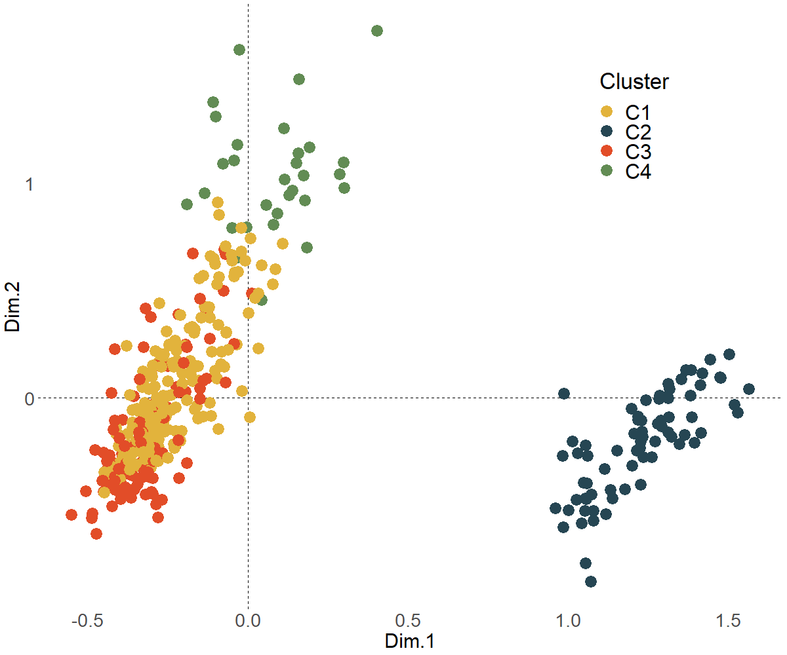
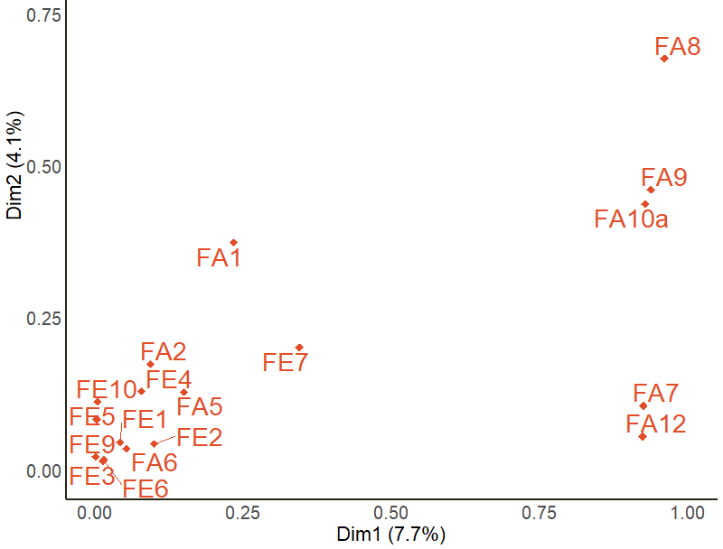
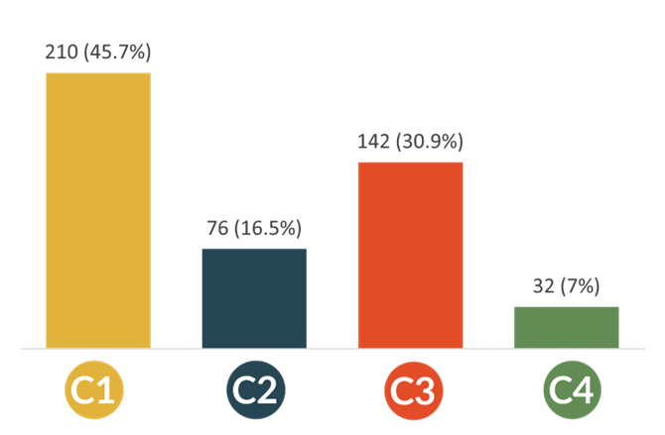
5. RESULTS: FARMERS HETEROGENEITY – CLUSTERING
Low explained variance
Farm size and irrigation practice as most relevant variables
4 clusters
SMALLER FARMS
IRRIGATED AGRICULTURE
RAINFED AGRICULTURE
LARGER FARMS
IRRIGATION PRACTICE
FARM SIZE

Slide 9
5. RESULTS: FARMERS HETEROGENEITY – PROFILES
C1
C2
CLUSTER 1 (46%)
CLUSTER 2 (16%)
Older farmers, traditional methods
Younger farmers, rainfed farms
Adapted through crop diversification
Adapted through cooperation
Key attitude: most isolated
(AD18, cooperation 38%)
Key attitude: most insecure
(IDK answers 18%)
C3
CLUSTER 3 (31%)
C4
CLUSTER 4 (7%)
Older farmers, larger farms
Younger farmers, innovative methods
Adapted through crop insurance
Adapted through climate services
Key attitude: most confident
(AW2, human ingenuity 18% agree)
Key attitude: most aware
(AW1, climate change as the most important problem 97% agree)

Slide 10
5. RESULTS: FARMERS HETEROGENEITY – RISK PREFERENCES
C1
C3
C4
Indicator | Variable (survey) | Criterion | C1 | C3 | C4
Age¹ | FE1 - Age | The older, more risk averse | Risk averse | Risk averse | Risk prone
Insurance² | AD17 - Insurance use | More insurance use, more risk averse | Risk averse | Risk averse | Risk prone
Fertilizer use³ | AD15 - Fertilizer reduce | More fertilizer, more risk averse | Risk averse | Risk prone | Risk prone
Adaptive capacity⁴ | AD1-20 - average num. of implemented measures | More implementation, less risk averse | Risk averse | Risk prone | Risk prone
Risk averse
Risk neutral
Risk prone
Older, lower educated, and highly experienced farmers tend to focus on weather adverse scenarios
Younger, higher educated, and less experienced farmers focus on the options able to give better performance
1 Yu et al. 2021, 10.1080/13669877.2014.940597
2 Hossain et al. 2022, 10.1016/j.jclepro.2022.130584
3 Qiao & Huang (2020), 10.1016/S2095-3119(20)63450-5
4 Jin et al. 2020, 10.1080/09640568.2020.1742098

Slide 11
5. RESULTS: FARMERS HETEROGENEITY – RISK PROFILES
C1
RISK-AVERSE (Pessimistic) → Adopt maximin criterion. Aim at minimizing extreme losses.
B
BASELINE
2004 configuration used as a benchmark for comparison
$$a^{∗}= \text{arg}\max_{a}\left(\min_{ t ∈W }{u_{t}(a)}\right)$$
R-PR
PERFECT RATIONALITY MODE
performances only of current year
no risk aversion mechanism
C3
RISK-NEUTRAL → Adopt Hurwicz combination, with higher weighting towards extreme losses.
t0
t1
t2
t3
t4
t5
t6
t7
t8
t9
$$a^{∗}= \text{arg}\max_{a}\left(α \left[\min_{ t ∈W }{u_{t}(a)}\right]+\left(1−α\right) \left[\max_{t ∈W}{ u_{t}(a)}\right]\right)$$
R-RA4
RISK AVERSION MODE, 4Y
4 years of past performances considered
risk aversion mechanism implemented
$$α=\frac{2}{3}$$
C4
MODERATELY RISK PRONE (Optimistic)→ Adopt Hurwicz combination, with higher weighting towards expected gains.
t0
t1
t2
t3
t4
t5
t6
t7
t8
t9
R-RA8
RISK AVERSION MODE, 8Y
8 years of past performances considered
risk aversion mechanism implemented
$$a^{∗}= \text{arg}\max_{a}\left(α \left[\min_{ t ∈W }{u_{t}(a)}\right]+\left(1−α\right) \left[\max_{t ∈W}{ u_{t}(a)}\right]\right)$$
$$α=\frac{1}{3}$$
t0
t1
t2
t3
t4
t5
t6
t7
t8
t9

Slide 12
5. RESULTS: SIMULATIONS – CHANGES IN PREFERENCES
CROPS
IRRIGATION METHODS
Most risk-averse cluster has higher preference for legumes
Most risk-averse clusters have lower preference for Alternate Wetting and Drying (AWD) compared to flood irrigation
C1
C3
C1

Slide 13
6. REMARKS
Social learning provides new datasets/insights for behavior heterogeneity in decision-making processes
The triple-loop approach contributes to delineate farmers’ adaptive capacity (surveys & interviews) – enriching governance
Sample clustering provides an overview of farmers heterogeneity, being farmers adapted through: Crop diversification, Cooperation, Insurance, and Climate services
Rationality vs Risk preferences → risk aversion significantly influences farmers’ decisions on crops (more legumes) and irrigation methods (less AWD)
Behavior modelling provides clues to anticipate more robust decisions and facilitates strategies for policy co-design

Slide 14
HS5.3.1
THANKS FOR
YOUR ATTENTION!
sandra.ricart@polimi.it
@eiPolimi @sanriccas
https://www.ei.deib.polimi.it/
www.modfabe.deib.polimi.it

