Slide 1
Surface Solar Radiation
Algorithm Emulation
With Deep Learning
Kevin Schuurman, Dr. Angela Meyer, Alberto Carpentieri
Bern University of Applied Sciences

Slide 2
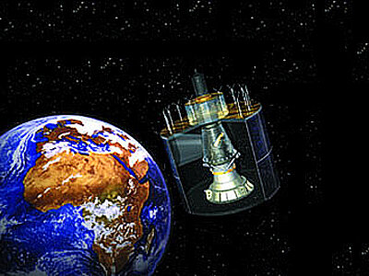
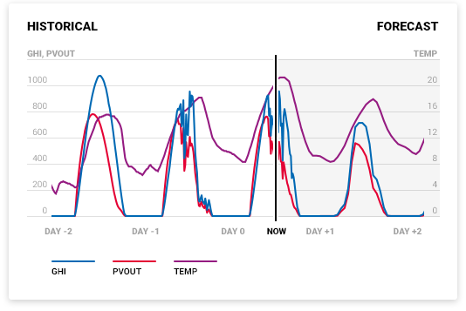
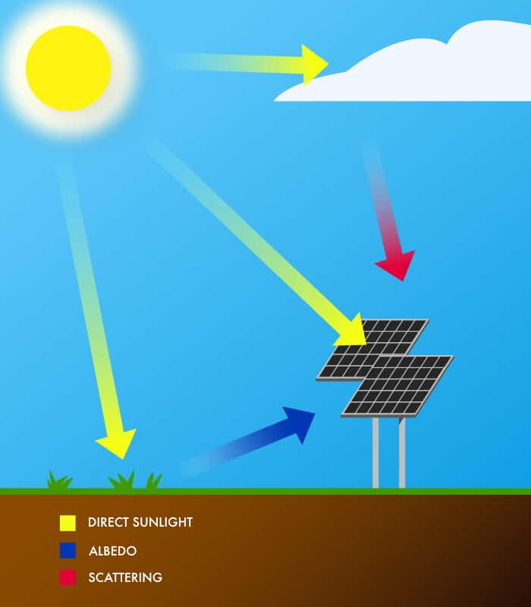
Notes:
As we want to progress to a greener society, solar energy and the prediction thereof is becoming more important to meet European energy demands. Solar energy is a variable resource and good predictions are most valuable for energy grid operators. Most prediction methods use level-2 surface products based on geostationary stationary satellites, which have a high temporal frequency. This high frequency data is necessary to make accurate predictions, because the main variability, clouds in the atmosphere, are highly variable on an hourly scale.
The level-2 products are not perfect and have a significant delay. Very short-term predictions, now-casting is reliant on these level-2 products to make accurate predictions.
Our goal is to diminish the delay by emulating a level-2 algorithm to estimate instantaneous surface solar irradiance products using deep learning.

Slide 3
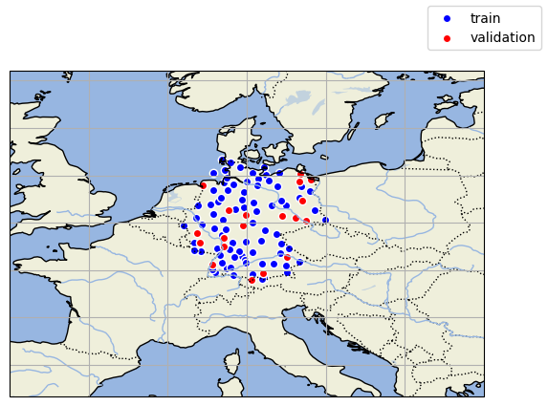
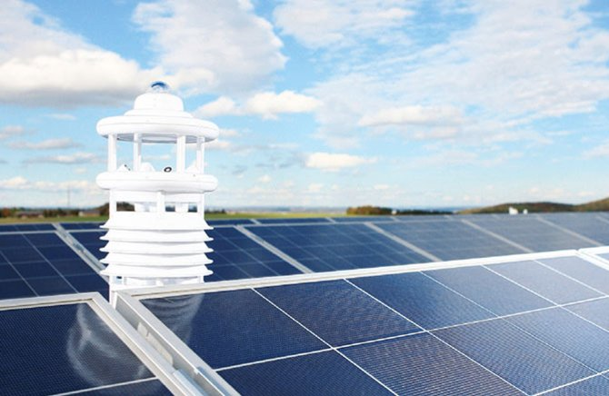
Background DL for Solar Estimation
Previous methods:
Surface Incoming Solar radiation (SIS)
Semi-physical algorithms using radiative transfer modeling
Validation with Pyranometers
Previous DL methods:
Directly estimate hourly SIS
Train on Pyranometers
Faster and more skillful on out-of-sample pyranometers (Verbois et al. 2023, Jiang et al. 2019)
Copr. Lufft
Notes:
One of the most important parameters for solar energy prediction is the Surface Incoming Solar radiation. The algorithms for the L2 products use a semi-physical formulations to estimate SIS based on the reflectivity from the geostationary satellite.
These algorithms are normally validated against ground observation pyranometers. In literature there are few deep learning models that have skipped to directly estimating surface incoming solar radiation based on pyranometer datasets with as input the satellite images. They have shown that a common deep learning model can estimate SIS very accurate on multiple spots with higher precision than most common level-2 products.
But there is a problem with these deep learning models. There is no guarantee an agnostic estimator can generalize to all out-of-sample pyranometer stations and locations.

Slide 4
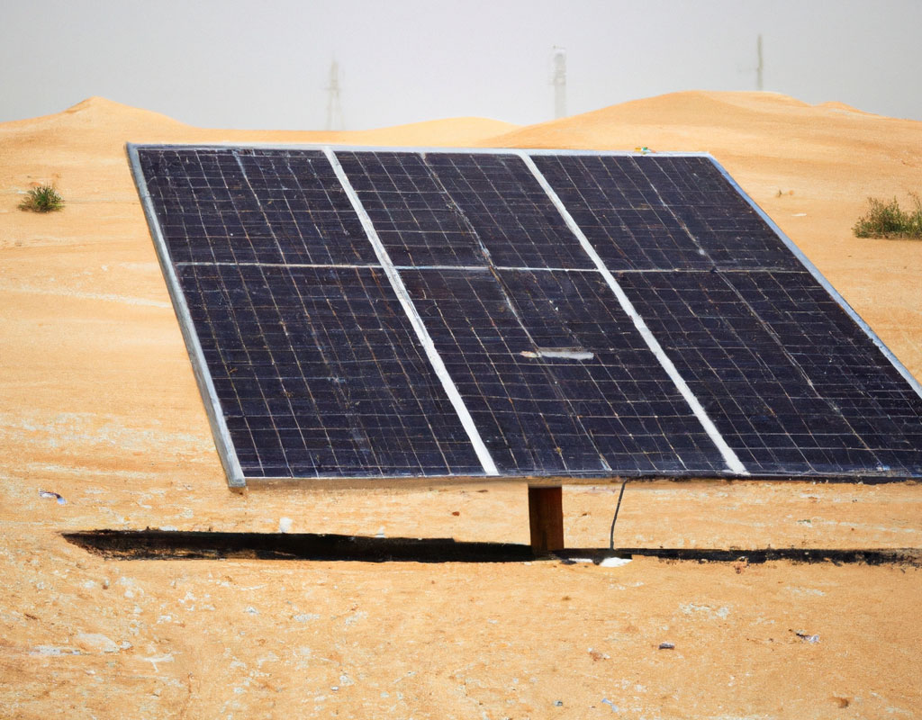
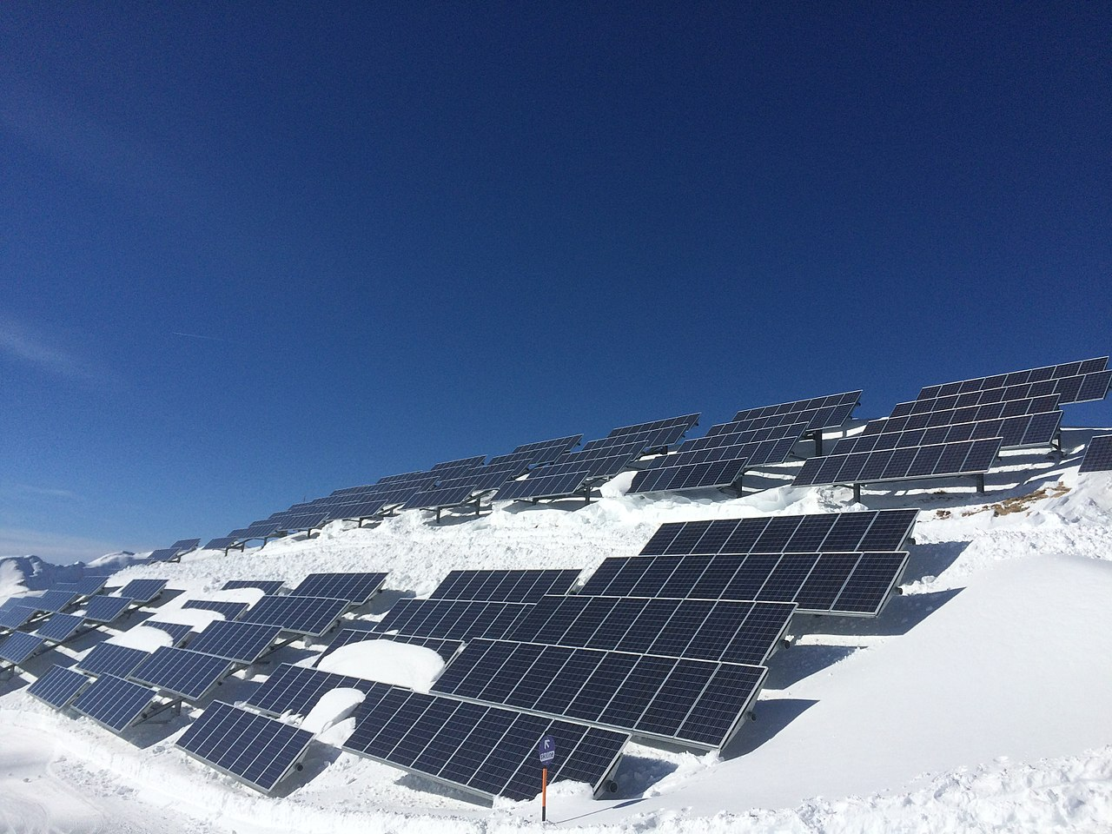
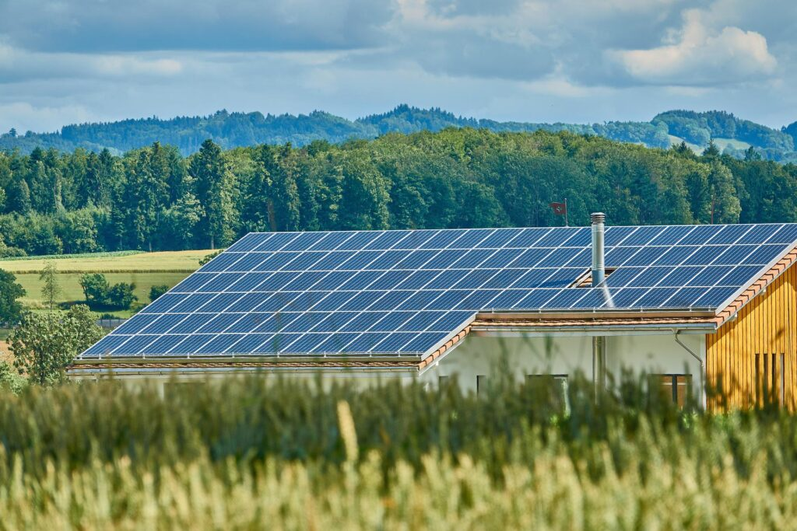
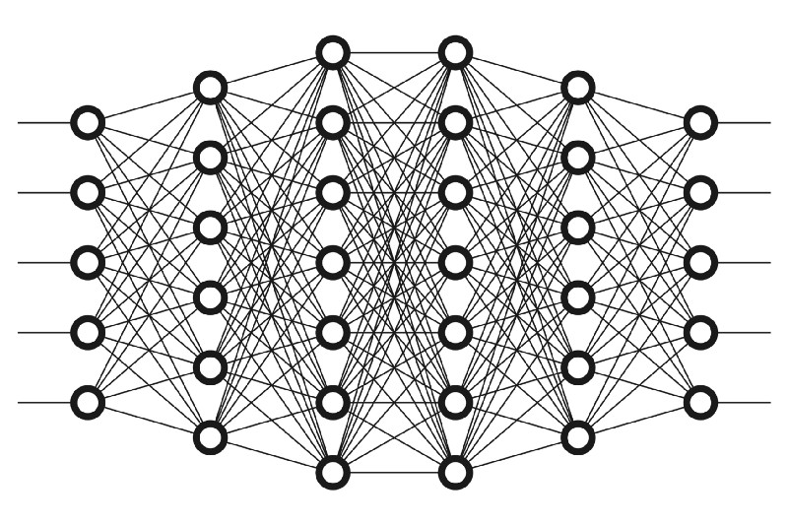
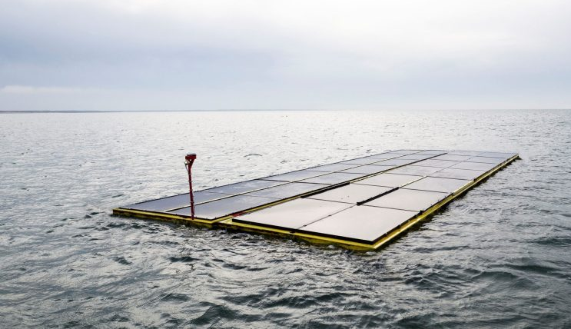
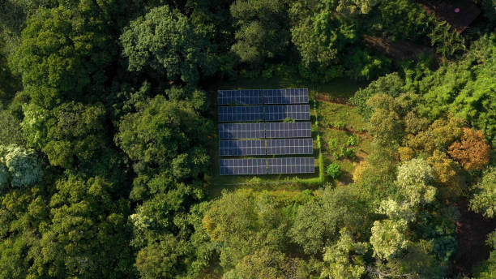
Generalizability
Biased to the dataset used?
Surface albedo differences
Scarce pyranometer datasets
More input is no option
Notes:
Recent research suggests that the way the way a deep learning model is trained to estimate at a pyranometer dataset, it becomes biased towards that dataset. For a generally good performing estimator it becomes a problem when most of the pyranometer data we have is from a select few countries with no guarantee of variety.
Thus came the idea to emulate one of the existing surface incoming solar irradiance products. An emulator could theoretically capture the unbiased estimates from a level-2 product for a wide region.
If the emulator shows it can accurately represent a large region enables us to fine-tune on a pyranometer dataset.

Slide 5
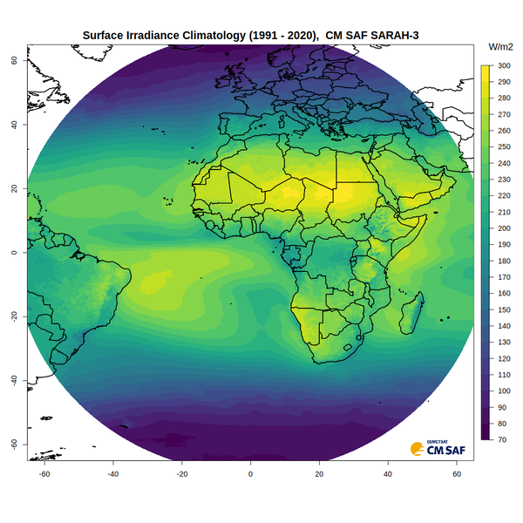
Emulate SARAH3
Climate Record of SIS
Instantaneous records
Semi-physical
Established
SARAH3 Dataset
2016-2021 train
2022 validation
Validation
BSRN pyranometers
DWD/KNMI pyranometers
Notes:
We picked one of the more established climate records SARAH3 from the Satellite Application Facility on Climate Monitoring, because it is freely available and contains instantaneous records of SIS with a large spatial extent.
Our goal is to show that it is possible for a single deep learning model to generalize to subset of the disk copying the semi-physical model used.

Slide 6
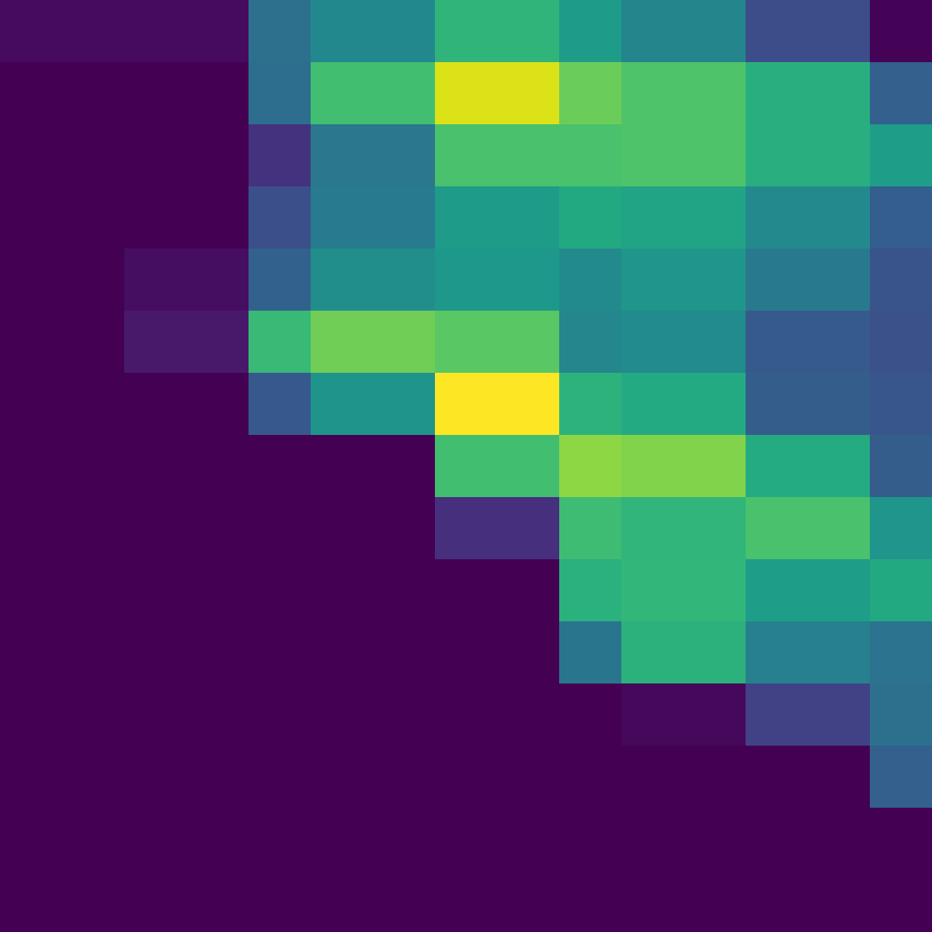
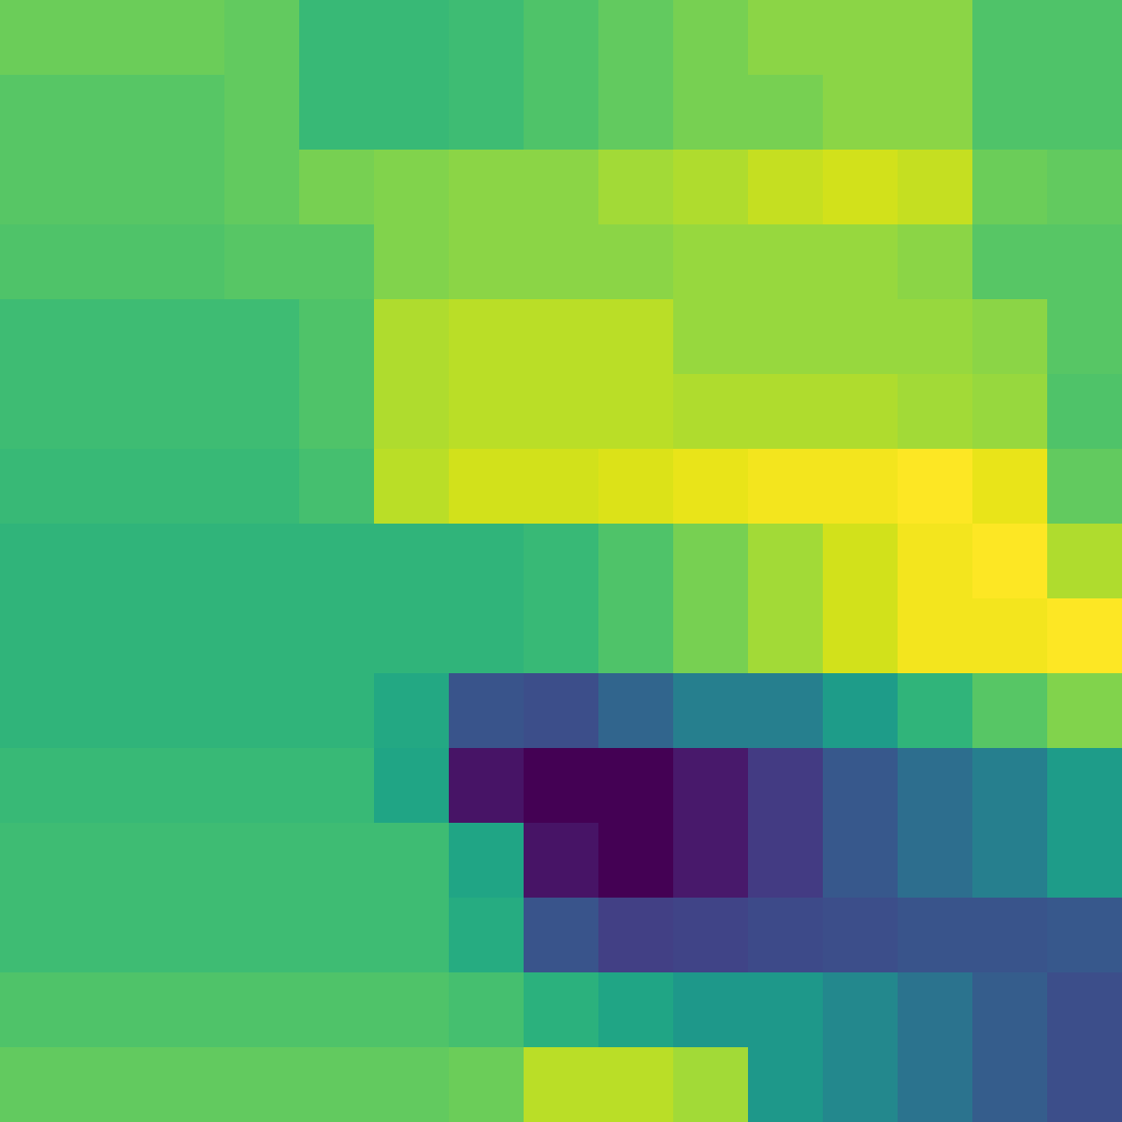
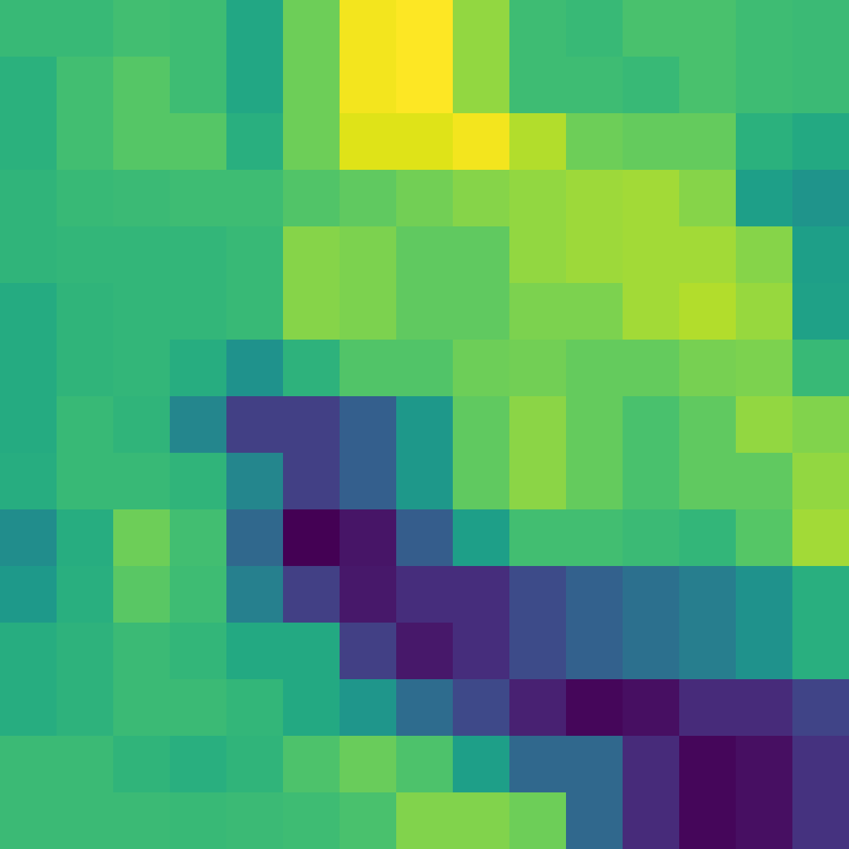
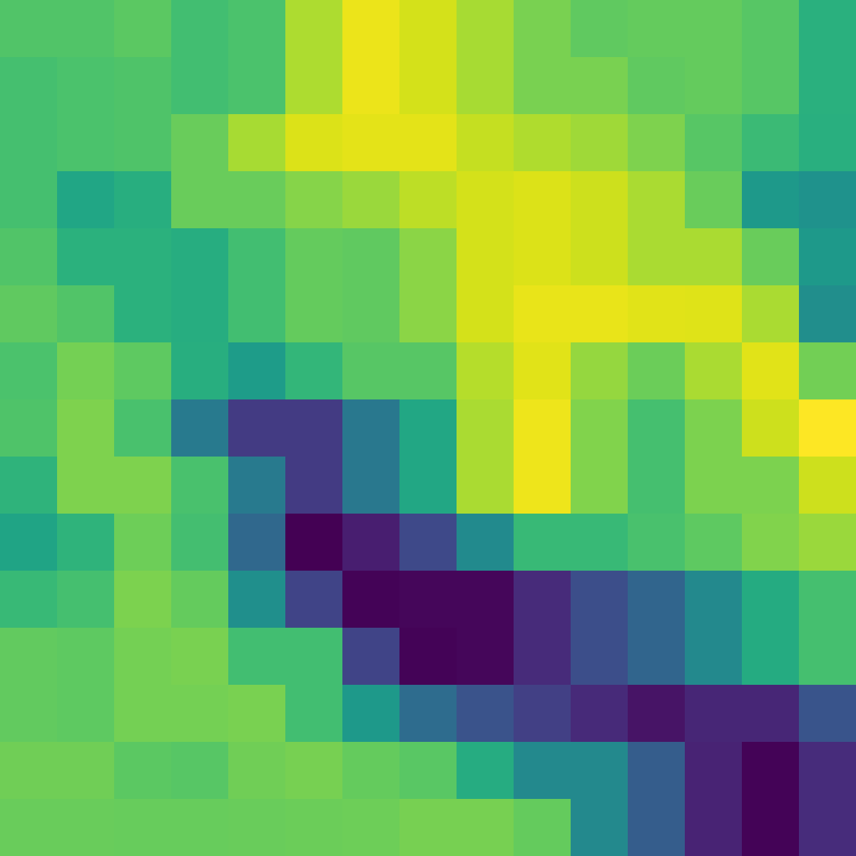
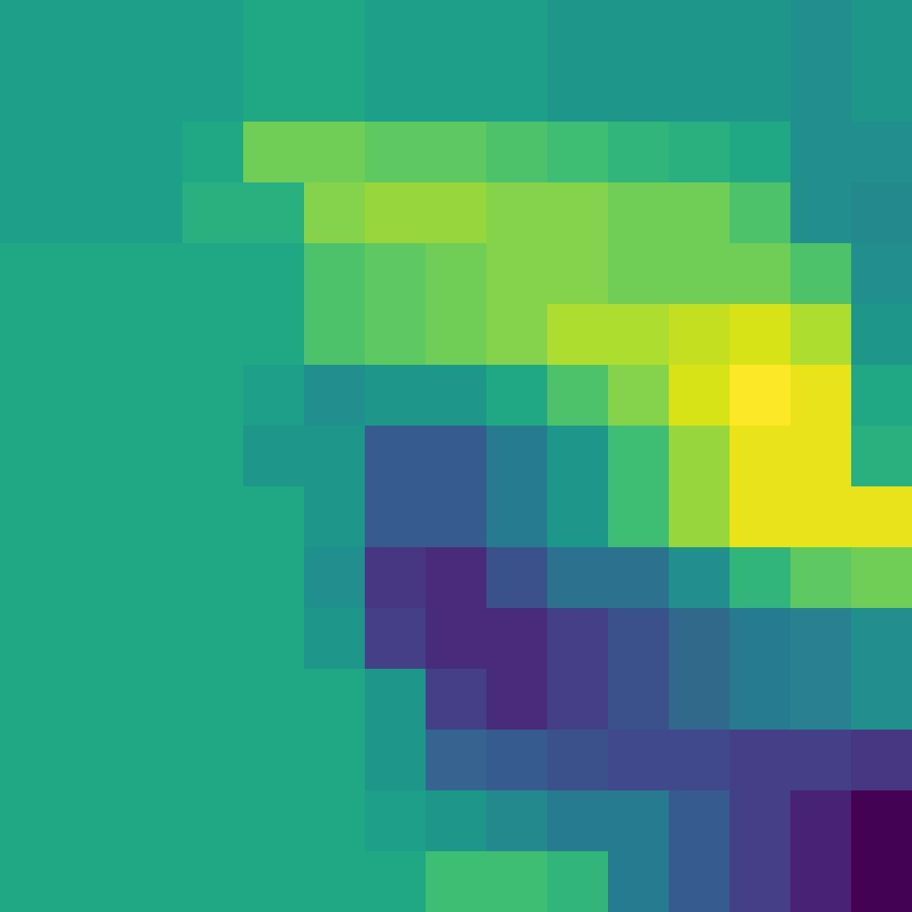
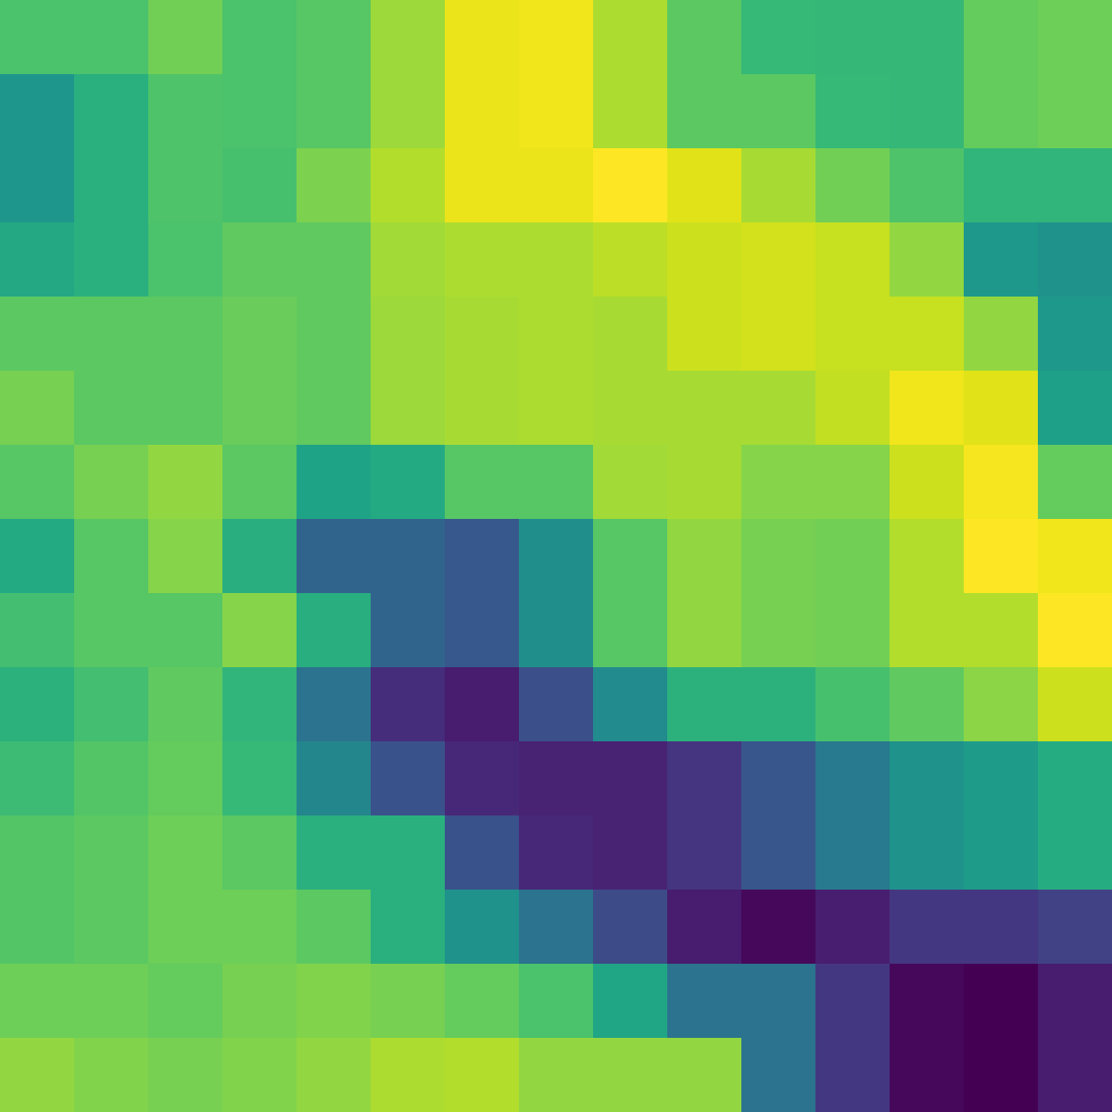
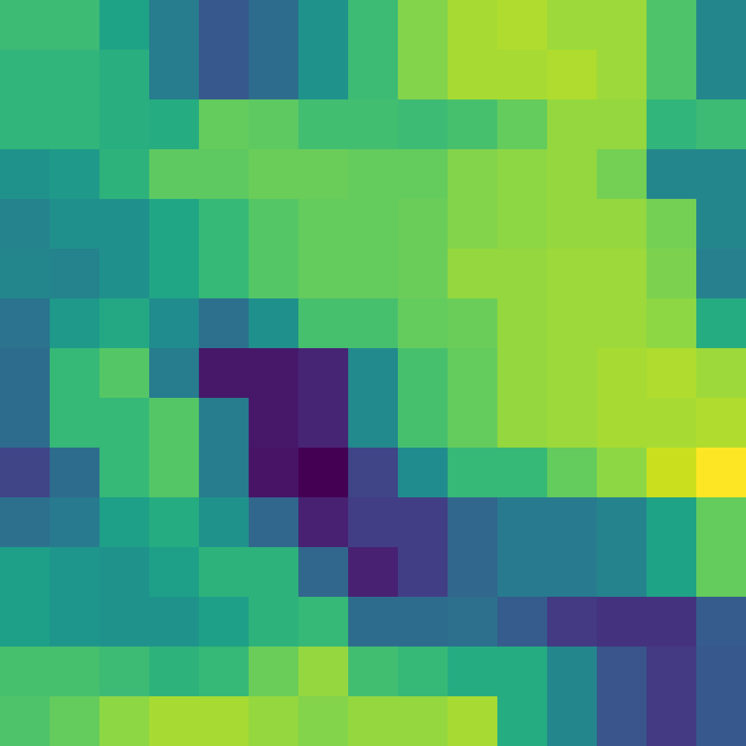
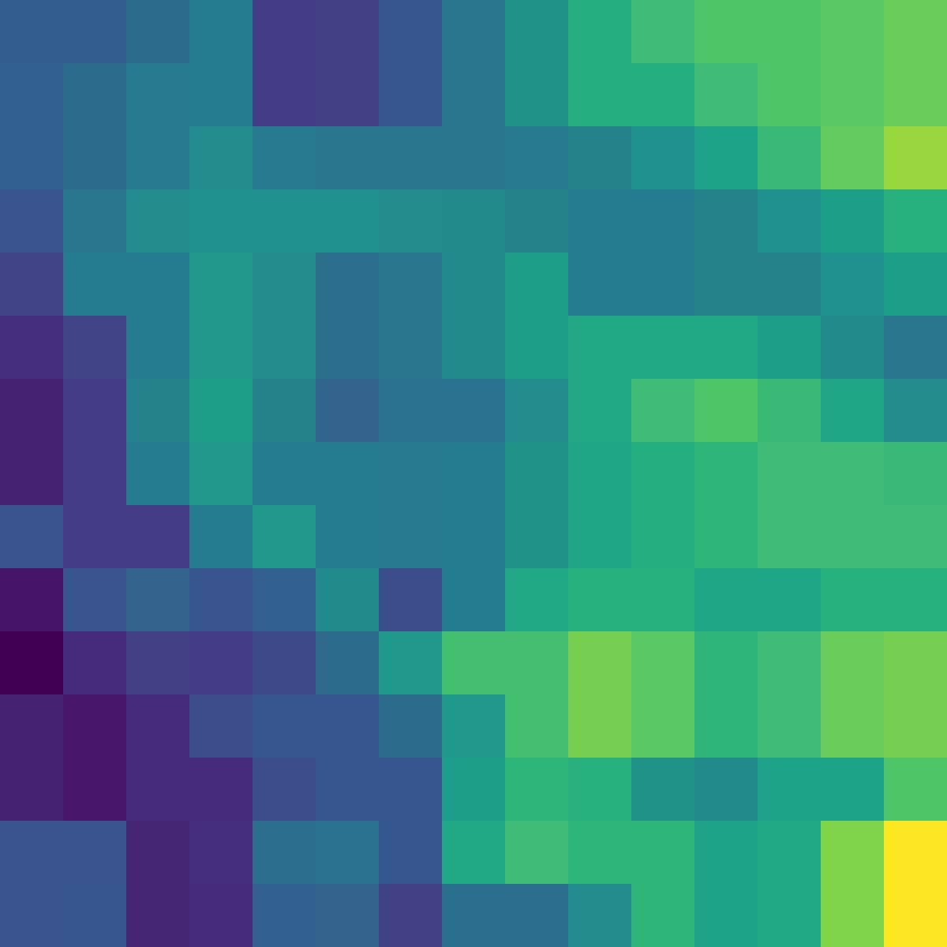
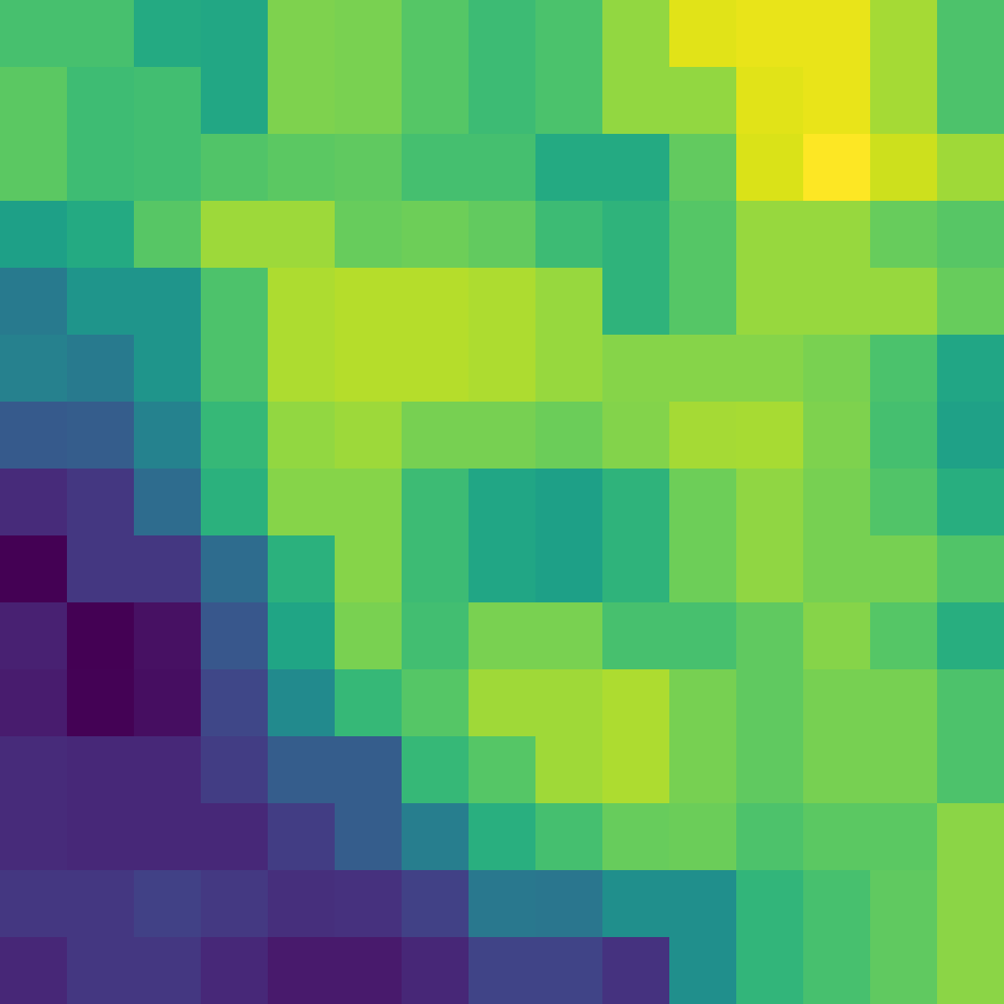
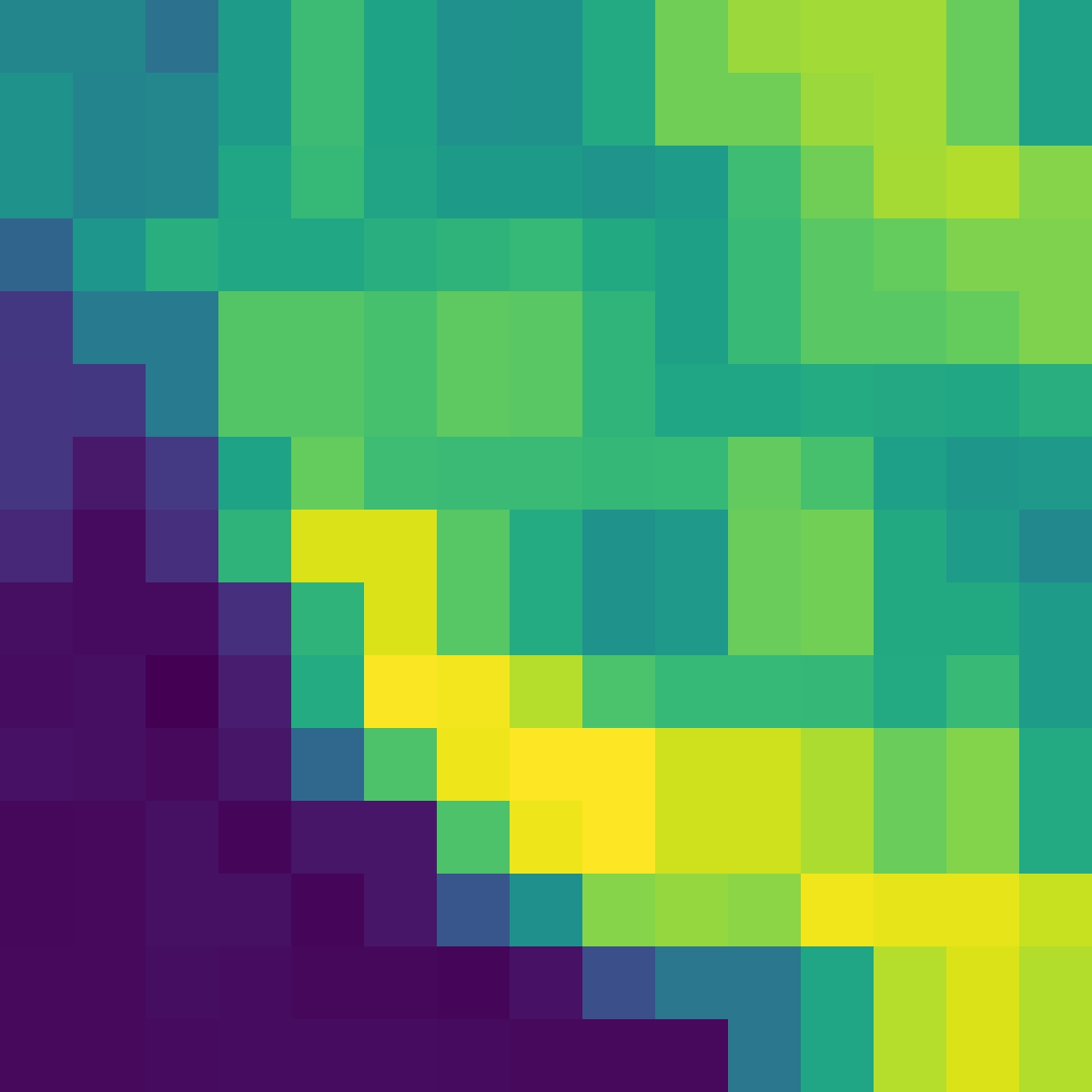
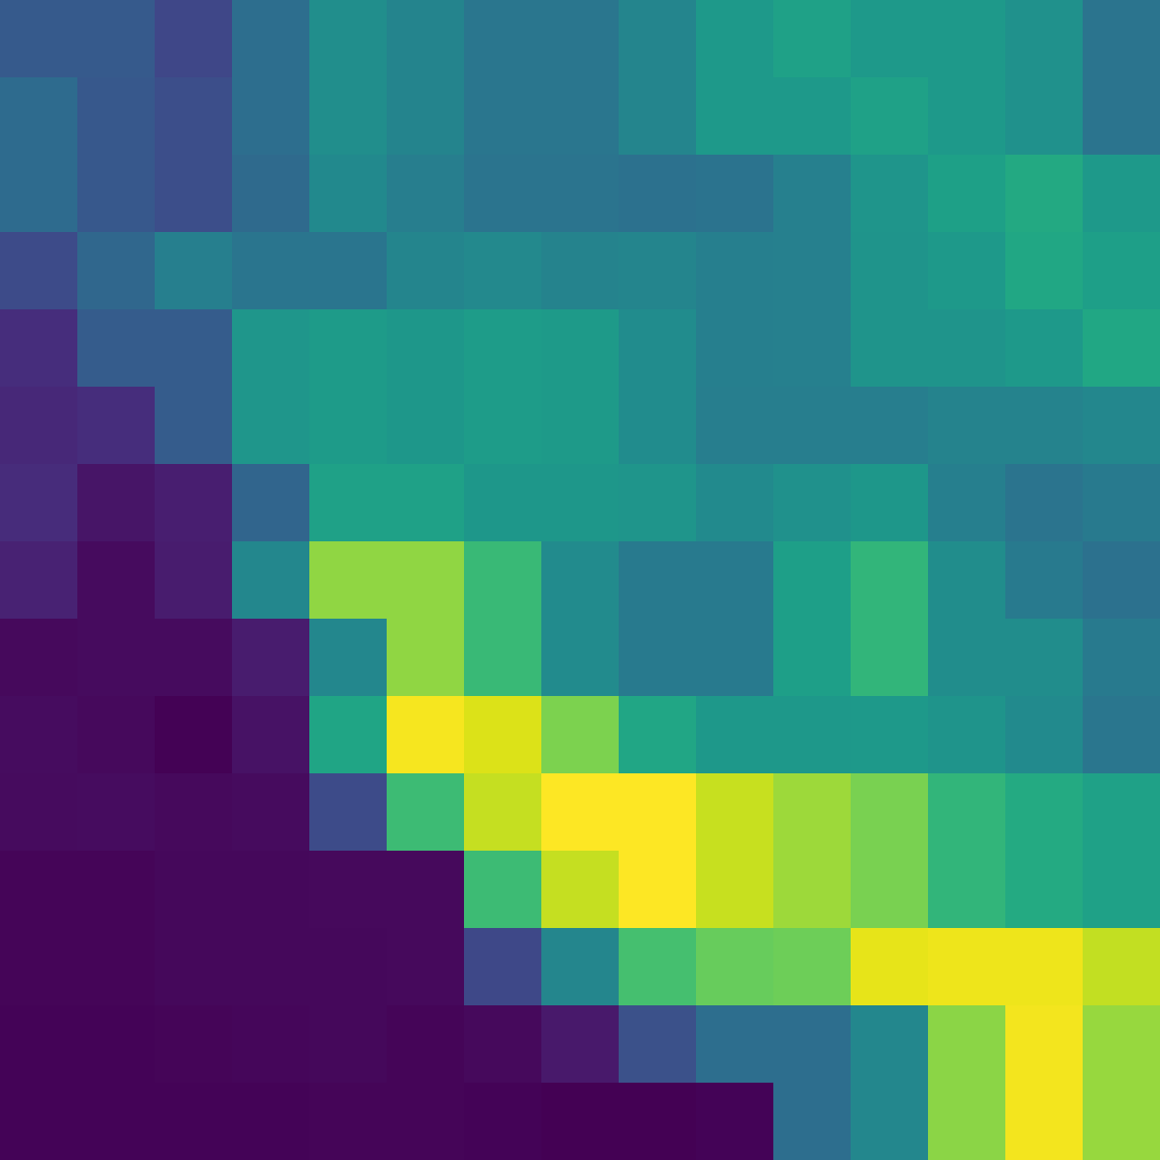
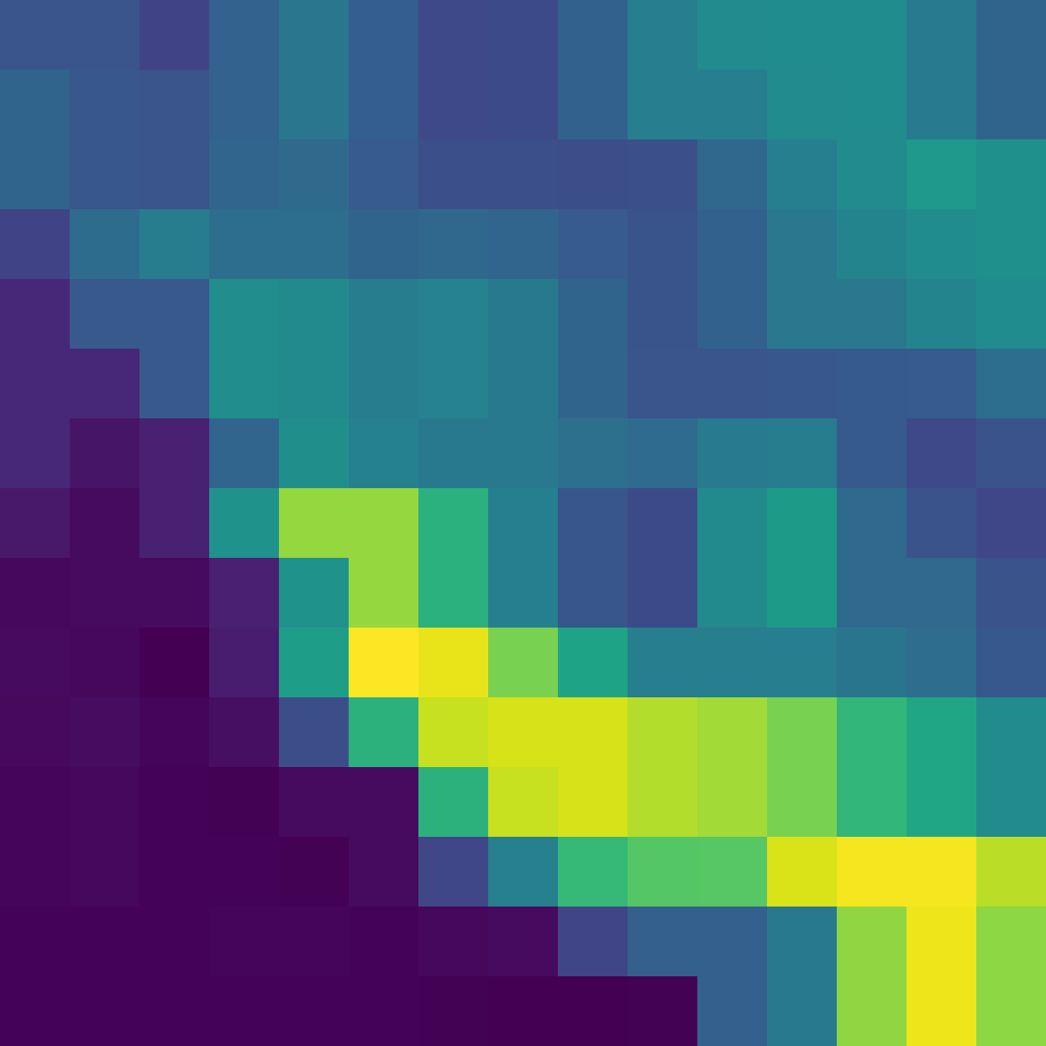
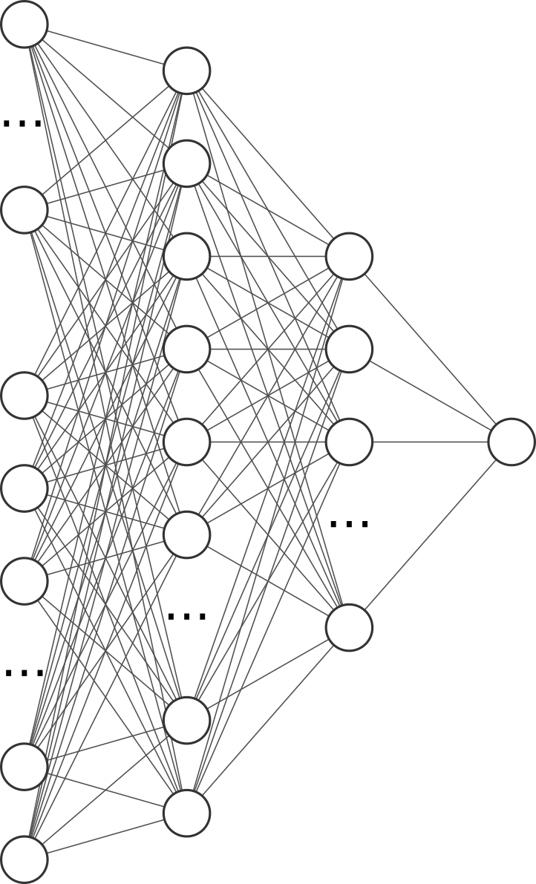
DEM
Architecture
IR 134
IR 120
IR 108
IR 097
IR 087
WV 073
WV 062
IR 039
Day of year
Solar Zenith
Solar Azimuth
Latitude
Longitude
IR 016
VIS 008
VIS 006
256+5 -> 256 -> 64 -> 1
MSG
12x15x15
MP
SIS
128x7x7
MP
GAP
64x15x15
256x3x3
Notes:
For the emulation we set up a deep convolutional network. By taking all bands we hope to gain information on if deep learning methods can use other bands than visible light to their advantage.
It takes about 32 gpu hours to train the model on Nividia T16 gpus and a full image prediction takes around 10 seconds on a single gpu.

Slide 7
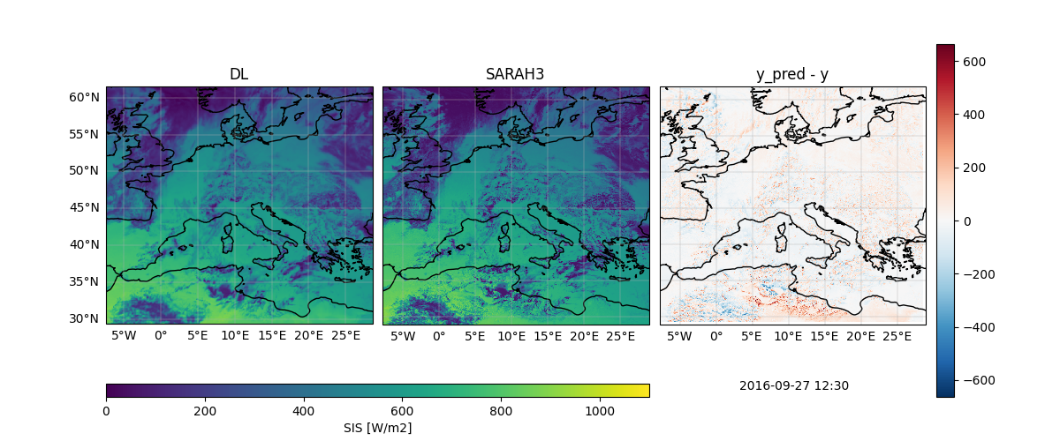
Comparison
09-10-2020
Notes:
This results in the following point wise emulator. Here we see a comparison between the deep learning estimate and the SARAH3 estimate. In general the emulator seems to smooth out some details, but in some cases there are also features found in the DL estimate which SARAH3 does not have any knowledge off.

Slide 8
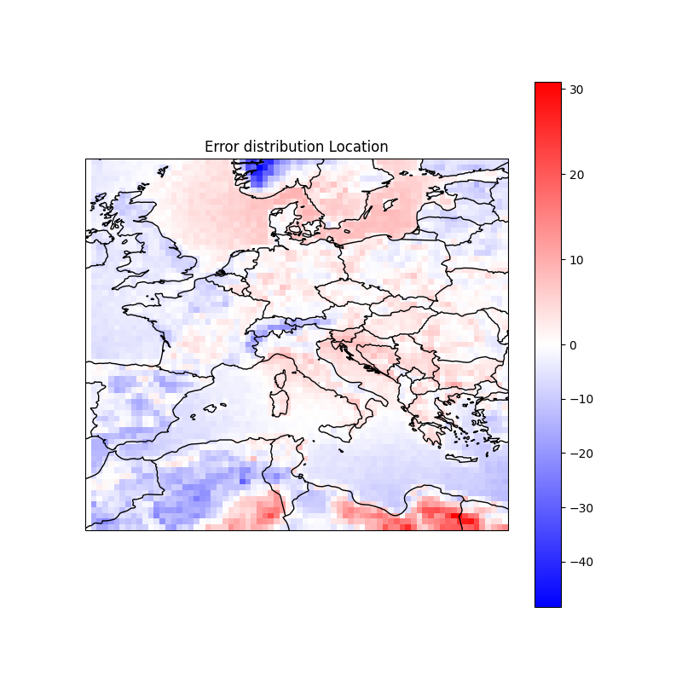
Emulator vs. SARAH3
Average Bias on Validation Dataset (2022)
09-10-2020
Notes:
Calculating the statistics over the entire region we can see the deep learning model small biases in different regions where it under or overestimates compared to SARAH3.
SARAH3 is not a ground truth in this situation so a comparison between the two is a bit disingenuous. For a more accurate performance metric we collected pyranometer data from multiple meteorological organisation and the BSRN network over Europe.

Slide 9
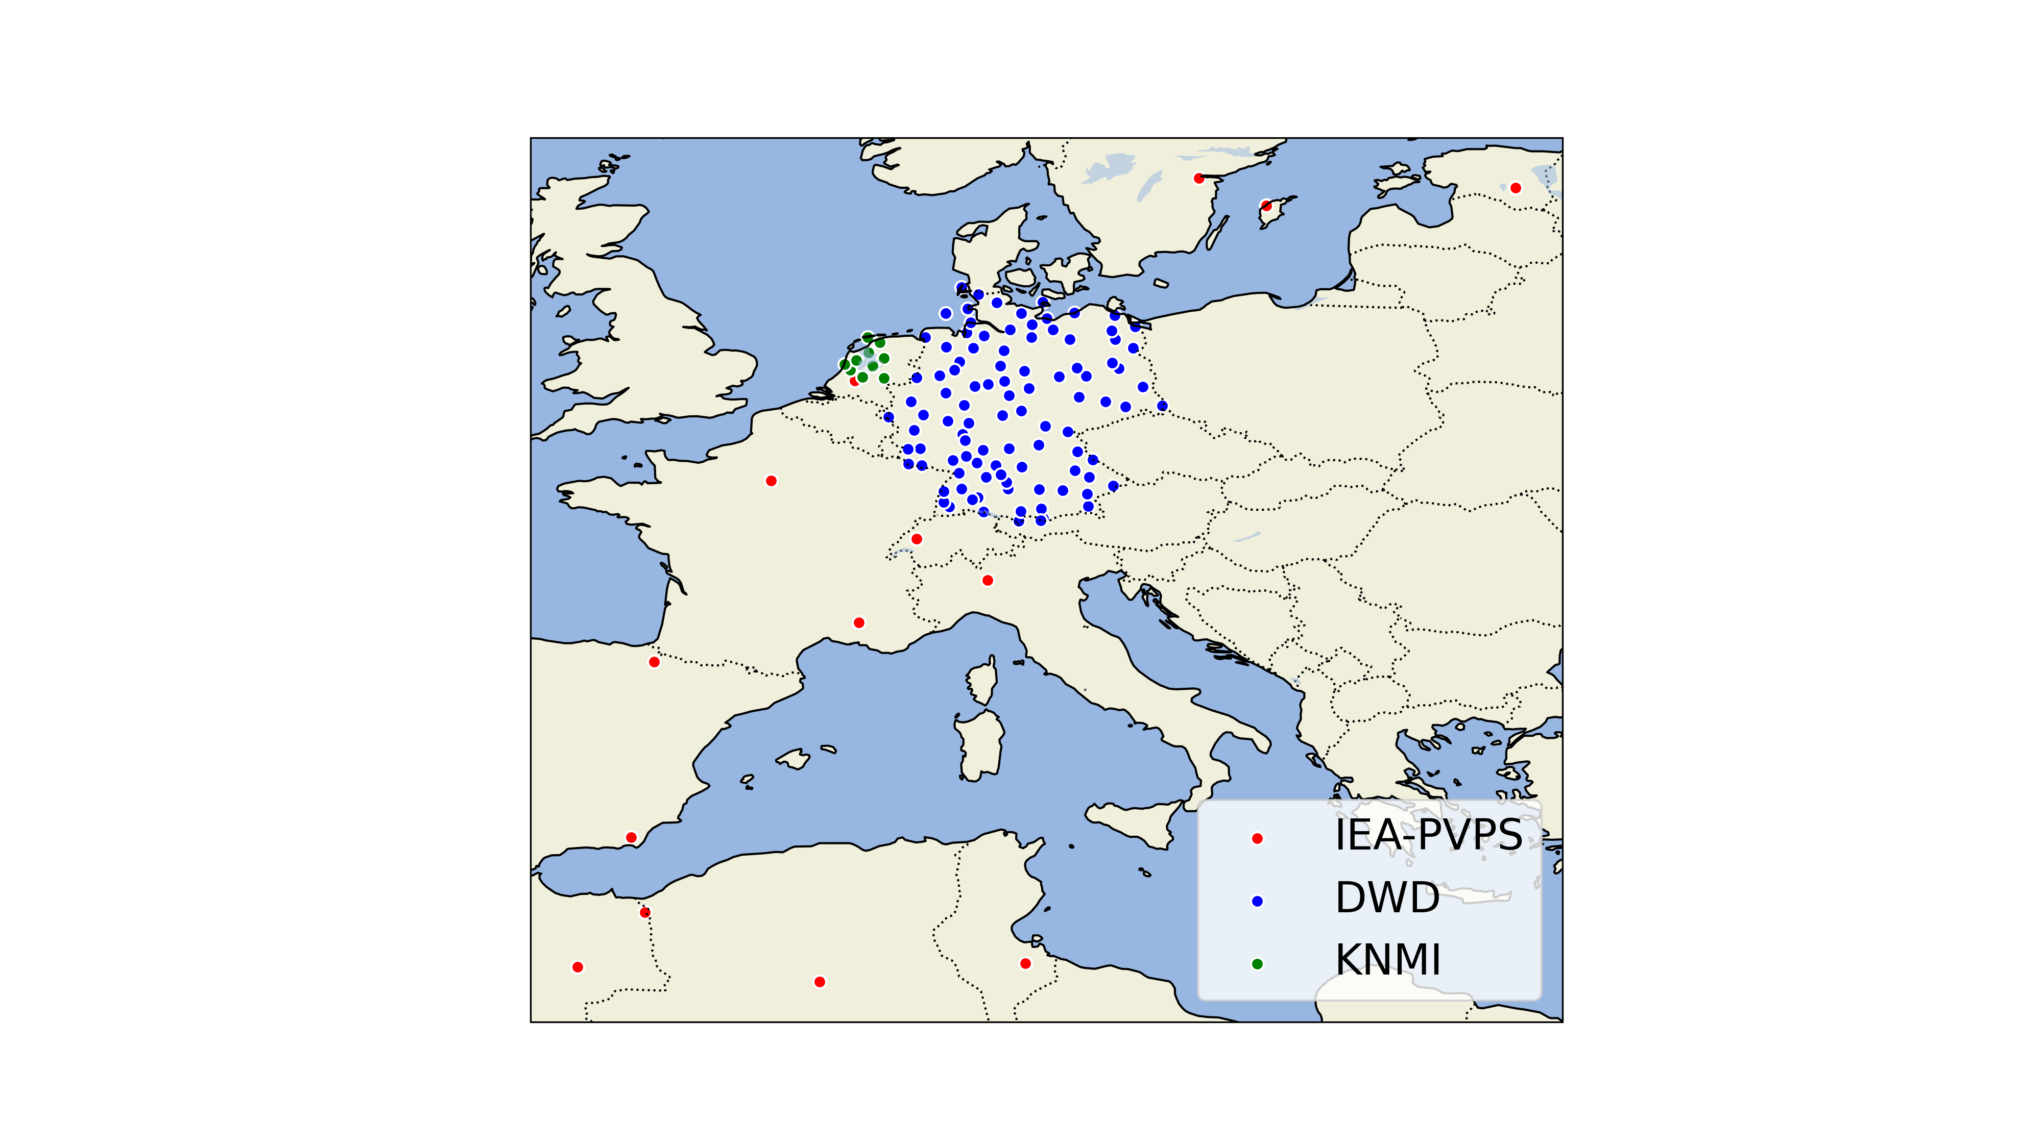
Validation
Pyranometers
10 min avg.
automatic QC
09-10-2020
Notes:
We considered only 10 minute averaged data as maximum requirement for instanteneous estimates.

Slide 10
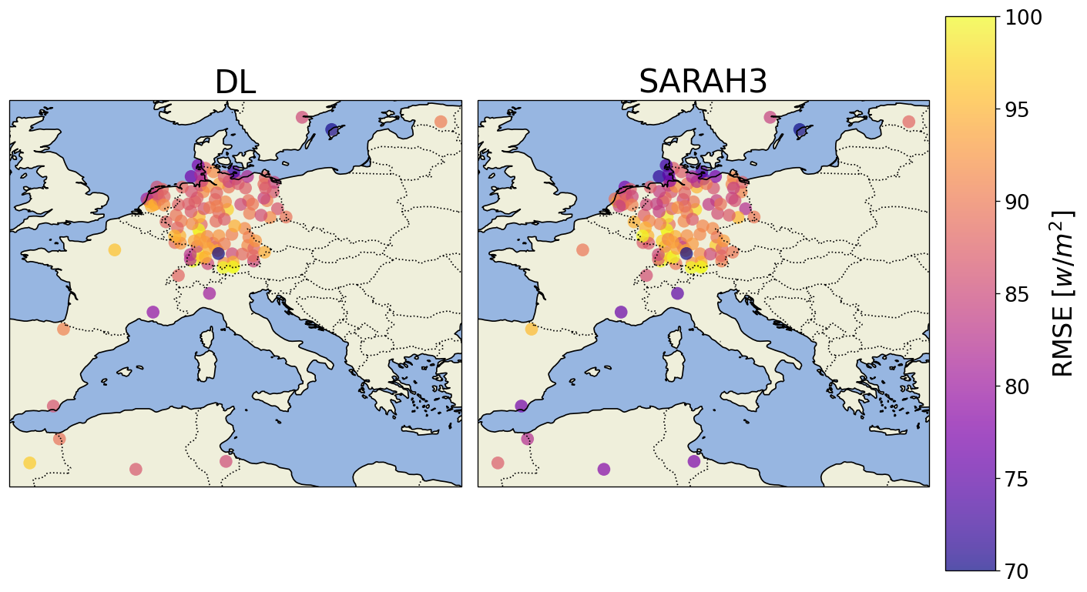
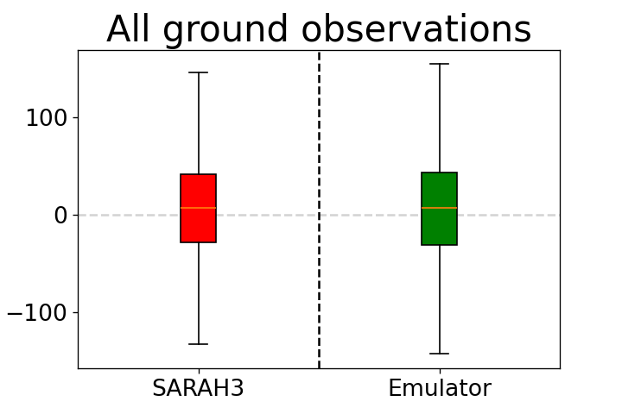
Validation
Emulator
09-10-2020
Notes:
When comparing the root mean square error the emulator shows similar magnitude errors as the SARAH3 algorithm, which shows the emulator has almost equal performance to a physical model.

Slide 11
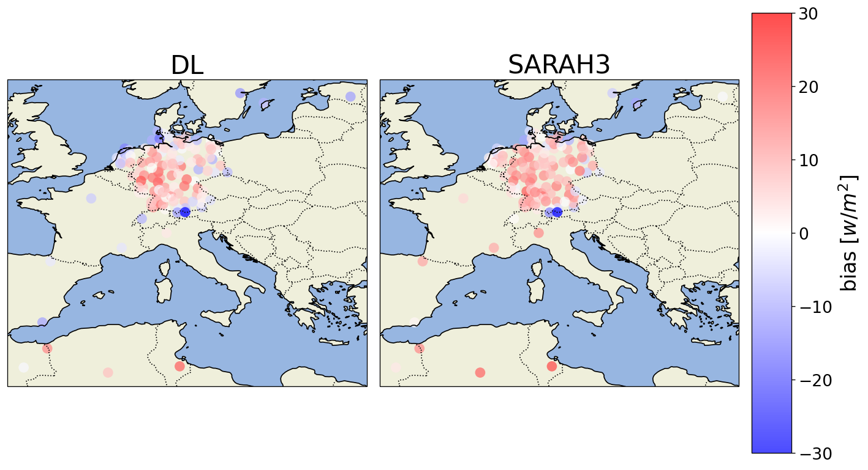
Validation
Emulator
Notes:
and similarly for the bias which means it understands the general regression problem for a large region based on these select groundstations.
But we can do better than that. If we also finetune on pyranometer data the performance increased by around 20 w/m2.

Slide 12
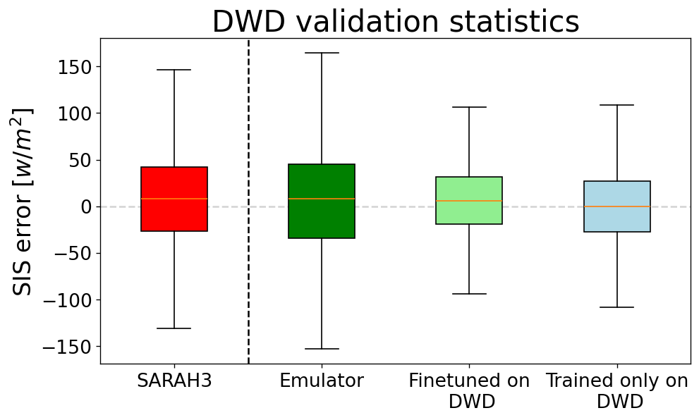
Fine tuning on DWD
Notes:
To showcase this, we divided a subset of DWD into a validation and training part and finetuned the emulator.
It is clear that the deep learning model while finetuned on ground observations perfoms much better than SARAH3.

Slide 13
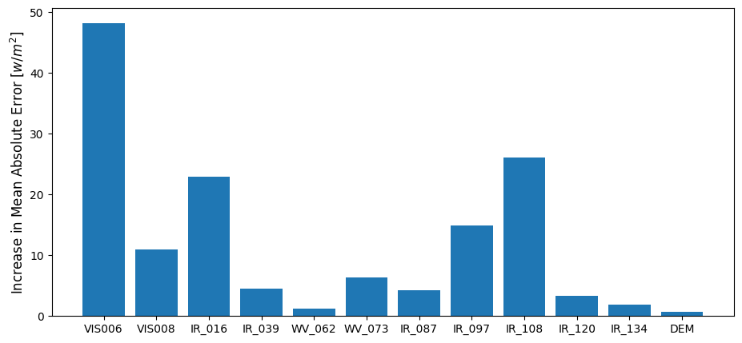
Feature permutation importance - IEA-PVPS pyranometers

Slide 14
Summary
SARAH-3 emulated with fast convolutional network
RMSE and bias are equivalent
Fast emulator – Latency of 10 seconds
Finetuning on pyranometers reduces the SSI uncertainty further
Emulator uses IR/NIR bands for estimation
Bern University of Applied Sciences
Kevin Schuurman, Dr. Angela Meyer, Alberto Carpentieri
Notes:
So in conclusion:

