Slide 1
Supplementary Materials for
Greening fails to translate into an increase in Net Primary Productivity due to warming constraints in India
Ripan Das, Rajiv Kumar Chaturvedi, Adrija Roy, Subhankar Karmakar, Subimal Ghosh
Ghosh^{1,3}

Slide 2
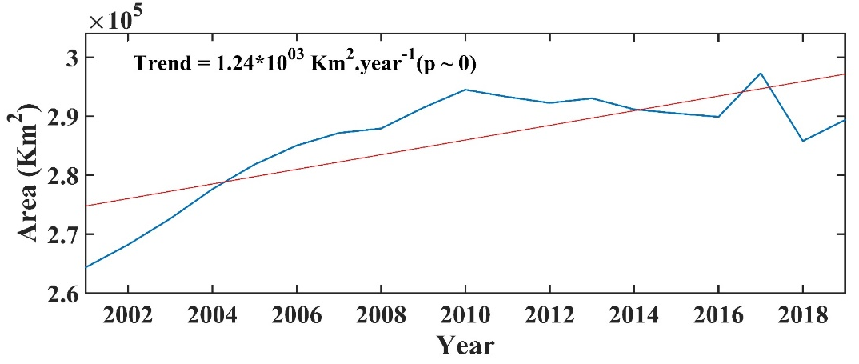
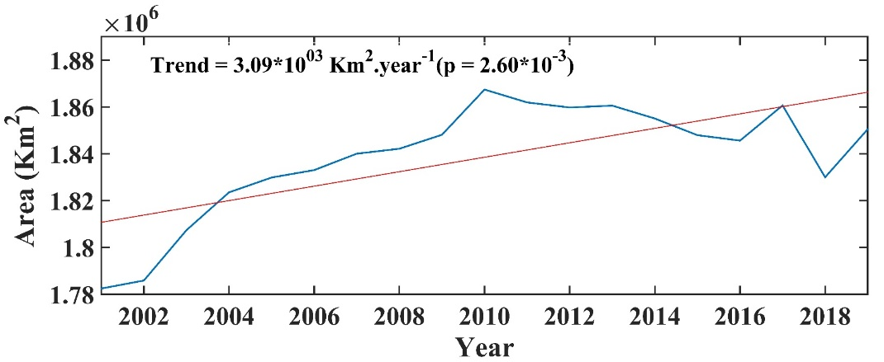
Land use change or climatic impacts could have potentially inhibited the growth of GPP and NPP in India. The annual time series of both forests, and croplands area show a steadily increasing trend over the last two decades (Fig. S1)
(a)
(b)
Fig S1 : Greening in India: The time series of Forest cover area (a) and Cropland area (b) over India from 2001 to 2019

Slide 3
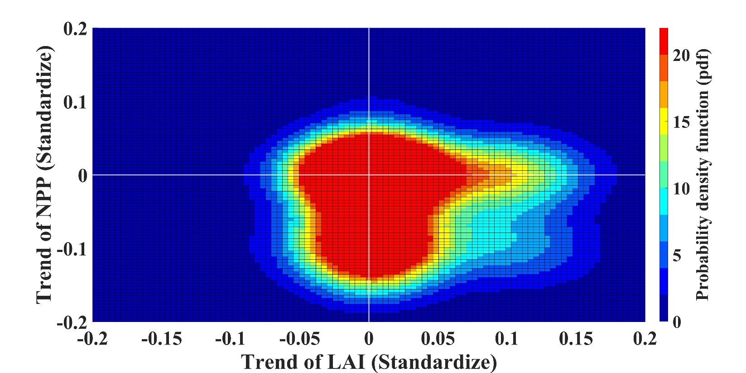
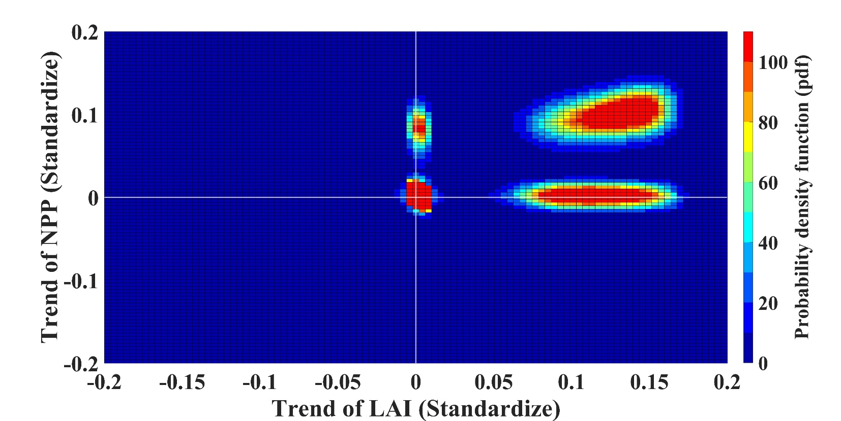
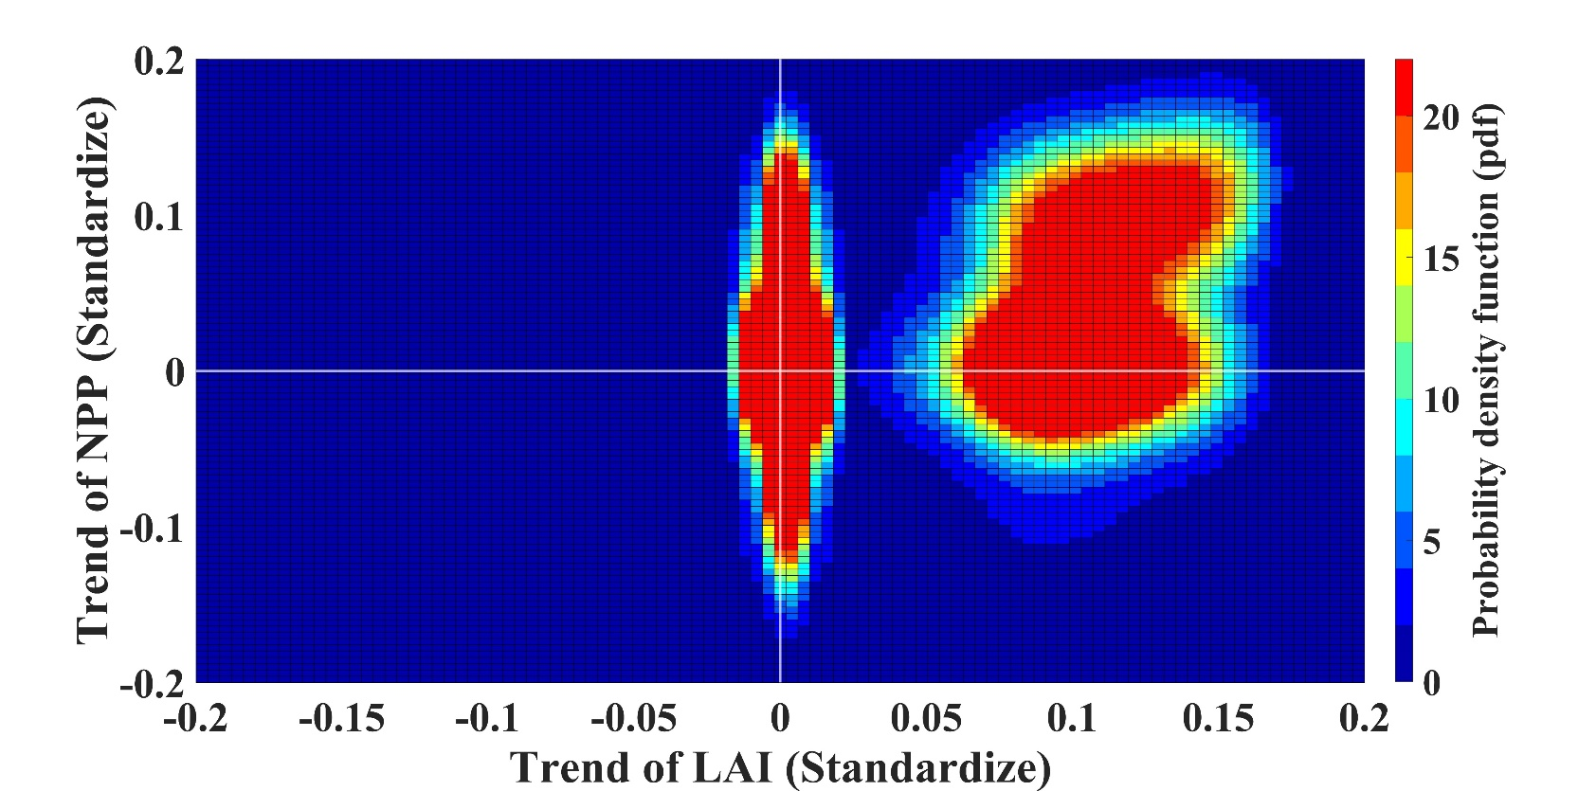
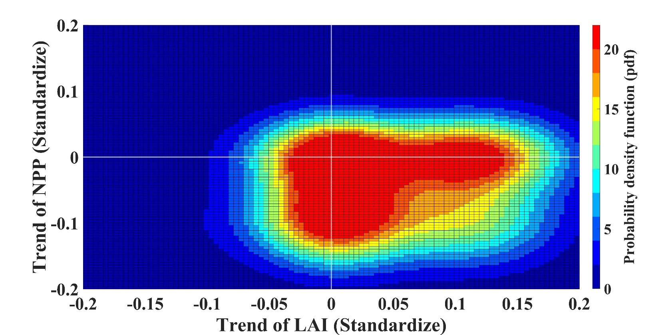
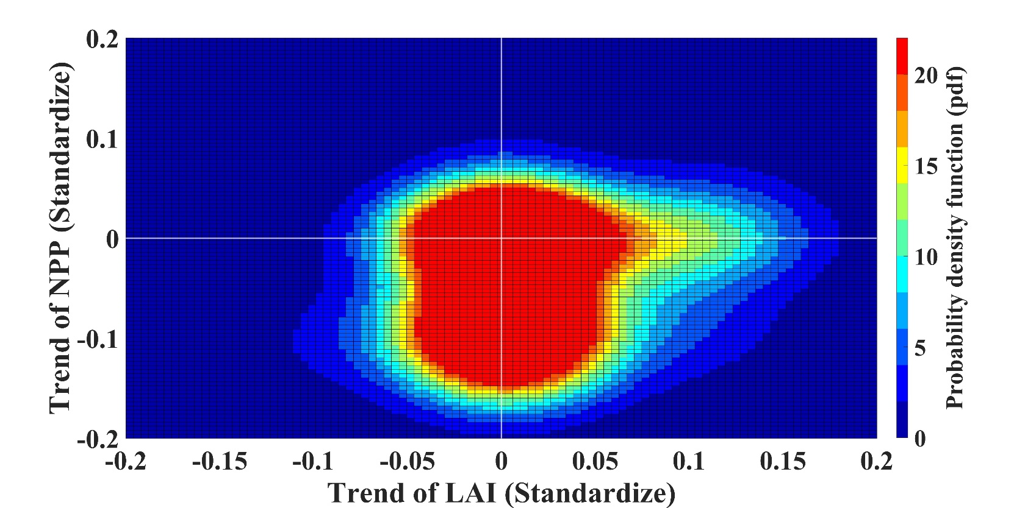
Each point in the sample for generating pdfs (Fig. S2) represents a single grid.
We also found a trend divergence between LAI and NPP in regions 1 (Fig S1a), 4 (Fig S2d) and 5 (Fig S2e)
Pixel density was higher in the fourth quadrant of these three regions (1,4 and 5), where the LAI trend value is positive and the NPP trend value is negative
This plot demonstrate more quantitatively that the LAI trend diverges from the NPP trend in these regions.
(a)
(b)
(c)
(d)
(e)
Fig S2 : Divergence of Trend (density): Probability density function (pdf) of the trends of standardized LAI and NPP trends using bivariate kernel density estimate for Region 1: Northeast (a), Region 2: Northwest Arid (b), Region 3: Central Peninsular (c), Region 4: The Western Ghats (d) and Region 5: East Coast Peninsular (e).

Slide 4
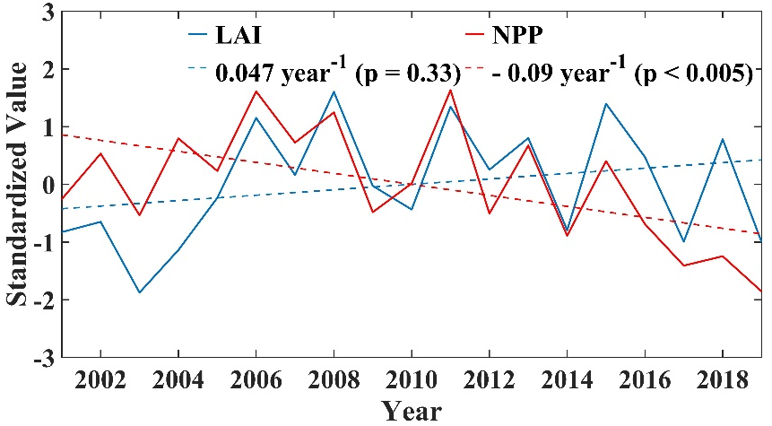
(a)
(b)
In Fig S3, we have plotted the standardized time series of forestland area, cropland area, LAI, and NPP for all five regions. We found that for Region 1, the changes in NPP are not consistent with changes in forest land and cropland (Fig. S3a and S3b). The same is true for regions 4 (Fig. S3g and S3h), and 5 (Fig. S3i and S3j).
Therefore, land use and land cover changes cannot account for the divergence in trend between LAI and NPP over these regions (1, 4 and 5).
Region 1
(c)
(d)
Region 2
(e)
(f)
Region 3
(g)
(h)
Region 4
Region 5
(i)
(j)
Figure S3 Trends in cropland area, forest area, LAI and NPP: Time series of Standardized values of Forest land and Cropland area in Region 1 (a), 2(c), 3 (e), 4 (g) and Region 5 (i). Time series of Standardized values of LAI and NPP in Region 1 (b), 2(d), 3 (f), 4 (h) and Region 5 (j). The dotted line represents the trends in corresponding variables.

Slide 5
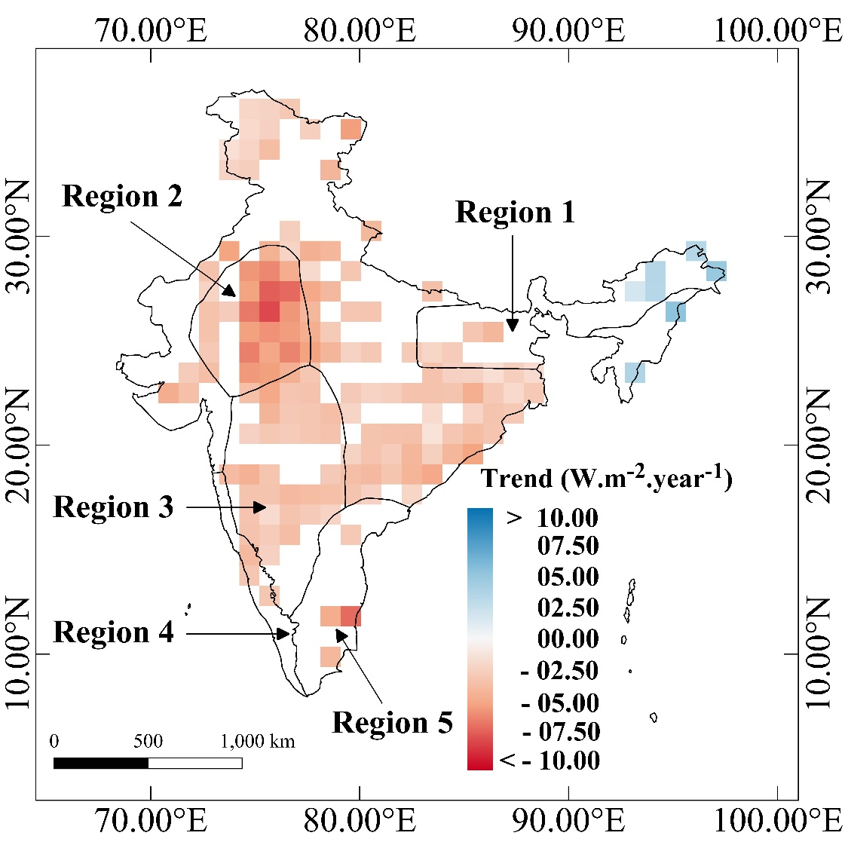
Surface Direct PAR (All-sky) Trend
In the Fig. S4 we have plotted the trend of Photosynthetic Active Radiation (PAR) . We have used monthly mean CERES Surface PAR (Direct) data for all sky conditions. The data has a spatial Resolution of 1° x 1°.
A significant decreasing trend in PAR values has been observed in Regions 2, 3. There are a few decreasing grids in other regions (1, 4 and 5) but the patterns are inconsistent.
We found no consistent trend pattern in PAR in regions where NPP decreased.
This figure confirms that radiation changes have no effect on the decreasing trend in NPP across regions 1, 4, and 5.
Fig. S4: Annual Trend of Surface Direct PAR (All-sky) over India for the period 2001-2019. The Figure only shows statistically significant trends at 0.1 level.

Slide 6
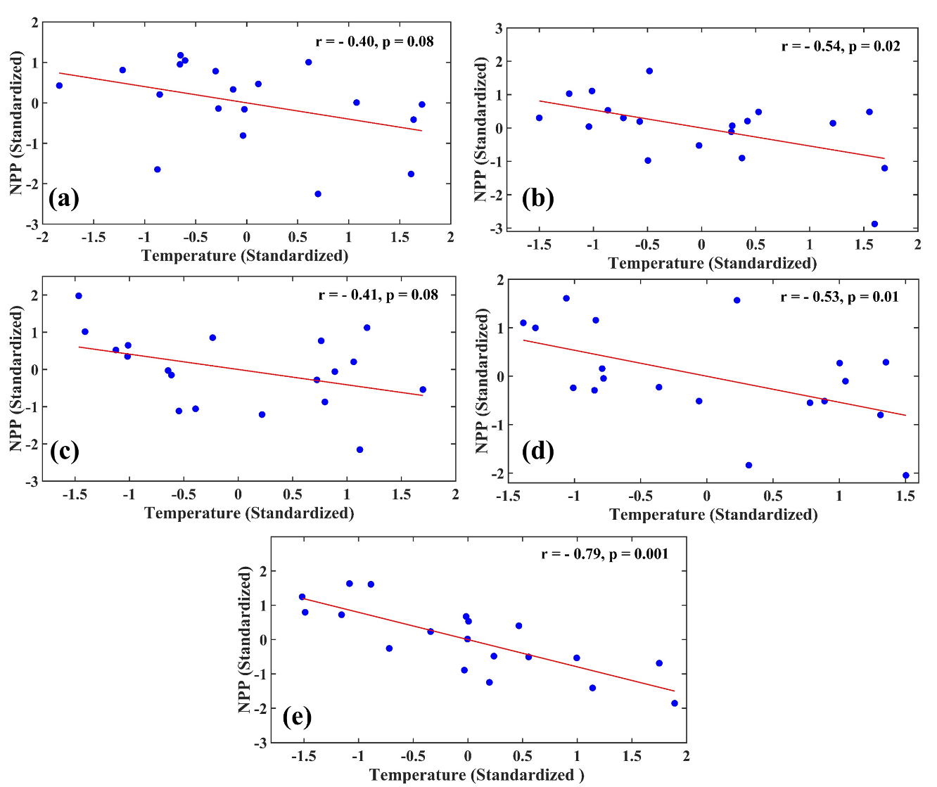
In Fig S5. we have shown the scatter plots between annual mean temperature (Standardized) and NPP (Standardized) for all five regions. Temperature exhibits a significant negative correlation with NPP in all five regions.
Fig S5 : Impacts of Temperature on NPP: Relationship between annual mean temperature (Standardized) and NPP (Standardized) in Region 1(a), 2 (b), 3 (c), 4 (d) and 5 (e).

Slide 7
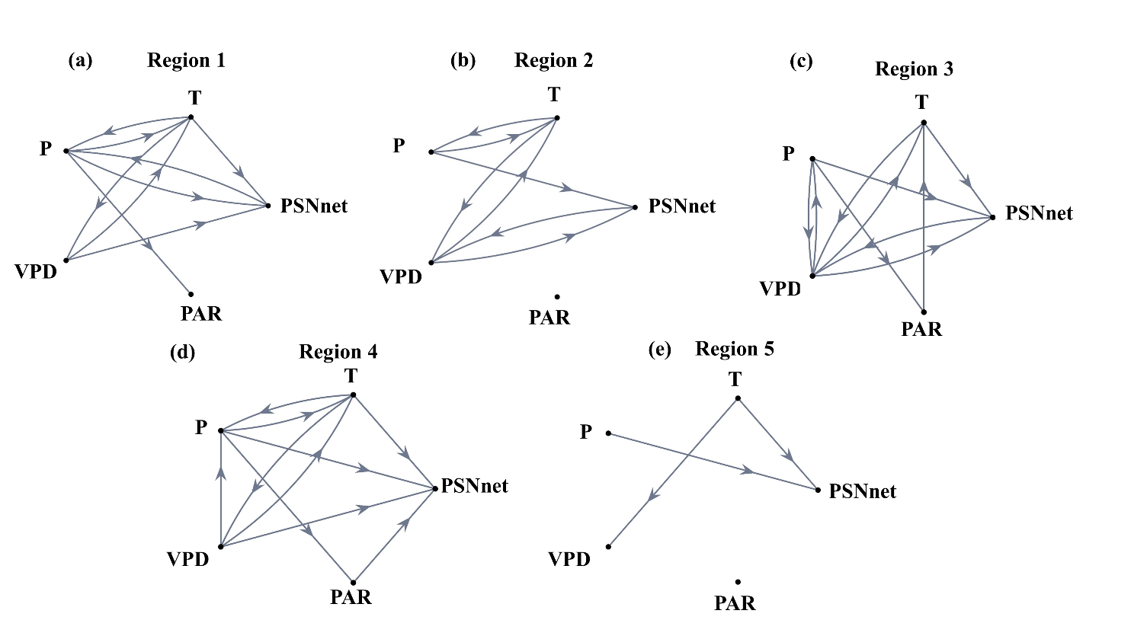
We use the Granger causality approach to further ascertain the climate controls on changing PSNnet (and subsequently, NPP). Except for Region 2, for all the other regions, there are causal links from temperature to PSNnet. For Region 2, temperature causes vapor pressure deficit that subsequently causes PSNnet.
Hence, for all the regions, the causal links from temperature to PSNnet are established.
This causal analysis allows us to conclude that temperature has a causal relationship with net vegetation productivity.
Fig. S6 Causal Network between Climate and Productivity Variables: The causal network derived from Granger causality at the Regions 1 (a), 2(b), 3(c), 4(d), 5 (e). The variables used are Precipitation (P), Temperature (T), Vapor Pressure Deficit (VPD), Photosynthetic Active Radiation (PAR), and net Photosynthesis (PSNnet). The causal links are shown from source to sink using an arrow at a statistically significance level of 0.05.

