Slide 1
Assessment and Planning of Water Allocation for Agricultural Irrigation – A Case Study of Kinmen
Yi Su, Hwa-Lung Yu
Department of Bioenvironmental Systems Engineering, NTU
Notes:
Hello everyone, professors and fellow students. I'm Su Yi, a second-year master's student under Teacher Yu. It's a great honor to be here today to share my research in Kinmen, titled "Assessment and Planning of Water Allocation for Agricultural Irrigation – A Case Study of Kinmen."

Slide 2
Outline
Research Background
Irrigation Water Allocation Plan Settings
01
04
Research Methods
Yield Results and Discussion
02
05
Simulated Scenario
03
Notes:
Let me give you an overview of my presentation today. I'll start with the research background, briefly touch on the research methods, discuss simulation scenarios, and the settings for Irrigation Water Allocation Plans. Finally, I'll wrap up with a brief discussion based on the results.

Slide 3
01
Research Background

Slide 4
The impacts of climate change on agriculture in Kinmen
“Rain-fed Farming”
“Extreme Precipitation”
“Utilizing Reclaimed Water
for Irrigation”
Notes:
Firstly, let's talk about the impact of climate change on agriculture in Kinmen. Due to the local reliance on Rain-fed Farming, recent extreme rainfall has significantly affected the local agriculture heavily dependent on weather conditions. In response, the government plans to use reclaimed water for irrigation to mitigate the impact.

Slide 5
The historical annual rainfall and annual unit yield of sorghum in Kinmen
Data sources: Central Weather Administration, Kinmen Farmer's Association
Mean
Yield of Sorghum
Linear Trend of Yield
Notes:
Looking at the graph titled "The historical annual rainfall and annual unit yield of sorghum in Kinmen," we can see that since 2016, Kinmen has experienced extreme rainfall, and the unit yield of sorghum has been declining annually.

Slide 6
Research Purpose
Testing the efficiency of different water allocation plans for sorghum-wheat rotation in various scenarios.
Notes:
Given this background, our research aims to determine the optimal irrigation water allocation plan through testing the efficiency of different plans for sorghum-wheat rotation under various historical scenarios.

Slide 7
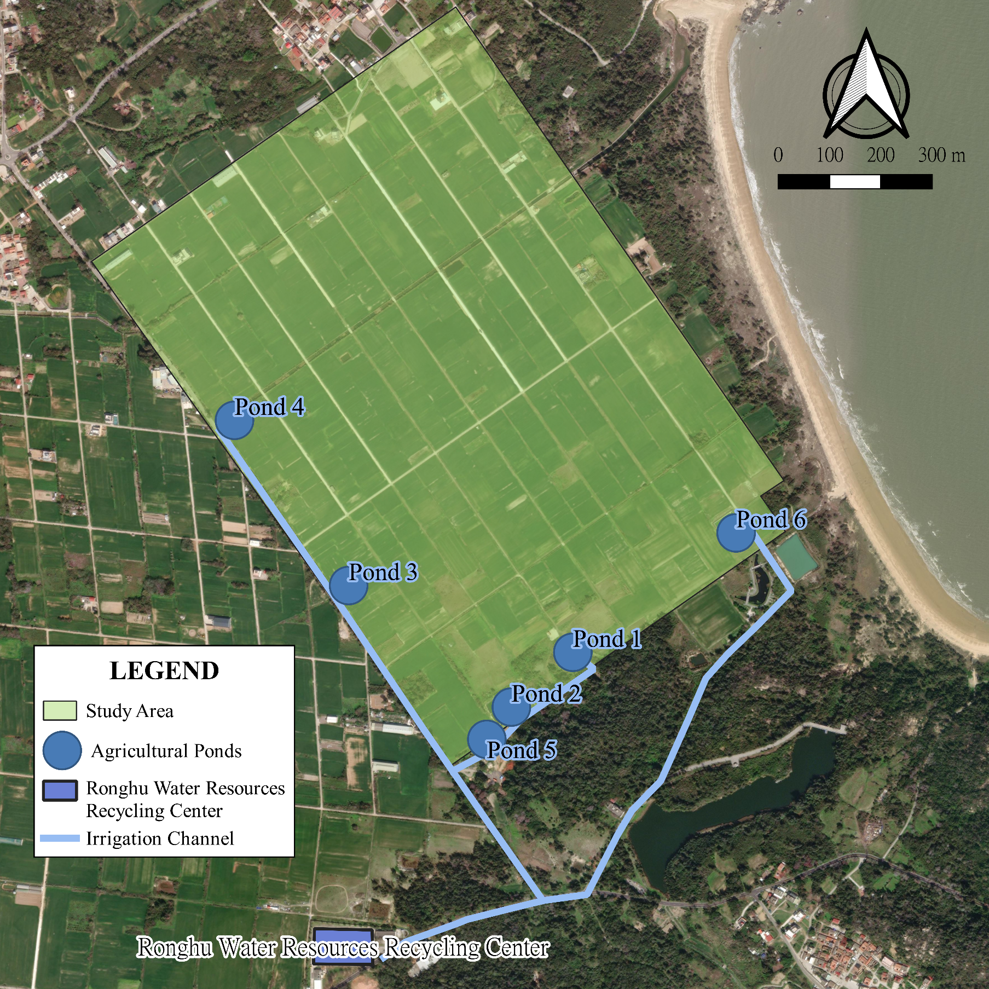
Research Area
Area: 100 hectares
Water Storage Capacity: 20,750 cubic meters (6 agricultural ponds)
Reclaimed Water: 750 tons per day
Soil: Sandy loam, relatively poor water retention
(Agricultural Research Institute of Kinmen, 2008)
Ponds | 1 | 2 | 3 | 4 | 5 | 6
Water Storage Capacity(m³) | 1500 | 6900 | 1450 | 2500 | 1400 | 7000
Notes:
Before diving into the details, let me introduce the study area briefly. The area is 100 hectares, with a water storage capacity of 20,000 cubic meters. The nearby water recycling center can provide 750 tons of reclaimed water daily. Additionally, the local soil is sandy loam with poor water retention.

Slide 8
02
Research Methods

Slide 9
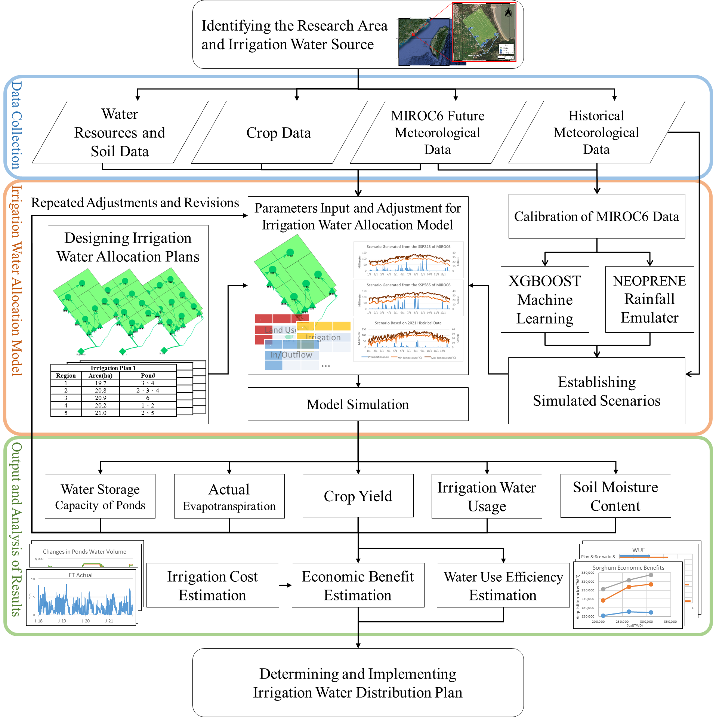
Research Framework
Notes:
In the second chapter, I'll briefly outline our research methods. Here's our research framework: first, after determining the area and water source, we calculate ETo using the Penman-Monteith Equation. Then, we use the MABIA method to establish a model. In the third step, historical weather data serves as our simulation scenario to set irrigation plans and parameters. Finally, we'll generate yield results and determine the best irrigation plan through efficiency calculations.

Slide 10
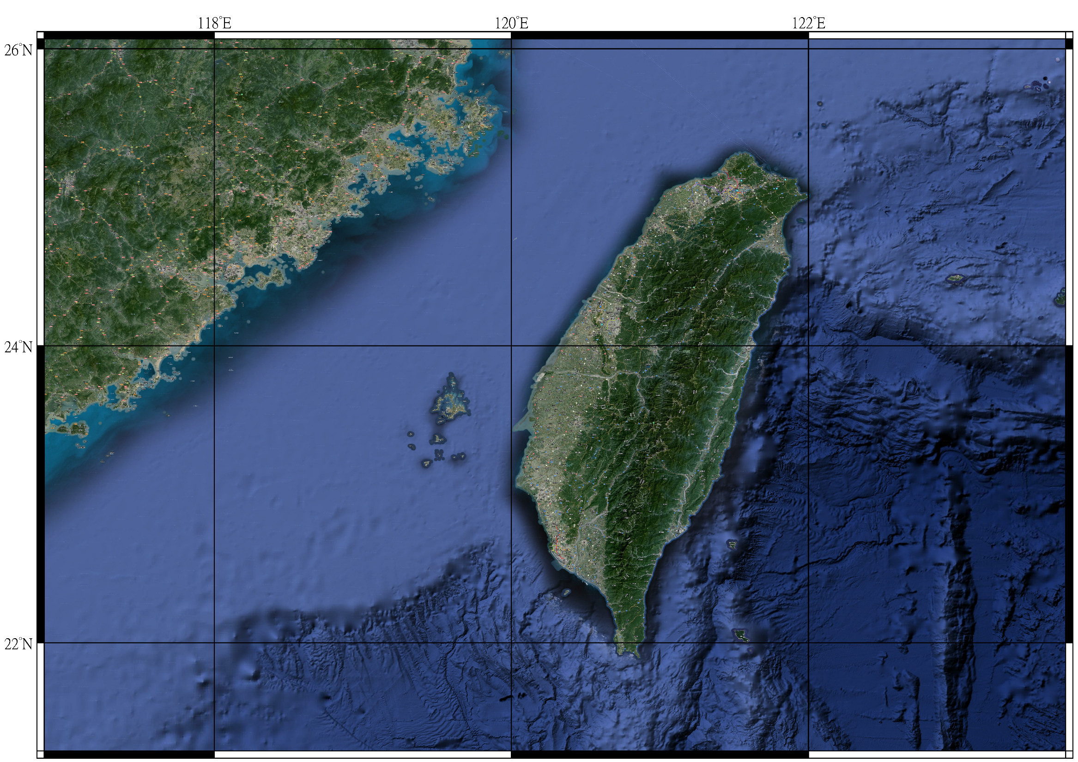
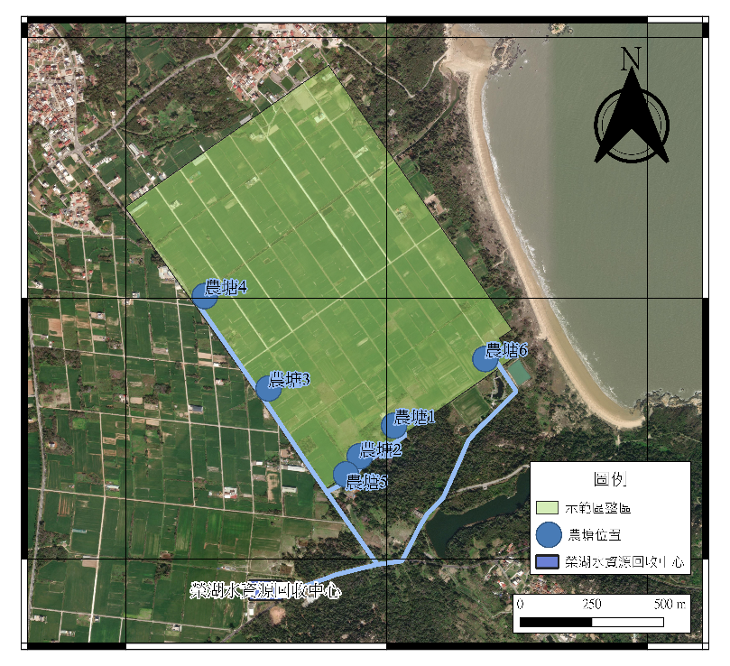
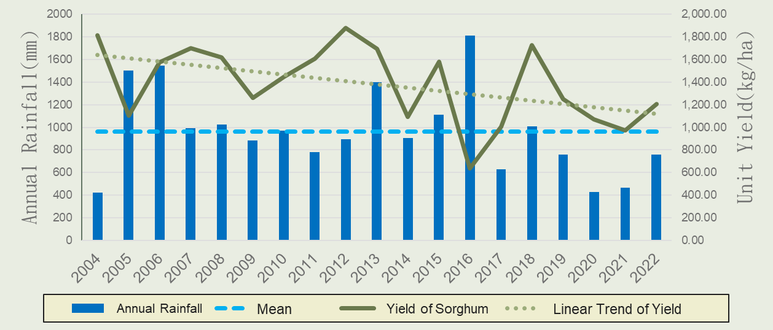
Data Collection
Historical Rainfall and Yield Data
Identifying the Research Area
and Irrigation Water Source
Data Collection
金門水資源與土壤資料
Historical Meteorological Data
Water Resources and Soil Data
Crop Data
MIROC6 Future Meteorological Data

Slide 11
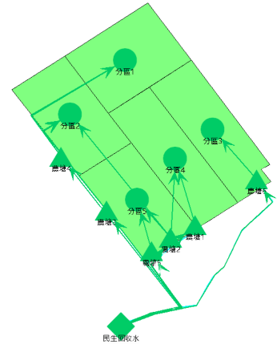
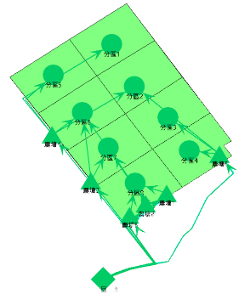
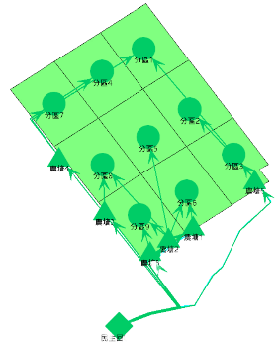
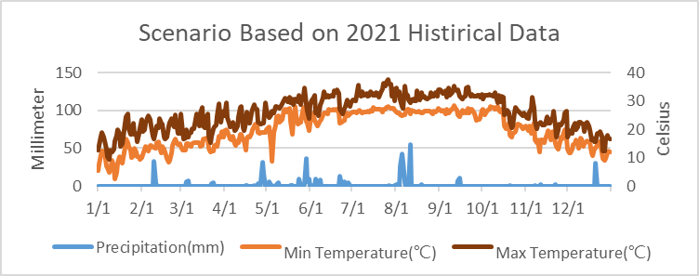
Irrigation Water Allocation Model
Irrigation Water Allocation Model
Repeated Adjustments and Revisions
Parameters Input and Adjustment for Irrigation Water Allocation Model
Calibration of MIROC6 Data
Designing Irrigation Water Allocation Plans
XGBOOST Machine Learning
NEOPRENE
Rainfall Emulater
.
.
Land Use
Irrigation
.
In/Outflow
…
Irrigation Plan 3
Region | Area(ha) | Ponds
1 | 19.7 | 3、4
2 | 20.8 | 2、3、4
3 | 20.9 | 6
4 | 20.2 | 1、2
5 | 21.0 | 2、5
Establishing Simulated Scenarios
Irrigation Plan 2
Region | Area(ha) | Ponds
1 | 19.7 | 3、4
2 | 20.8 | 2、3、4
3 | 20.9 | 6
4 | 20.2 | 1、2
5 | 21.0 | 2、5
Irrigation Plan 1
Region | Area(ha) | Pond
1 | 19.7 | 3、4
2 | 20.8 | 2、3、4
3 | 20.9 | 6
4 | 20.2 | 1、2
5 | 21.0 | 2、5
Model Simulation

Slide 12
Output and Analysis of Results
Repeated Adjustments and Revisions
Output and Analysis of Results
Water Storage Capacity of Ponds
Actual Evapotranspiration
Crop Yield
Irrigation Water Usage
Soil Moisture Content
Irrigation Cost Estimation
Economic Benefit Estimation
Water Use Efficiency Estimation
Determining and Implementing
Irrigation Water Distribution Plan

Slide 13
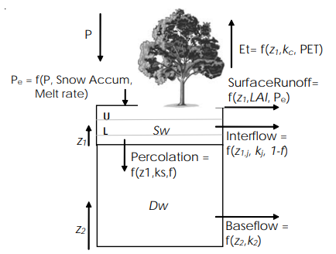
Irrigation Water Allocation Model
Using WEAP to assist in constructing our model. (Water Evaluation And Planning System)
Surface Hydrological Model
MABIA Method
Used for calculating crop water balance, including the Penman-Moteith formula and dual Kc method.
ETo
Soil Water Contnet
Kcb
Ke
ETa
Root Zone Water Balance
Irrigation Water Volume
Crop Yield
Jack Sieber, M.S., Chris Swartz, Ph.D.& Annette Huber-Lee, Ph.D., “USER GUIDE for WEAP21,” WA: Stockholm Environment Institute, 2005.
Notes:
We utilize WEAP to assist in model building, which is based on the Surface Hydrological Model, including calculations for evaporation, runoff, infiltration, and more. We also employ the MABIA method for crop water balance calculations, incorporating the Penman-Monteith formula and dual Kc method, along with the necessary parameter settings and calculations.

Slide 14
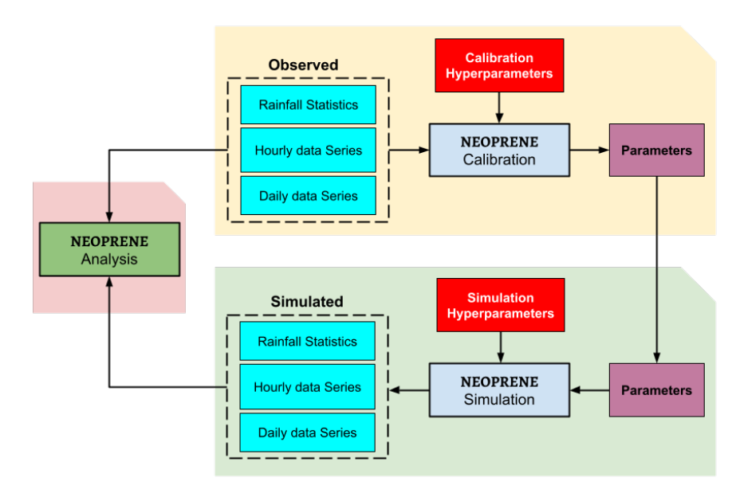
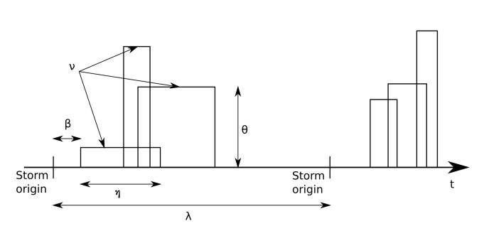
Rainfall Emulator(Based on Neyman-Scott process)
Using NEOPRENE v1.0.1: A Python library
Diez-Sierra, J., Navas, S., and del Jesus, M.: NEOPRENE v1.0.1: a Python library for generating spatial rainfall based on the Neyman–Scott process, Geosci. Model Dev., 16, 5035–5048, https://doi.org/10.5194/gmd-16-5035-2023, 2023.

Slide 15
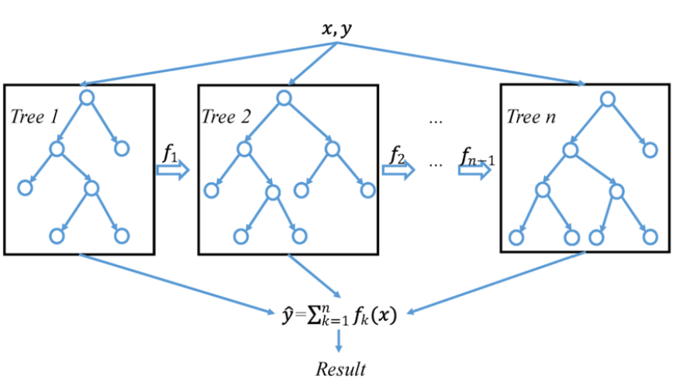
XGBOOST
eXtreme Gradient Boosting
An ensemble machine learning method composed of decision trees
Handling both regression and classification problems
Chen, Tianqi & Guestrin, Carlos. (2016). XGBoost: A Scalable Tree Boosting System. 785-794. 10.1145/2939672.2939785.

Slide 16
Simulation Scenario
03

Slide 17
Historical Scenarios
We chose abundant year, normal year, and drought year as simulation scenarios.
Scenario 1(Abundant Year)：2015-2016：
Annual Rainfall：1906mm
Annual ETo：1150mm
Reference Evapotranspiration(mm)
Notes:
In the third chapter, we delve into simulation scenarios. To understand the impact of rainfall on irrigation plans, we've chosen three scenarios: an abundant year, a normal year, and a drought year. For the abundant year, we selected 2015-2016, with an annual rainfall of 2000 millimeters. The graph here illustrates the rainfall distribution for that year, along with our calculated ETo.

Slide 18
Scenario 2(Normal Year)：2018-2019：
Annual Rainfall：1051mm
Annual ETo： 1214mm
Rainfall(mm)
Reference Evapotranspiration(mm)
Scenario 3(Drought Year)：2020-2021：
Annual Rainfall：406.5mm
Annual ETo： 1411mm
Rainfall(mm)
Reference Evapotranspiration(mm)
Notes:
Now, let's take a look at two charts displaying the distribution for an average year and a drought year. The average year is represented by 2018-2019, while the drought year is 2020-2021. These graphs provide insights into the rainfall patterns and ETo calculations for each of these scenarios.

Slide 19
MIROC6 Meteorological Data
Precipitation
Rainfall Emulator: Calculating rainfall characteristics and simulating
Calibration using historical data from 2015 to 2023.
Temeprature
Simulated Scenarios based on MIROC6 data
ssp245、ssp585
Near-Surface Wind Speed
XGBOOST:
Learning the relationship between meteorological data and predicting.
Relative Humidity
Gebrechorkos, S., Leyland, J., Slater, L. et al. A high-resolution daily global dataset of statistically downscaled CMIP6 models for climate impact analyses. Sci Data 10, 611 (2023). https://doi.org/10.1038/s41597-023-02528-x

Slide 20
Simulated Future Scenarios
Annual Rainfall：1297mm
Annual ETo：1352 mm
Annual Rainfall：1396mm
Annual ETo：1480 mm

Slide 21
04
Irrigation Water Allocation Plan Settings

Slide 22
Irrigation intervals?
Plan 1: Irrigation once a week. Plan 2: Irrigation once every two weeks. Plan 3: Irrigation once every three weeks.
Our Team
Local Farmers
Frequent irrigation!
Extensive cultivation!
Notes:
In the fourth chapter, we discuss the Irrigation Water Allocation Plan Settings. First, we need to determine the irrigation intervals. Our team believes that more frequent irrigation yields better results, while local farmers suggest that extensive crops may not require as many irrigation cycles. Therefore, we set three different intervals as three distinct plans for comparison.

Slide 23
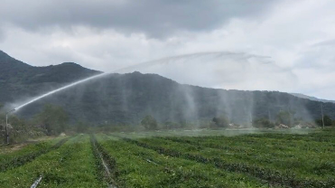
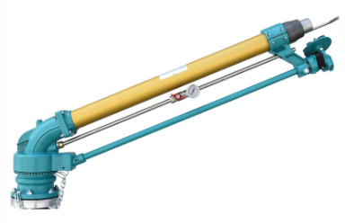
Irrigation Working Days
Assuming irrigation using JET70 3” and 4” large sprinklers
Flow rate: 1050~3150 liters/minute
Spraying radius: 50~79 meters
Irrigation once | a week | every 2 weeks | every 3 weeks
Weekly Irrigated Area | 100 ha | 50 ha | 33.3 ha
Weekly Irrigation Hours | 65.8 hr | 49.6 hr | 44.2 hr
Working Days per Week (Using 2 Sprinklers, Working < 8hr per Day) | 5 days | 4 days | 3 days
Sources：Floright Irrigation Co.
Notes:
Next, we calculate the number of working days per week for each plan. Assuming irrigation is carried out using JET70 3” and 4” large sprinklers, and after calculating Weekly Irrigated Area and Weekly Irrigation Hours, we further assume simultaneous irrigation with two guns, each working less than 8 hours a day. This results in different plans having 5, 4, and 3 working days per week.

Slide 24
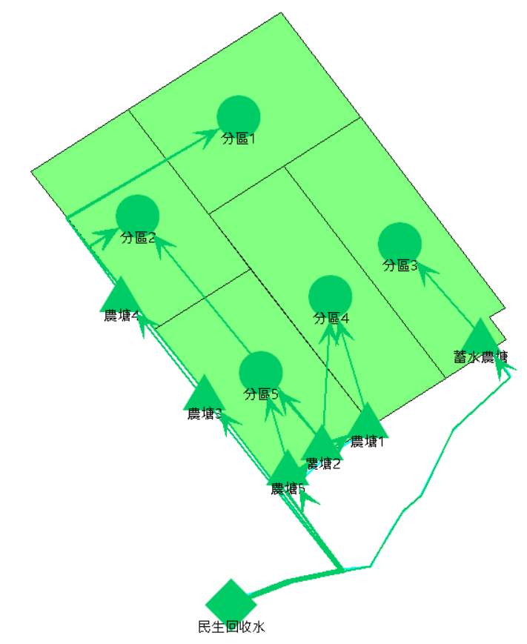
Plan 1: Irrigation once a week
Simulated Crops: Sorghum (June to October), Wheat (November to April)
Assuming stable irrigation conditions, water resources can provide an irrigation depth of 6mm each time.
Irrigation Efficiency: 50% (3mm)
 | Mon. | Tue. | Wed. | Thu. | Fri | WKND
Region1 | Irrigate | X | X | X | X | X
Region2 | X | Irrigate | X | X | X | X
Region3 | X | X | Irrigate | X | X | X
Region4 | X | X | X | Irrigate | X | X
Region5 | X | X | X | X | Irrigate | X
Ponds | Storage of reclaimed water /utilized for water supply |  |  |  |  | Storage
Notes:
In Plan 1, with five working days per week, we divide the area into five regions. Irrigation is carried out in a rotational manner from Monday to Friday within these regions. The agricultural pond plays the role of water storage and supply. The irrigation depth is set at 6 millimeters, chosen for its stability and optimal utilization of the agricultural pond's water capacity. We conservatively estimate the irrigation efficiency at 50%.

Slide 25
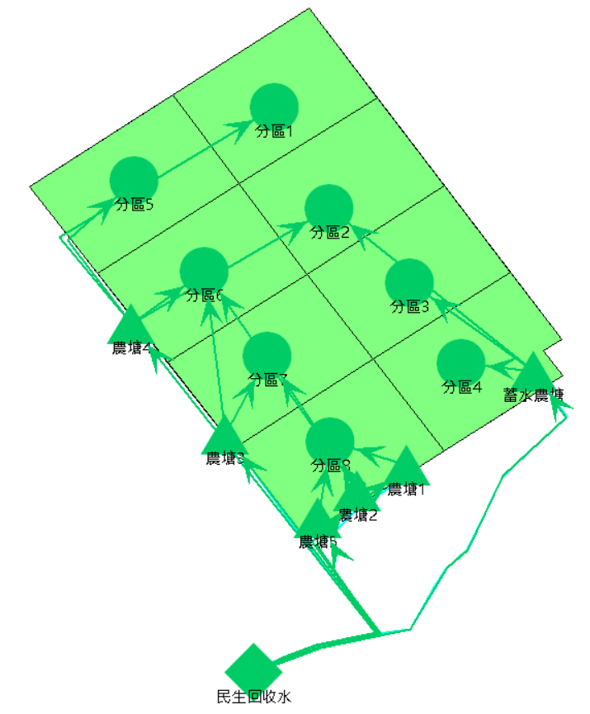
Plan 2: Irrigation once every two weeks
Assuming stable irrigation conditions, water resources can provide an irrigation depth of 12mm each time.
Irrigation Efficiency: 50% (6mm)
Week1
 | Mon. | Tue. | Wed. | Thu. | Fri | WKND
Region1 | Irrigate | X | X | X | X | X
Region2 | X | Irrigate | X | X | X | X
Region3 | X | X | X | Irrigate | X | X
Region4 | X | X | X | X | Irrigate | X
Region5 | Irrigate | X | X | X | X | X
Region6 | X | Irrigate | X | X | X | X
Region7 | X | X | X | Irrigate | X | X
Region8 | X | X | X | X | Irrigate | X
Ponds | Storage of reclaimed water /utilized for water supply |  |  |  |  | Storage
Week2
Notes:
For Plan 2, with four working days per week, the area is divided into eight regions. During the first week, irrigation covers regions 1 to 4, and in the second week, regions 5 to 8 are irrigated. The irrigation depth is increased to 12 millimeters due to the doubled irrigation interval.

Slide 26
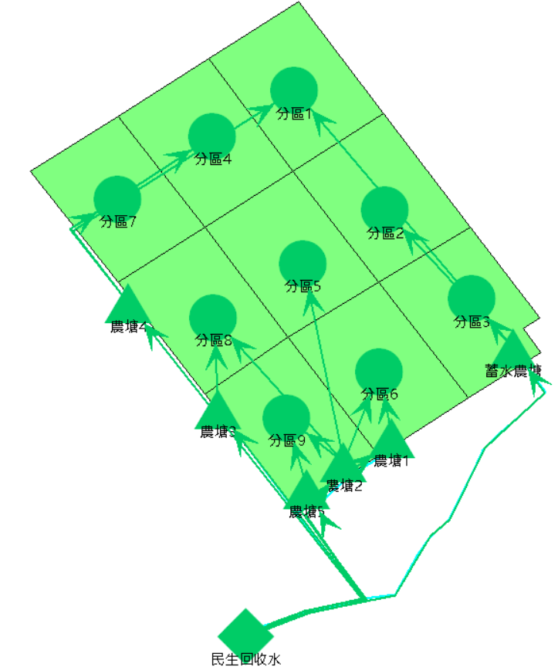
Plan 3: Irrigation once every three weeks
Assuming stable irrigation conditions, water resources can provide an irrigation depth of 18mm each time.
Irrigation Efficiency: 50% (9mm)
Week2
 | Mon. | Tue. | Wed. | Thu. | Fri | WKND
Region1 | Irrigate | X | X | X | X | X
Region2 | X | X | Irrigate | X | X | X
Region3 | X | X | X | X | Irrigate | X
Region4 | Irrigate | X | X | X | X | X
Region5 | X | X | Irrigate | X | X | X
Region6 | X | X | X | X | Irrigate | X
Region7 | Irrigate | X | X | X | X | X
Region8 | X | X | Irrigate | X | X | X
Region9 | X | X | X | X | Irrigate | X
Ponds | Storage of reclaimed water /utilized for water supply |  |  |  |  | Storage
Week1
Week3
Notes:
In Plan 3, with three working days per week, the area is divided into nine regions. Irrigation covers regions 1 to 3 in the first week, regions 4 to 6 in the second week, and regions 7 to 9 in the third week. The irrigation depth is further increased to 18 millimeters.

Slide 27
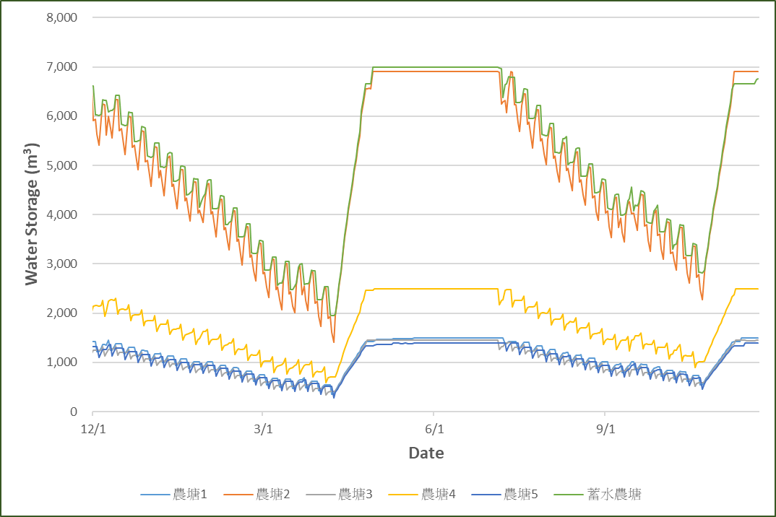
Operation of agricultural pond water storage
During the planting period, we made full use of the stored water in the agricultural pond for irrigation.
During the fallow period, we could replenish the water stored in the agricultural pond.
Ponds | Water Storage(m³) | Percentage
1 | 1500 | 7.2%
2 | 6900 | 33.2%
3 | 1450 | 7.0%
4 | 2500 | 12.1%
5 | 1400 | 6.7%
6 | 7000 | 33.7%
Pond1
Pond2
Pond3
Pond4
Pond5
Pond6
Notes:
Now, let's discuss the operation of agricultural pond water storage capacity. The earlier irrigation depth is based on this setting. During the planting period, we maximize the use of stored water in the agricultural pond for irrigation. During the fallow period, we can replenish the water stored in the agricultural pond.

Slide 28
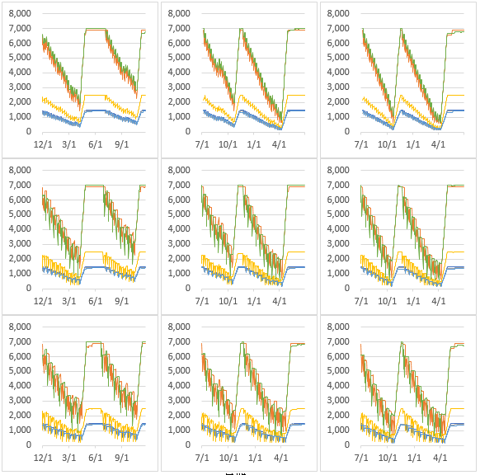
Operation of agricultural pond water storage
Scenario 1
Scenario 2
Scenario 3
Plan 1
Plan 2
Plan 3
Notes:
In summary, regardless of the scenario or irrigation plan, we follow the same logic in managing water supply from the agricultural pond.

Slide 29
Yield Results and Discussion
05

Slide 30
Crop yield estimation results
Maximum Potential Yield：2000(Sorghum)、3000(Wheat)kg/ha Evaluate the benefits by comparing the yields with and without irrigation plans.
Scenario 1
Scenario 2
Scenario 3
 | Yeild↑ | Percentage↑(Relative to Max)
S. | 58.89 | 2.94
W. | 82.93 | 2.76
Yeild↑ | Percentage↑(Relative to Max)
121.21 | 6.06
322.32 | 10.74
Yeild↑ | Percentage↑(Relative to Max)
141.57 | 7.08
335.20 | 11.17
Plan 1
S. | 60.58 | 3.03
W. | 80.24 | 2.67
115.26 | 5.76
305.94 | 10.20
130.33 | 6.52
326.35 | 10.88
Plan 2
S. | 51.83 | 2.59
W. | 38.78 | 1.29
85.12 | 4.26
251.10 | 8.37
110.23 | 5.51
303.90 | 10.13
Plan 3
Notes:
In the fifth chapter, we discuss Yield Results and Discussion. First, we evaluate the benefits by comparing yields with and without irrigation plans, setting the maximum potential yields at 2000 and 3000, referencing historical yield records. From the table, it's evident that in the abundant water scenario, regardless of the irrigation plan, there isn't a significant increase in yield. However, in the water-scarce scenario three, adopting the frequent irrigation plan one leads to the highest yield increase. Nevertheless, the highest yield increase does not necessarily equate to the greatest economic benefit.

Slide 31
Crop yield estimation results
Maximum Potential Yield：2000(Sorghum)、3000(Wheat)kg/ha Evaluate the benefits by comparing the yields with and without irrigation plans.
Scenario 245
Scenario 585
 | Yeild↑ | Percentage↑(Relative to Max)
S. | 39.30 | 1.96
W. | 275.68 | 9.19
Yeild↑ | Percentage↑(Relative to Max)
139.60 | 6.98
234.90 | 7.83
Plan 1
S. | 48.02 | 2.40
W. | 238.81 | 7.96
115.74 | 5.79
231.81 | 7.73
Plan 2
S. | 17.32 | 0.87
W. | 212.57 | 7.09
101.30 | 5.06
169.90 | 5.66
Plan 3
Notes:
In the fifth chapter, we discuss Yield Results and Discussion. First, we evaluate the benefits by comparing yields with and without irrigation plans, setting the maximum potential yields at 2000 and 3000, referencing historical yield records. From the table, it's evident that in the abundant water scenario, regardless of the irrigation plan, there isn't a significant increase in yield. However, in the water-scarce scenario three, adopting the frequent irrigation plan one leads to the highest yield increase. Nevertheless, the highest yield increase does not necessarily equate to the greatest economic benefit.

Slide 32
Relationship between increased yield and yield w/o irrigation

Slide 33
Economic Benefits
Assuming the cost involves employing workers for irrigation at an hourly wage,
and the profit is assumed to be fixed at a price set by the government.
Notes:
To translate the results into economic efficiency, we calculate costs and profits. Assuming labor costs for irrigation at an hourly wage and fixed government-set prices for crops, the graph's horizontal axis represents wages for irrigation labor, and the vertical axis represents the total price for crop acquisition. By subtracting costs from profits, we find that, overall, Plan 2 yields the best returns. Additionally, the economic efficiency of wheat is significantly higher than that of sorghum.
In summary, our economic evaluation considers both costs and profits, highlighting that Plan 2 yields the best overall economic benefits. Moreover, wheat demonstrates superior economic efficiency compared to sorghum.

Slide 34
Water Usage Effectiveness
Notes:
To translate the results into economic efficiency, we calculate costs and profits. Assuming labor costs for irrigation at an hourly wage and fixed government-set prices for crops, the graph's horizontal axis represents wages for irrigation labor, and the vertical axis represents the total price for crop acquisition. By subtracting costs from profits, we find that, overall, Plan 2 yields the best returns. Additionally, the economic efficiency of wheat is significantly higher than that of sorghum.
In summary, our economic evaluation considers both costs and profits, highlighting that Plan 2 yields the best overall economic benefits. Moreover, wheat demonstrates superior economic efficiency compared to sorghum.

Slide 35
Conclusions
Our findings indicate that wheat contributes to greater economic benefits than sorghum.
Furthermore, the economic gains are more significant in drought year.
Scheme2(Irrigation once every two weeks) stands out as the most beneficial due to its cost-effectiveness and satisfactory yield, making it the optimal choice.

Slide 36
Recommendations
Use API to build a model of automated test simulation scenarios.
Additionally, validating the crop yield and benefits through experimental fields.
Notes:
We will be utilizing a weather generator to sincerely simulate scenarios for testing more extreme climates. We have already employed a Markov Chain to establish a simple rainfall generator, and in the future, we will use the Neyman-Scott Process Rainfall Emulator to obtain more precise generation results.

Slide 37
References
1. Abel, M. E., “Irrigation systems in Taiwan: Management of a decentralized public enterprise,” Water Resour. Res., 12(3), 341–348, 1976.
2. Al-Jayyousi, O.R., “Rehabilitation of Irrigation Distribution Systems: The Case of Jericho City,” Water Resources Management 13, 117–132, 1999.
3. Allen, R.G., Pereira, L.S., Raes, D., et al., “Crop Evapotranspiration-Guidelines for Computing Crop Water Requirements-FAO Irrigation and Drainage Paper 56,” FAO, Rome, 300(9): D05109, 1998.
4. Amir Hossein Dehghanipour, Bagher Zahabiyoun, Gerrit Schoups, Hossein Babazadeh, “A WEAP-MODFLOW surface water-groundwater model for the irrigated Miyandoab plain, Urmia lake basin, Iran: Multi-objective calibration and quantification of historical drought impacts,” Agricultural Water Management, Volume 223, 105704, ISSN 0378-3774, 2019.
5. Anwar, Arif A.; de Vries, T. T.. “Sequential irrigation scheduling avoiding night irrigation,” Journal of Irrigation and Drainage Engineering, 143(7):1-10, 2017.
6. Carpenter, A. ., & Choudhary, M. K. , “Water Demand and Supply Analysis using WEAP Model for Veda River Basin Madhya Pradesh (Nimar Region), India,” Trends in Sciences, 19(6), 3050, 2022.
7. Chen, Tianqi & Guestrin, Carlos. , “XGBoost: A Scalable Tree Boosting System,” 785-794. 10.1145/2939672.2939785, 2016.

Slide 38
References
8. David Yates, Jack Sieber, David Purkey & Annette Huber-Lee, “WEAP21—A Demand-, Priority-, and Preference-Driven Water Planning Model,” Water International, 30:4, 487-500, 2005.
9. Diez-Sierra, J., Navas, S., and del Jesus, M., “NEOPRENE v1.0.1: a Python library for generating spatial rainfall based on the Neyman–Scott process, Geosci. Model Dev., ” 16, 5035–5048, https://doi.org/10.5194/gmd-16-5035-2023, 2023.
10. Gebrechorkos, S., Leyland, J., Slater, L. et al. , “A high-resolution daily global dataset of statistically downscaled CMIP6 models for climate impact analyses, ” Sci Data 10, 611, https://doi.org/10.1038/s41597-023-02528-x, 2023.
11. Jack Sieber, M.S., Chris Swartz, Ph.D.& Annette Huber-Lee, Ph.D., “USER GUIDE for WEAP21,” WA: Stockholm Environment Institute, 2005.
12. Lam, Wai Fung, “Coping with Change: A Study of Local Irrigation Institutions in Taiwan,” World Development. 29. 1569-1592, 2001
13. Levine, G. & Chin, L. T. & Miranda, S. M., “Requirements for the successful introduction and management of rotational irrigation,” Agricultural Water Management, Elsevier, vol. 1(1), pages 41-56, December, 1976.
14. Najm, Abu Baker & Abdulhameed, Isam & Sulaiman, Sadeq, “Water Requirements of Crops under Various Kc Coefficient Approaches by Using Water Evaluation and Planning (WEAP),” International Journal of Design & Nature and Ecodynamics, 15, 2020.

Slide 39
References
15. Najm, A. B., Al-bayati, I., & Sulaiman, S., “Improving the Cultivated Area for Ramadi Irrigation Project Using Water Evaluation and Planning Model (WEAP),” Al-Rafidain Engineering Journal (AREJ), 26(1), 105-114, 2021.
16. Sahli, A., Jabloun, M., “MABIA-ETc: a tool to improve water use in field scale according to the FAO guidelines for computing water crop requirements,” The WUEMED Workshop (Improving Water Use Efficiency in MEDiterranean Agriculture: what limits the adoption of new technologies?), Rome, Italy, 2005.
17. Teare, I.D., Kanemasu, E.T., Powers, W.L. and Jacobs, H.S., Water-Use Efficiency and Its Relation to Crop Canopy Area, Stomatal Regulation, and Root Distribution1. Agron. J., 65: 207-211,1973.
18. Yates, D., Sieber, J., Purkey, D., Huber-Lee, A., WEAP21 – A Demand-, Priority-, and Preference-Driven Water Planning Model. Part 1: Model Characteristics. Water International, 30 (4), 487–500, 2005a.
19. Yates, D., Sieber, J., Purkey, D., Huber-Lee. A., Galbraith, H., WEAP21 – A Demand, Priority-, and Preference-Driven Water Planning Model. Part 2: Aiding Freshwater Ecosystem Service Evaluation. Water International, 30 (4), 501–5012, 2005b.
20. 何柏賢、朱德民，「不同期作環境下雜種高粱台中五號雜種優勢的反應」，農林學報，49(2)，53-61，2000。
21. 林薰生、陳廷煥，「雜交高粱台中五號及栽培」，管理臺中區農推專訊 41 期，1985。
22. 陳勃聿，「以栽培種高粱作為芻料生產之評估」，畜產研究，52(1)，37-44，2019。

Slide 40
Thanks for your listening!
Do you have any questions?
ethansuuu@gmail.com +886 989 193 366

