Slide 1
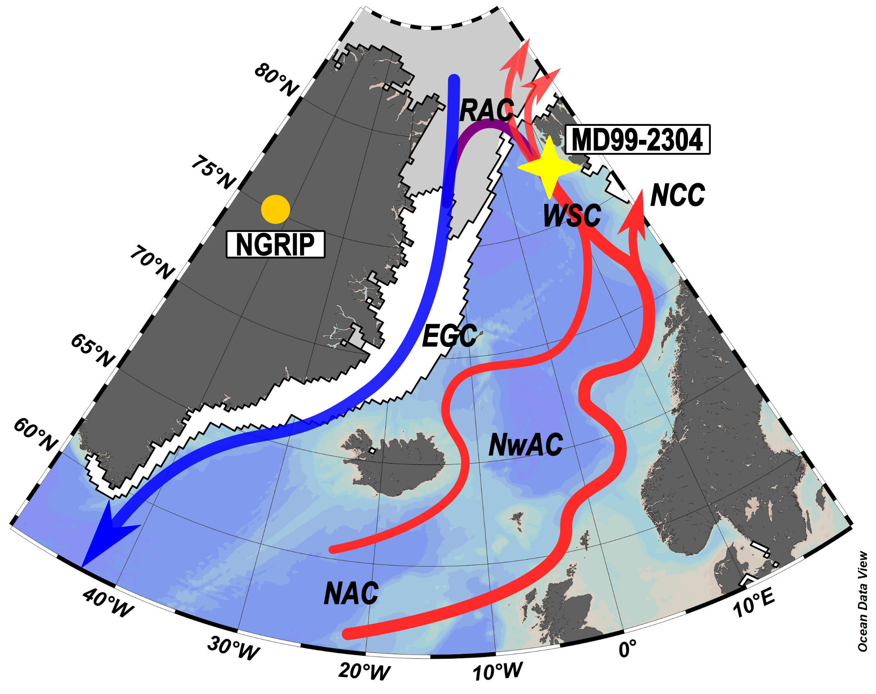
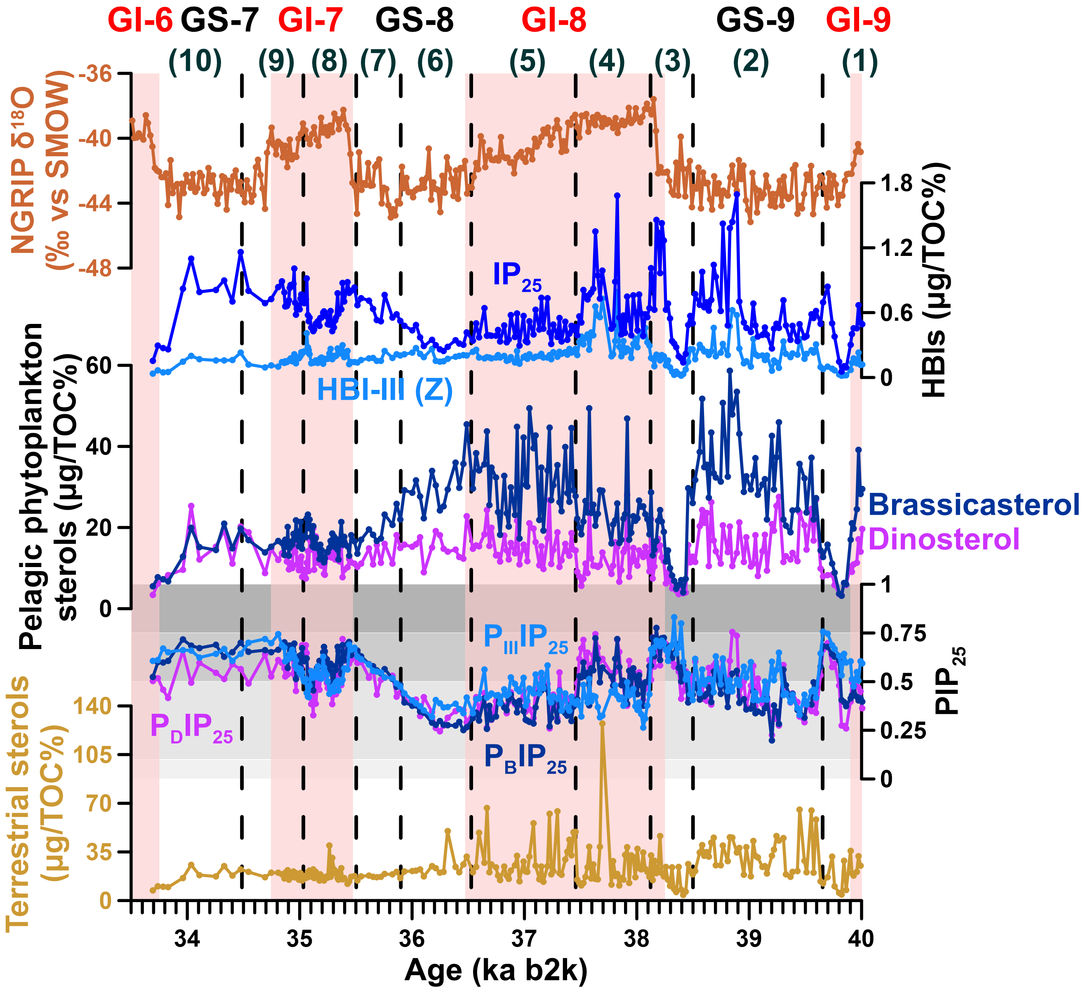
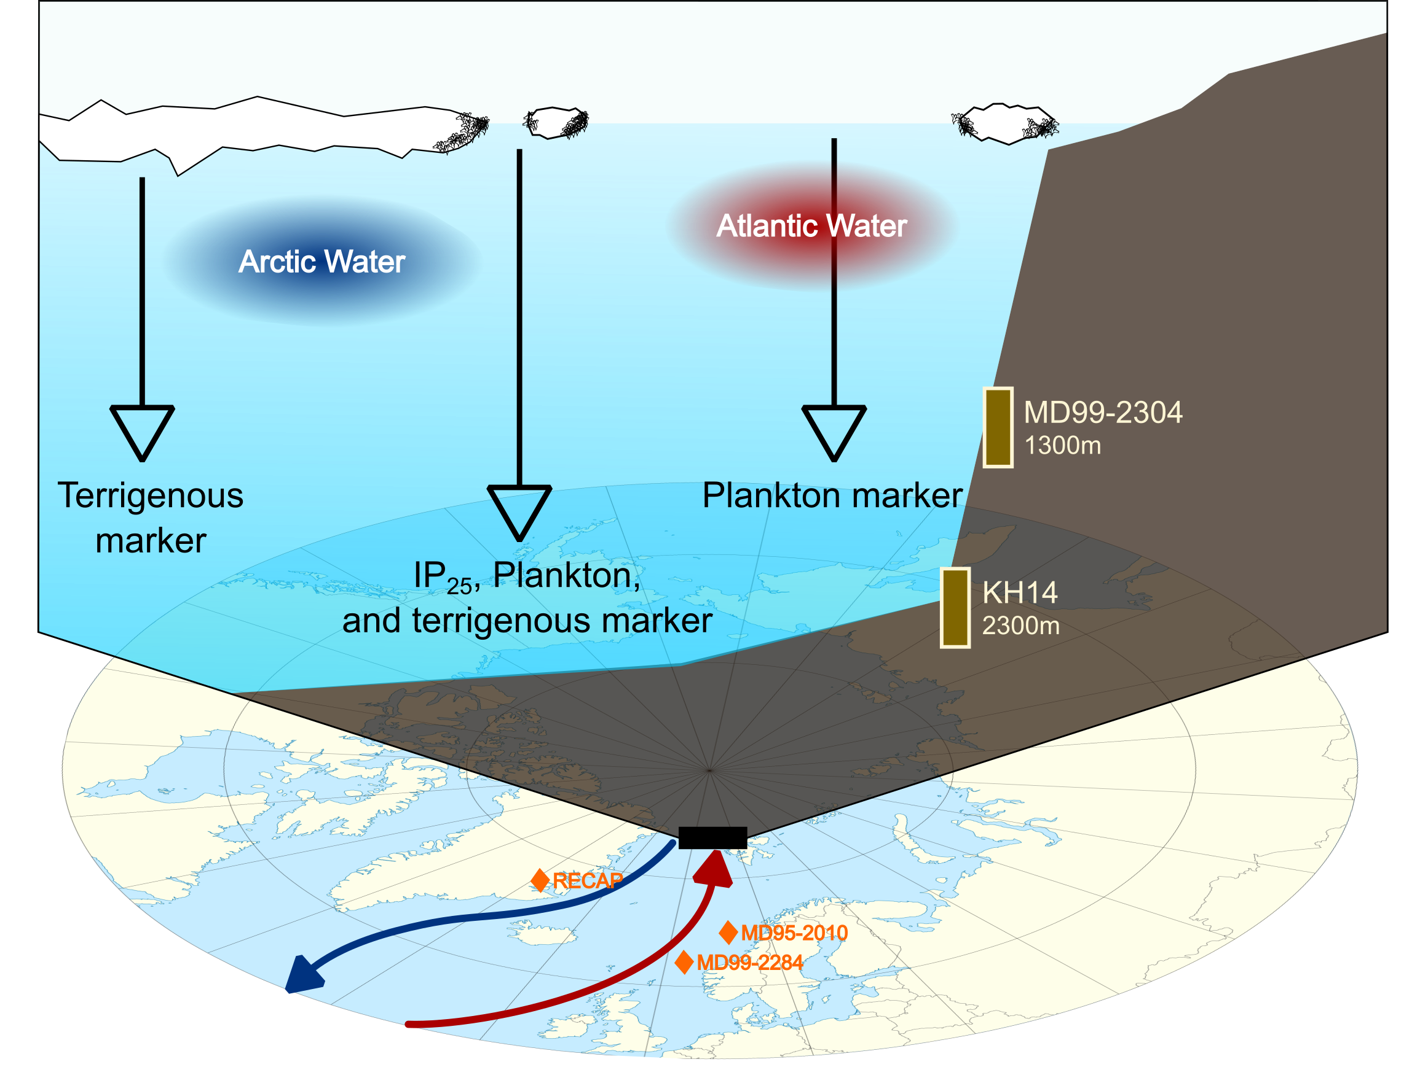
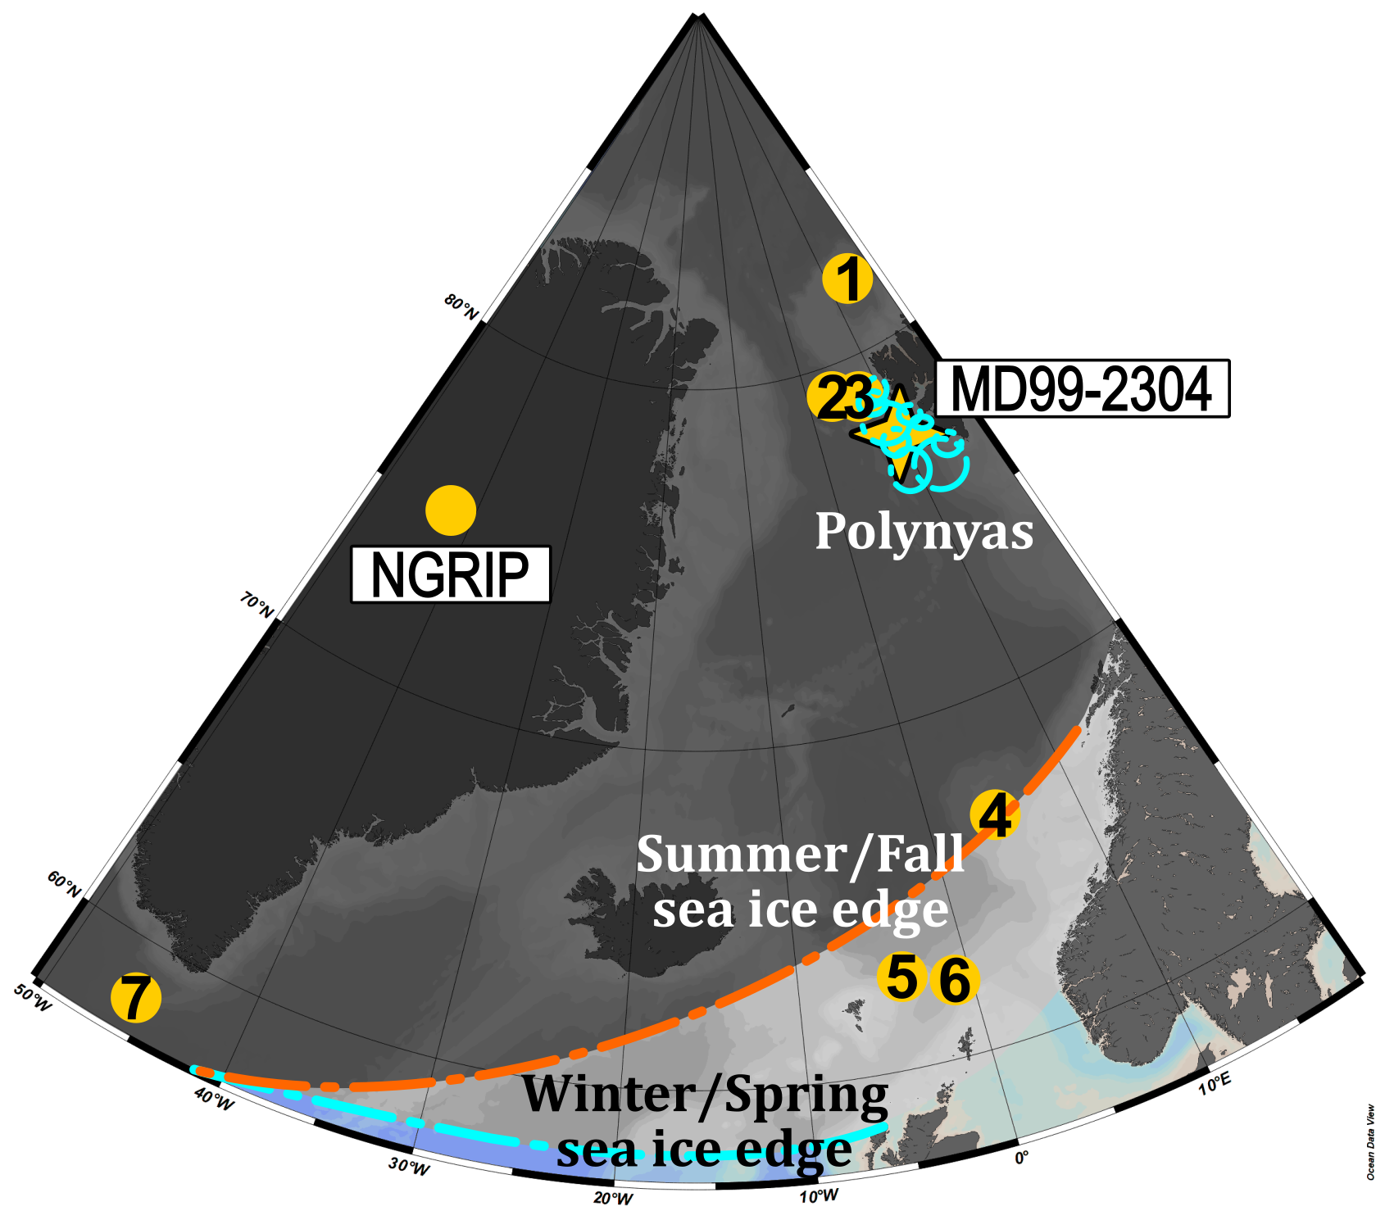
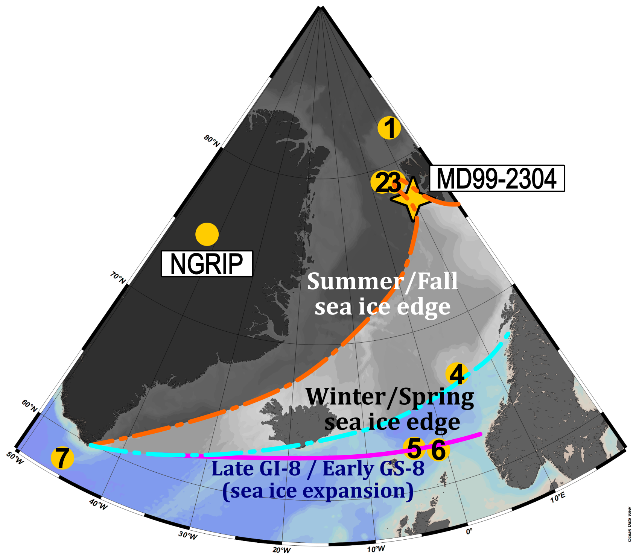
Millennial-scale variations of sea ice in the northern Nordic Seas Wanyee Wong¹, Bjørg Risebrobakken¹, Kirsten Fahl³, Ruediger Stein^{3,4,5}, Eystein Jansen^{1,2}, Katherine Kissel⁶
Abstract
Sea ice conditions in the eastern Fram Strait during the Dansgaard-Oeschger (D-O) events, encompassing a time interval between 40 and 33.5 ka b2k, were reconstructed using biomarkers in detailed resolutions (20-40 yr/sample). The role of the Nordic Seas sea ice has long been recognized as a significant factor influencing the D-O climate changes. Preliminary results suggest that repeated polynyas were both present during HS-4 and during GS-8, but with different characteristics. The retreat of the extended sea ice cover in the eastern Fram Strait occurred earlier during the GS-GI transition than during the HS-GI transition. Both interstadials were characterized by a seasonal sea ice cover, with the summer/fall sea ice edge moving farther north than the research area occasionally.
Methodology
Chronology based on magnetic susceptibility fine-tuning
Lipid biomarker analyses: highly branched isoprenoids (HBIs) and sterols
Results
Summary
Polynyas were active during GSs
Sea ice retreated later during the HS-GI transition than during the GS-GI transition
GIs were characterized by seasonal sea ice
¹NORCE Norwegian Research Centre, Bjerknes Centre for Climate Research. ²Department of Earth Science, University of Bergen, Bjerknes Centre for Climate Research. ³Alfred Wegener Institute, Helmholtz Centre for Polar and Marine Research. ⁴Faculty of Geosciences (FB5) and Center for Marine Environmental Sciences (MARUM), University of Bremen. ⁵Key Laboratory of Marine Chemistry Theory and Technology, Ocean University of China. ⁶Laboratoire des Sciences du Climat et de l'Environnement, CEA/CNRS/UVSQ.

Slide 2
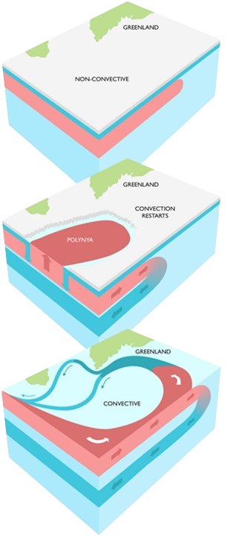
Background information
Stadial (cold):
Sea ice cover +
Ocean stratification +
Ocean-atmosphere heat and moisture exchange —
Interstadial (warm):
Sea ice cover —
Ocean stratification —
Ocean-atmosphere heat and moisture exchange +
Malmierca-Vallet and Sime, 2023.

Slide 3
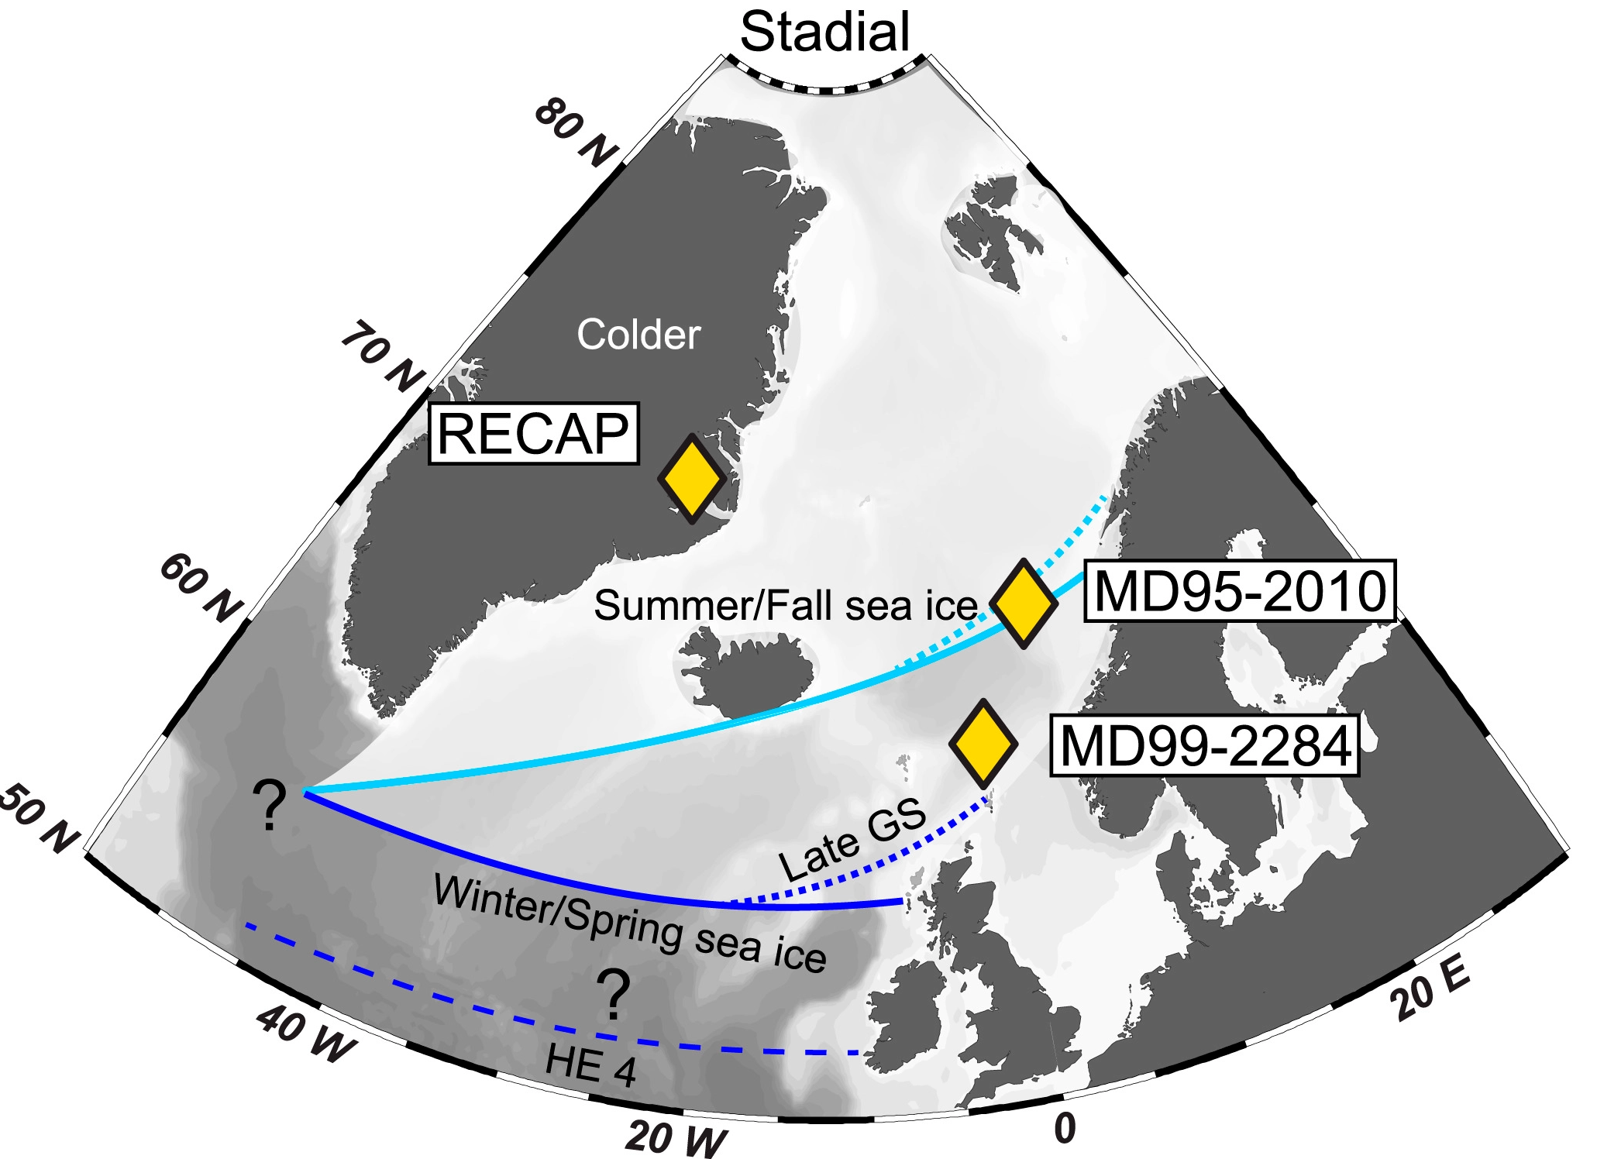
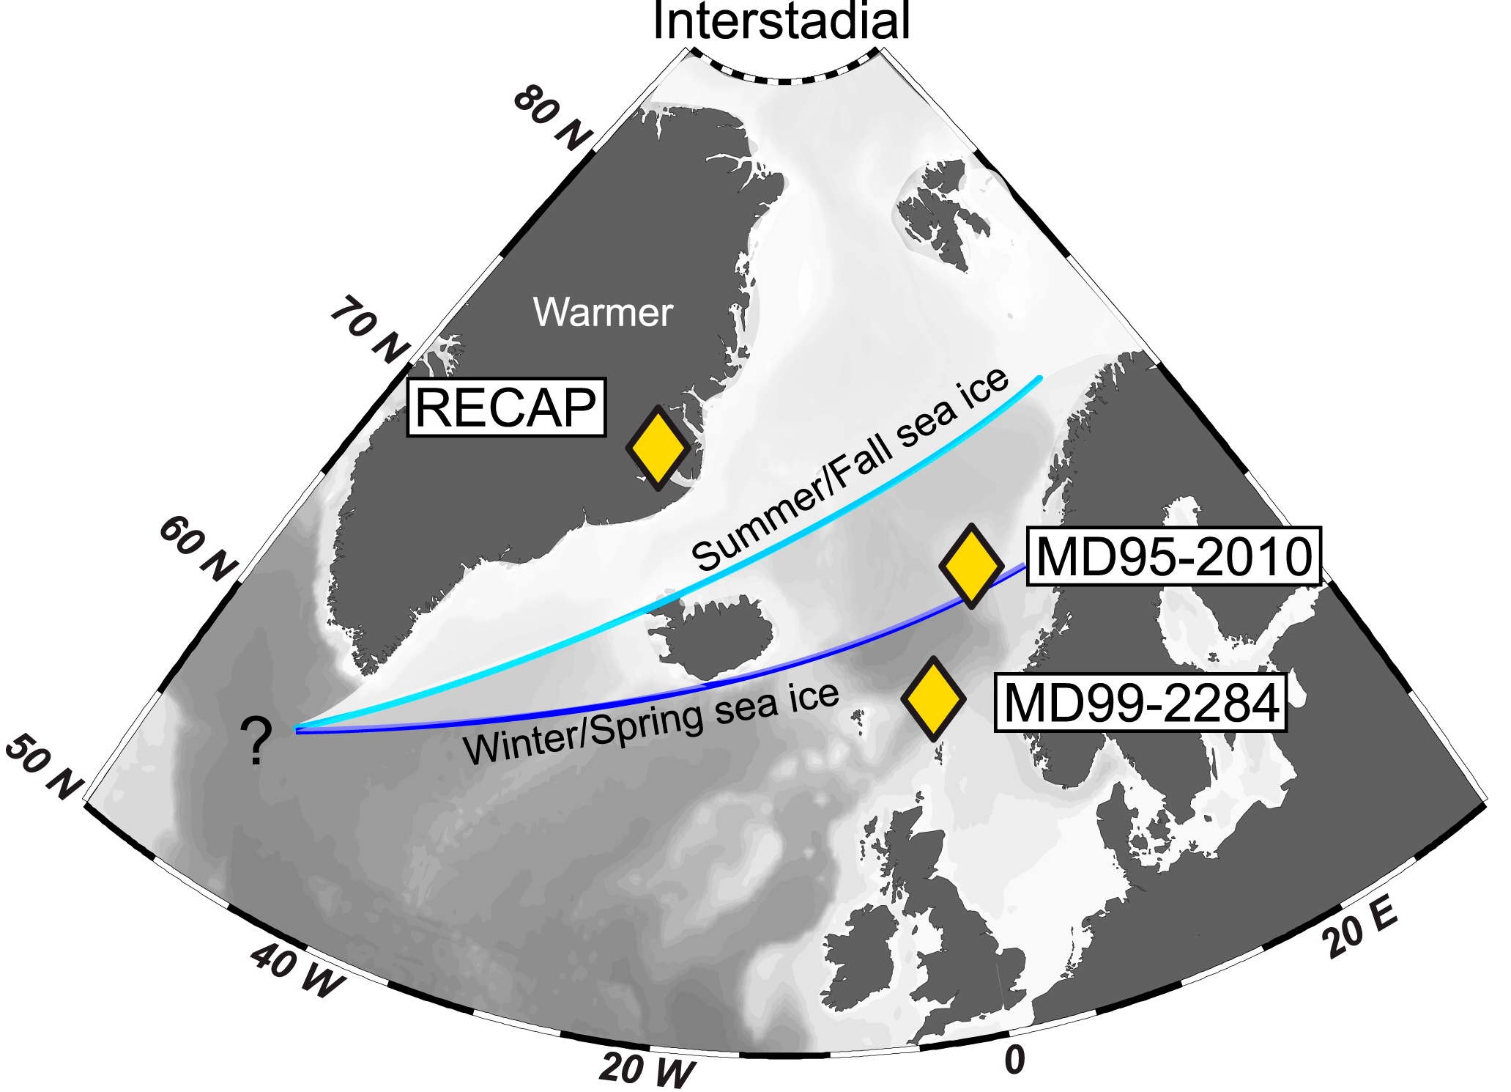
How did the northern Nordic Seas sea ice cover change during D-O events?
?
?
Sadatzki et al., 2020.

Slide 4
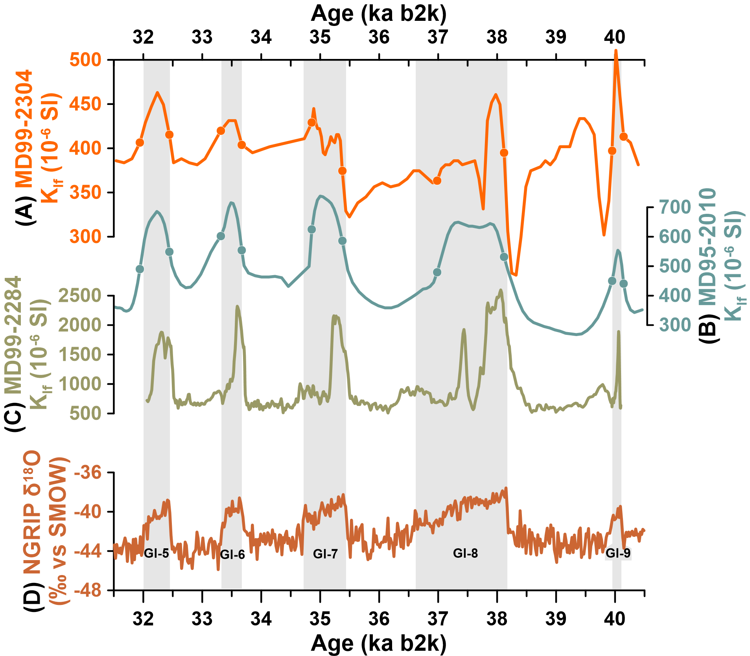
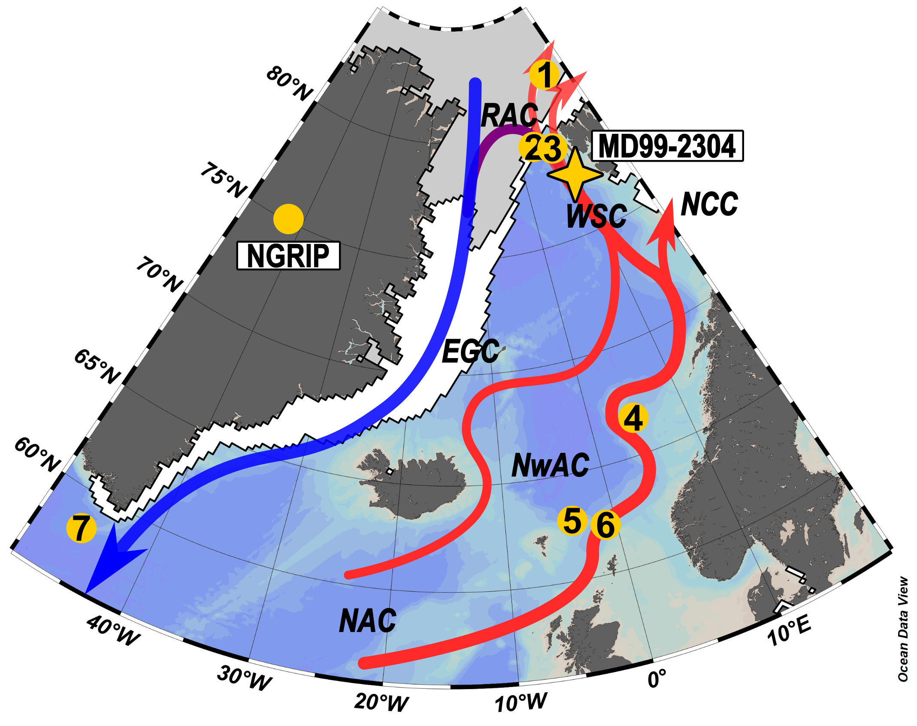
Chronology
Based on the fine tuning of the low field magnetic susceptibility (K_{lf}) of MD99-2304 to the K_{lf} of the core MD95-2010 (4) from the central Norwegian Sea.

Slide 5
Greenland
Air temperature
IP₂₅: sea ice diatom
HBI-III (Z): marginal ice
Open ocean
condition
Sea ice extent
Terrestrial
organic material

Slide 6
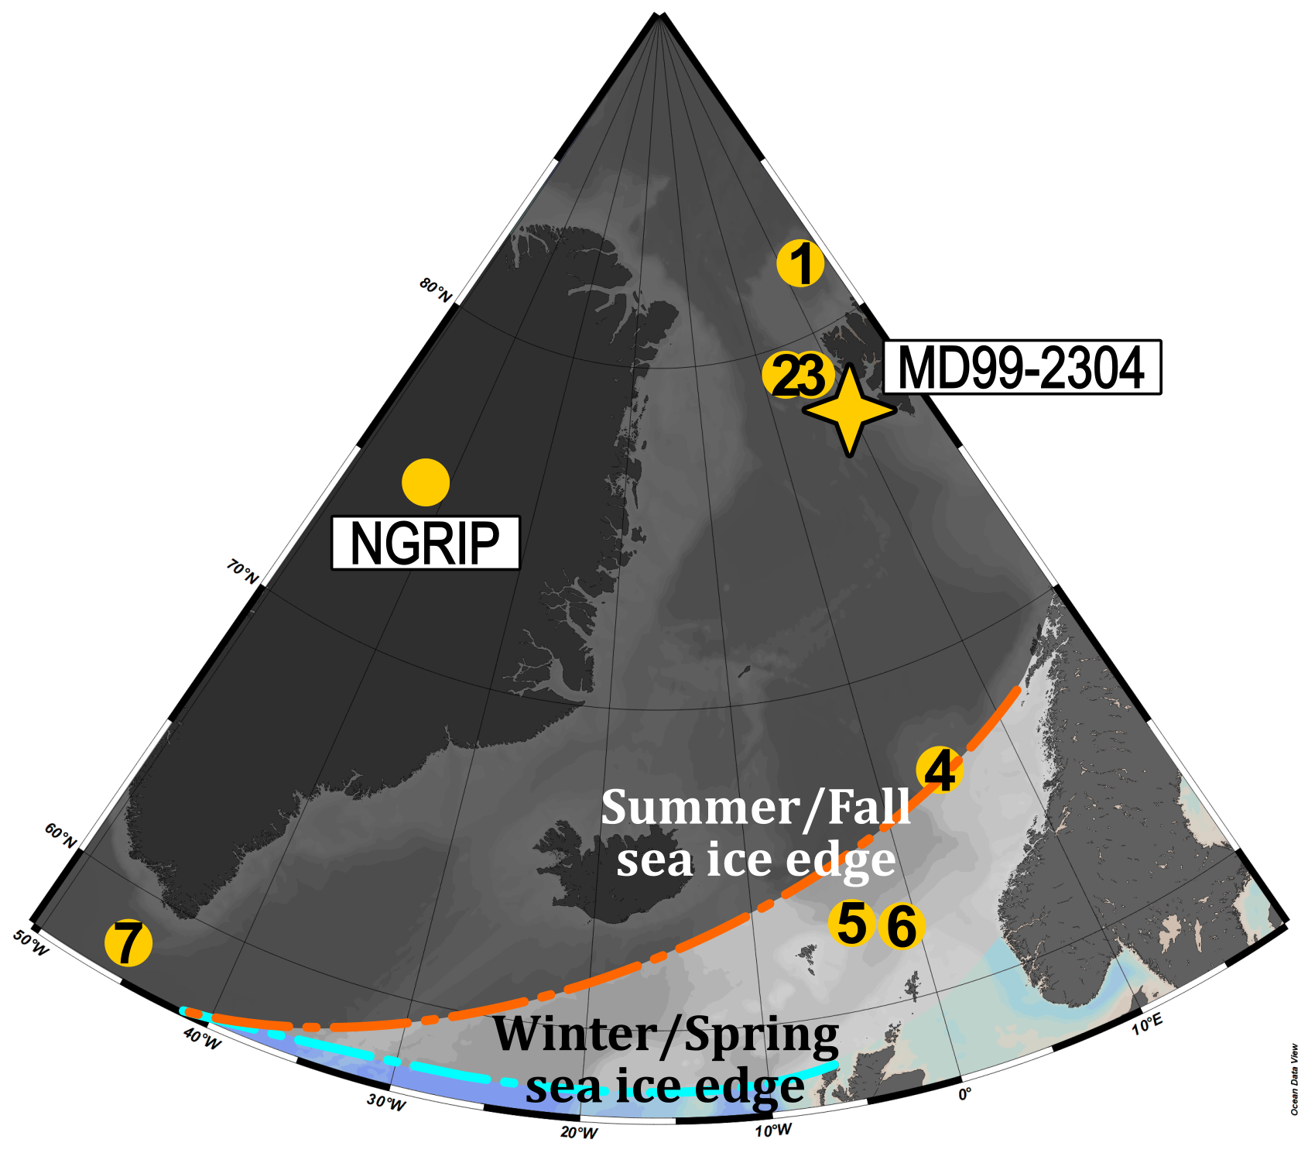
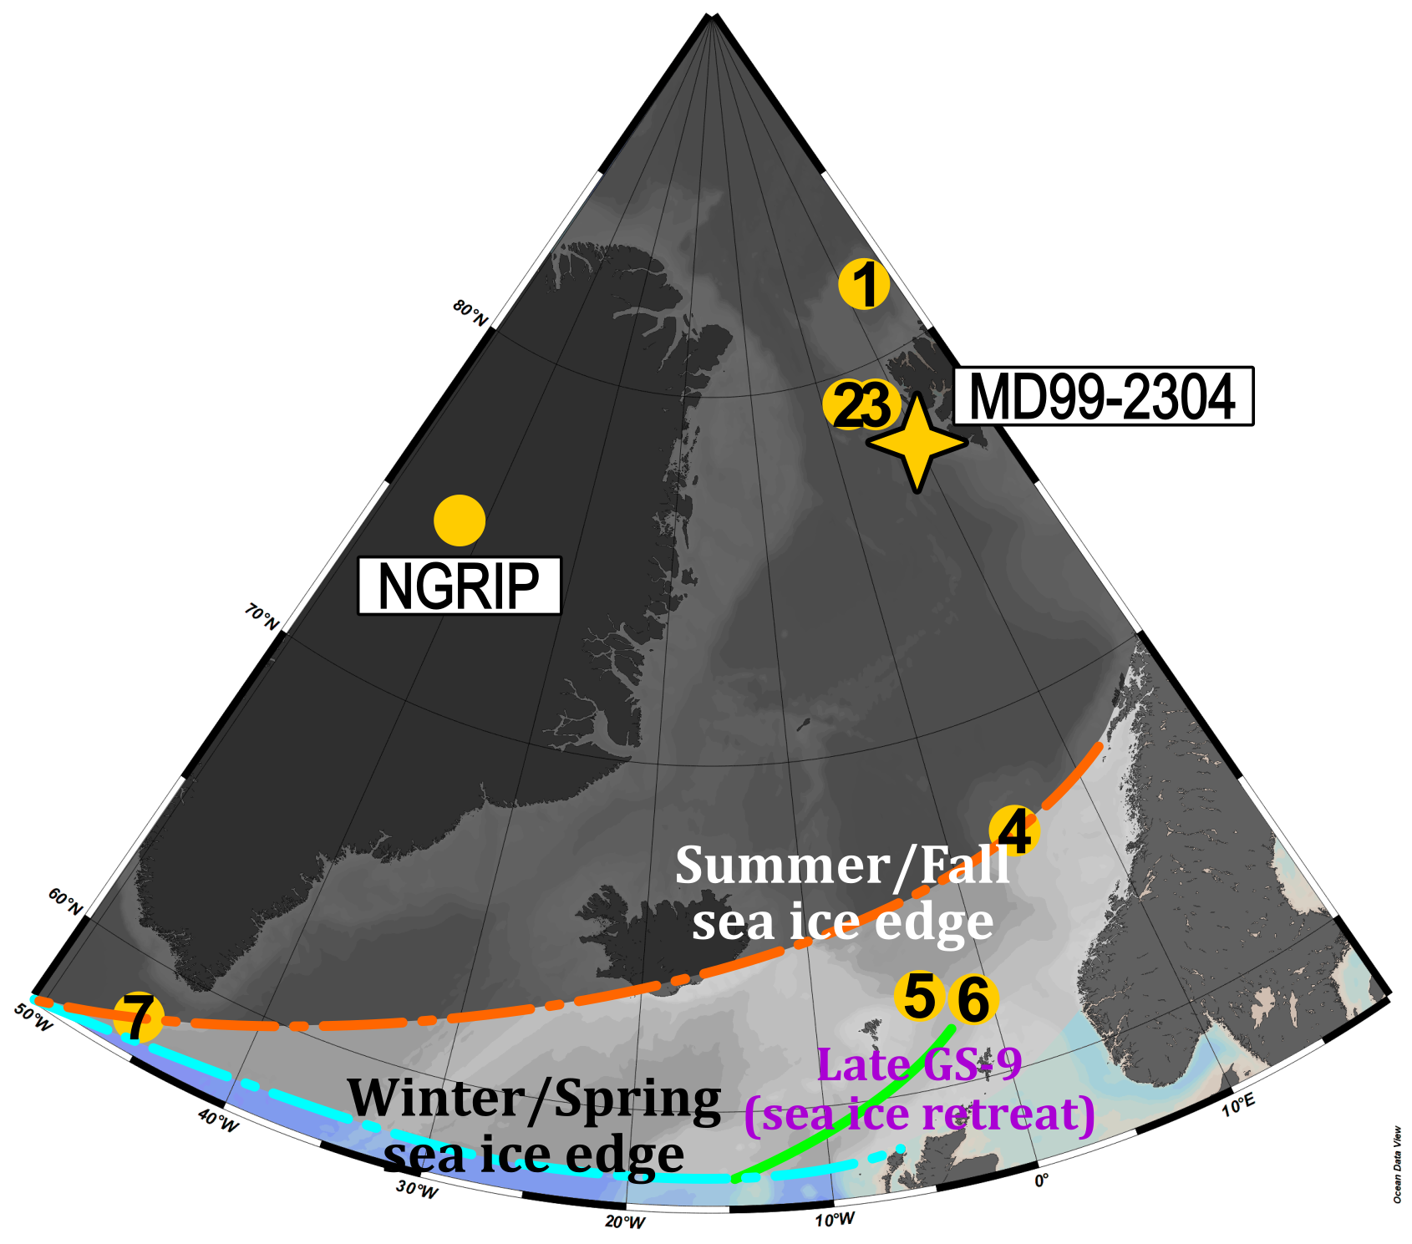
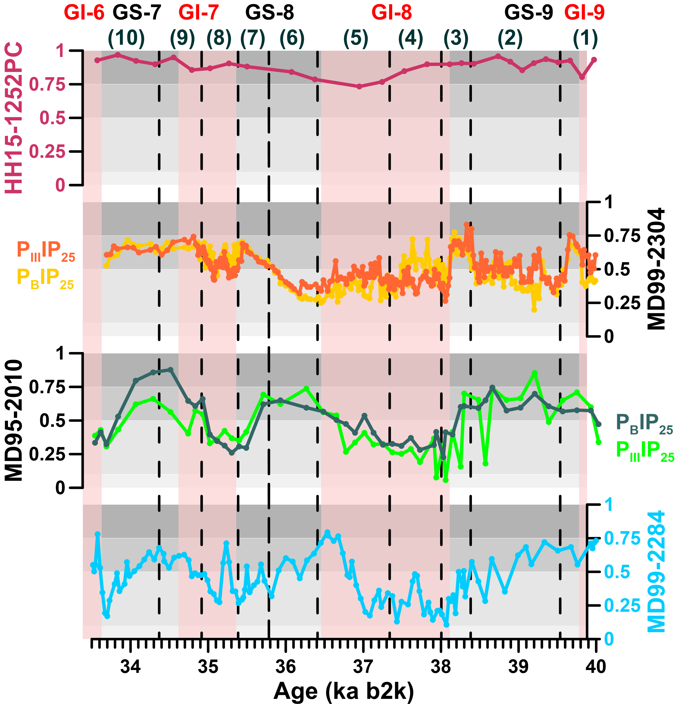
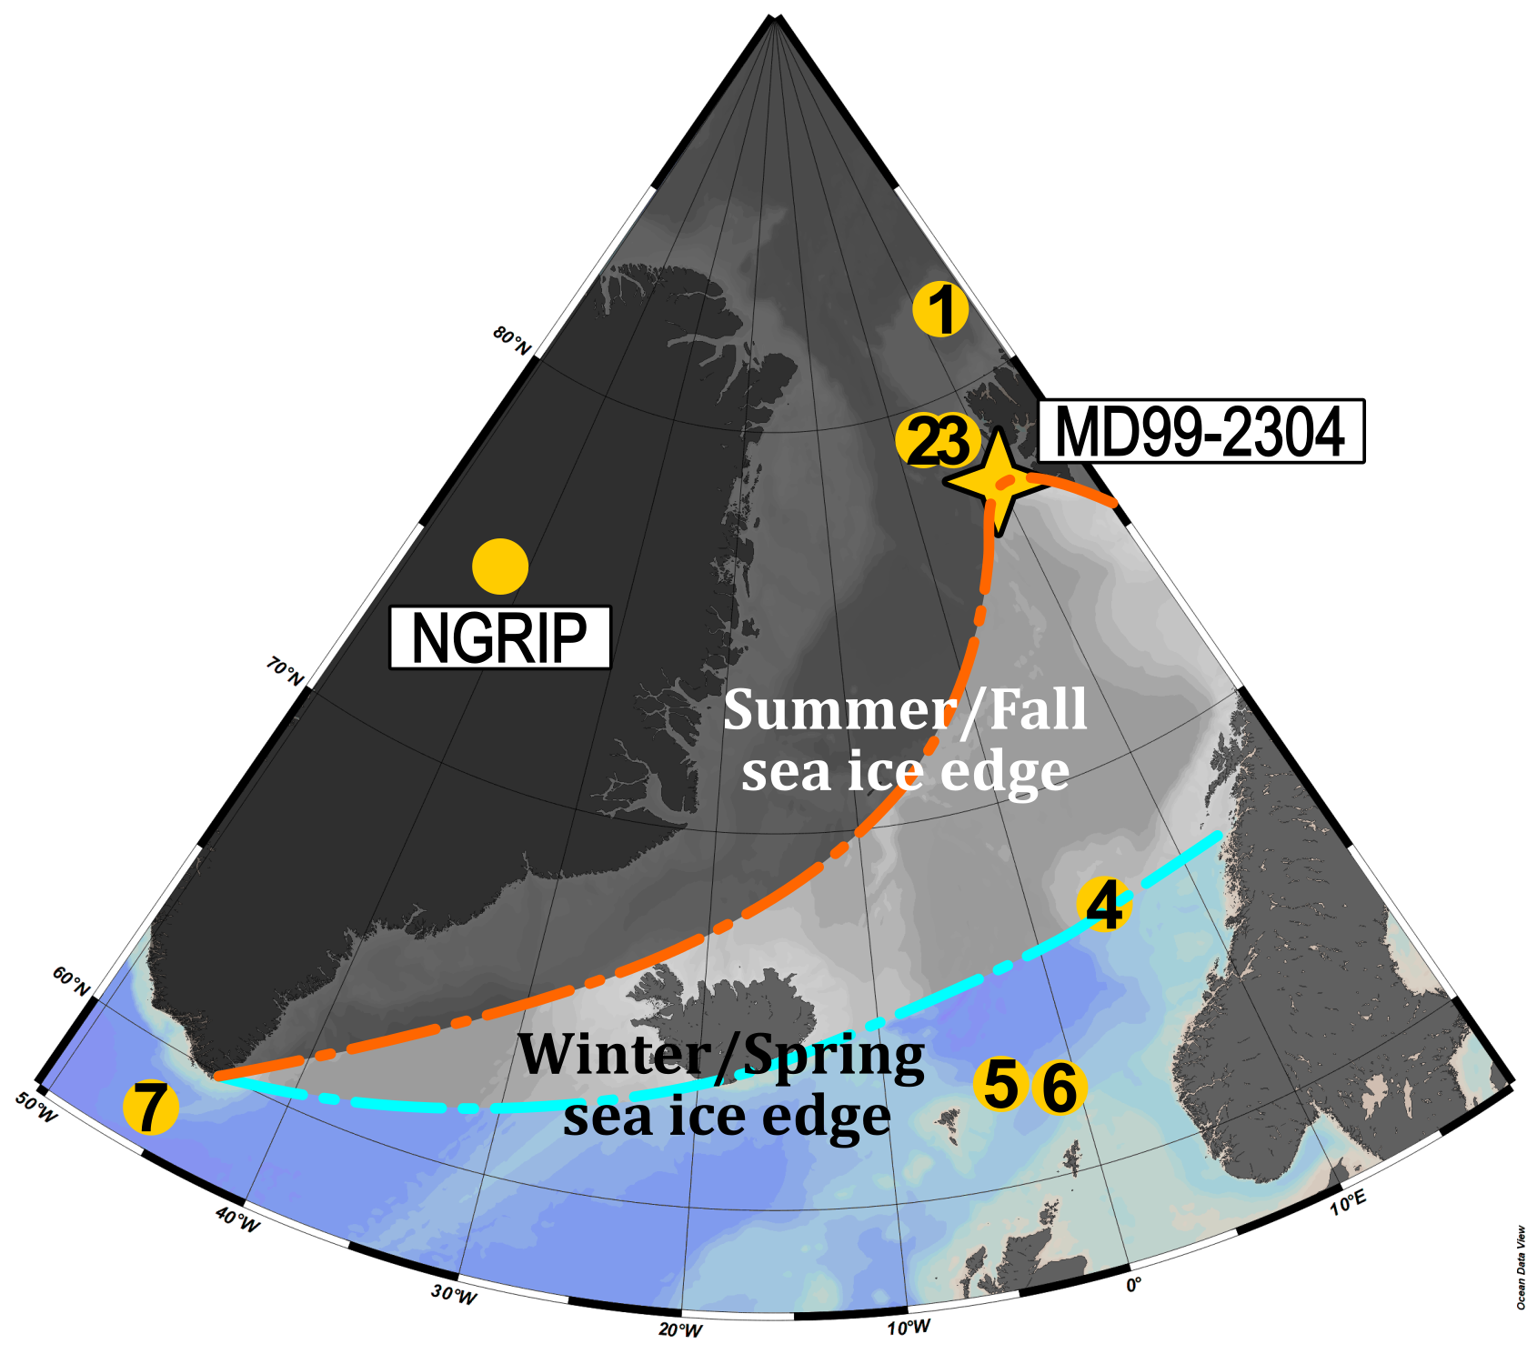
Summary
(1)
(2)
(3)
(4)
(5)
1. PS92/039-2 (Kremer et al., 2018b), 2. PS93/006-1 (Kremer et al., 2018a), 3. HH15-1252PC (El bani Altuna et al., 2021, 2024), 4. MD95-2010 (Sadatzki et al., 2020), 5. JM11-FI-19PC (Hoff et al., 2016), 6. MD99-2284 (Sadatzki et al., 2019), 7. GS16-204-23-CC (Scoto et al., 2022)

Slide 7
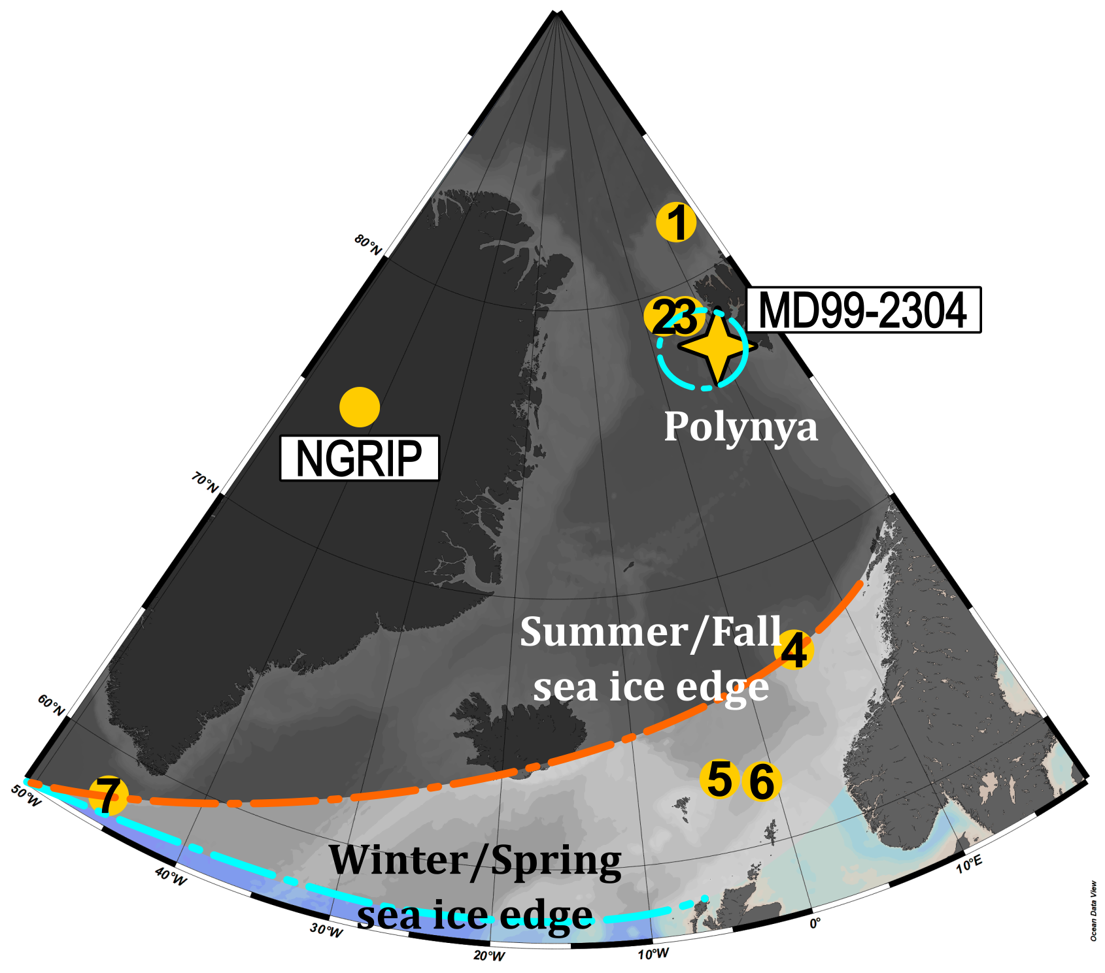
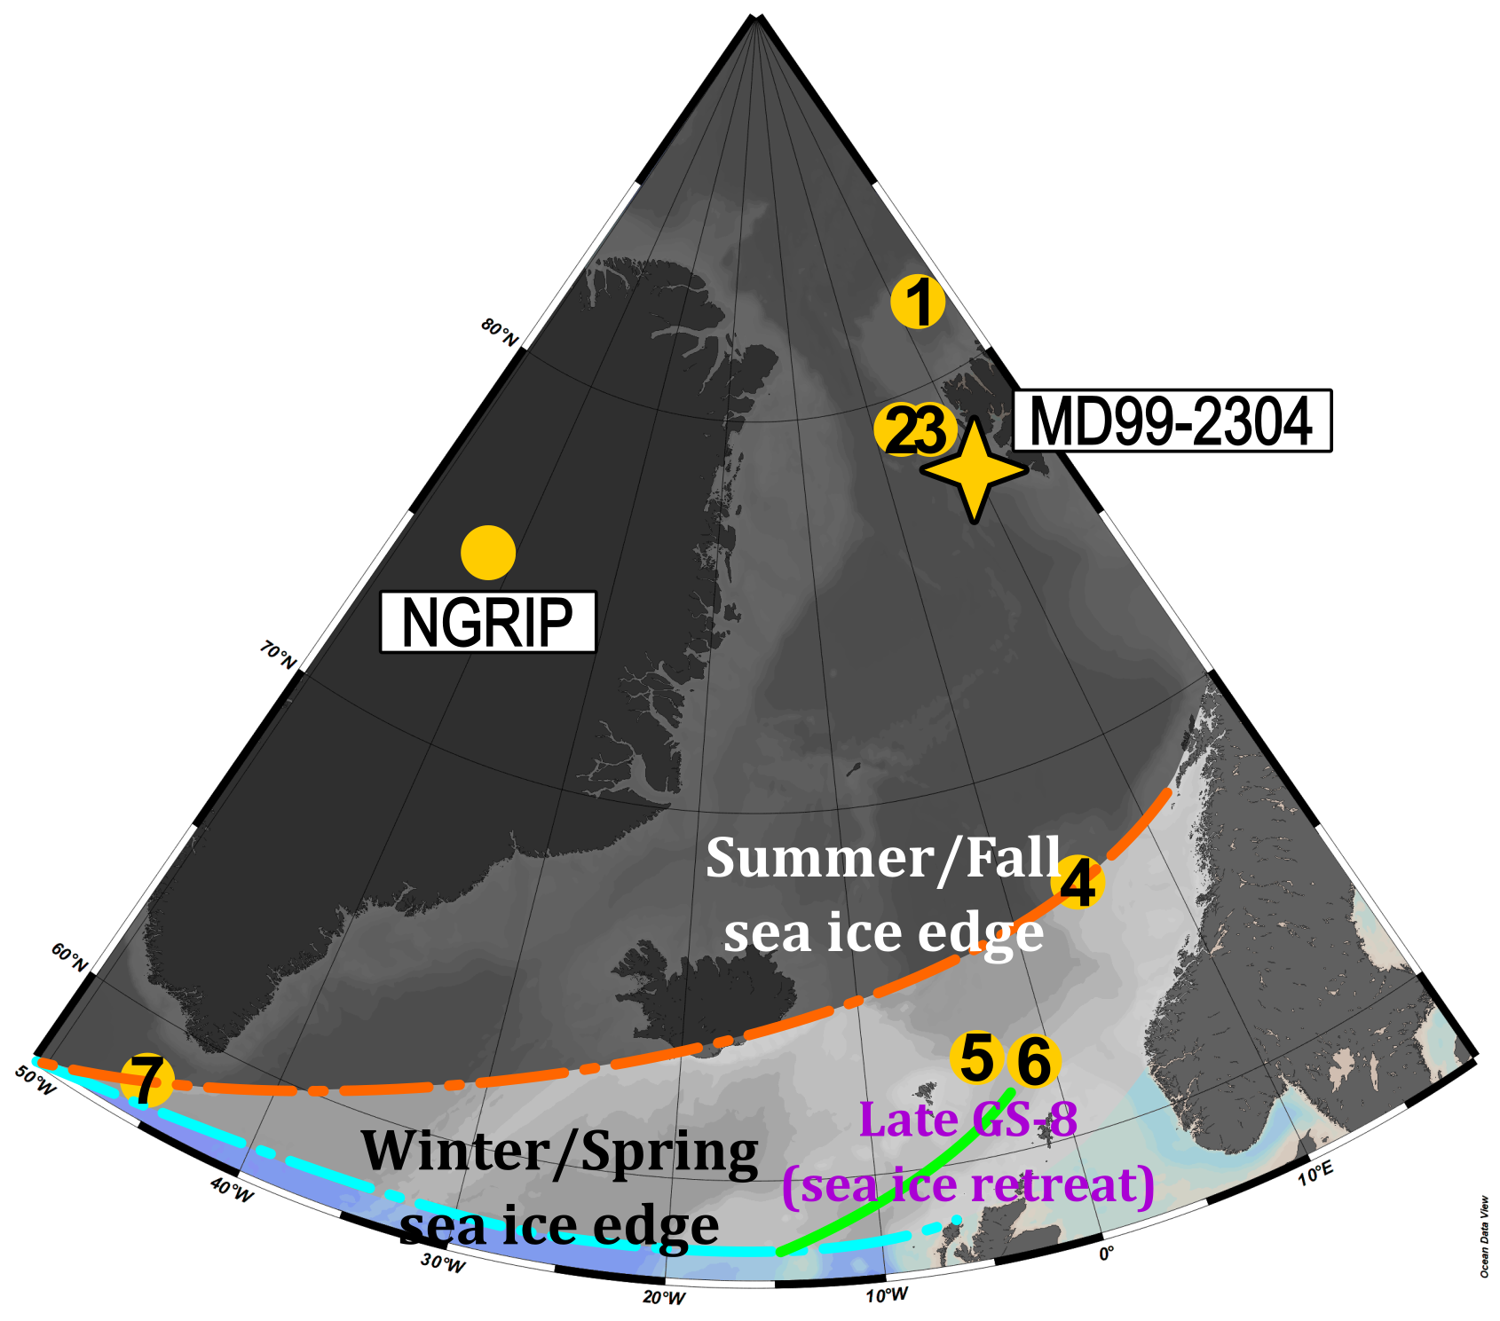
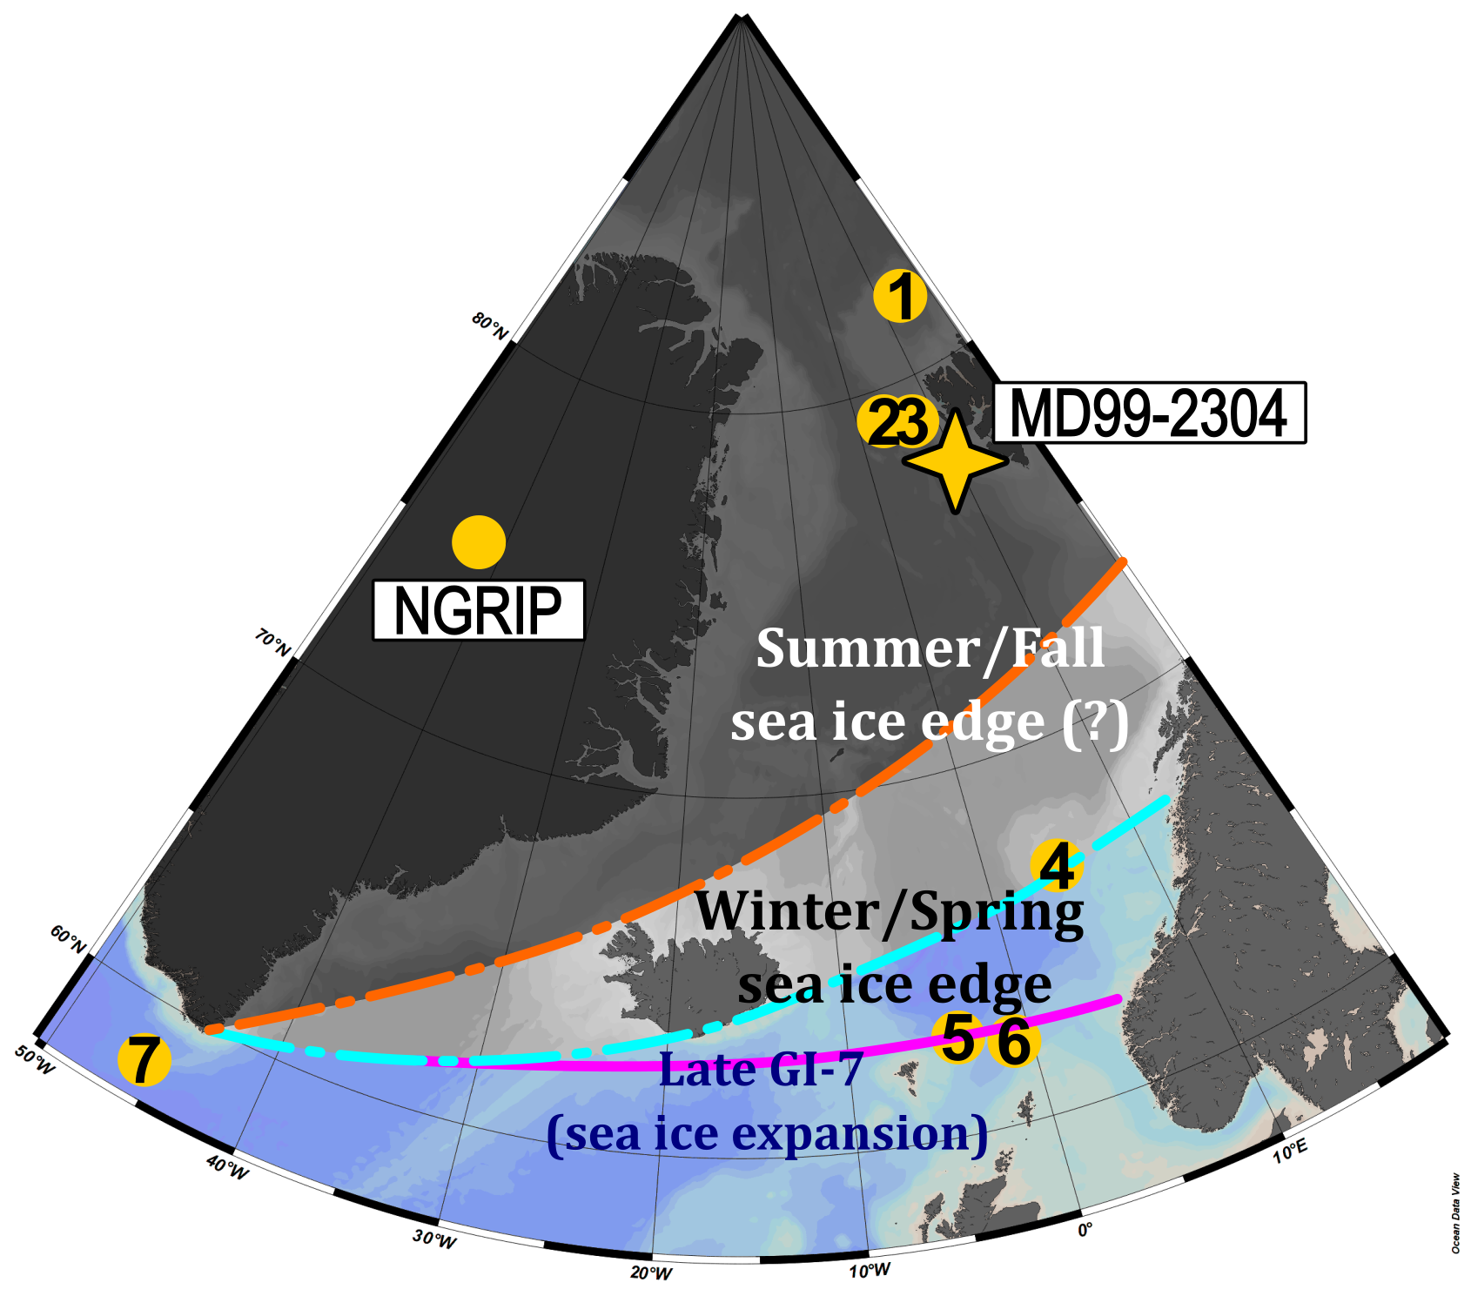
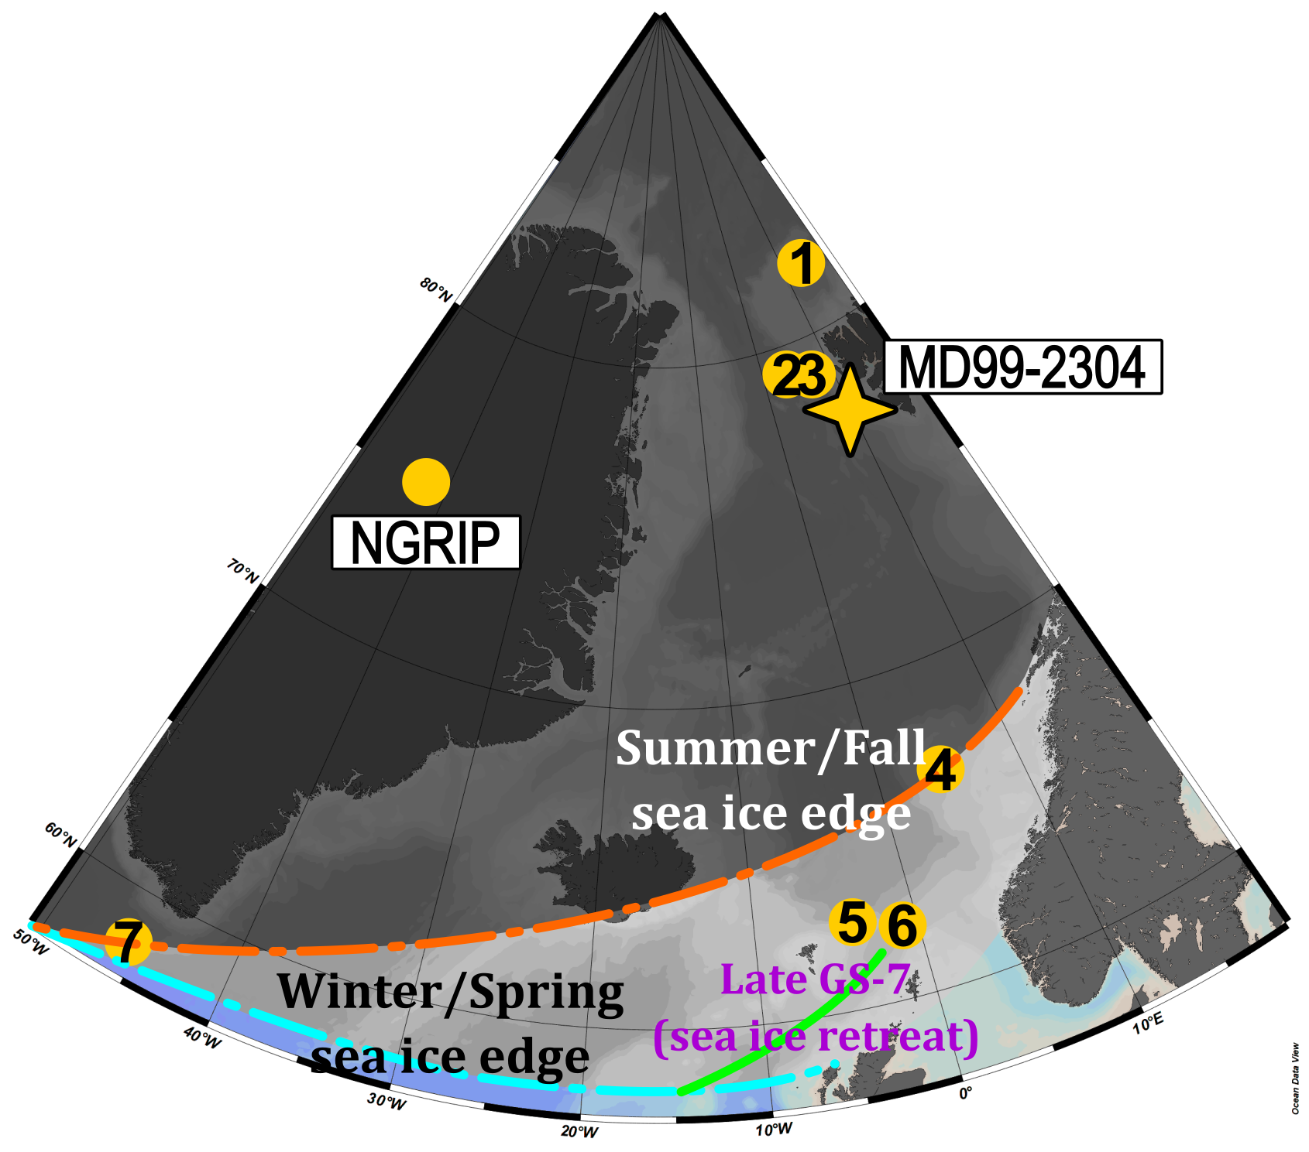
Summary
(6)
(7)
(8)
(9)
(10)
1. PS92/039-2 (Kremer et al., 2018b), 2. PS93/006-1 (Kremer et al., 2018a), 3. HH15-1252PC (El bani Altuna et al., 2021, 2024), 4. MD95-2010 (Sadatzki et al., 2020), 5. JM11-FI-19PC (Hoff et al., 2016), 6. MD99-2284 (Sadatzki et al., 2019), 7. GS16-204-23-CC (Scoto et al., 2022)

Slide 8
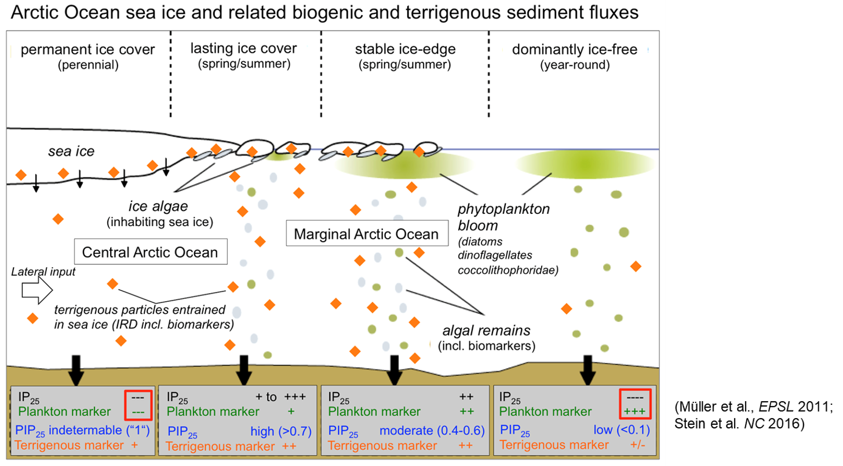
Methodology
IP₂₅: sea ice diatom
HBI-III (Z): marginal ice zone (MIZ) phytoplankton
Brassicasterol and dinosterol: pelagic phytoplankton
PIP₂₅: sea ice proxy
Campesterol + sitosterol: terrigenous organic matter
Müller et al., 2011; Stein et al., 2016.

Slide 9
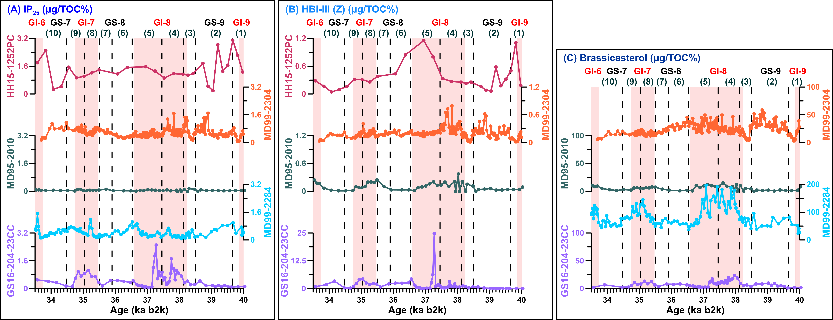
Supplement
Biomarker results comparison with cores in the Nordic Seas
1. PS92/039-2 (Kremer et al., 2018b), 2. PS93/006-1 (Kremer et al., 2018a), 3. HH15-1252PC (El bani Altuna et al., 2021, 2024), 4. MD95-2010 (Sadatzki et al., 2020), 5. JM11-FI-19PC (Hoff et al., 2016), 6. MD99-2284 (Sadatzki et al., 2019), 7. GS16-204-23-CC (Scoto et al., 2022)

Slide 10
Reference
El bani Altuna, N., Ezat, M.M., Smik, L., Muschitiello, F., Belt, S.T., Knies, J., Rasmussen, T.L., 2024. Sea ice-ocean coupling during Heinrich Stadials in the Atlantic–Arctic gateway. Sci Rep 14, 1065. https://doi.org/10.1038/s41598-024-51532-7
Hoff, U., Rasmussen, T.L., Stein, R., Ezat, M.M., Fahl, K., 2016. Sea ice and millennial-scale climate variability in the Nordic seas 90 kyr ago to present. Nat Commun 7. https://doi.org/10.1038/ncomms12247
Kremer, A., Stein, R., Fahl, K., Bauch, H., Mackensen, A., Niessen, F., 2018a. A 190-ka biomarker record revealing interactions between sea ice, Atlantic Water inflow and ice sheet activity in eastern Fram Strait. arktos 4, 1–17. https://doi.org/10.1007/s41063-018-0052-0
Kremer, A., Stein, R., Fahl, K., Ji, Z., Yang, Z., Wiers, S., Matthiessen, J., Forwick, M., Löwemark, L., O’Regan, M., Chen, J., Snowball, I., 2018b. Changes in sea ice cover and ice sheet extent at the Yermak Plateau during the last 160 ka – Reconstructions from biomarker records. Quat Sci Rev 182, 93–108. https://doi.org/10.1016/j.quascirev.2017.12.016
Malmierca-Vallet, I., Sime, L.C., 2023. Dansgaard–Oeschger events in climate models: review and baseline Marine Isotope Stage 3 (MIS3) protocol. Climate of the Past 19, 915–942. https://doi.org/10.5194/cp-19-915-2023
Müller, J., Wagner, A., Fahl, K., Stein, R., Prange, M., Lohmann, G., 2011. Towards quantitative sea ice reconstructions in the northern North Atlantic: A combined biomarker and numerical modelling approach. Earth Planet Sci Lett 306, 137–148. https://doi.org/10.1016/j.epsl.2011.04.011
Sadatzki, H., Maffezzoli, N., Dokken, T.M., Simon, M.H., Berben, S.M.P., Fahl, K., Kjær, H.A., Spolaor, A., Stein, R., Vallelonga, P., Vinther, B.M., Jansen, E., 2020. Rapid reductions and millennial-scale variability in Nordic Seas sea ice cover during abrupt glacial climate changes. Proceedings of the National Academy of Sciences 117, 29478–29486. https://doi.org/10.1073/pnas.2005849117
Sadatzki, H., Dokken, T.M., Berben, S.M.P., Muschitiello, F., Stein, R., Fahl, K., Menviel, L., Timmermann, A., Jansen, E., 2019. Sea ice variability in the southern Norwegian Sea during glacial Dansgaard-Oeschger climate cycles. Sci Adv 5. https://doi.org/10.1126/sciadv.aau6174
Scoto, F., Sadatzki, H., Maffezzoli, N., Barbante, C., Gagliardi, A., Varin, C., Vallelonga, P., Gkinis, V., Dahl-Jensen, D., Kjær, H.A., Burgay, F., Saiz-Lopez, A., Stein, R., Spolaor, A., 2022. Sea ice fluctuations in the Baffin Bay and the Labrador Sea during glacial abrupt climate changes. Proceedings of the National Academy of Sciences 119. https://doi.org/10.1073/pnas.2203468119
Stein, R., Fahl, K., Schreck, M., Knorr, G., Niessen, F., Forwick, M., Gebhardt, C., Jensen, L., Kaminski, M., Kopf, A., Matthiessen, J., Jokat, W., Lohmann, G., 2016. Evidence for ice-free summers in the late Miocene central Arctic Ocean. Nat Commun 7. https://doi.org/10.1038/ncomms11148

