Slide 1
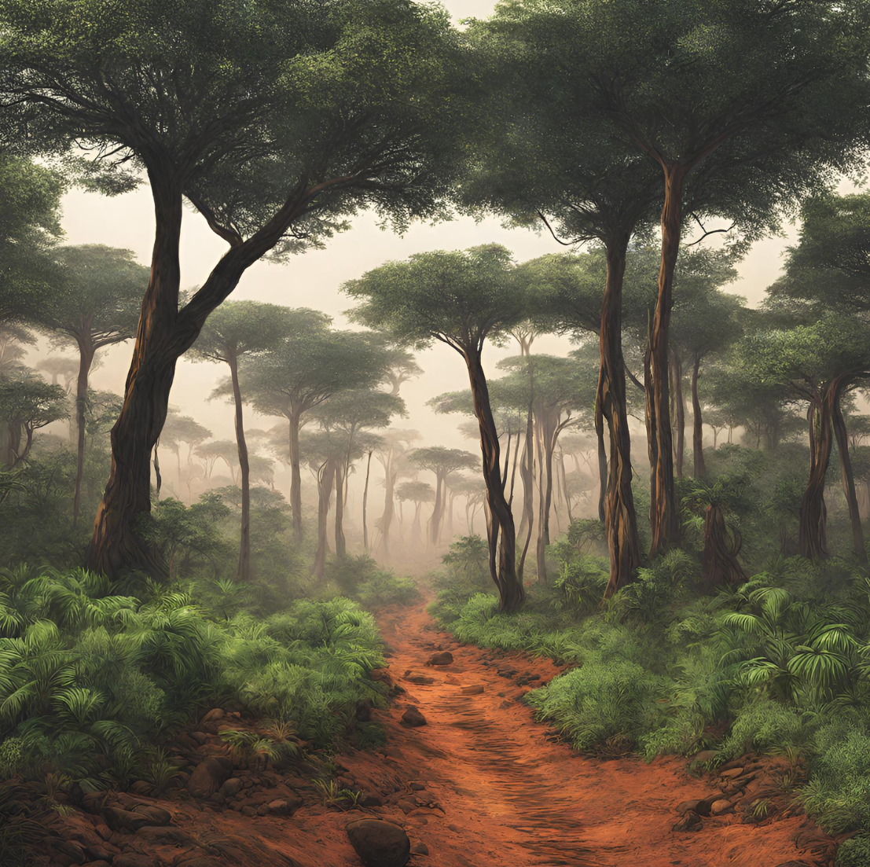
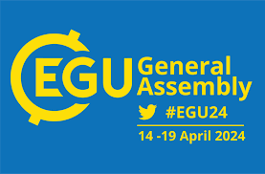
Predicting future land cover degradation through the integrated use of the Cellular-Automata-Markov chain model and the Trends.Earth model: An application in the Upper Zambezi River Basin in southern Africa
H. ZIMBA^{1’2}, K, BANDA², S. MBEWE², I, NYAMBE²
¹ Department of Agriculture, Ministry of Agriculture, P.O. Box 50595, Mulungushi House, Independence Avenue, Lusaka, Zambia.
² Integrated Water Resources Management Centre, Department of Geology, School of Mines, University of Zambia, Great East Road Campus, Lusaka, Zambia.

Slide 2
INTRODUCTION
Land cover degradation continues to pose a significant challenge in Africa (Lewandowski et al., 2013).
Reporting under the Global Environment Facility (GEF) and the United Nations Convention to Combat Desertification (UNCCD) framework using the Trends.Earth platform relies only on historical data up to the year 2021.
Yet, the target to achieve a land degradation neutral world is the year 2030, and requires both historical and forecasted information in order to enhance the implementation of targeted remedial regimes to reverse the trend.

Slide 3
INTRODUCTION
The prediction of land cover degradation holds great potential in informing targeted interventions to address this issue.
In this study we show an approach which involves leveraging the predictive capabilities of the CA-Markov chain to forecast land cover changes, while simultaneously utilising the assessment capabilities of the Trends.Earth model to evaluate the extent of land cover degradation.
This combined information can then be utilised at a local level, where targeted interventions are most needed, to provide a more comprehensive and detailed understanding of the situation.

Slide 4
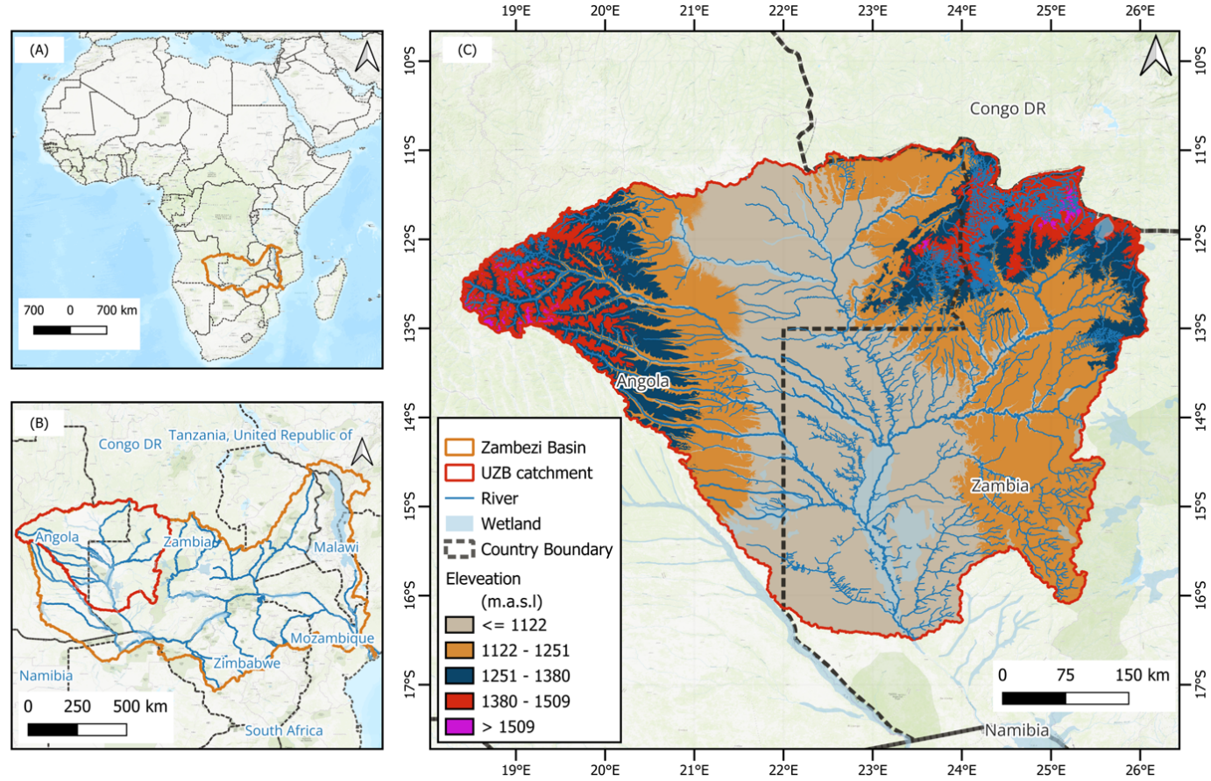
STUDY AREA
Africa south of the equator, where the Upper Zambezi Basin is located, is one of the regions in the world which is severely affected by land cover degradation and accounts for 13% of the global degrading area (Lewandowski et al., 2013).
The Zambezi Basin is also highly vulnerable to climate variability (Beilfuss, 2012).
Historical and forecasted land cover degradation information is important for informing planning of targeted interventions and reverse the land cover degradation trend.

Slide 5
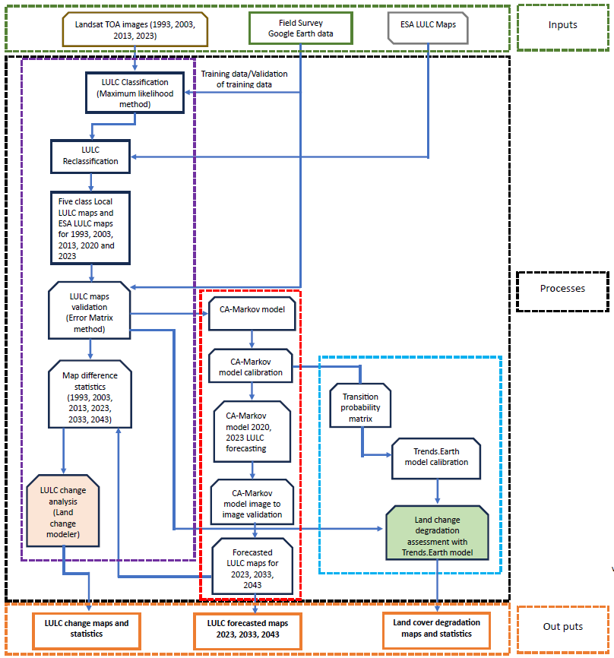
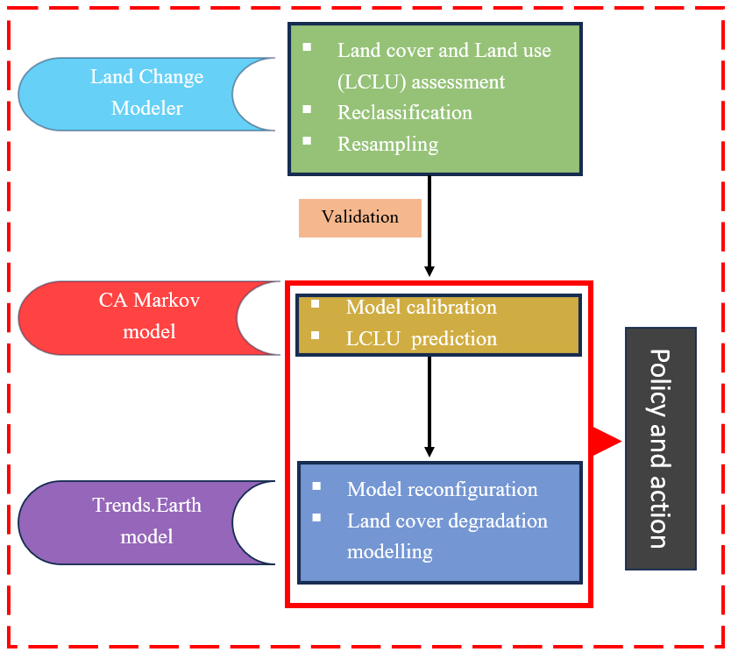
METHODOLOGY

Slide 6
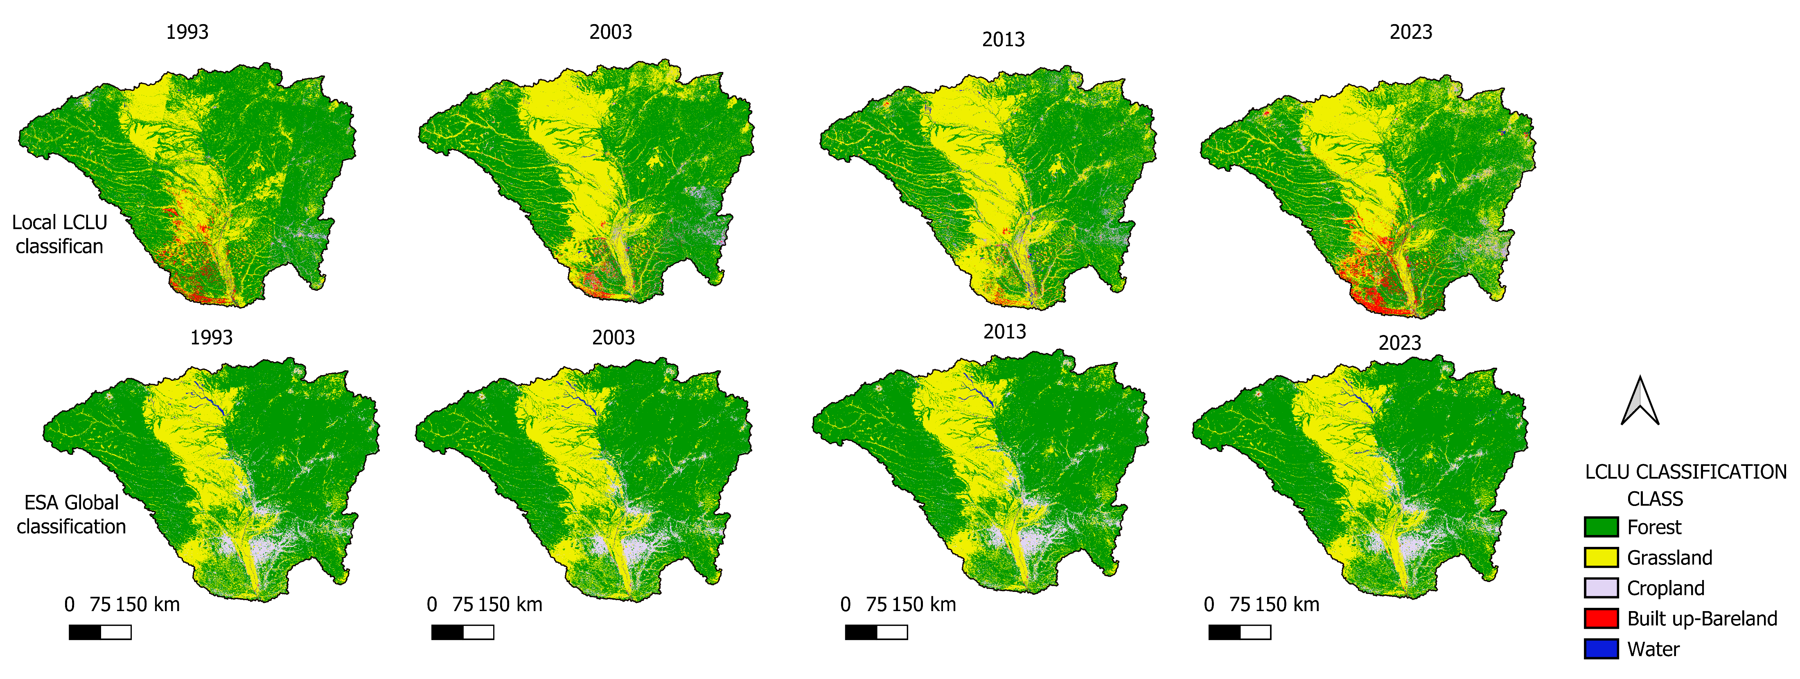
RESULTS
Historical LCLU classifications 1993 - 2023
ESA LCLU maps:
misclassify some settlements and forest cover as cropland
Misclassify some areas as forest instead of grassland

Slide 7
LCLU ACCURACY ASSESSMENT
Compared to local LCLU classifications, the ESA LCLU :
Show lower Producer Accuracy (PA) & User Accuracy (AC) in Build up/Bare land and grassland classes
shows lower Overall Accuracy(OA) and Kappa Index (KI)

Slide 8
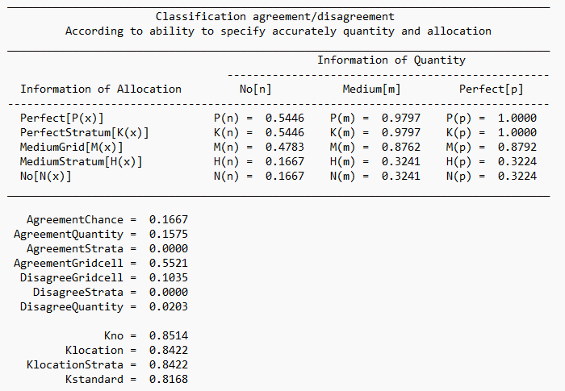
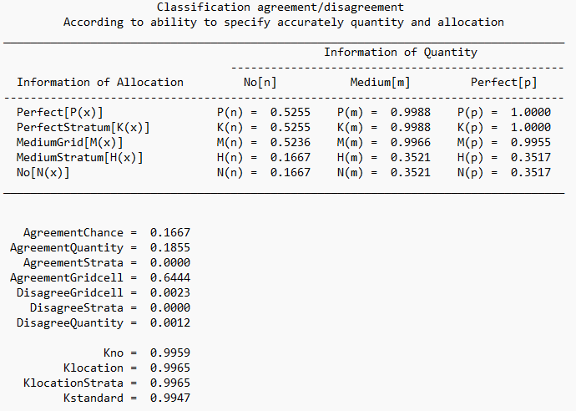
CA-MARKOV MODEL CALIBRATION
Calibration with local LCLU maps
Calibration with ESA LCLU maps
CA-Markov model overall agreement (Kno) > 85% with both classifications

Slide 9
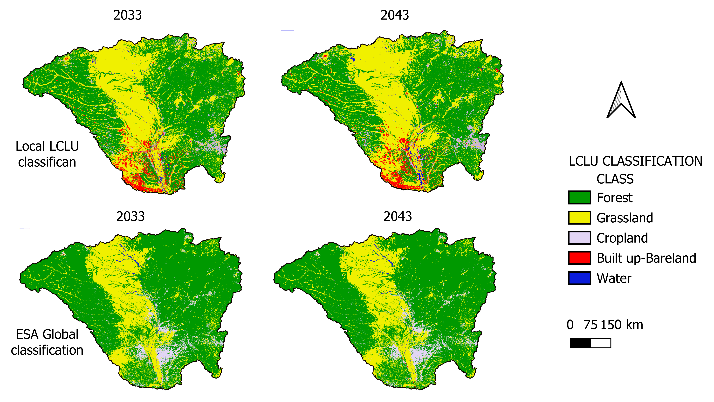
FORECASTED LCLU CLASSIFICATIONS 2023 – 2033 and 2033 - 2043

Slide 10
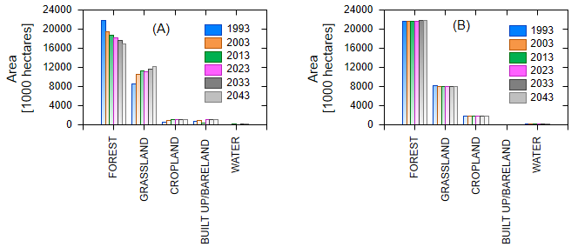
LAND COVER LAND USE (LCLU) COMPOSITION AND TEMPORAL TREND
Local LCLU classifications
ESA LCLU classifications
Contrary to local classifications and other studies ESA LCLU maps:
Shows increasing forest cover
Reducing grassland and cropland
These results may be indicative of errors associated with global scale LCLU classification

Slide 11
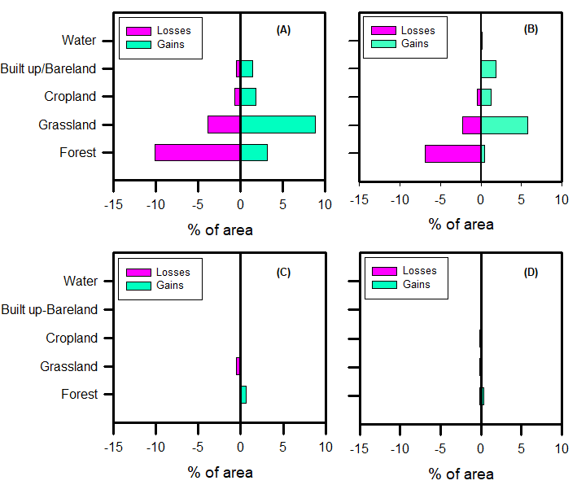
GAINS AND LOSSES
1993 - 2023
2023 - 2043
ESA Classification show low change values
Contrary to trends in Forest cover and grassland in the region and local classification
LOCAL CLASSIFICATION
Between 2023 and 2043, the UBZ is predicted to experience a net reduction of about 3.2 million hectares of forest cover, with a net annual rate of reduction of -0.13%.
ESA CLASSIFICATION

Slide 12
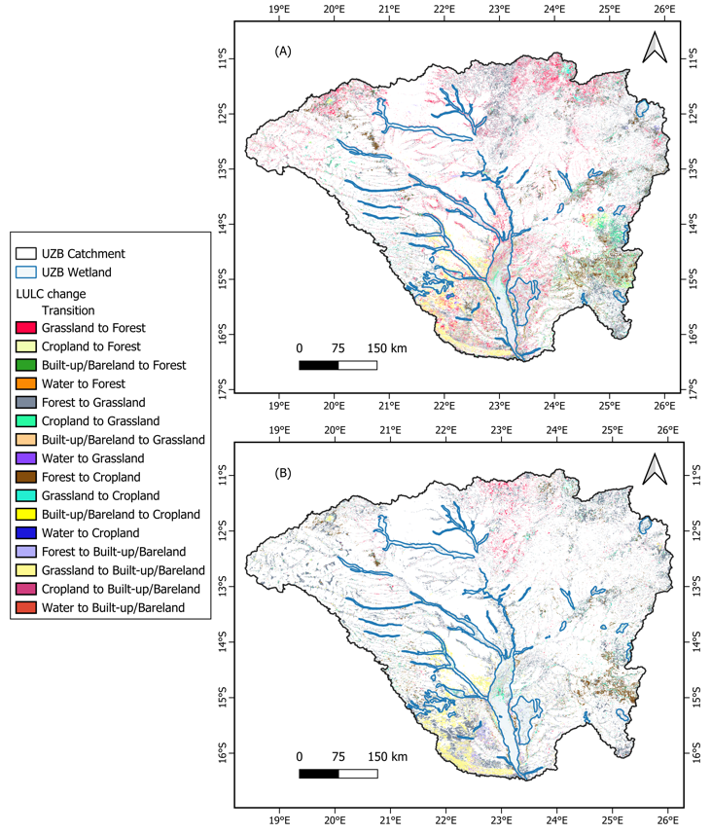
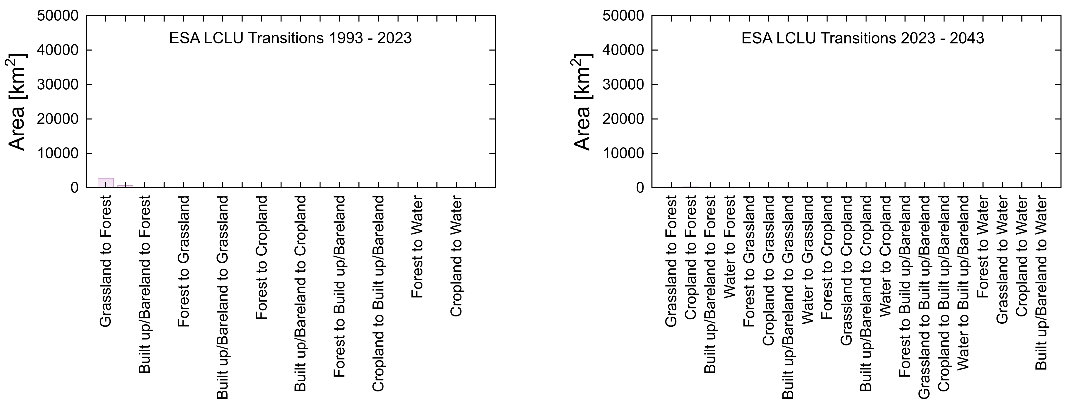
LAND COVER DEGRADATION ASSESSMENT
Estimates of transitions area
Spatial transitions
1993 -2023
2023 - 2043
1993 -2023
Based on LOCAL LCLU classifications
Major land cover transitions are from Forest to Grassland, Grassland to Forest and Forest to Cropland
Transitions from Forest and Grassland to Built-up/bareland estimates are 2500 square kilometres
Transitions based on the ESA global LCLU appear negligible
2023 - 2043

Slide 13
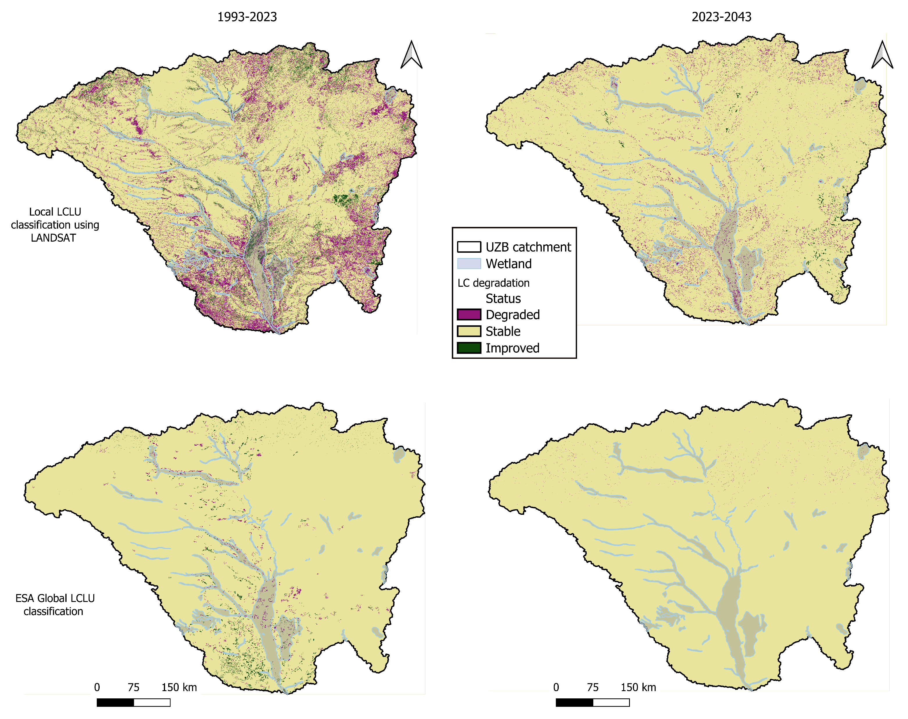
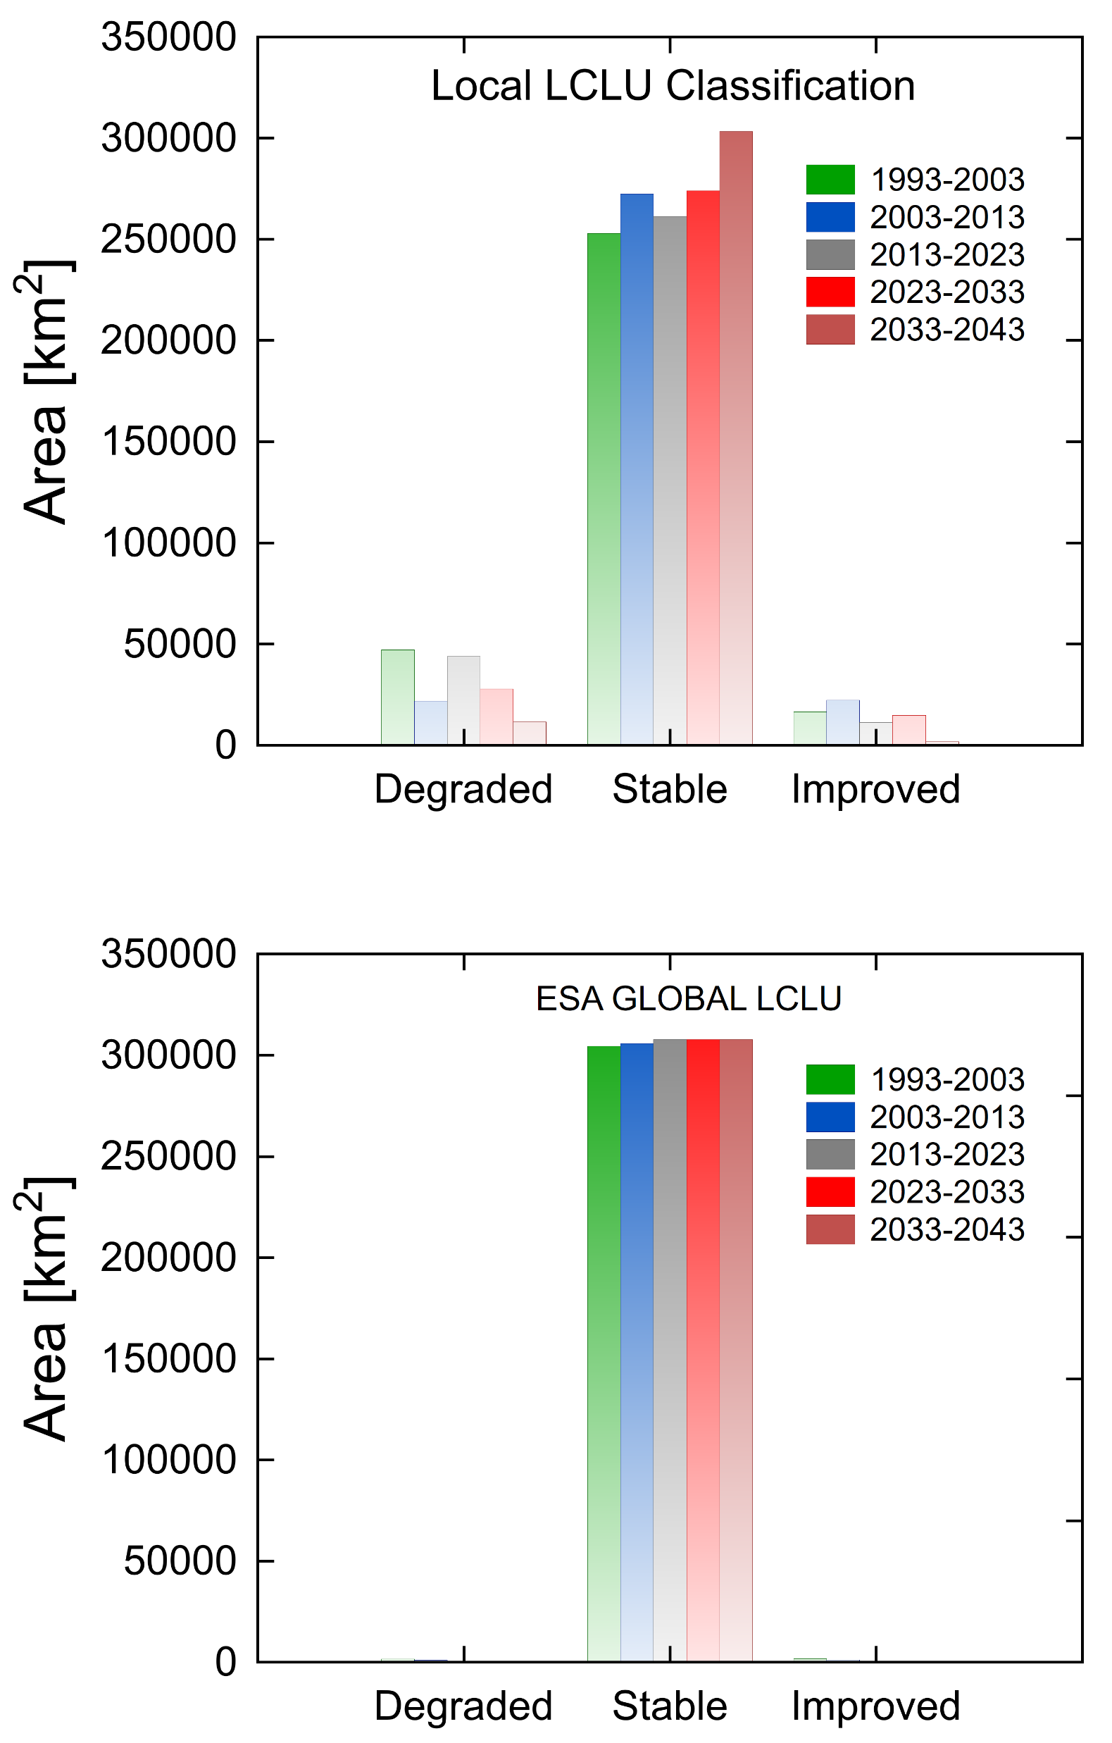
SPATIAL AND TEMPORAL DISTRIBUTION OF LAND COVER DEGRADATION

Slide 14
CONCLUSIONS
By using locally produced LCLU maps derived from high-resolution multispectral satellite data, it is possible to obtain more accurate assessments of historical and projected land cover degradation compared to using global products like the ESA global LCLU maps.
This finding underscores the importance of incorporating local knowledge of the study area to improve the accuracy of LCLU classifications.
The integration of historical and projected data on land cover degradation provides reliable information for reporting under the Global Environment Facility (GEF) and the United Nations Convention to Combat Desertification (UNCCD) framework, and increases the likelihood of effectively implementing targeted remedial measures.
This, in turn, enhances the prospects of reversing the trend in Africa south of the equator, and contribute to achieving a degradation-neutral world.

Slide 15
IMPLICATIONS OF THE RESULTS OF THE STUDY
Land cover degradation is a significant environmental problem with extensive policy implications. It involves the permanent loss of natural vegetation due to various factors such as deforestation, urbanization, and agriculture (Kouassi et al., 2021;Herrmann et al., 2020).
This degradation has a profound impact on the environment. For instance, land cover degradation results in the destruction of natural habitats, leading to a decline in biodiversity. This, in turn, has a domino effect on the entire ecosystem, as the loss of one species can affect the survival of others (Baidoo et al., 2023;Maitima et al., 2009).
Land cover degradation contributes to climate change by releasing carbon dioxide into the atmosphere. Trees and other plants absorb carbon dioxide as part of photosynthesis, so when they are removed, this carbon is released back into the atmosphere (Barati et al., 2023).
Land cover degradation can lead to soil erosion, resulting in the loss of topsoil due to wind or water. This can damage soil fertility and reduce agricultural productivity (Ferreira et al., 2022; Gebresamuel et al., 2010).
Land cover degradation can lead to changes in hydro-morphology, flow volumes and water pollution by allowing sediment and nutrients from eroded soil to enter waterways. This contamination can harm aquatic ecosystems, such as rivers and wetlands, and contaminate drinking water supplies (Kayitesi et al., 2022;Näschen et al., 2019b).

Slide 16
POLICY CONSIDERATIONS
The Upper Zambezi Basin is home to the source of the Zambezi River and has diverse ecosystems. These ecosystems support livelihoods in Angola and Zambia. One such ecosystem is the Barotse wetlands in Zambia, designated as a Ramsar site. Changes in the Upper Zambezi Basin can affect the Lower Zambezi's ecosystems, hydro-power generation, and agriculture. Given the significant environmental impacts of land cover degradation, it is important for policymakers to take action to address this issue.
Policymakers can protect and restore natural habitats by implementing conservation measures, such as creating protected areas and reforestation programs. Policymakers can promote sustainable agriculture by providing incentives for farmers to adopt practices that minimize land degradation, such as crop rotation and contour ploughing.
Policymakers can reduce deforestation by implementing policies that discourage the clearing of forests, such as taxes on logging and land use regulations.
By taking these steps, policymakers can help to mitigate the impacts of land cover degradation and protect the environment ultimately contributing a land degradation neutral world.

Slide 17
References
Baidoo, R., Arko-Adjei, A., Poku-Boansi, M., Quaye-Ballard, J. A., & Somuah, D. P. (2023). Land use and land cover changes implications on biodiversity in the Owabi catchment of Atwima Nwabiagya North District, Ghana. Heliyon, 9(5). https://doi.org/10.1016/j.heliyon.2023.e15238
Barati, A. A., Zhoolideh, M., Azadi, H., Lee, J. H., & Scheffran, J. (2023). Interactions of land-use cover and climate change at global level: How to mitigate the environmental risks and warming effects. Ecological Indicators, 146. https://doi.org/10.1016/j.ecolind.2022.109829
Beilfuss, R. (2012). A Risky Climate for Southern African Hydro ASSESSING HYDROLOGICAL RISKS AND A Risky Climate for Southern African Hydro. September. https://doi.org/10.13140/RG.2.2.30193.48486
Ferreira, C. S. S., Seifollahi-Aghmiuni, S., Destouni, G., Ghajarnia, N., & Kalantari, Z. (2022). Soil degradation in the European Mediterranean region: Processes, status and consequences. In Science of the Total Environment (Vol. 805). Elsevier B.V. https://doi.org/10.1016/j.scitotenv.2021.150106
Gebresamuel, G., Bal, R. S., & Øystein, D. (2010a). Land-use changes and their impacts on soil degradation and surface runoff of two catchments of Northern Ethiopia. Acta Agriculturae Scandinavica Section B: Soil and Plant Science, 60(3), 211–226. https://doi.org/10.1080/09064710902821741
Herrmann, S. M., Brandt, M., Rasmussen, K., & Fensholt, R. (2020). Accelerating land cover change in West Africa over four decades as population pressure increased. Communications Earth and Environment, 1(1). https://doi.org/10.1038/s43247-020-00053-y
Kayitesi, N. M., Guzha, A. C., & Mariethoz, G. (2022). Impacts of land use land cover change and climate change on river hydro-morphology- a review of research studies in tropical regions. In Journal of Hydrology (Vol. 615). Elsevier B.V. https://doi.org/10.1016/j.jhydrol.2022.128702
Kouassi, J. L., Gyau, A., Diby, L., Bene, Y., & Kouamé, C. (2021). Assessing land use and land cover change and farmers’ perceptions of deforestation and land degradation in south-west Côte d’Ivoire,West Africa. Land, 10(4). https://doi.org/10.3390/land10040429
Lewandowski, Z. I., Dent, D., Wu, Y., & De Jong, R. (2013). Land degradation and ecosystem services. In Ecosystem Services and Carbon Sequestration in the Biosphere (pp. 357–381). Springer Netherlands. https://doi.org/10.1007/978-94-007-6455-2_15
Maitima, J. M., Mugatha, S. M., Reid, R. S., Gachimbi, L. N., Majule, A., Lyaruu, H., Pomery, D., Mathai, S., & Mugisha, S. (2009). The linkages between land use change, land degradation and biodiversity across East Africa. African Journal of Environmental Science and Technology, 3(10), 310–325. https://doi.org/10.5897/AJEST08.173
Näschen, K., Diekkrüger, B., Evers, M., Höllermann, B., Steinbach, S., & Thonfeld, F. (2019a). The Impact of Land Use/Land Cover Change (LULCC) on Water Resources in a Tropical Catchment in Tanzania under Different Climate Change Scenarios. Sustainability (Switzerland), 11(24). https://doi.org/10.3390/su11247083

