Slide 1




Integration of health indicators and quantification of benefits from BGS-based urban interventions
……………….
Wenfei Huo
Anastasios Temenos
Aikaterini Angeli
Stanislava Bošković
Čedo Maksimović
………….
EGU General Assembly, Vienna, Austria & Online 14-19 April,2024
This project has received funding from the European Union's Horizon 2020
research and innovation programme under grant agreement No 945105

Slide 2
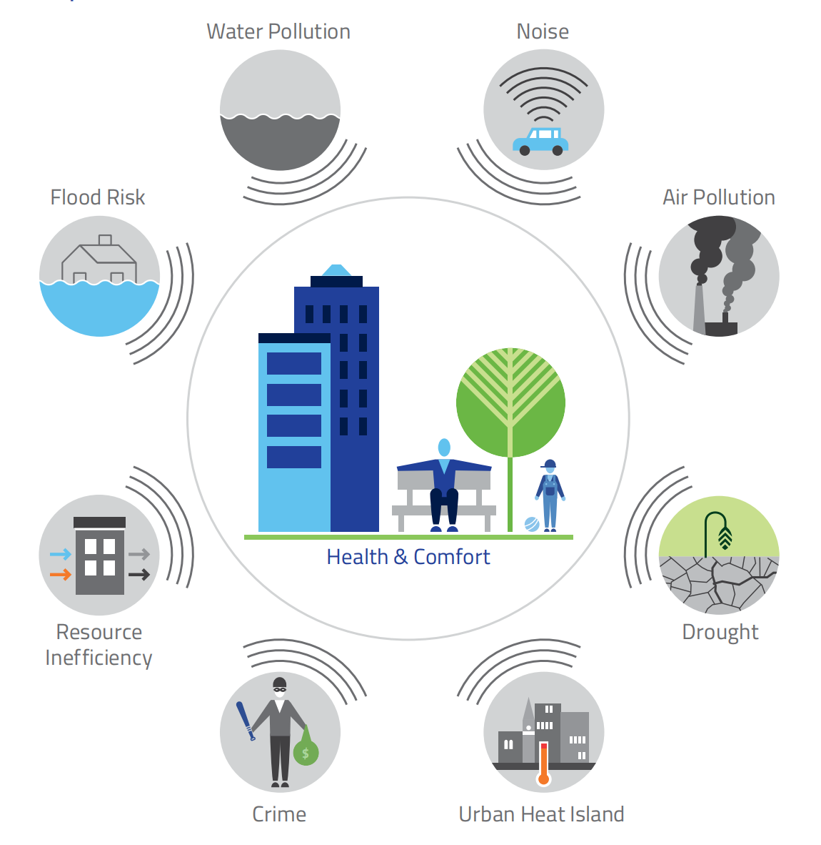
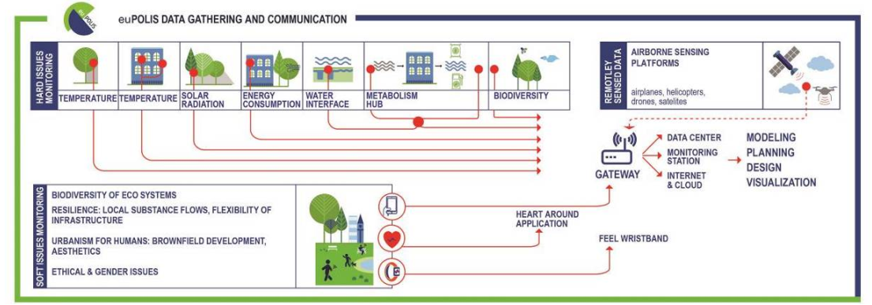

Background
Blue Green Solutions
euPOLIS project from monitoring to impact quantification

Slide 3
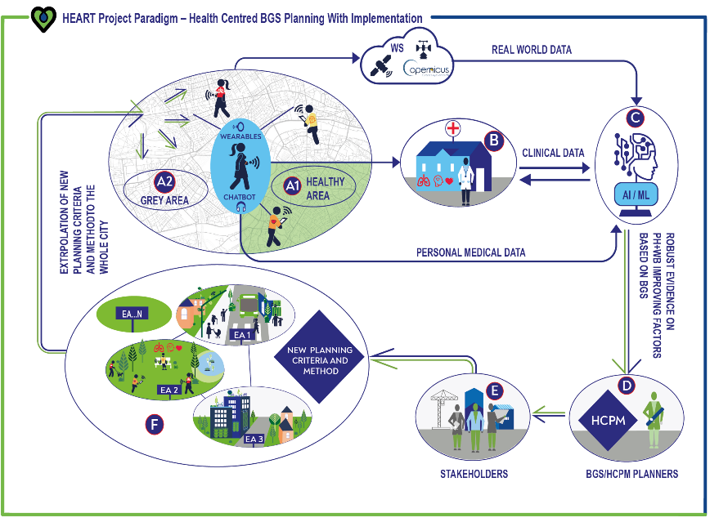
HEART project

Slide 4


Aim of Study
Establish connections between the changes in heart rate among park users in the “healthy environment areas” and the local environmental conditions.
Consolidate the opportunity of wearable technology and remotely sensed data to monitor the availability on public green, as an epidemic management tool.

Slide 5
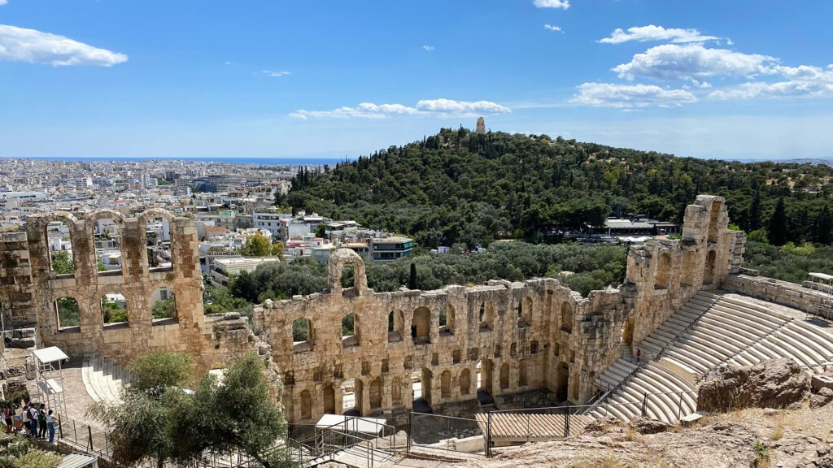
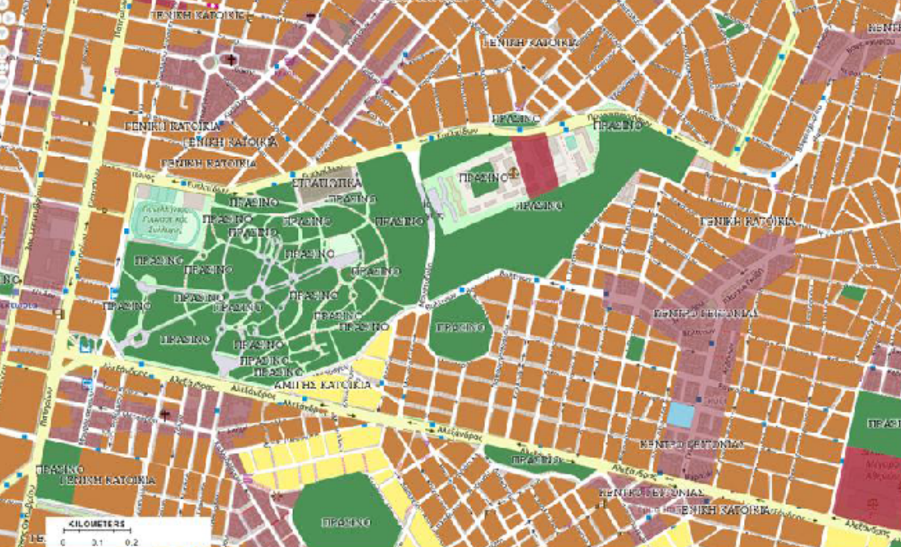
Study Area
Attica Region --- Park Pedion of Areos
in the central part of Athens
Total area: 27.7 ha
Location: 37.98° N, 23.73° E
1052 sets of 11 participants’ heart rates are being recorded using the Huawei band 6 smartwatches walking in Attica region.
2 initial park users’ datasets were used, includeing 94 sets of observations and 11 variables recorded from 8th February 2023 to 11th April 2023.

Slide 6
Methodology
Geographic Information System (GIS) data: Normalized difference vegetation index (NDVI), road networks, pedestrian pathways, and public transportation routes.
Meteorological data: Air pressure, Land Surface Temperature (LST), air temperature, and humidity.
Air pollutant data: CO, NO, NO2, O3, SO2, PM2.5, PM10.
Biomonitoring data: Heart rate from the “HEART by BioAsssist” application.
Statistical
Analysis
SPSS
Descriptive analysis
Spatial
Analysis
QGIS
Correlation between LST and NDVI
Spearman Correlation
Linear regression

Slide 7
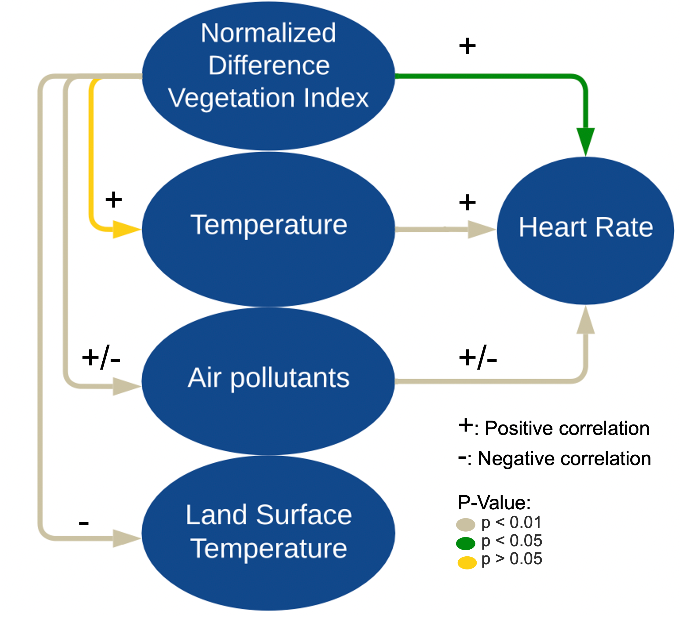
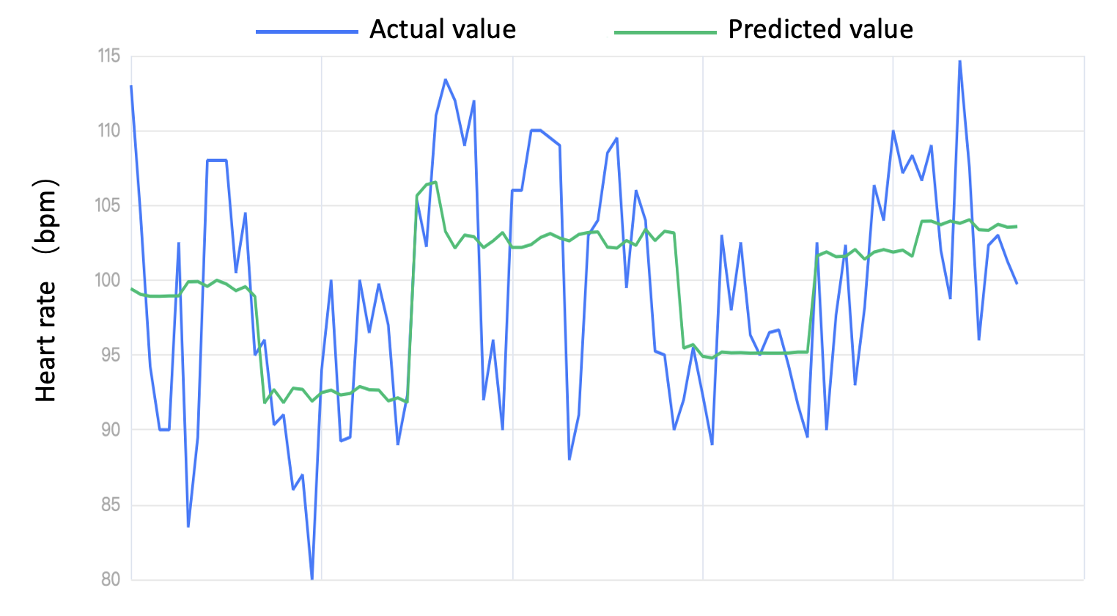
Results from statistical analyses
a)
The role of NDVI in calming the heart rate (HR) is unexpected.
A positive correlation relationship is found between HR and temperature.
The impact of air pollutants on heart rate is not clearly evidenced here.
From the linear regression model, 24.7% of the variance in HR can be explained by the independent variables.
b)
a) The correlation between indicators from Spearman correlation; b) fitted effect graph of heart rate simulated from the linear regression model

Slide 8
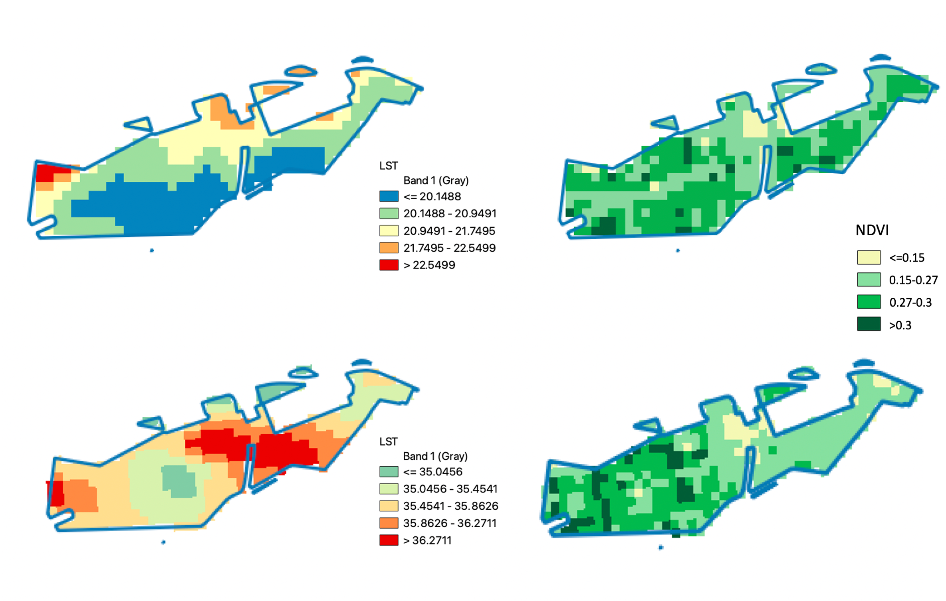
Results from spatial analysis
a)
Significant correlation between the increase in NDVI and the reduction in LST.
38.22% of the variation in LST can be explained by the NDVI during the spring season.
b)
Comparison of LST and NDVI images: a) 25th March and b) 16th July 2023

Slide 9
Limitation and Future Scope
Requires bigger sample which is forthcoming;
Privacy constraints;
Current stage of the project;
Exclusivity of the study to healthy young females;
As the park region is in small buffers (less than 100m), it would be better to have higher-resolution satellite or drone images;
In the future, conducting comparative studies with more indicators, e.g. Heart Rate Variability, vegetation species etc. to evaluate long-term health impacts could offer more valuable insights.

Slide 10


Thank You!
Name: Wenfei Huo
Email: Wenfei.huo@atkinsrealis.com
https://www.facebook.com/heartproject2020
https://www.linkedin.com/company/heart-horizon2020
This project has received funding from the European Union's Horizon 2020 research and innovation programme under grant agreement No 945105

