Slide 1
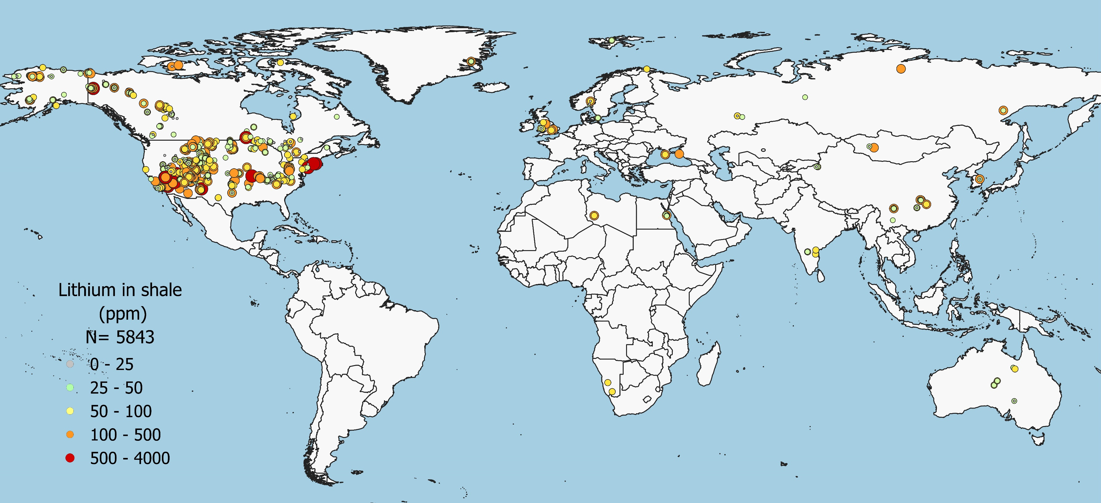
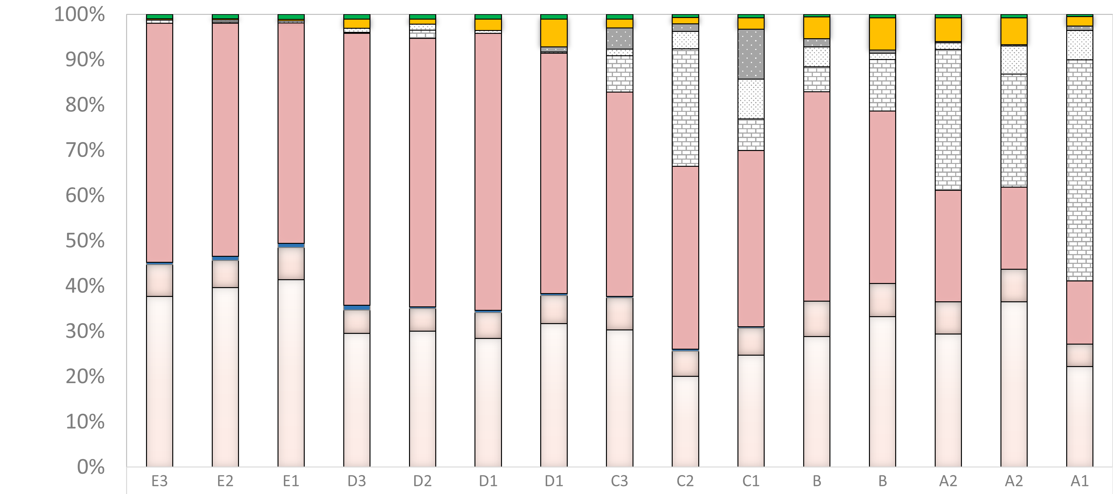
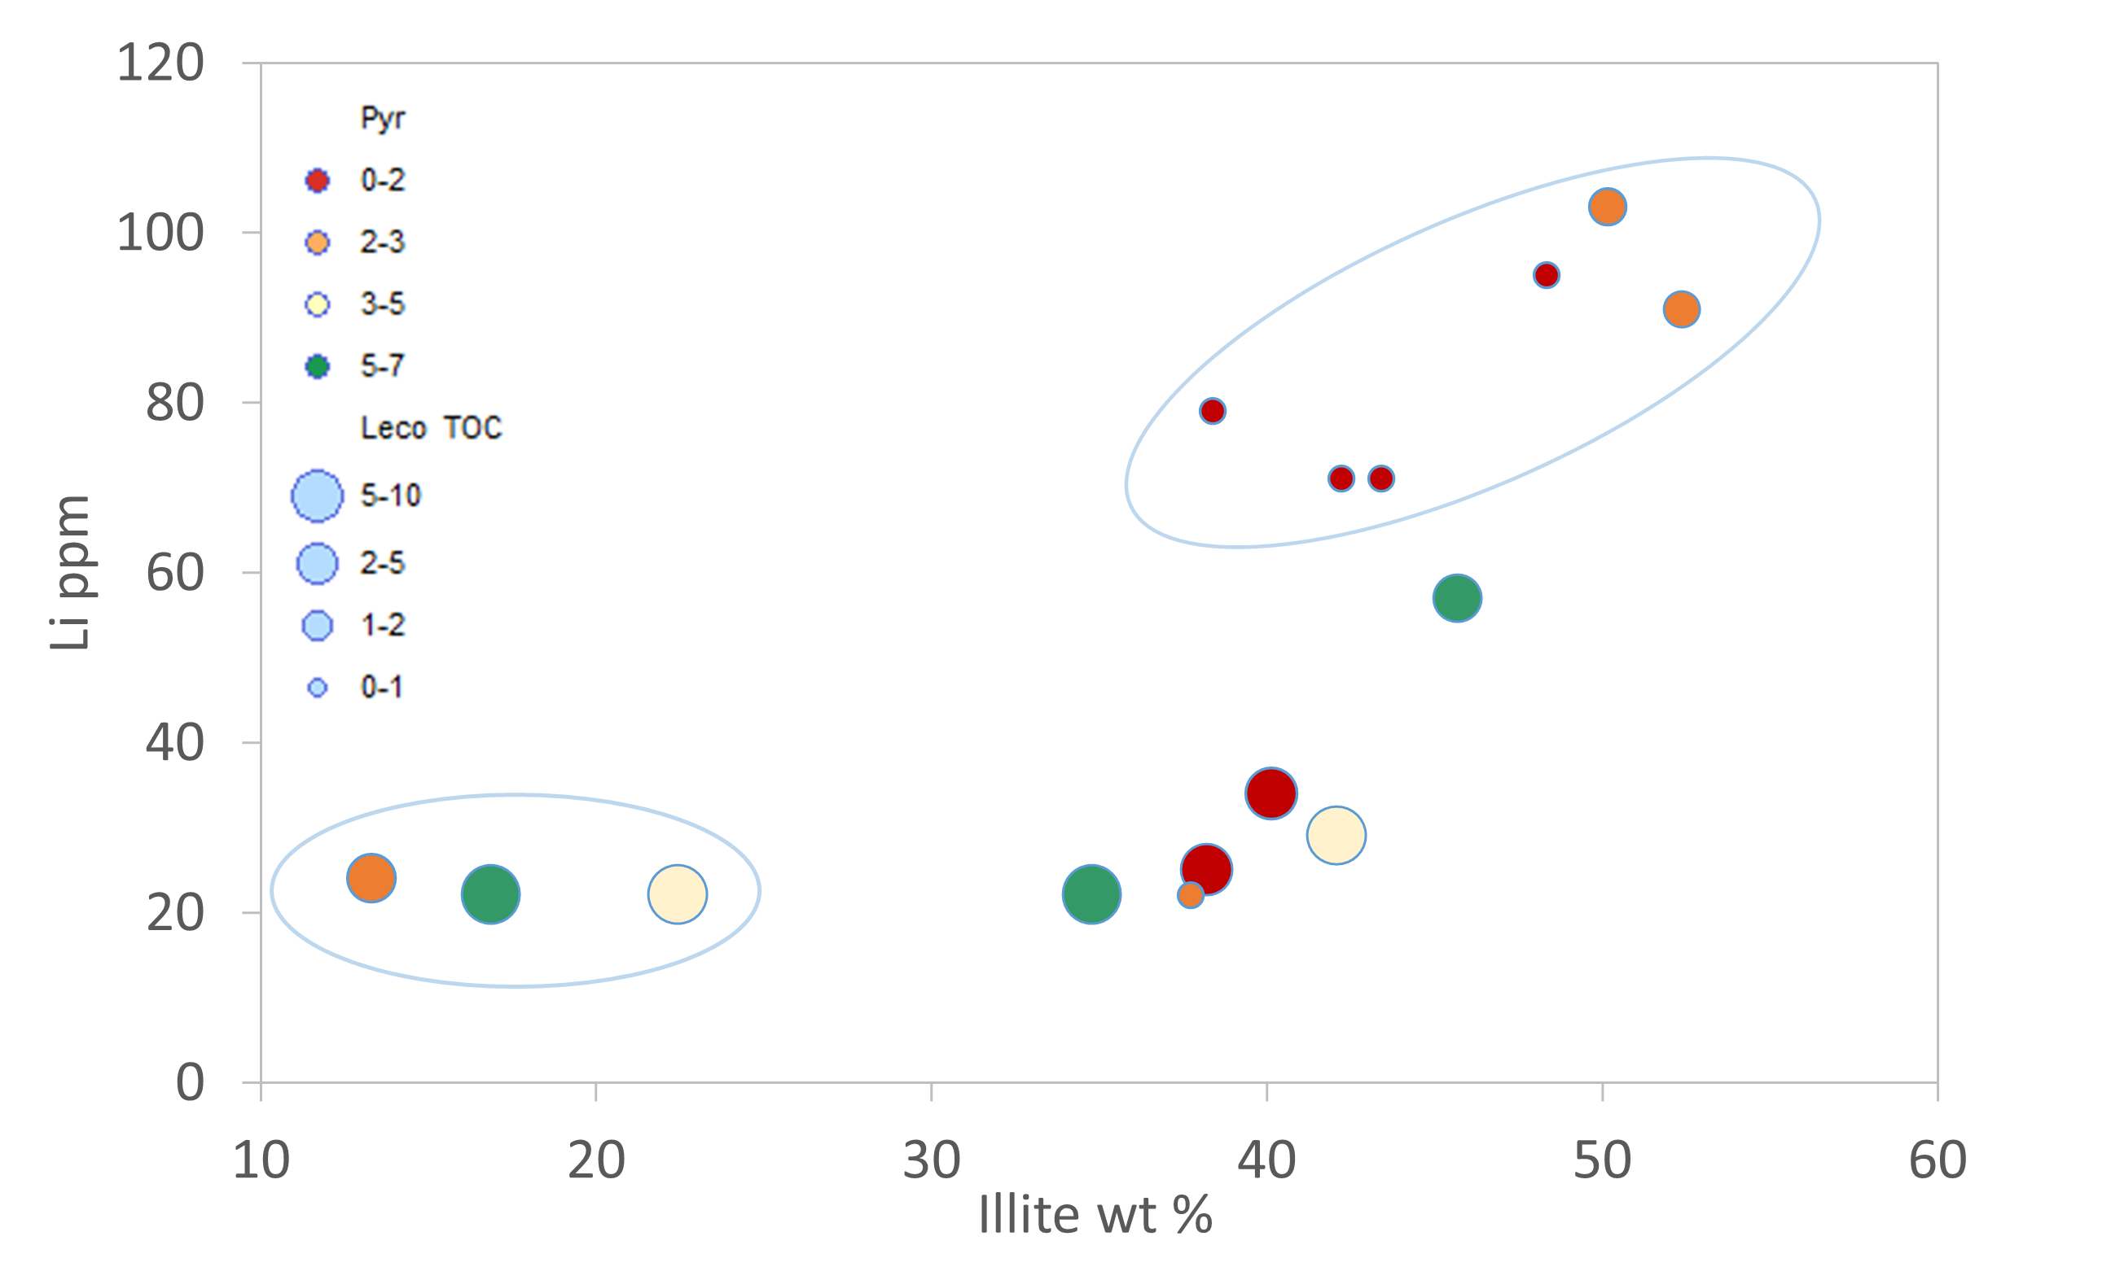
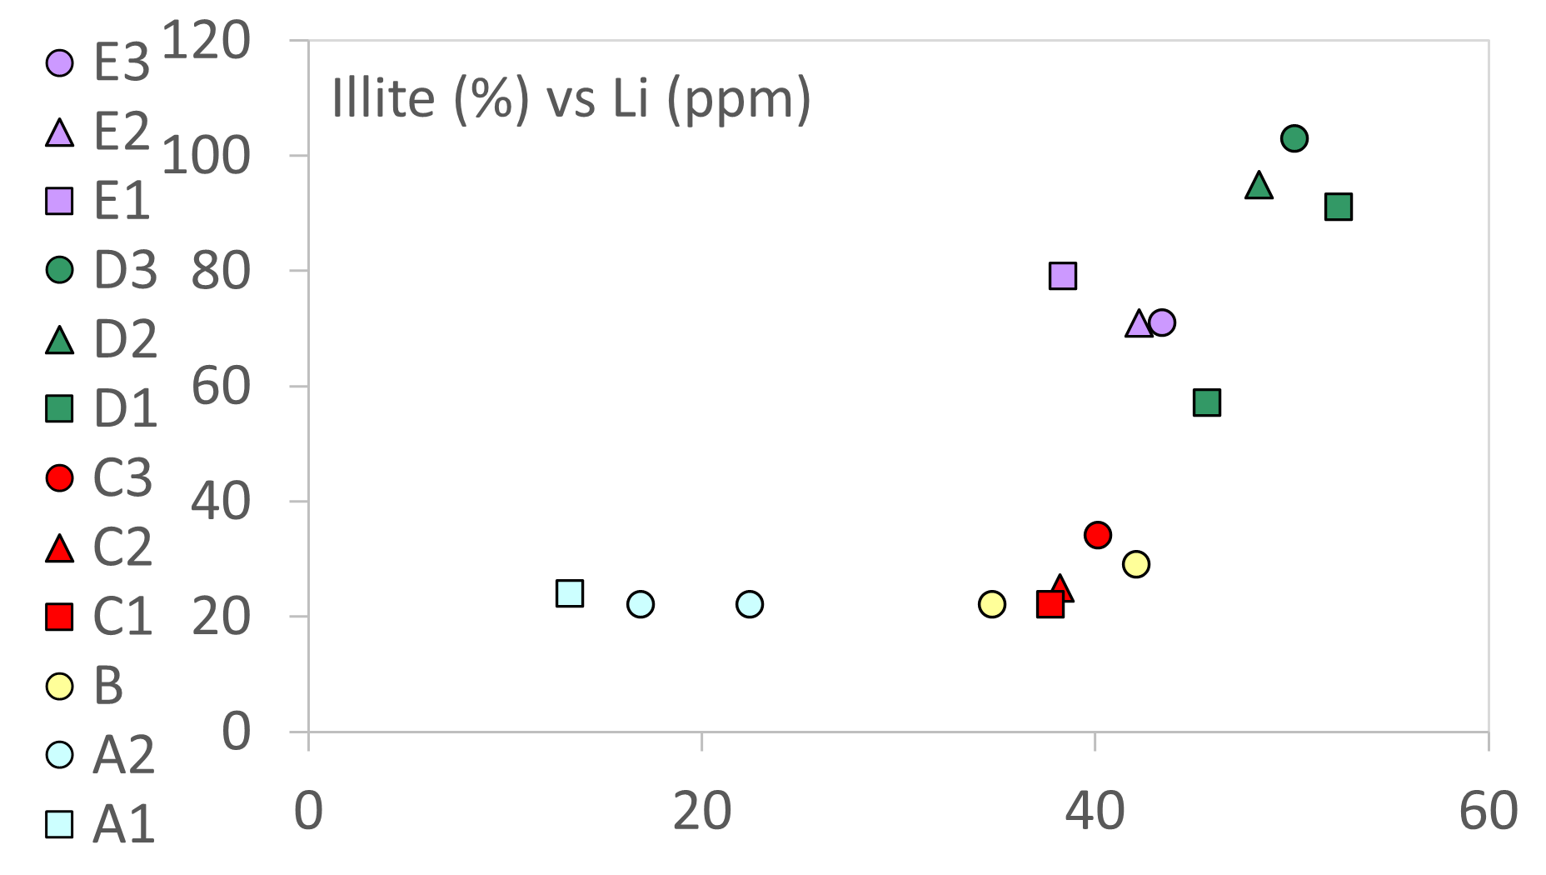
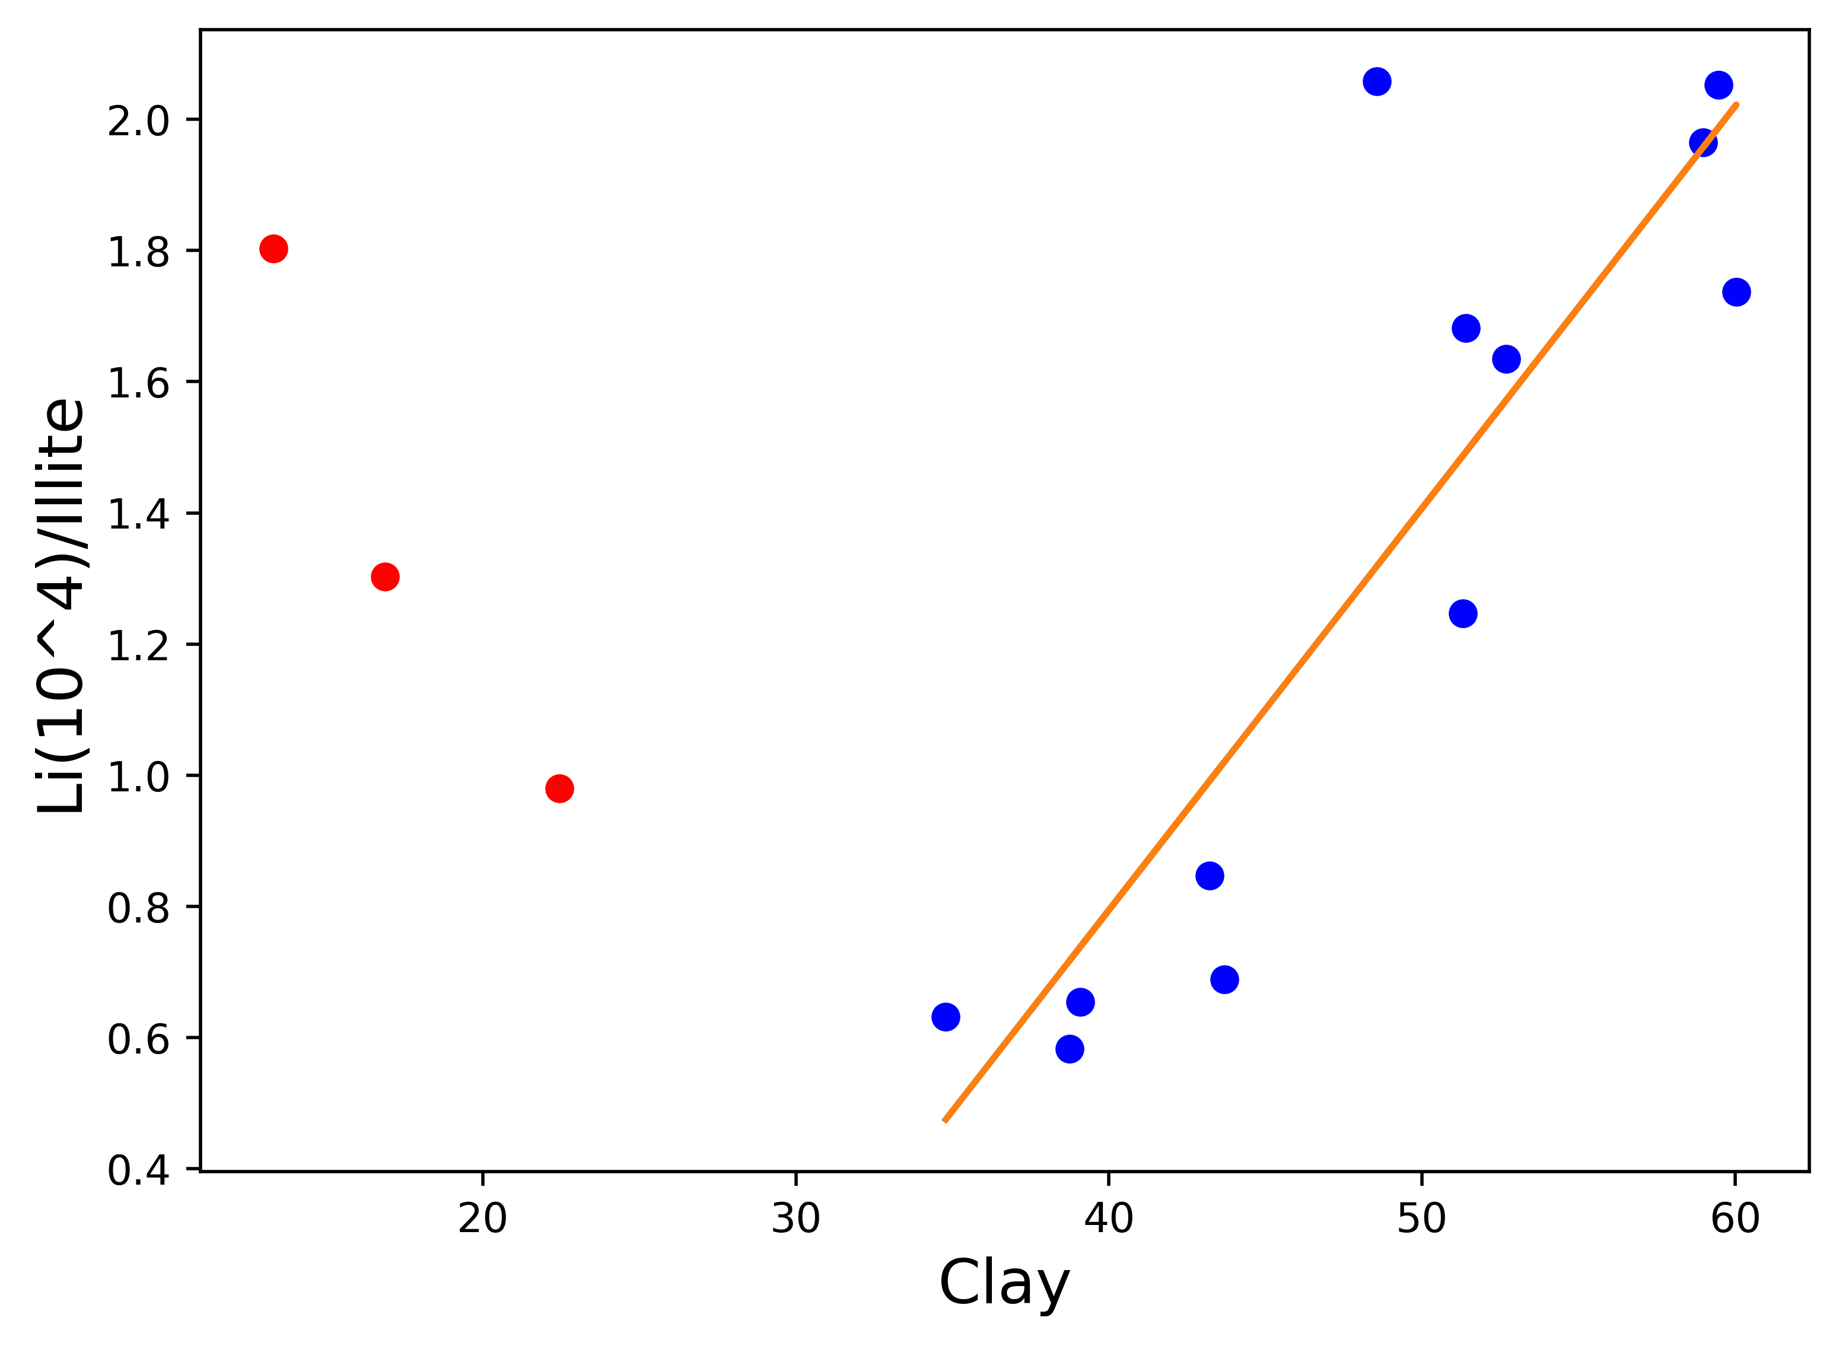
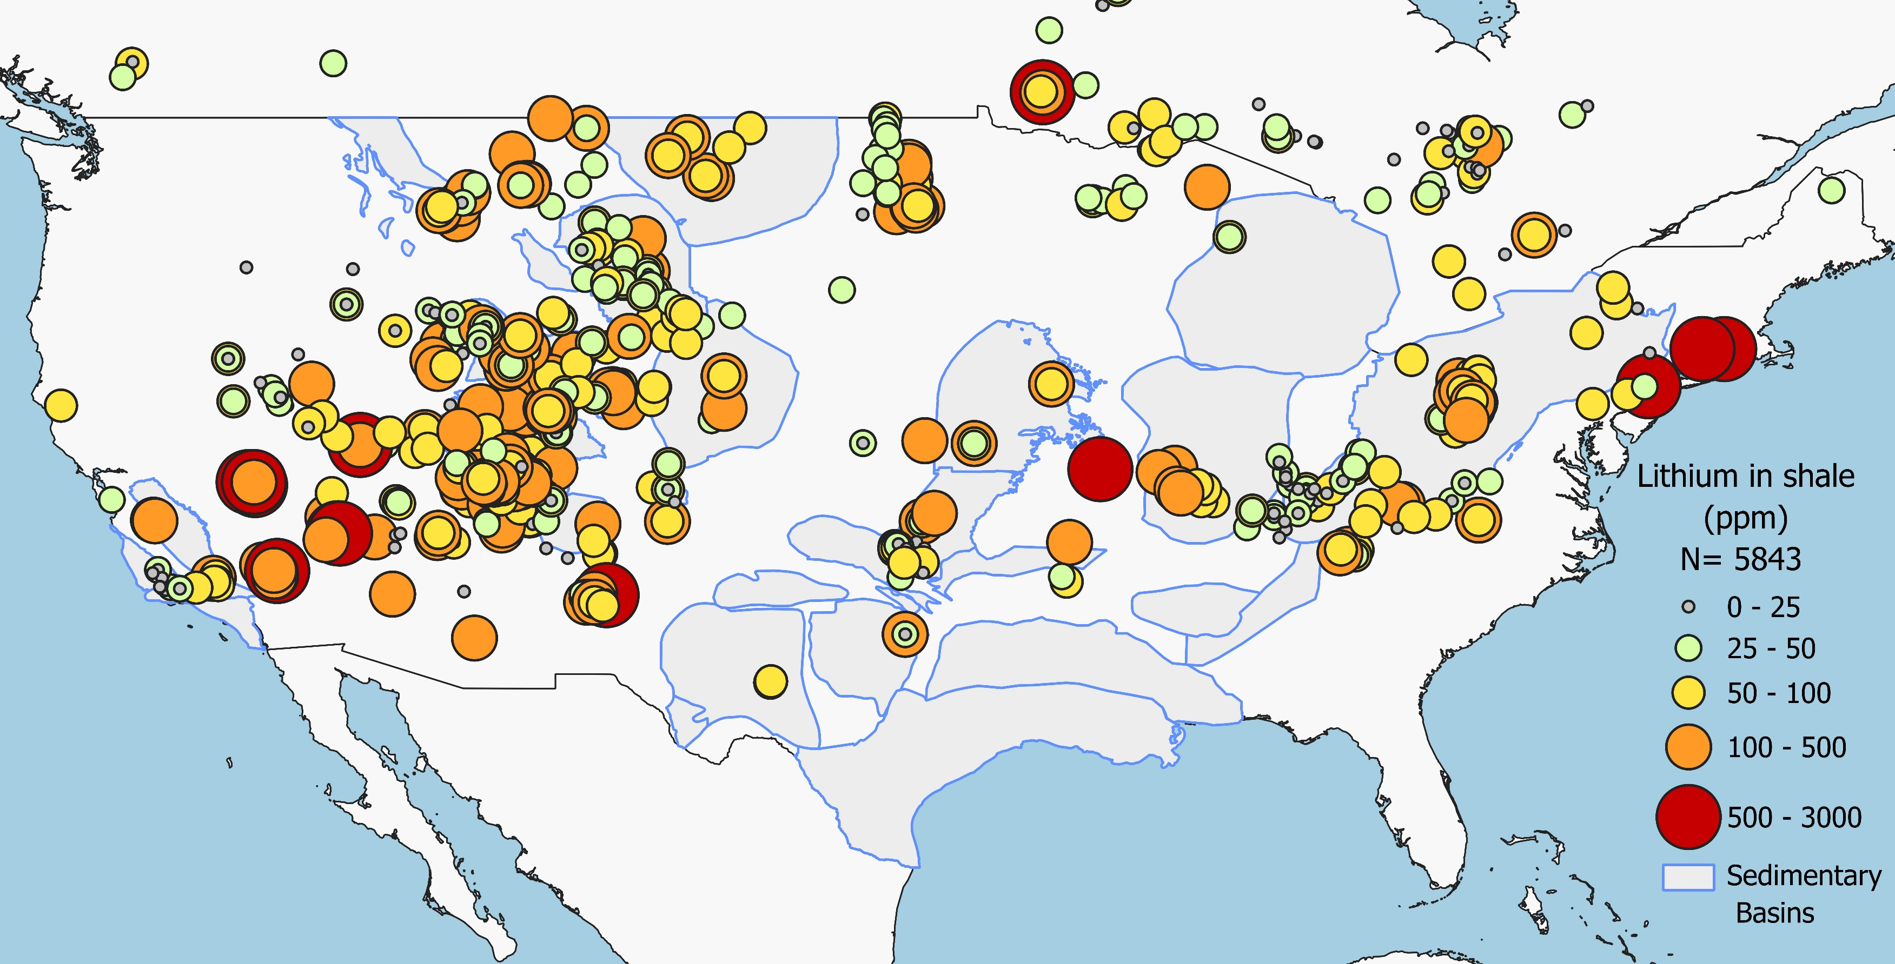
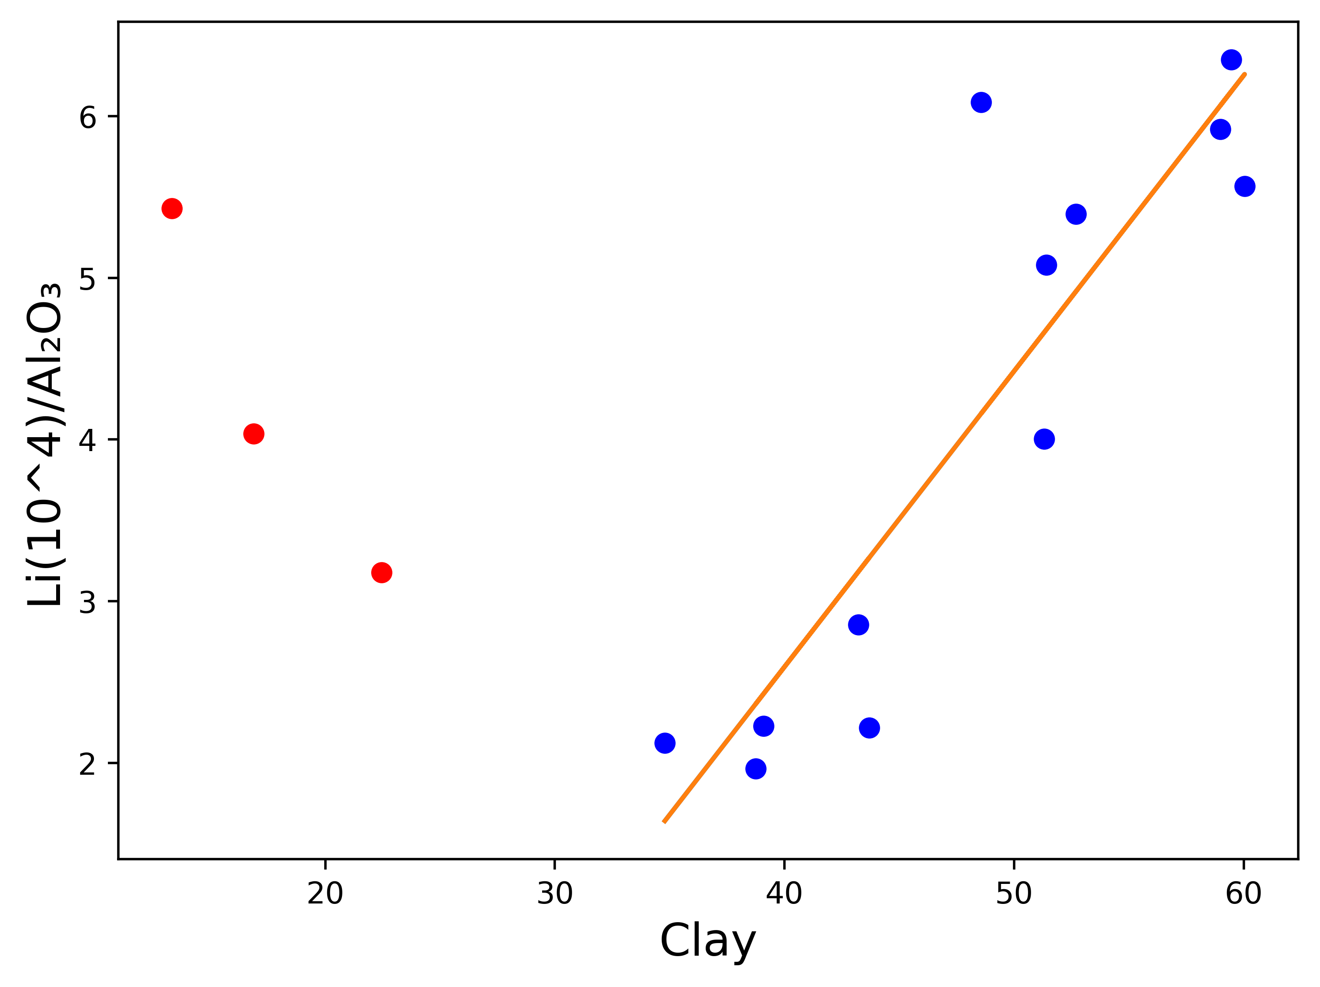
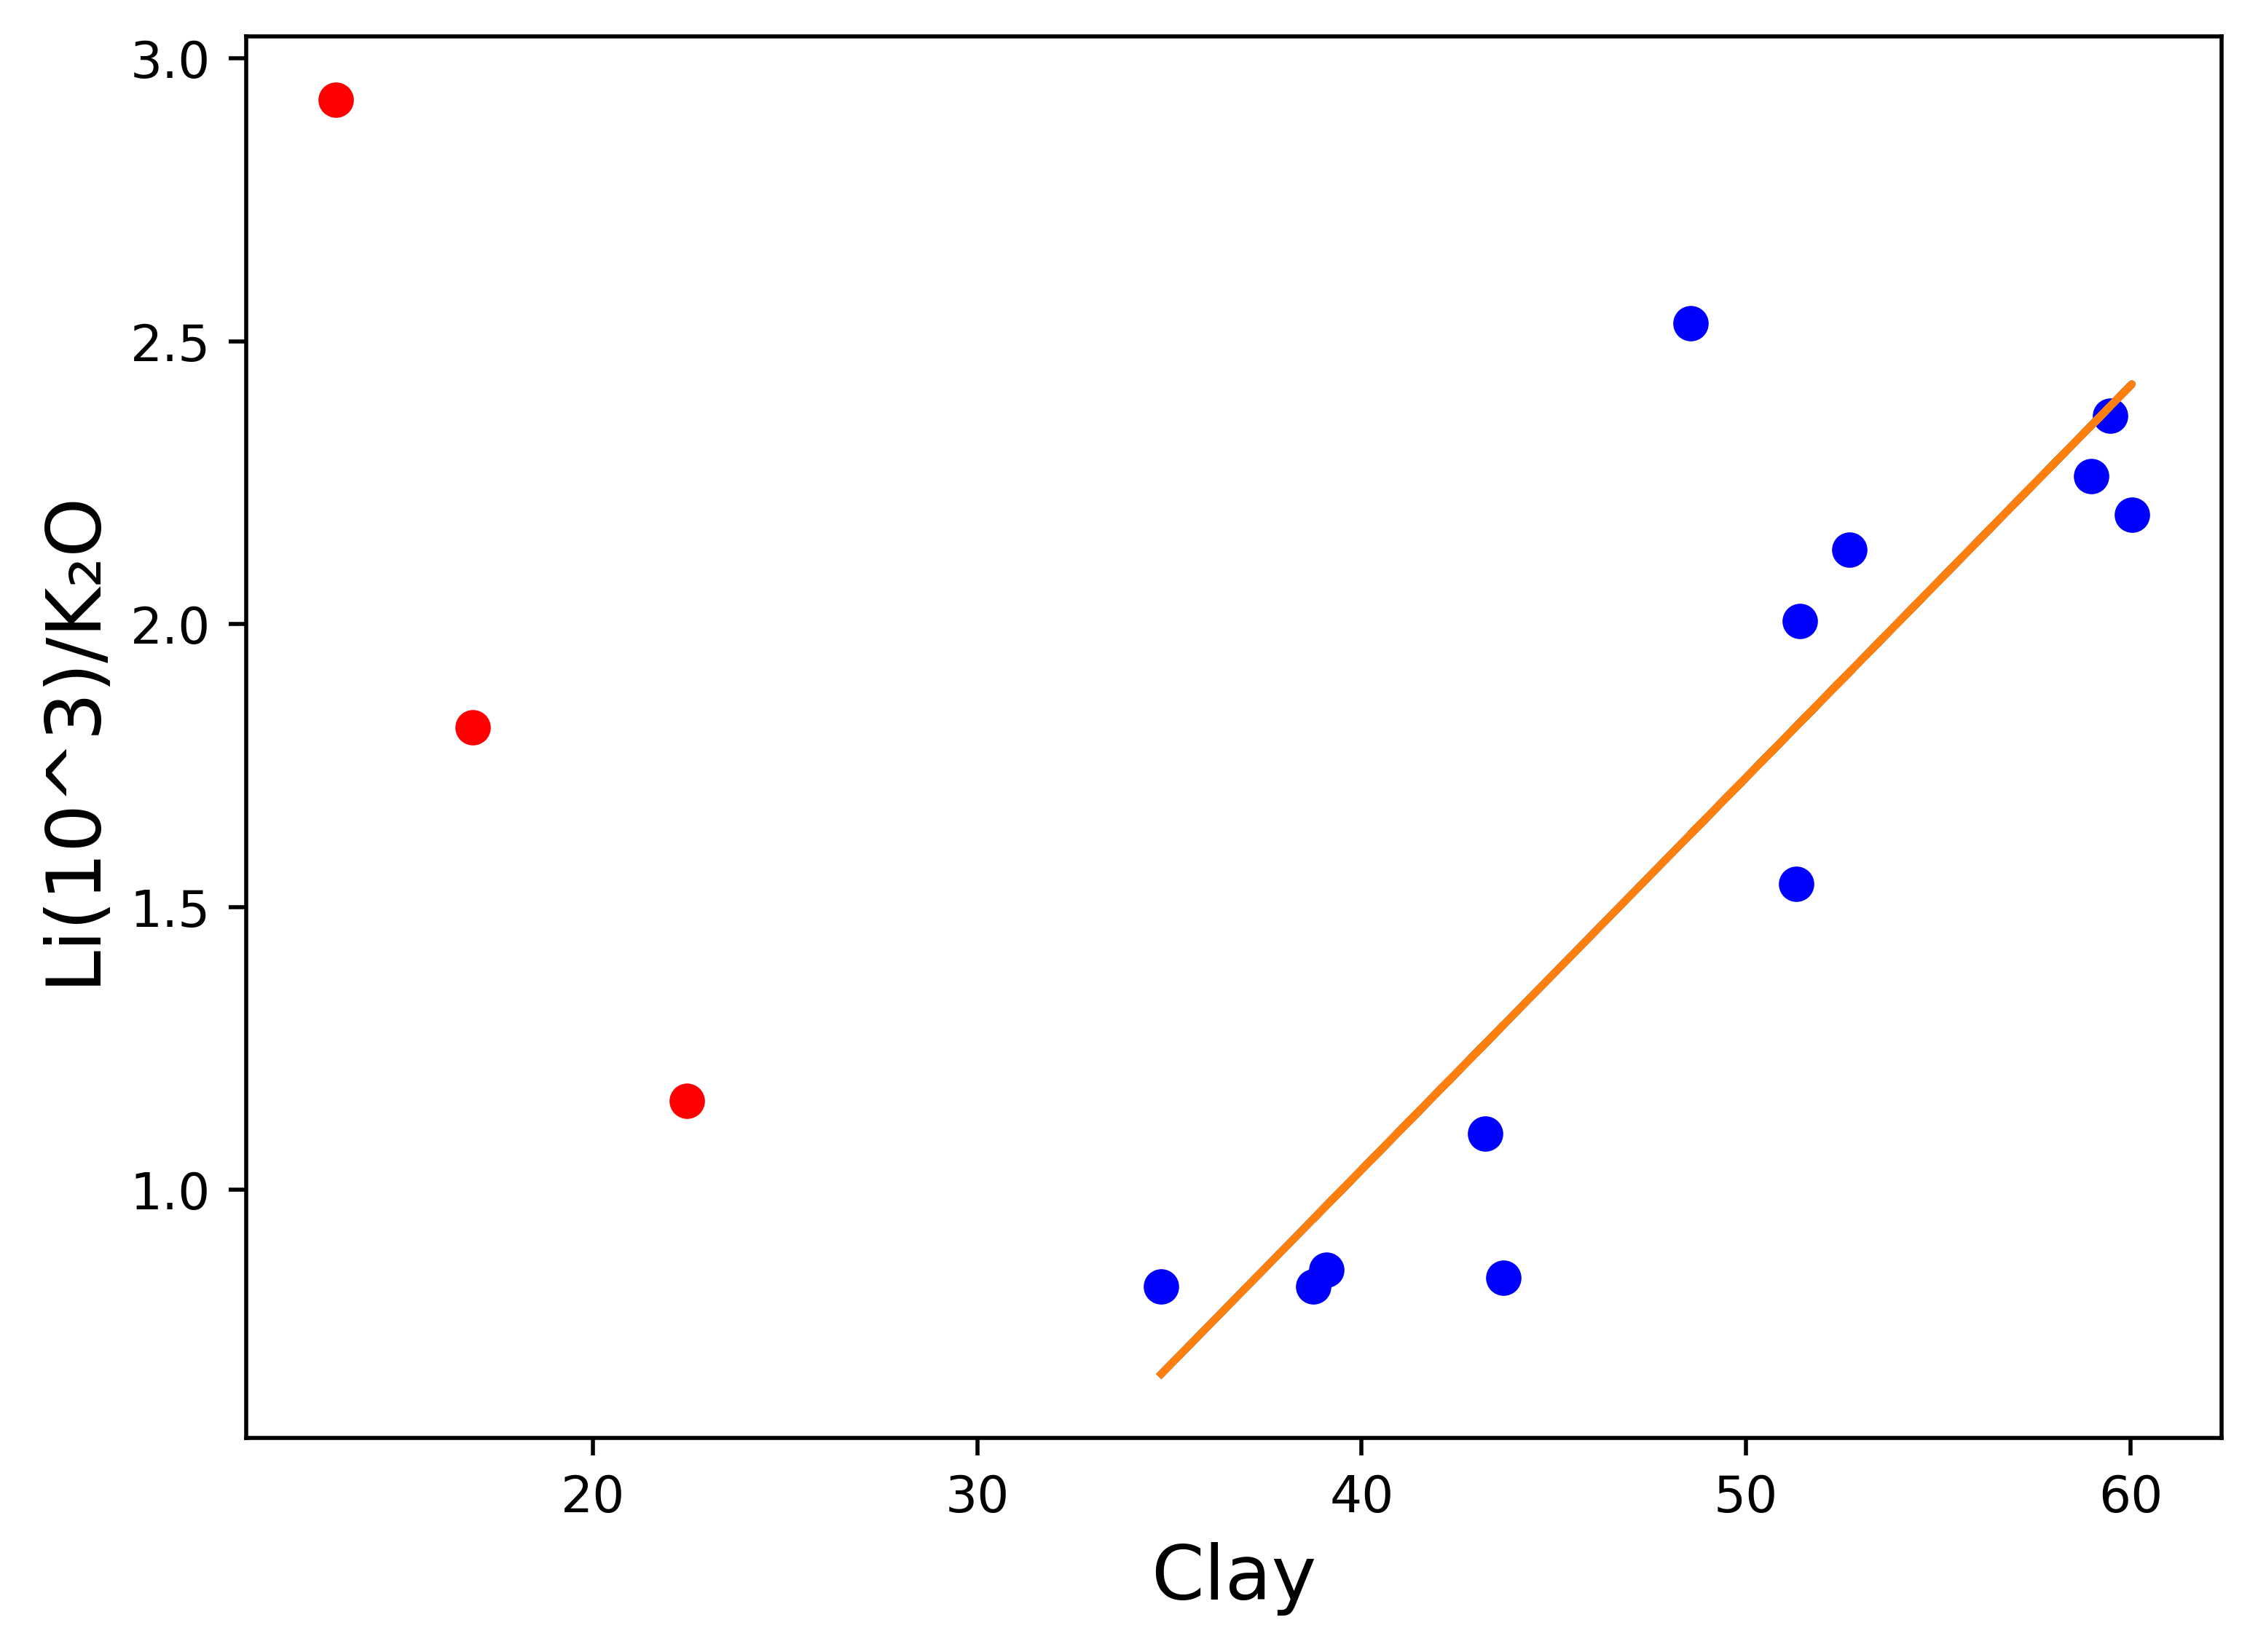
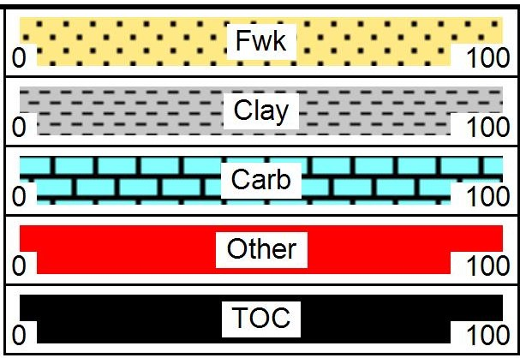
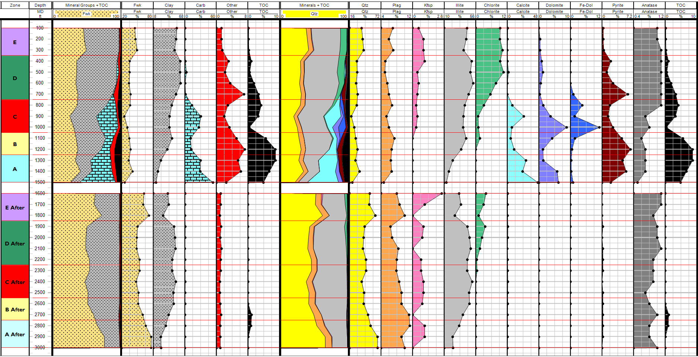
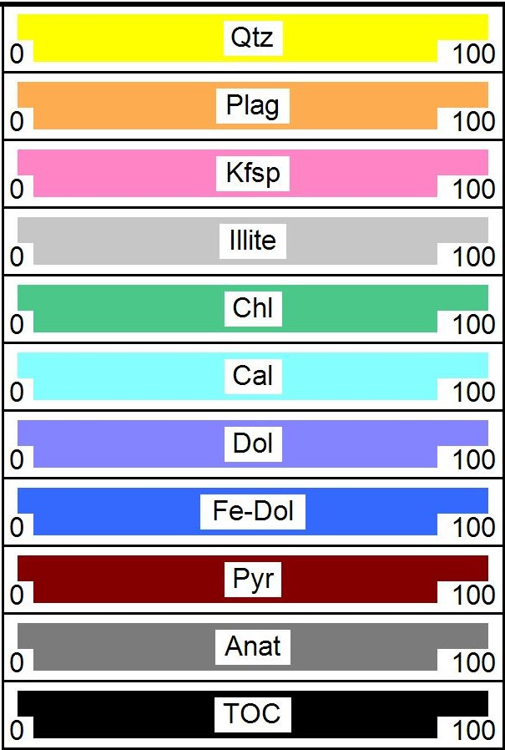
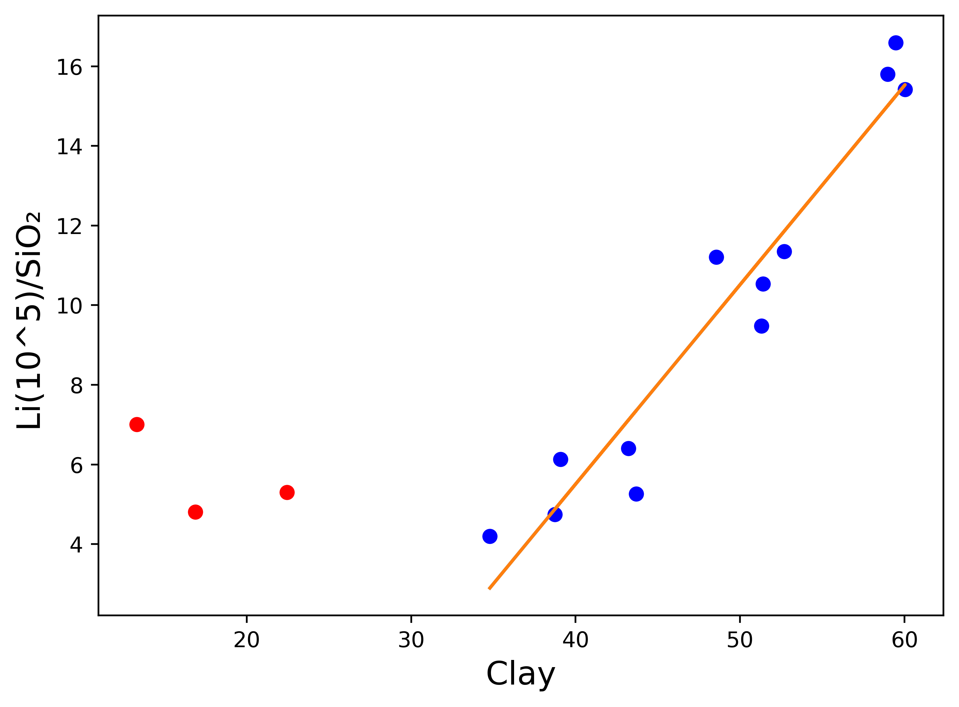
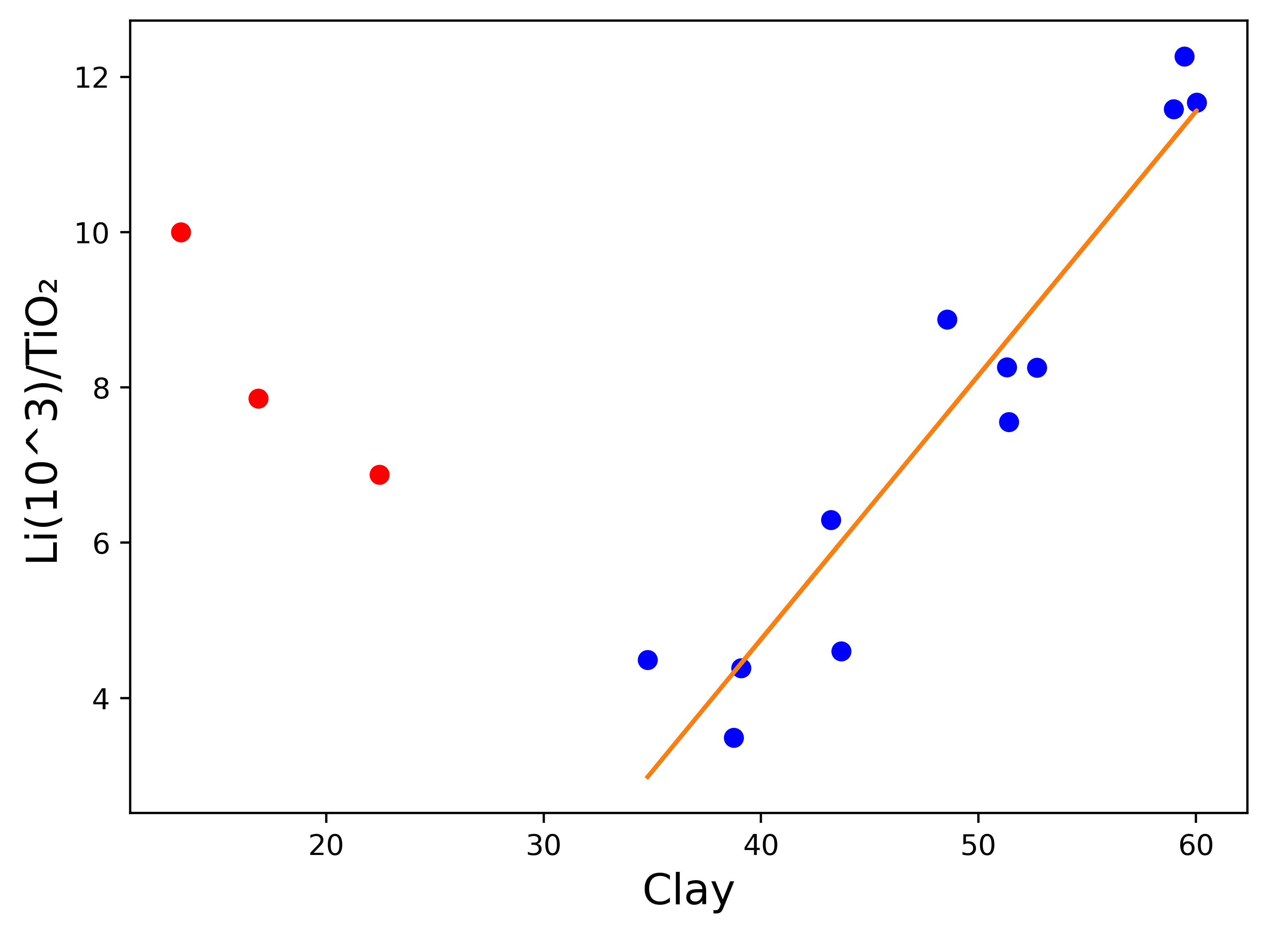
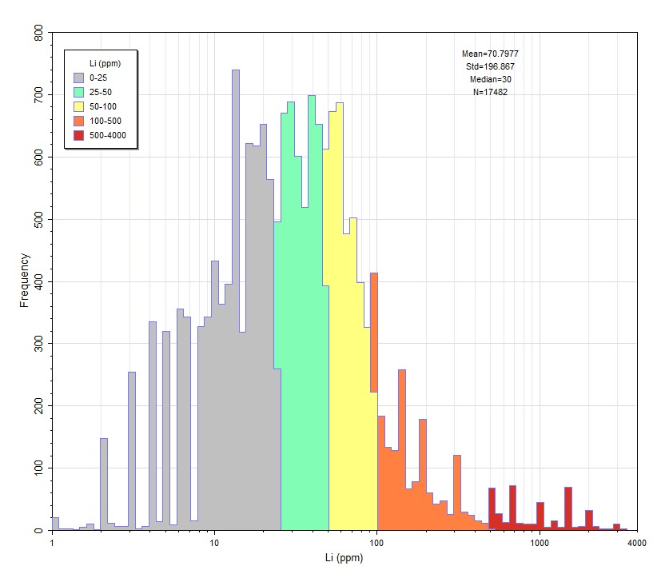
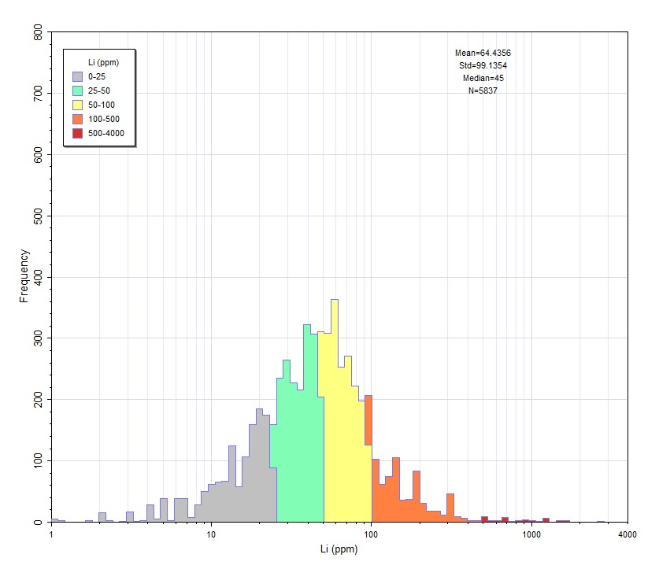
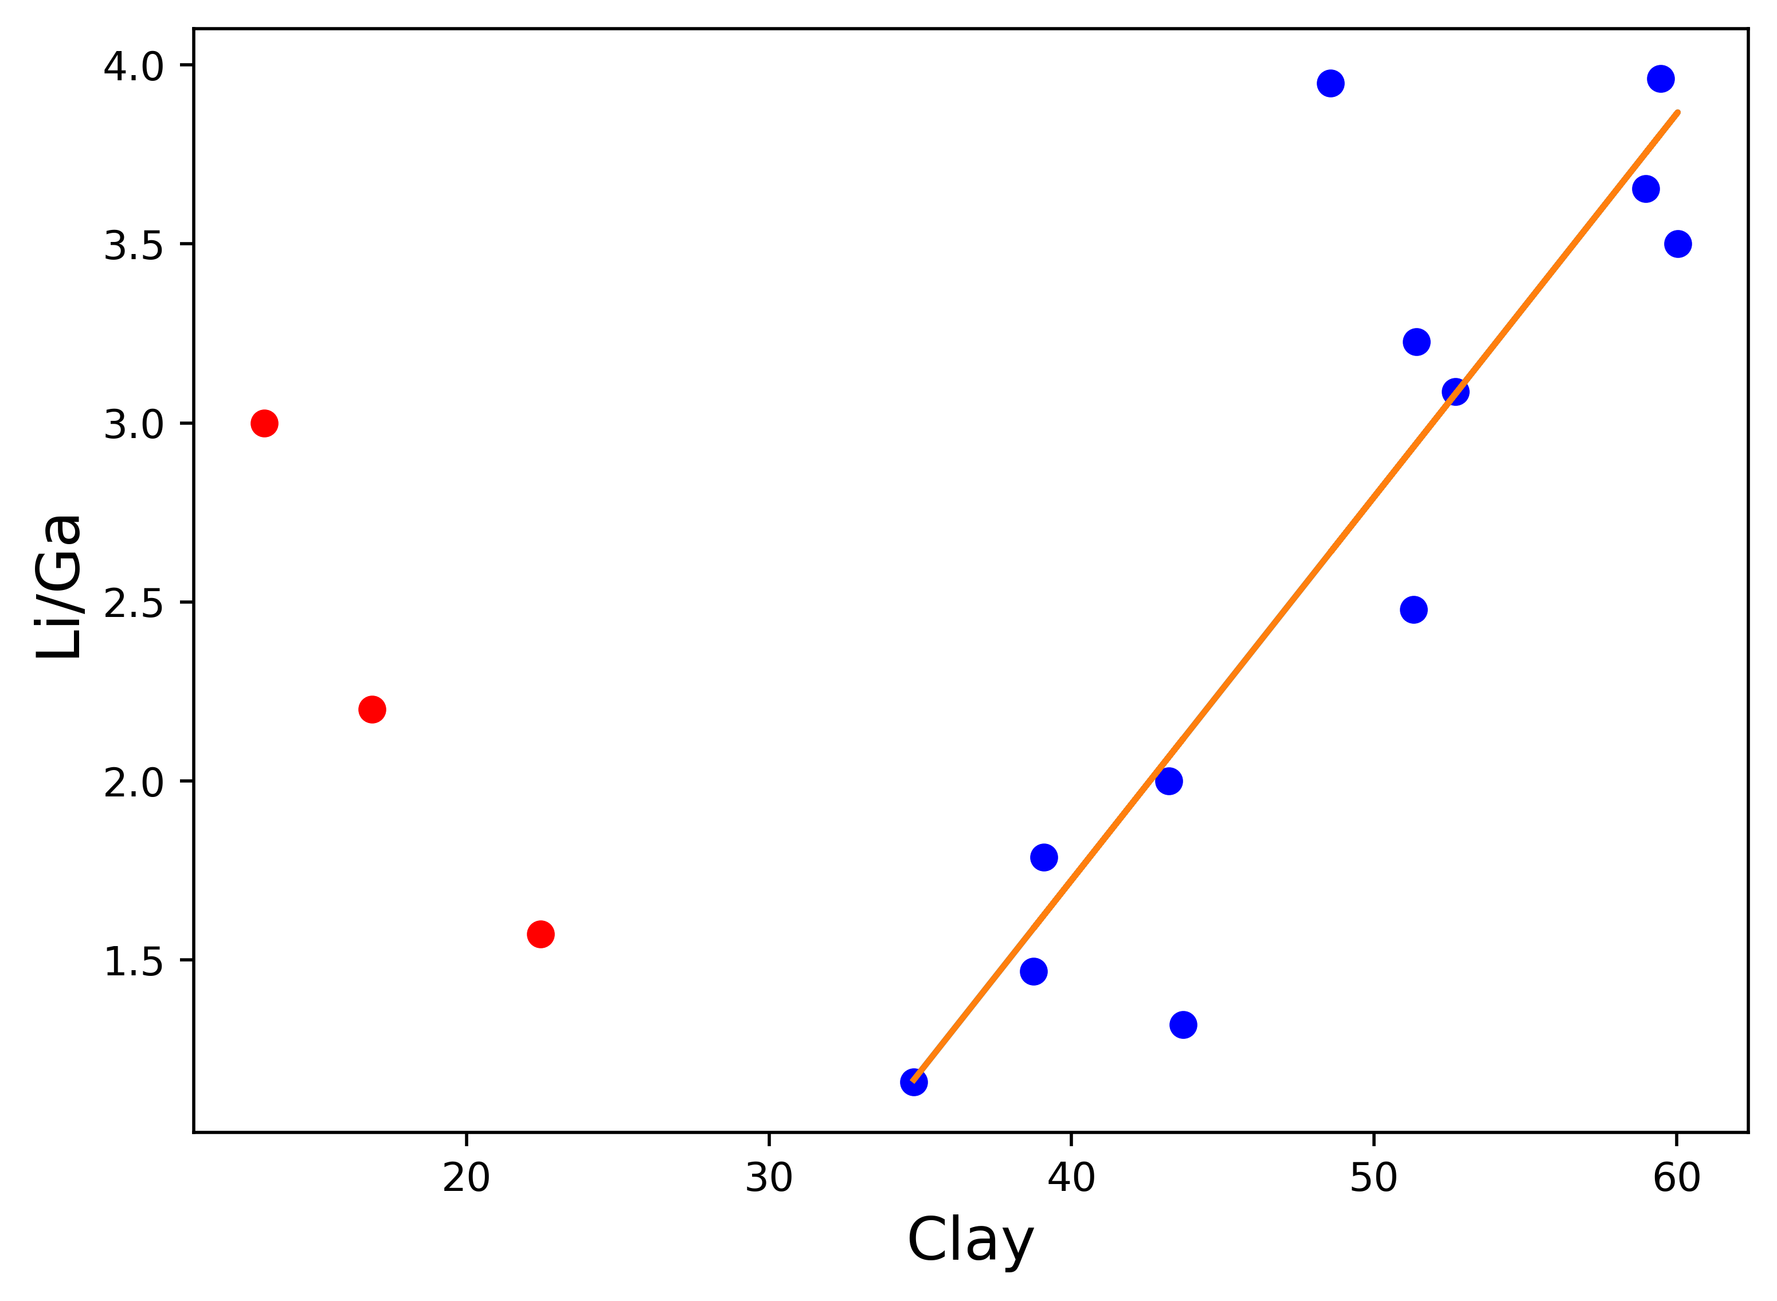
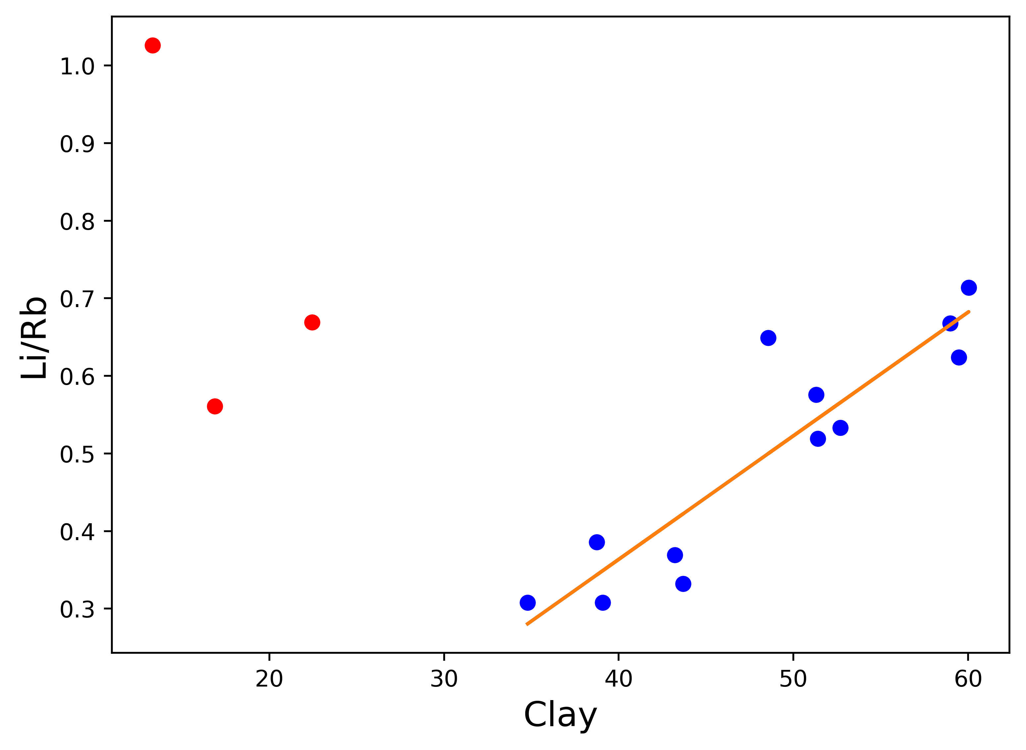
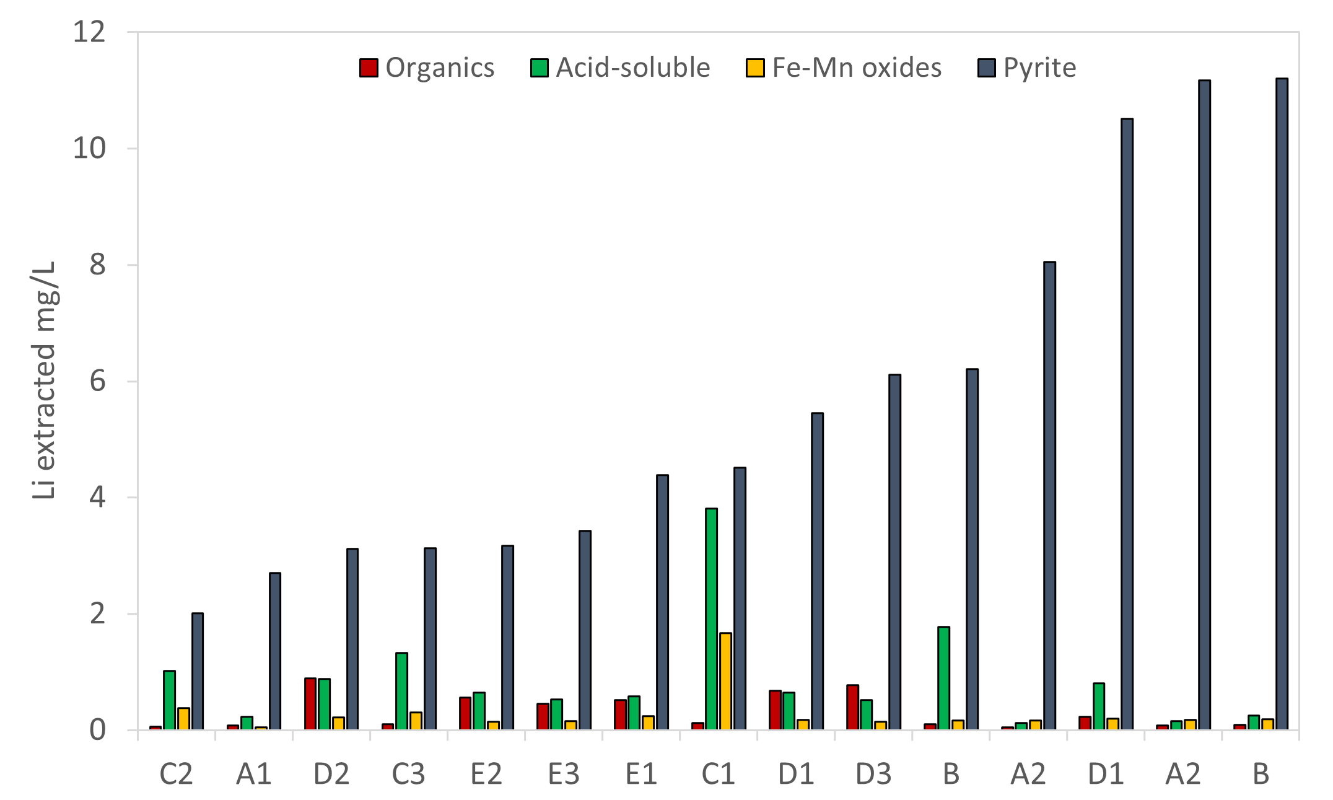
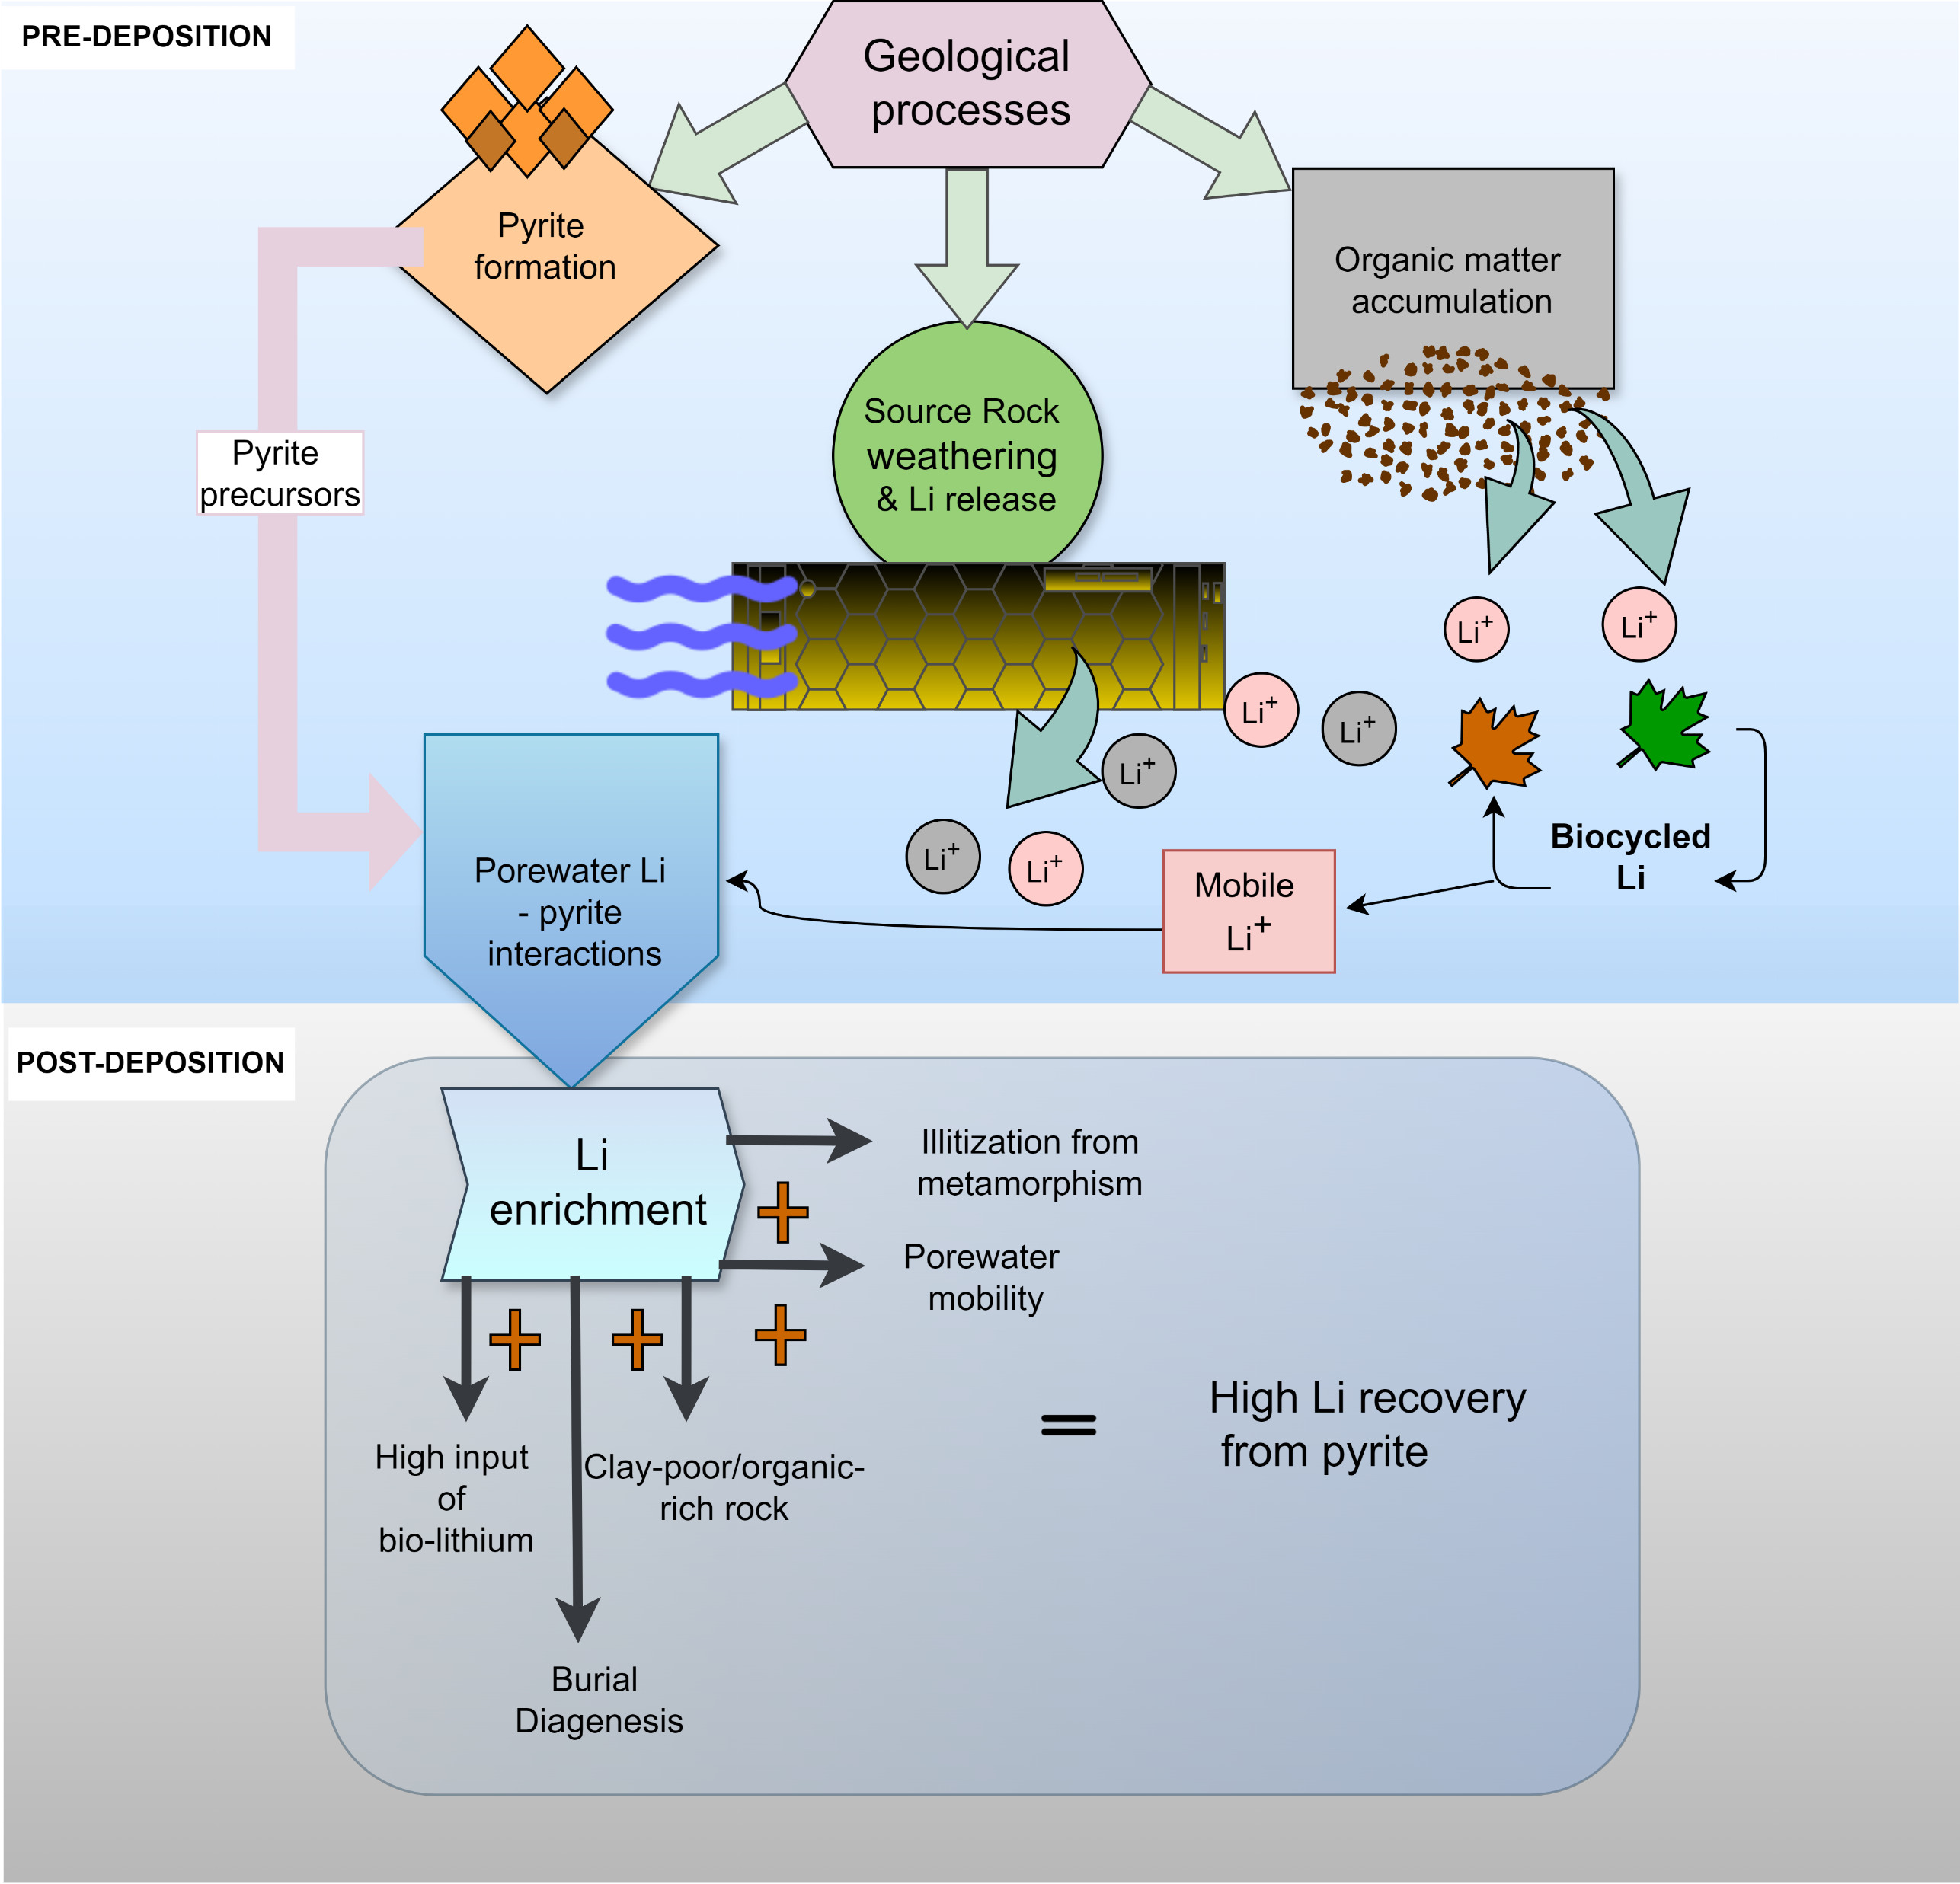
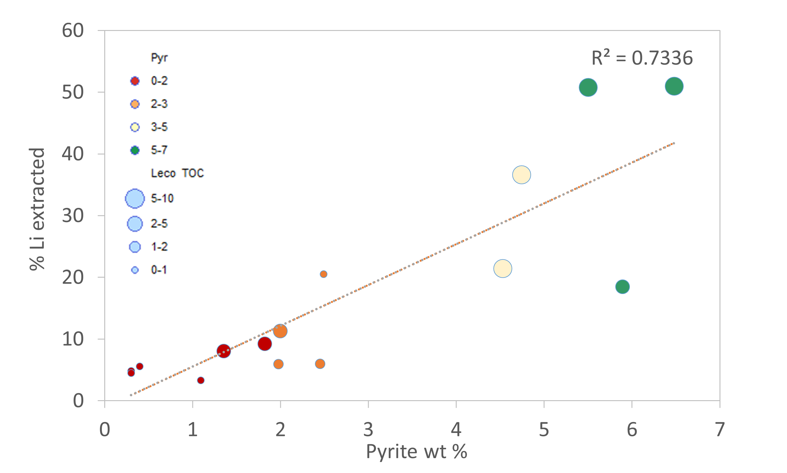
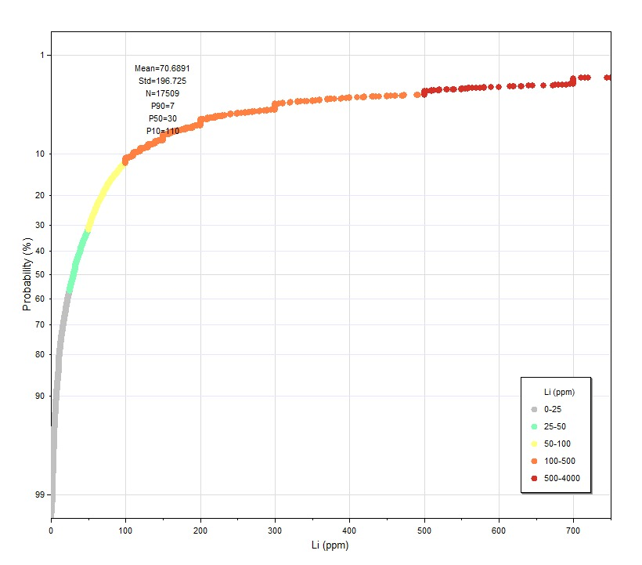
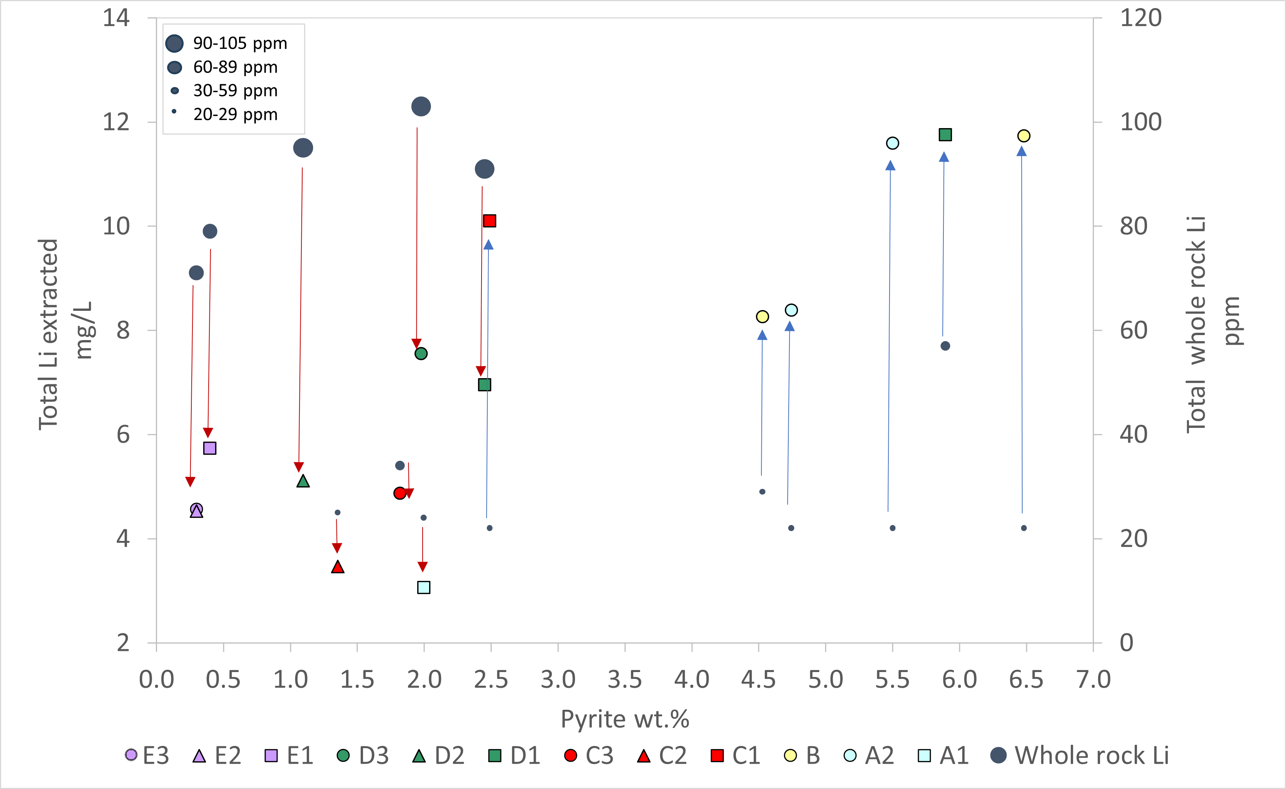
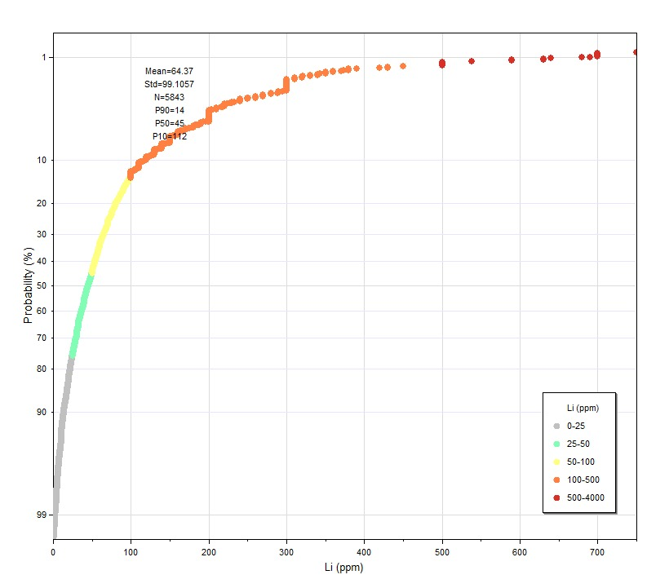
Potential lithium enrichment in pyrites from organic-rich shales
Shailee Bhattacharyaª, Shikha Sharmaª, Michael C. Dix^{b}, Albert S. Wylie, Jr^{c}, Tom Wagner^{d}
a: Department of Geology and Geography, West Virginia University, 330 Brooks Hall, 98 Beechurst Ave, Morgantown, WV 26506 b: Consultant, 3414 Beauchamp Street, Houston, TX 77009
c: P.O. Box 380, Mohawk, MI 49950 d: Coterra Energy Inc., 2000 Park Lane, Suite 300, Pittsburgh, PA, USA 15275
LITHIUM IN SHALE
KEY FINDINGS
In the upper continental crust,
lithium (Li) concentration is approximately 35 ppm¹. Modes of
Li occurrence in pegmatites and
volcanic tuff are well documented.
But in average shale, the concentration is usually low, and
the association is not well understood. Although used as a detrital weathering proxy, Li is often enriched within organic-rich shales with a median value of 45 ppm². This is promising and perhaps bridges the gap between our understanding between the source of Li and oilfield brines.
Bulk lithium-clay association and mineralogical controls
To remove the effect of clay dilution from the high TOC-pyrite-carbonate samples and evaluate the degree of enrichment with respect to clay, Li was normalized to illite, Rb, Ga and oxides of K, Si, Al, Ti
HTC layers show some degree of variation in the carbonate minerals, in the form of calcite, dolomite, and Fe-dolomite. These minerals may have negligible to moderate influence on the Li distribution
Illite-rich/TOC-pyrite-poor samples show strongest
positive correlation with Li
Illite-poor and increasing TOC-pyrite-rich samples show
no correlation with Li
Samples with higher carbonate content usually have lower pyrite content
Three sample classes- i) high clay/low TOC-pyrite-carbonate (HCL), ii) medium clay/high pyrite-TOC/low carbonate (HPT), and iii) medium clay/high TOC/high carbonate (HTC).
Illitization is an important process by which a significant fraction of Li gets mobilized, caused by smectite dewatering, and then incorporated into authigenic minerals
D1, D2, D3, E1, E2, and E3 correspond to the highest Li contents in the bulk rock- samples posing the least effect of carbonate, OM and pyrite dilution
XRD Mineralogy Key
Data source: Farrell et al., 2021, The sedimentary geochemistry and paleo-environments project.
Negligible change in the quartz-plagioclase abundance, suggesting that these framework silicates neither have been affected by the burial diagenesis nor been altered by low-grade metamorphism
Pyrite leachate, dissolved lithium and major drivers for lithium remobilization
Phases- acid-soluble carbonates, Fe-Mn hydroxides, pyrite, and organic matter were leached
Pyrite phases exhibited notably elevated Li concentrations
Dilution effect and syngenetic pyritization influenced by organic matter, calcite, and clays, influence lithium geochemistry within non-silicate phases
The presence of lithium in sulfidic porewaters, potentially enriched through bio-cycling processes, contributes further Li enrichment at higher P/T
Pyrite-induced Li adsorption stems from its association with organic matter and interactions with benthic organisms
Variability of weathering and lithium sources influences Li abundance and bioavailability.
Mechanistic Model for lithium Enrichment in Sedimentary Pyrite
Pyrite formation
$$Fe^{2+}+ HS^{−}=^{ ′}FeS^{′}(greigite)+H^{+}$$
$$Fe_{3}S_{4}+2H_{2}S⟺3FeS_{2}+4H^{+}+4e^{−}$$
$$4H^{+}+4e^{−}+2S^{0 }⟺ 2H_{2}S$$
$Fe_{3}S_{4}+ 2S^{0 }⟺ 3FeS_{2}$
In this context, we have shown a range of Li concentrations (N= 5843) within the major hydrocarbon-producing basins. We can assume as a first-order approximation that organic-rich shales could be a source of Li. The second order of approximation is critical and challenging as we yet don’t fully understand the host phase of Li, whether it is within the clays, carbonates, organic matter, or pyrites. Here, in this study, we present a suite of samples from the Appalachian basin to showcase the potential of Li recovery from pyrites and a potential source of Li in our brines from the organic-rich source rocks.
Rock-fluid interaction
$$Fe^{0}+2Li_{2}S−2e^{− }→Li_{2}FeS_{2}+2Li^{+ }$$
$$Li_{2}FeS_{2}−xe^{−}→Li_{2−x}FeS_{2}+xLi^{+}\left(0<x<0.8\right)$$
$$Li_{2−x}FeS_{2}−\left(2−x\right)e^{−} →FeS_{y}+\left(2−y\right)S+\left(2−x\right)Li^{+}$$
Low-grade metamorphic reactions
$$FeS_{2}+2Li^{+}+2e^{−} → Li_{2}FeS_{2}\left(FeS+Li_{2}S\right)$$
$$Li_{2}FeS_{2}\left(FeS+Li_{2}S\right)+2Li^{+}+2e^{−} →Fe+2Li_{2}S$$
$$Fe^{0}+2Li_{2}S−2e^{− }→Li_{2}FeS_{2}+2Li^{+ }$$
$$Li_{2}FeS_{2}−xe^{−}→Li_{2−x}FeS_{2}+xLi^{+}\left(0<x<0.8\right)$$
$$Li_{2−x}FeS_{2}−\left(2−x\right)e^{−} →FeS_{y}+\left(2−y\right)S+\left(2−x\right)Li^{+}$$
Shale cuttings and core
n=15
Sequential leaching
Post-leaching residue XRD-Clay; Leco TOC
Pre-leaching
XRD; Leco-TOC, S; ICP-OES/MS
Pyrite formation, occurring under fluctuating anoxic conditions, involves sulfate reduction mediated by bacteria, which accelerates sulfide generation
Lithium enrichment in pyrite may occur due to its adsorption facilitated by organic matter and benthic organisms.
Lithiation of pyrite occurs in conjunction with organic matter and explains the high leachability of lithium in this association. Geological processes, including pyrite formation and sulfate reduction, may play crucial roles in lithium geochemistry.
Isotopic studies indicate the variability of lithium sources and processes, contributing to its complex behavior in sedimentary rocks
METHODOLOGY
Geological, geochemical, and biological processes shape Li distribution and enrichment in sedimentary rocks, with a focus on the role of pyrite and organic matter. Key factors governing enrichment are:
Availability of bio-cycled Li
Syngenetic pyrite-porewater interaction: Interaction between pyrite and porewater, resulting in lithium sulfide formation
Carbonate and clastic dilution: Change in source rock weathering influences Li recovery.
Pyrite-organic matter association: Amount of organic matter and degree of preservation
Burial diagenesis: Mineral-fluid interactions induced by pressure and temperature
Illitization and porewater mobility: Temperature and burial diagenesis enhance Li enrichment
Future directions: High-resolution analyses (e.g., SHRIMP-RG) are recommended to further elucidate the relationship between intermediate sulfide phases, lithium, and pyrite in black shales.
[1] Teng, F-Z., W. F. McDonough, R. L. Rudnick, C. Dalpé, P. B. Tomascak, B. W. Chappell, and S. Gao. "Lithium isotopic composition and concentration of the upper continental crust." Geochimica et Cosmochimica Acta 68, no. 20 (2004): 4167-4178.
[2] Farrell,Ú. C., Samawi,R., Anjanappa,S., Klykov,R., Adeboye,O. O., Agic,H., et al. (2021).The sedimentary geochemistryand paleo-environmentsproject.Geobiology,19(6), 545–556.
EGU24-369

