Slide 1
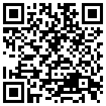
Determining the relative potential of future igneous activity in Germany – A multi-criteria approach
Lisa Rummel, Alexander Bartels, Franz May, Maximilian O. Kottwitz, Tobias S. Baumann

Slide 2
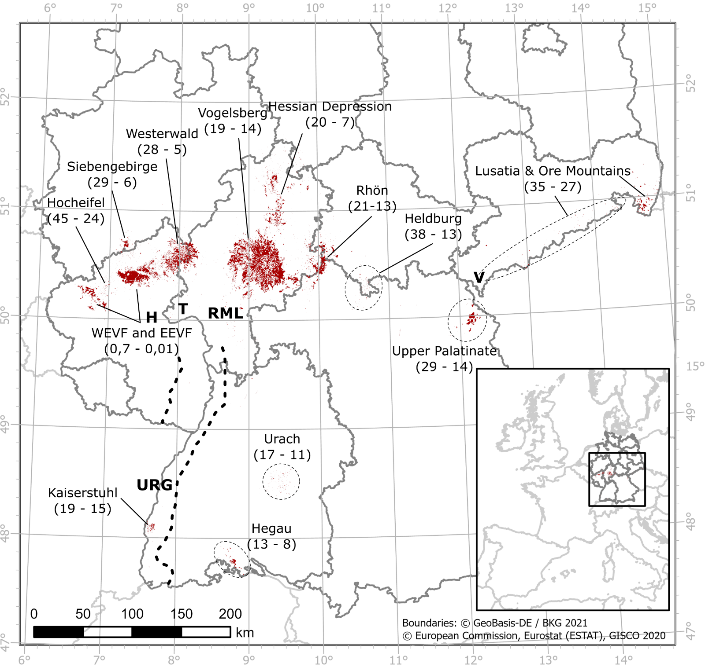
Motivation
Volcanic fields and their ages (in Ma)
Widespread and long-lasting volcanism in Germany
Cause of volcanic activity is controversially discussed
Expected volcanic activity within the next 1 Ma must be excluded from site selection process of a high-level radioactive waste repository
How can we determine the relative potential of future igneous activity?

Slide 3
Method
Applying a multi-criteria approach, considering a variety of geoscientific indicators and related parameters, which may promote magmatism and/or show its long-term evolution
21 (+2) parameters quantitatively describe 15 (+2) indicators
All parameter values are normalized to a standardized scale within their range of significance and summed up to a semi-quantitative index
Germany-wide index maps are used to differentiate regions regarding the relative potential for future igneous activity

Slide 4
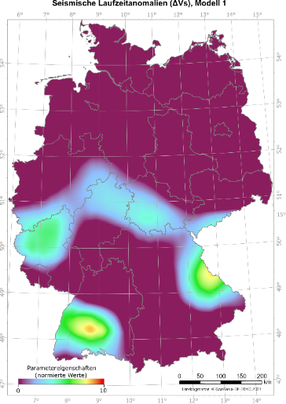
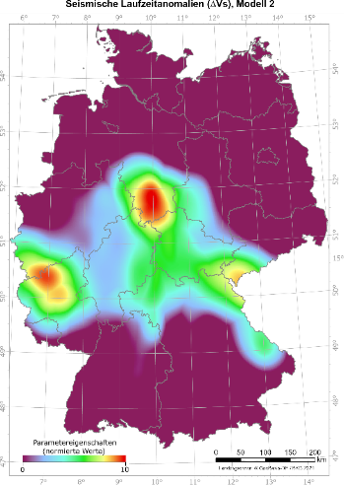
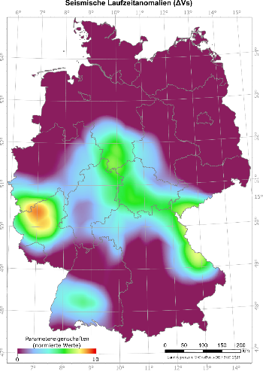
Quantification of indicators and related parameters
Indicator: Seismic anomalies in the earth‘s mantle
Mineralogy
Temperature
Water content
Melt content
Defining a quantifiable property
Parameter: ΔVs
(ΔVs_{min}, 60 - 90 km depth)
Data processing
Determination of relevant values by defined threshold values
Standardization of values
Combination of datasets
Collaborative Seismic Earth Model (CSEM)

Slide 5
Combination of parameters to an index map
Define process categories for parameters:
1) melt formation
2) melt pathways
3) past eruption sites
Summation of all scaled and within process categories weighted parameters to an index value
Distribution of index values is used to determine the relative potential of future igneous activity
movy
index

Slide 6
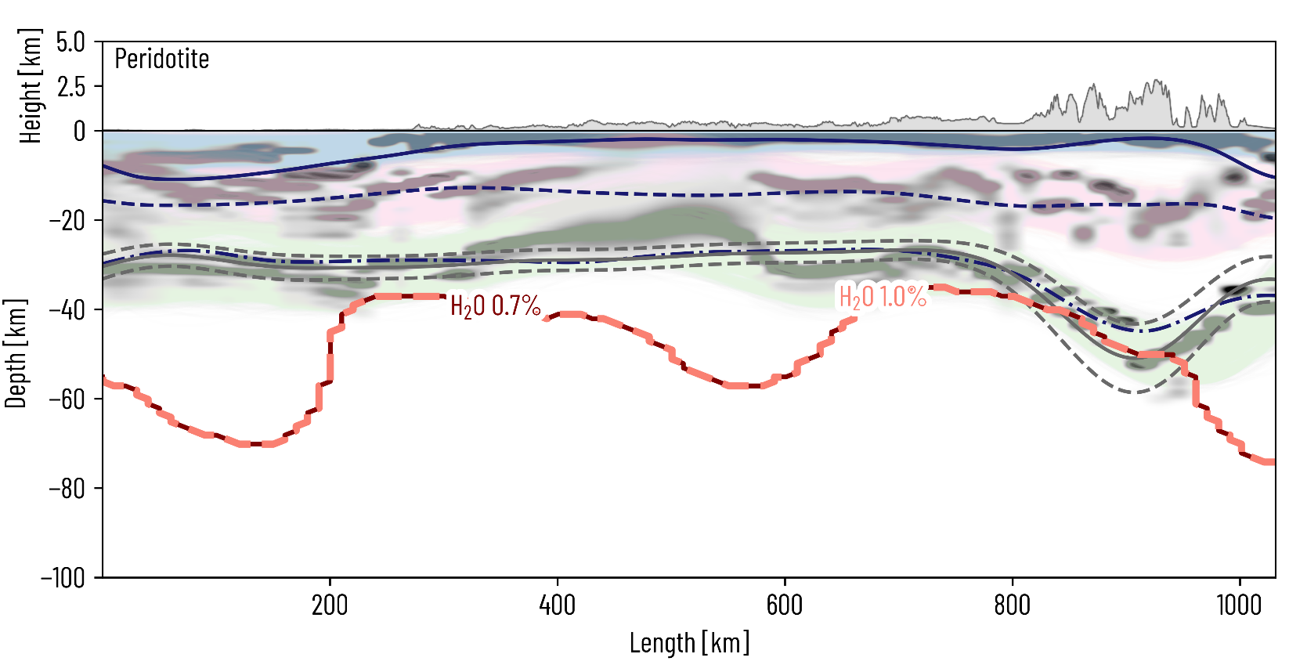
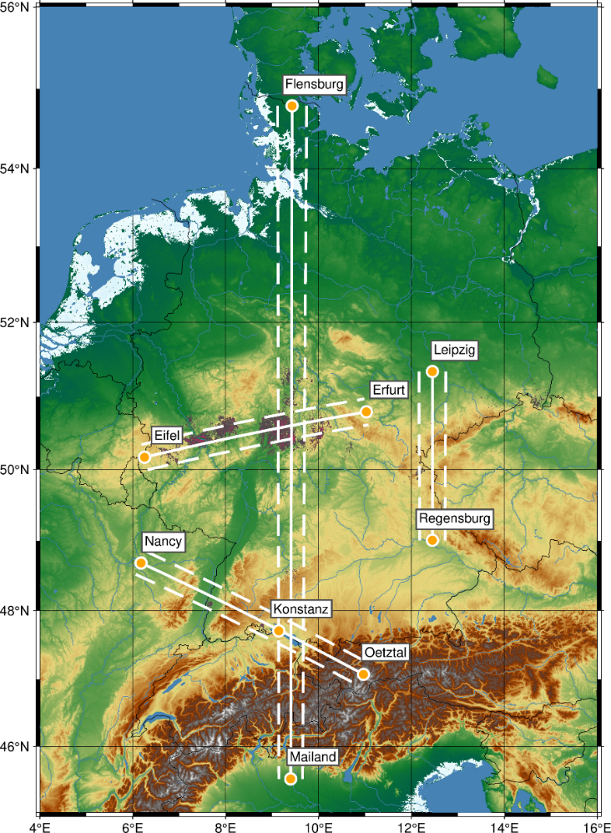
Using geodynamic simulations & uncertainty analyses
For each profile 3,000 possible thermo-lithostatic models are computed, based on different structural constraints, temperature simulations and uncertainty analyses
Minimal depth of critical melt fractions is determined for different rock compositions and water contents
Milan
Flensburg
critical melt fraction

Slide 7
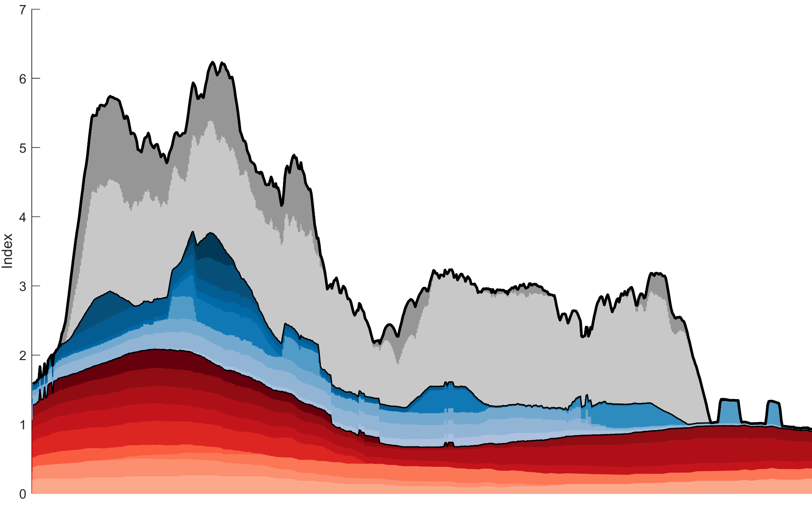
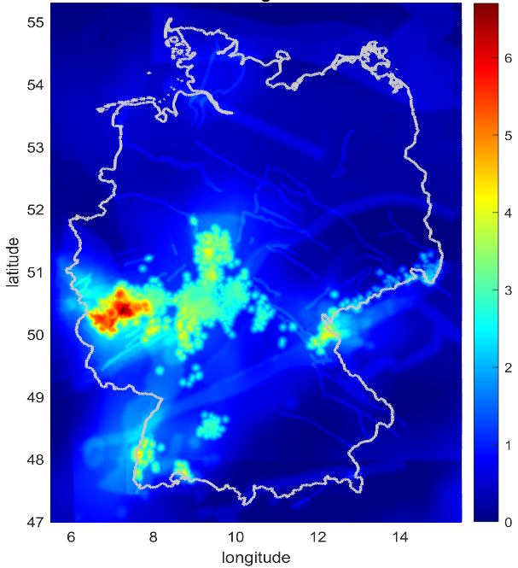
Index distribution along profiles
Eifel
Erfurt
Parameters within process categories:
1) melt formation
2) melt pathways
3) past eruption sites
past eruption sites
melt pathways
melt fraction
(simulation)
index
melt formation

Slide 8
Summary
Germany-wide collection of data that may provide information about future igneous activity
22 parameters were quantified and evaluated using threshold values
A calculated index is used to quantify the relative potential of future igneous activity in Germany
Numerical simulations show possible melt fractions at shallow depths
Results show an elevated risk of future volcanic activity in regions beside the Quaternary volcanic fields

Slide 9
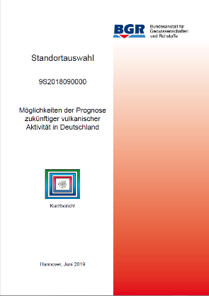
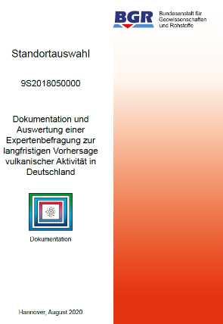
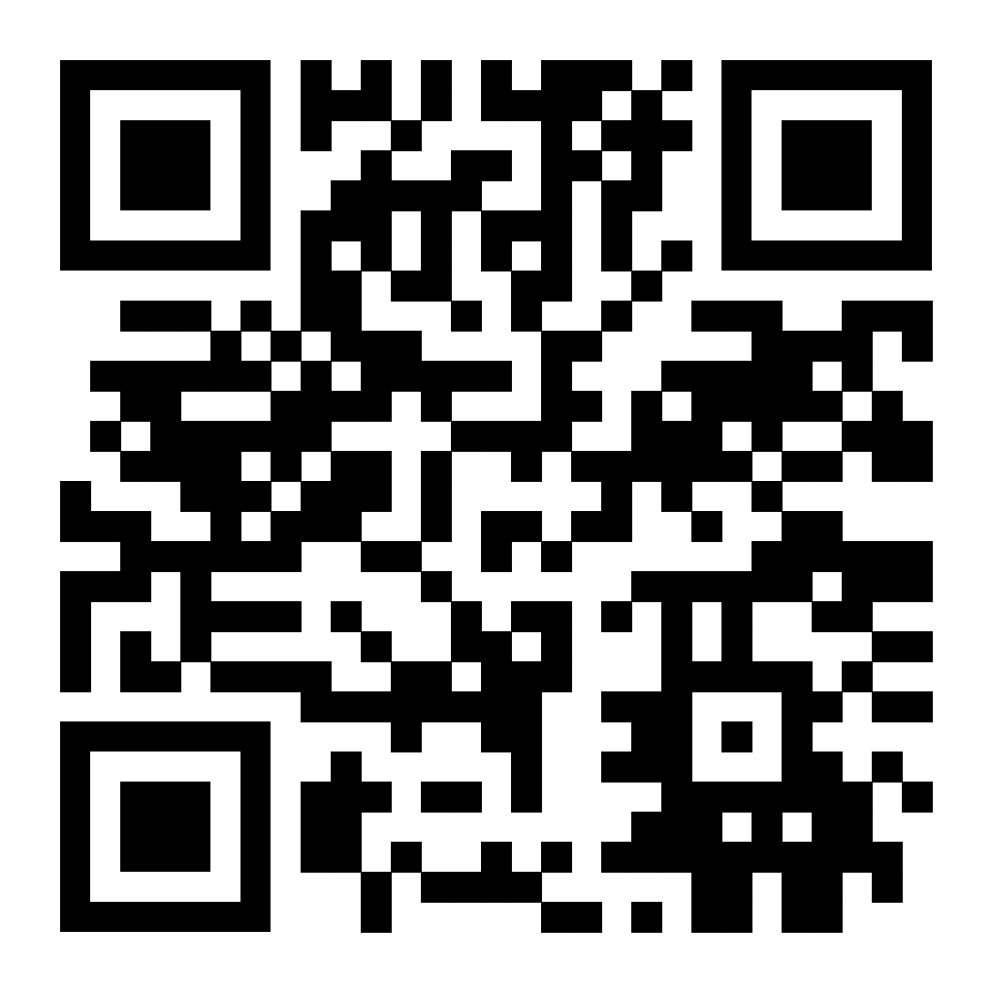
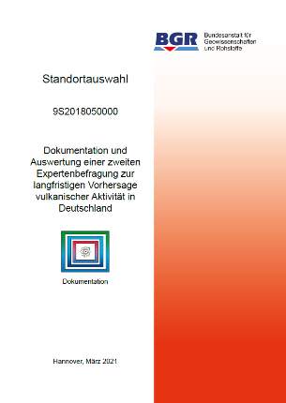
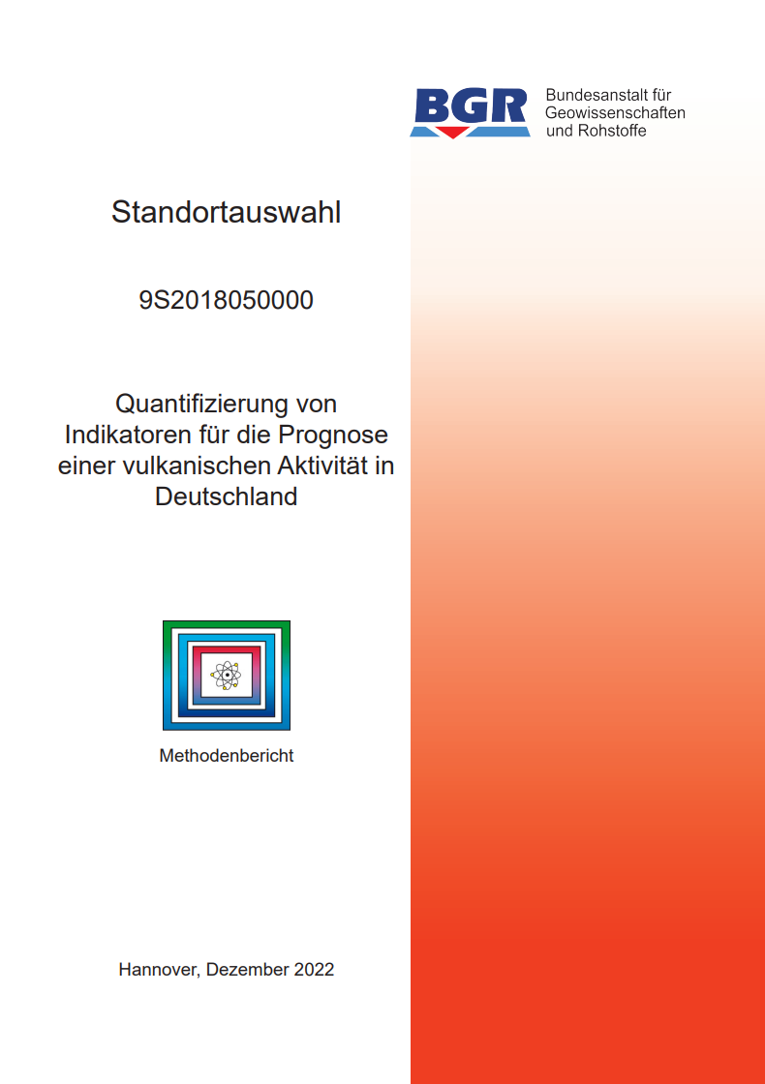
For more information…
May, 2019
Bartels et al., 2020
Rummel et al., 2021
Rummel et al., 2021
Bartels et al., 2022
Rummel et al., 2023
Thank you for your attention!
https://www.bgr.bund.de/EN/Themen/Endlagerung/Projekte/Standortauswahl/laufend/magmatismus_en.html?nn=1548518

