Slide 1
Energy, Resources and the Environment (ERE1.1) - Open session
PICO | Wed, 17 Apr, 10:45–12:30 (CEST)
The Importance of Silicon Metal on the Green Transition and the Role of Northern Countries in the Silicon Metal Market
by Ozge Akyıldız – PhD Candidate

Slide 2
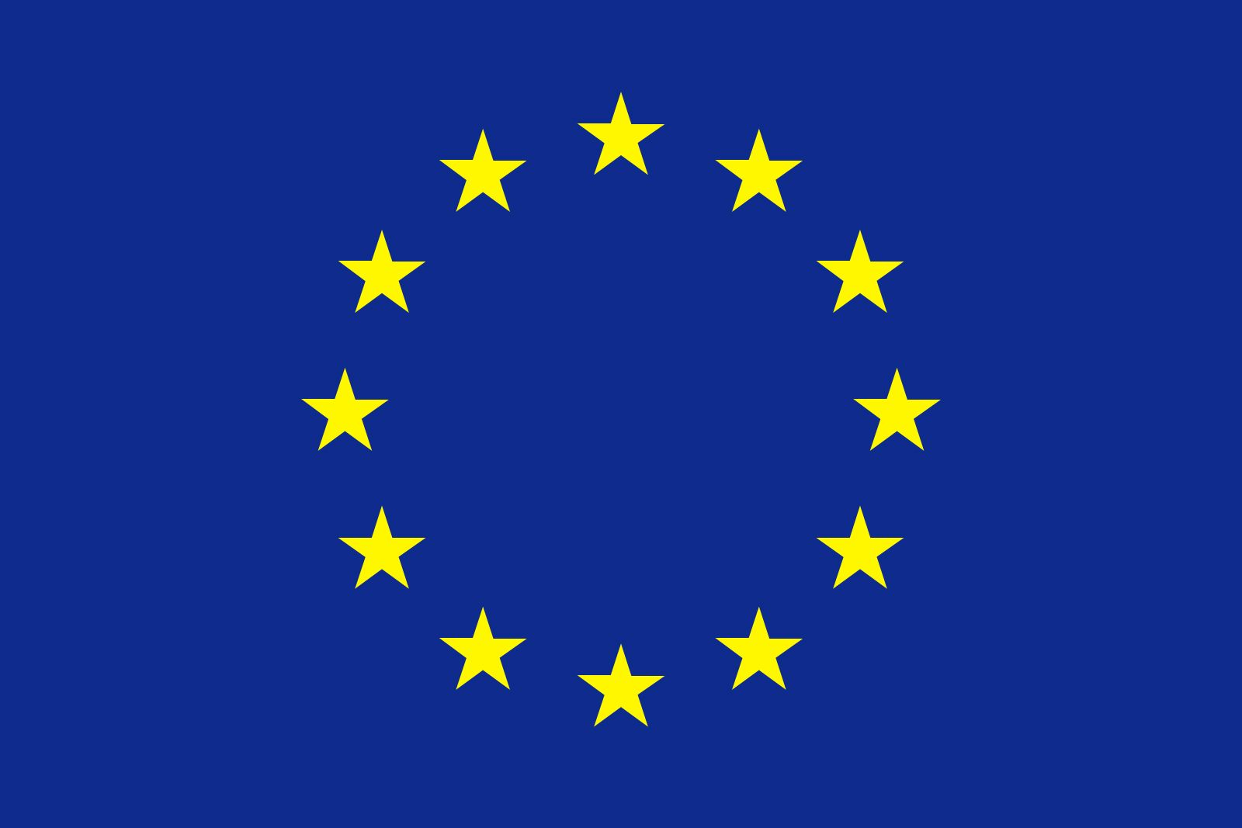
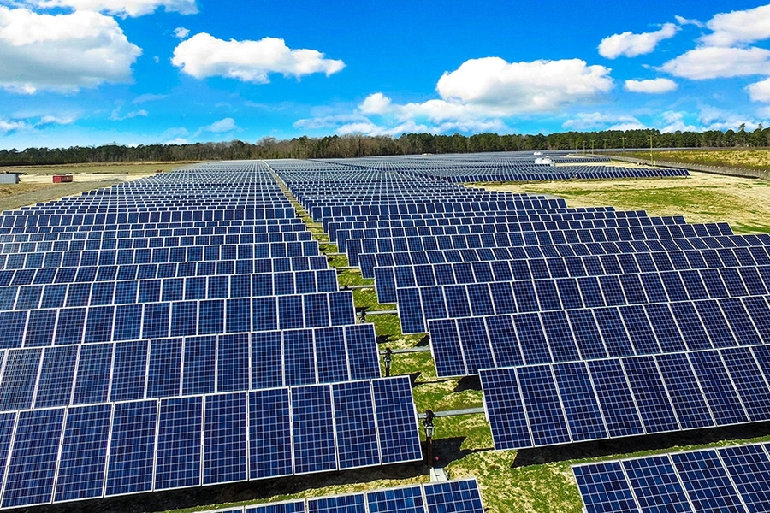
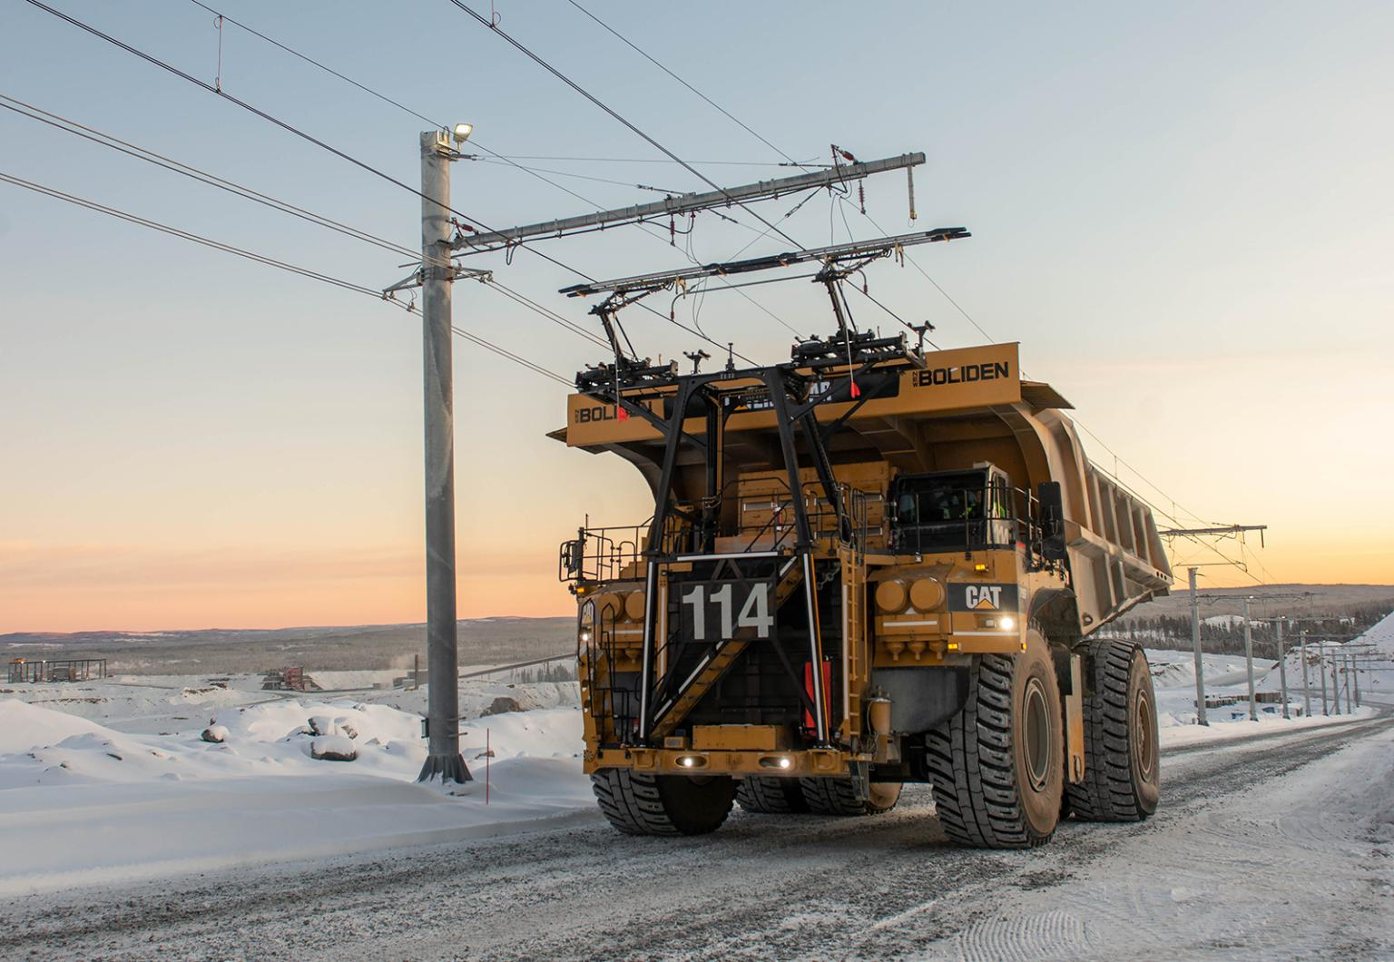
GREEN TRANSITION IN THE EU
RENEWABLE ENERGY NEED
INDUSTRIAL MINERALS NEED
SUPPLY CHAIN DISTRUPTION RISK
RESPONSIBLE MINING
Figure 2. Silicon Metal
https://news.mit.edu/2020/researchers-find-solar-photovoltaics-benefits-outweigh-costs-0623
https://im-mining.com/2019/10/24/boliden-backs-trolley-assist-haulage-aitik-kevitsa/
Figure 1. Solar Panels
Figure 3. Mine truck

Slide 3
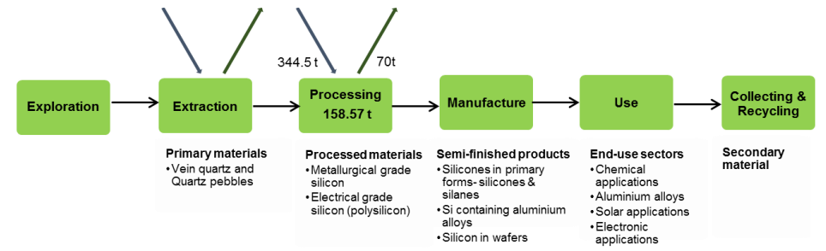
SILICON METAL AND ITS IS CRITICALITY?
Figure 4. Simplified value chain for silicon metal, averaged over 2012-2016 (European Commission, 2020)
Table 1. Comparison of 2023 results and previous assessments
 | 2011 |  | 2014 |  | 2017 |  | 2020 |  | 2023
Material | SR* | EI | SR* | EI | SR | EI | SR | EI | SR | EI
Silicon metal | - | - | 1.6 | 7.1 | 1 | 3.8 | 1.2 | 4.2 | 1.3 | 4.9
* In 2011 and 2014 assessments, the SR calculation was based on Global supply only

Slide 4
SILICON METAL AND ITS IS CRITICALITY?
Figure 5. End-of-life recycling input rates (EOL-RIR) in the EU-28 (CRMs and non-CRMs) (European Commission, 2018)

Slide 5
Figure 6. Overall structure of the criticality methodology (European Commission, 2023).

Slide 6
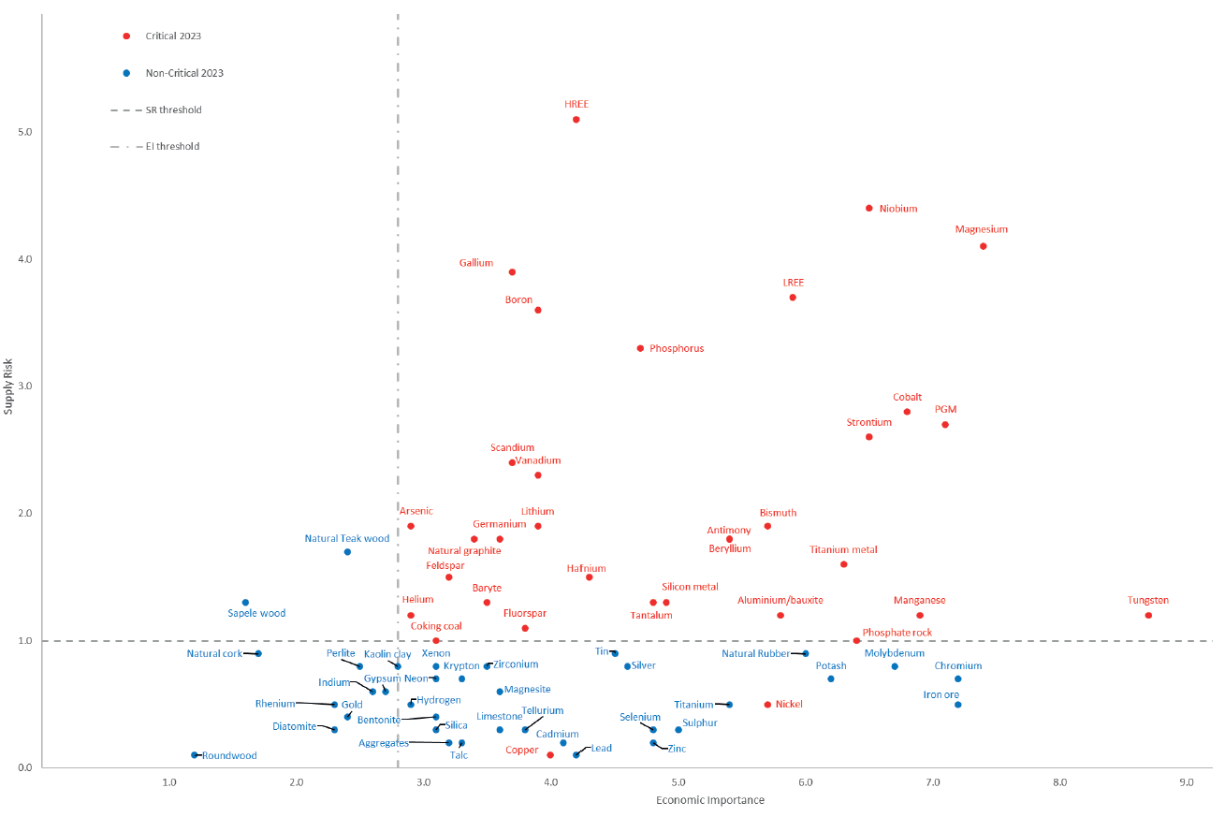
SILICON METAL AND ITS IS CRITICALITY?
Figure 7. Countries accounting for the largest share of the global supply of CRMs (European Commission, 2023)
Figure 8. Results of the 2023 the EU criticality assessment (European Commission, 2023)

Slide 7
Figure 9. The EU producers of CRMs, in brackets shares of global supply, 2016-2020 (European Commission, 2023)

Slide 8
Table 2. Silicon metal global supply shares
Table 3. Silicon metal the EU sourcing shares
Country | Share
China | 75.7%
Brazil | 7.2%
Norway | 6.3%
France | 4.3%
Russia | 1.6%
USA | 1.2%
Canada | 1.0%
Germany | 1.0%
Bosnia and Herzegovina | 0.9%
Spain | 0.7%
Iceland | 0.3%
Slovakia | <0.1%
Country | Share
Norway | 33%
France | 28%
Brazil | 9%
Germany | 6%
Bosnia and Herzegovina | 4%
Spain | 4%
Russia | 3%
Australia | 3%
China | 2%
Iceland | 1%
South Africa | 1%
Kazakhstan | 1%
Malaysia | 1%
Figure 10. World production of silicon metal (USGS, 2022)

Slide 9
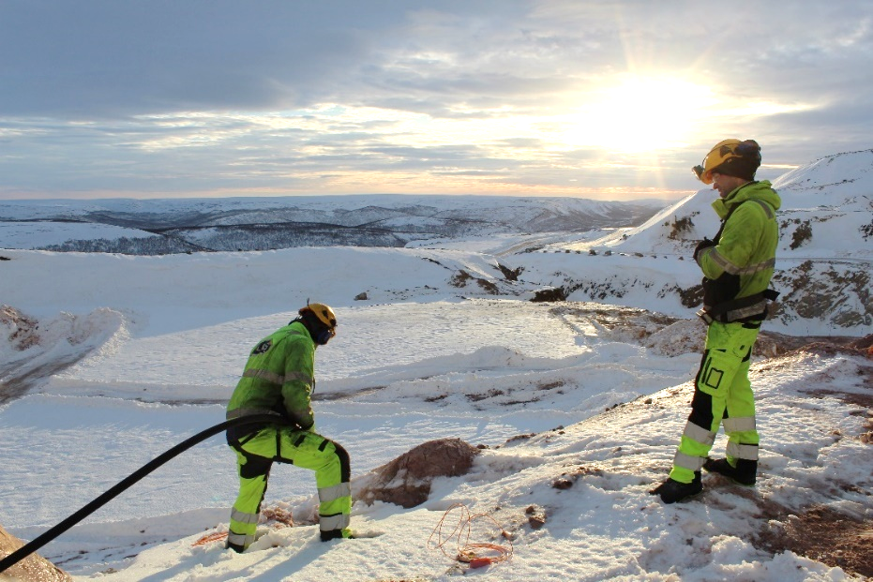
WHY NORDIC COUNTRIES?
RESOURCES + NO TRANSPORTATION COST + RESPONSIBLE MINING
QUARTZITE CLOSER THAN CHINA GREEN ENERGY AVALIABLE
WITH GEOTHERMAL AND HYDRO POWER
BOLIDEN AITIK MINE
Figure 13. Drill and blast operations in Elkem Tana quartzite mine (Photo: Ozge Akyildiz)
Figure 11. Locations of deposits with known silicon metal resources and areas with known or assumed potential for silicon metal resources in the Nordic countries (Eilu etal. 2021).
Figure 12. Important quartz deposits in Norway (Wanvik, 2015)
Figure 14. Blast drilling in a large quartz vein on the Nasa Mountain (photo: Elkem ASA, Wanvik, 2015)

Slide 10
References
Eilu, P., Bjerkgård, T., Franzson, H., Gautneb, H., Häkkinen, T., Jonsson, E., Keiding, J.K., Pokki, J., Raaness, A., Reginiussen, H., Róbertsdóttir, B.G., Rosa, D., Sadeghi, M., Sandstad, J.S., Stendal, H., Þórhallsson, E.R. & Törmänen T. 2021. The Nordic supply potential of critical metals and minerals for a Green Energy Transition. Nordic Innovation Report.
European Commission, European Green Deal, Delivering on our Targets. 2021. Luxembourg: Publications Office of the European Union, 2021.
European Commission, 2018. Report on Critical Raw Materials in the Circular Economy.
European Commission, 2023. Study on the Critical Raw Materials for the EU 2023 – Final Report.
European Commission, 2020. Study on the EU’s list of Critical Raw Materials, Factsheets on Critical Raw Materials.
European Commission, 2008. Communication from the commission to the European Parliament and the council. The raw materials initiative — meeting our critical needs for growth and jobs in Europe.
Ferro, P. & Bonollo, F. 2019. Design for Recycling in a Critical Raw Materials Perspective. Recycling, 4, 44.
Gregoir, L. & Acker, K.V. 2022. Metals for Clean Energy: Pathways to solving Europe’s raw materials challenge. KU Leuven.
Hannah Ritchie (2020) - “Sector by sector: where do global greenhouse gas emissions come from?” Published online at OurWorldInData.org. Retrieved from: 'https://ourworldindata.org/ghg-emissions-by-sector' [Online Resource] https://www.ted.com/talks/hannah_ritchie_are_we_the_last_generation_or_the_first_sustainable_one?subtitle=en, accessed on December 2022.
Righetti. E., Rizos, V. 2023. The EU’s Quest for Strategic Raw Materials: What Role for Mining and Recycling? Intereconomics, 58(2), 69-73.
SCRREEN2, Solutions for Critical Raw Materials – A European Expert Network. Horizon 2020, Project Report. 958211.
USGS 2022, Mineral Commodity Summaries 2022 - Silicon, https://pubs.usgs.gov/periodicals/mcs2022/mcs2022-silicon.pdf, accessed on October 2022.
Wanvik, J. 2015. Quartz resources in Norway, a varied spectrum. NGU FOCUS, No: 11.
Zepf, V., Reller, A., Rennie, C., Ashfield, M., Simmons, J., BP 2014. Materials critical to the energy industry. An introduction. 2nd edition.
https://im-mining.com/2019/10/24/boliden-backs-trolley-assist-haulage-aitik-kevitsa/
https://www.nordicenergy.org/article/nordics-lead-europe-in-renewables/

