Slide 1
Fully Differentiable Physics-informed Lagrangian Convolutional Neural Network for Precipitation Nowcasting
EGU24-4445 | ESSI1.3
Peter Pavlík, Martin Výboh, Anna Bou Ezzeddine, and Viera Rozinajová

Slide 2
What’s it all about?
Using machine learning in precipitation nowcasting
Applying deep learning computer vision approaches
Combining data-driven learning with physics-informed domain knowledge

Slide 3
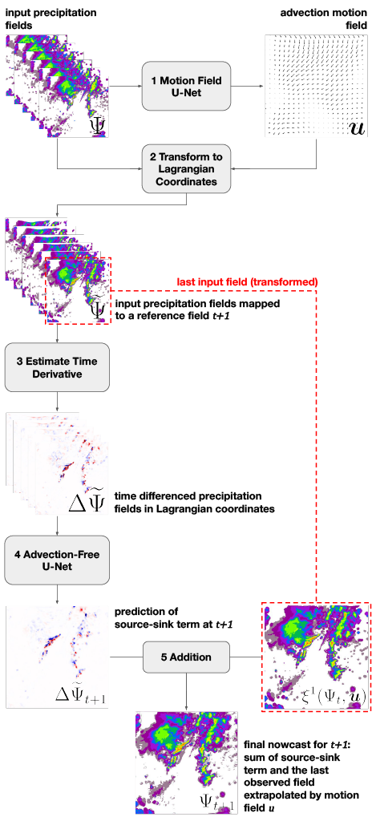
Lagrangian Double U-Net for Physics-Informed Nowcasting – LUPIN
Draws from existing extrapolation-based nowcasting methods
Performs the Lagrangian coordinate system transformation of the data in a fully differentiable manner
Matches the performance of the chosen benchmark

Slide 4
Hope to see you at my PICO screen!

Slide 5
EGU24 QR code
Sky Park Offices
Bottova 7939/2A
811 09 Bratislava
Slovakia
www.kinit.sk

Slide 6
Start of PICO Screen Slides

Slide 7
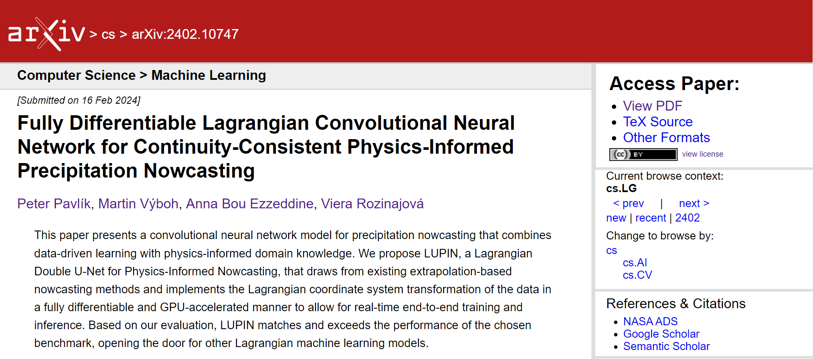
https://arxiv.org/abs/2402.10747

Slide 8
Premise I: U-Net-based Precipitation Nowcasting

Slide 9
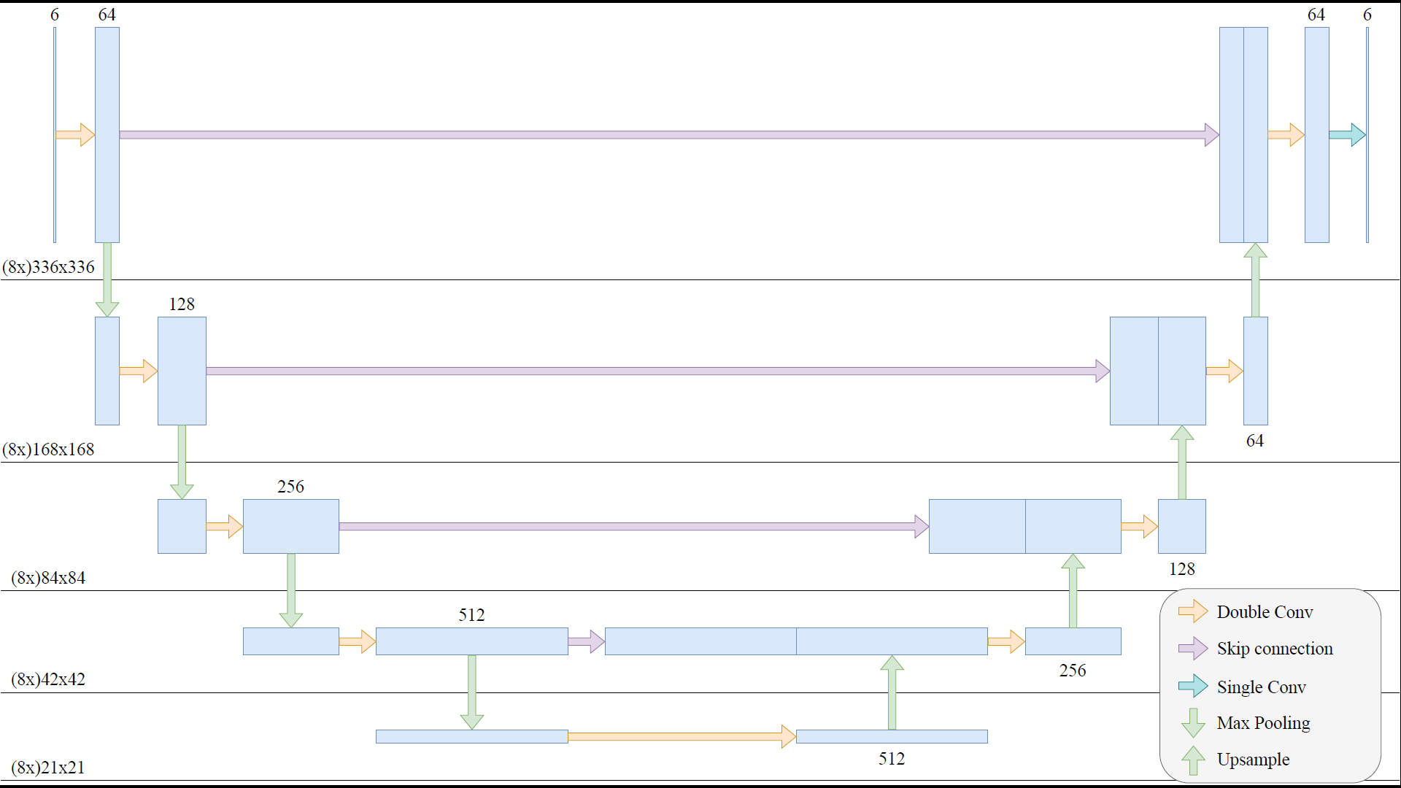
U-Net (Convolutional Neural Network)

Slide 10
Precipitation Nowcasting U-Net
Real
Prediction

Slide 11
Premise II: Traditional Extrapolation-based Nowcasting

Slide 12
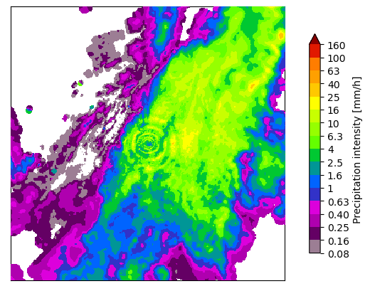
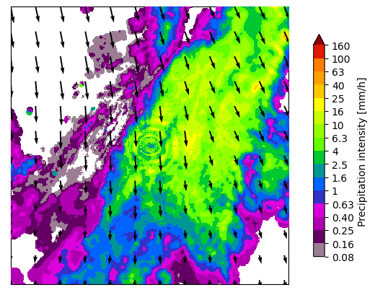
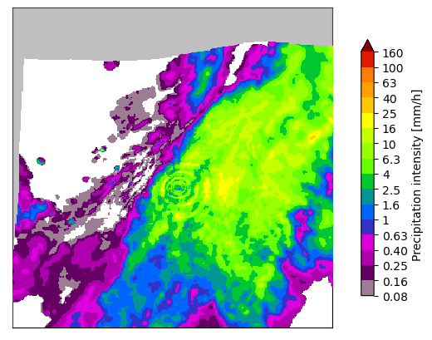
Simple Lagrangian Persistence
Take the last precipitation observation
Estimate motion field with the Lukas-Kanade algorithm
Extrapolate

Slide 13
LUPIN Motivation

Slide 14
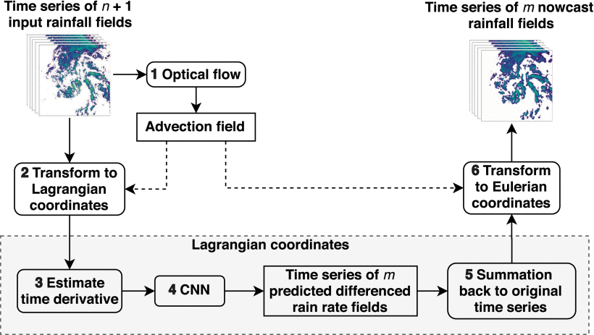
Ritvanen, Jenna, et al. "Advection-free convolutional neural network for convective rainfall nowcasting." IEEE Journal of Selected Topics in Applied Earth Observations and Remote Sensing 16 (2023): 1654-1667.

Slide 15
Lagrangian CNN
separates the learning of rainfall growth and decay from motion
advection motion field is used to transform the input into the Lagrangian coordinate system, where a U-Net processes the temporally differenced advection-free inputs
model outperformed a benchmark U-Net-based RainNet
the motion field being a product of a non-differentiable optical flow method, it can not be trained in an end-to-end approach

Slide 16
Lagrangian (Double) U-Net for Physics-Informed Nowcasting

Slide 17
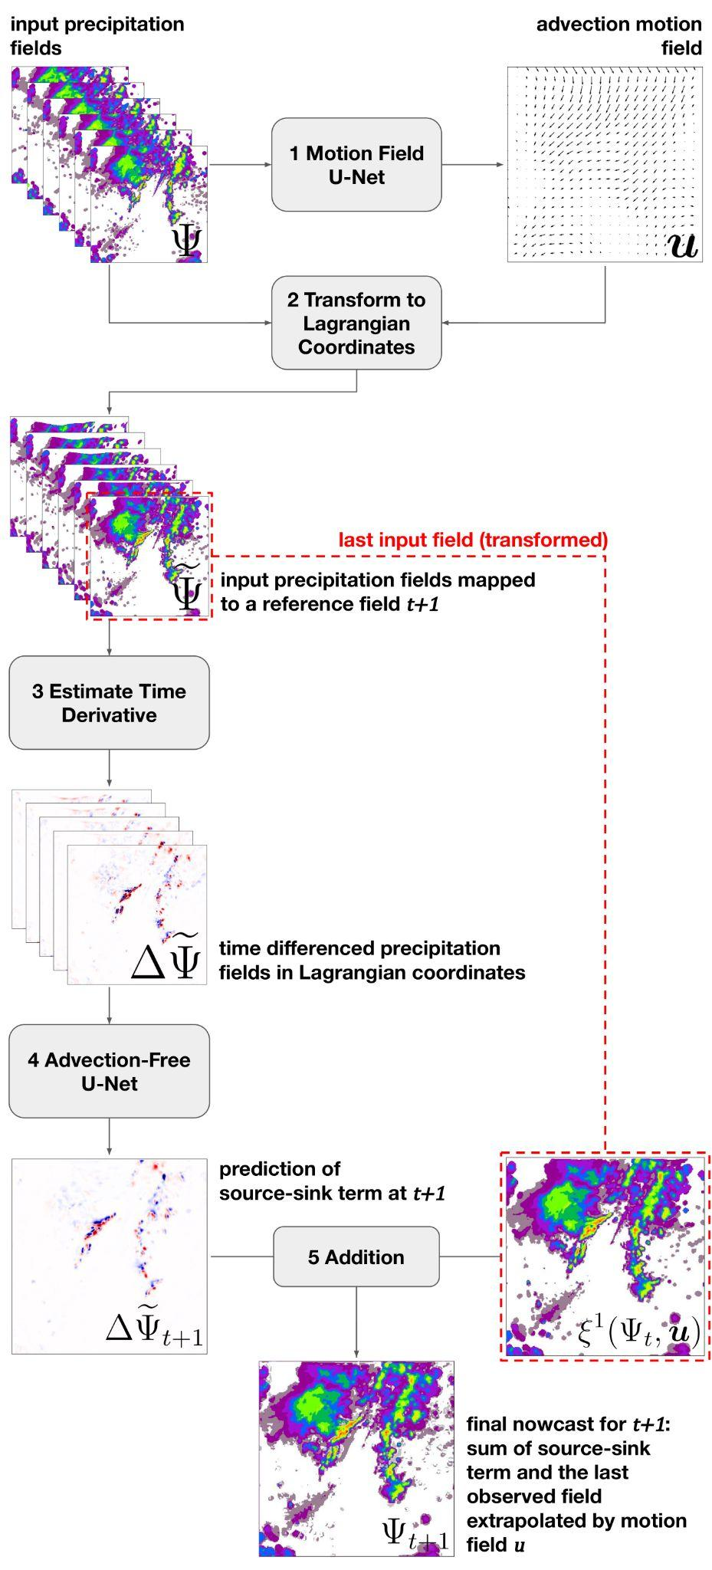
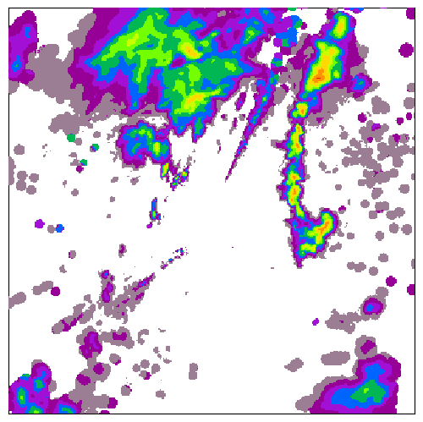
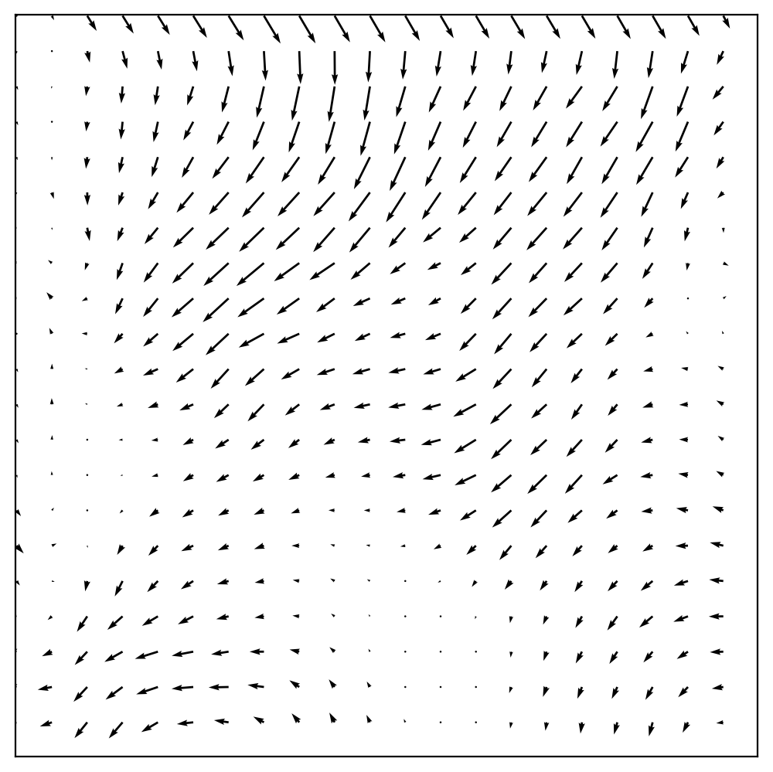
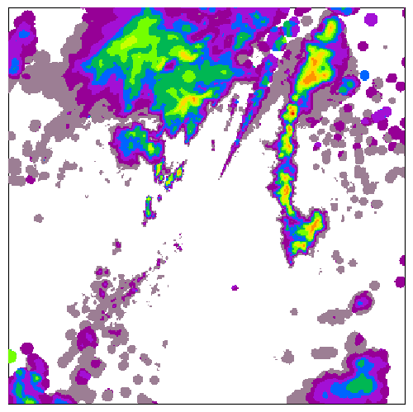
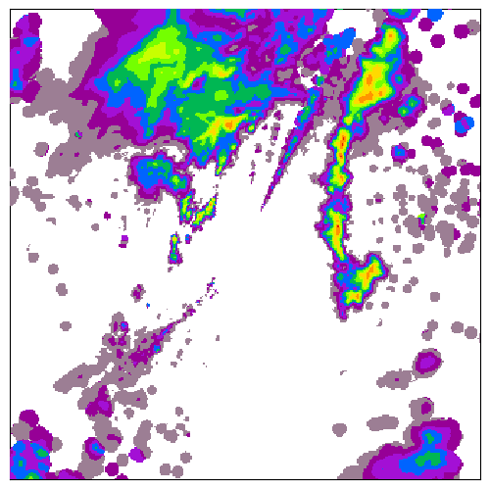
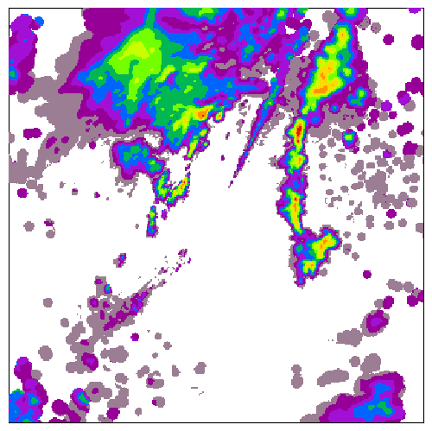
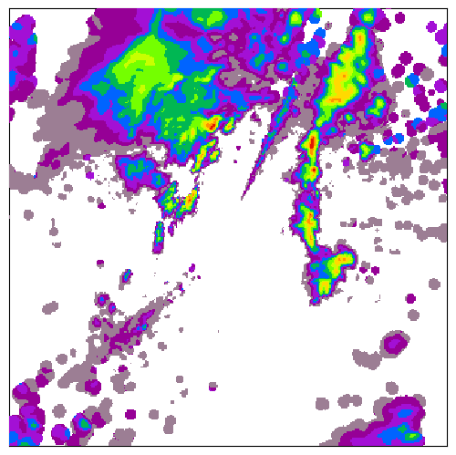
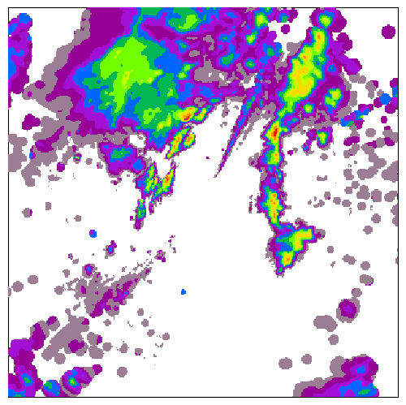
input precipitation fields
advection motion field
1 Motion Field
U-Net

Slide 18
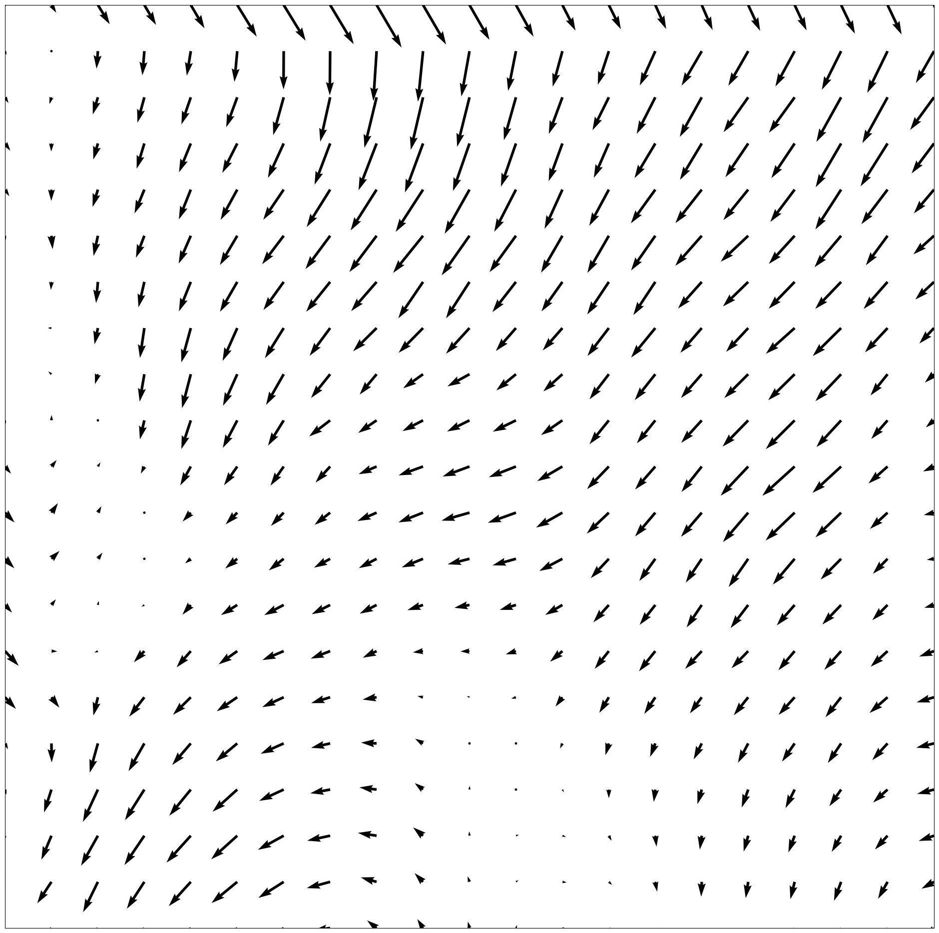
Motion Field U-Net

Slide 19
input precipitation fields
advection motion field
2 Transform to Lagrangian Coordinates

Slide 20
Transform to Lagrangian (Advection-free)

Slide 21
Transform to Lagrangian (Advection-free)

Slide 22
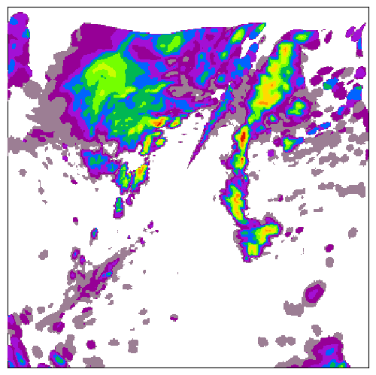
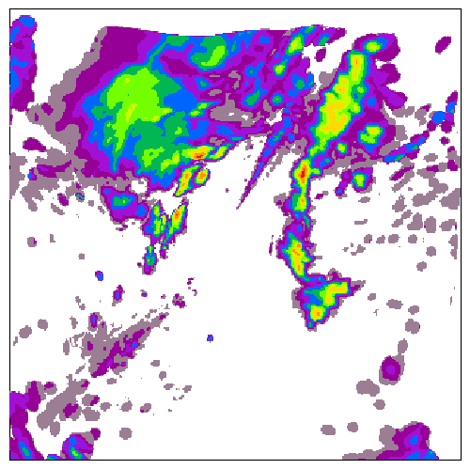
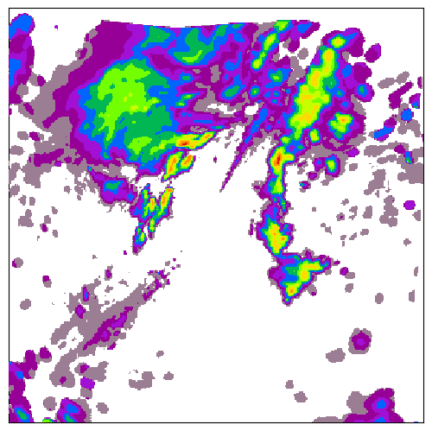
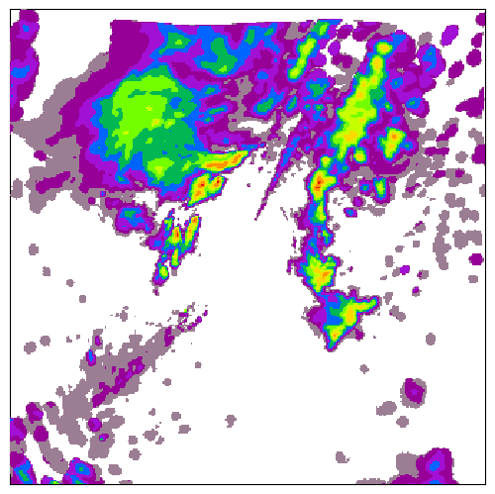
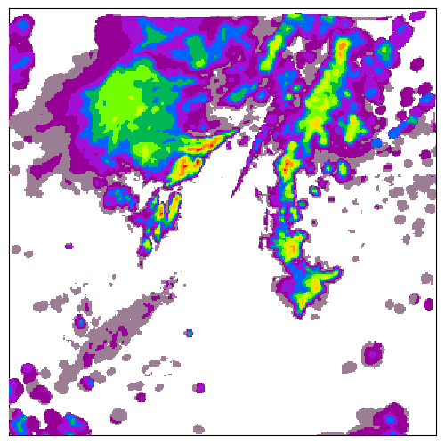
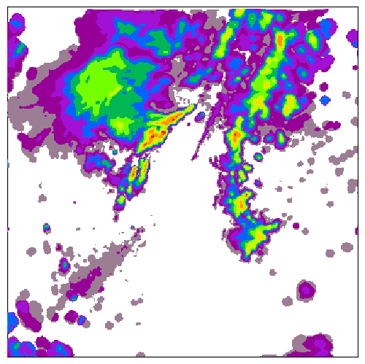
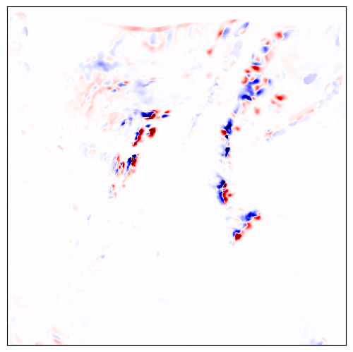
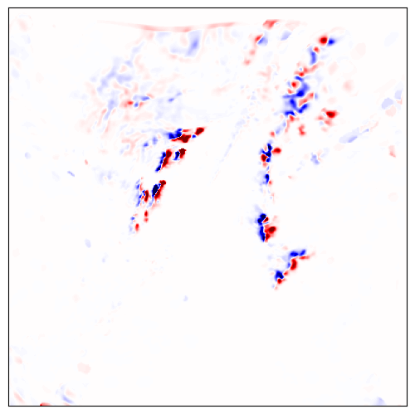
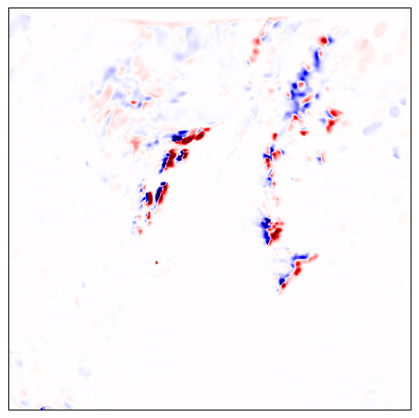
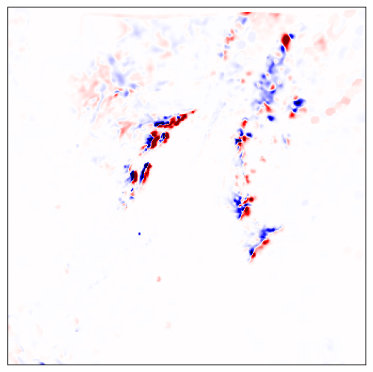
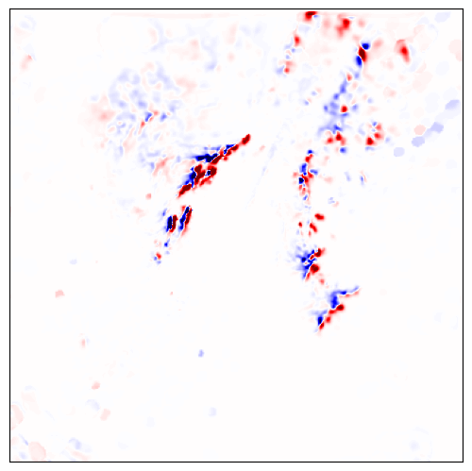
input precipitation fields mapped to a reference field t+1
3 Estimate Time Derivative
time differenced precipitation fields in Lagrangian coordinates

Slide 23
Estimate Time Derivative

Slide 24
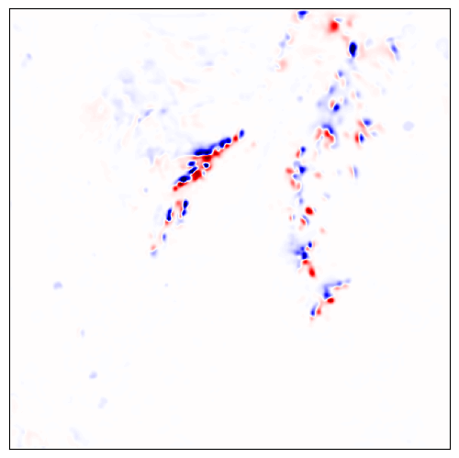
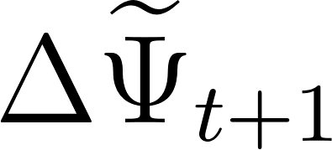
time differenced precipitation fields in Lagrangian coordinates
4 Advection-Free
U-Net
prediction of source-sink term at t+1

Slide 25
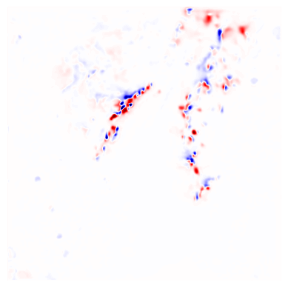
Advection-free U-Net

Slide 26
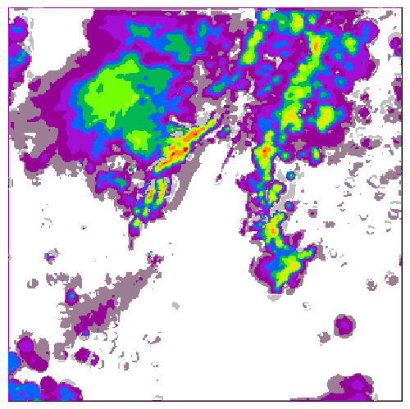
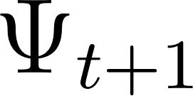
prediction of source-sink term at t+1
5 Addition
final nowcast for t+1:
sum of source-sink term and the last observed field extrapolated by motion field u

Slide 27
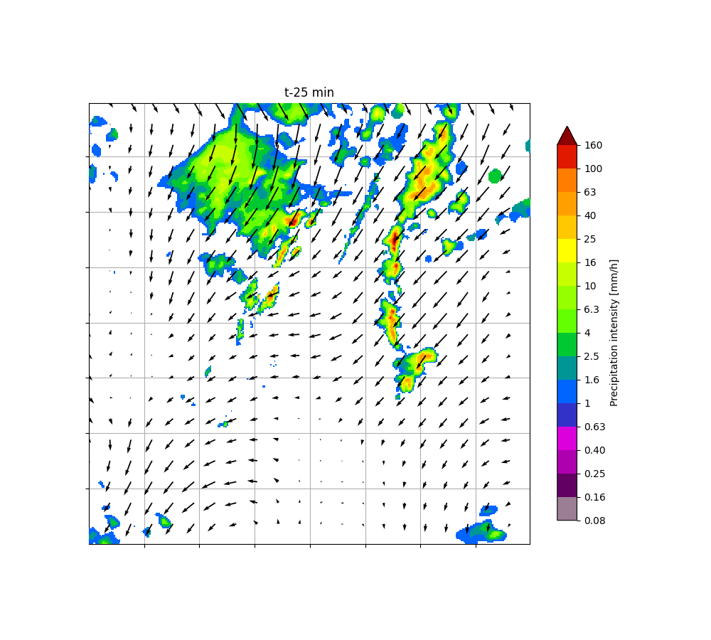
Iterative Inference
Generate the next frame and feed it back as last input frame to generate nowcast for the next lead time

Slide 28
Implementation: How was it trained?

Slide 29
Reimplement semi-Lagrangian extrapolation in pyTorch to allow backpropagation of error
pysteps/extrapolation/semilagrangian.py
implemented using numpy and scikitlearn interpolation.map_coordinates
based on Scale-Dependence of the Predictability of Precipitation from Continental Radar Images. Part I: Description of the Methodology (2002)
reimplementation in torch
torch operations are mostly the same as in numpy
grid_sample operation is roughly analogous to scikitlearn map_coordinates (part of spatial transformer architecture)

Slide 30
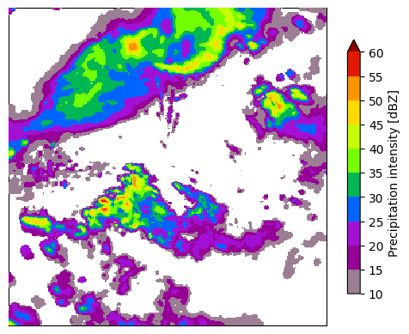
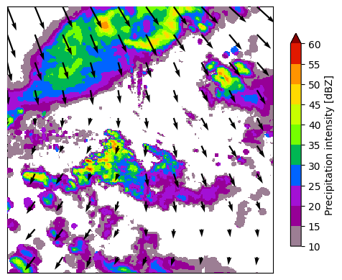
Extrapolation in pyTorch

Slide 31
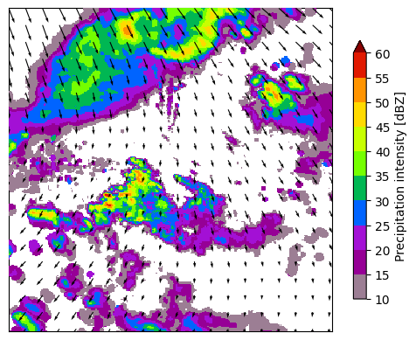
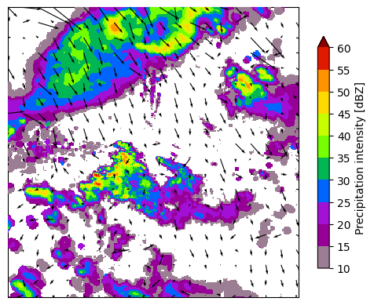
Lukas-Kanade motion field vs. learned

Slide 32
Physics-informed Motion Field Regularization

Slide 33
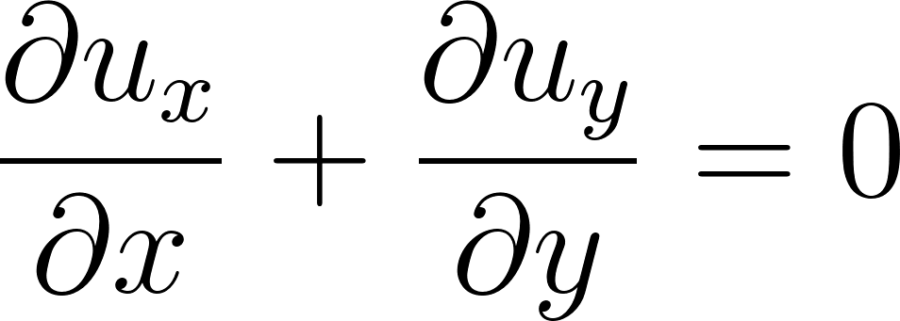
Physics-informed Regularization Based on
Conservation of Mass
The motion field should have no sources or sinks – the divergence should be zero

Slide 34
Physics-informed Regularization Based on
Conservation of Mass
Compute discrete approximations of motion field partial derivatives using 2D convolutions with a sobel filter
-1 | 0 | 1
-2 | 0 | 2
-1 | 0 | 1
-1 | -2 | -1
0 | 0 | 0
1 | 2 | 1

Slide 35
Physics-informed Regularization Based on
Conservation of Mass
Divergent Motion Field
↖ | ↑ | ↗
← |  | →
↙ | ↓ | ↘
u in x direction ⇄
u in y direction ⇅
-1 | 0 | 1
-1 | 0 | 1
-1 | 0 | 1
-1 | -1 | -1
0 | 0 | 0
1 | 1 | 1

Slide 36
Physics-informed Regularization Based on
Conservation of Mass
u in x direction ⇄
x direction Sobel filter
Hadamard Product
-1 | 0 | 1
-1 | 0 | 1
-1 | 0 | 1
-1 | 0 | 1
-2 | 0 | 2
-1 | 0 | 1
1 | 0 | 1
2 | 0 | 2
1 | 0 | 1
Sum
⊙
=
8

Slide 37
Physics-informed Regularization Based on
Conservation of Mass
Add the minimization of absolute motion field divergence as a secondary term to loss function for regularization

Slide 38
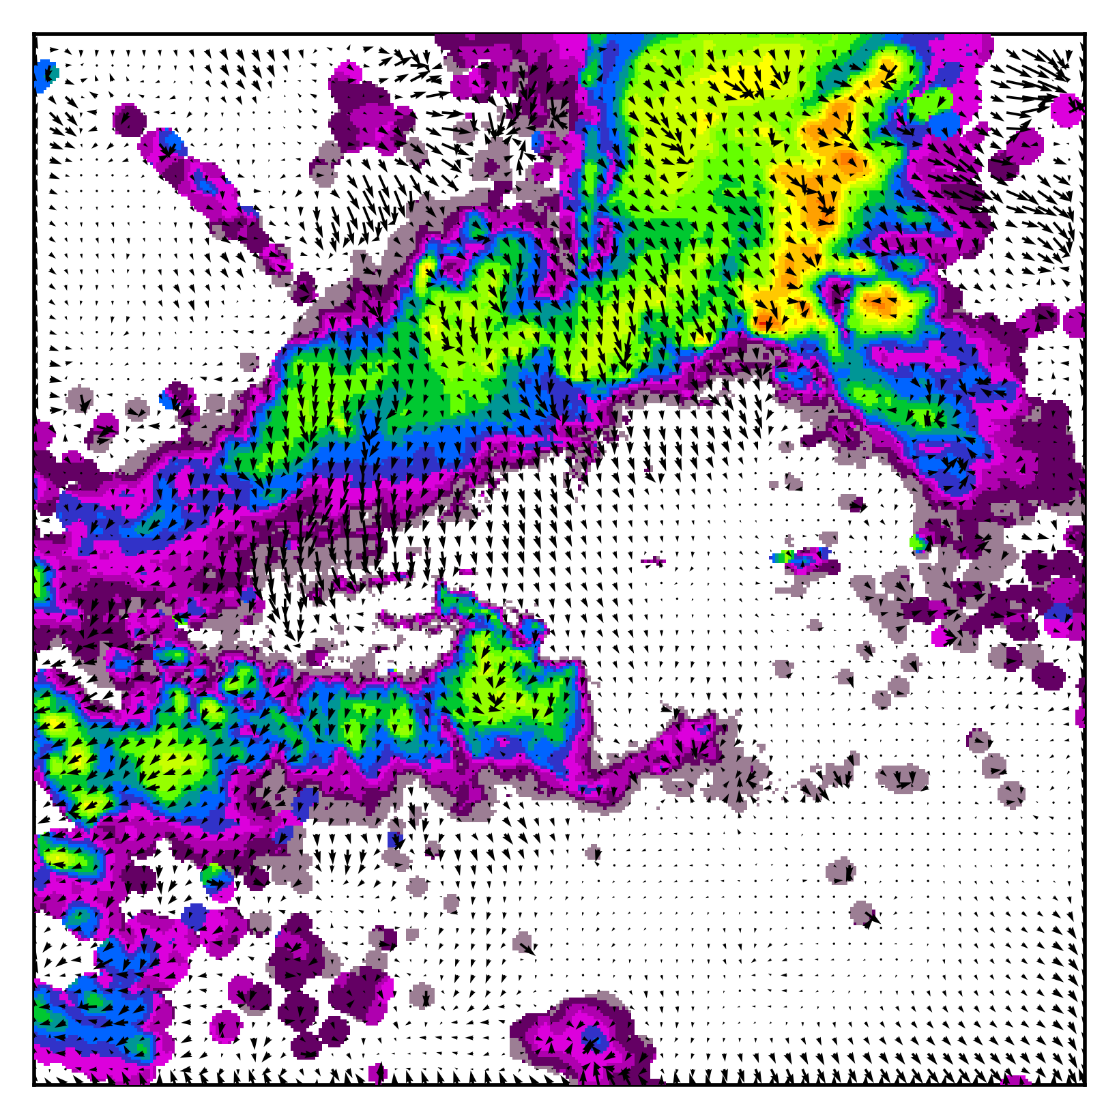
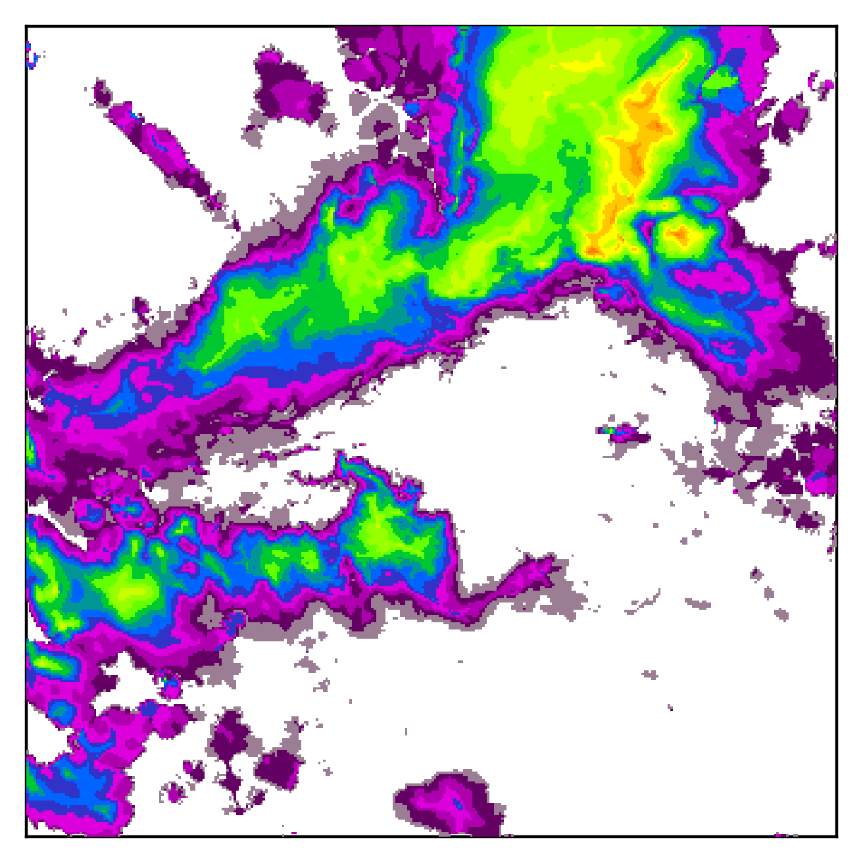
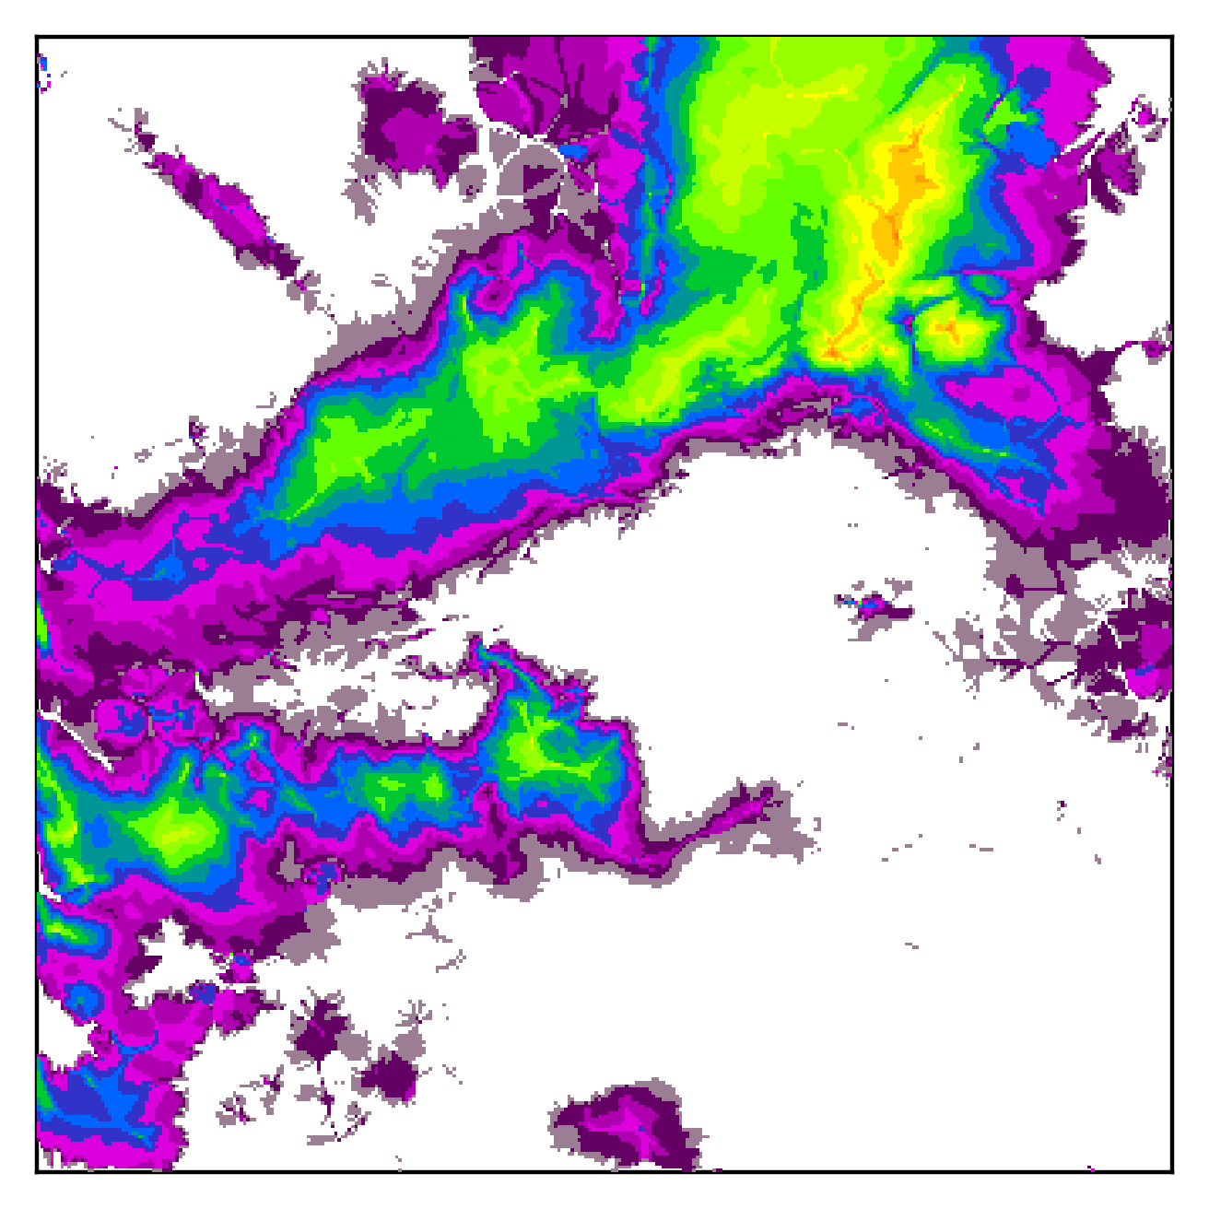
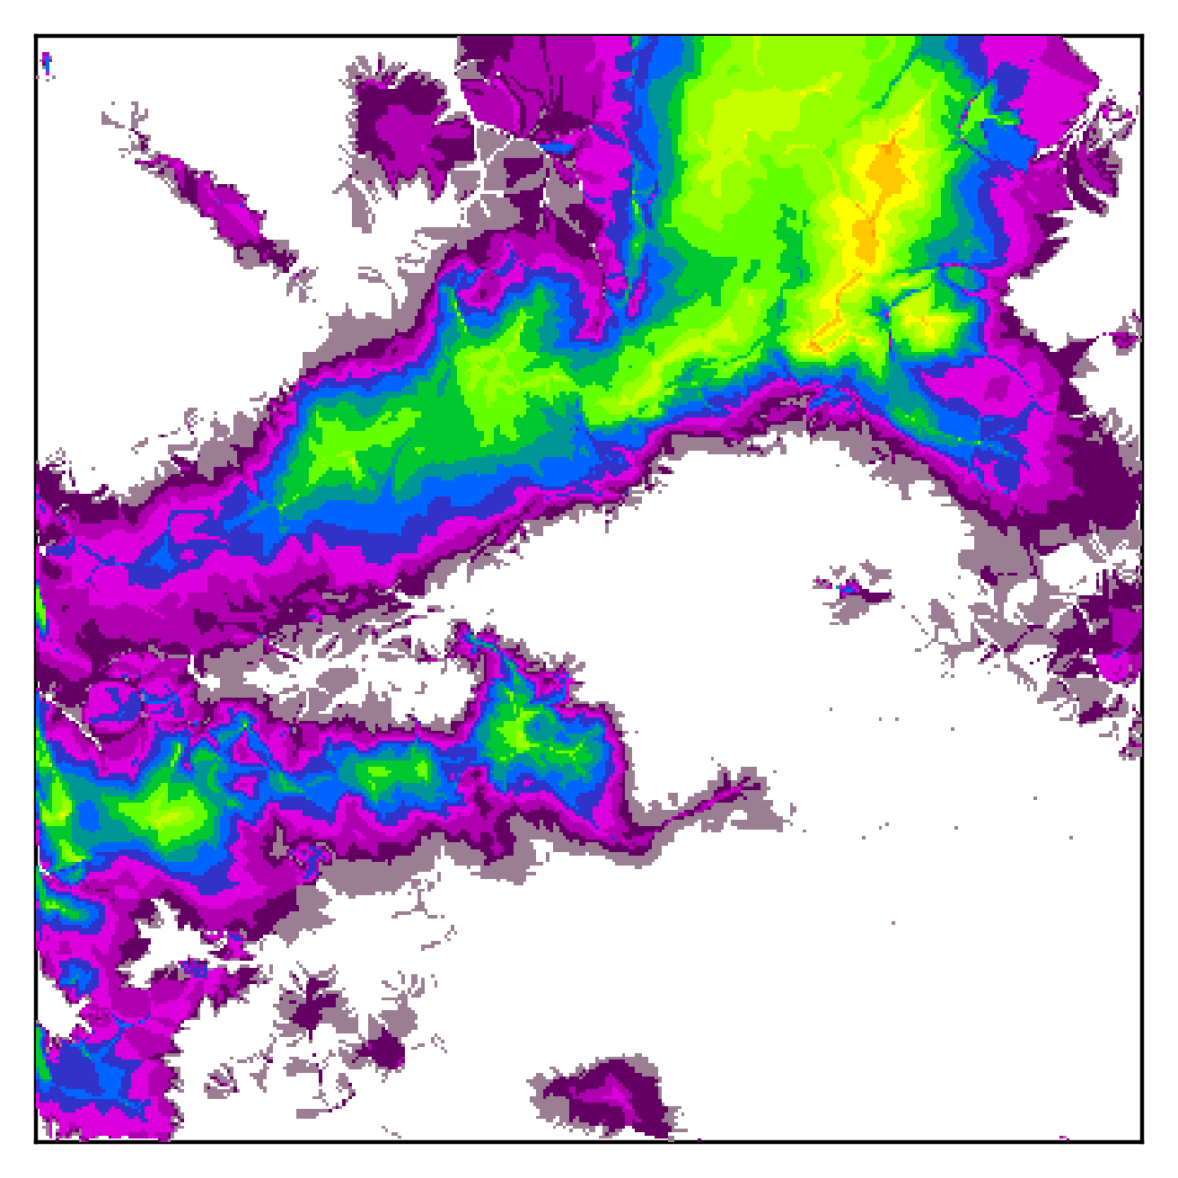
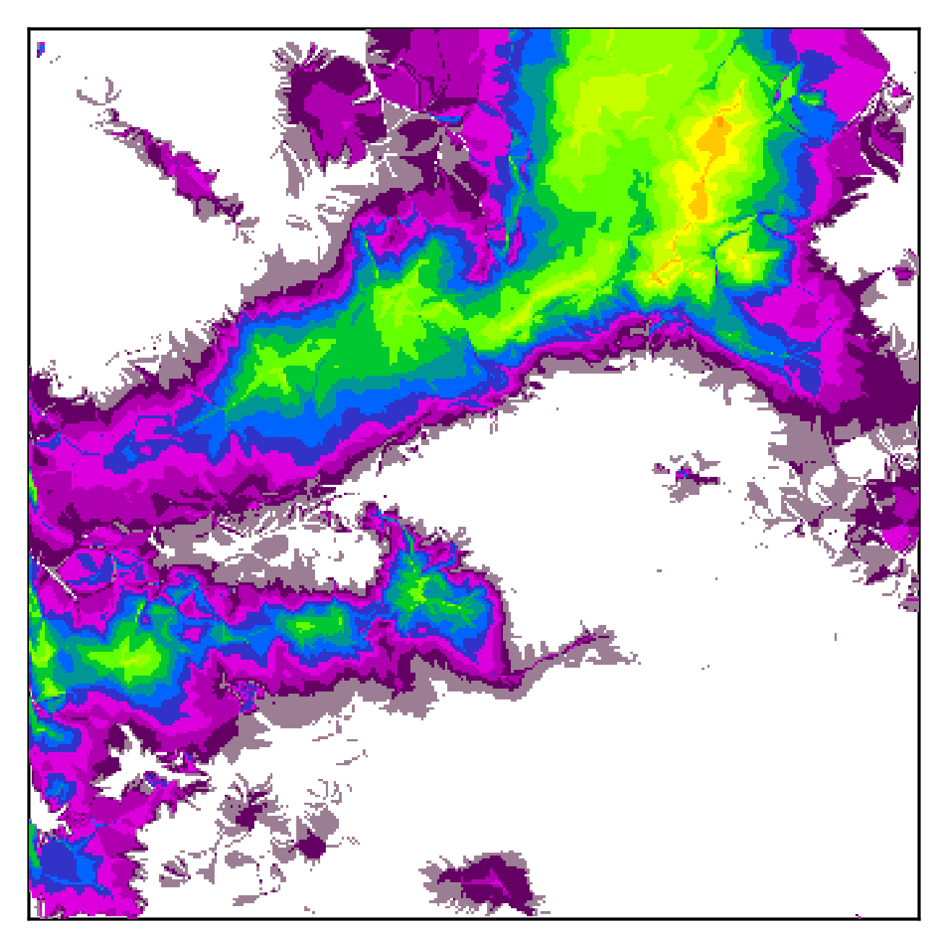
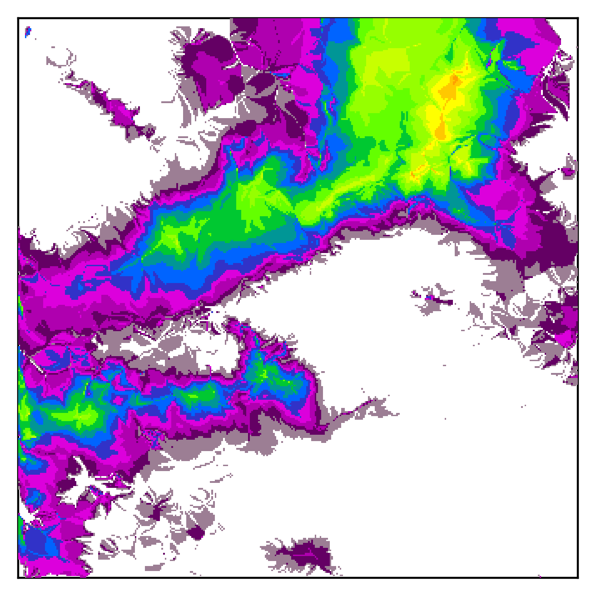
Extreme example:
No regularization

Slide 39
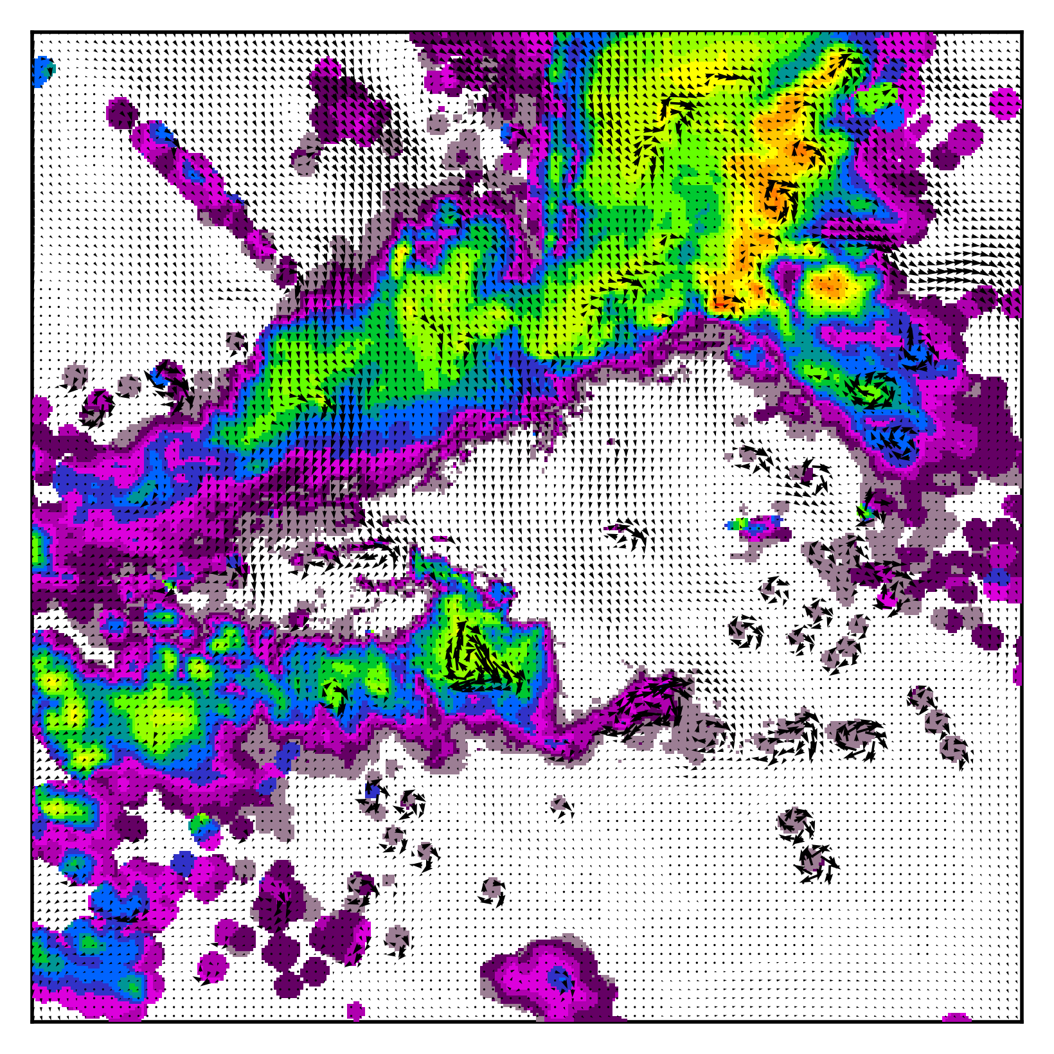
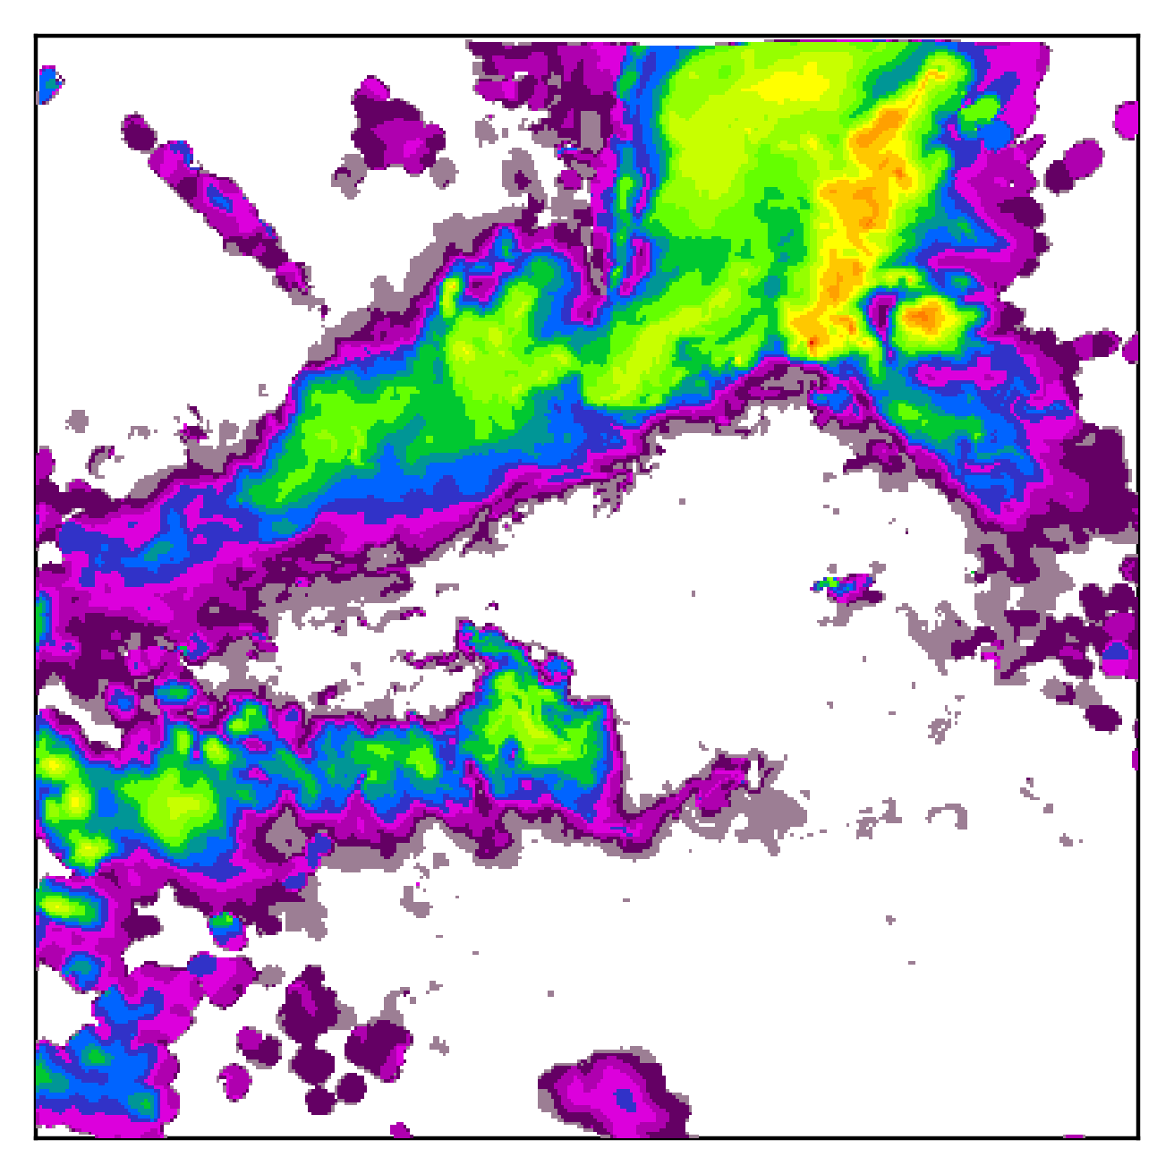
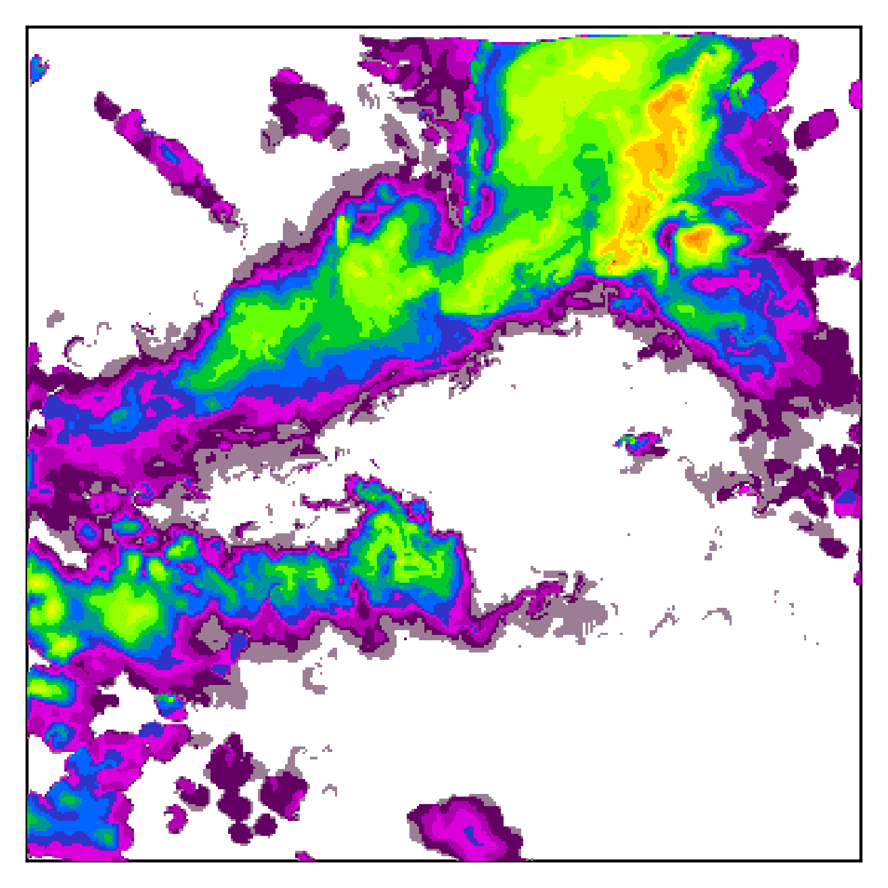
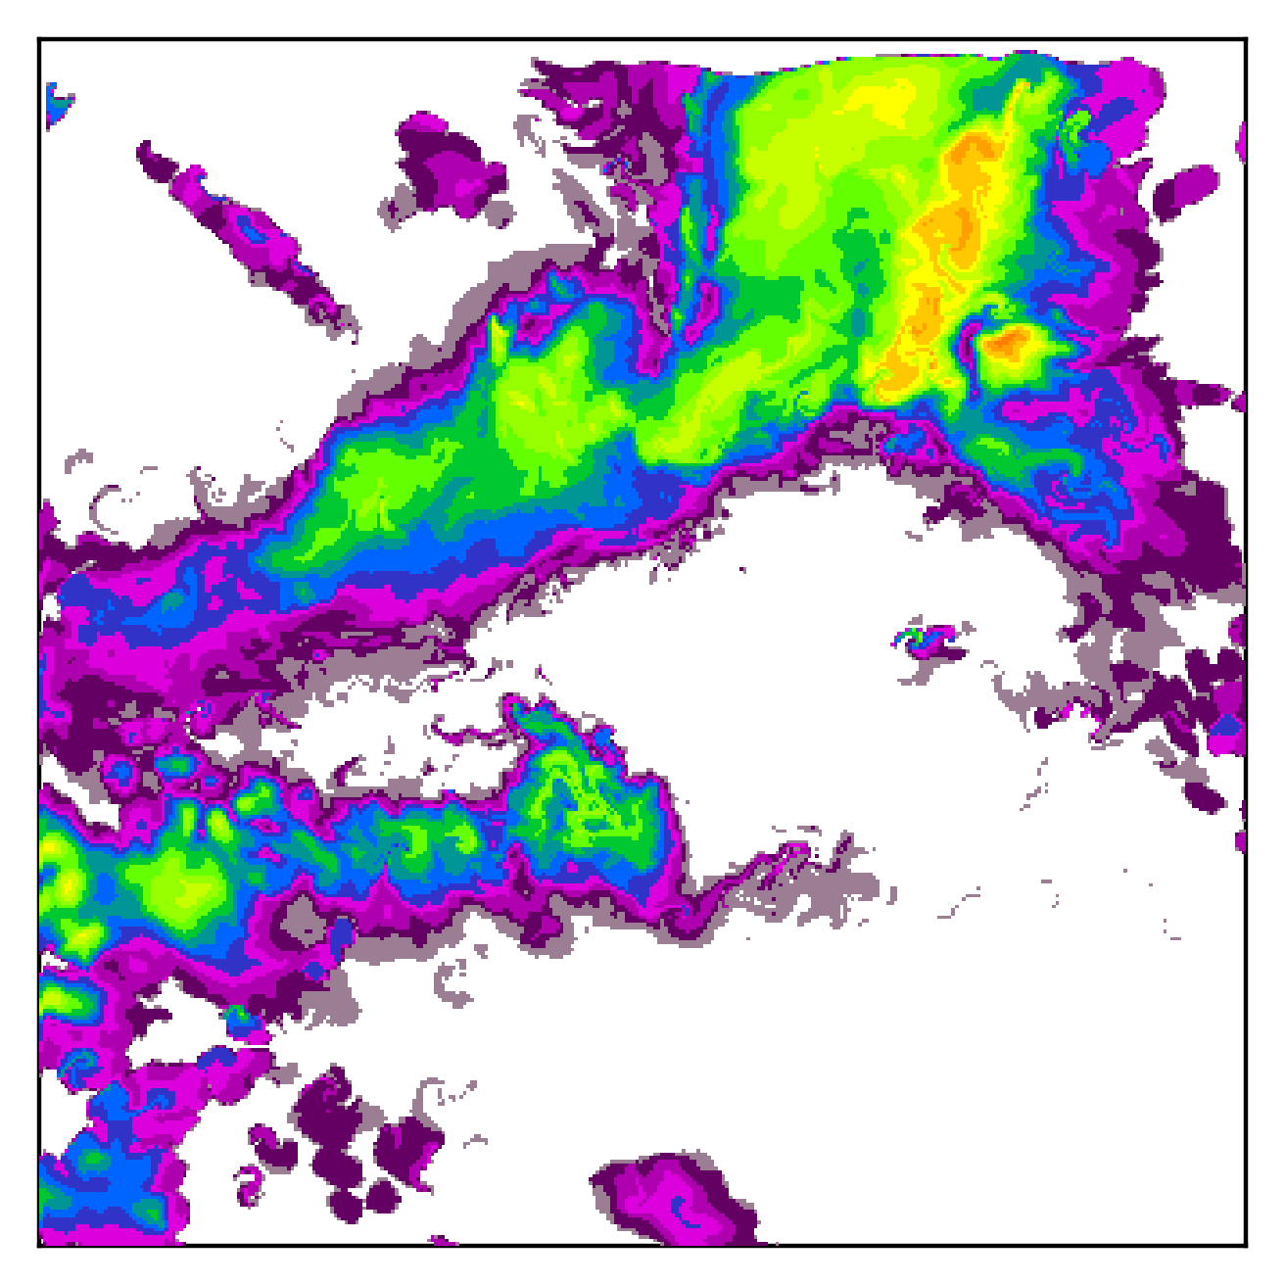
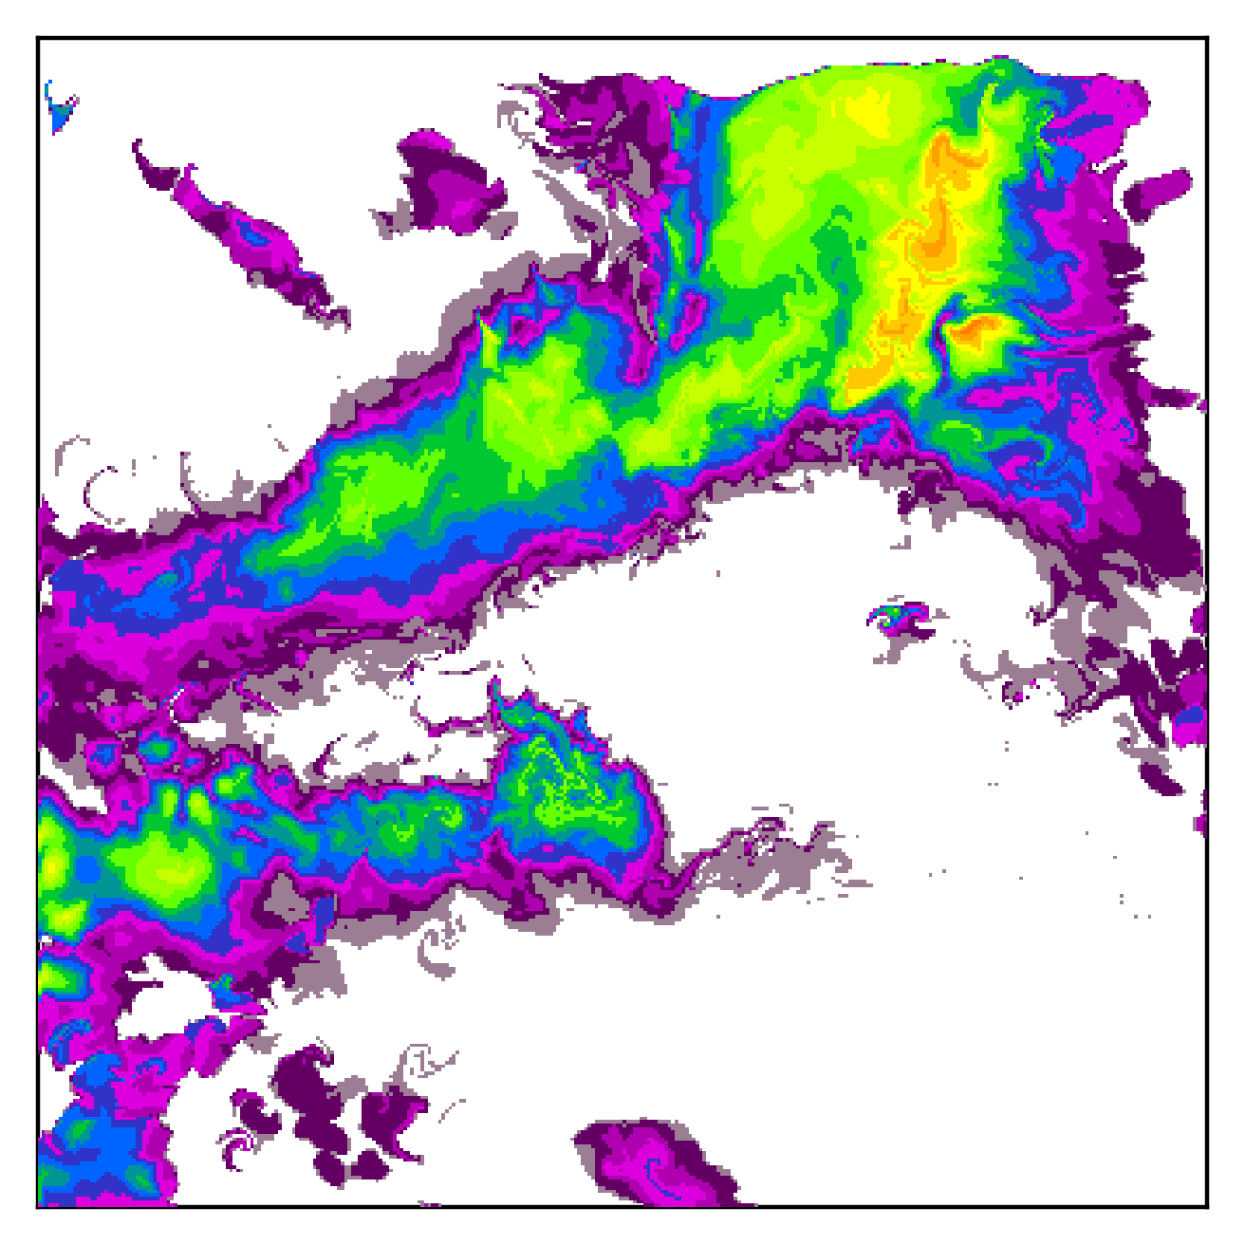
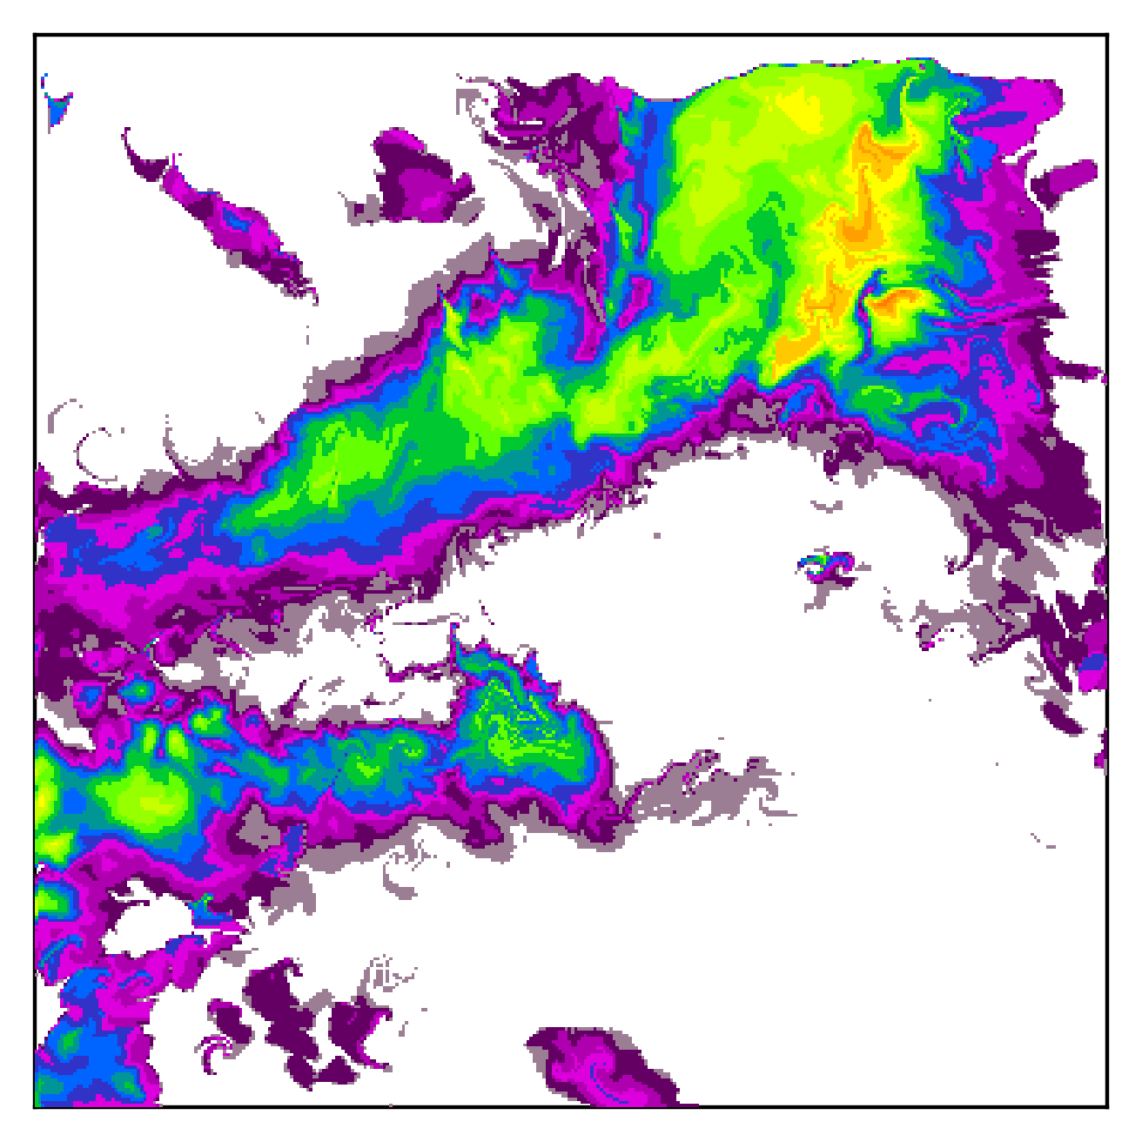
Extreme example:
With regularization

Slide 40
Loss functions

Slide 41
Training MF-U-Net
Data-driven extrapolation loss
Physics-informed regularization loss
Total weighted loss

Slide 42
Training AF-U-Net and LUPIN
Error of the nowcast
Final LUPIN weighted training loss (AF-U-Net & MF-U-Net together)

Slide 43
Dataset

Slide 44
Radar Reflectivity Dataset
provided by the Slovak Hydrometeorological Institute
1st of January 2016 to 30th of June 2019, 5-minute intervals
from Malý Javorník weather radar station
CMAX, 336 ✕ 336 km (1 ✕ 1 km resolution)

Slide 45
Evaluation

Slide 46
Extreme Rainfall Event Case Study

Slide 47
Quantitative Evaluation I

Slide 48
Quantitative Evaluation II

Slide 49
Quantitative Evaluation III

Slide 50
Summary

Slide 51
LUPIN Summary
we eliminated most of the drawbacks of the L-CNN model while matching its performance
mitigates the higher computational cost
removes the need to precompute Lagrangian inputs
possibly better Lagrangian mapping due to the temporally varying motion field
not tied to a specific neural network architecture, opens the door for other models to use the Lagrangian approach

Slide 52
EGU24 QR code
Sky Park Offices
Bottova 7939/2A
811 09 Bratislava
Slovakia
www.kinit.sk

