Slide 1
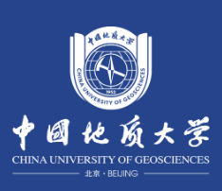
Role of sediment-derived melts in Mo cycling of subduction zone
Feng Huang¹, Jie Li², Jifeng Xu¹, Yunchuan Zeng¹, Xiao Liang¹
¹ China University of Geosciences Beijing
² Guangzhou Institute of Geochemistry, Chinese Academy of Sciences
15th April, 2024

Slide 2
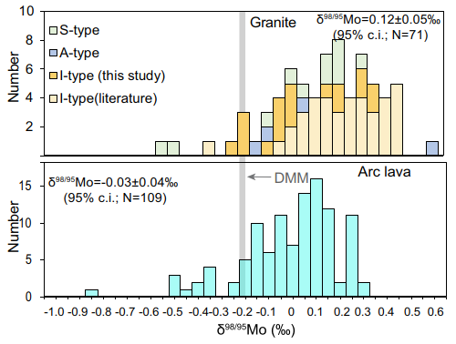
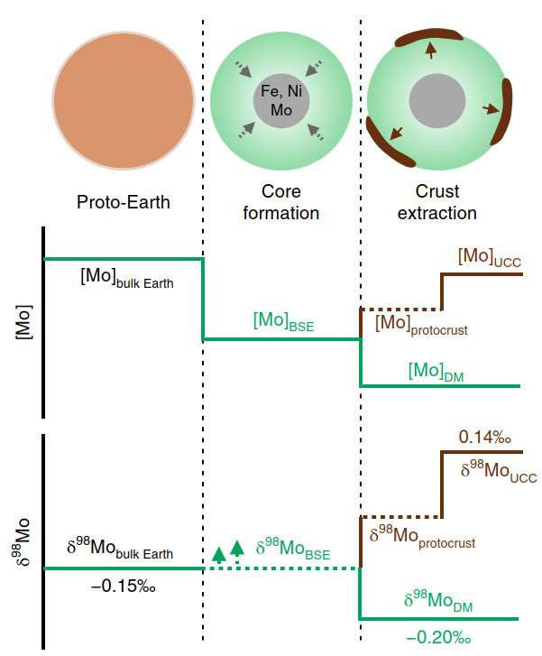
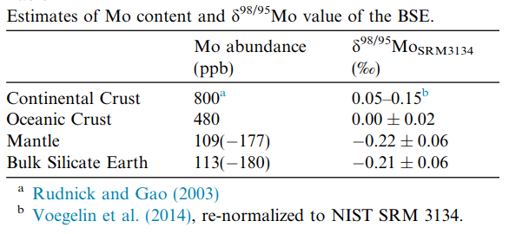
Role of sediment-derived melts in Mo cycling of subduction zone
科学问题：
Question：
Mo isotope equilibrium between the crust and mantle
Upper continental crust
Heavy Mo isotopes
δ^{98/95}Mo = 0.05-0.15‰
Chen et al., 2022, CG
Depleted mantle
Light Mo isotopes
δ^{98/95}Mo = -0.2‰
Liang et al., 2017， GCA
McCoy-West et al., 2019, NG

Slide 3
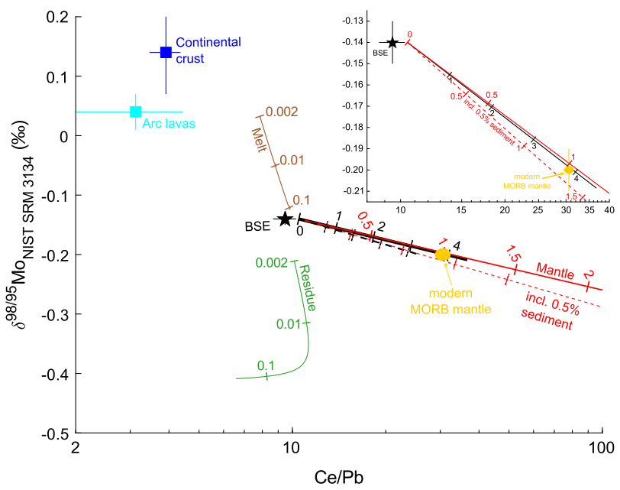
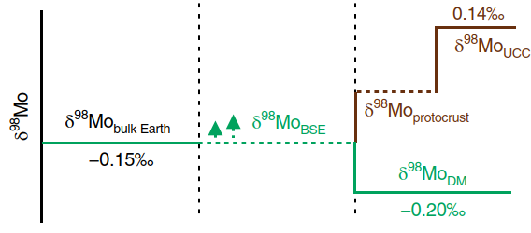
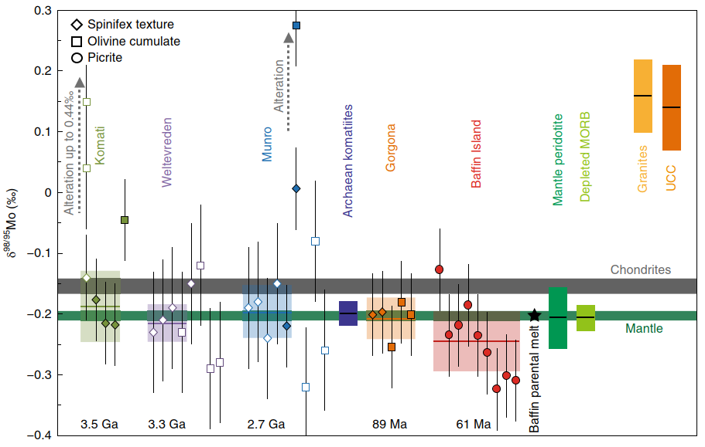
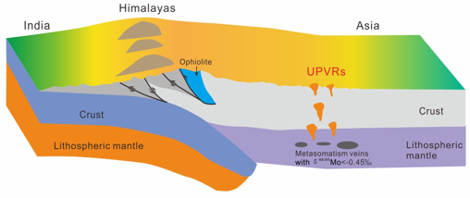
Mo isotope equilibrium between the crust and mantle
Before 3.5 Ga, extensive crustal differentiation led to the Mo isotopic composition observed in the present-day mantle
Subducting oceanic crust carries light Mo isotopes into the mantle
Hin et al., 2022, EPSL
Huang et al., 2023, GCA
The continental mantle lithosphere in the Tethys domain, affected by subducted sediment metasomatism, exhibits light Mo isotopes
McCoy-West et al., 2019, NG

Slide 4
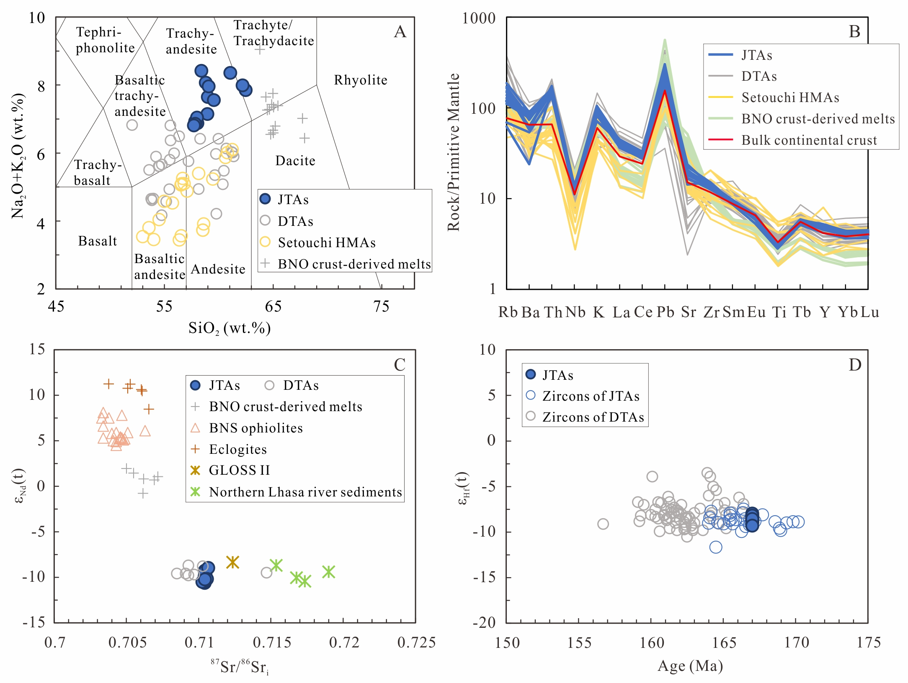
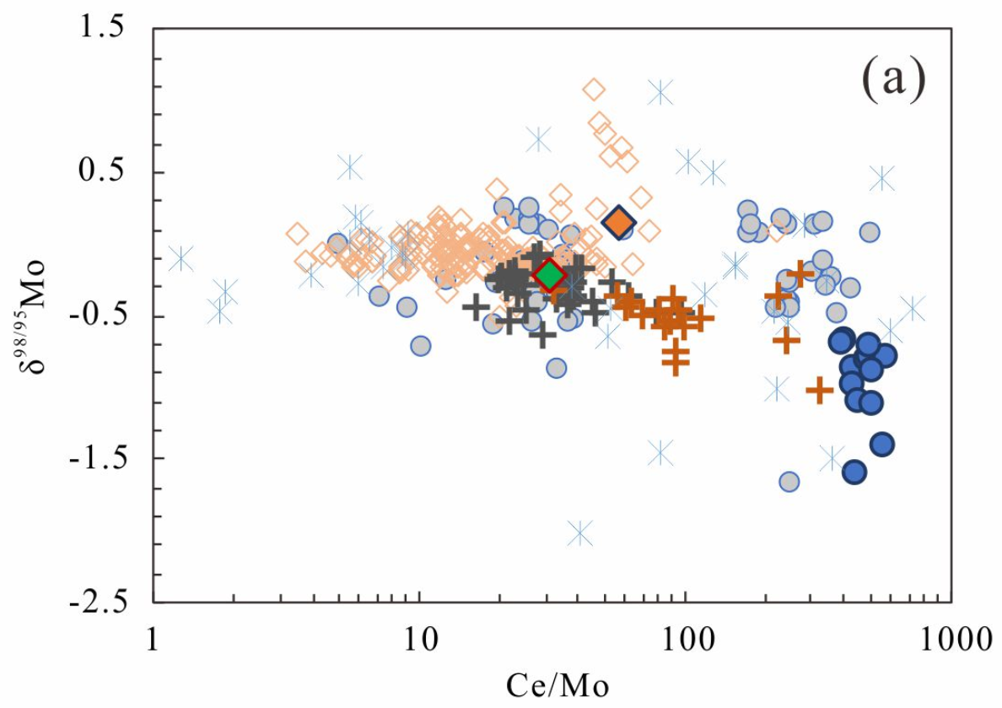
Role of sediment-derived melts in Mo cycling of subduction zone
Findings
The lighter Mo isotopes in sediment-derived melts may equilibrate the heavier Mo isotopes in the Earth's crust
The Jiang Tso andesites (JTAs) have geochemical affinities of the typical sediment-derived melts

