Slide 1
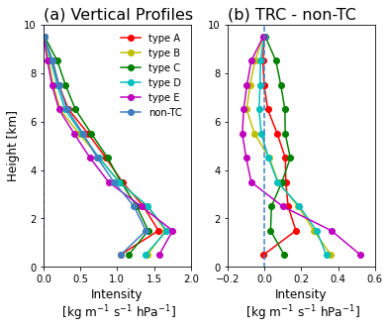
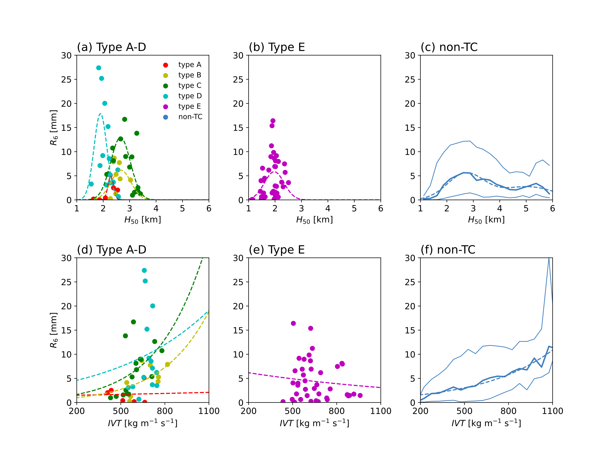
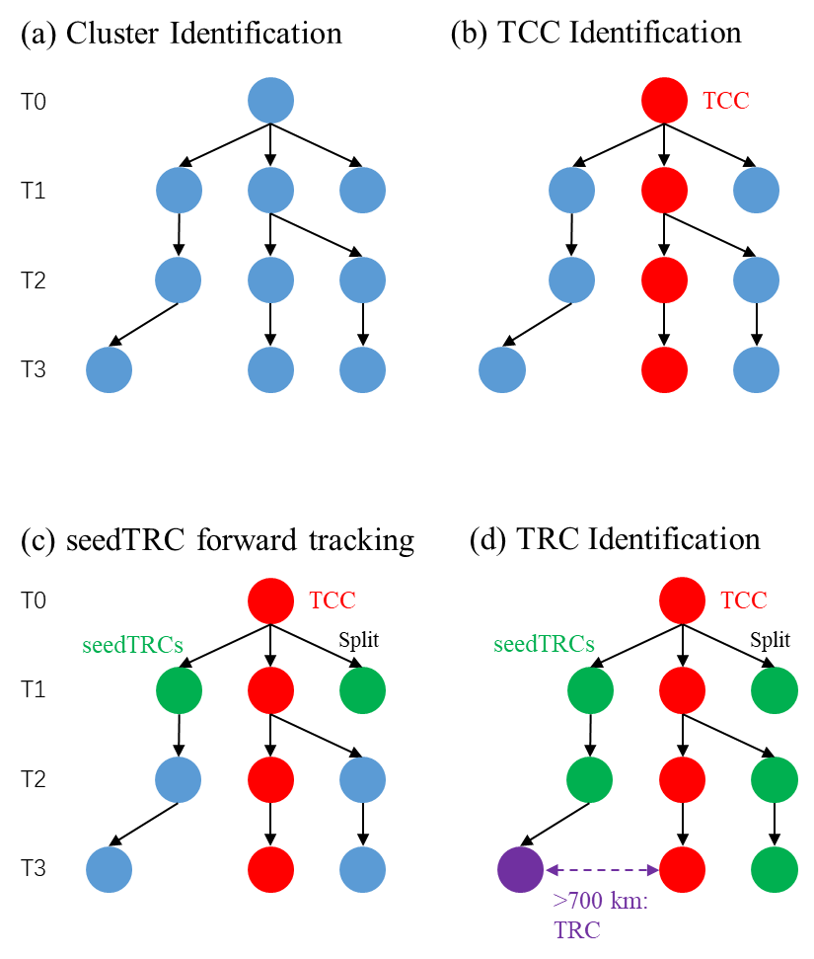
Association Between Torrential Rainfall and Tropical Cyclone Induced Remote Moisture Transport over East Asia Shiqi XIAO (xiaoshq9@mail2.sysu.edu.cn), Aoqi ZHANG, Yilun CHEN, Weibiao LI School of Atmospheric Sciences, Sun Yat-sen University, Zhuhai 519082, China
1. Introduction
3. Results
3. Results
Tropical Cyclones (TCs) attract heated discussion among researchers.
TC induced remote rainfall has been studied by cases and a few statistics.
There is stark contrast between TC induced remote rainfall and that of non-TCs.
Quantifying rainfall-moisture association can deepen understandings of mechanisms underlying TC induced remote rainfall and increase forecast skills.
Association between rainfall and moisture transport features are rarely studied.
This study aims to reveal the rainfall-moisture features quantitatively.
About TRCs
Frequency: 0.5–1 % over East China Sea, 2–3 % of all clusters at East China Sea (ECS) and Yellow Sea (YS).
Annual mean rainfall: 10–50 mm yr⁻¹ at ECS, YS and Tsushima Strait, 3–10 % contribution to that of all clusters.
Contributes larger than cluster average by 0.5–4 times.
TRC vs non-TC in Vertical Profiles
Type A, C: intense at all heights → warm conveyor belt
Type B, D: intense at below 5 km
Type E: intense at below 3 km → orographic steering + TC moisture
Nonlinear fitting
R₆ vs H₅₀: Type B, C (midlatitude effect)
R₆ vs IVT: Type A (thermodynamics); Type E (orographic effect); Type B, C (frequent land-sea change of tracks)
2. Data and Methods
Data
July August September during 2001–2020
6-houly ERA5 data with 0.25° resolution
Half-hourly GPM-IMERG with 0.1° resolution
6-houly CMA best-track data
$$\begin{aligned}{IVT}_{u}=\frac{1}{g}\int_{1000hPa}^{300hPa}{qu dp}\#\#\#\#\end{aligned}$$
$$\begin{aligned}{IVT}_{v}=\frac{1}{g}\int_{1000hPa}^{300hPa}{qv dp}\#\end{aligned}$$
$$\begin{aligned}IVT=\sqrt{{IVT}_{u}^{2}+{IVT}_{v}^{2}}\#\end{aligned}$$
Gaussian
No.
6
8
16
14
41
7240
Methods
Cluster identification: select regions with IVT exceeding local 85 % quantile and segmentate to obtain clusters.
TC Clusters (TCCs) identification: find nearest cluster to each TC track.
Forward tracking: find clusters split from TCs and those along temporal graphs.
TC Remote Clusters (TRCs) identification: among seed TRCs, those with distance > 700 km from TCs.
non-TCs: clusters beyond the figure.
6-hour total rainfall
median moisture transport height
Sigmoid
Insignificant increase
Categorization
We select xy features of 65 TRC tracks by K-means $(w=\sqrt{IVT})$:
$$\begin{aligned}\overline{x}=\frac{\sum_{i=1}^{n}{w_{i}x_{i}}}{\sum_{i=1}^{n}{w(i)}}\#\end{aligned}$$
$$\begin{aligned}\overline{y}=\frac{\sum_{i=1}^{n}{w_{i}y_{i}}}{\sum_{i=1}^{n}{w(i)}}\#\end{aligned}$$
$$\begin{aligned}Var\left(x\right)=\frac{\sum_{i=1}^{n}{w_{i}{\left(x_{i}−\overline{x}\right)}^{2}}}{\sum_{i=1}^{n}{w(i)}}\#\end{aligned}$$
$$\begin{aligned}Var\left(y\right)=\frac{\sum_{i=1}^{n}{w_{i}{\left(y_{i}−\overline{y}\right)}^{2}}}{\sum_{i=1}^{n}{w(i)}}\#\end{aligned}$$
$$\begin{aligned}Var\left(xy\right)=\frac{\sum_{i=1}^{n}{w_{i}\left(x_{i}−\overline{x}\right)\left(y_{i}−\overline{y}\right)}}{\sum_{i=1}^{n}{w_{i}}}\#\end{aligned}$$
4. Conclusions
TRCs, occupying less than 3 % of all clusters, contribute up to 10 % of cluster rainfall
65 TRC tracks are categorized into five types from track orientations and locations.
Rainfall may not increase with more intense moisture transport, likely because of land-sea thermodynamic contrast and orographic effects.
TRC Tracks

