Slide 1
Future tropospheric ozone budget and distribution over East Asia under a Net Zero scenario
AS3.15
Xuewei Hou, Oliver Wild, Bin Zhu, James Lee
(houxw@nuist.edu.cn)
04/17/2024
Hou‘s page
ResearchGate

Slide 2
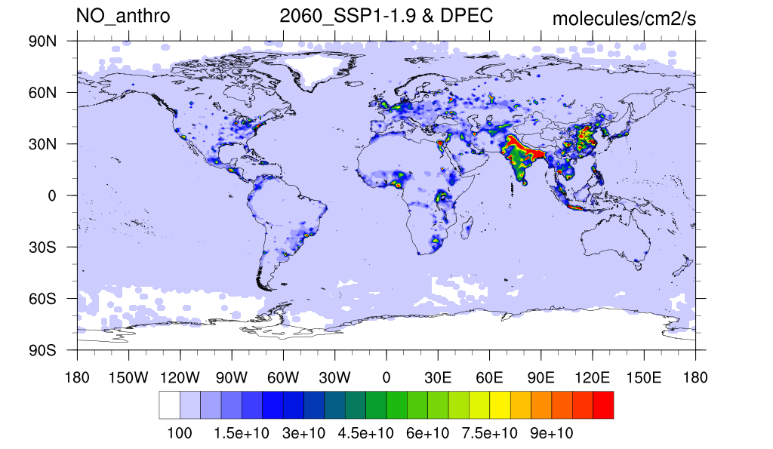
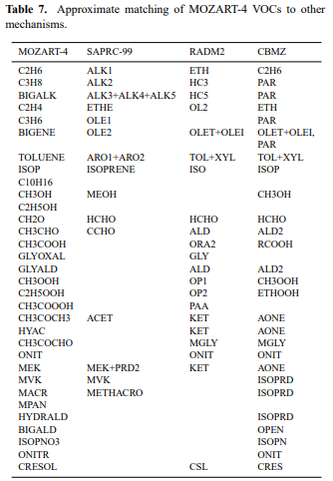
Net Zero:2060 (China carbon neutral)
Combined SSP1-1.9 with DPEC
>29 species
>20 VOCs species

Slide 3
Net Zero:2060 (China carbon neutral)
Change of emissions under a Net Zero scenario
NO, VOCs and CO emissions and CH₄ concentrations under present day and future net zero scenarios in the global and East Asia
Emission (Tg yr⁻¹) |  | Globe |  | East Asia
 |  | Present Day | Net Zero | Present Day | Net Zero
NO | ANT | 87.5 | 19.1 | 36.9 | 7.5
 | BB | 8.9 | 7.5 | 0.7 | 0.5
 | Soil | 10.6 | 10.6 | 2.3 | 2.3
 | Total | 106.9 | 37.2 | 39.8 | 10.2
VOCs | ANT | 125.0 | 27.5 | 42.9 | 11.0
 | BB | 66.6 | 50.2 | 6.3 | 4.0
 | BIO | 868.5 | 868.5 | 111.0 | 111.0
 | Total | 1060.1 | 946.2 | 160.3 | 126.0
CO | ANT | 559.8 | 151.7 | 266.9 | 72.7
 | BB | 325.5 | 248.2 | 30.2 | 18.9
 | Ocean | 20.0 | 20.0 | 1.3 | 1.3
 | Total | 905.2 | 419.9 | 298.4 | 92.9
CH₄ (ppbv) |  | 1830.5 | 1312.2 | 1860.8 | 1337.3
Emissions inventory：
SSP1-1.9 + DPEC Ambitious Pollution-Neutral-Goals scenario
78%
80%
78%
74%
Anthropogenic emission over East Asia decreases ~70%
73%
73%
Notes:
基于碳中和情景，预估的各污染物排放量大幅降低，如NO,VOCs,CO等，其中人为排放减少量最高，达70%。

Slide 4
Future tropospheric ozone burden and budget
CESM model
Tropospheric O₃ burden and budget terms in chemical transport model (CTM) (Tg/yr).
Photochemical process weaker
Tropospheric ozone burden decrease, back to the pre-industrial revolution level.
The decrement in East Asia less than the global
Lifetime increase by 2 days, 10% (global), 13% (East Asia)
Stratospheric contribution increase, 12% (global), 20% (East Asia)
Models | Prod | Loss | NetChem | Residual | DryDep | Burden (O₃/O₃S) | Lifetime (days) | Reference
Globe |  |  |  | STE
33 | 3948±761 | 3745±554 | 245±346 | 636±273 | 902±255 | 307±38 | 21-25 | Wild (2007)
17 | 4465±514 | 4114±409 | 396±247 | 529±105 | 949±222 | 314±33 | 22±2 | Stevenson et al. (2006)
15 | 5110±606 | 4668±727 | 442±309 | 552±168 | 1003±200 | 344±39 | 22±2 | Young et al. (2013)
PI | 2549 | 2437 | 112 | 415 | 528 | 241 | 29 | Griffiths et al. (2021)
PD | 4510 | 3948 | 562 | 284 | 846 | 337 | 26
PD | 5038 | 4641 | 397 | 595 | 992 | 316/69 | 20 | This study
NZ | 3392 | 3311 | 81 | 626 | 707 | 247/77 | 22 | This study
East Asia |  |  |  | Transport
PD | 682 | 455 | 227 | -89 | 138 | 25/5 | 15 | This study
NZ | 430 | 293 | 137 | -38 | 99 | 19/6 | 17 | This study
Notes:
Prod for chemical production, Loss for chemical loss, Prod-Loss for net chemical production (NetChem) and DryDep for dry deposition; Residual is the term balance by Residual=Loss-Prod+DryDep. Units of Prod, Loss, NetChem, Residual and DryDep are in Tg(O3)/yr, Burden in Tg(O3), and Lifetime in days. The climatological pressure tropopause is used. PD is the online present day experiment simulation. NZ is online net zero experiment simulation.

Slide 5
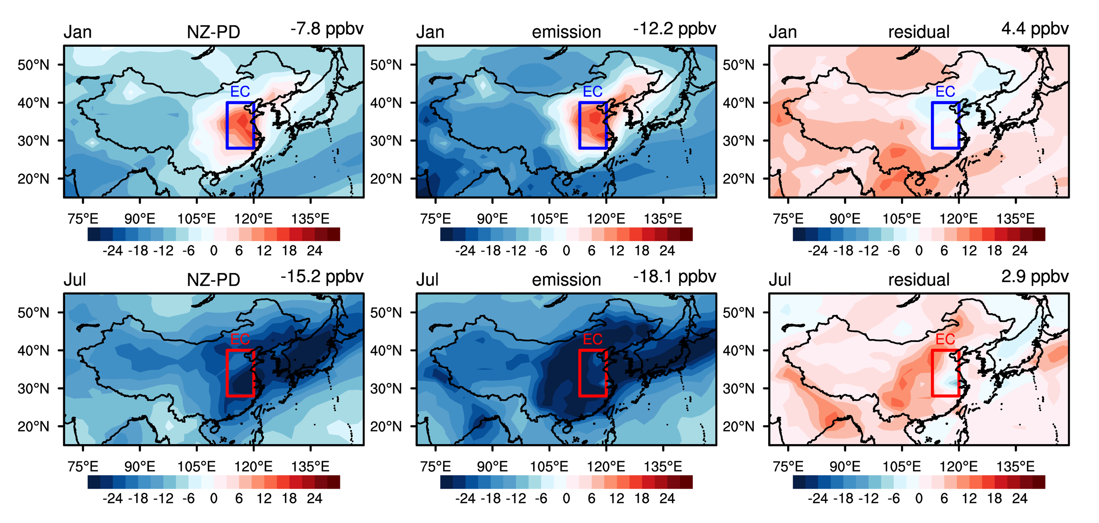
Future tropospheric ozone distribution
Change of surface ozone over East Asia
Over high emission regions, weak NO titration -> surface O₃ increase in winter.
In summer, surface O₃ decrease by -18 ppbv
Reduced emission
Climate change etc. ->surface O₃ increase, 2.9ppbv in summer
Winter
NZ-PD
Emission
Residual
Summer

Slide 6
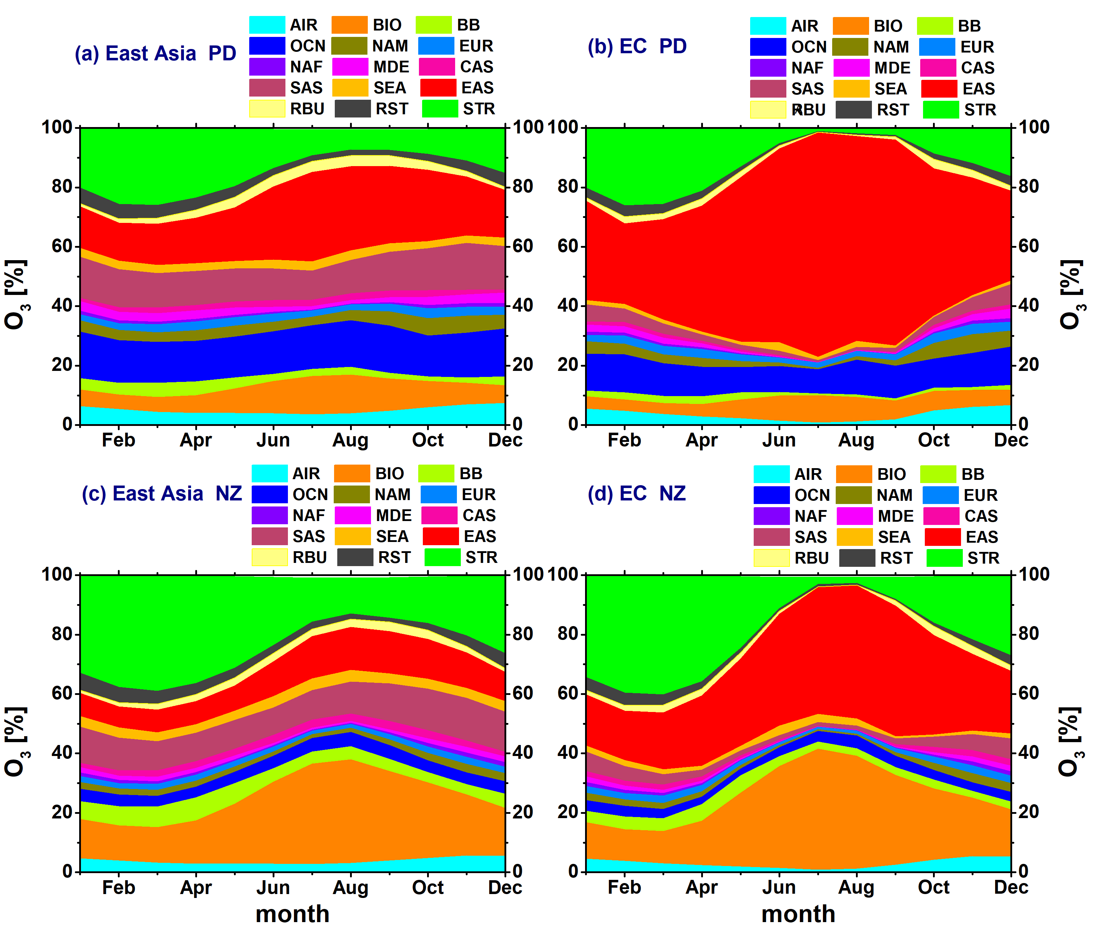
Quantifying the contributions of different sources to surface O₃
TOAST1.0- Tropospheric Ozone Attribution of Sources with Tagging
(Butler, et al., 2018;2020)
In summer, local anthropogenic contribution decrease from 75% to 50% over eastern China;
Oceanic contribution decrease from 17% to 4%, (shipping);
Biogenic contribution increase (OPE);
Stratospheric contribution increase, 26% to 39% in February and March.
Hou et al., ACP, 2023
Notes:
The subsequent ozone production is quantified by tracking NO/VOCs and its related species
在CESM大气化学模块中引入在线臭氧源追踪算法，通过标记臭氧前体物NO或VOCs以及NO或VOCs相关衍生物的方法，计算全球范围内某NO源区或VOCs源区对臭氧的影响，包含输送过程中臭氧的二次产生。可按前体物排放类型及区域进行追踪 。
如表中按NOx生物质排放、生物质燃烧、飞机、闪电以及平流层O3源进行标记追踪，或者按区域进行追踪。
左下角的图为2015年各源区对我国东部近地面臭氧的贡献量。
An extension to the ozone-tagging system described by Emmons et al. (2012).
Tagging NOx and VOCs to track ozone
Can specify an arbitrary number of tag identities for each NOx or VOC

Slide 7
Vertical changes in stratospheric contribution
Winter
PD
NZ-PD
emission
Stratospheric contribution increases due to climate change under:
Enhancement of circulation; Changes in tropopause (folding, lifting, etc.);
Mitigation of chemical loss; longer lifetime of O₃
Summer
Notes:
&prescribed_ozone_nl
prescribed_ozone_cycle_yr = 2065
prescribed_ozone_datapath = '/nuist/scratch/zhubin/zb_houxw/CESM_INPUT/atm/cam/ozone'
prescribed_ozone_file = 'ozone_rcp26_v1_1.9x2.5_L26_1995-2105_c100316.nc'
prescribed_ozone_name = 'O3' prescribed_ozone_type = 'CYCLICAL'

Slide 8
Thanks for your attention!
Paper’s link

