Slide 1
Vertebrate Biogeography of the Late Cretaceous (Cenomanian-Maastrichtian) Western Interior Seaway of North America by Percent Community Similarity with the Faunal Assemblages of South-Central Canada
Supplementary Slides
Aaron Kilmury MSc
Notes:
Thank you for the most kind introduction. As mentioned, I will be presenting my research involving vertebrate biogeography of the Late Cretaceous Western Interior Seaway with insights from the Manitoba escarpment.

Slide 3
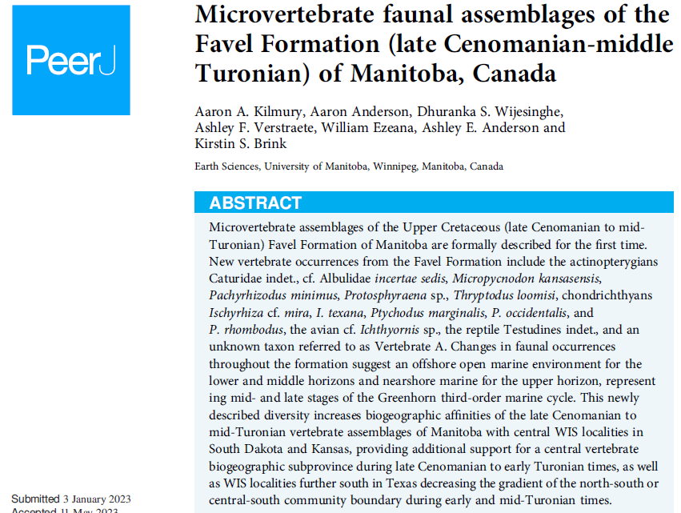

Slide 4
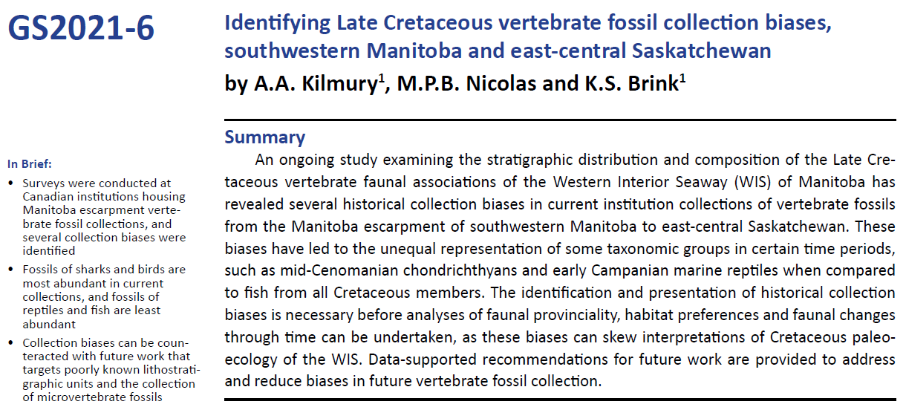

Slide 5
Discussion
General WIS Molluscan Zones
Radiometric ages since 1990 have increased stratigraphic resolution of biostrat correlations
Correlation of time-averaged WIS assemblages provides insights into major biogeographic trends, with limits
Apparent biases include: geographic, stratigraphic, preservational, taxonomic, & size
These biogeographic results may be used to better inform efforts to counteract existing biases
A.R., NWT
L.B., NWT
AB
AB
SK
MB
ND
MN
WY
SD
IA
NE
KS
AL
TX
Kauffman (1984)
Notes:
Mostly seeing how zonation appeared during transgressive phases of major marine cycles when more sediment is being deposited and burying vertebrate remains, and less so during regressive phases and lowstand events.
Uneven sampling over geographic space, stratigraphic intervals, and of taxonomic groups and size classes.
And build fossil collections more representative of WIS vertebrate communities.
This study provides more resolved and better supported information on WIS vertebrate zonation than previously known, and also provides important information on existing biases.

Slide 6
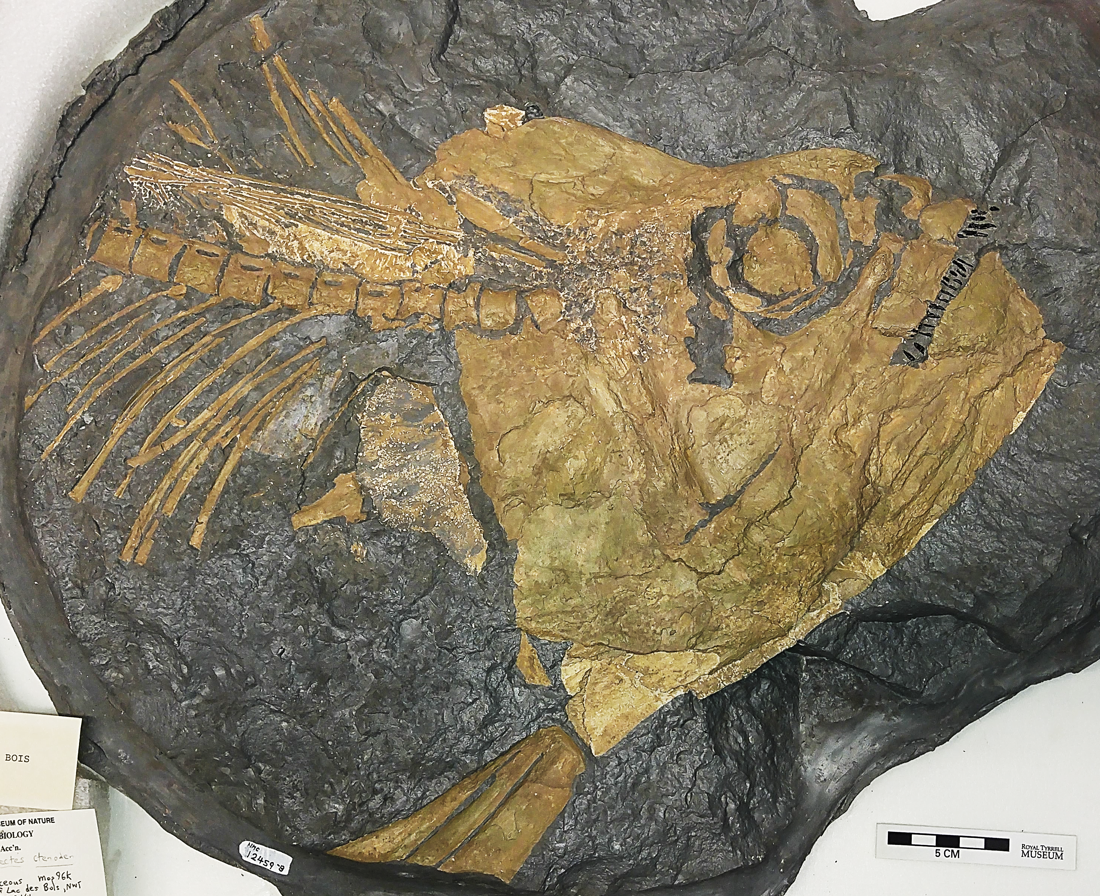
Future Work
CFDC P.04.01.15
MM V-3652
0.1 mm
Further Address Geologic Unit & Size Biases:
Microvertebrate faunal assemblages of the Late Turonian to Late Campanian of Manitoba
Address Geographic Bias:
Vertebrate faunal assemblages of northern sites within the Arctic Circle of Northwest Territories (NWT), Canada
1 mm
CFDC M.04.01.15
1 mm
CMN FV 12459-B

Slide 7
Relative ages determined using foraminifera assemblages (McNeil & Caldwell, 1981)
Recent absolute ages obtained by TIMS analysis of zircons sorted from bentonites
= Low Amount
of Fossils
Notes:
Here is a lithostratigraphic scheme for the MB escarpment along with foraminiferal zones and subzones, which were originally used to determine the relative ages of these deposits. In 2016, the Manitoba Geological Survey published these U-Pb radiometric ages obtained through TIMS analyses of zircons sorted from bentonite beds sampled from the escarpment. My project considers these 9 Late Cretaceous lithostratigraphic members.

Slide 8
Percent Similarity Calculations
PS values calculated for both genera and species, using RA data:
PS_{g} = Sum of Common Genera
Relative Abundance with Lowest %
For KS-MB, Early Campanian:
No. of Common Genera, c_{g} = 6
PS_{g} = 1.0%+0.3%+1.2%+5.4%+5.4%+1.2%
PS_{g} = 14.50%
Notes:
As alluded to in the presented methods, community similarity values are calculated for both genera and species-level datasets. The first calculation is determining Sorensen’s Coefficient of Community (CC) and involves analysis of presence-absence data, so whether a genus or species is present in an assemblage or not. The Coefficient of Community is equal to double the amount of common genera or species, divided by the number of genera or species in assemblage 1 plus that of assemblage 2. For example, for the early Campanian community correlation of the Pembina Member assemblage of MB with the Sharon Springs Fm assemblage of Kansas involves six common genera, with 20 and 11 genera from each assemblage. With these values, the Coefficient of Community is 10% similarity. The other calculation employed is solving for Percent Similarity with the use of relative abundance data. This calculation is simply the sum of common genera with the lowest relative abundance between the two compared assemblages. Using the same example as for the Coefficient of Community example, the lowest relative abundances of the six common genera are added to equal a sum of 14.5% community similarity. Since relative abundances of genera are examined in the 1990 study and are generally recommended for biogeographic comparisons, I will now show you preliminary results using the last equation, calculation of Percent Similarity using relative abundance data of genera, for three of the nine time bins.

Slide 9
Best Supported Time Interval
L. Cenomanian-E. Turonian, ~93.5-95 Ma
8.54
Low association between PSg and primary lithology
r = 0.44 (p = 9.61e-3)
NWT only non-calcareous site
Mostly comparable sample sizes
NWT, MB, SD, IA: 70-120
KS & TX: 305 & 1838
NE: 39
Contains highest PSg values
KS: 45.52%
NE: 37.39%
?
MB
33.35
21.91
37.39
45.52
9.12

Slide 10
Museum Survey Results
Total of 8185 museum specimens accounted for
Belle Fourche is the most represented member with 6732 specimens
Odanah is the least represented member with 1 specimen
Morden
Lithostratigraphic Member
Gam. Fer.
Odanah
Odanah
Millwood
Pembina
Gammon Ferruginous
Boyne
Morden
Assiniboine
Keld
Belle Fourche
Kilmury et al. (2021)
Notes:
A total of 8,185 specimens were accounted for and in terms of distribution by lithostratigraphic member, the Belle Fourche is the most represented with 6,732 specimens, and the Odanah the least represented with only one known specimen.

Slide 11
Museum Survey Results
?
Total = 8185 specimens
Total = 75 species
Kilmury et al. (2021)
Notes:
In terms of the traditional vertebrate classes represented in all Manitoba escarpment units combined, cartilaginous fish are most represented and marine reptiles the least represented. In terms of species known to date, a total of 75 vertebrate species were accounted for with cartilaginous fish the most diverse group and birds the least diverse group.
Now what do the vertebrate diversity trends look like over time and how do they compare with other faunal groups?

Slide 12
Litho-, Chemo-, & Cyclostratigraphic Correlations
Upper Cretaceous units of MB were correlated with WIS T-R megacycles by:
Age
Grain size & lithology
TOC content
Mg, Al, K, & Ca content
V & Zn content
Notes:
The Upper Cretaceous units of Manitoba were correlated with Western Interior Seaway transgressive-regressive megacycles by:
Age, grain size and lithology, total organic carbon content, as well as amounts of major and trace elements influenced by water depth, which include magnesium, aluminum, potassium, calcium, vanadium, and zinc.
Geochemical data available from three cores allowed for correlation of the Belle Fourche Member with the informal ‘Belle Fourche’ megacycle, the Favel Formation with the Greenhorn megacycle, and the Carlile Formation with the Niobrara megacycle. Correlations made with Pierre Shale Formation units mainly relied on absolute and relative age determinations. The Gammon Ferruginous and Pembina members were correlated with the Claggett megacycle, the Millwood Member with the Bearpaw megacycle, and the Odanah with the informal ‘Fox Hills’ megacycle.

