Slide 1
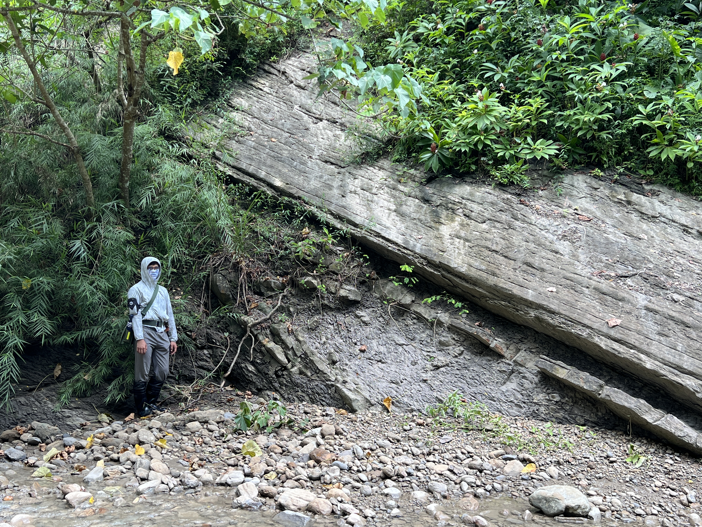




Sedimentary environment of Tangenshan sandstone in southwestern Taiwan and its tectonic implications
Tien-Kai Tang
Research Center of Geothermal, CO2 Storage and Petroleum Strategy, National Cheng Kung University
Guan-Wei Lin¹, Le-Chun Wu³, Kenn-Ming Yang^{1,2}, and Sung-Ping Chang¹
¹Department of Earth Sciences, National Cheng Kung University
²Research Center of Geothermal, CO2 Storage and Petroleum Strategy, National Cheng Kung University
³Department of geology, Chinese Culture University

Slide 2
Outline
Introduction
Research purposes
Methods
Geological Background
Results
  Lithofacies description
  Lithofacies associations
  Sedimentary environments
Discussion
  Shallow water turbidite
  The relationship between sedimentary environments and terrane structure
Conclusion

Slide 3
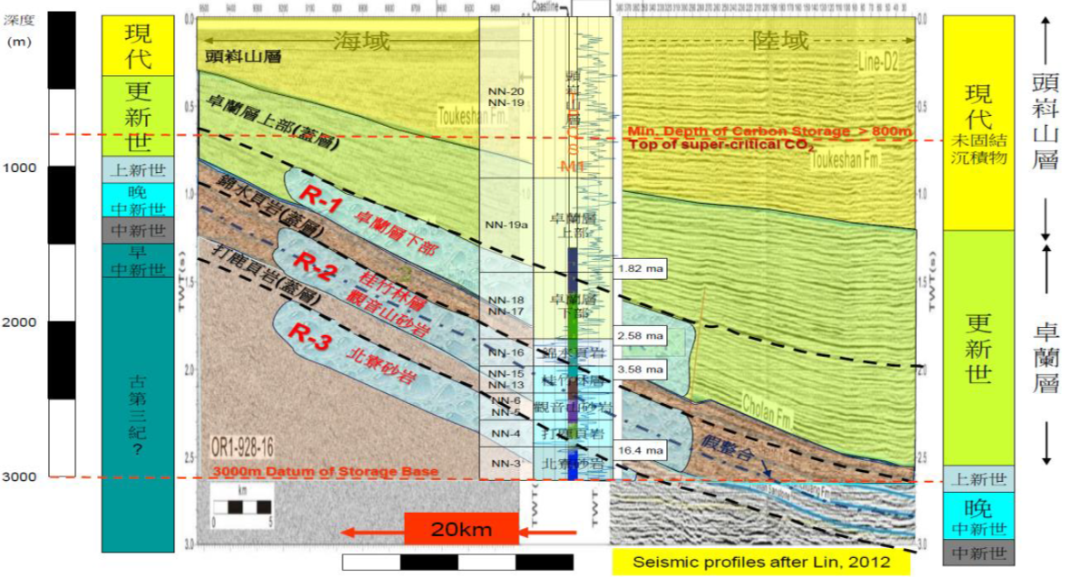
Introduction─Research purposes
Academic research
Except for studies on sedimentary environments of the Tangenshan Sandstone in the Hungfatszu sections and some areas in Kaohsiung, there have been few studies or publications on the sedimentology of the Tangenshan Sandstone in other nearby regions. （Oinomikado and Huang, 1957；Huang, 1977；Chi, 1978；Ting et al., 1991；Yeh and Chang, 1991；Yu et al., 2008 ）
The industrial application
Records of oil and gas production
Designated sites for reservoir dam construction
Prospective stratigraphic layers for carbon dioxide sequestration
The lithofacies characteristics, sedimentary environment, benthic fossil assemblages, and regional variations of the Tangenshan Sandstone are all the objectives of this study

Slide 4
Introduction─Methods
Field geological survey
Field geological surveys
Construction of sedimentary stratigraphic columns
Sedimentology
  Establishment and analysis of lithofacies
  Interpret the sedimentary environment changes
Ichnology ( Trace fossil )
  Identifying trace fossils to assist in interpreting sedimentary environments
Lithological characters
Sedimentary structure
Trace fossil
Establishment of lithofacies
Construction of stratigraphic columns
Interpreting sedimentary environments

Slide 5
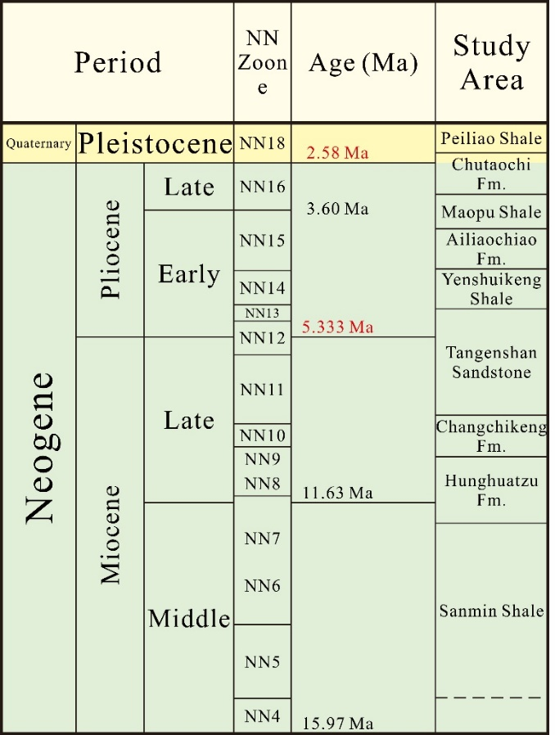
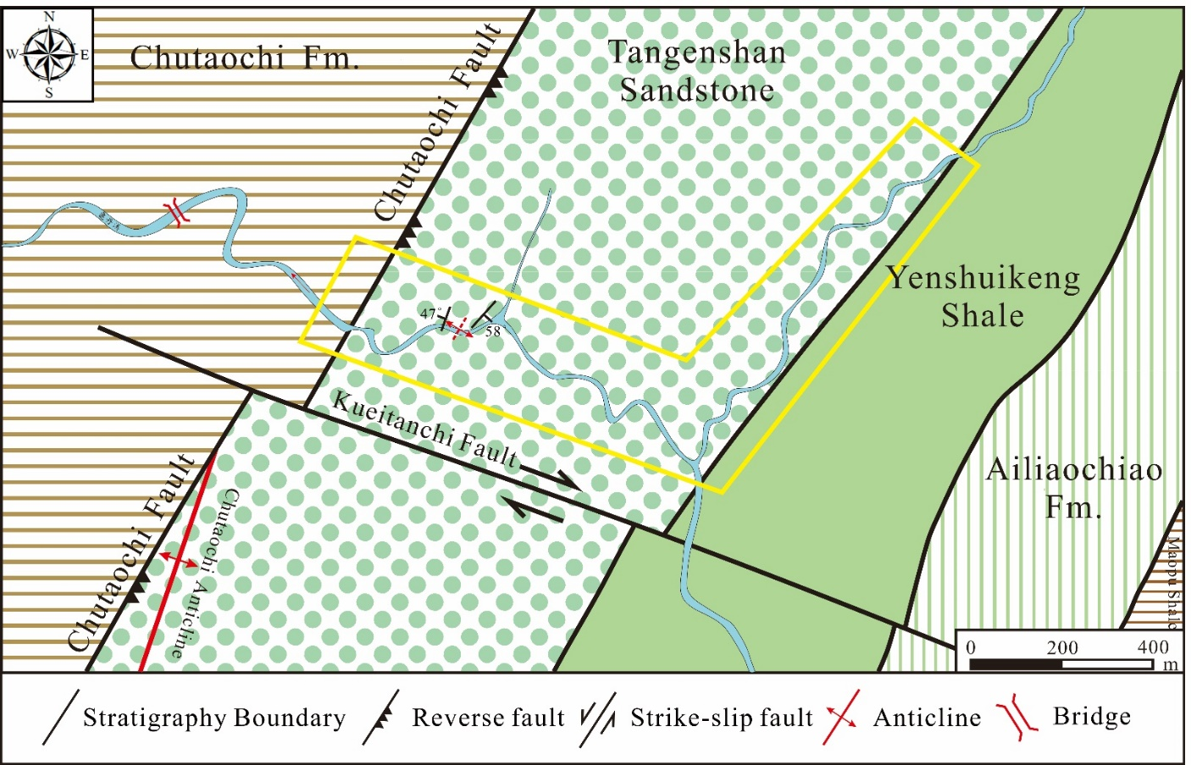
Geological Background
The tectonic structure belongs to the passive continental margin.
The age of the Tangenshan Sandstone ranges from Late Miocene to Early Pliocene（NN11-NN13）.
The lithology mainly consists of thick-bedded fine to medium-grained sandstone, with interbedded dark gray shale or siltstone.

Slide 6
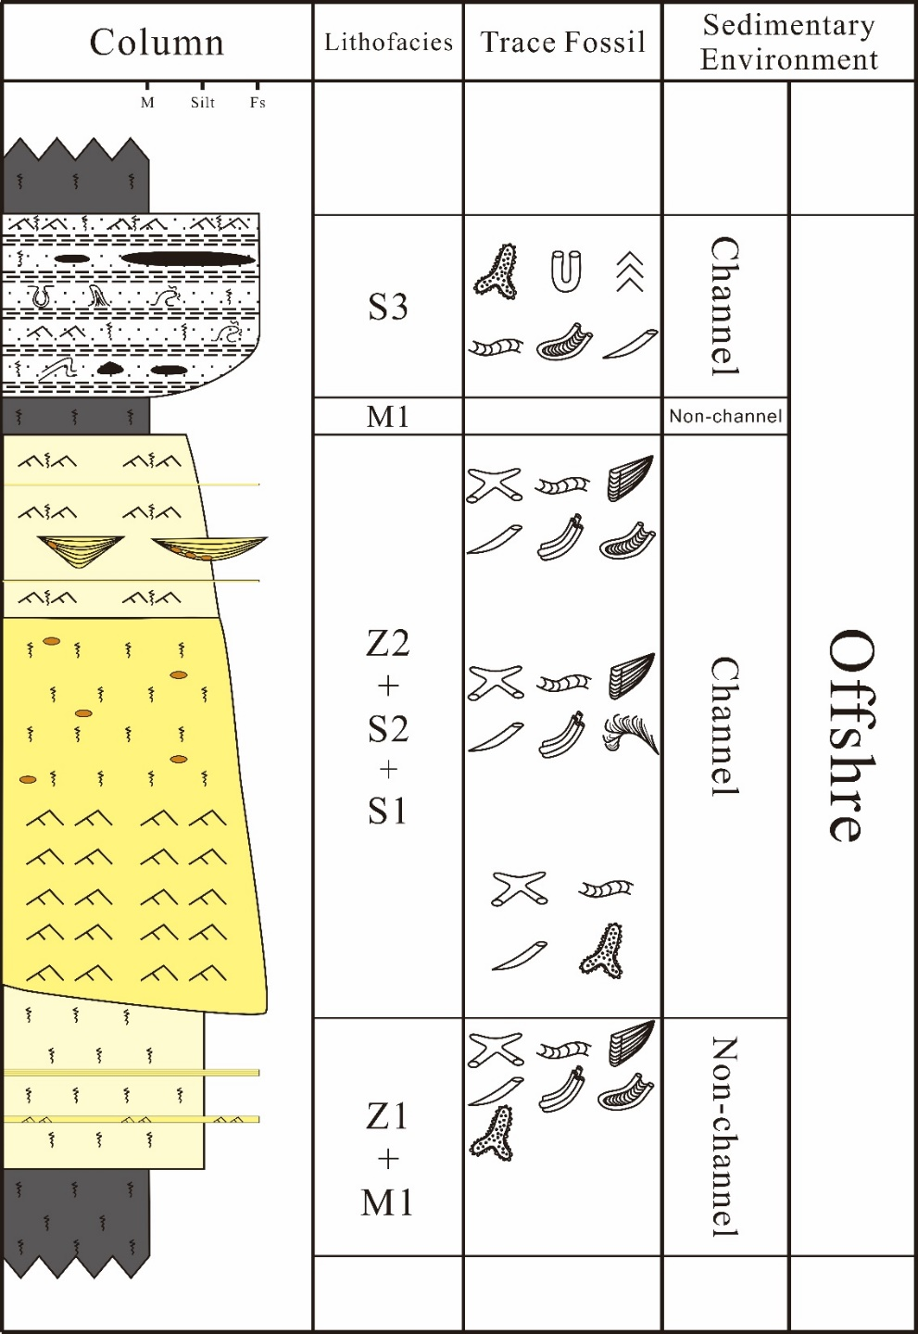
Results─Lithofacies description
Lithofacies | Lithology and sedimentary structures | Trace fossils | Depositional Processes
M1: Massive mudstone facies | Grain size: mud ; 1.5-15m thick bedsets ; No visible sedimentary structure ; | No visible trace fossil | Low energy, deposition primarily from suspension.
Z1: Massive siltstone facies | Grain size: mud to silt ; 2-40m thick bedsets with 5-10cm thin-bedded fine grain sandstone ; Load, Convolute structure Parallel lamination, current ripple lamination in thin-bedded fine grain sandstone ; | Teichichnus Rhizocorallium Palaeophycus Schaubcylindrichnus Scolicia Thallassinoides ; Ophiomorpha in thin bedded-fine grain sandstone | Mud and silts are deposited by suspension Parallel and current ripple lamination may have been induced by storms
Z2: Thick-bedded fine grain sandstone with small-scale channel facies | Grain size: silt to fine sand ; Relict sedimentary structure (current ripple lamination, Load, dewatering structure) ; V or U-shape small-scale channel structure ; | Teichichnus Rhizocorallium Palaeophycus Schaubcylindrichnus Scolicia Thallassinoides | May have been induced by turbidity currents triggered by storms

Slide 7
Results─Lithofacies description
Lithofacies | Lithology and sedimentary structures | Trace fossils | Depositional Processes
S1: Current ripple lamination sandstone facies | Grain size: silt to fine sand ; 0.5-5m thick bedsets ; Current ripple lamination, Load, dewatering structure ; small gravel with pyrite nodules ; | Palaeophycus Scolicia Thallassinoides Ophiomorpha | High energy and high sedimentary ratio
S2: Thick-bedded bioturbation sandstone facies | Grain size: fine to medium sand ; 10-50m thick bedsets ; Visible bioturbation ; Relict current rippe lamination ; small gravel with pyrite nodules ; | Teichichnus Thallassinoides Scolicia Palaeophycus Schaubcylindrichnus Zoophycos | Zoophycos and pyrite nodules suggests that the environment was relatively hypoxic initially ; Sediment was transported to deeper environments by turbidity currents caused by storms
S3: Bioturbation siltstone interbeded with fine grain sandstone facies | Grain size: silt to fine sand ; About 40m thick bedsets ; Many small-scale synsedimentary deformation, current ripple lamination ; Small-scale mud clast and mud streak ; | Palaeophycus Scolicia Rhizocorallium escape structure Ophiomorpha Arenicolites

Slide 8
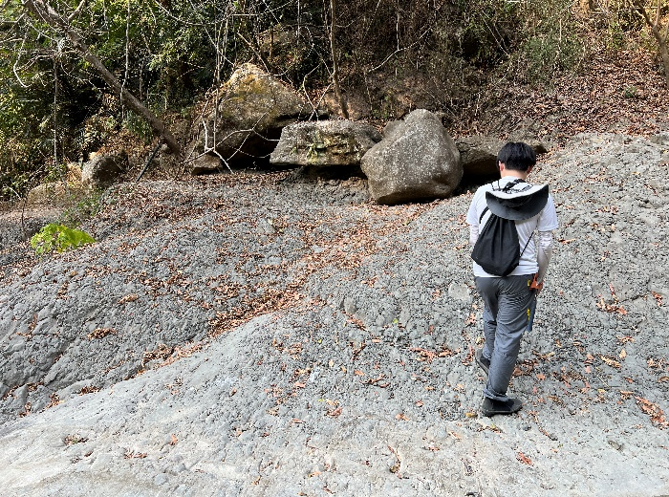
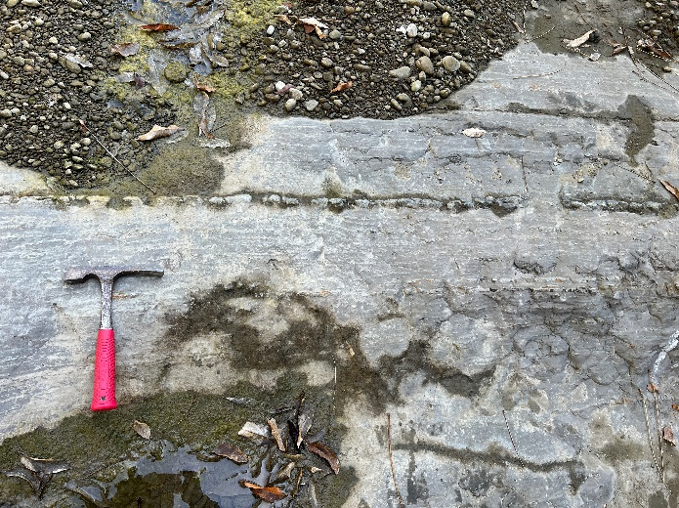
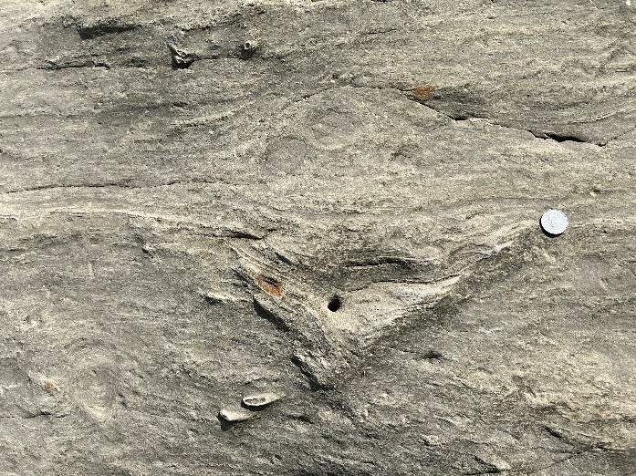
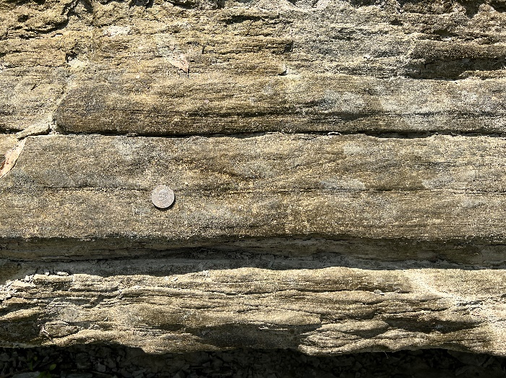
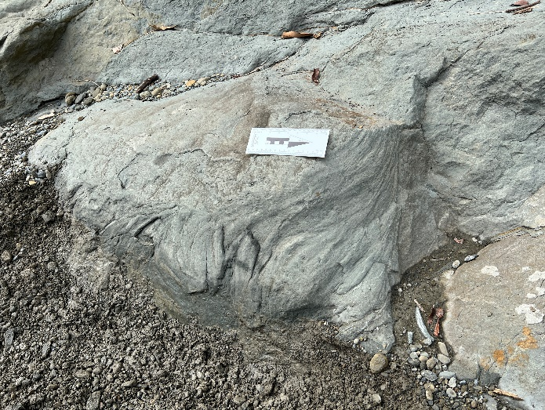
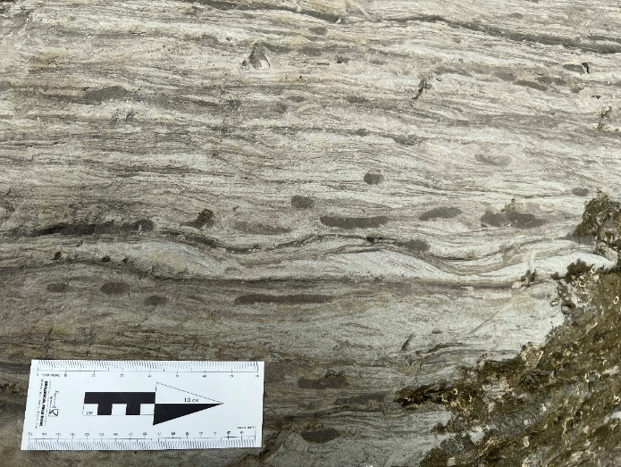
Results─Lithofacies description
a
b
c
a : Massive mudstone facies (M1)
b : Massive siltstone facies (Z1)
c : Thick-bedded fine grain sandstone with small-scale channel facies (Z2)
d : Current ripple lamination sandstone facies (S1)
e : Thick-bedded bioturbation sandstone facies (S2)
f : Bioturbation siltstone interbeded with fine grain sandstone facies (S3)
d
e
f

Slide 9
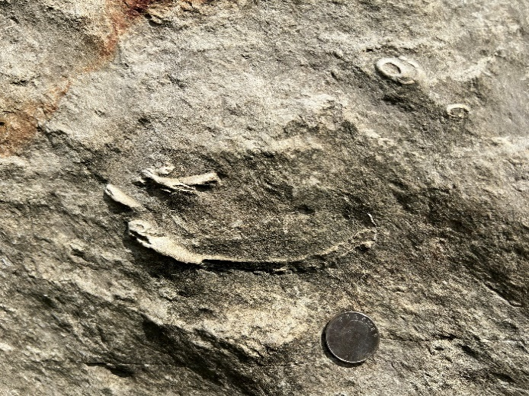
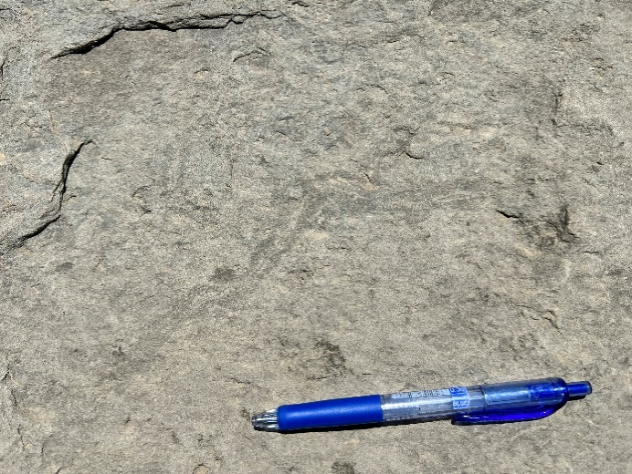
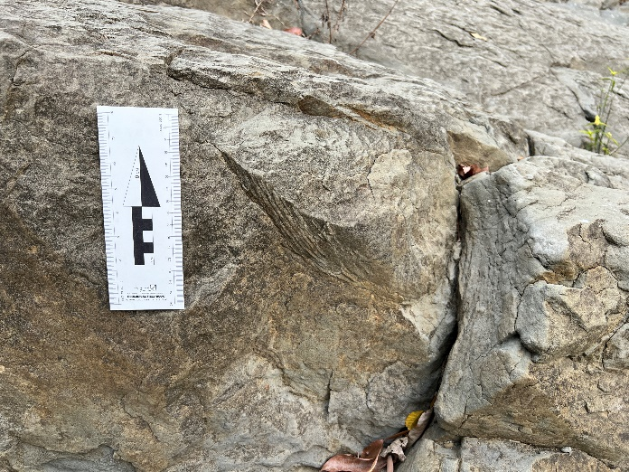
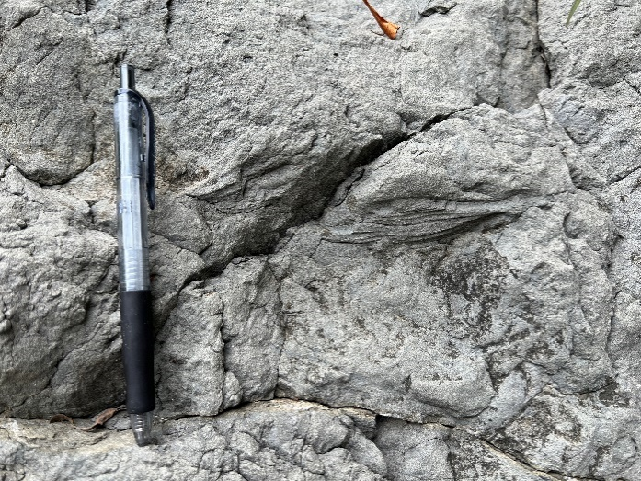
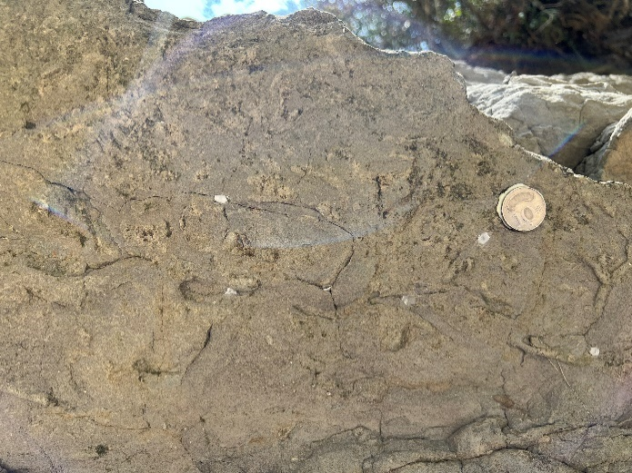
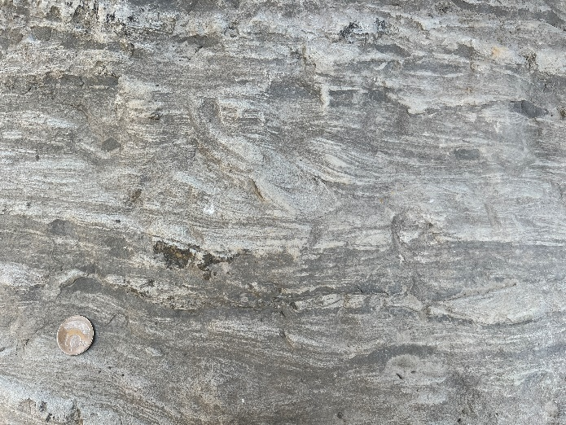
Results─Lithofacies description
a
b
c
a : Schaubcylindrichnus (Sch)
b : Scolicia (Sc)
c : Zoophycos (Zo)
d : Teichichnus (Tei)
e : Thallassinoides (Th)
f : Rhizocorallium (Rh)
Sch
Sc
Sch
Zo
d
e
f
Rh
Tei
Th

Slide 10
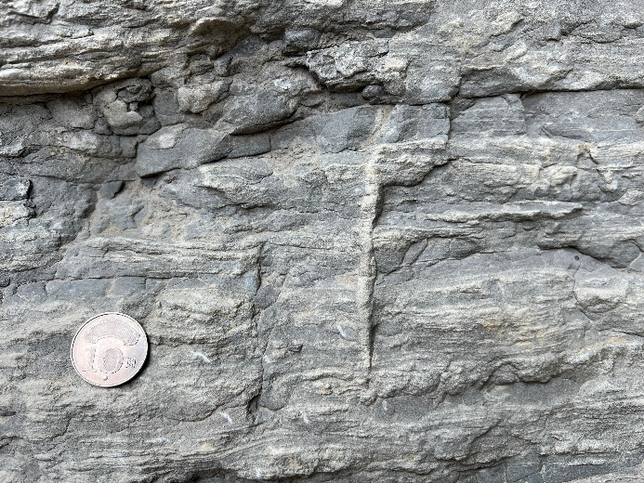
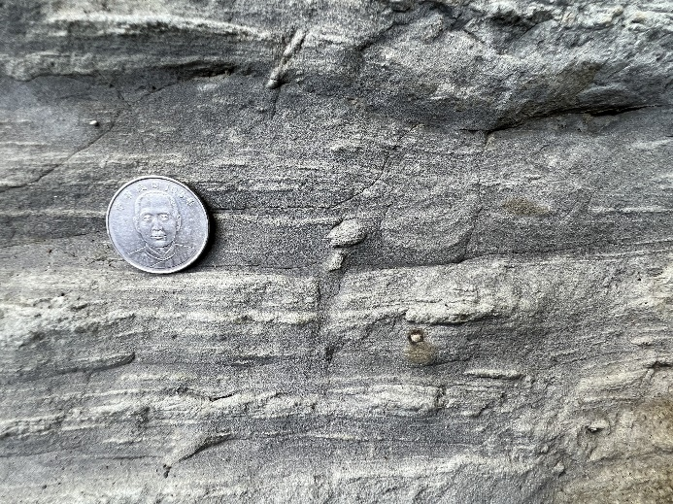
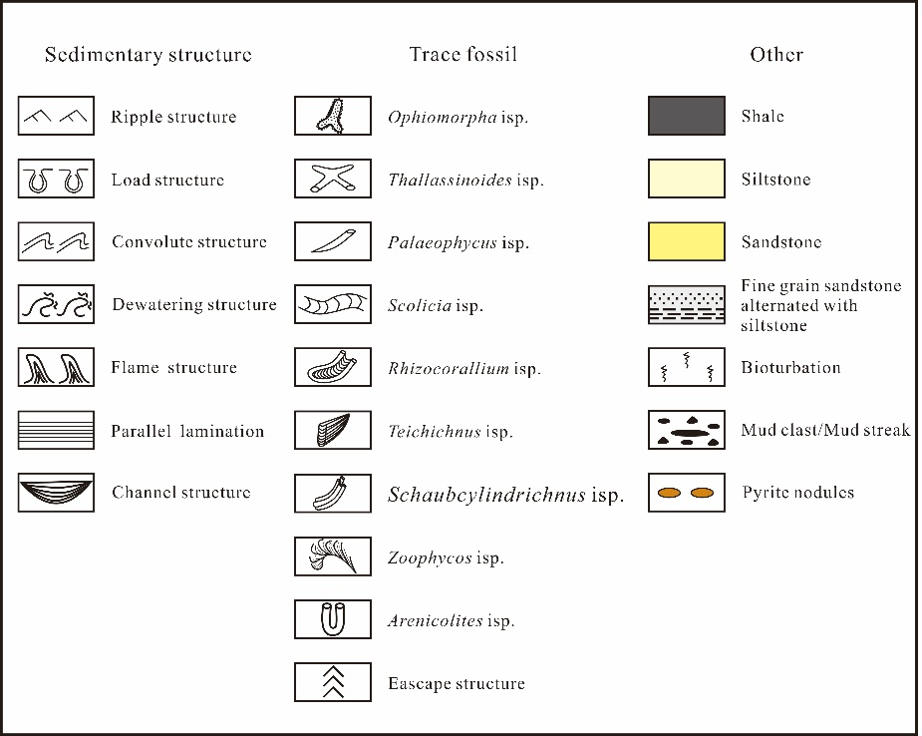
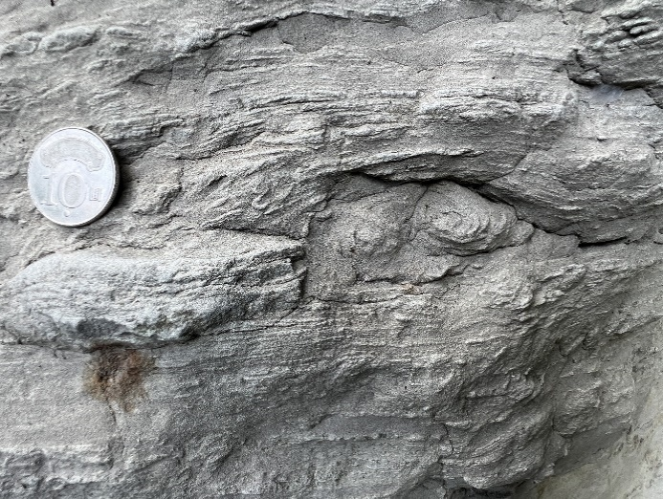
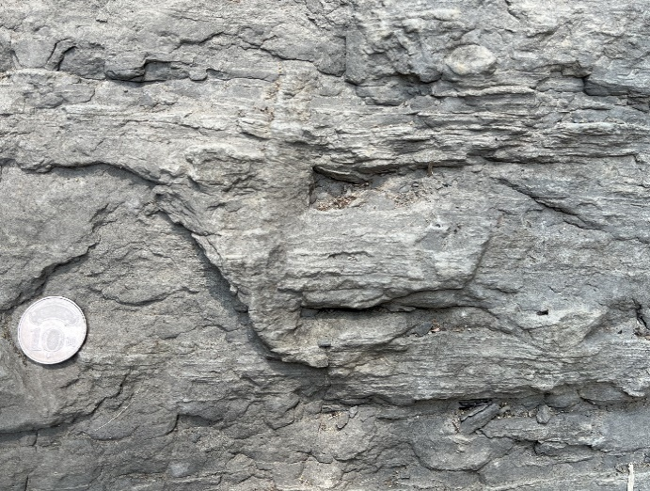
Results─Lithofacies description
a
b
Load structure
Dewatering structure
c
d
Ar
a : Dewatering structure
b : Load structure
c : Convolute structure
d : Arenicolites (Ar)
Convolute structure

Slide 11

Results─Lithofacies associations
The lithofacies assemblage suggests one sedimentary environment, characterized by an offshore depositional system dominated by storm and suspected turbidity currents.
M1 and Z1 represent the lithofacies deposited in a generally quiet / low energy environment.
S1, S2, S3, and Z2 represent lithofacies observed within channel structures, which through channel action, transport oxygen and nutrients from shallower environments to below the storm wave base, providing the necessary conditions for benthic biological activity.
The presence of large or small-scale channel structures suggests erosion caused by turbidity currents, likely triggered by storms, sliding down the shelf slope → It may be indicative of Shallow Water Turbidites.

Slide 12
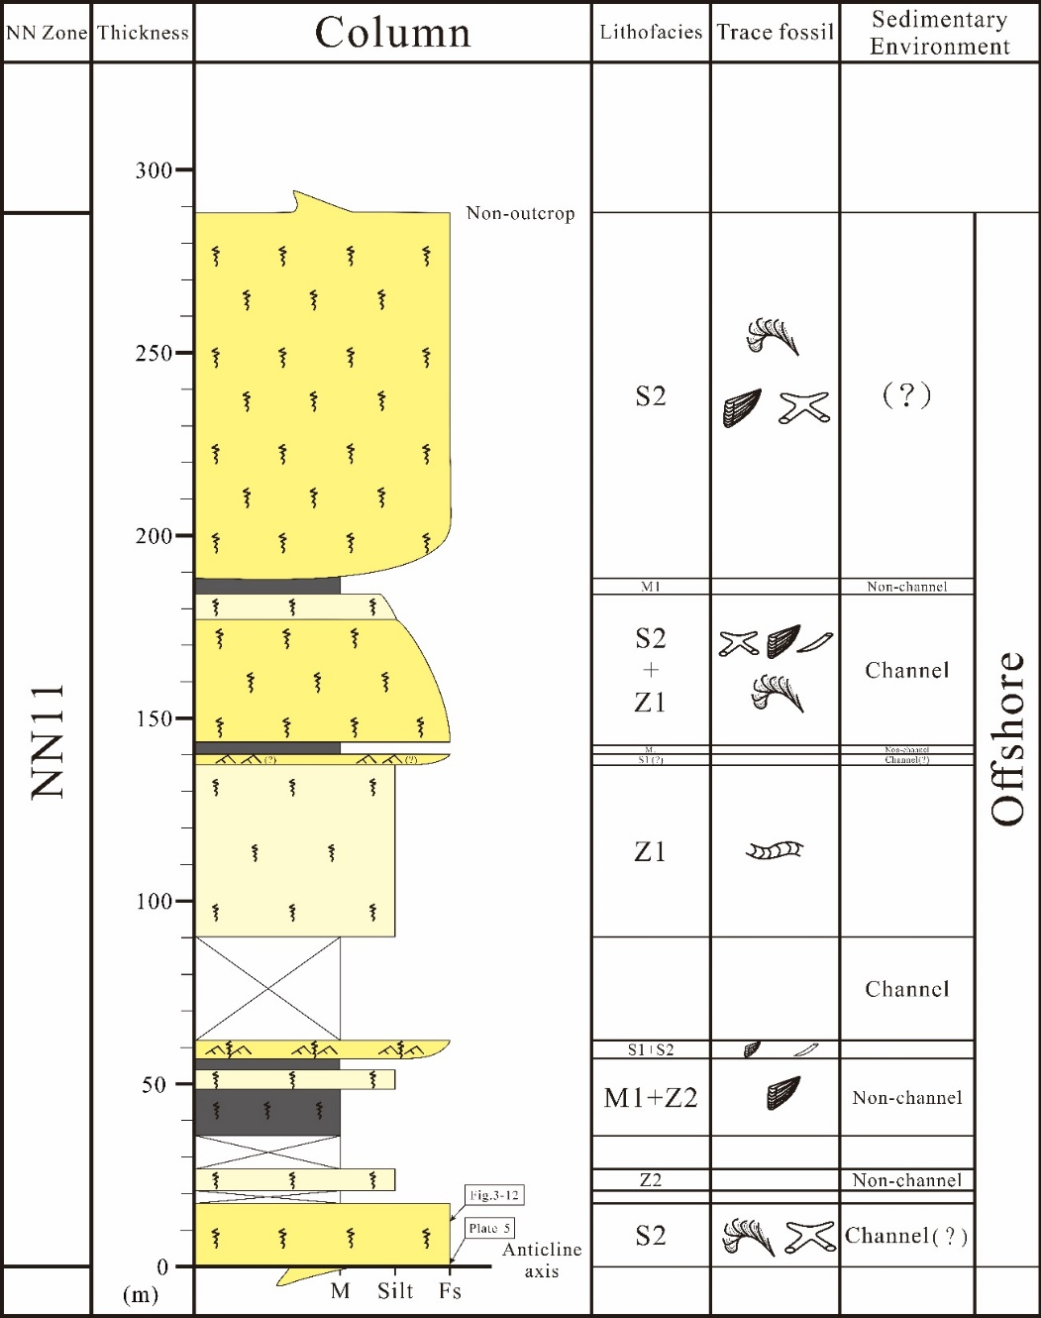
Results─Sedimentary environments
Kueitanchi Section anticline axis western limb
The total thickness is approximately 288.3m
The sedimentary environment is located in the offshore environments
The bottom of the column (i.e., the axis of the anticline) have abundant Zoophycos trace fossil.

Slide 13
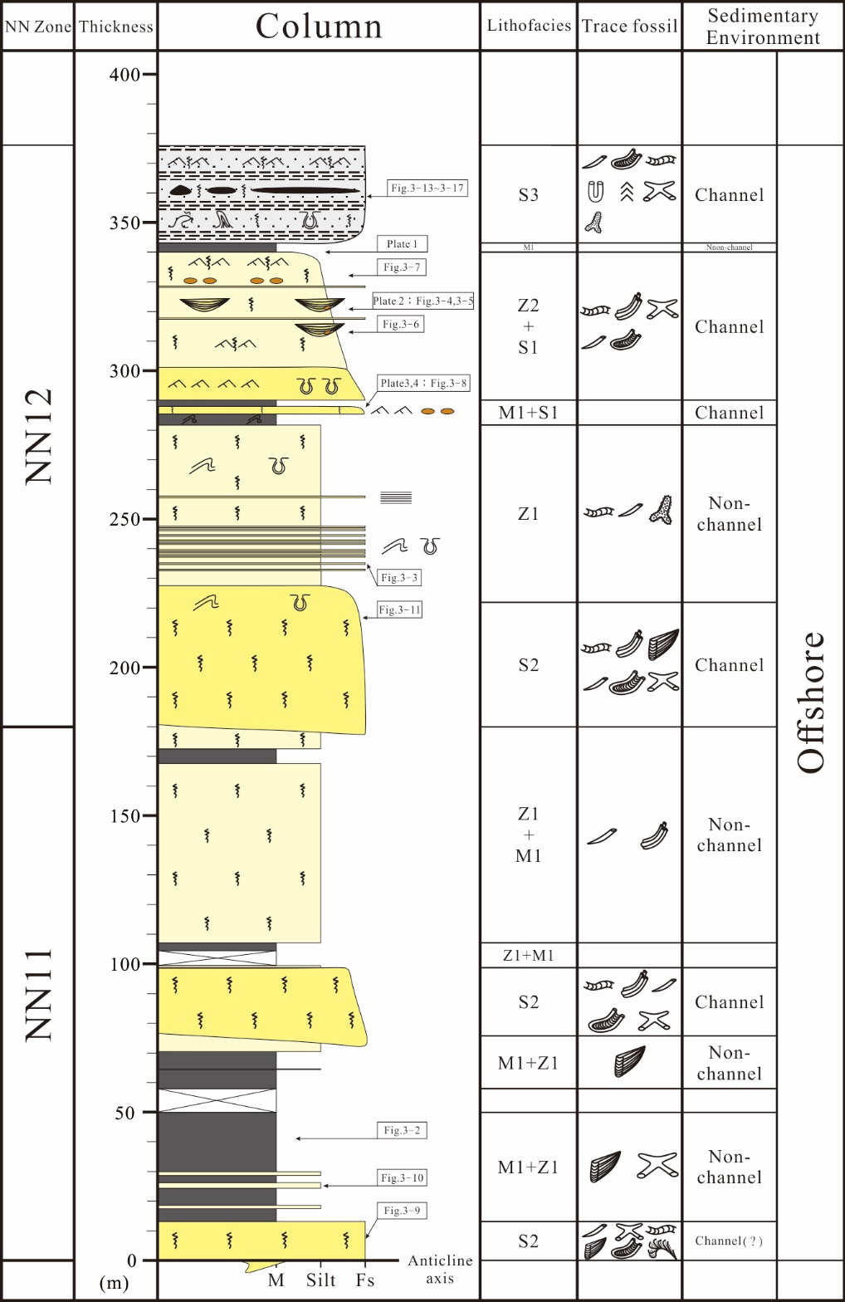
Results─Sedimentary environments
Kueitanchi Section anticline axis eastern limb
The total thickness is approximately 378m
The sedimentary environment is located in the offshore environments
The bottom of the column (i.e., the axis of the anticline) have abundant Zoophycos trace fossil.
Large-scale channel structures with multiple cross-cutting features, as well as small-scale channel structures, occur in this study area.

Slide 14
Discussion─Shallow water turbidite
It is inferred that these features were formed by turbidity currents caused by storm-induced erosion and transported in the continental shelf bottom toward the deeper areas.
When the retreating flow of a storm surge passed below the average storm wave base, it could reach deeper environments
The main difference between shallow-water turbidites and deep-sea turbidites lies in the diversity of sediment grain sizes. Shallow-water turbidites typically exhibit lower variability in grain size. Graded bedding can be better observed through the preparation of petrology thin sections.
（ Bouma, 1962 ; Seilacher, 1982 ; Brenchley, 1989 ; Walker and James, 1992）

Slide 15
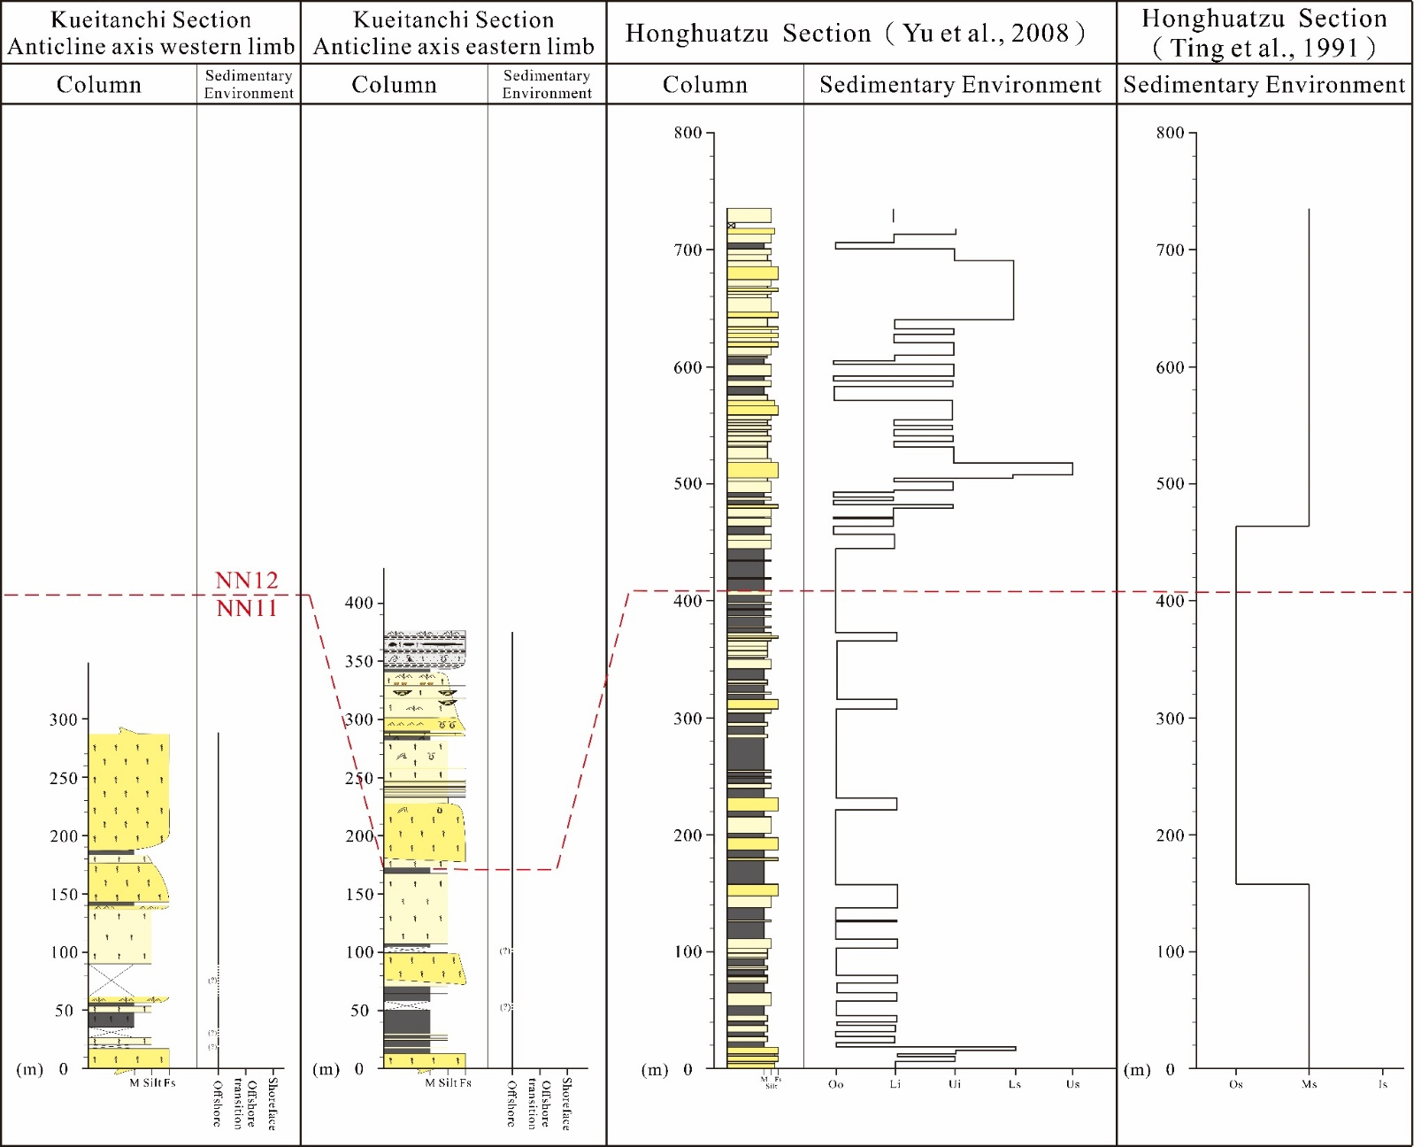
Discussion─ The relationship between sedimentary environments and terrane structure
The deposition of the Tangenshan Sandstone in the study area, as well as the Hunghuatzu section, is believed to have been influenced by normal faulting.
This has resulted in different sedimentary environments and variations in sediment thickness between the contemporaneous Tangenshan Sandstone deposits. The sediment thickness in the Hunghuatzu section is thicker than that in the Kueitanchi section.
The sedimentary environment in the Kueitanchi section is relatively deeper compared to the Hunghuatzu section, indicating a reversing regional variation in lithofacies and environmental changes between the two locations.

Slide 16
Conclusion
Based on the description of various features such as lithology, sedimentary structures, and trace fossils observed in the field outcrops, the Tangenshan Sandstone in the Kueitanchi section can be divided into one mudstone facies (M1), two siltstone facies (Z1, Z2), and three sandstone facies (S1, S2, S3). Moreover, this study identifies two types of depositional characteristics, namely channel-fill deposits and non-channel deposits. It is inferred that the sedimentary environment of the Tangenshan Sandstone was primarily associated with storm wave and presumed turbidity current processes in an offshore depositional system.
Based on lithofacies analysis, the sedimentary environment of the study area is inferred to be a low-energy and relatively oxygen-deficit environment below the storm wave base. The environment can be characterized by the transportation of coarser sediment particles by suspected storm-induced turbidity currents in the continental shelf and their deposition below the average storm wave base. This process generated submarine channels and non-channel deposits, such as overbank and sheet flow deposits, exhibiting sedimentary characteristics and mechanisms similar to shallow marine turbidites.
The deposition of the Tangenshan Sandstone in the study area, as well as the Hunghuatzu section, is believed to have been influenced by normal faulting. This has resulted in different sedimentary environments and variations in sediment thickness between the contemporaneous Tangenshan Sandstone deposits. The sediment thickness in the Hunghuatzu section is thicker than that in the Kueitanchi section. However, the sedimentary environment in the Kueitanchi section is relatively deeper compared to the Hunghuatzu section, indicating a reversing regional variation in lithofacies and environmental changes between the two locations.

Slide 17
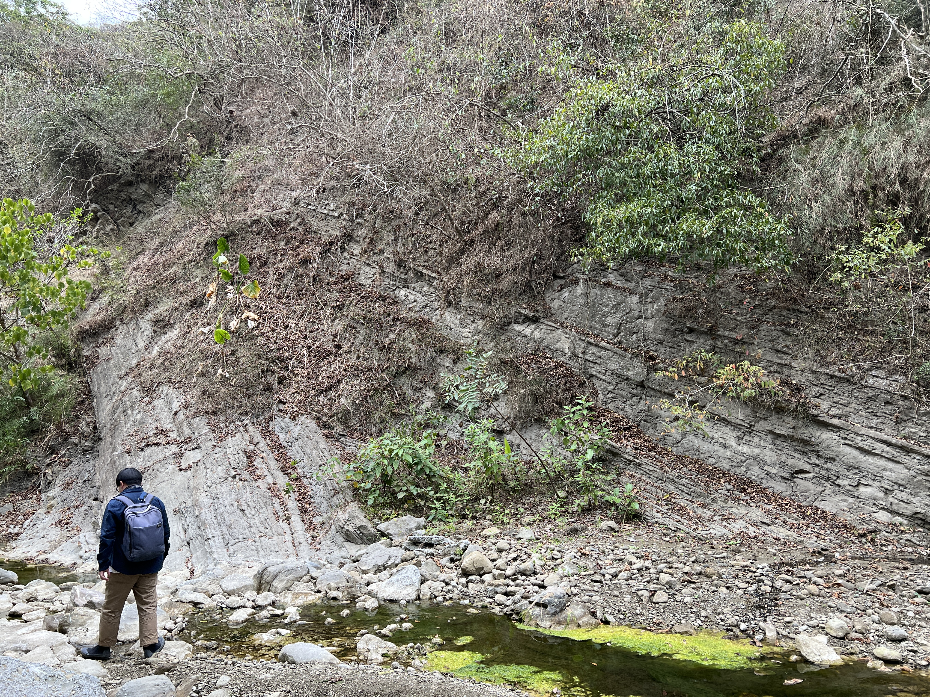
Thank you for your attention

