Slide 1
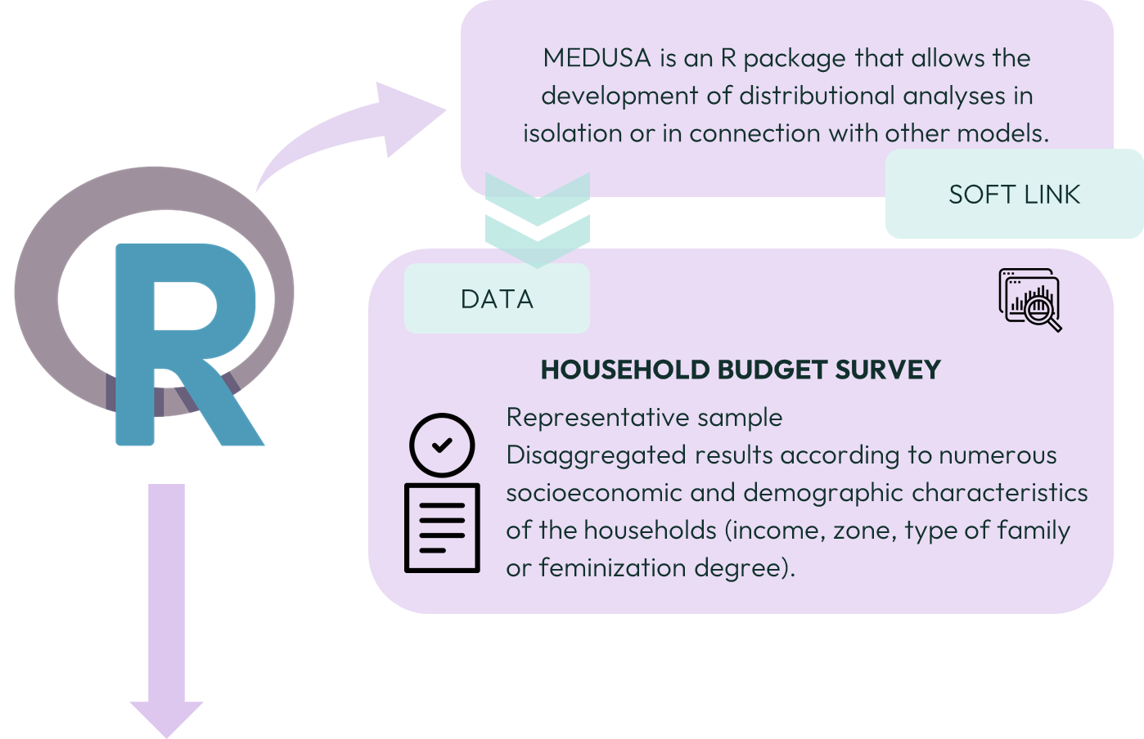
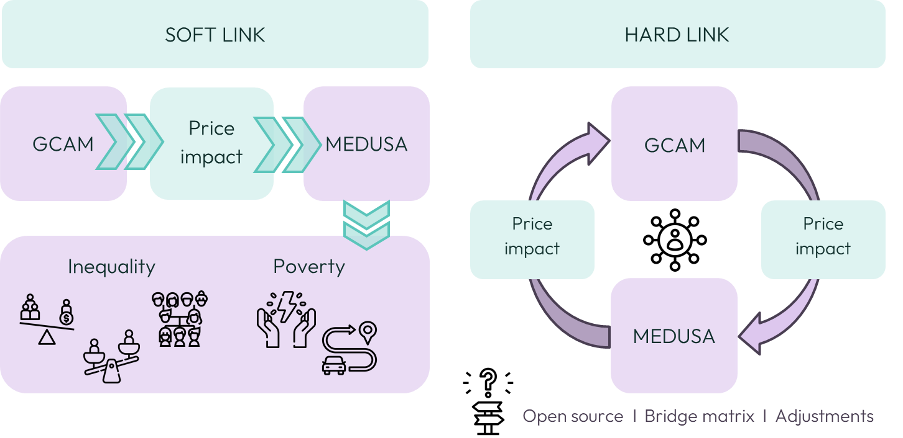
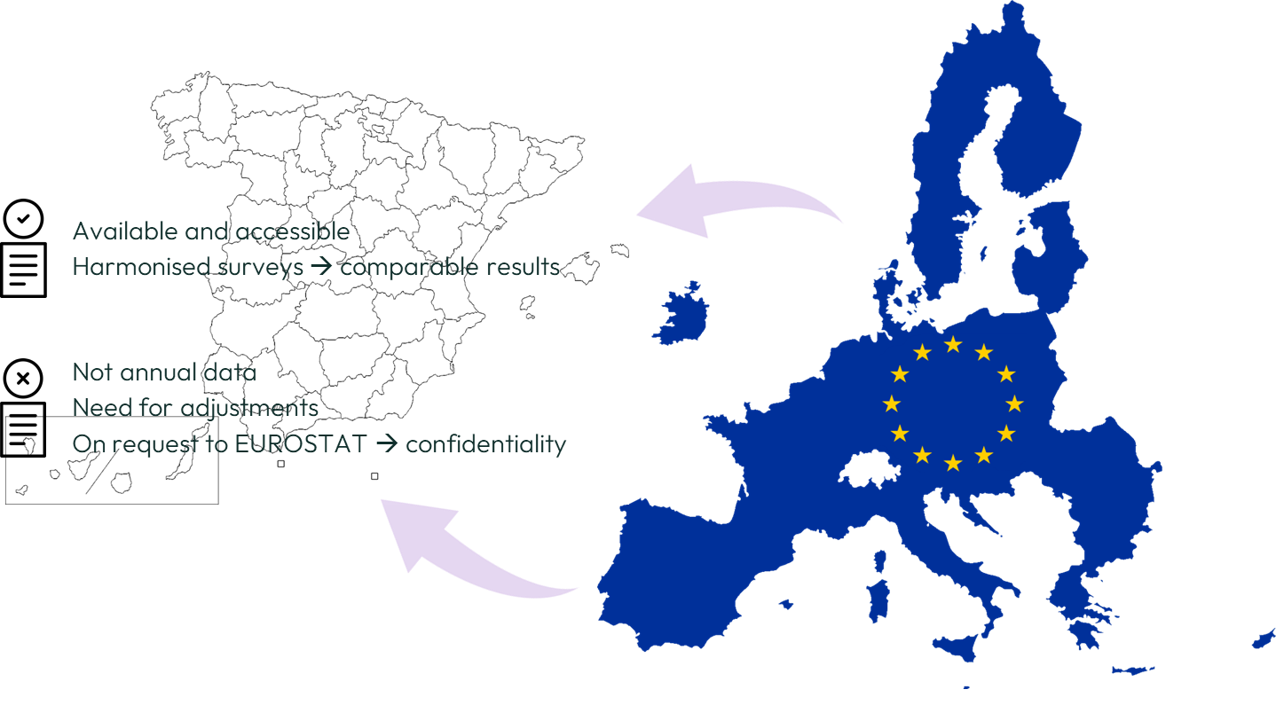
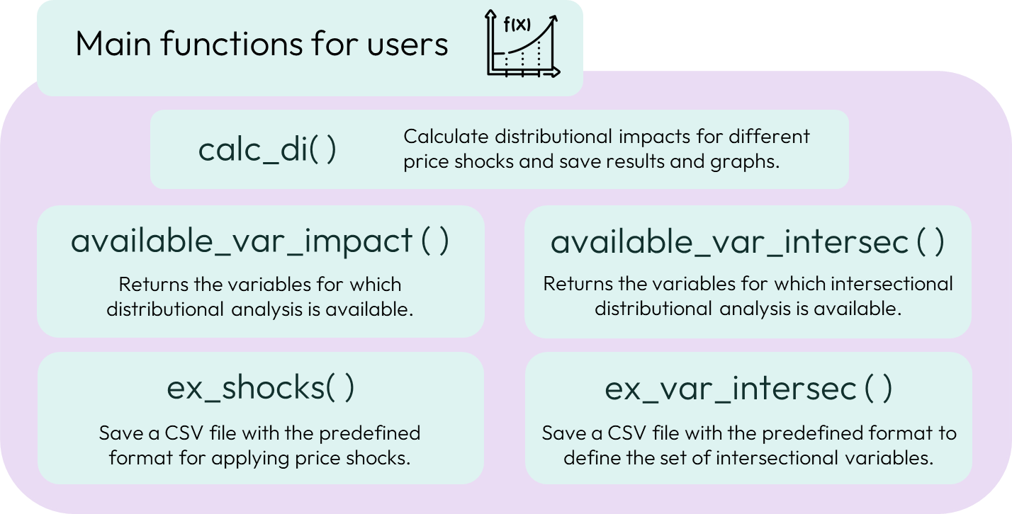
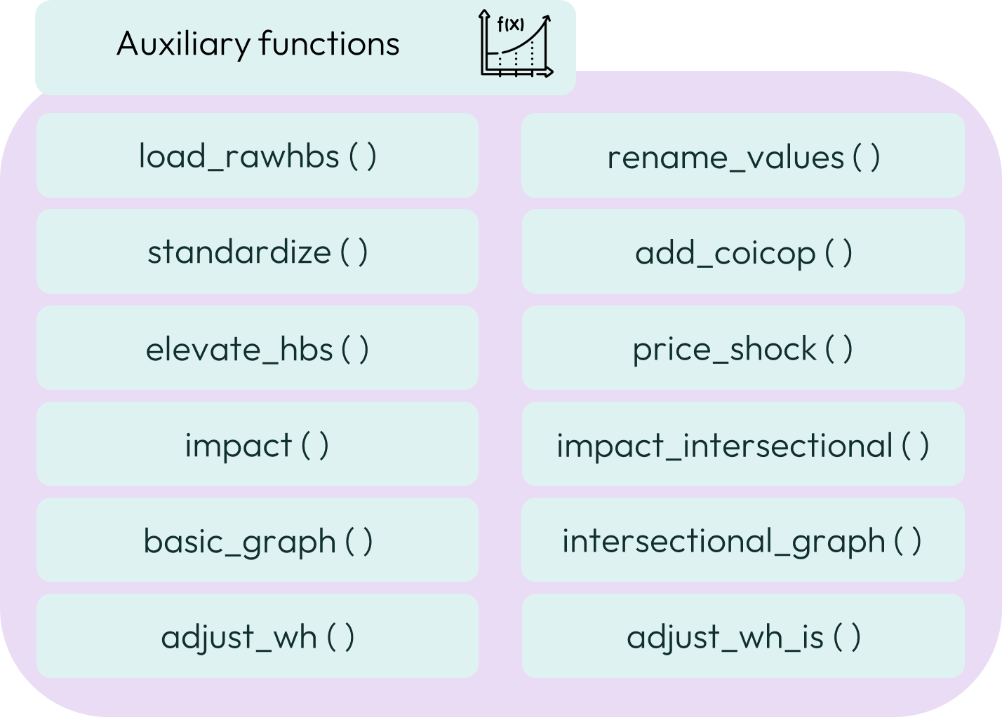
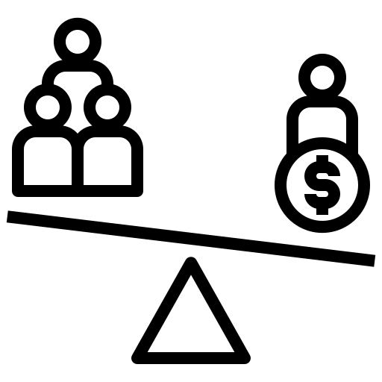
MEDUSA – Modelling Equity and DistribUtional impacts for Socioeconomic Analysis
Eva Alonso-Epelde, Basque Centre for Climate Change
eva.alonso@bc3research.org
https://bc3lc.github.io/medusa/
21st century challenges
Prototype for Spain
Complex and ambitious policies that promote social justice
impact analysis that assesses social, economic, energy, land and water implications in an integrated way
INEQUALITY
Vertical
Horizontal
Intersectional
Who will be most affected?

