Slide 1
Long-term warming and interannual variability contributions’ to marine heatwaves in the Mediterranean
Simon A, Plecha SM, Russo A, Teles-Machado A, Donat MG, Auger P-A and Trigo RM (2022) Hot and cold marine extreme events in the Mediterranean over the period 1982-2021. Frontiers and Marine Science
Simon, A., Pires, C., Frölicher, T. L., & Russo, A. (2023) Long-term warming and interannual variability contributions’ to marine heatwaves in the Mediterranean. Weather and Climate Extremes, 100619.
Amélie Simon,
IDL Portugal / IMT-Atlantique, France
EGU 2024 - 14-19 April of 2024

Slide 2
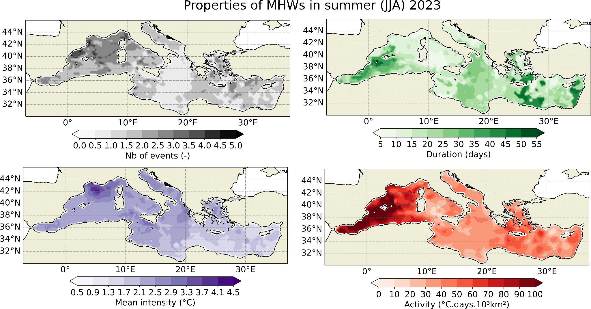
Marine heatwaves (MHWs) in the Mediterranean
Daily SST from NOAA OISSTV2 satellite data 0.25°x0.25° (1982-2023)

Slide 3
Marine heatwaves (MHWs) in the Mediterranean
Daily SST from NOAA OISSTV2 satellite data 0.25°x0.25° (1982-2023)

Slide 4
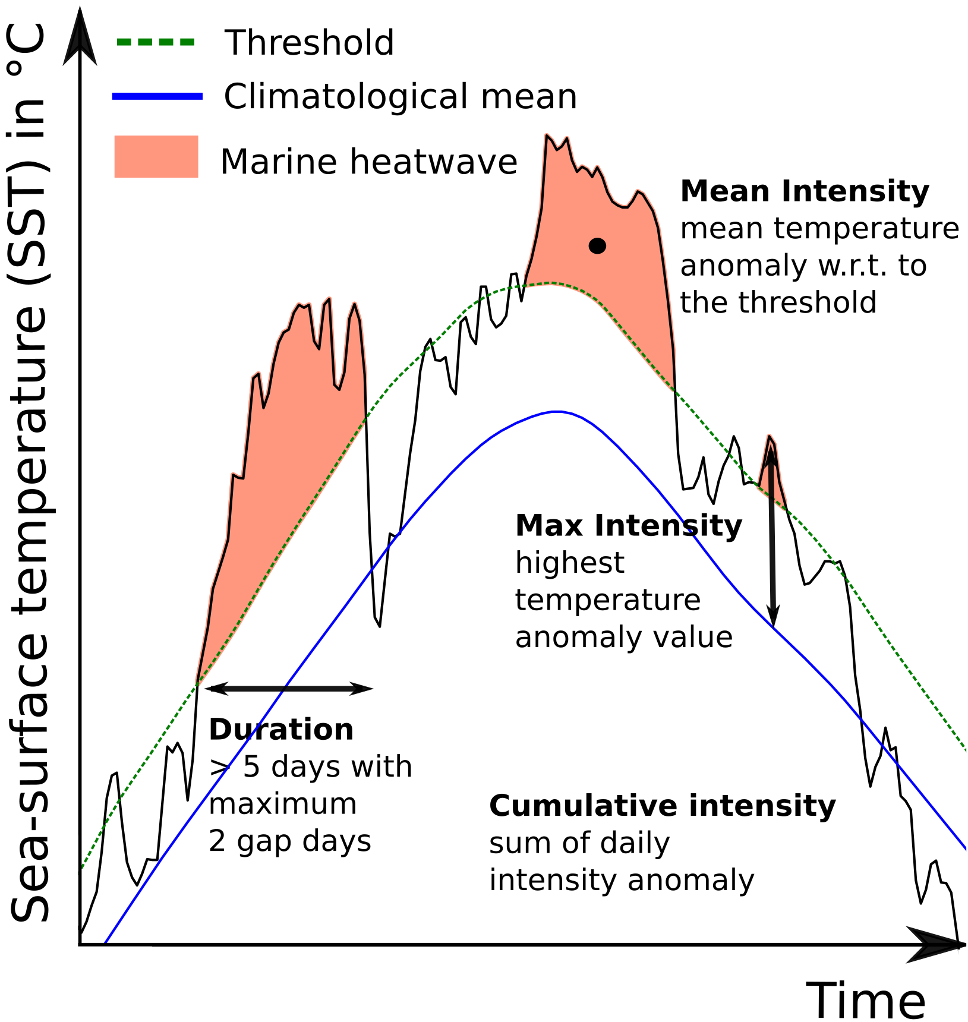
An index for MHWs - Activity
Step 1 For each grid cell, detect extreme events (EE) using the definition of Hobday et al., 2016 (90th percentile, 5 days)
Step 2 For each grid cell, calculate the activity index
Cumulative intensity*area
of all events during a season
(ºC.days.km²)
Step 3 Calculate total activity
Sum of all activities
over a domain
(ºC.days.km²)
Time evolution of MHWs

Slide 5
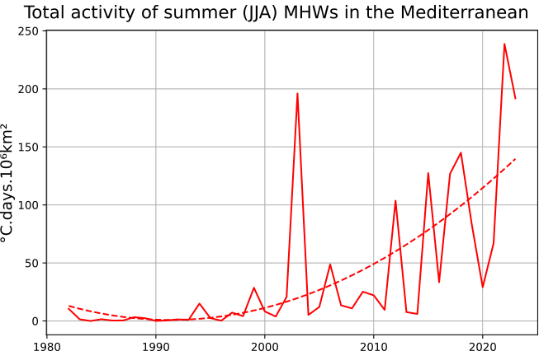
Summer MHWs in the Mediterranean
The total activity increases non-linearly for MHWs in summer over the last four decades
Most active summers: 2022, 2023, 2003
Total activity of summer MHW (°C.days.10⁶km²)

Slide 6
Summer MHWs in the Mediterranean
The total activity increases non-linearly for MHWs in summer over the last four decades
Most active summers: 2022, 2023, 2003
The highest MHWs activities occurred preferably in the western Mediterranean.
Total activity of summer MHW (°C.days.10⁶km²)
2022
2003
2023
MHW summer activity (°C.jours.10³km²)

Slide 7
Summer MHWs in the Mediterranean - Mean warming vs variability changes
(1982-2022)

Slide 8
Summer MHWs in the Mediterranean - Mean warming vs variability changes
(1982-2022)
Contribution for the trend on summer MHW activity [(°C.days.10³km²)/summer]
(a) Mean warming (b) interannual variability

Slide 9
Summer MHWs in the Mediterranean - Mean warming vs variability changes
(1982-2022)
Contribution for the trend on summer MHW activity [(°C.days.10³km²)/summer]
(a) Mean warming (b) interannual variability
Regions with larger interannual variability are regions with most severe MHWs ?

Slide 10
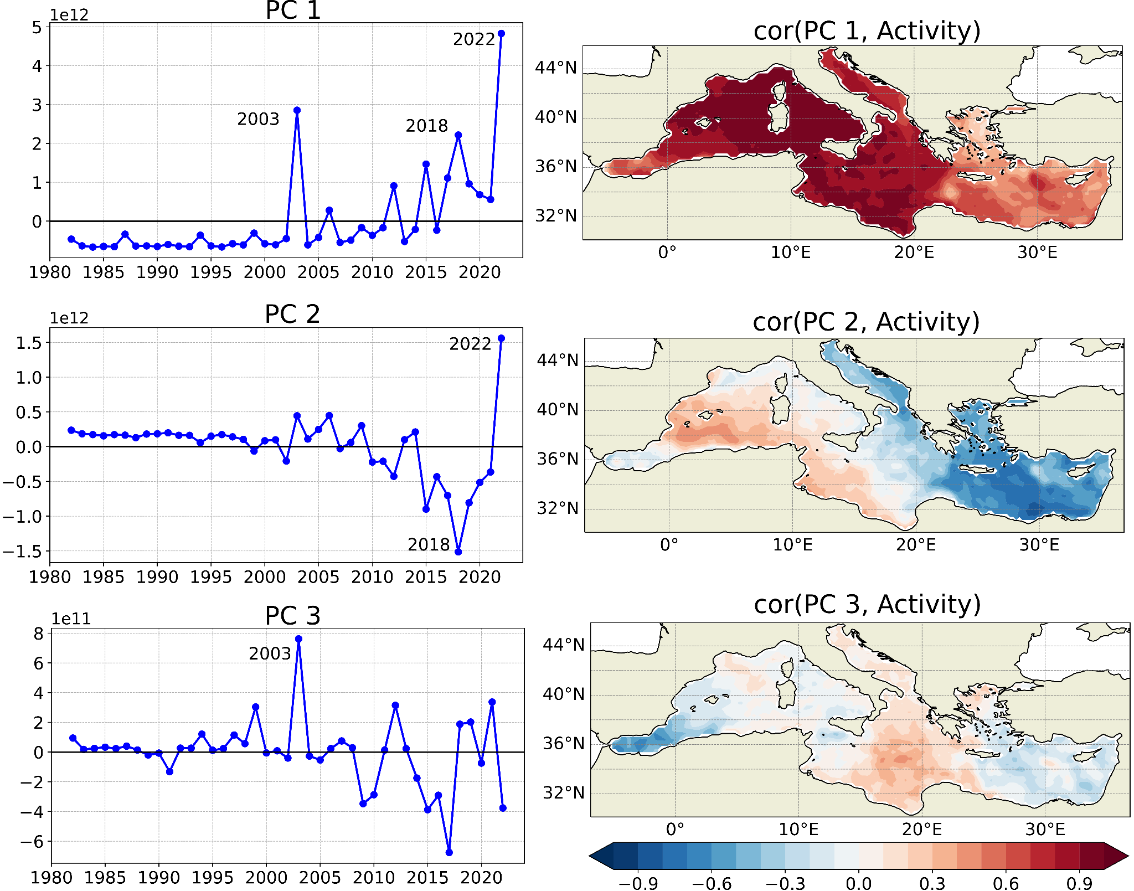
Summer MHWs in the Mediterranean - Spatio-temporal mode
Principal Component Analysis (PCA) on summer MHW activity
Their respectively explained variances by PCs are 72%, 12% and 3%

Slide 11
Summer MHWs in the Mediterranean - Atmospheric circulation
Joint Principal Component Analysis (PCA): How spatio-temporal patterns of MHW co-varies with Z500 ?
Methodology 1. PCA on summers MHW activity and Z500 separately
2. Joint PCA with the first ten leading and standardized PCs of the 2 variables.

Slide 12
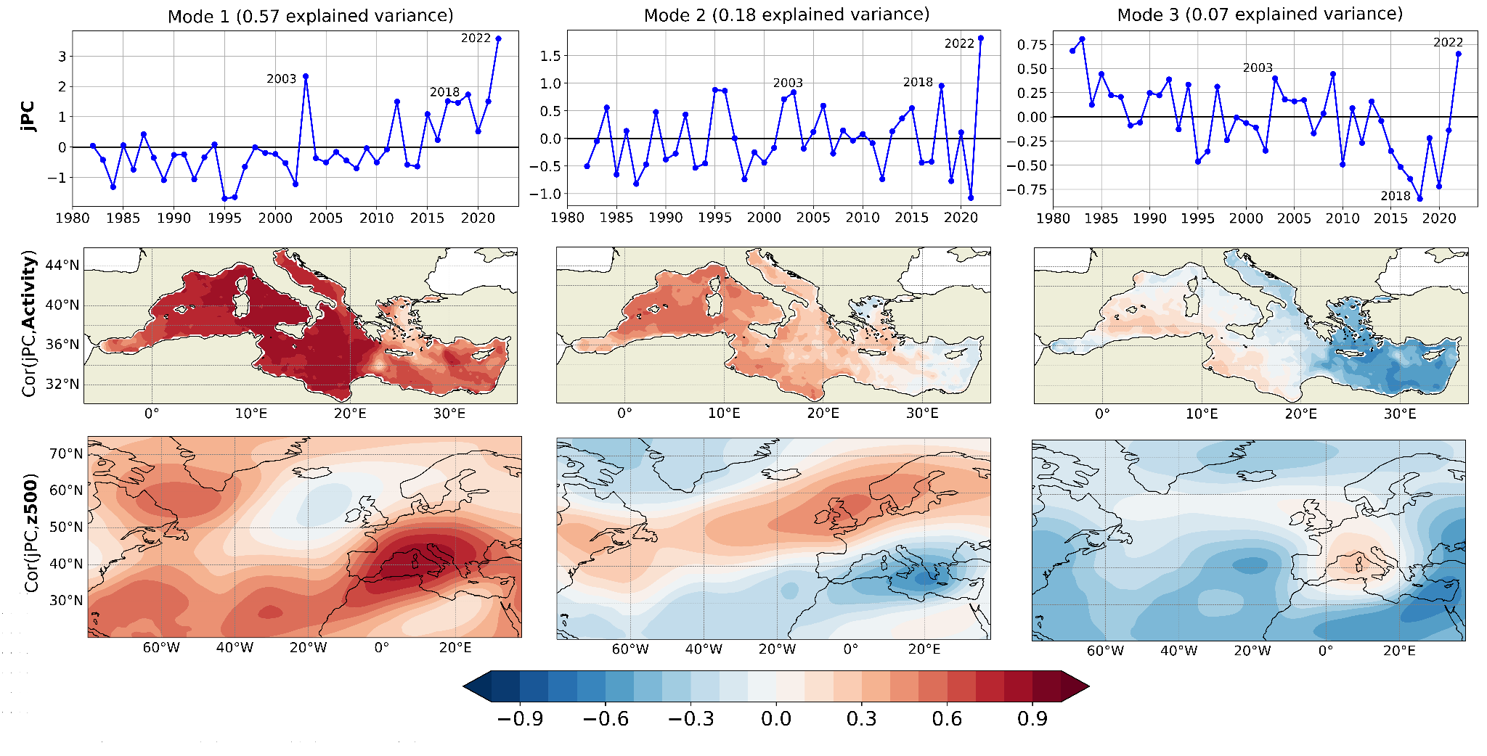
Summer MHWs in the Mediterranean - Atmospheric circulation
Joint Principal Component Analysis (PCA): How spatio-temporal patterns of MHW co-varies with Z500 ?
Methodology 1. PCA on summers MHW activity and Z500 separately
2. Joint PCA with the first ten leading and standardized PCs of the 2 variables.
~Positive phase of the summer East Atlantic (SEA)
~Positive phase of the summer North Atlantic Oscillation (SNAO)

Slide 13
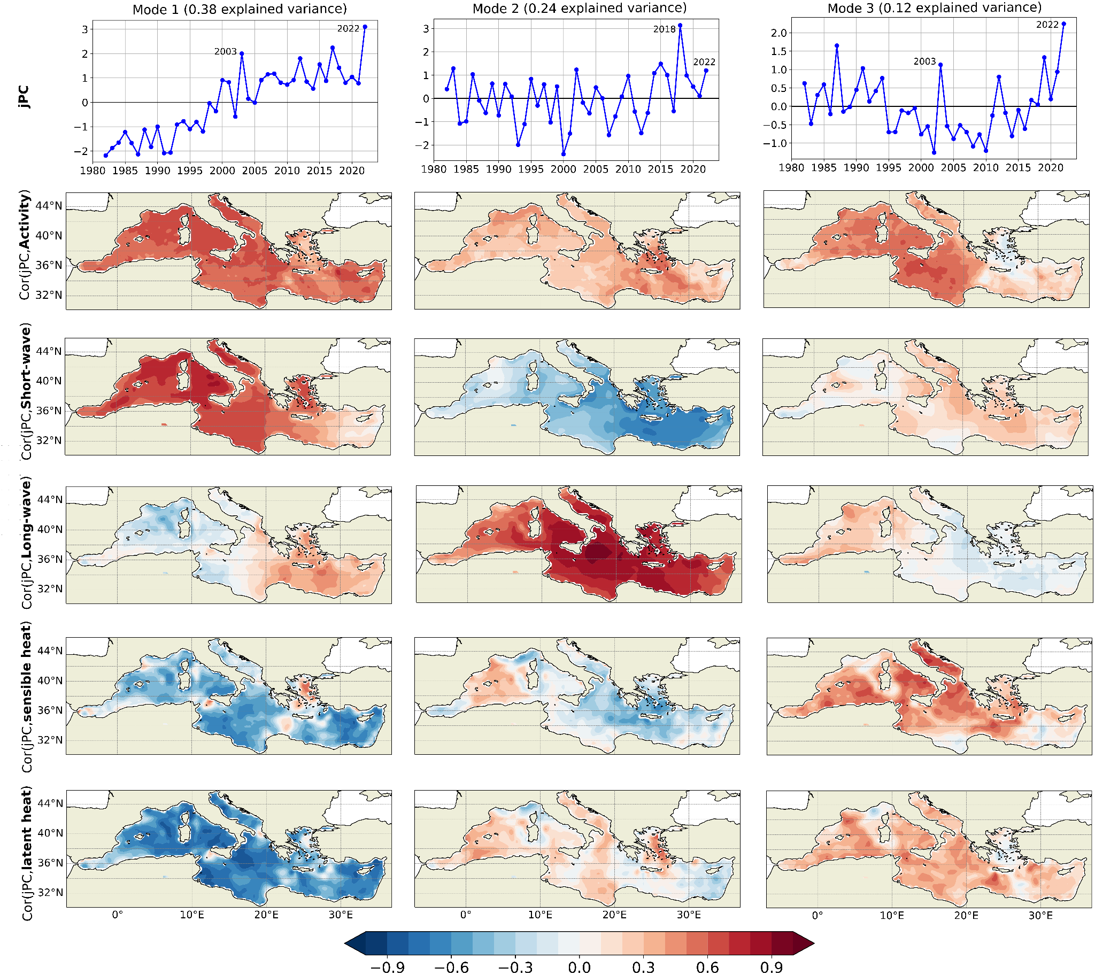
Summer MHWs in the Mediterranean - Atmospheric circulation
Joint PCA: How spatio-temporal patterns of MHW co-varies with the components of air-sea flux ?
Physical processes depend on the region and on the mode of variability
Positive downward

Slide 14
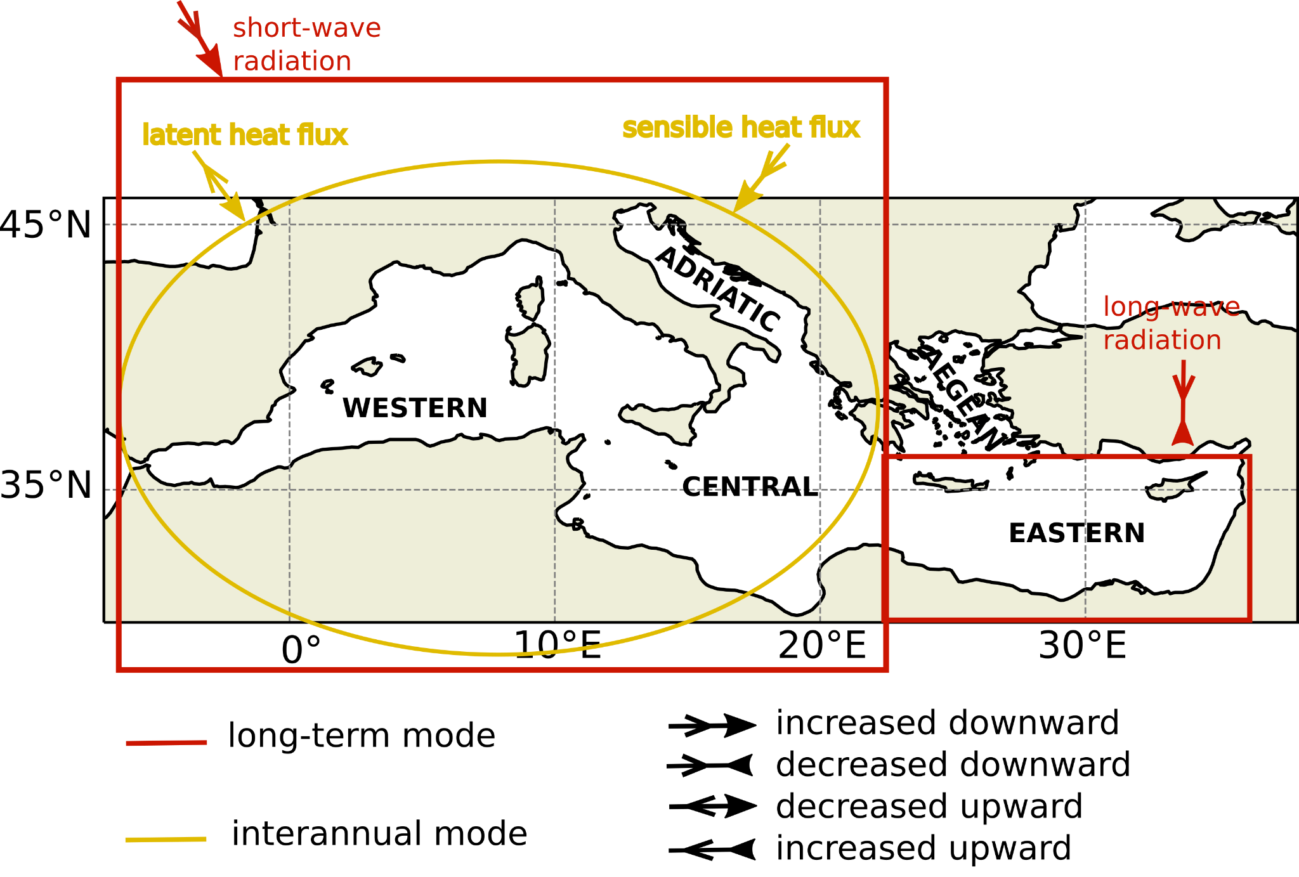
Summer MHWs in the Mediterranean - Atmospheric circulation
Joint PCA: How spatio-temporal patterns of MHW co-varies with the components of air-sea flux ?
Physical processes depend on the region and on the mode of variability

Slide 15
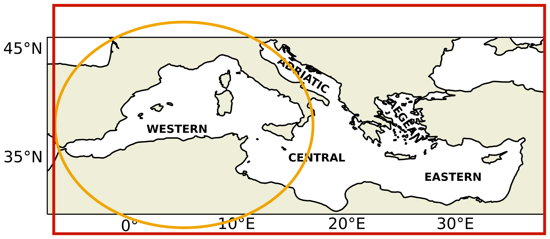
Summary
Daily SST from NOAA OISSTV2 satellite data 0.25°x0.25°
Statistics
MHW activity trend
Evolution
(°C.days.10³km²/summer)
Physical processes
Radiation fluxes
Total activity of summer MHWs in the Mediterranean (°C.days.10⁶km²)
Heat fluxes

Slide 16
Summary
Daily SST from NOAA OISSTV2 satellite data 0.25°x0.25°
Statistics
MHW activity trend
Evolution
(°C.days.10³km²/summer)
Physical processes
Radiation fluxes
Total activity of summer MHWs in the Mediterranean (°C.days.10⁶km²)
Heat fluxes
Thank you for your attention ! Any comments or questions ?
amelie.simon@imt-atlantique.fr

