Slide 1





Quantitative evaluation of sand body connectivity in shallow water delta front based on extreme learning machine
Junjie Wang, Xianguo Zhang
School of Geosciences in China University of Petroleum(East China),
April 15th, 2024

Slide 2
Outline
1
Introduction
2
Materials and Methods
3
Results
4
Conclusions

Slide 3
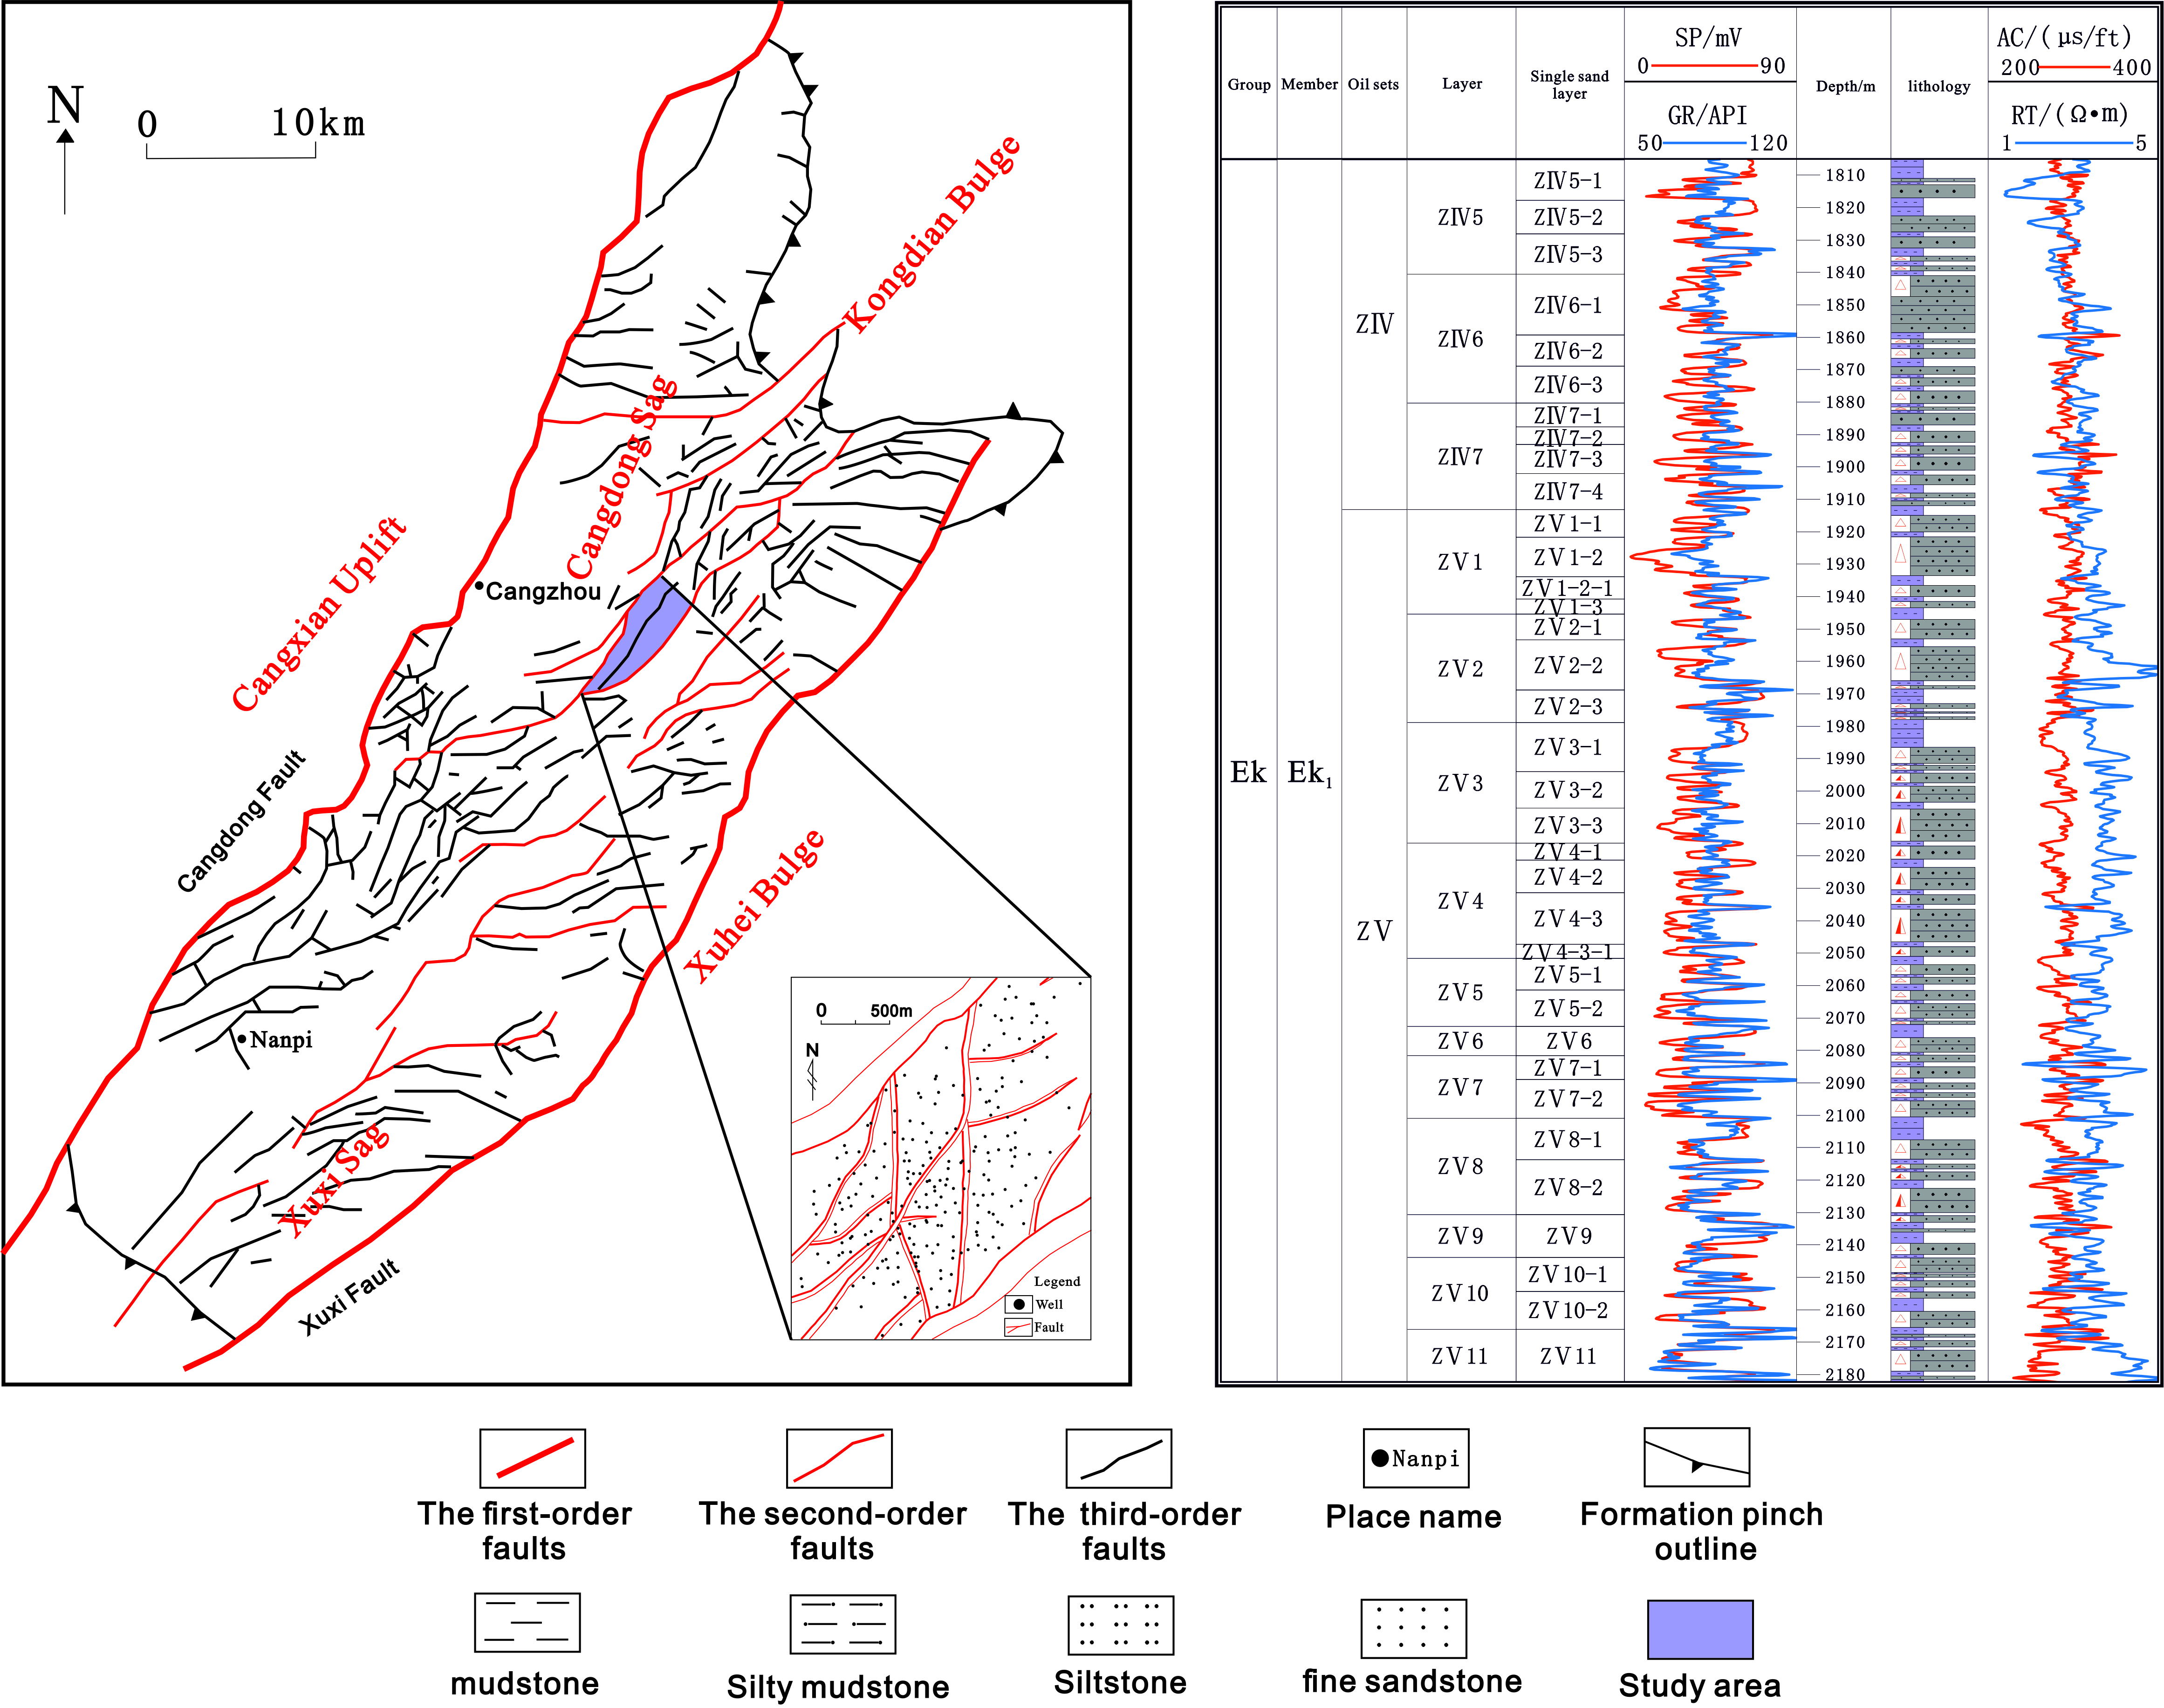
1.introduction
Fenghuadian oilfield is located in the middle of Kongdian structural belt in the southern area of Huanghua Depression
The stratum studied is Ek₁
The lithology is mainly fine, siltstone and mudstone. The lithology changes greatly and is interbedded with sand and mudstone

Slide 4
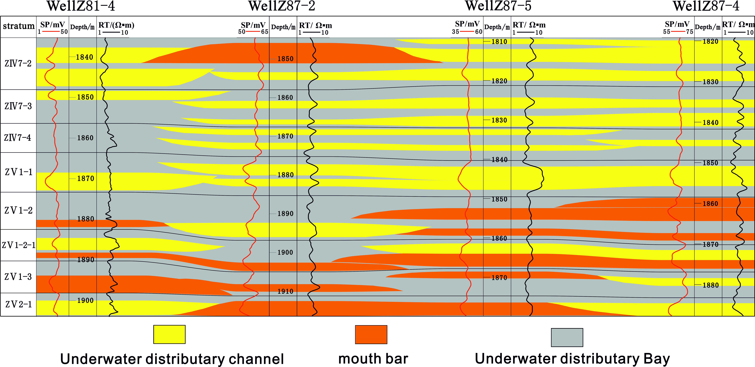
1.introduction
Challenge：How to judge the complex connectivity of sand bodies between wells
The study area is mainly a shallow water delta sedimentary environment.
It mainly develops underwater distributary channels, mouth barsand underwater distributary bays

Slide 5
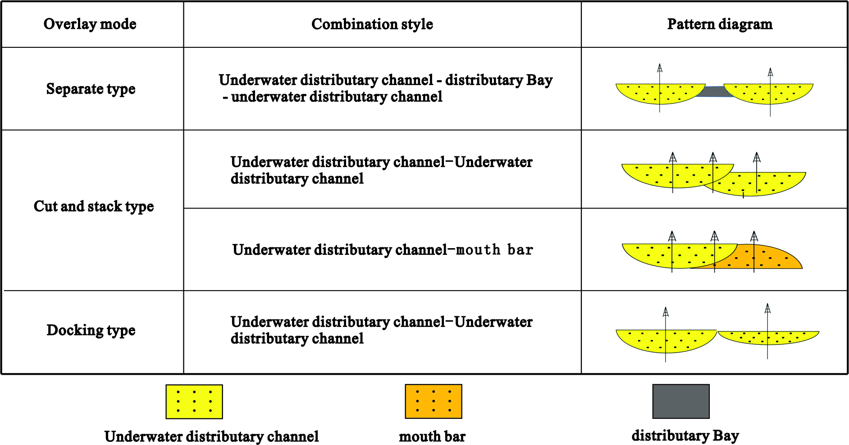
1.introduction
Multiple and complex stacking styles

Slide 6
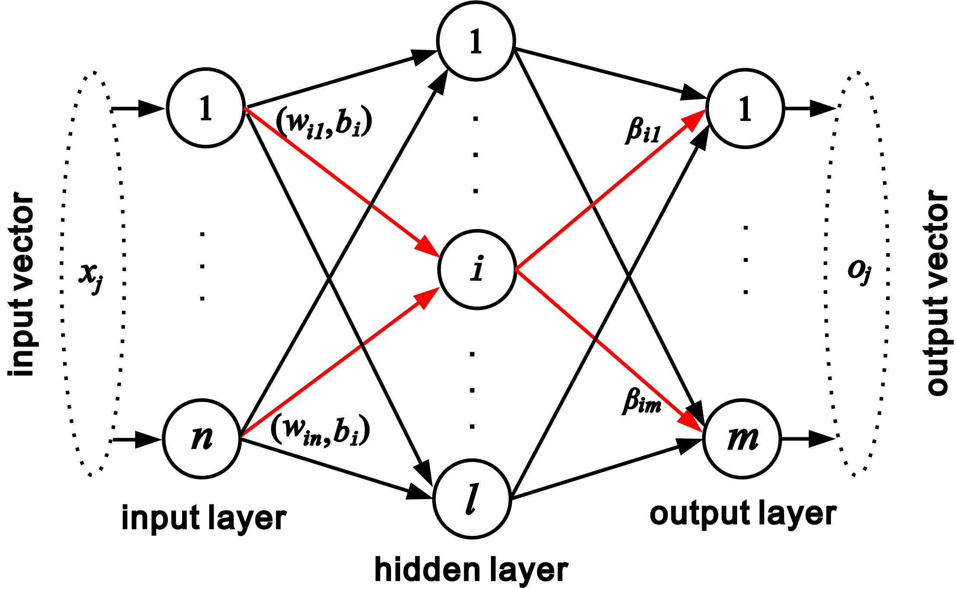
2.Materials and Methods
Principle of Extreme Learning Machine Algorithm
x_{j} =[ x_{j1}, x_{j2},…,x_{jn}]^{T}∈R^{n}（j=1,2, ..., N）
t_{j} =[ t_{j1}, t_{j2},…, t_{jm}]^{T}∈R^{m}（j=1,2, ..., N）
β_{i} =[β_{i1}, β_{i2}, …, β_{im}]^{T}
w_{i}=[ w_{i1}, w_{i2},…w_{in}]^{T}
n—number of nodes in the input layer
m—number of nodes in the output layer
l—number of nodes in the hidden layer

Slide 7
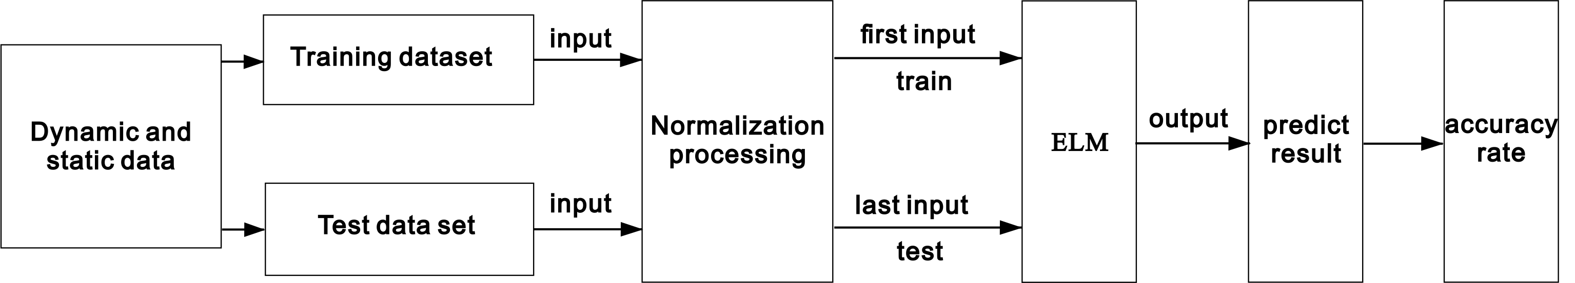
2.Materials and Methods
Prediction Model Design Process
Sample construction
Input vector：X={parameter 1，parameter 2，...，parameter n}
Output vector：Y={1，2}
1——bad connectivity
2——good connectivity

Slide 8
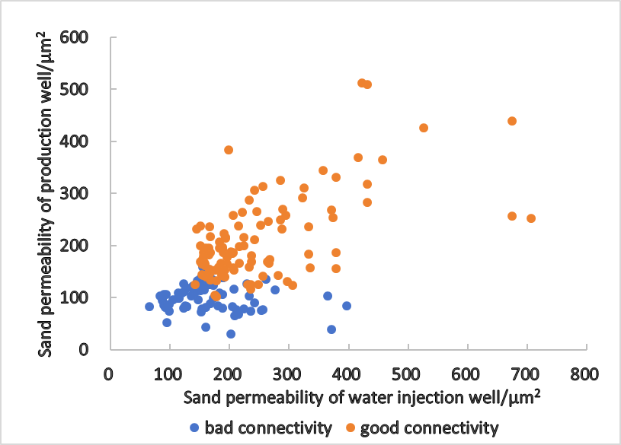
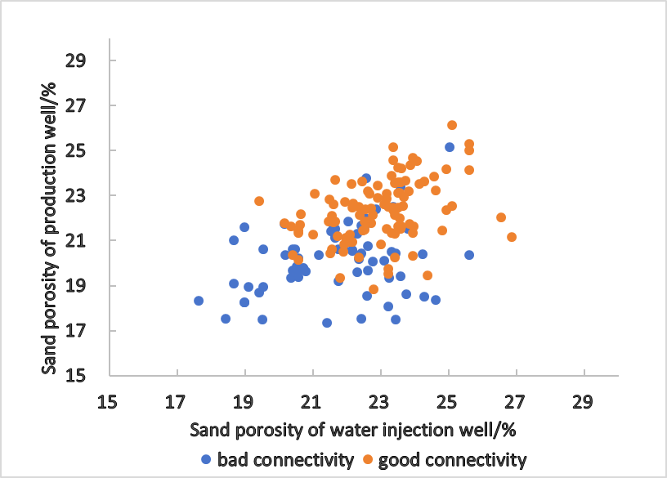
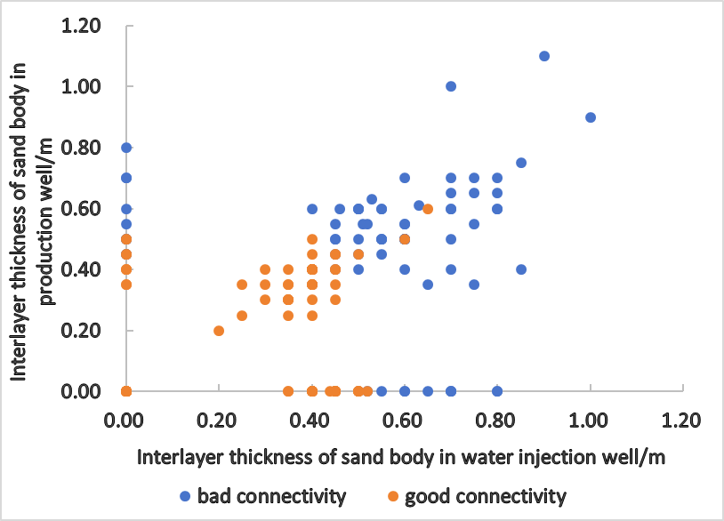
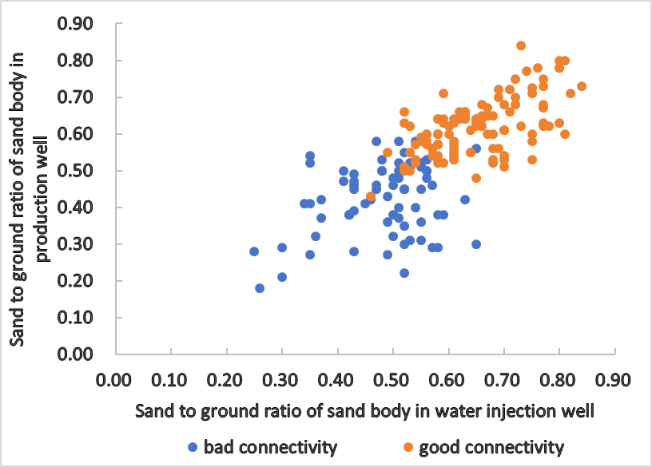
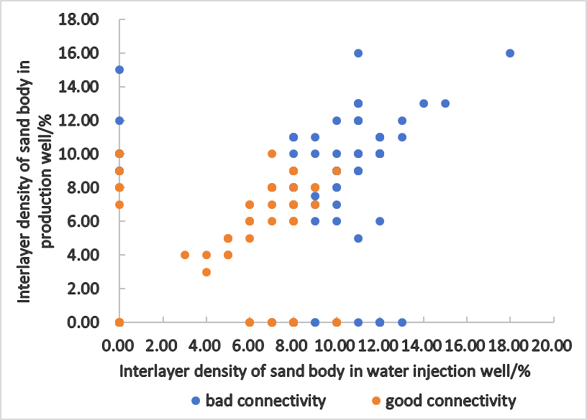
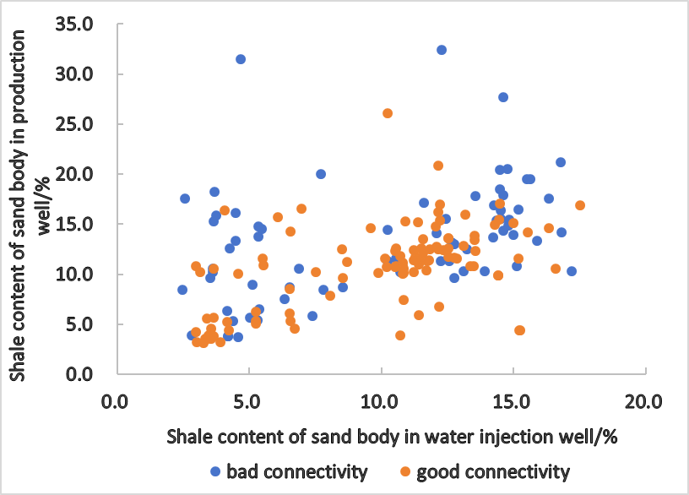
2.Materials and Methods
Parameter optimization
√
✘
√
√
√
✘
Input vector：X={sand to ground ratio, interlayer thickness, interlayer density, permeability}

Slide 9
2.Materials and Methods
Sample dataset partitioning and data preprocessing
Bad
53
Training dataset
128
70%
data set
182
Good
75
Bad
22
Test dataset
54
30%
Good
33
x*——Sample raw value
x_{max}*——Maximum value within the sample set
x_{min}*——Minimum value within the sample set

Slide 10
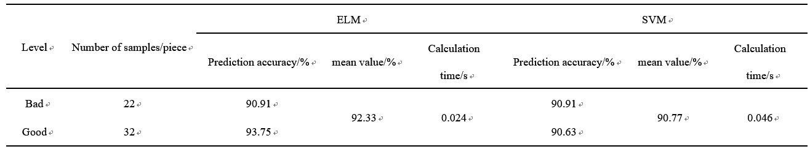
3.Results
The classification effect is mainly measured by the classification accuracy and calculation time
In addition, we compare the classification performance of ELM with SVM which is commonly used
The prediction accuracy reaches 92.33%
ELM performance is better than that of SVM

Slide 11
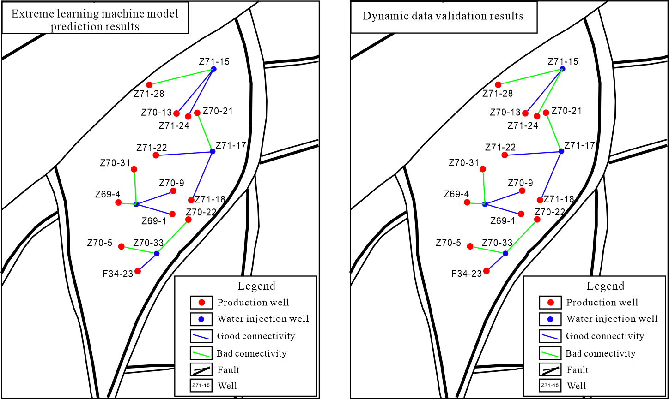
3.Results
The model is applied to the actual study area to predict and get good results
The dynamic verification coincidence rate reaches 92.3%

Slide 12
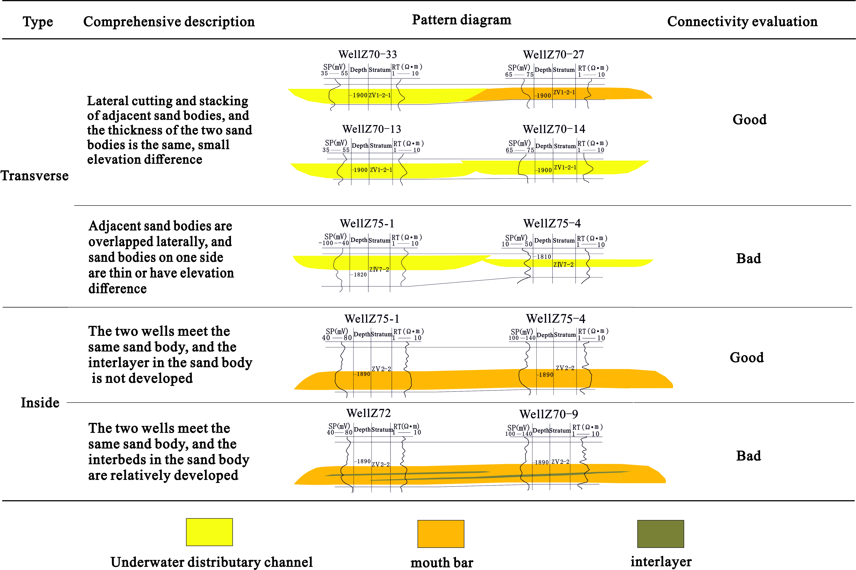
3.Results
The sand body connectivity model in study area is summarized

Slide 13
4.Conclusions
1) Four geological parameters, namely sand to ground ratio, interlayer thickness, interlayer density, and permeability, were selected for sand body connectivity prediction using the Extreme Learning Machine algorithm, with an accuracy rate of 92.33%. ELM have higher training efficiency while ensuring prediction accuracy, which is superior to SVM.
2) The extreme learning machine training model was applied to predict the inter well sand connectivity of single sand layer ZV2-1 in the research area, and the dynamic verification coincidence rate reached over 92%, showing good application effects.
3) The target layer in the research area has two types of inter well sand body connectivity modes, horizontal and internal. In the lateral connectivity mode, when two sand bodies are laterally cut and stacked with equal thickness, the connectivity between the sand bodies is good. When two sand bodies are laterally connected with a large thickness difference, the connectivity between the sand bodies is poor; In the internal connectivity mode, when the interlayer in the sand body is not developed, the connectivity of the sand body is good, but when the interlayer is more developed, the connectivity of the sand body is poor.

Slide 14
Thank You
Question ? Suggestion?
Junjie Wang
Email: 3039296075@qq.com

