Slide 1
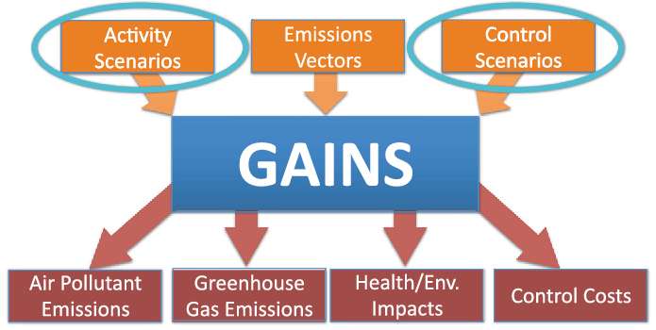
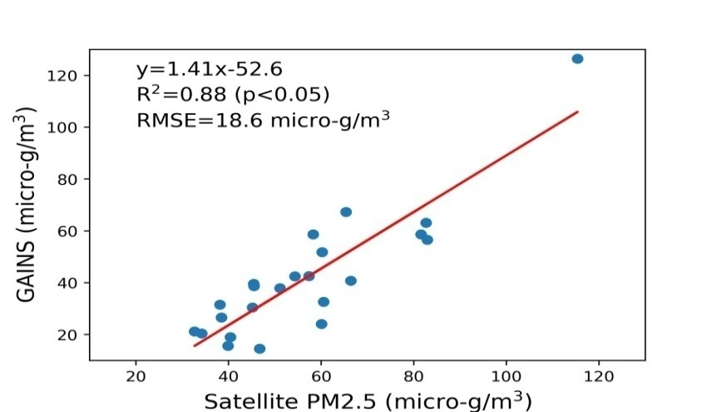
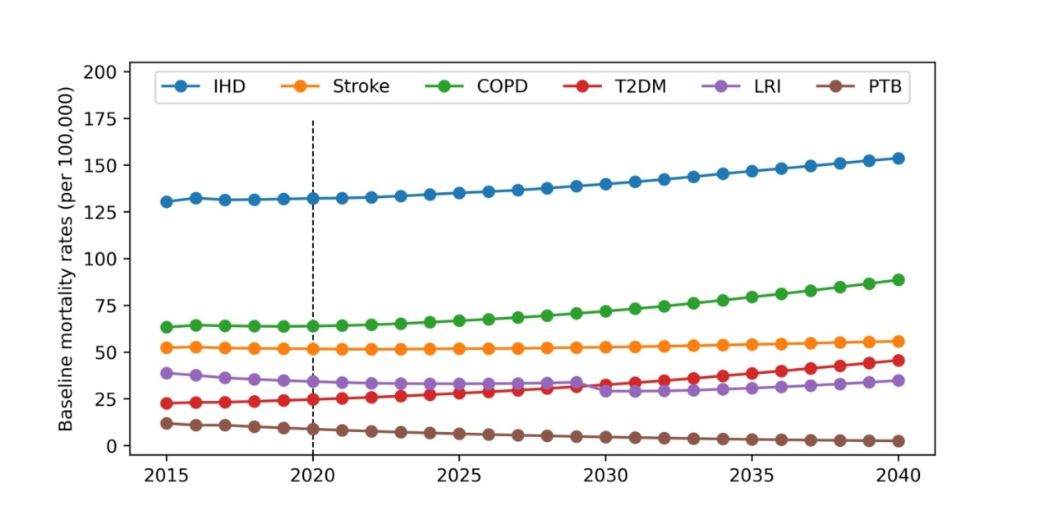
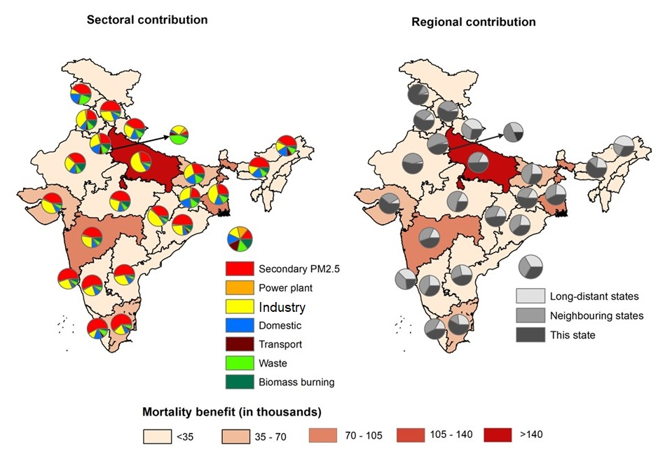
Health Benefits of Meeting 2-degree Warming Scenario in India
Debajit Sarkar (asz218001@iitd.ac.in)¹, Fahad Imam¹, Alok Kumar¹, Sagnik Dey¹, Pallav Purohit², Gregor Kiesewetter², Zbigniew Klimont², Sourangsu Chowdhury³
¹Centre for Atmospheric Sciences, Indian Institute of Technology Delhi, India; ²International Institute for Applied Systems Analysis, Luxemburg, Austria; ³ CICERO Center for International Climate Research, Oslo, Norway
1. MOTIVATION
GAINS-model Framework (Purohit et al., 2019):
4. RESULTS
4.3. Economic Assessment and Co-benefits
India has one of the highest health burden attributable to air pollution (Fuller et al., 2022).
Growing population and aging could elevate this burden further in future (Choudhury et al., 2018).
India has made commitments to reduce GHG emission and also embarked on clean air mission.
Whether mitigating GHG emissions from various sectors will lead to air quality improvement and if yes, how much is not well known.
4.1. Health Burden Scenarios in Mid-century
/ below 2℃ warming
BAU and SDS/below 2℃ warming level.
Local and regional source contributions were analyzed.
Under BAU pathway, economic loss would be 219.3 billion (175.5-263.2); keeping the warming below 2℃, 55.1 billion Euros could be recovered.
High and middle SDI states would have largest monetary benefits.
2. OBJECTIVES
To estimate the health burden in mid-century under contrasting climate change mitigation pathways and apportion into local and regional sources.
Assessment of health and economic co-benefits of keeping the warming below 2℃ by 2050.
Projections of BMRs:
Premature deaths may increase upto 2.12 million (1.62-2.63) under BAU pathway; where growing population aging and BMRs would have greatest effects.
5. SUMMARY
Keeping the warming below 2℃, 0.77 million (0.58-0.97) deaths could be prevented, which may lead to 55.1 billion (46.8-63.4) monetary benefits.
Domestic, power plant, and industrial emissions would lead to maximal health benefits; especially in low and middle SDI states.
The complex feedback processes due to excessive fossil-fuel usage and decarbonization measures may alter our estimates.
3. METHODOLOGY
ARIMA function and projected for 2050.
4.2. Sectoral Contributions to Health Benefits
Determinants of health burden:
Age-distributed population [India-Census]
Population-weighted exposure [GAINS-model]
Baseline mortality rate (BMRs) [India-GBD MAPS]
Flowchart of the modeling framework:
3.2. Economic assessment: Cost-of-illness method
Present discounted value of lost in human capital.
Age-distributed Population
PM2.5 exposure
Baseline Mortality Rates
ACKNOLEDGEMENT
The work is supported by a research grant from the Clean Air Fund and from the SERB, Department of Science and Technology, GoI under SUPRA scheme.
We acknowledge IIASA for the GAINS-model simulated database and CICERO for their scientific inputs in this analysis.
Health burden
Source apportionment
Health burden apportionment to local and regional sectors
Assumptions:
Every individual from 10 to 84 yrs contributes equally to GDP.
0.77 million (0.58-0.97) premature deaths could be prevented; low SDI states would have largest shares.
Emissions from industry, domestic, and waste would contribute to largest co-benefits.
GAINS-model

