Slide 1
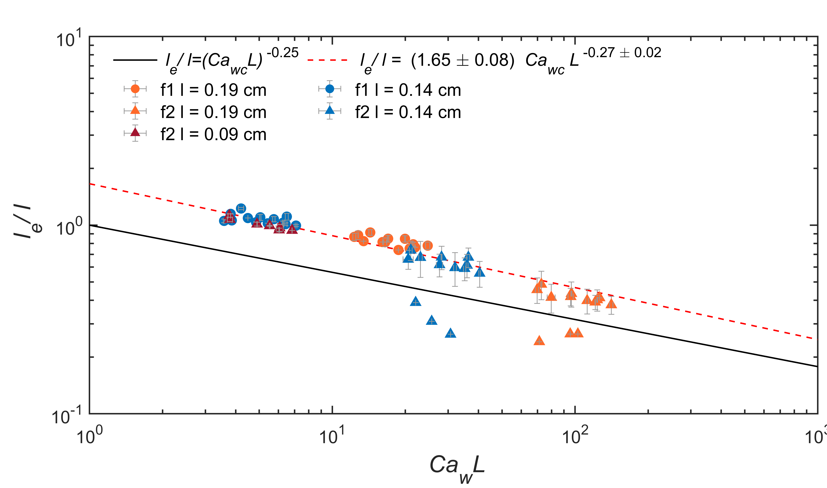
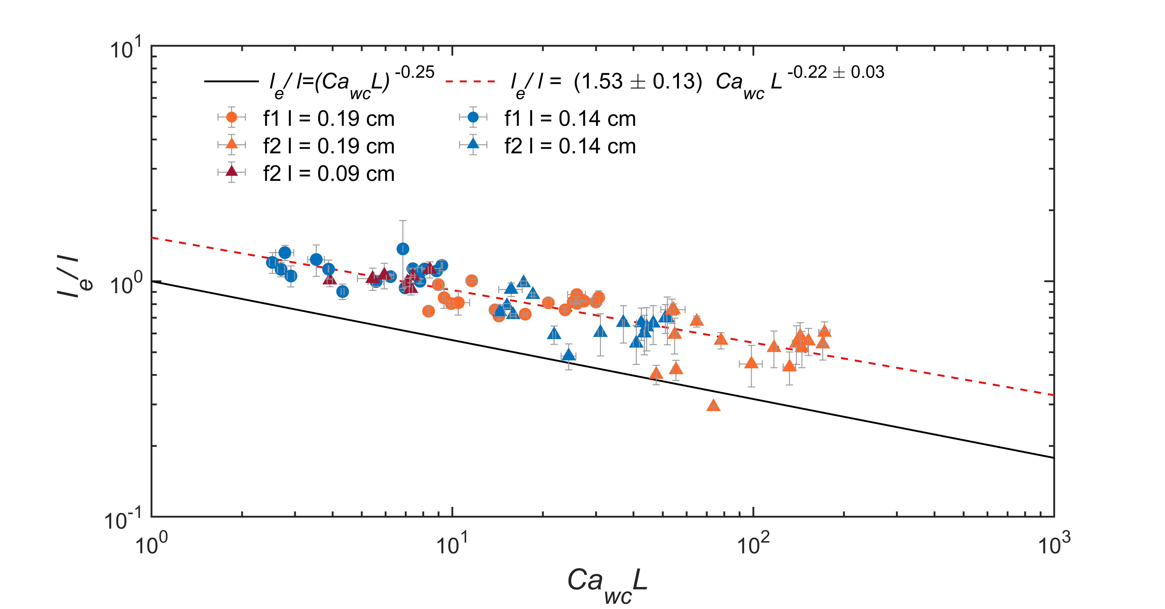
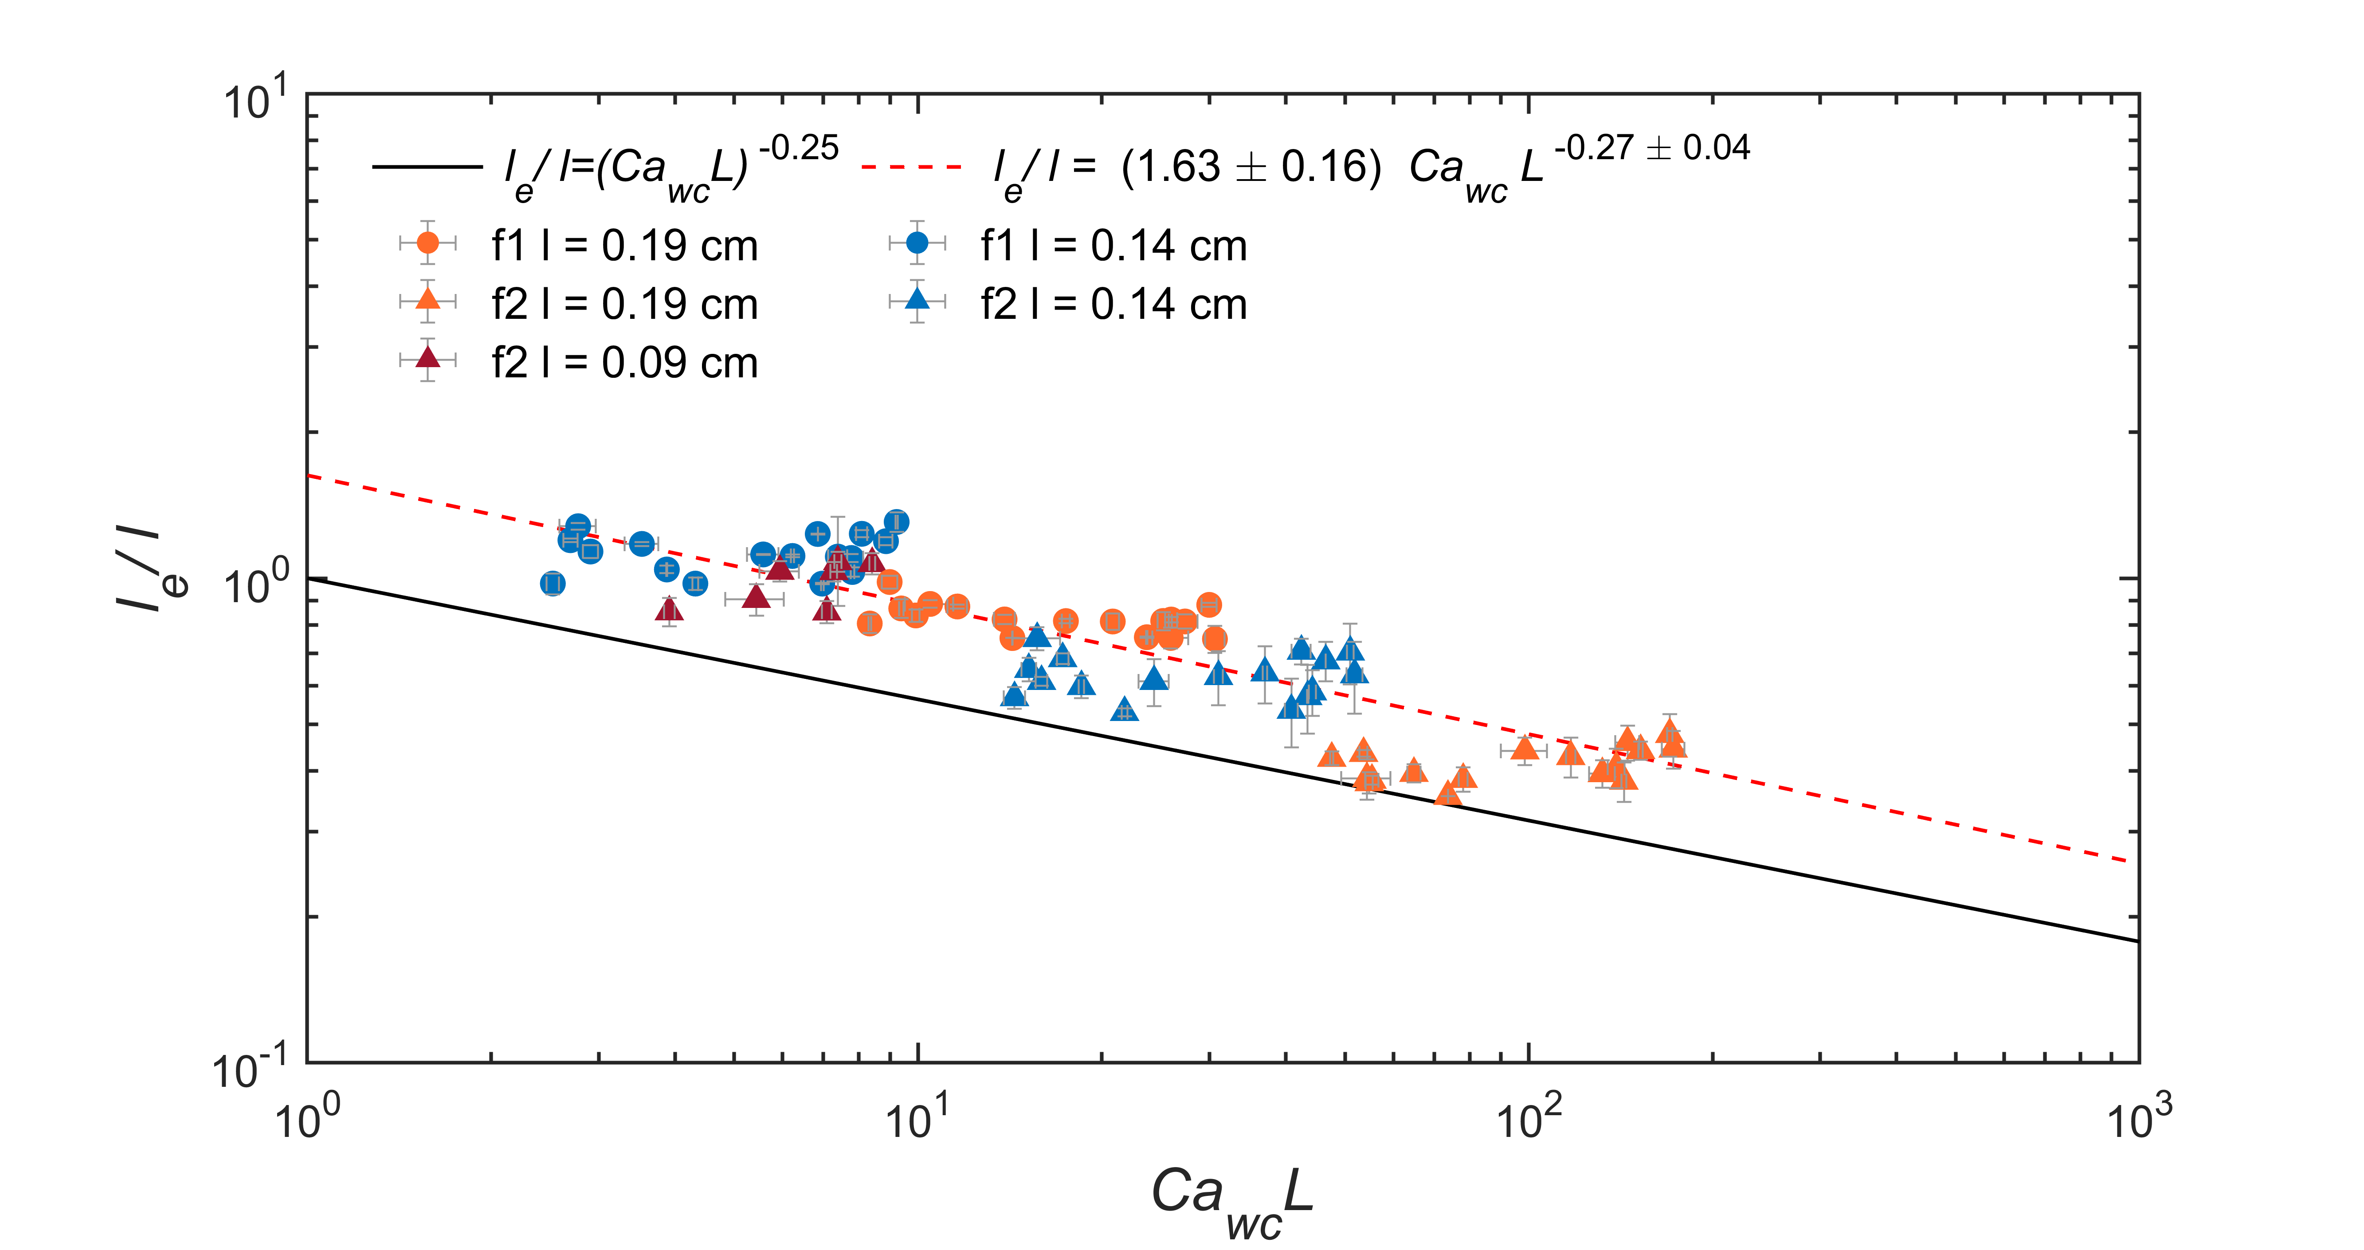
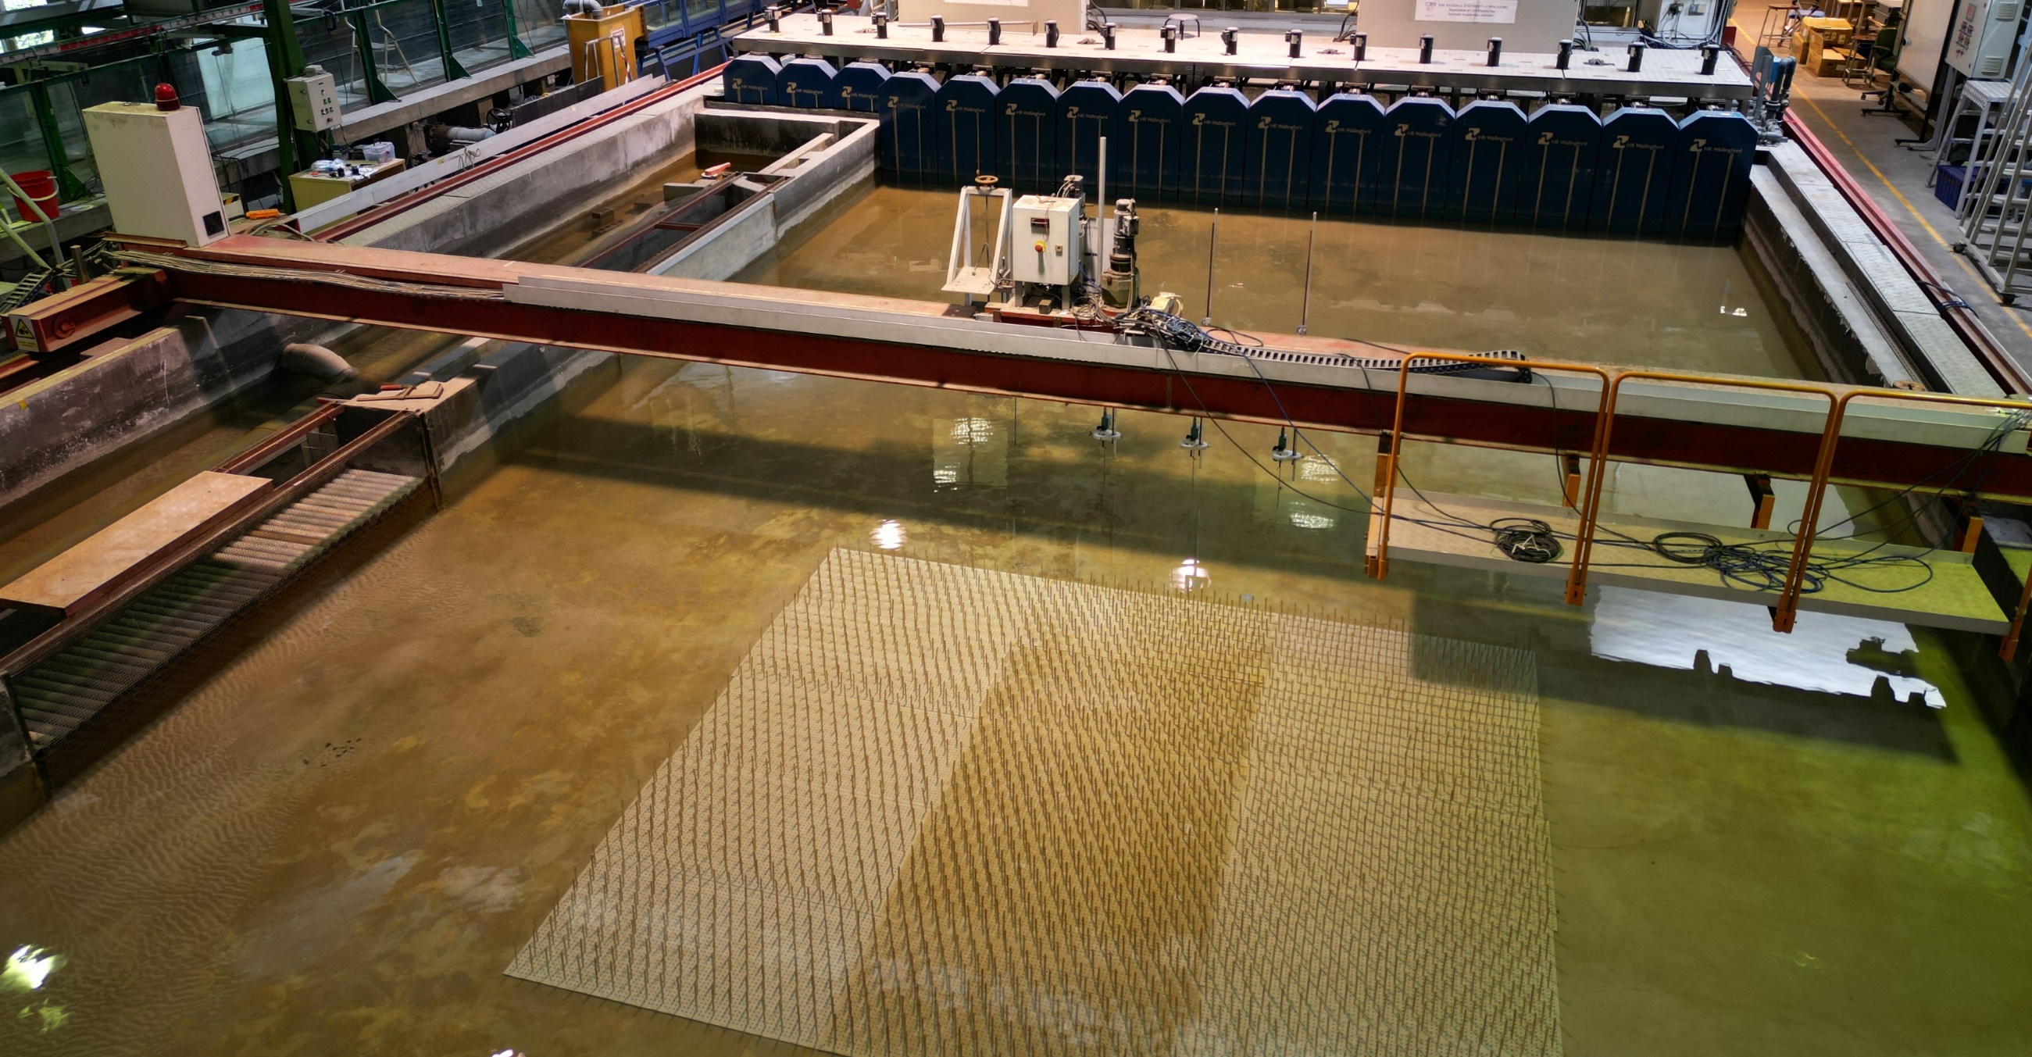
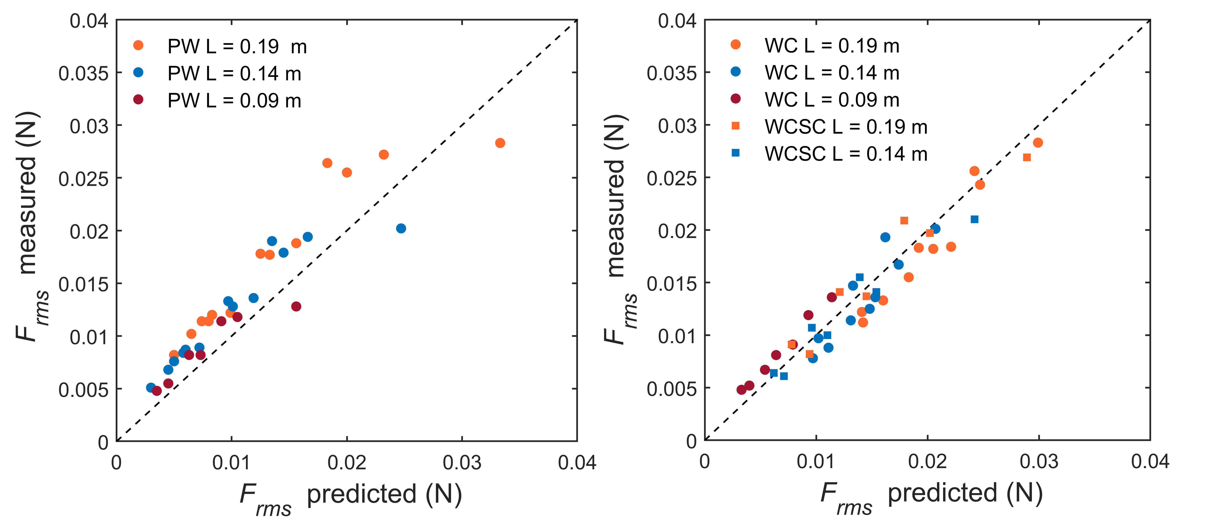
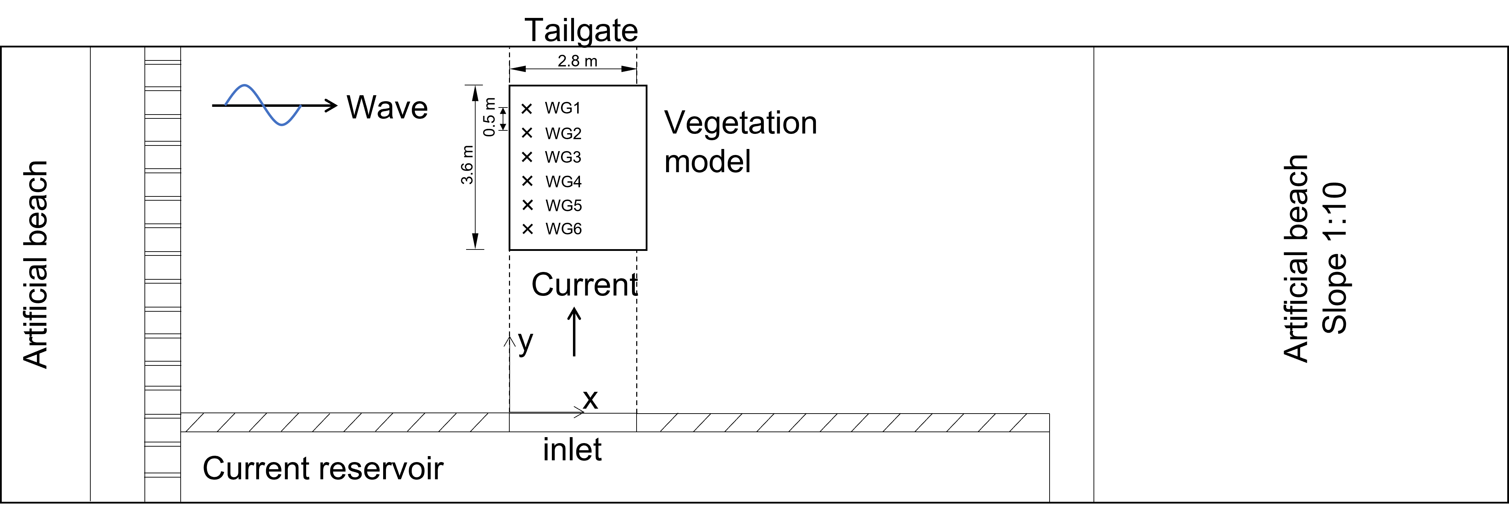
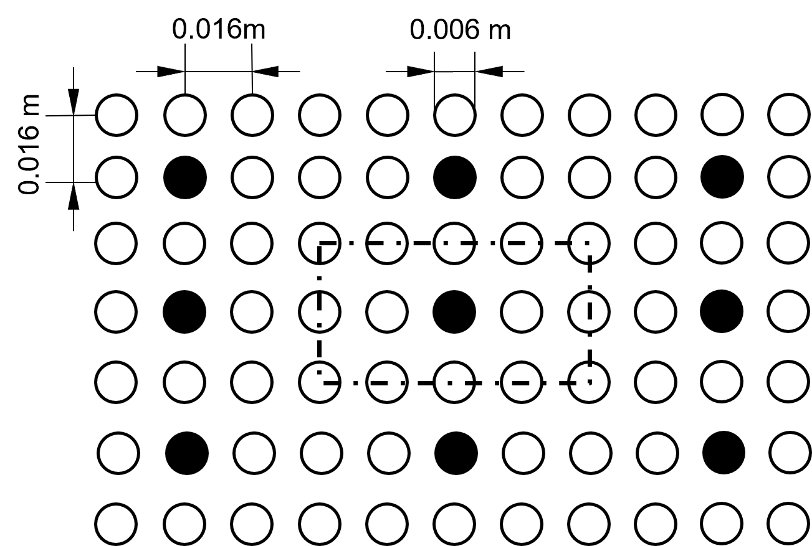
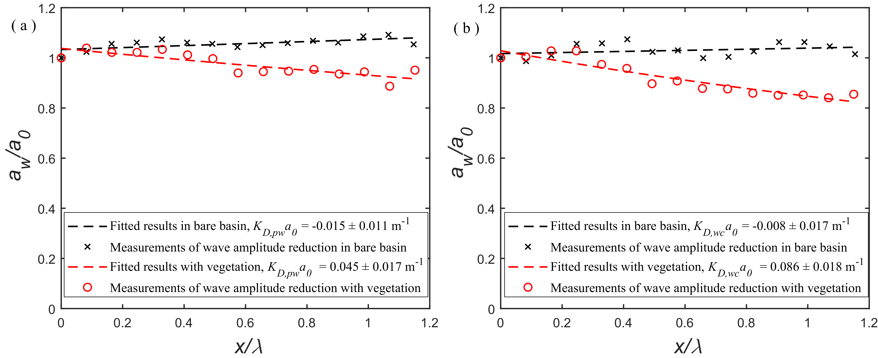
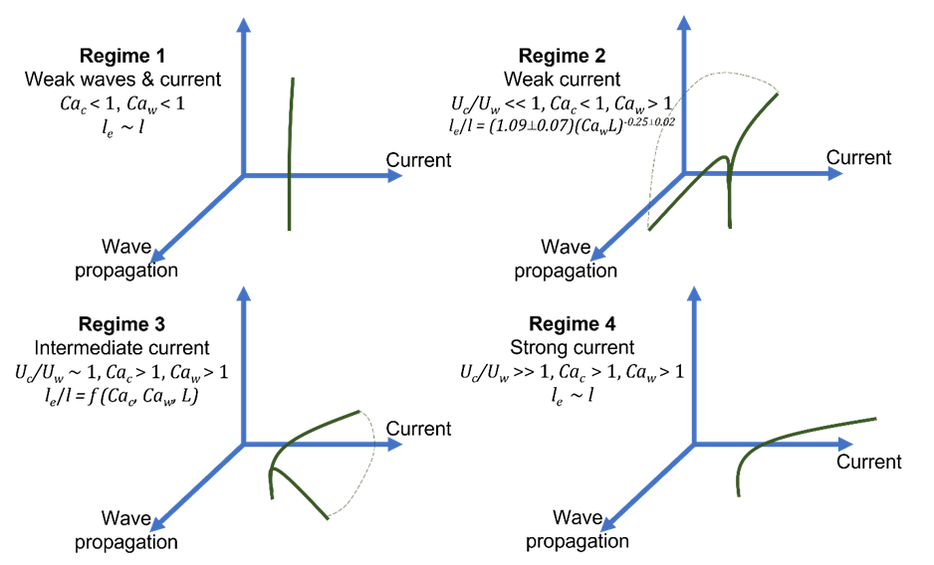
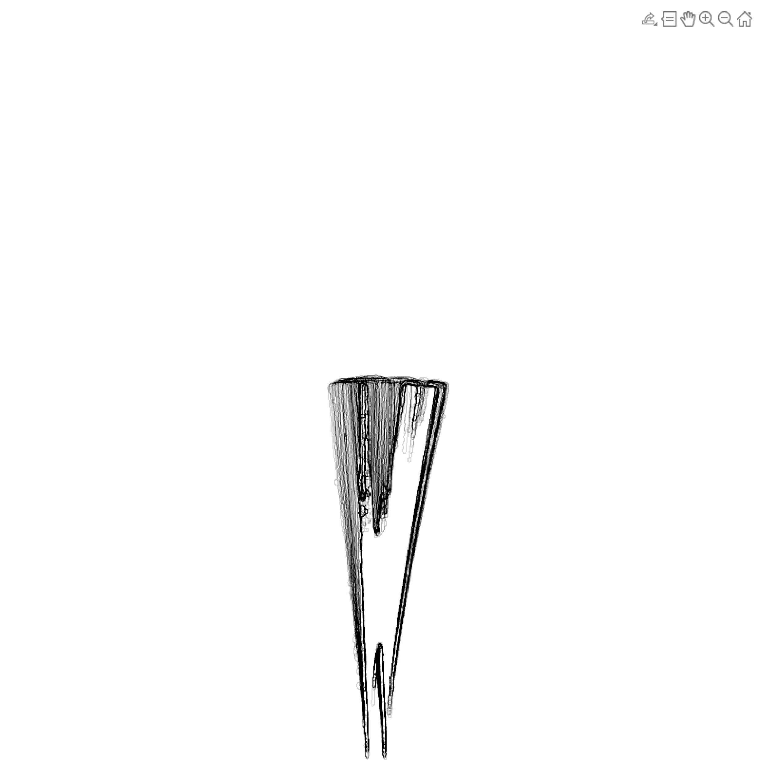
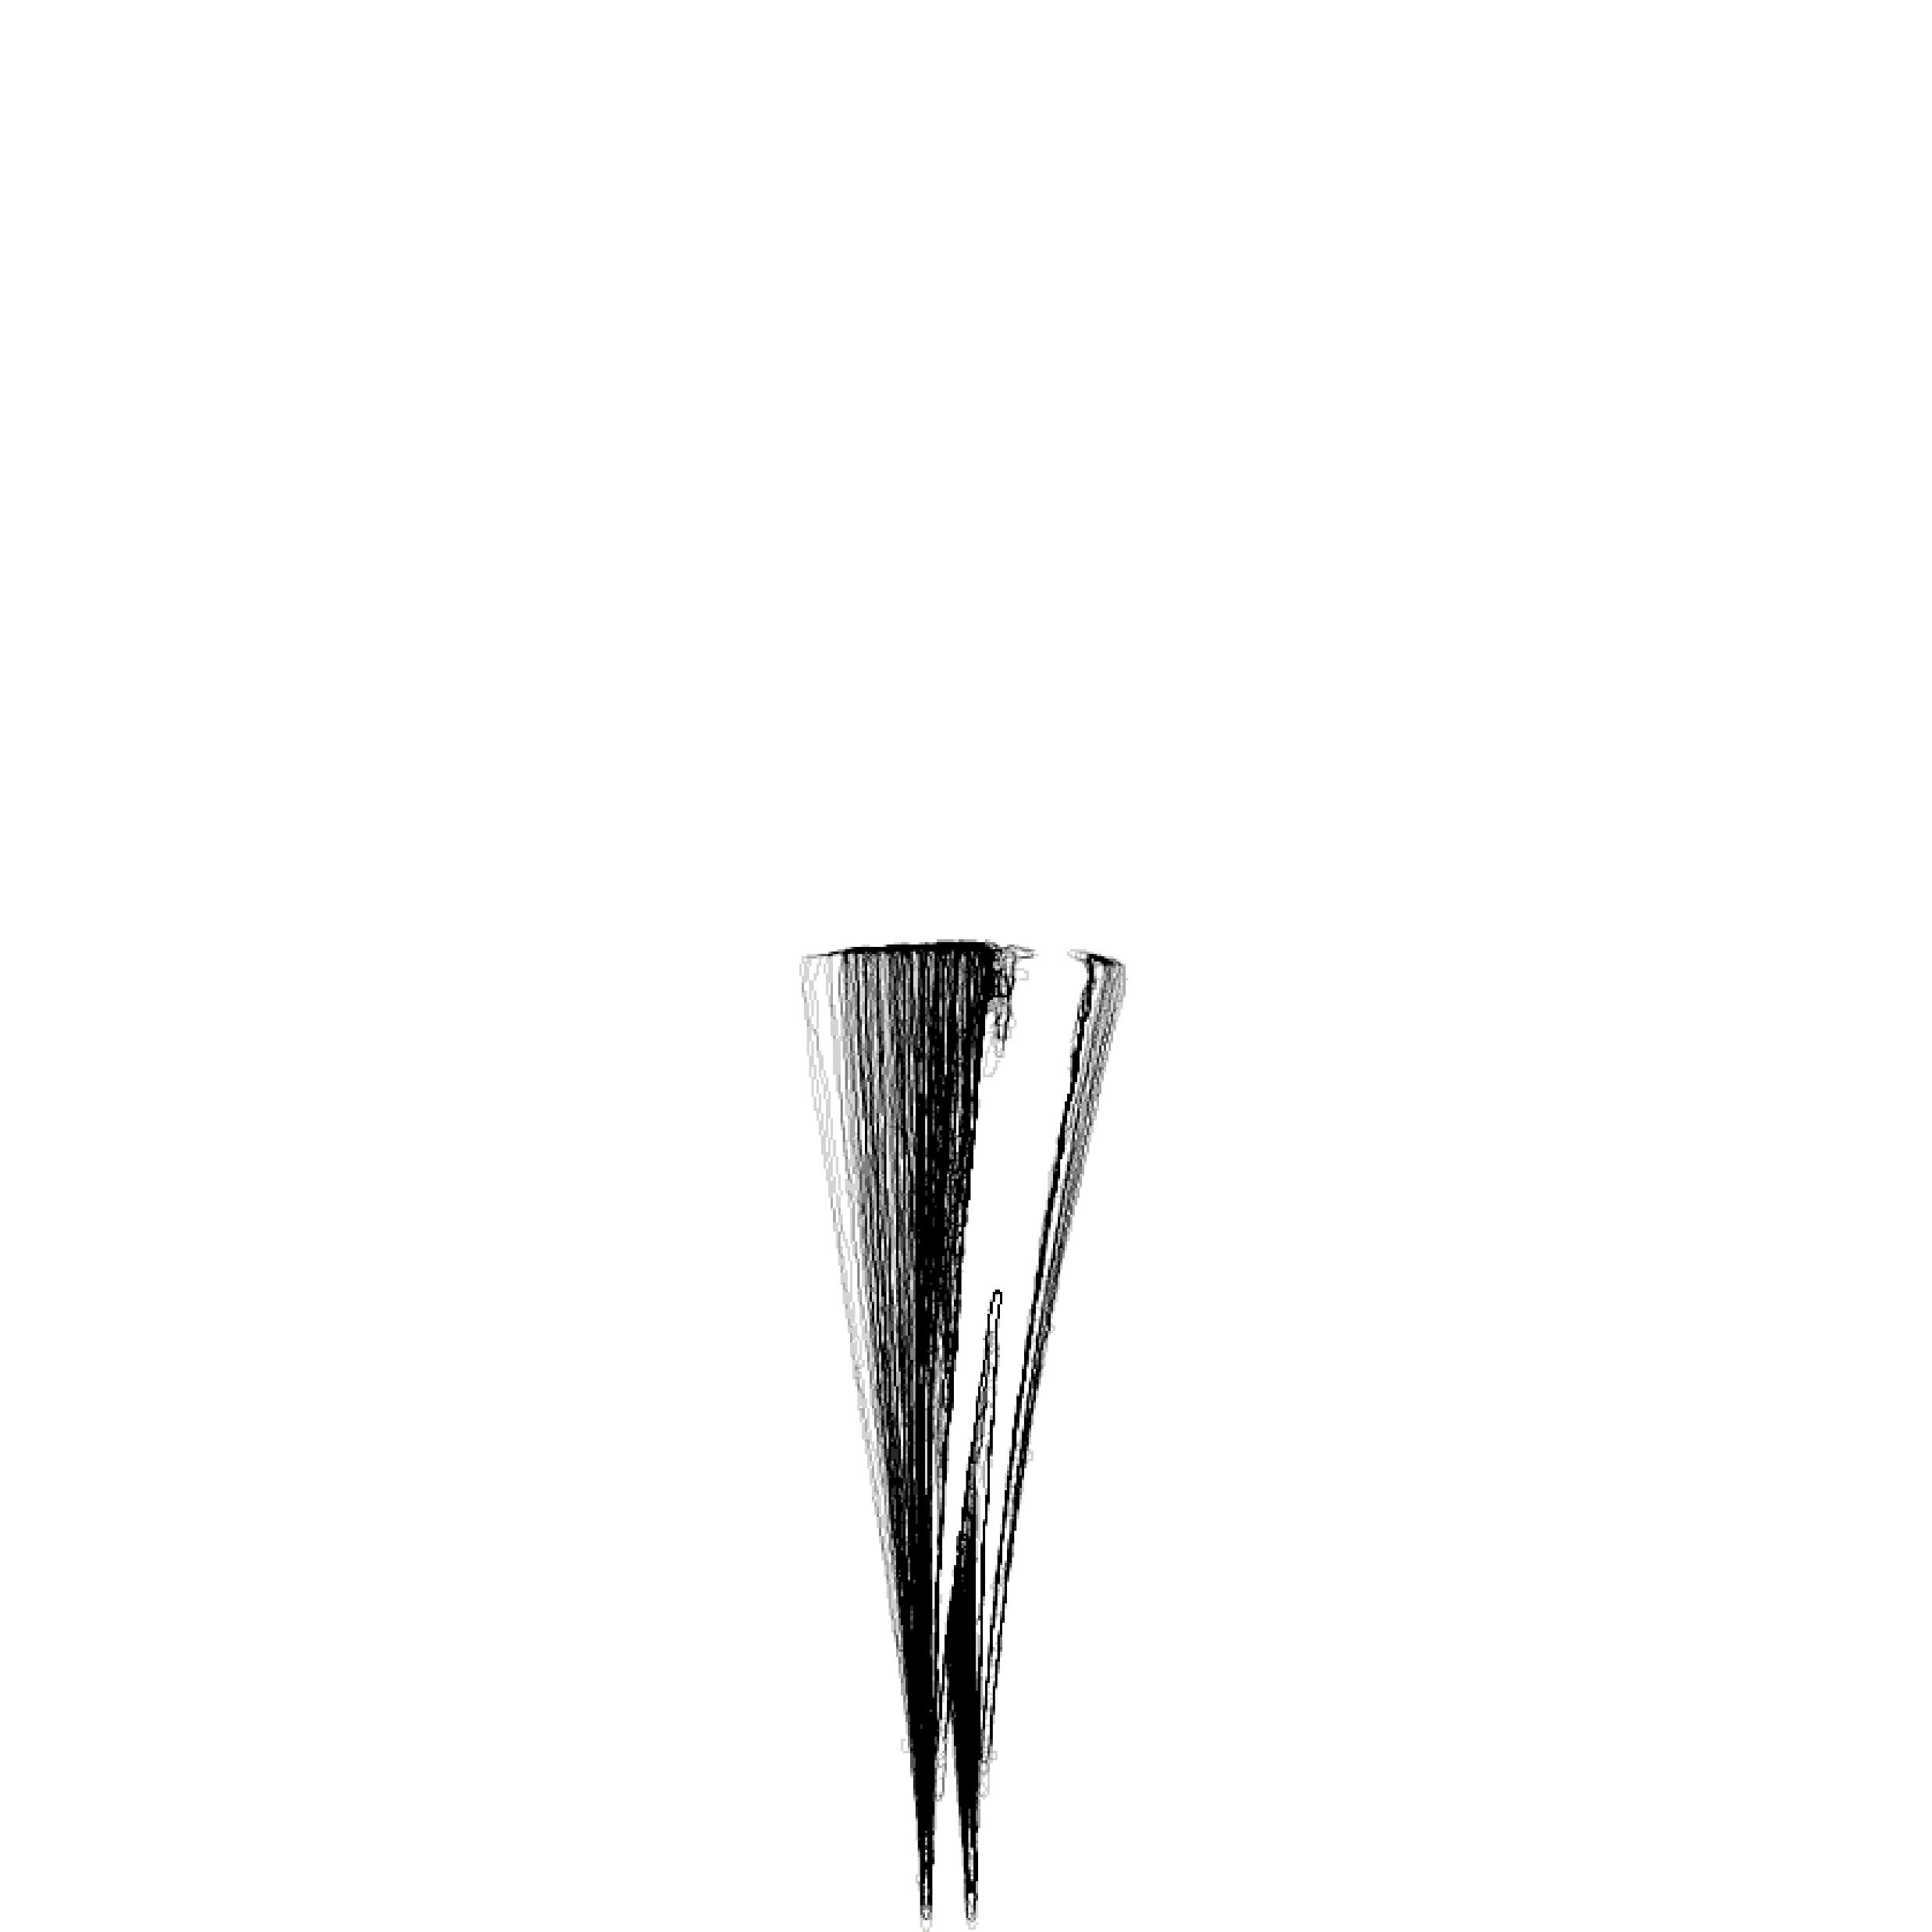
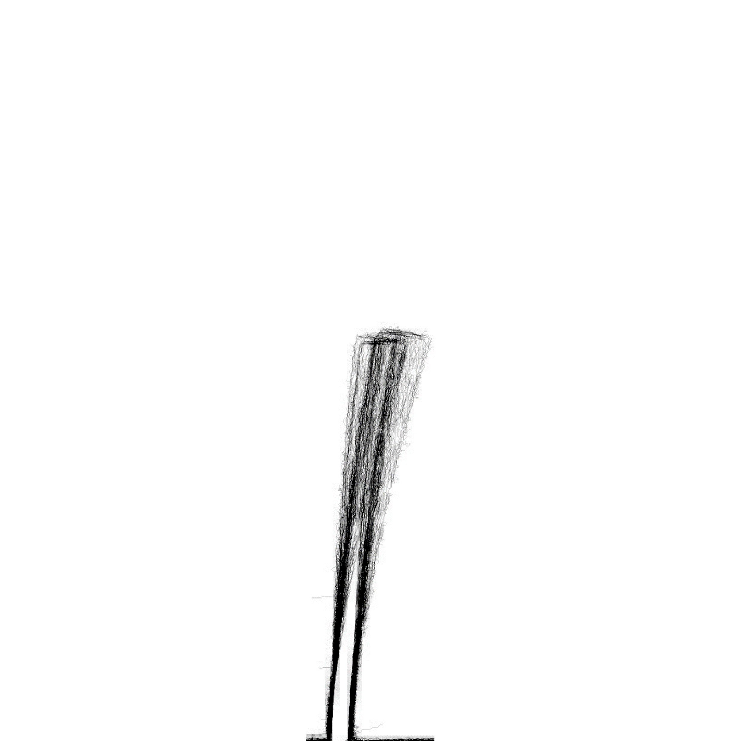
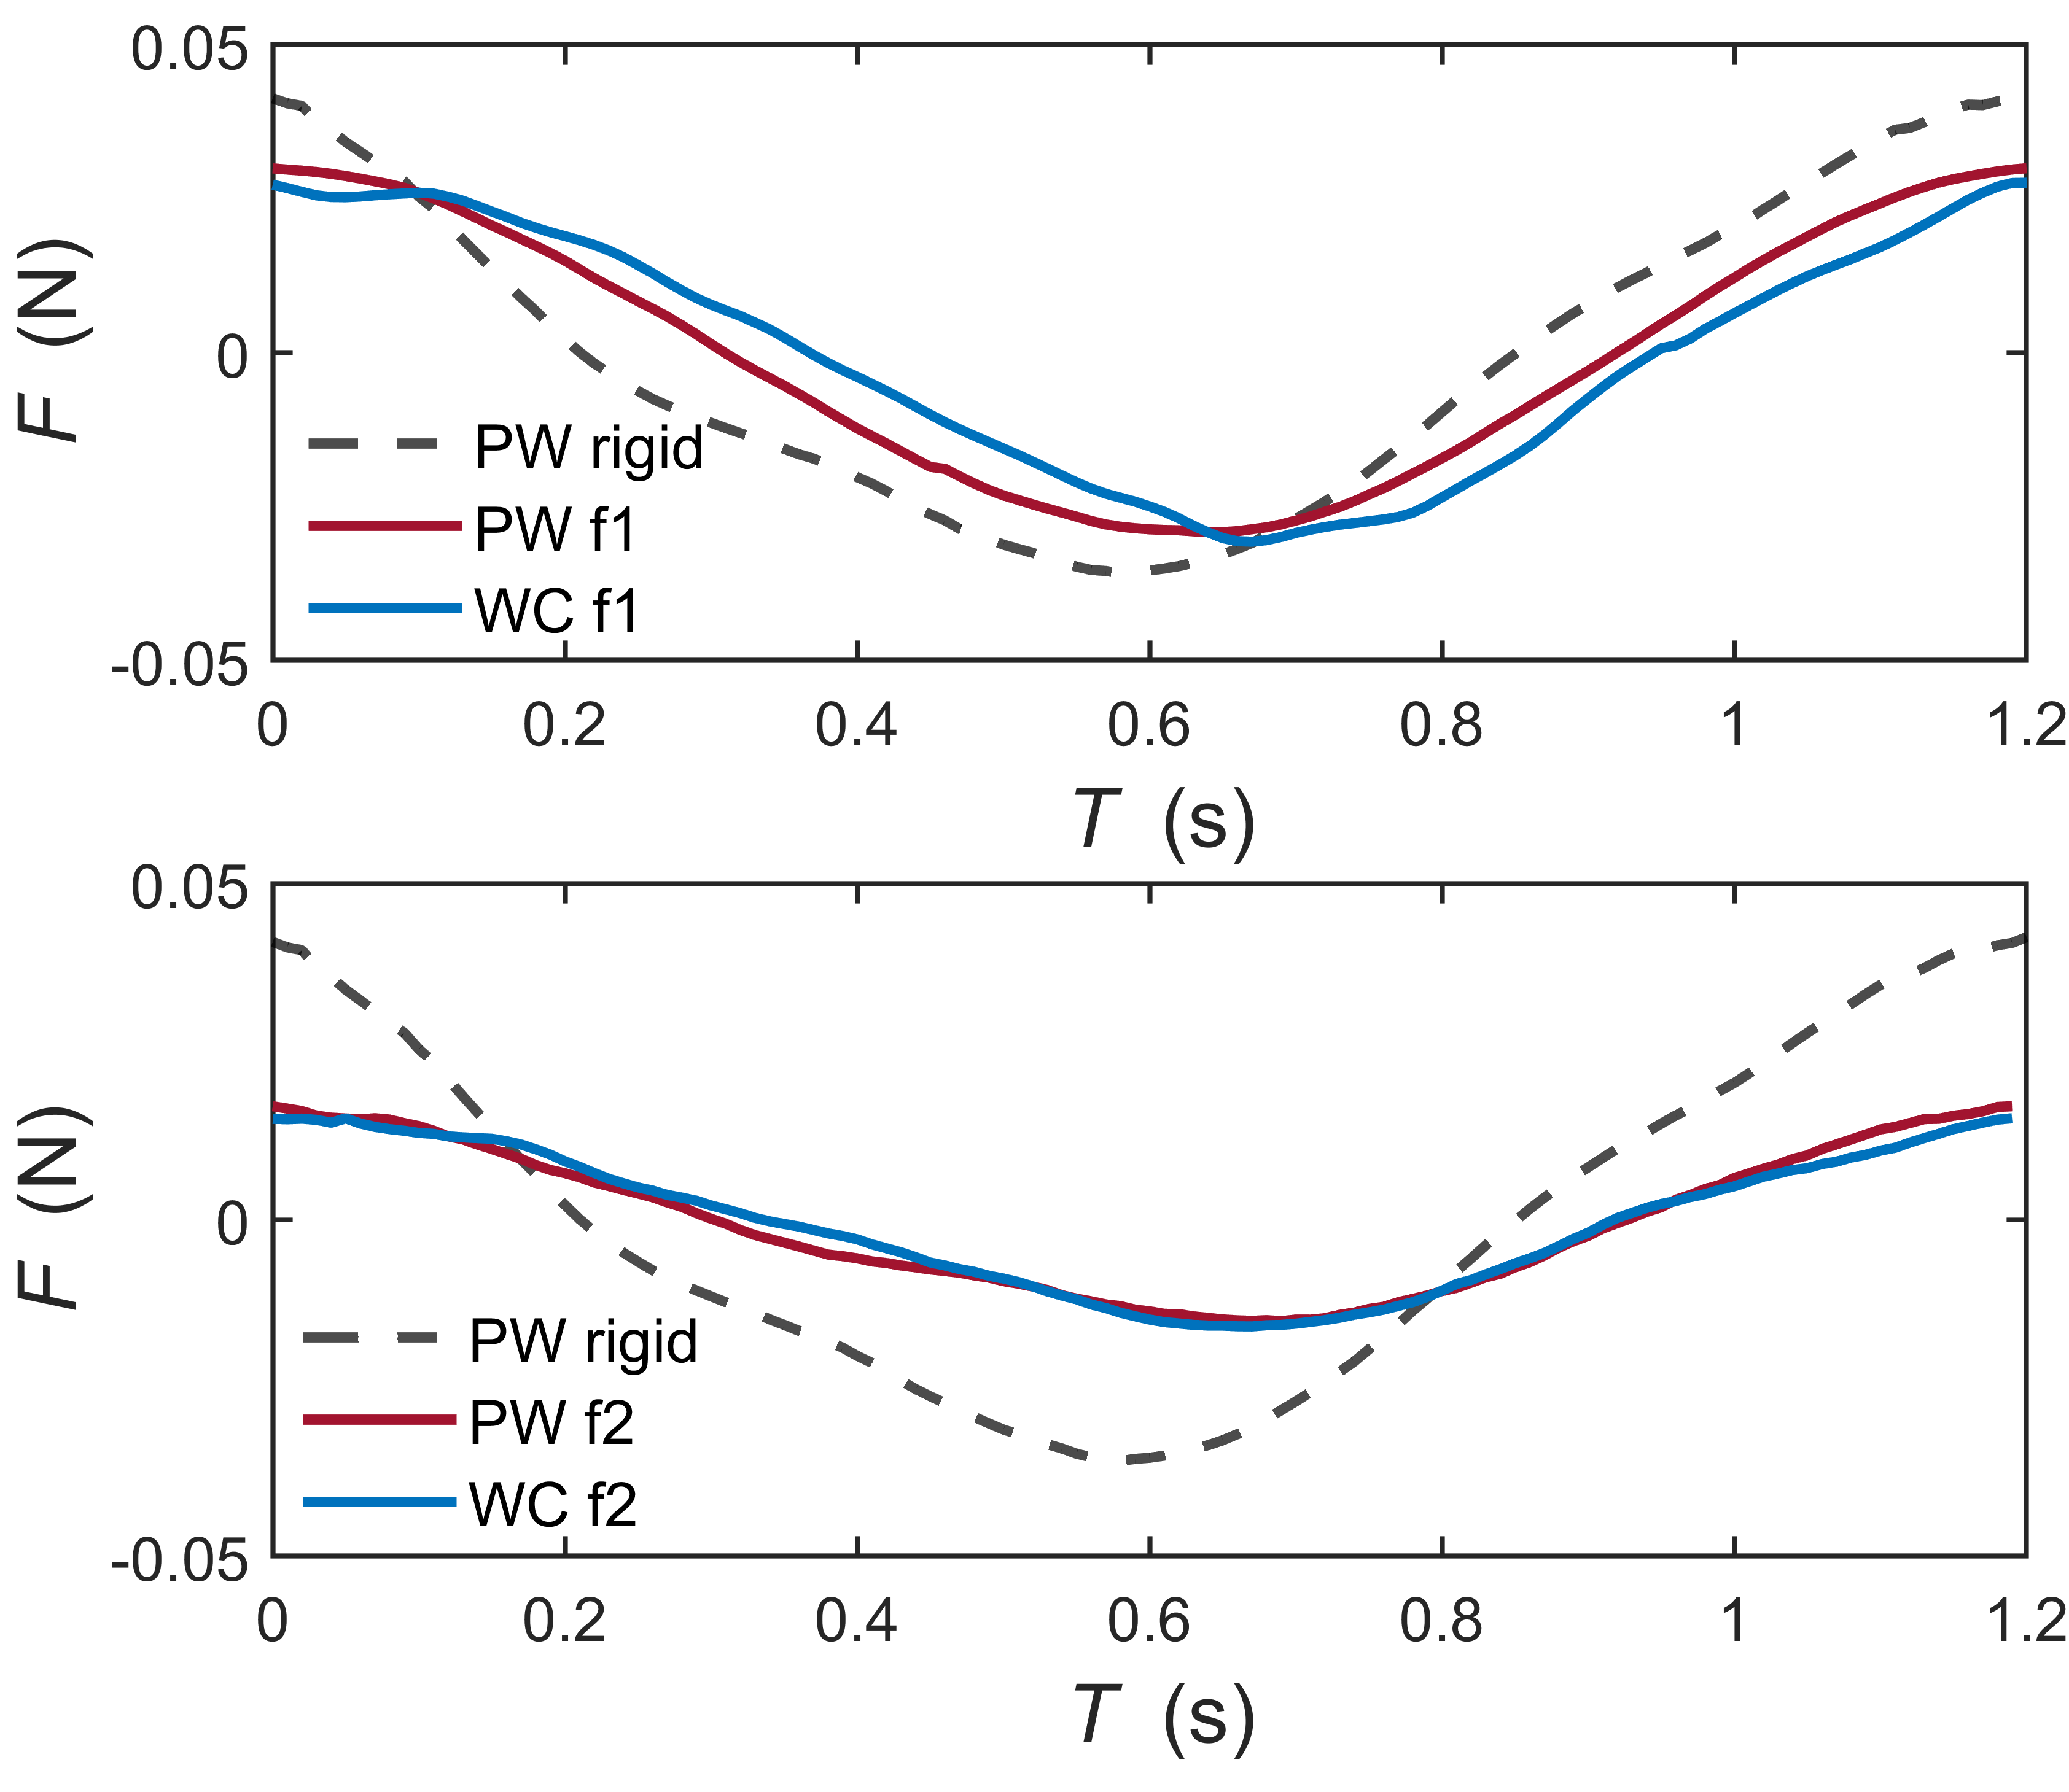
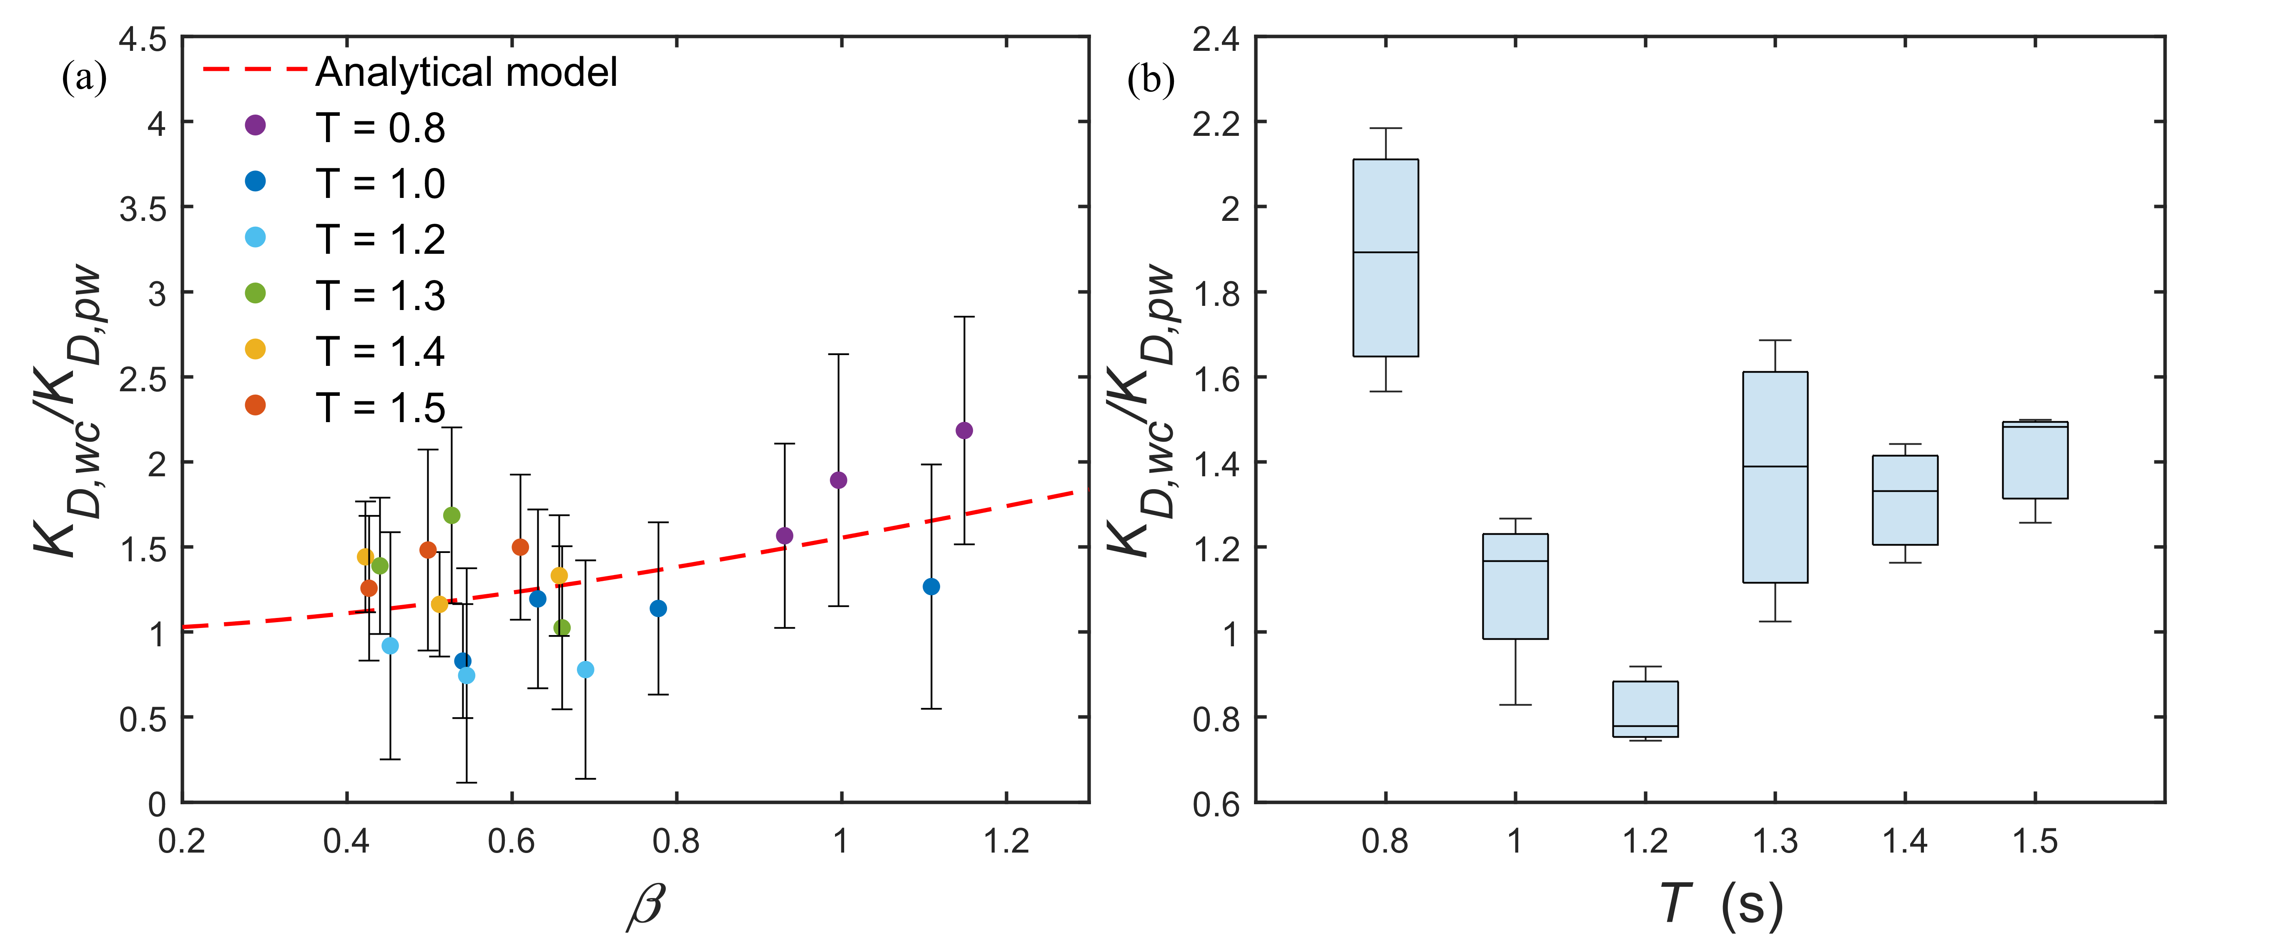
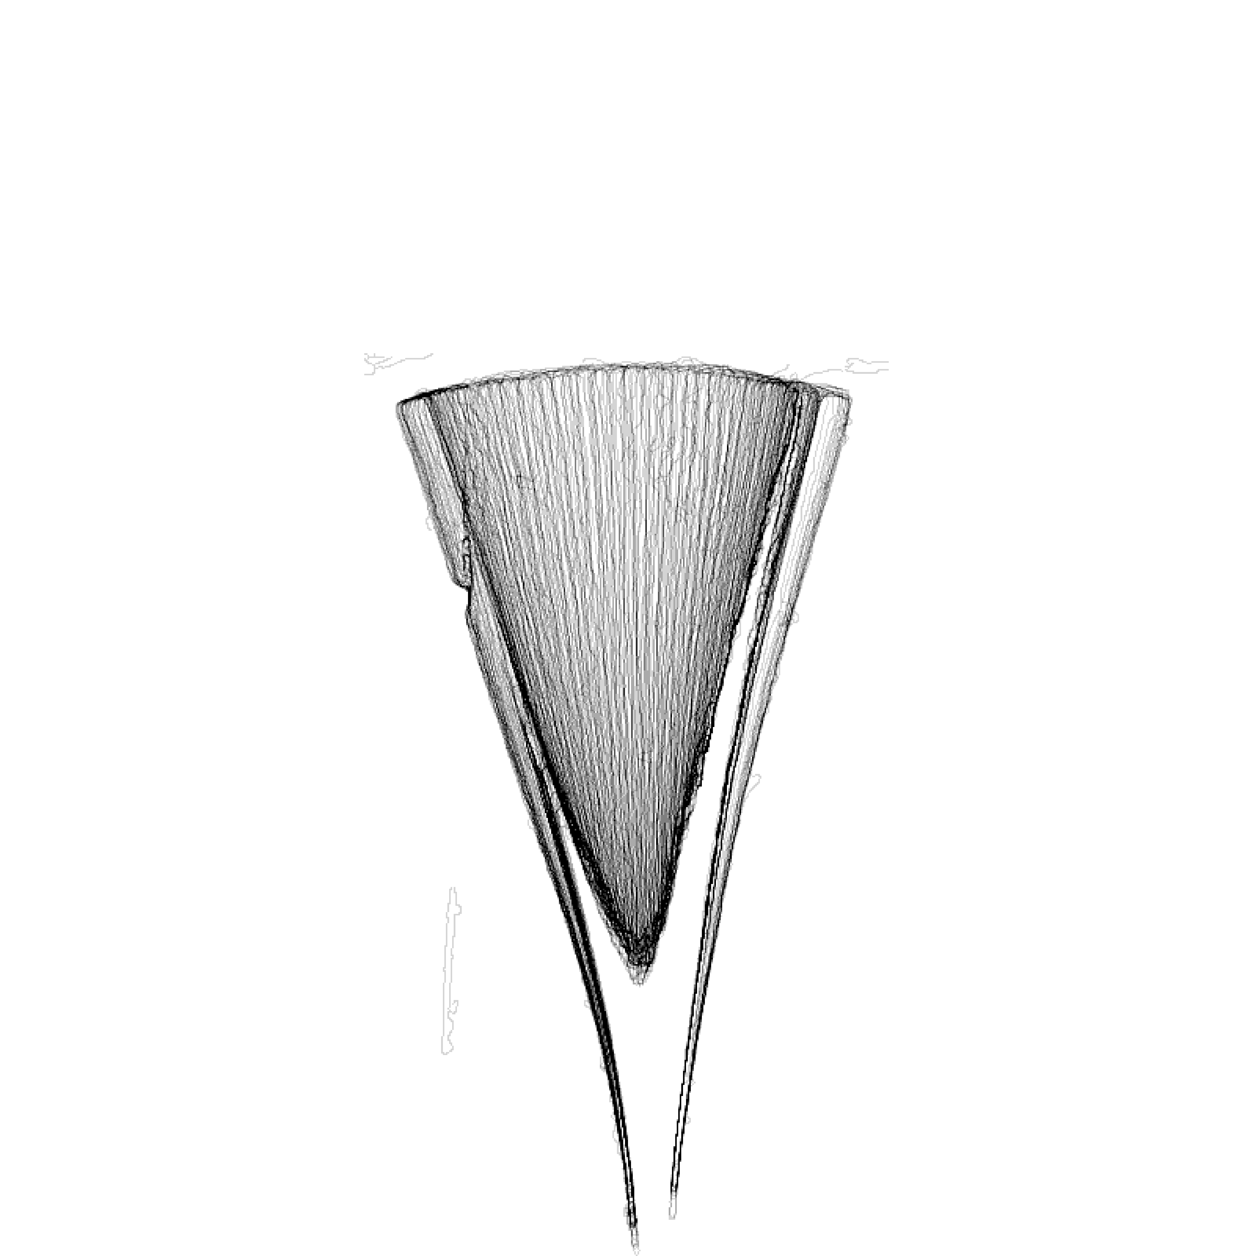
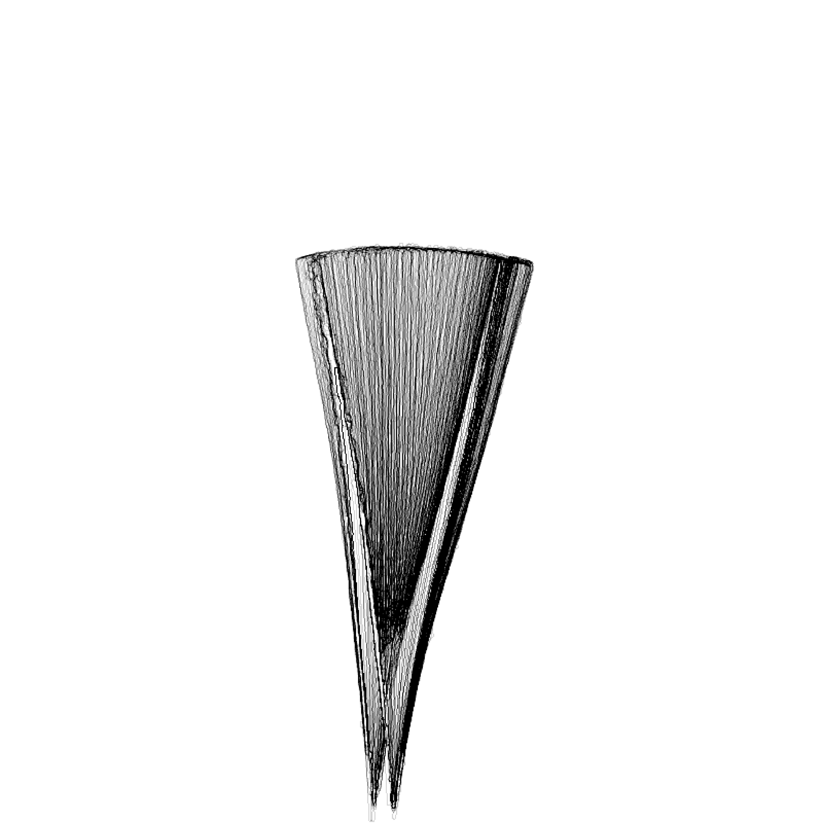
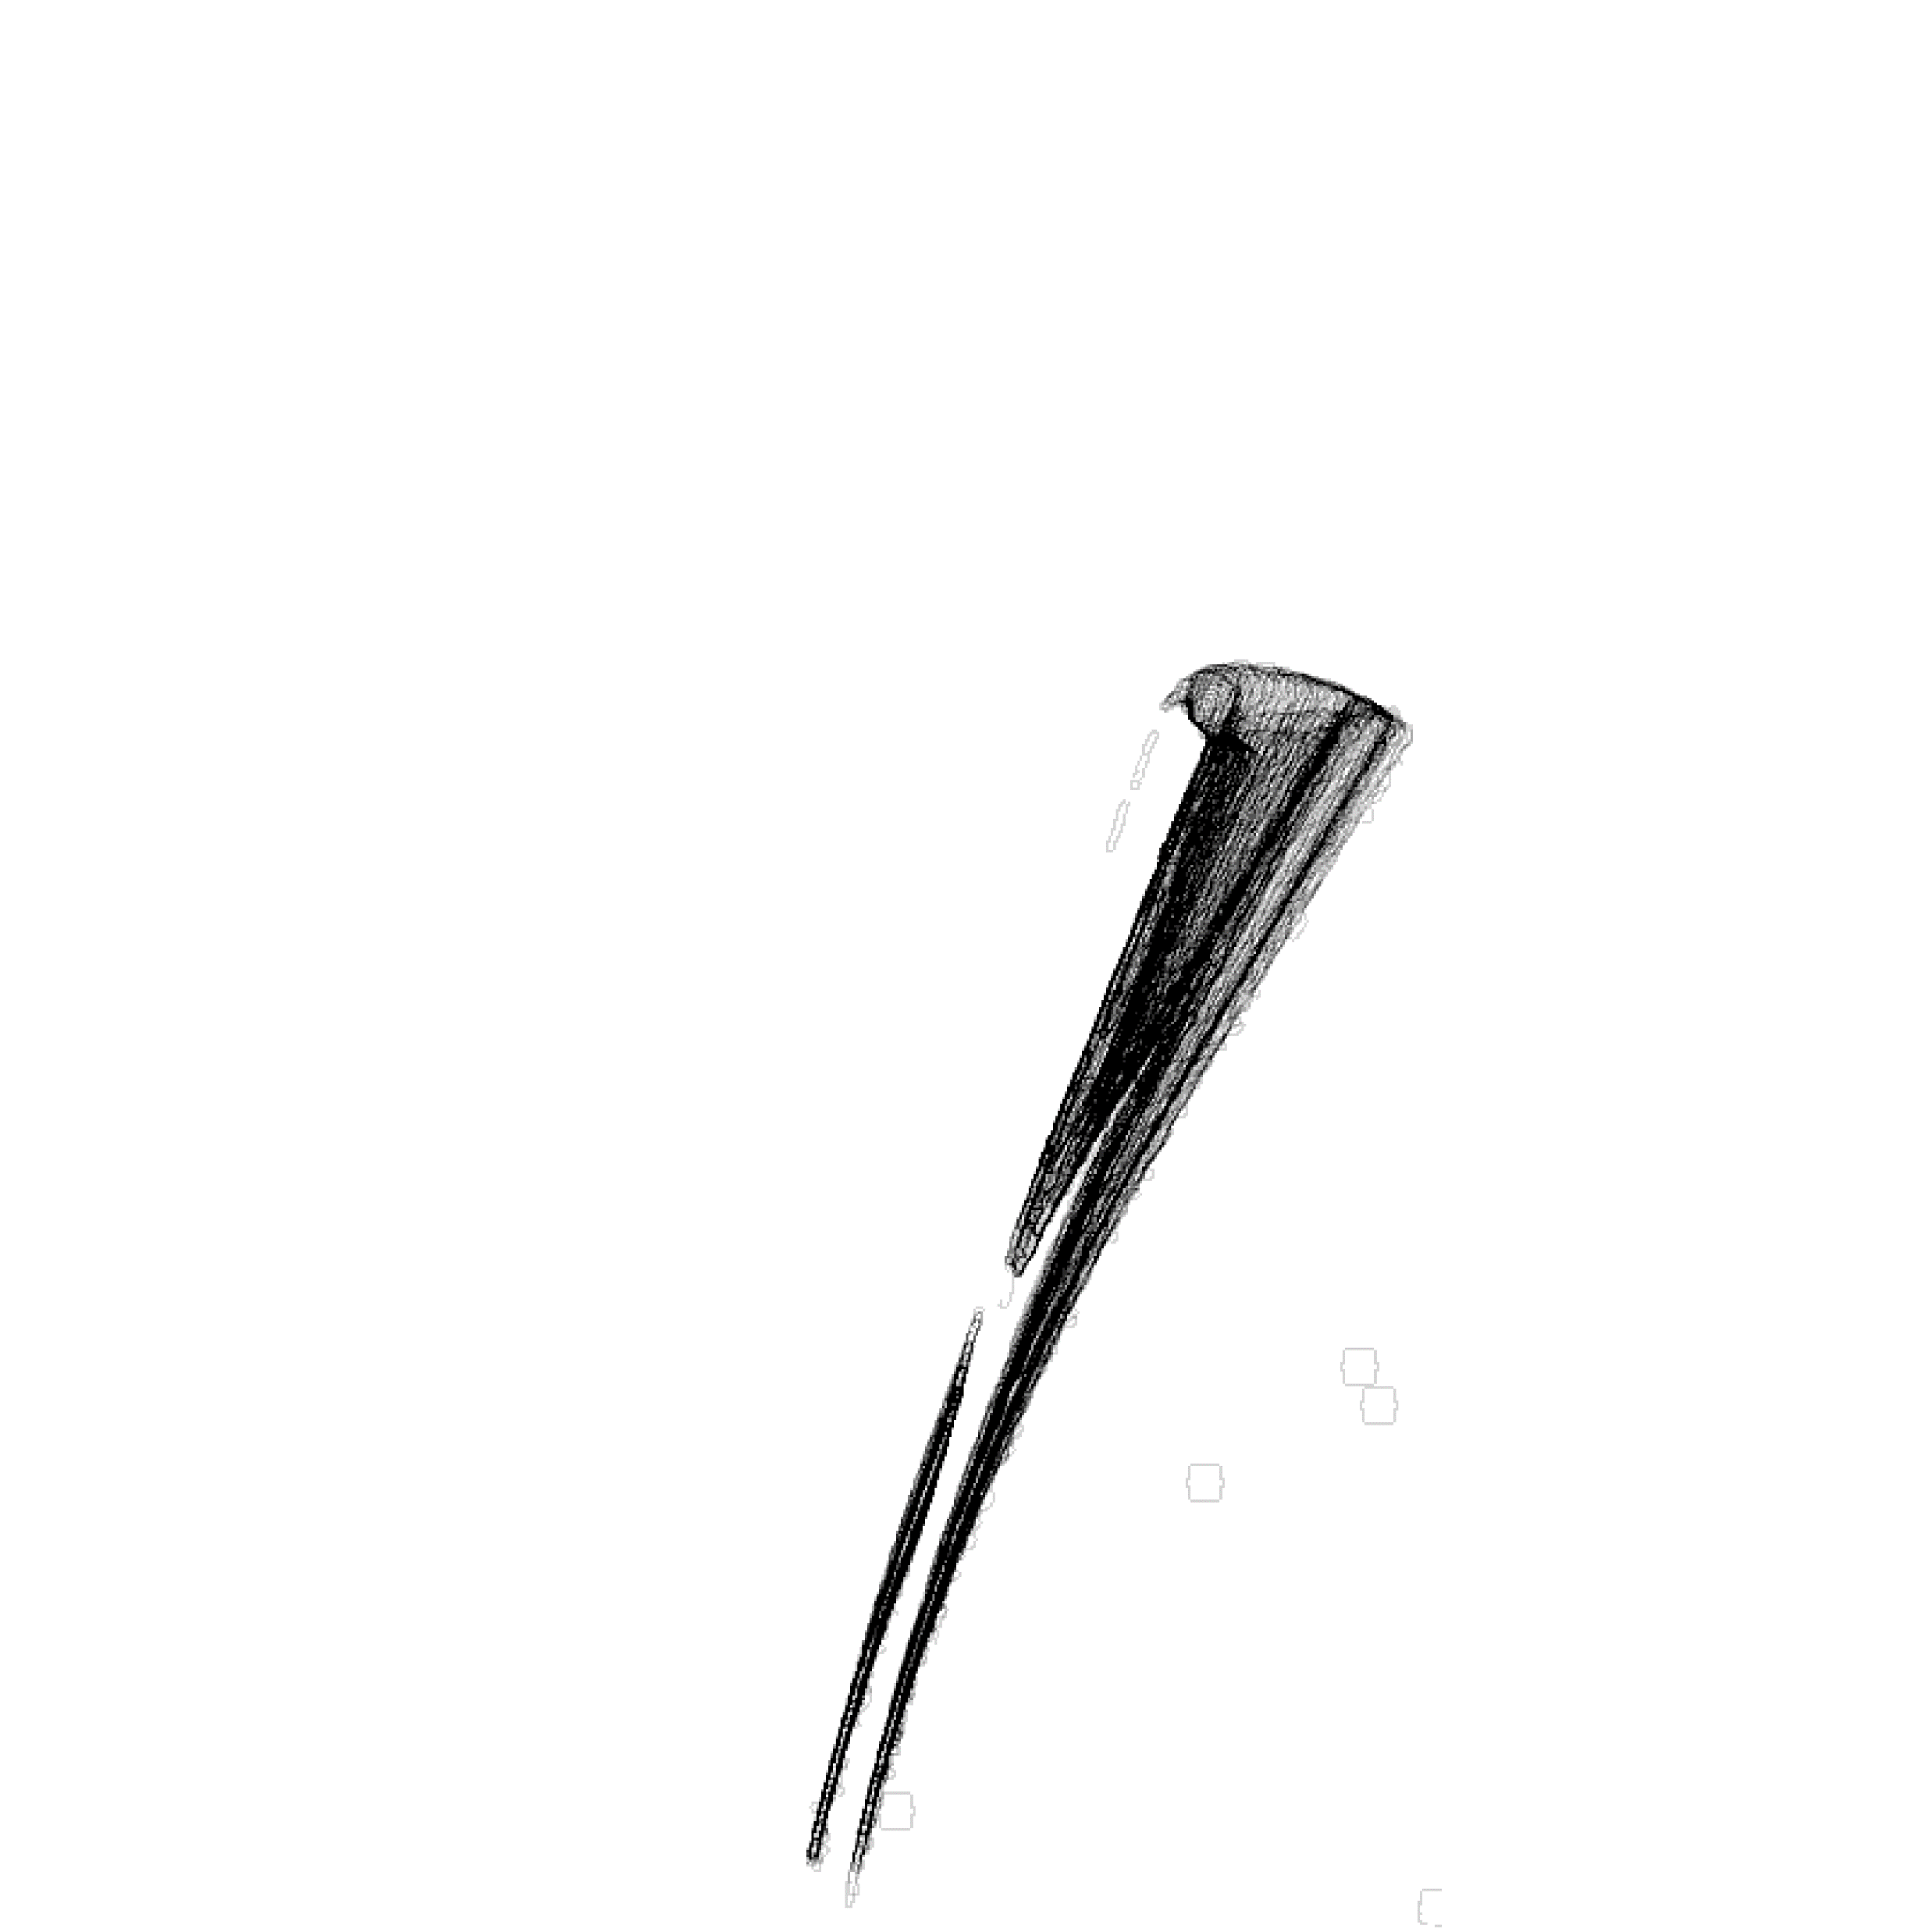
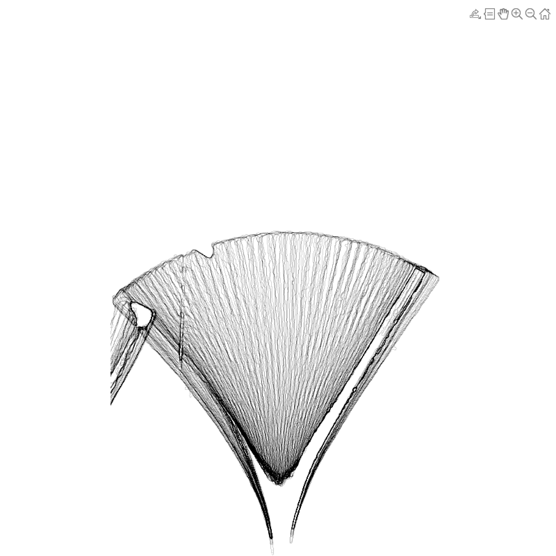
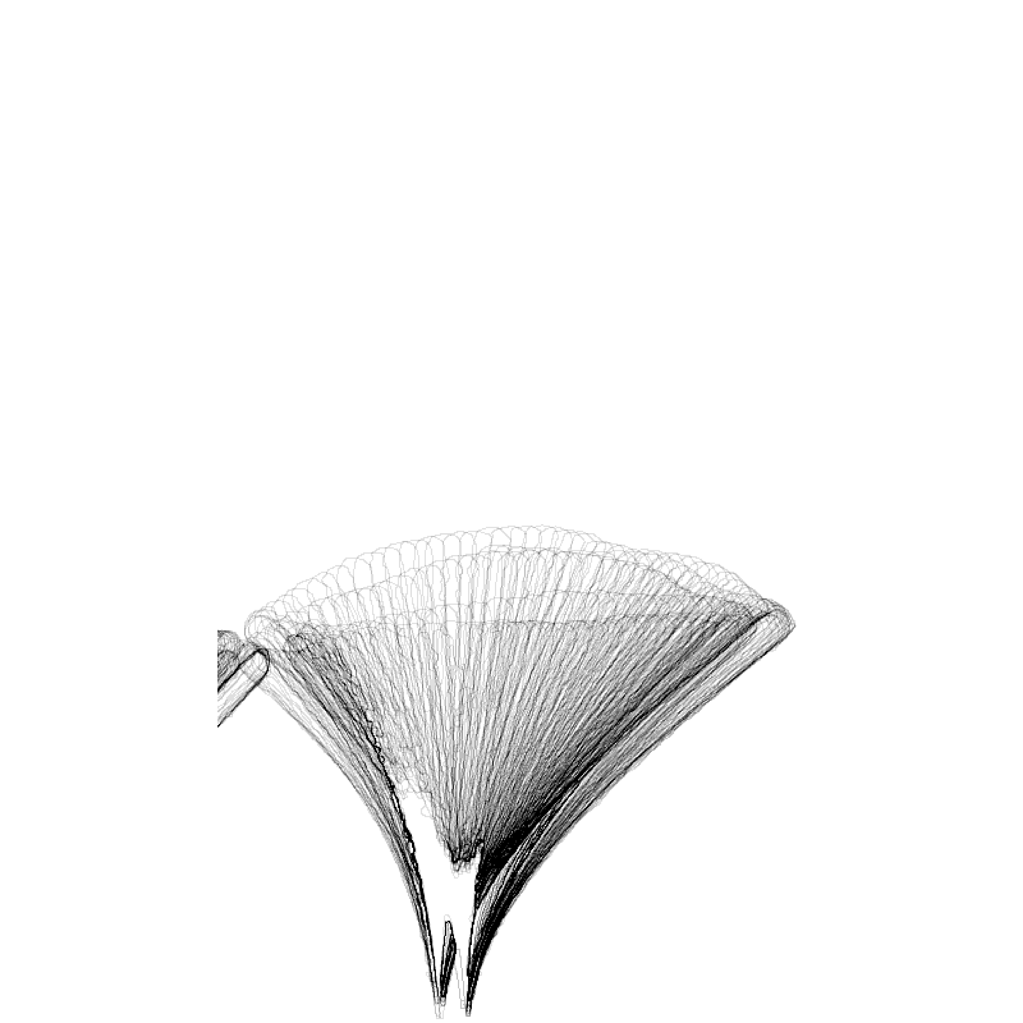
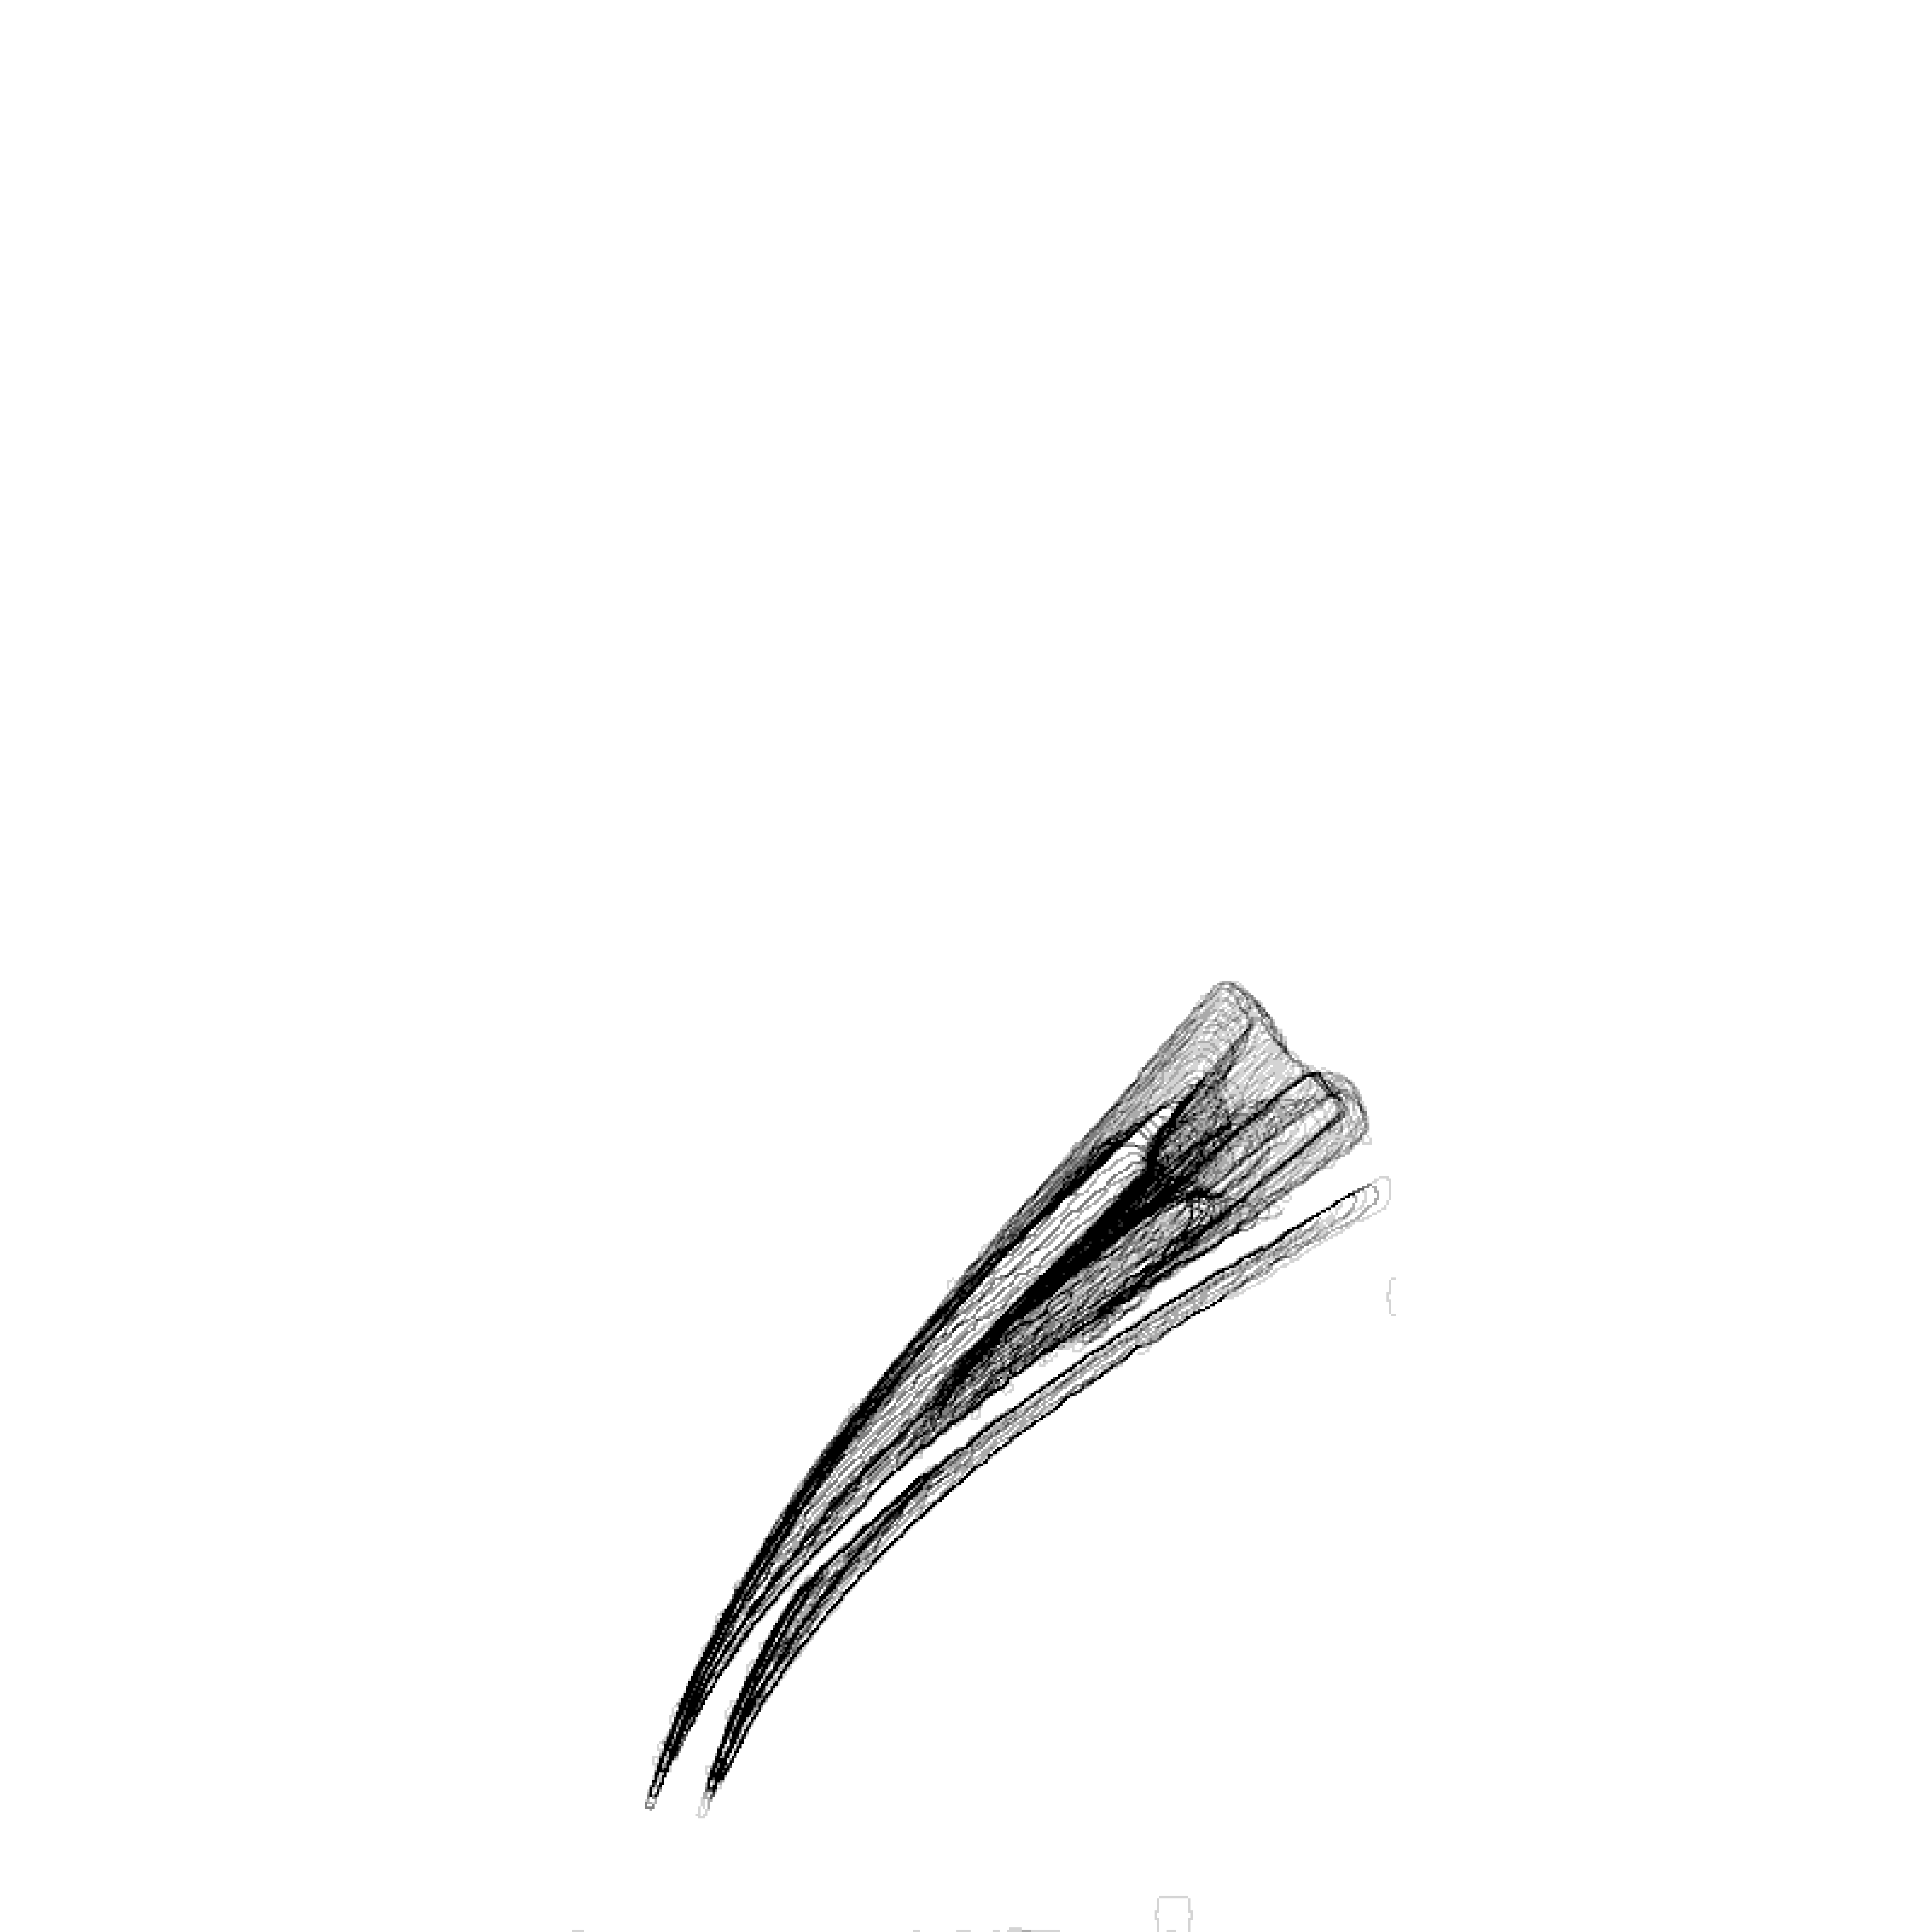
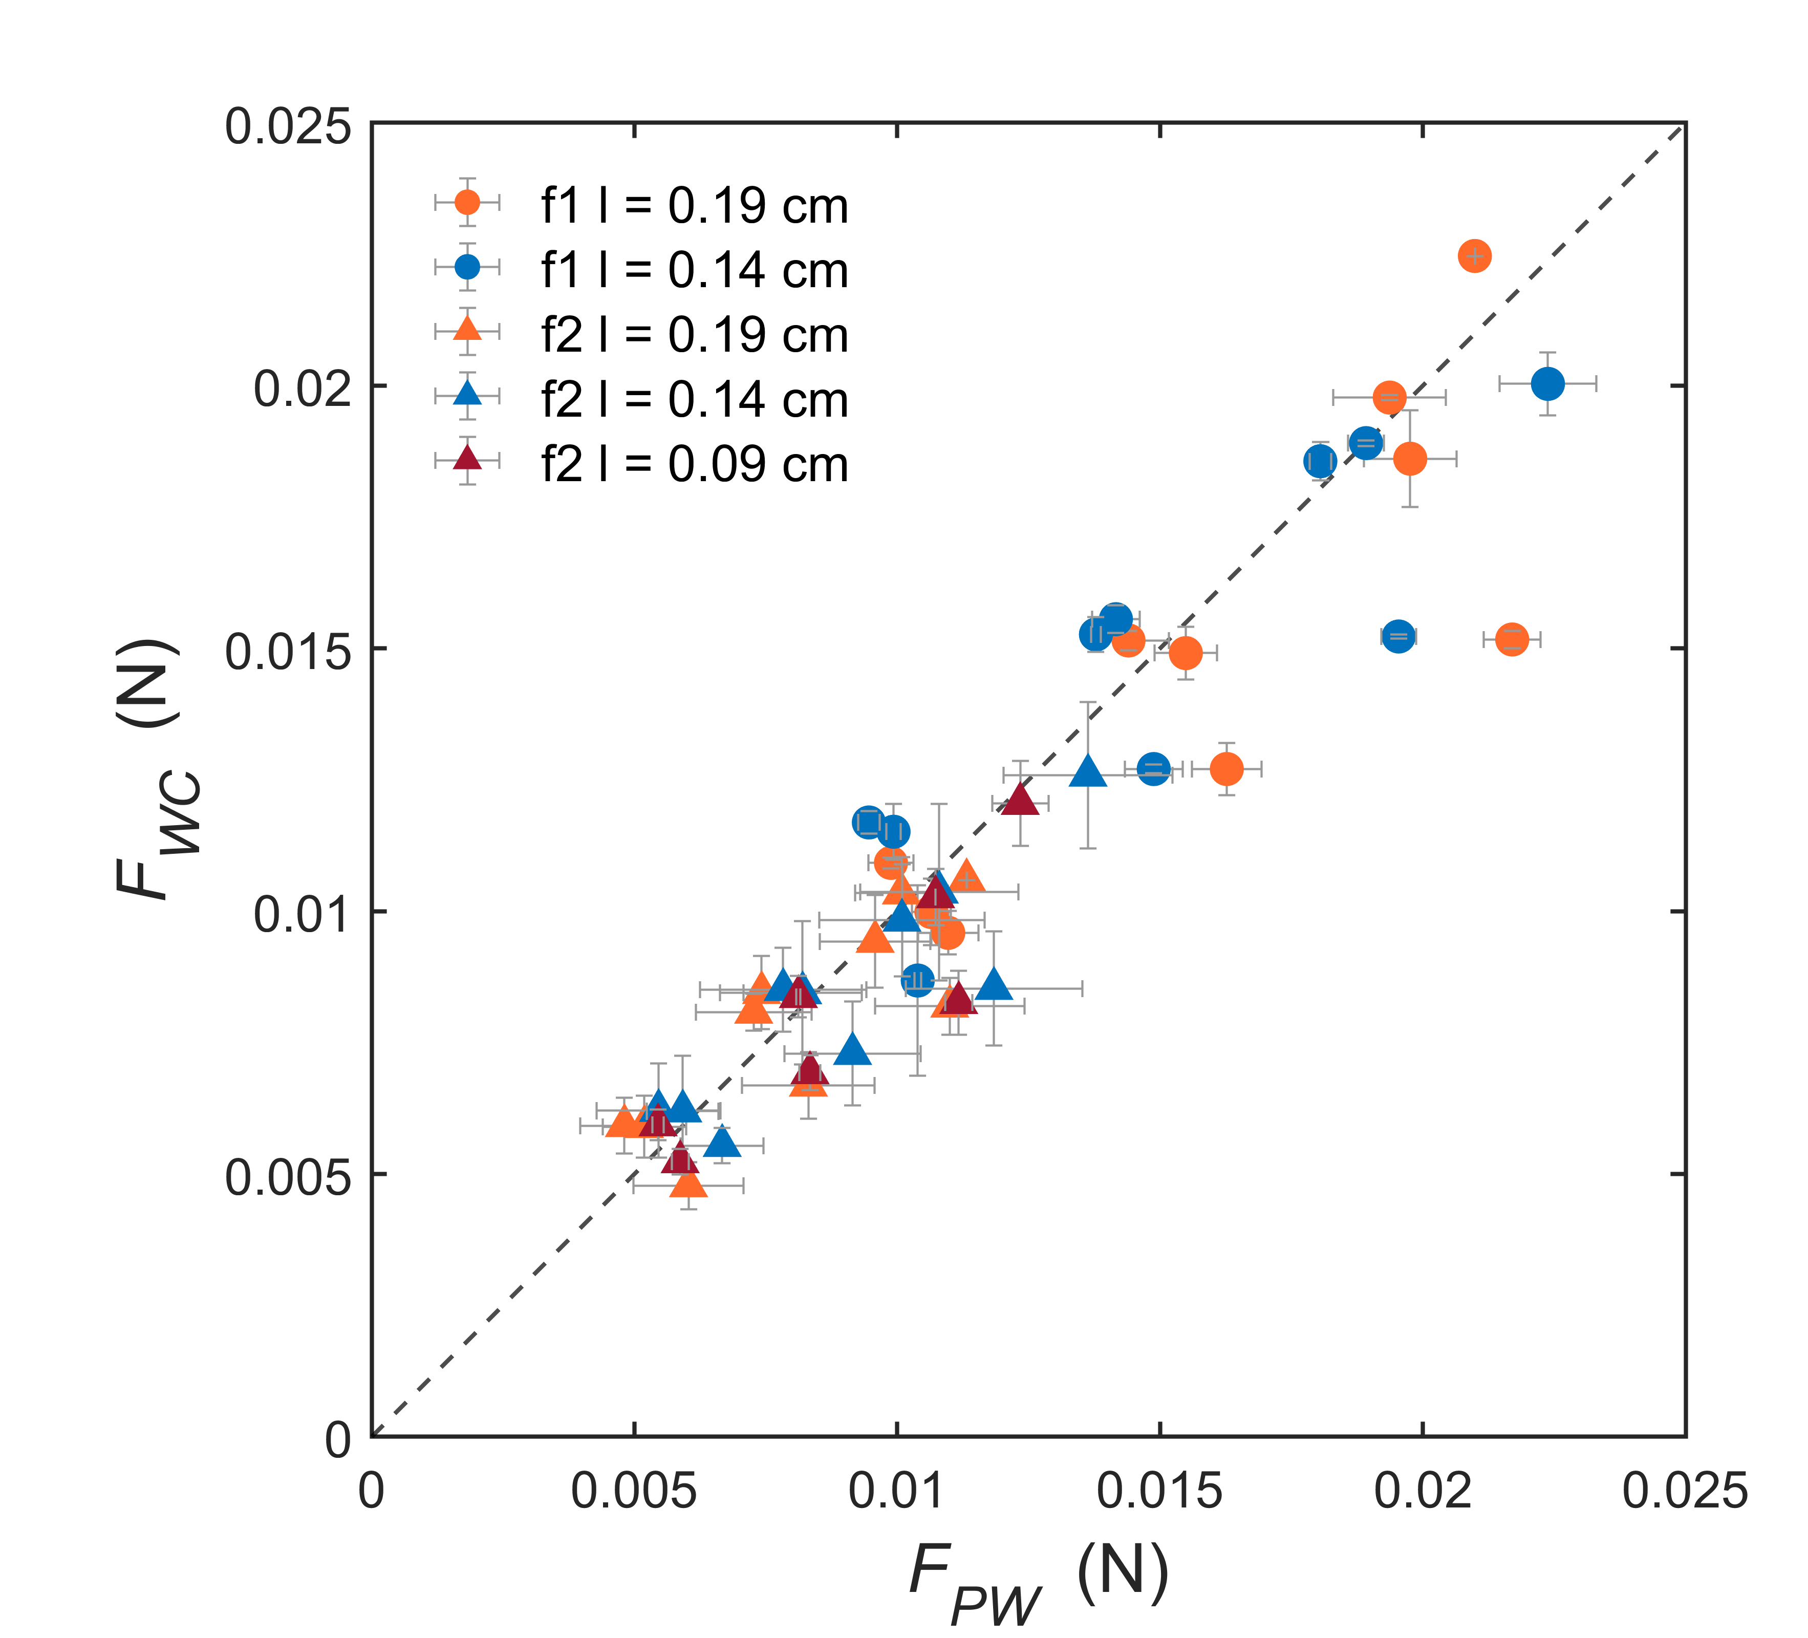
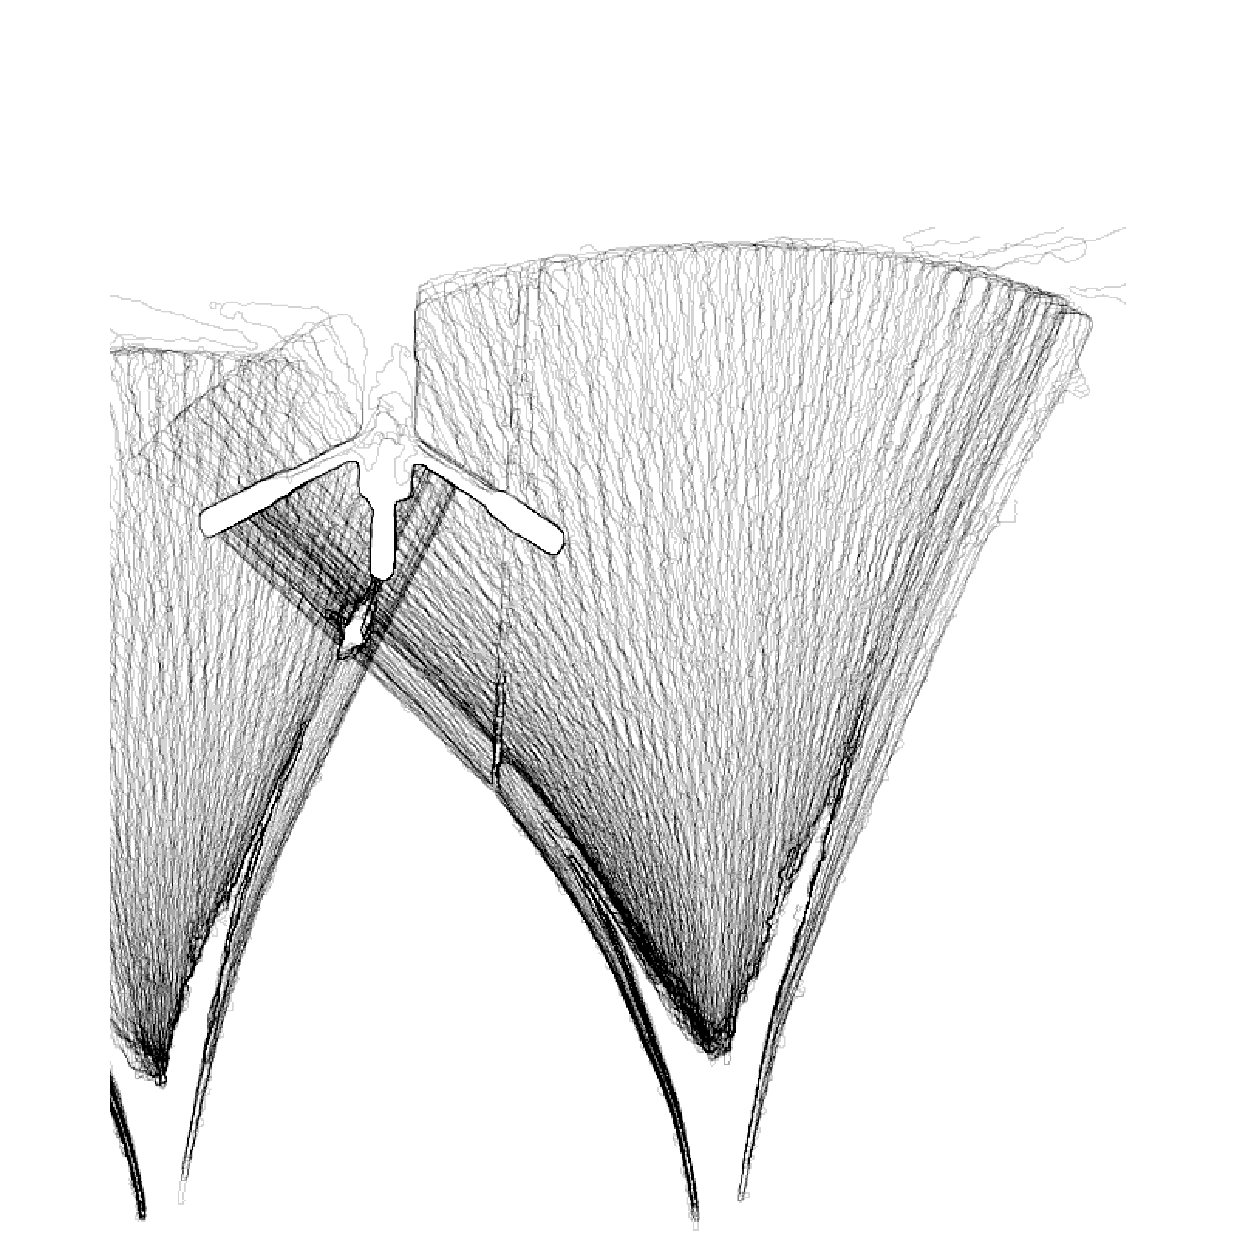
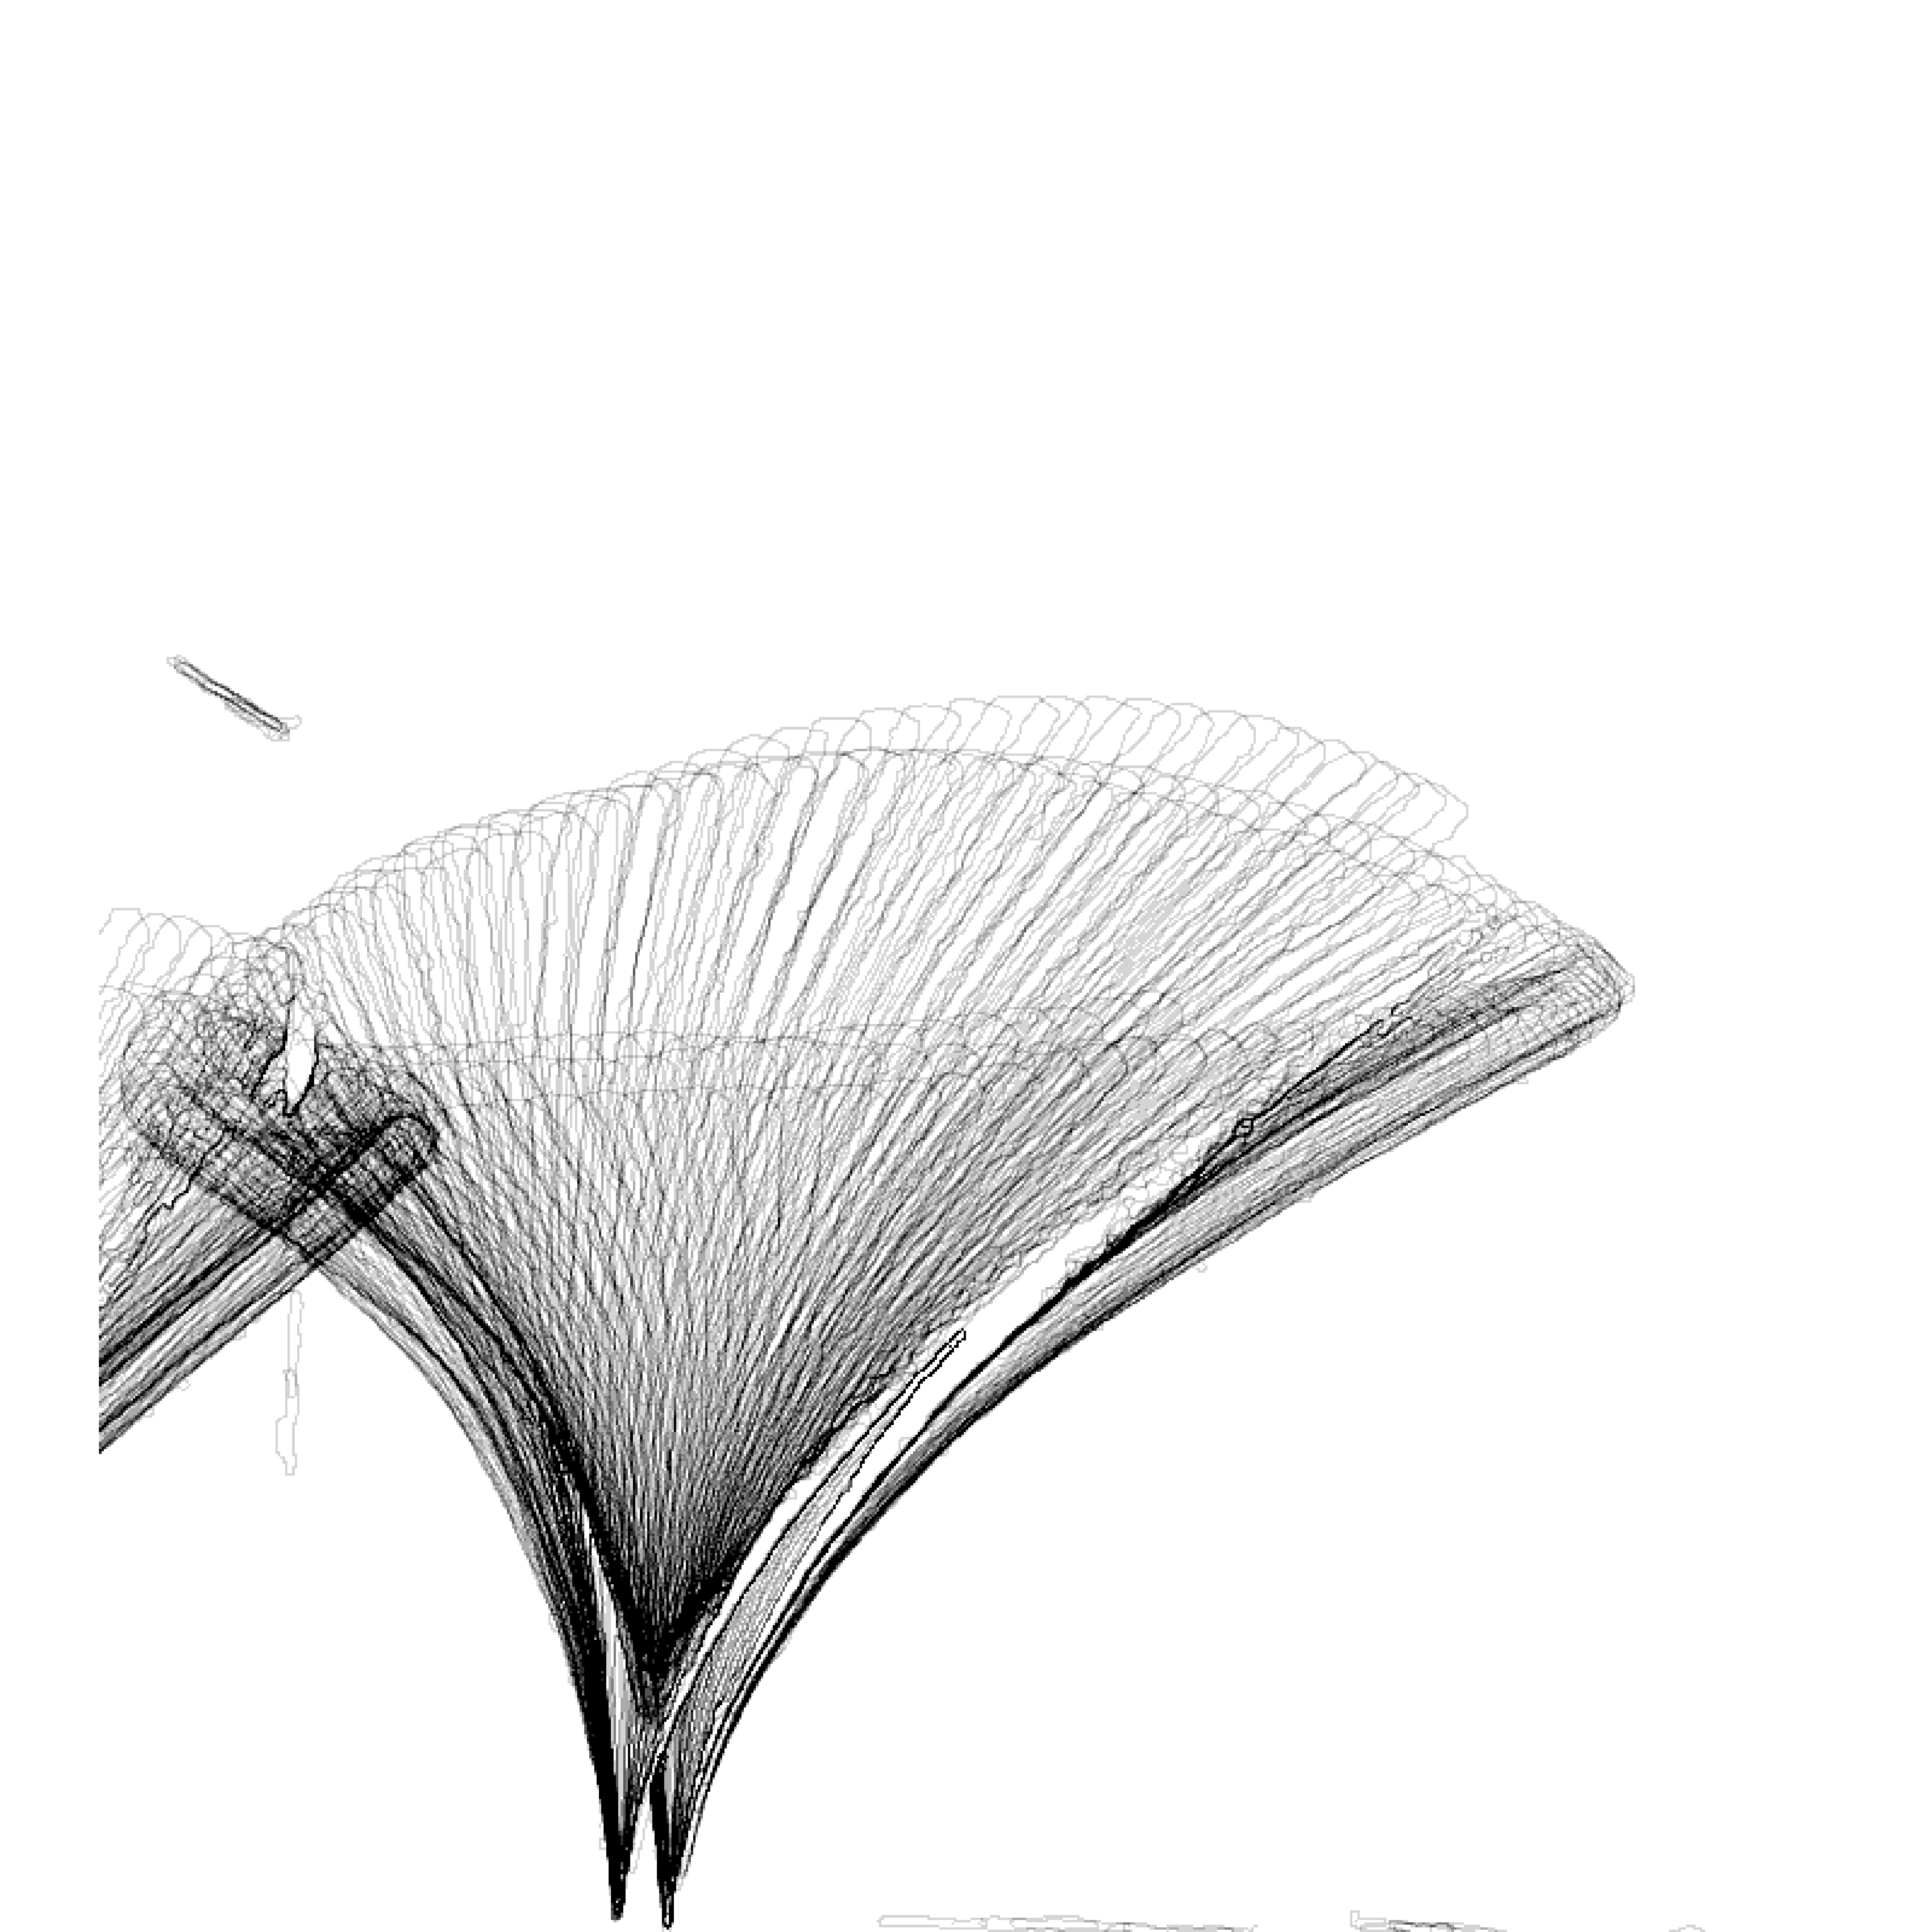
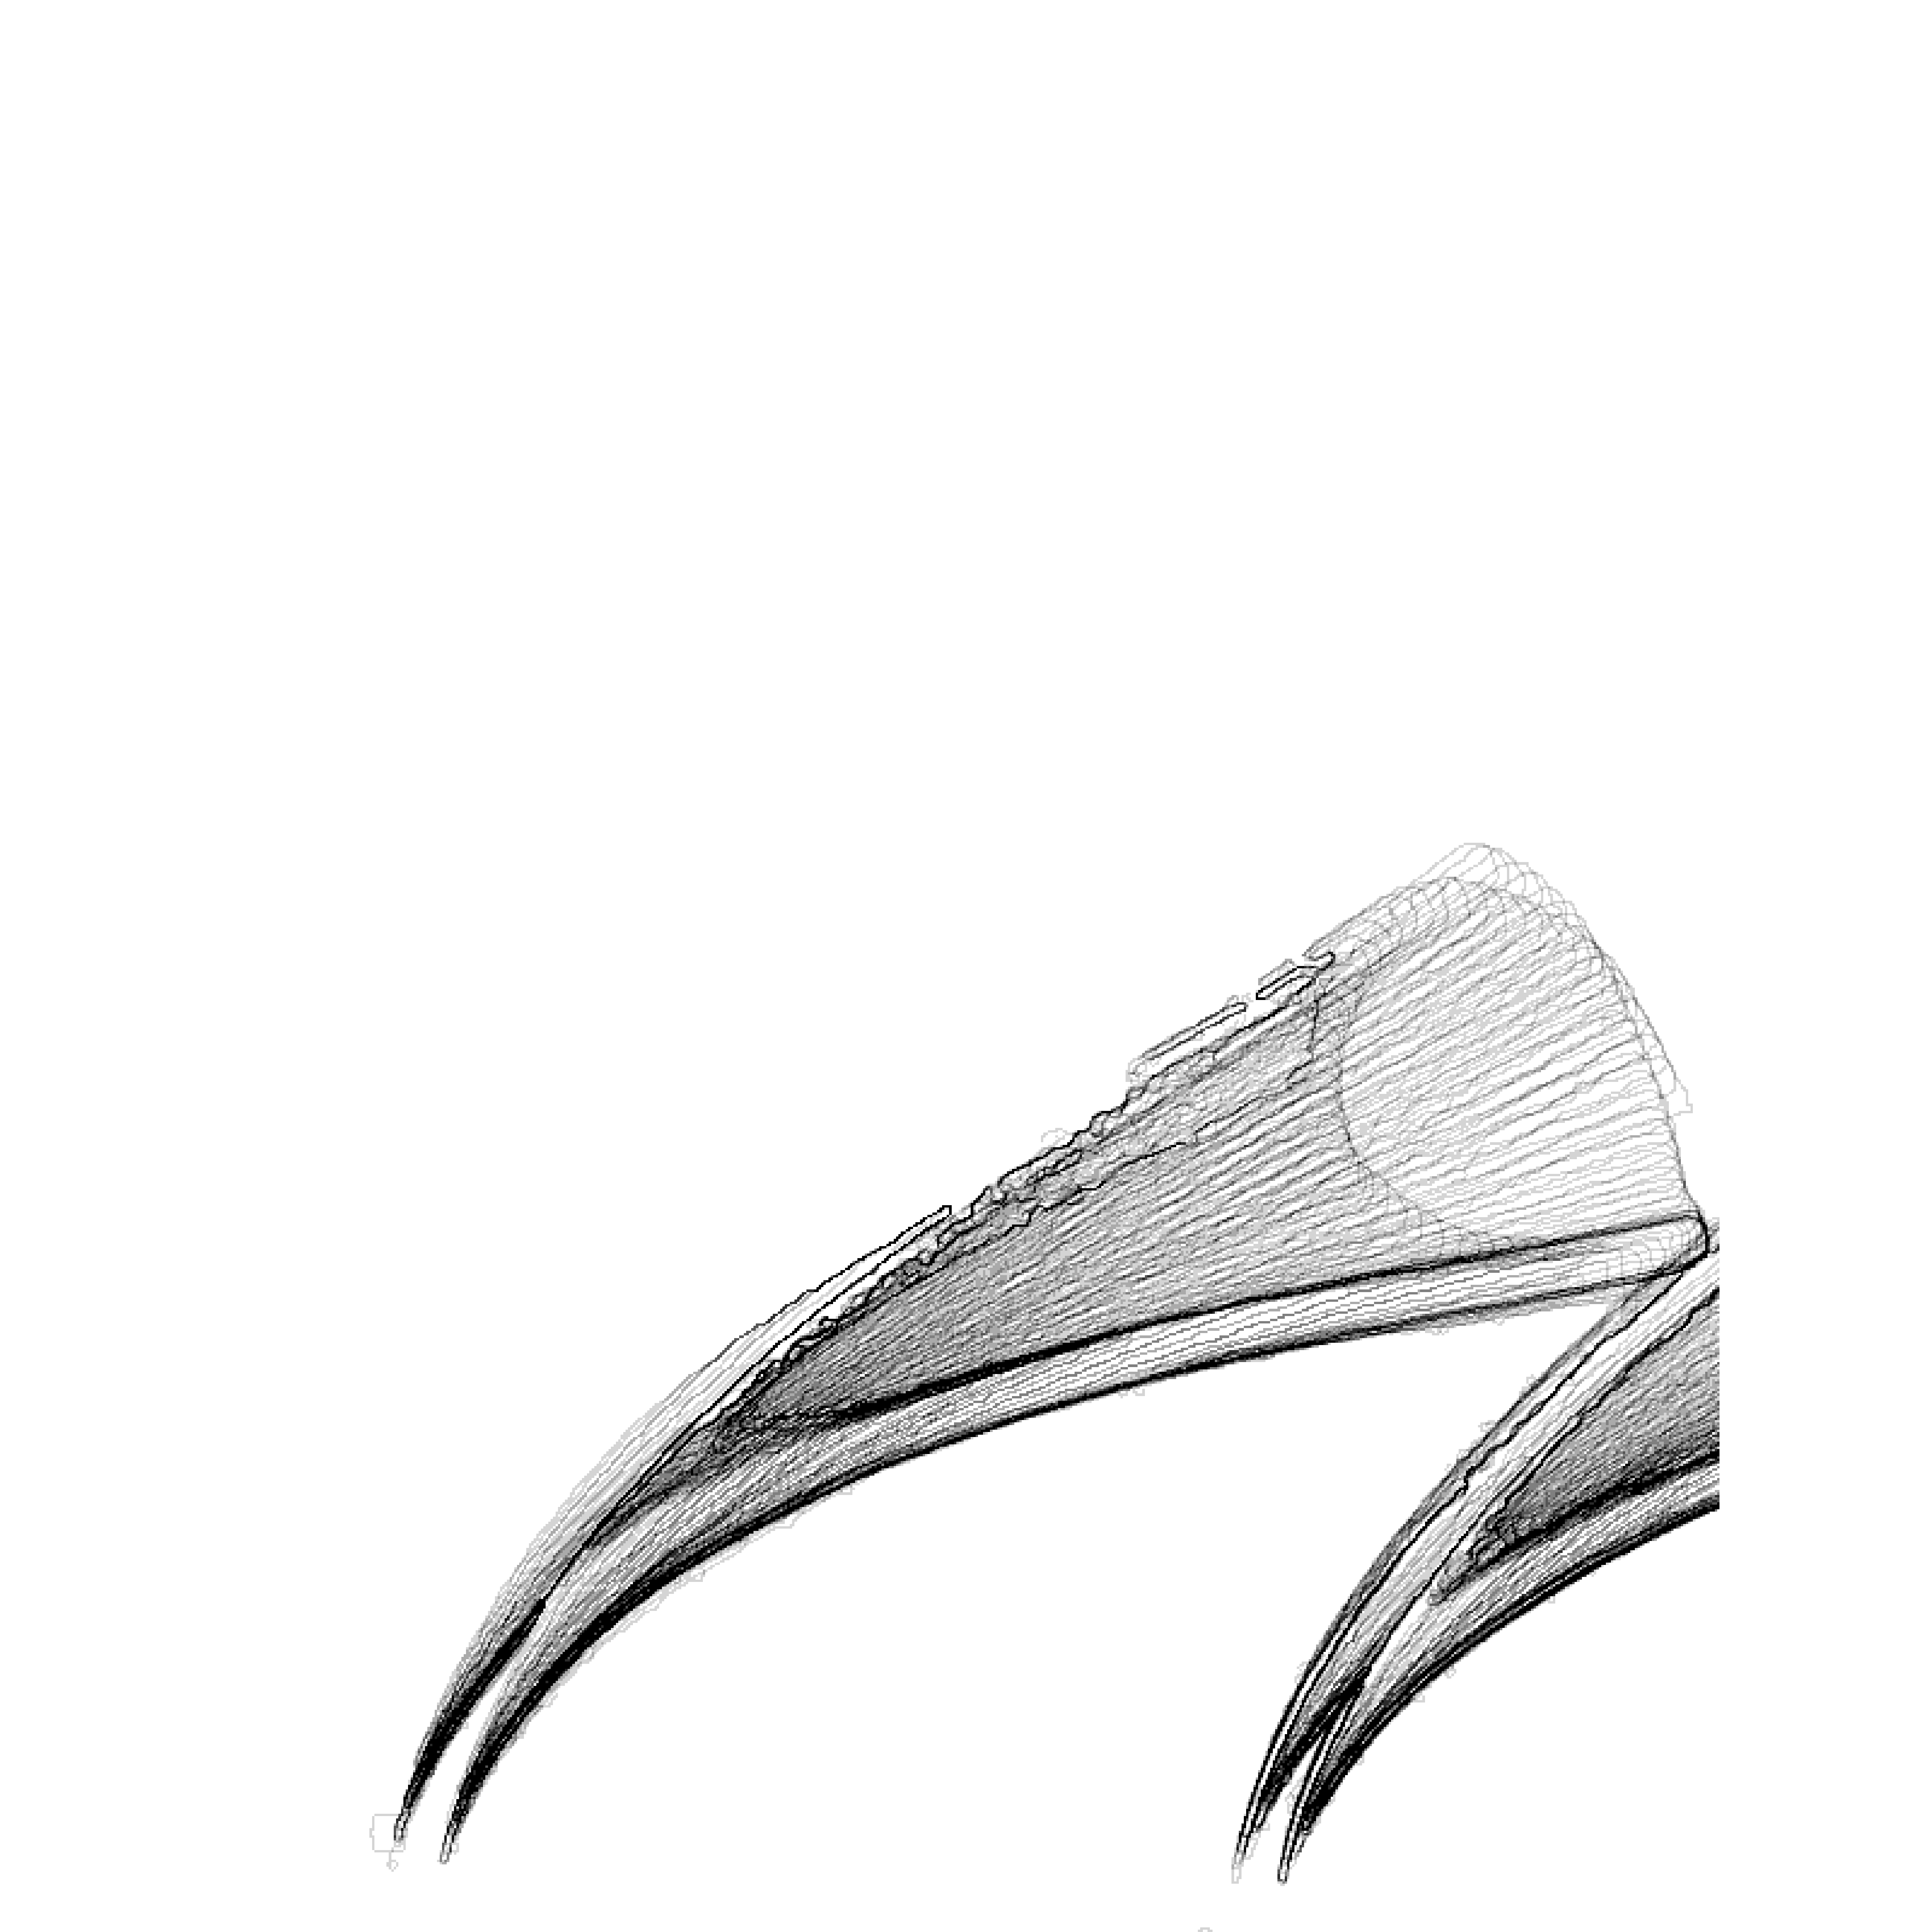
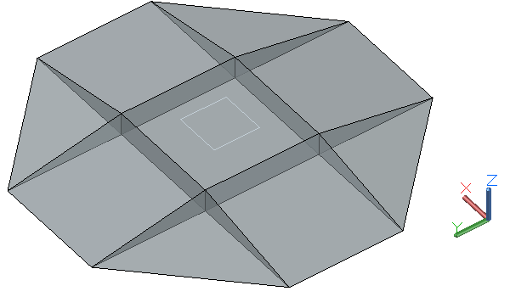
Blade dynamics and wave dissipation in orthogonal wave-current conditions
Zichen Xu, National University of Singapore, zichen_xu@u.nus.edu
Jiarui Lei, National University of Singapore, jlei@nus.edu.sg
Introduction
Methods-Wave energy dissipation
Aquatic vegetation has drawn attention as a promising nature-based solution for coastal protection by attenuating the energy of incoming waves.
Evaluating the effectiveness of and understanding the physics behind nature-based solutions require knowledge of the dynamics of vegetation under coastal flows.
Wave energy dissipation over rigid vegetation has long been noted and investigated in pure waves and codirectional wave-current conditions. Flexible vegetation will reconfigure with flows, thus leading to different wave-damping models.
To date, vegetation dynamics under orthogonal wave-current conditions (i.e., the current is perpendicular to the direction of wave propagation), which usually correspond to wave-induced longshore currents near the coast, have not yet emerged.
Analytical model
$$θ$$
$$u_{c}$$
$$\frac{∂}{∂x}\left(\frac{1}{2}ρga_{w}^{2}c_{g}\right) = \frac{1}{T}\int_{t=0}^{T}{\int_{z=0}^{l}{\frac{1}{2}ρC_{D}a\left|u_{w}\right|u_{wc}^{2}\cos{θ} dz dt}}$$
WC x direction
$$u_{w}$$
$$u_{wc}$$
Wave energy decay
Rate of work against drag
$β=\frac{u_{c}}{u_{w}}=\tan{θ}$current-to-wave velocity ratio
$$K_{D,wc}=\frac{8}{3π}C_{D}a_{v}k\left(\frac{\sinh^{3}{kl}+3\sinh{kl}}{3\sinh{kl}\left(\sinh{2kh+2kh}\right)}\right)f\left(β\right)$$
$$f\left(β\right)={\left[−\frac{β\left(β^{2}+1\right)}{8}F\left(x | −\frac{1}{β^{2}}\right)+\frac{β\left(β^{2}+2\right)}{8}E\left(x | −\frac{1}{β^{2}}\right)\right]|}_{x=0}^{2π}, for β>0$$
Small excursion ($L>1$) scaling, $l_{e}/l\sim {{(Ca}_{wc}L)}^{−0.25}$ applies well for orthogonal wave-current conditions.
The higher magnitude of experimental data can be attributed to the neglect of varying inertia terms and buoyancy forces in the expected scaling law.
The higher magnitude pattern is also found in other studies (Luhar and Nepf, 2016) and is explained by a higher relative motion induced by the vortex shedding, occurring together with the motion of flexible blades.
Research questions
What is the impact of an additional orthogonal current on the drag force experienced by a single blade and on wave energy decay by a meadow of vegetation?
What is the relationship between the drag force of a single flexible blade and the corresponding effective length, $l_{e}$,​ under orthogonal wave-current conditions?
How to extend the existing analytical model for wave energy dissipation to orthogonal wave-current conditions and how well does the extended analytical model match with experimental data?
Current
Longshore
Incoming waves
WC y direction
Photo of the wave-current basin, photo of real mangrove roots and artificial vegetation canopy
Results-Wave energy dissipation
Moving carriage
The predicted force is the sum of added mass and drag force from Morison equations. The good agreement of predicted forces with measured forces indicates that $C_{m}$, inertia coefficient, and $C_{D}$, drag coefficient from KC ($U_{max}T/d$) are applicable to orthogonal wave-current conditions.
Methods-Blade dynamics
wave
current
Scaling law of effective length
$\frac{l_{e}}{l} \sim$) ${({Ca}_{w}L)}^{−0.25}$
$${Ca}_{w}=\frac{ρC_{D}bU_{w}^{2}l^{3}}{EI}=\frac{hydrodynamic drag}{blade stiffness}$$
$${Ca}_{wc}=\frac{ρC_{D}b{(\frac{1}{2}U}_{w}^{2}+U_{c}^{2})l^{3}}{EI}$$
$$L=\frac{l}{A_{w}}=\frac{2πl}{U_{w}T}=\frac{blade length}{wave excursion}$$
Pure wave cases
Orthogonal wave-current cases
$$l$$
Original length
$$θ$$
Equivalent drag force
$$l_{e}$$
Effective length
The wave amplitude is decreasing along the vegetation canopy, indicating that wave energy is dissipated by vegetation. Compared with pure waves, the larger slope in (b) suggests that the wave energy is reduced more in orthogonal wave-current flow for this case.
$ρ$: | density of water | $b$: | Width of blade | $U_{w}$: | Wave velocity
$C_{D}$: | drag coefficient | $l$: | height of vegetation in water | $A_{w}$: | Wave excursion
$E$: | Young’s modulus | $$I:$$ | 2nd moment of inertia | $$T:$$ | Wave period
Pure wave cases
Orthogonal wave-current cases
Results-Blade dynamics
Hypothesis of the scaling laws under orthogonal wave-current conditions
Blade excursions
To evaluate the analytical model, the measured $K_{D,wc}$ for each orthogonal wave-current case was normalized by the $K_{D,pw}$ with the same wave condition and compared with β. Wave decay can be enhanced to as much as 218% and suppressed to 74% in the presence of orthogonal currents. A higher enhancement of wave decay was observed when β is larger. The influence from orthogonal currents depends on both β and wave period.
$\frac{l_{e}}{l}\sim 1$
$$\frac{l_{e}}{l}\sim {{(Ca}_{w}L)}^{−0.25}$$
PW x direction
WC x direction
WC y direction
f1 l = 19 cm
f1 l = 14 cm
f1 l = 19 cm
f2 l = 19 cm
$\frac{l_{e}}{l}\sim 1$
f2 l = 14 cm
Conclusions and future work
Effective length under orthogonal wave-current flows follows the existing scaling laws for ${Ca}_{wc}$ > 1 and small excursion limit ($L>1$), $l_{e}/l\sim {{(Ca}_{wc}L)}^{−0.25}$.
$C_{m}$ and $C_{D}$ from KC are applicable to orthogonal wave-current conditions.
Wave energy decay is significantly impacted by orthogonal currents; it can be enhanced to as much as 218% and suppressed to 74%.
The analytical model predict ${K_{D,wc}/K}_{D,pw}$ well with a RMSE of 0.32
Future work will advance the effective length concept from a single blade to a meadow of flexible vegetation and validate the analytical model for wave energy decay by a meadow of flexible vegetation.
Experimental setup
f2 l = 19 cm
GoPro
ADV
Wave
Flow condition: | Pure wave (PW) Orthogonal wave-current (WC)
Water depth (m): | 0.3
T (s): | 0.8~2.0
Wave height (cm): | 6~12
Blade material: | f1 $E=5.4 MPa$ f2 $E=0.96 MPa$
Blade length (l) (cm): | 9, 14 and 19
Current
The total force that acts on a single blade depends on the length and flexibility of the blade.
Blade motion increases with longer blade length and smaller flexibility. Smaller range motion contributed more drag force due to a larger frontal area and higher relative velocity.
Load cell
References
Luhar, M., Nepf, H.M., 2016. Wave-induced dynamics of flexible blades. Journal of Fluids and Structures 61, 20–41.
Dalrymple, R. A., Kirby, J. T., & Hwang, P. A. (1984). Wave Diffraction Due to Areas of Energy Dissipation. Journal of Waterway, Port, Coastal, and Ocean Engineering, 110(1), 67–79.
GoPro
Find more about our research!

