Slide 1




Evolution of Early Cretaceous Multi-provenance deposition system in the northwestern margin of Kuqa Depression:
Evidence from stratigraphic lithology proportions, mineral composition,
and bedding dip direction
Qing Ju, Lihua Ren, Guoqiang Luan
School of Geosciences
China University of Petroleum
April 15th, 2024

Slide 2
Research area
The Bozi-Dabei area is located in the northwestern margin of Kuqa Depression in the Tarim Basin, where Bashijiqike Formation and Baxigai Formation of the Lower Cretaceous are held by multiple uplifts, which leads to the possibility of multiple provenances.
South Tianshan Provenance
Wensu Uplift Provenance
Structural and stratigraphic development map
of Bozi-Dabei area
Mineral characteristics of different provenance in Kuqa Depressiom

Slide 3
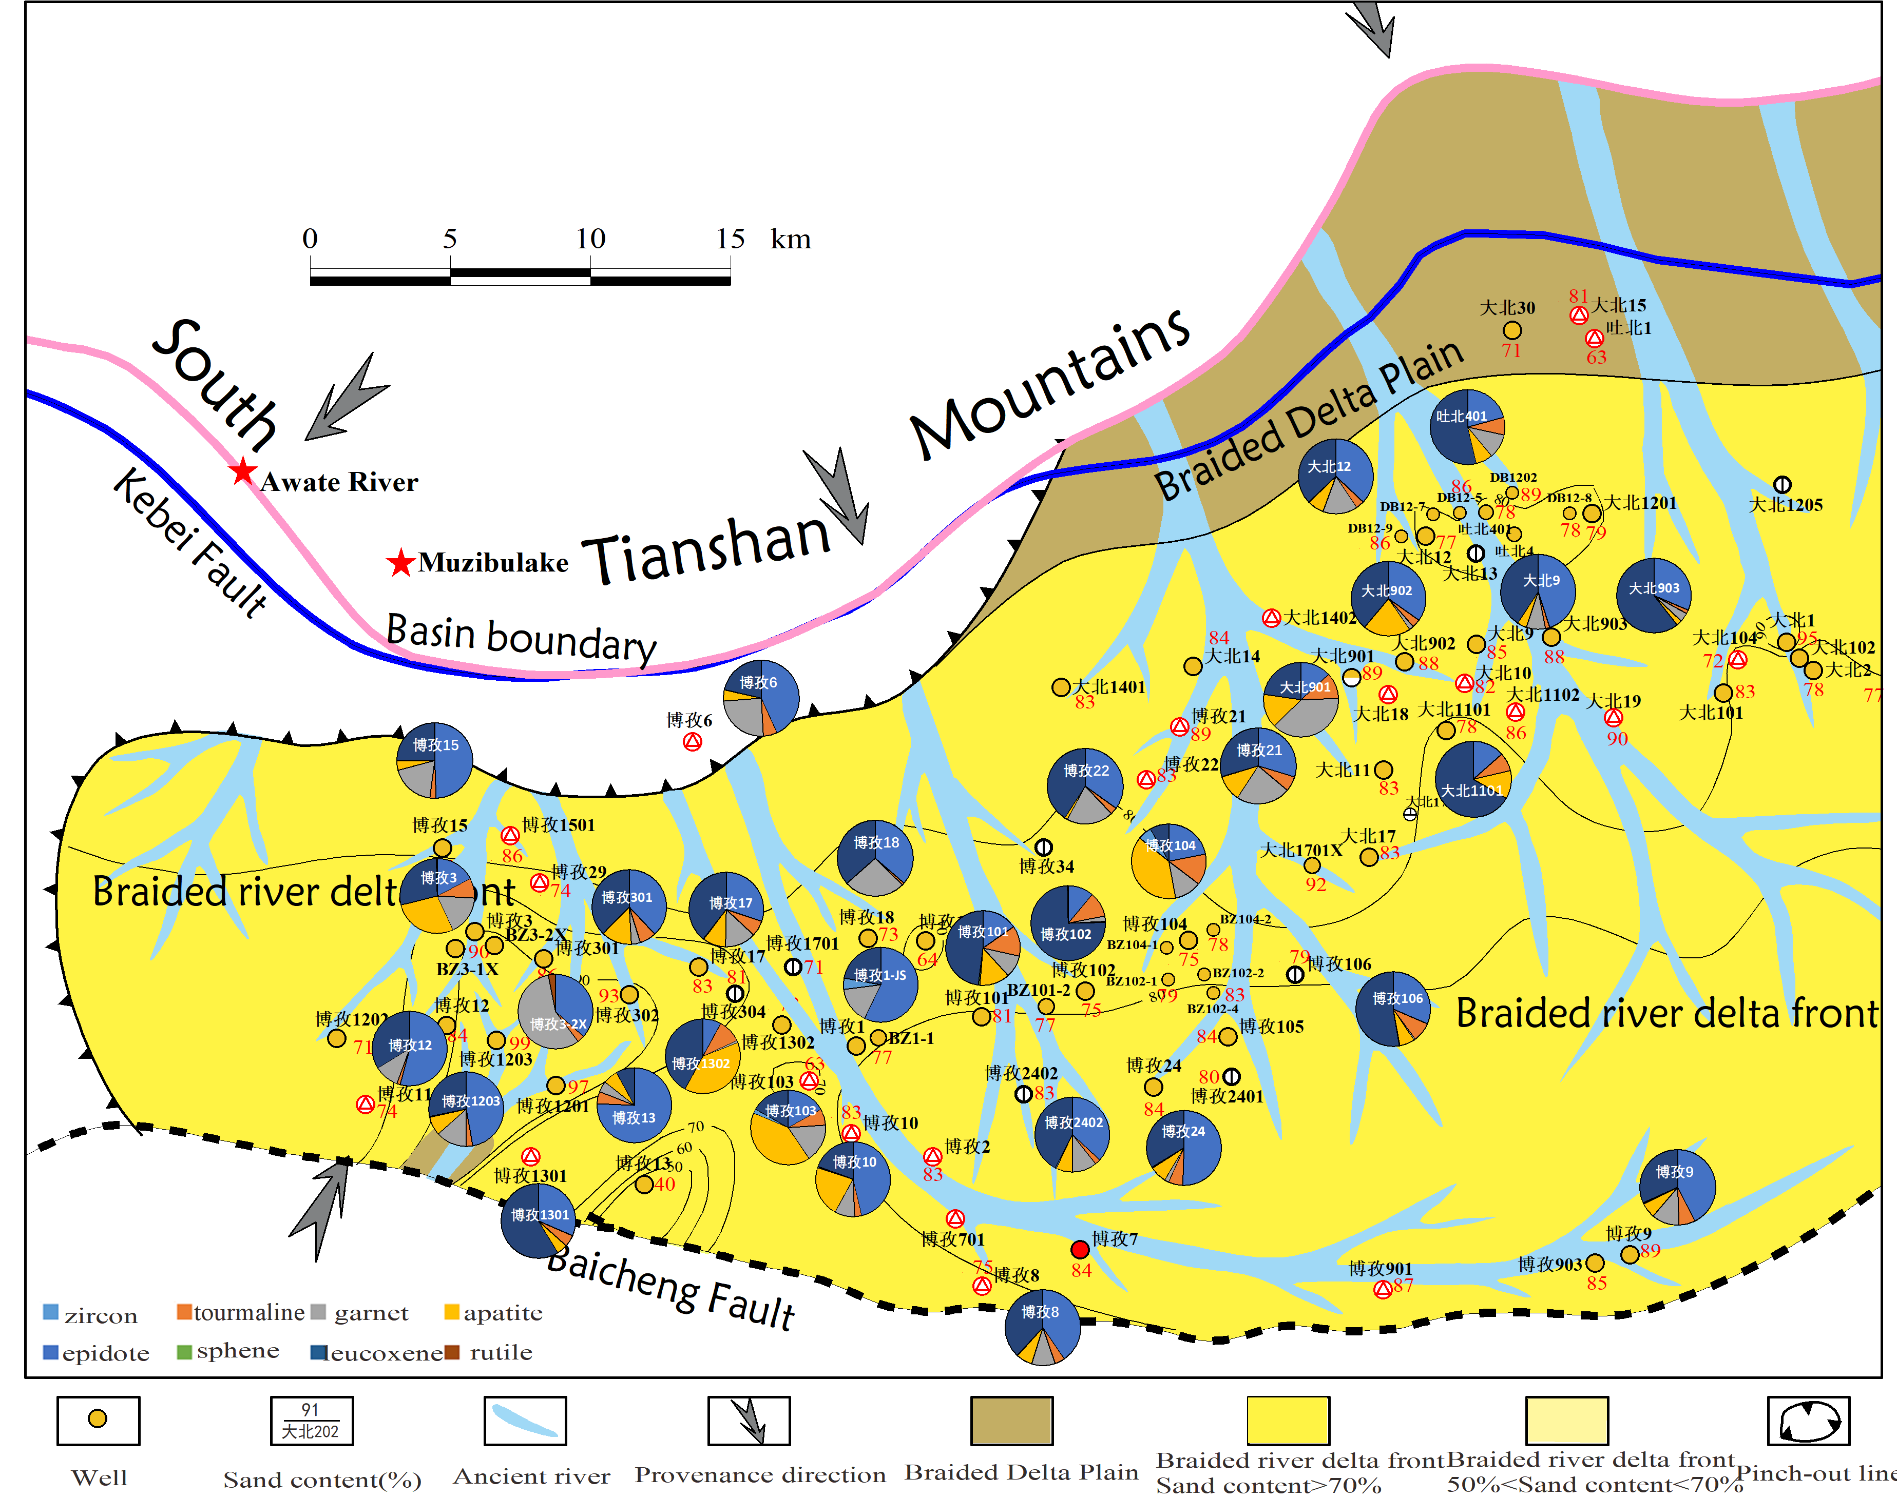
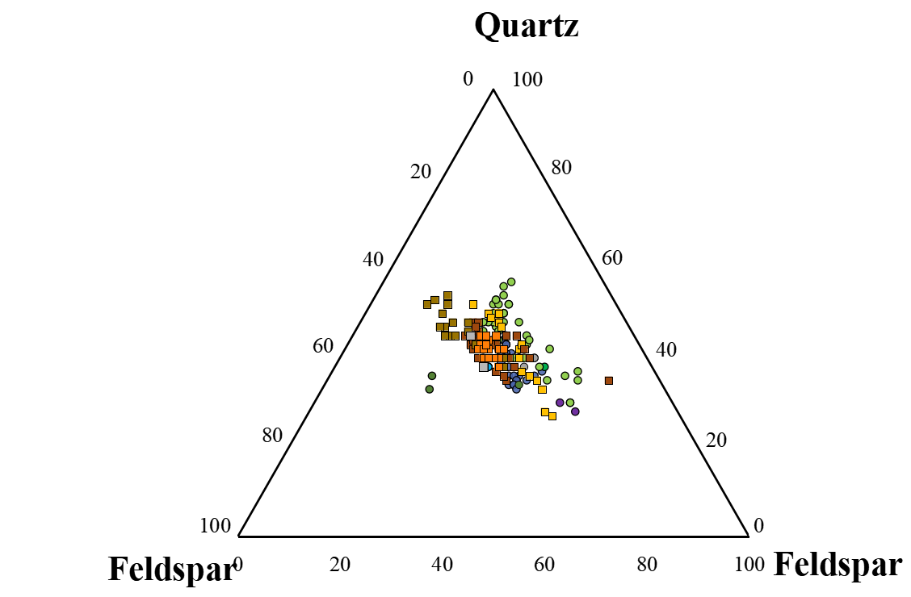
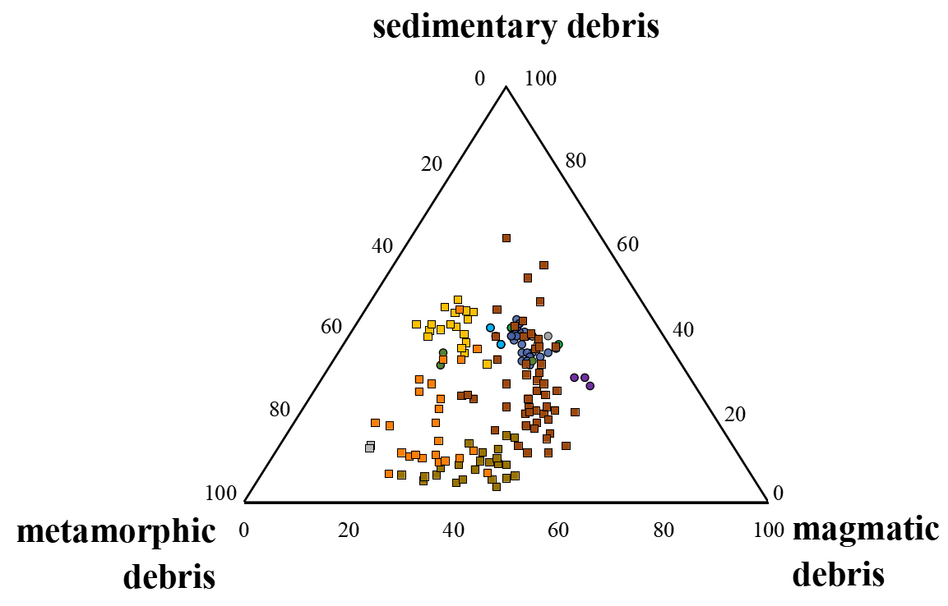
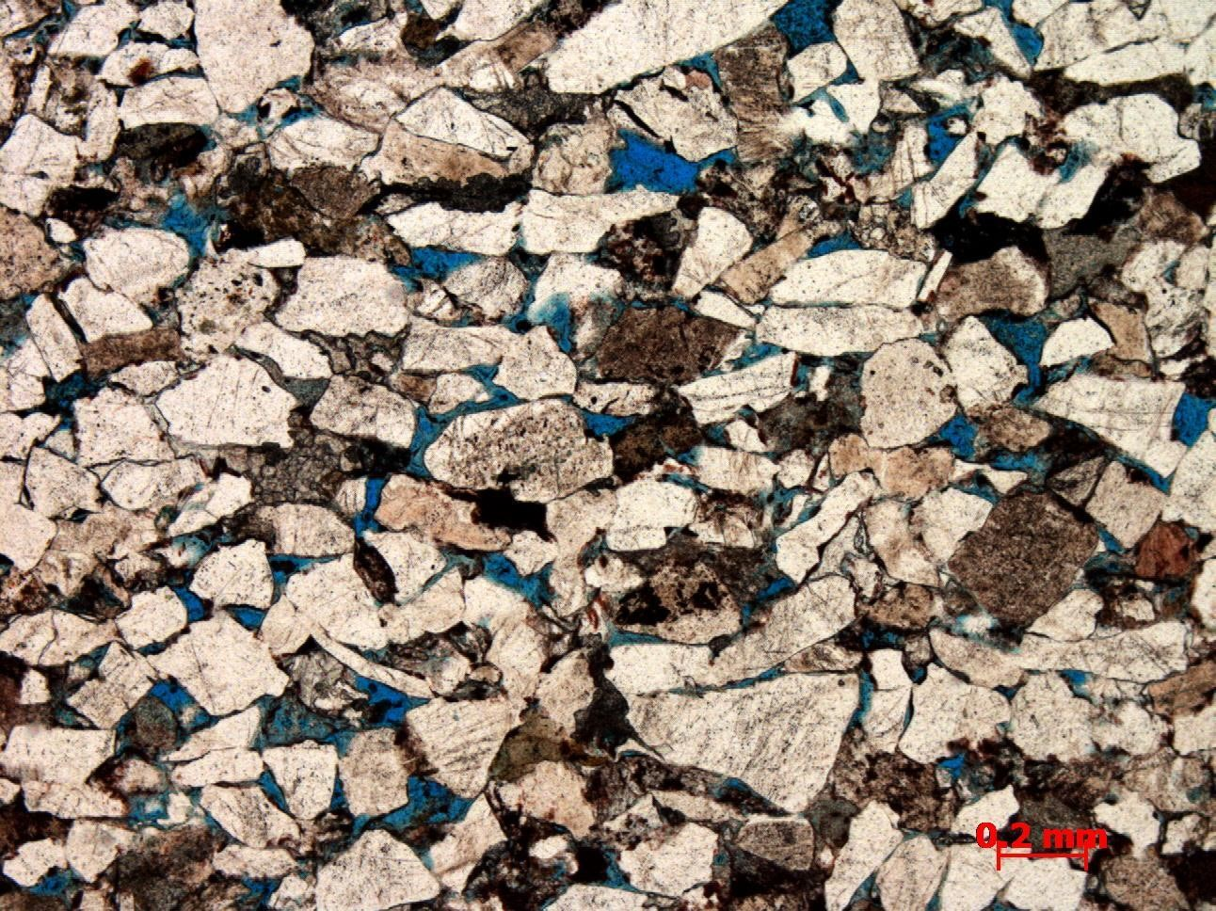
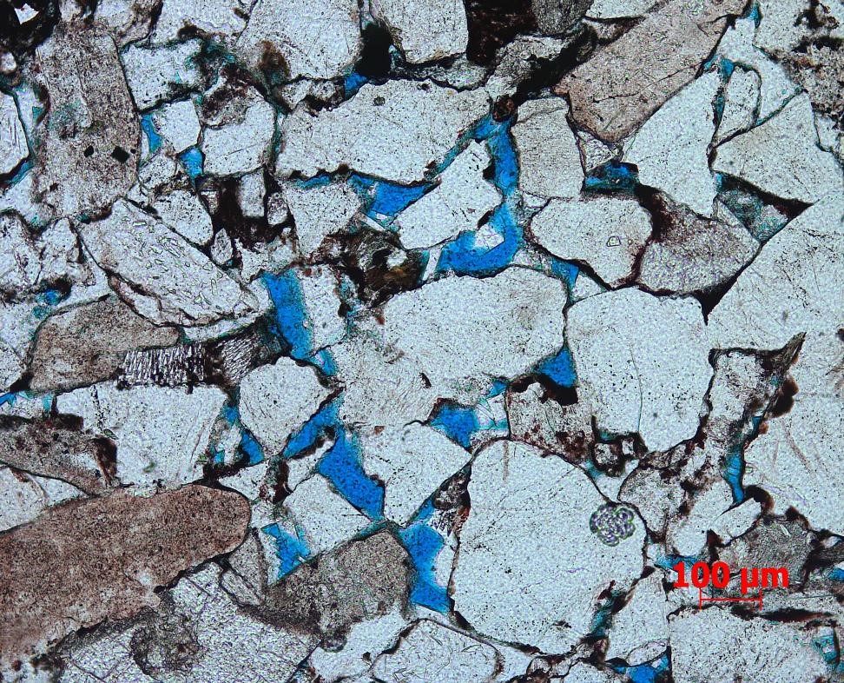
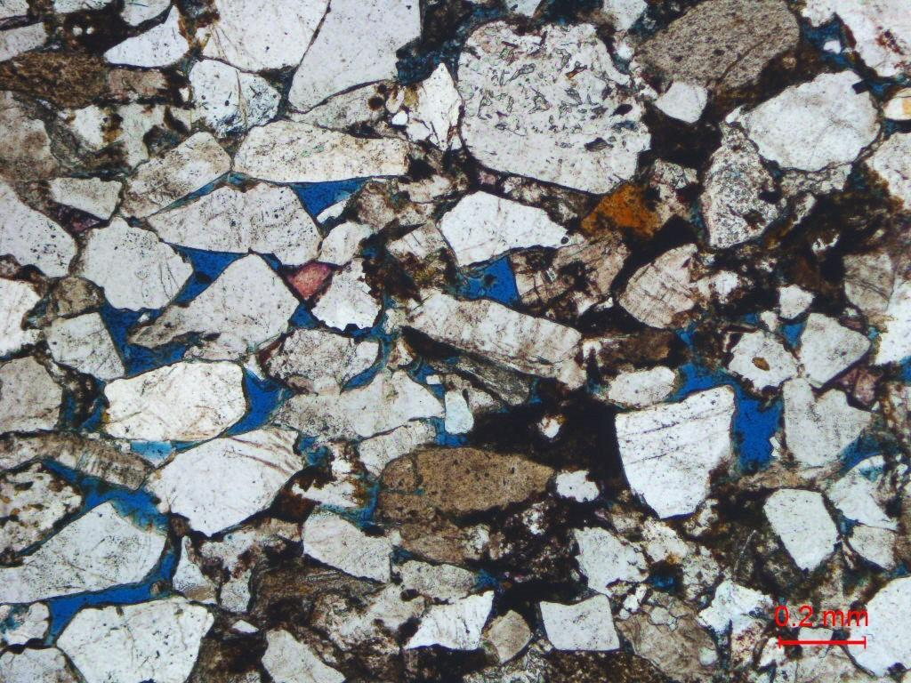
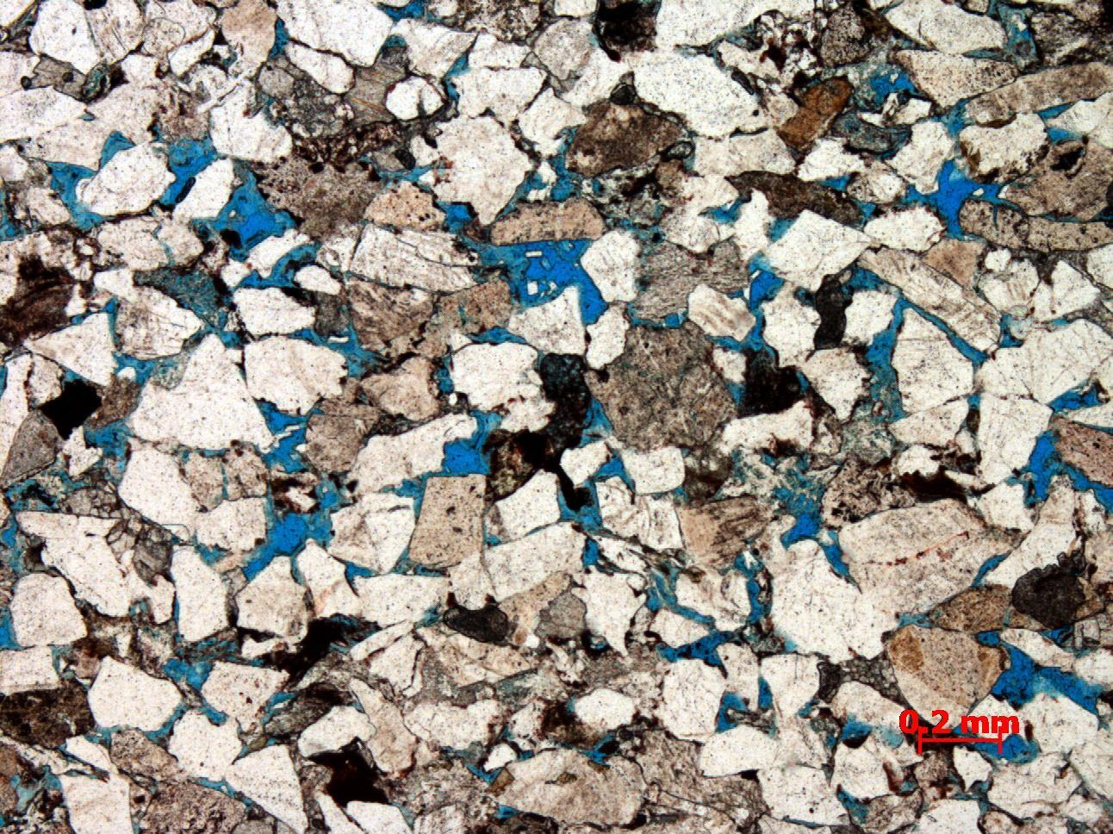
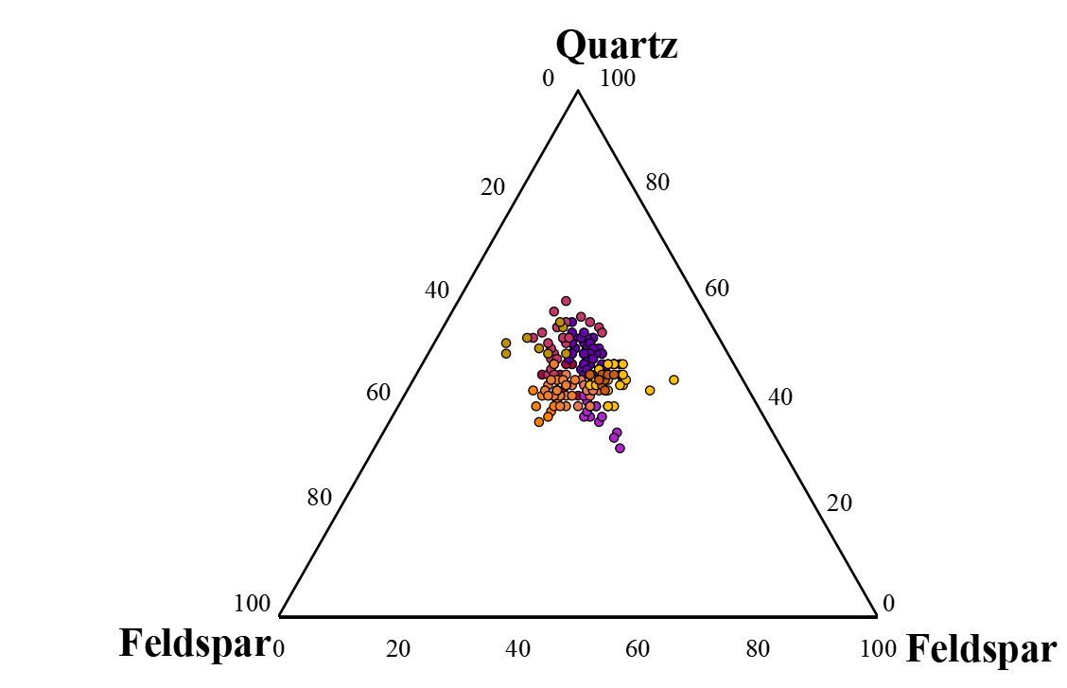
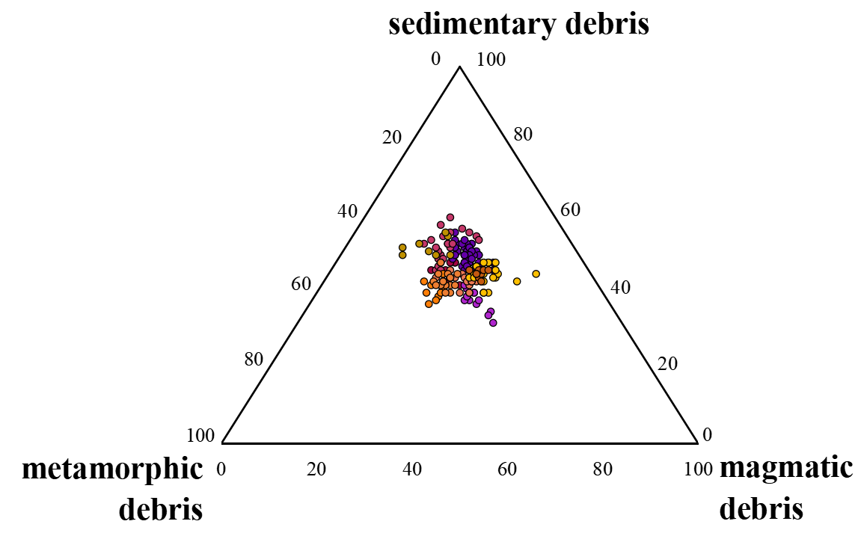
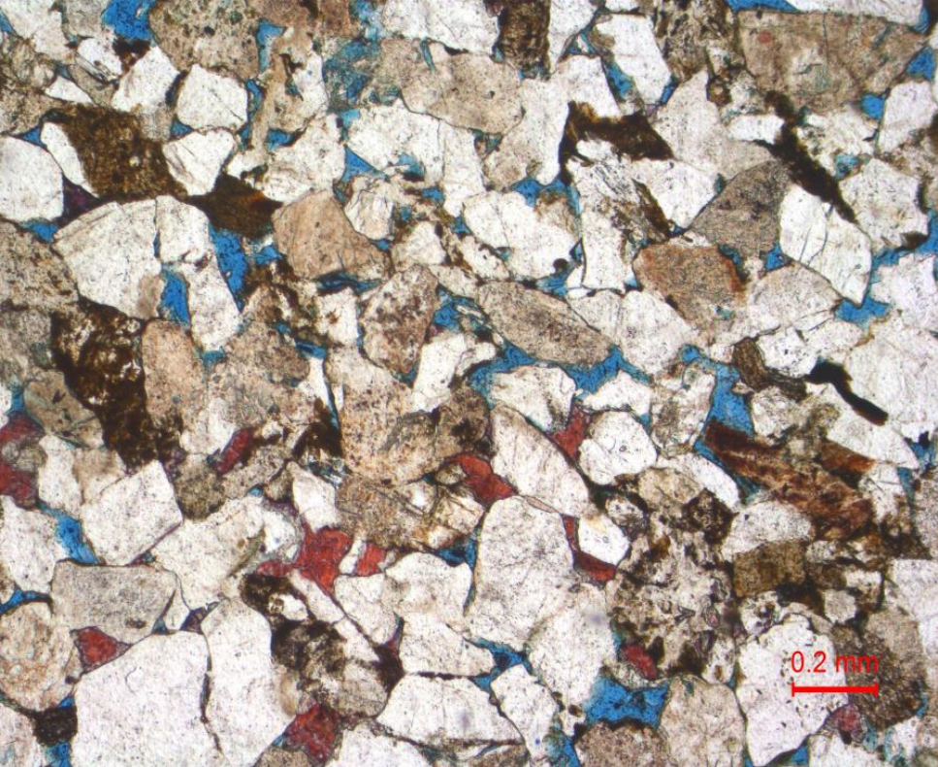
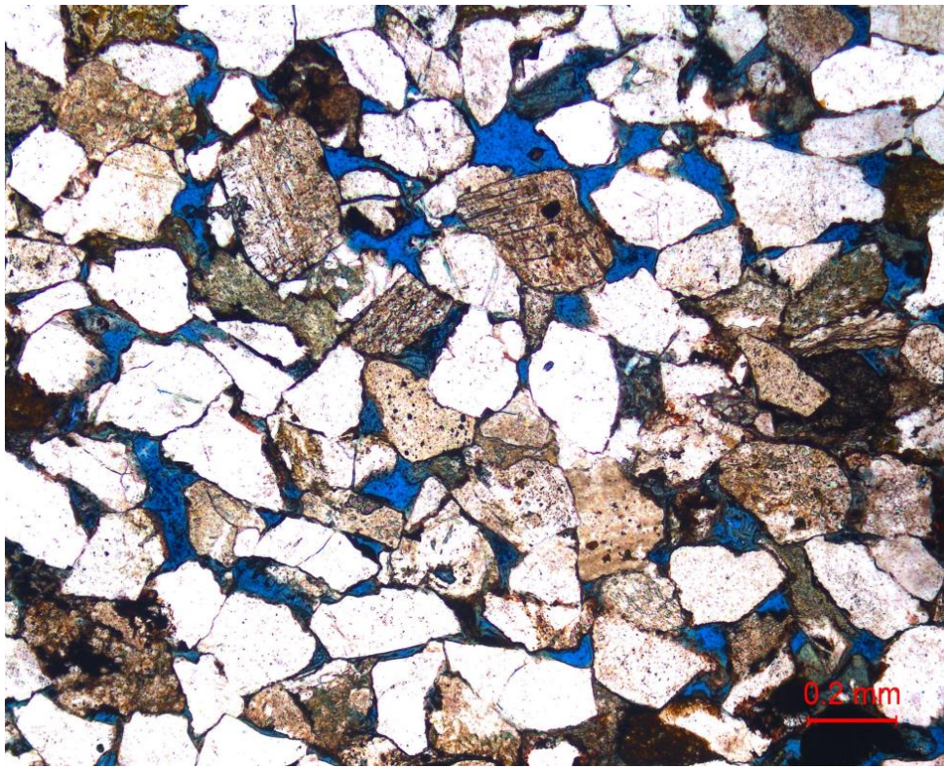
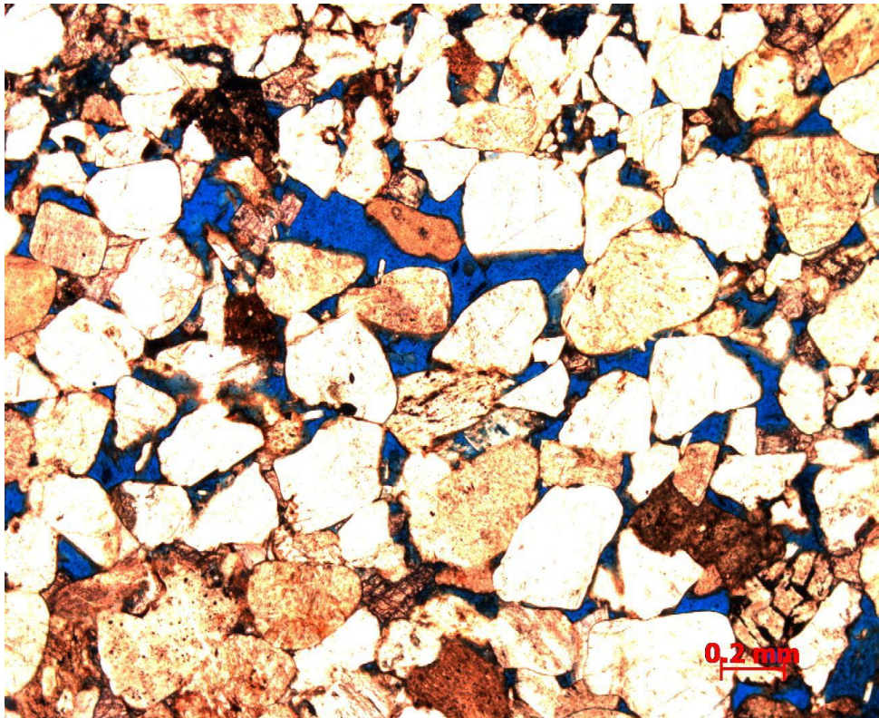
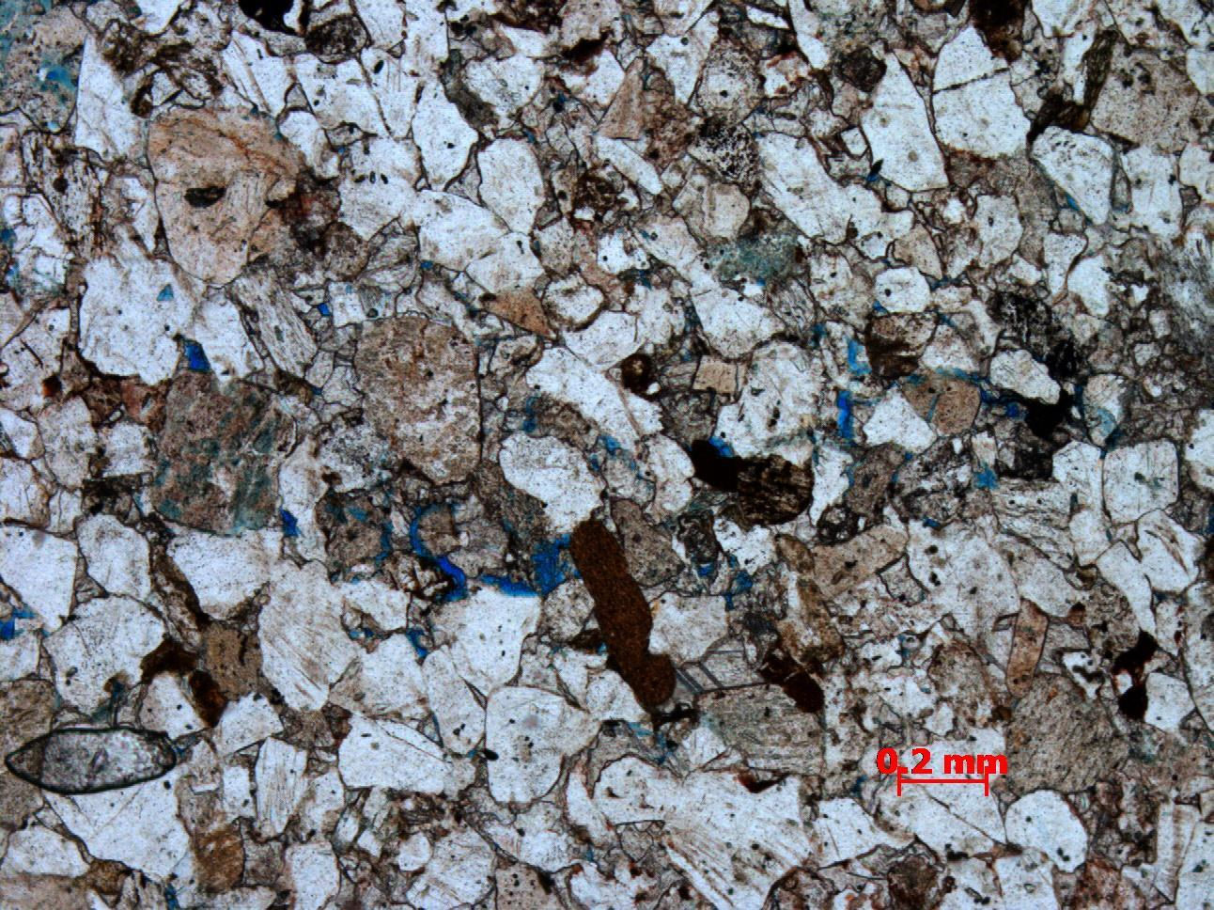
Stratigraphic lithology proportions & Mineral composition
We identify the sediment provenance combining proportion of stratum lithology, rock and mineral compositions, and heavy mineral combination characteristic.
An overall decreasing trend of the ratio between sandstone and stratum thickness from north to south.
According to the petrologic and mineralogical data of sandstone composition, detritus component, and heavy minerals, there is a certain regular variation from the northwest and northeast of the study area to the central location, such as the increasing proportion of quartz, metamorphic debris, and stable heavy minerals like garnet.
Bashijiqike Formation
South Tianshan
Provenance
Rock and mineral compositions of South Tianshan Provenance
Wensu Uplift
Provenance
Heavy mineral combination characteristic
& Proportion of stratum lithology
Rock and mineral compositions of Wensu Uplift Provenance

Slide 4
Paleocurrent direction interpreted by bedding dip direction
Paleocurrent data indicate three paleocurrent directions: NNW-SSE direction in northeast; NNE-SSW direction in northwest; SW-NE direction in southwest - all consistent with three paleocurrent systems indicated by rock and mineral compositions.
K₁bx—K₁bs3—K₁bs2 current direction: NE-SE-NE
K₁bx—K₁bs3—K₁bs2 current direction: S-N

Slide 5
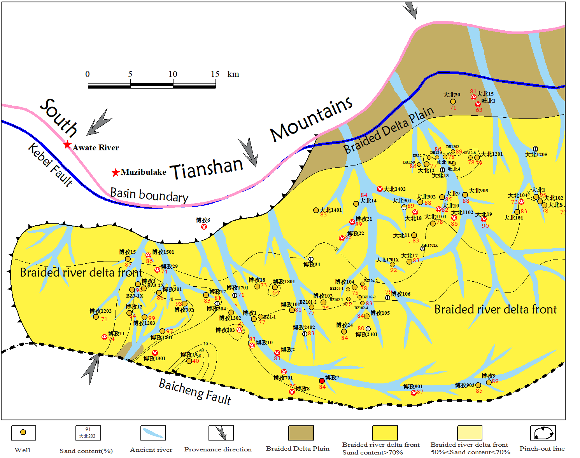
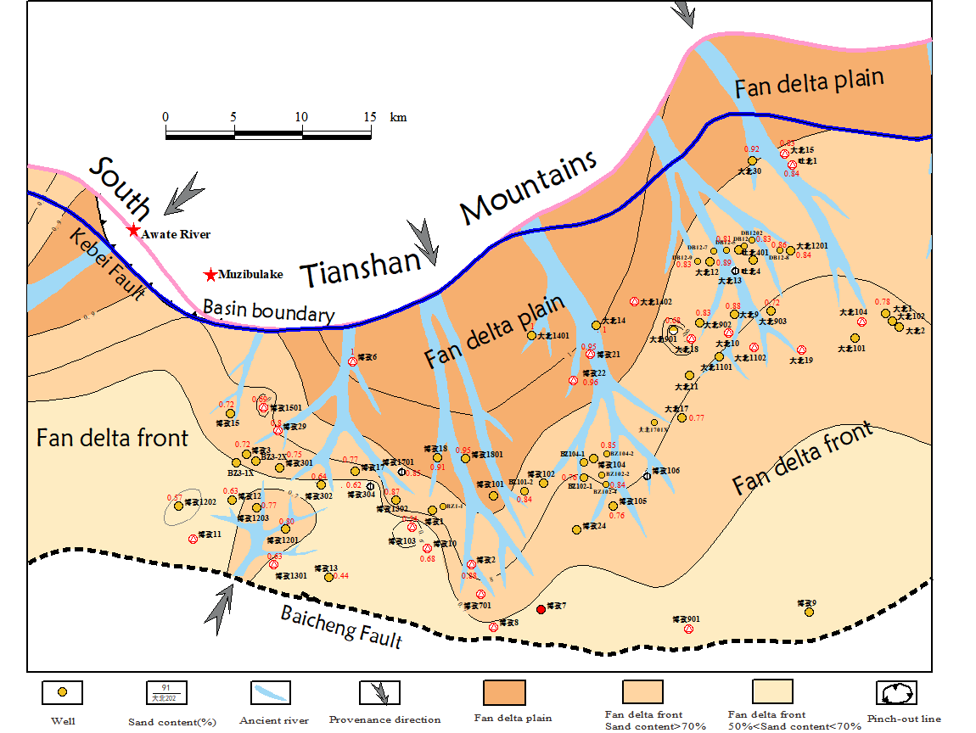
Conclusion
Sediments originating from both South Tianshan and Wensu Uplift have been deposited into DFS (Distributive fluvial system) during sedimentary period.
During Baxigai Formation deposition period, Wensu Uplift had a larger influence range which gradually diminished during Bashijiqike Formation deposition period - possibly implying a further tectonic uplift of Tianshan due to Himalayan movement.
Prototype basin restoration map
of Bashijiqike Formation
Prototype basin restoration map
Baxigai Formation
South Tianshan
Provenance Ⅱ
South Tianshan
Provenance Ⅰ
Wensu Uplift
Provenance

Slide 6
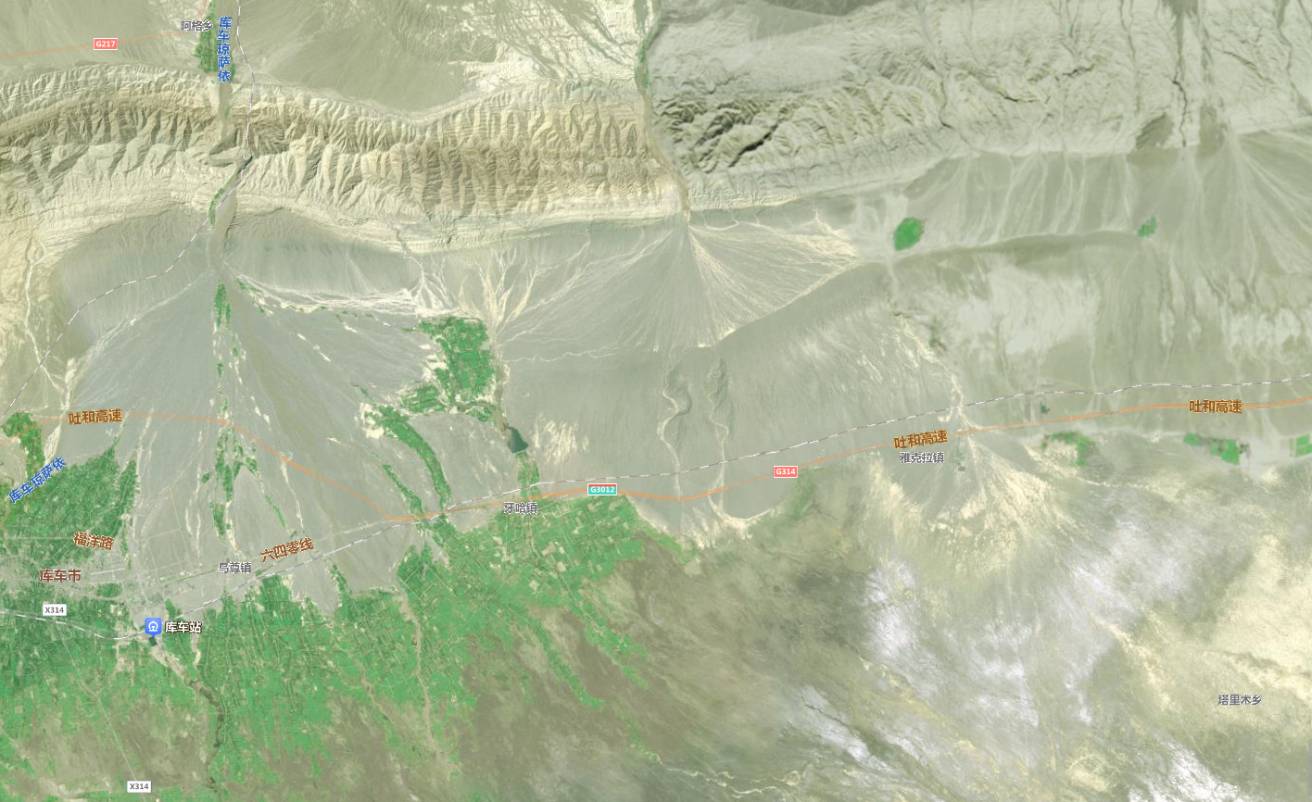
THANKS FOR YOUR ATTENTION!
Qing Ju, Lihua Ren, Guoqiang Luan
April 15th, 2024

