Slide 1



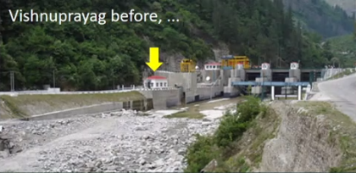
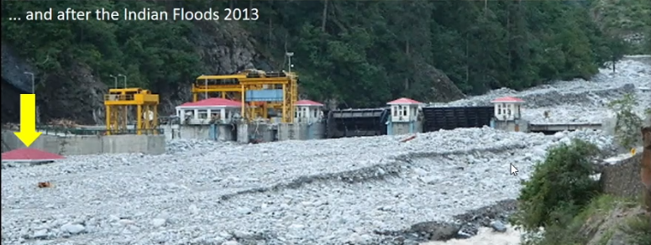
EGU General Assembly 2024
Estimating bed material transport in Himalayan streams using the virtual velocity approach
Anshul Yadav*, Sumit Sen, Luca Mao, Marwan A. Hassan
Soil erosion & sediment transport → global environmental issues → degradation of land, deterioration of ecological balance
Eroded material in high elevated mountains → gravel-bed channels → downstream reaches → morphology of downstream reaches and alluvial plains (Johnson and Whipple, 2007)
Monitoring coarse grain transport → traps, acoustic sensors, grain tracking (RFIDs) → challenging during floods, expensive
Global perspective
Himalayan perspective
Huge transport of coarse material particularly during Indian Summer Monsoon (ISM)
Relatively lesser investigated
No known scientific observatory in Himalayas
© JPPVL, Uttarakhand
Painted tracers – cost effective alternate
Role of ISM in annual transport?
Implications of using local vs c/s averaged hydraulic forcing?
Role of partial vs full transport conditions?
Objectives

Slide 2
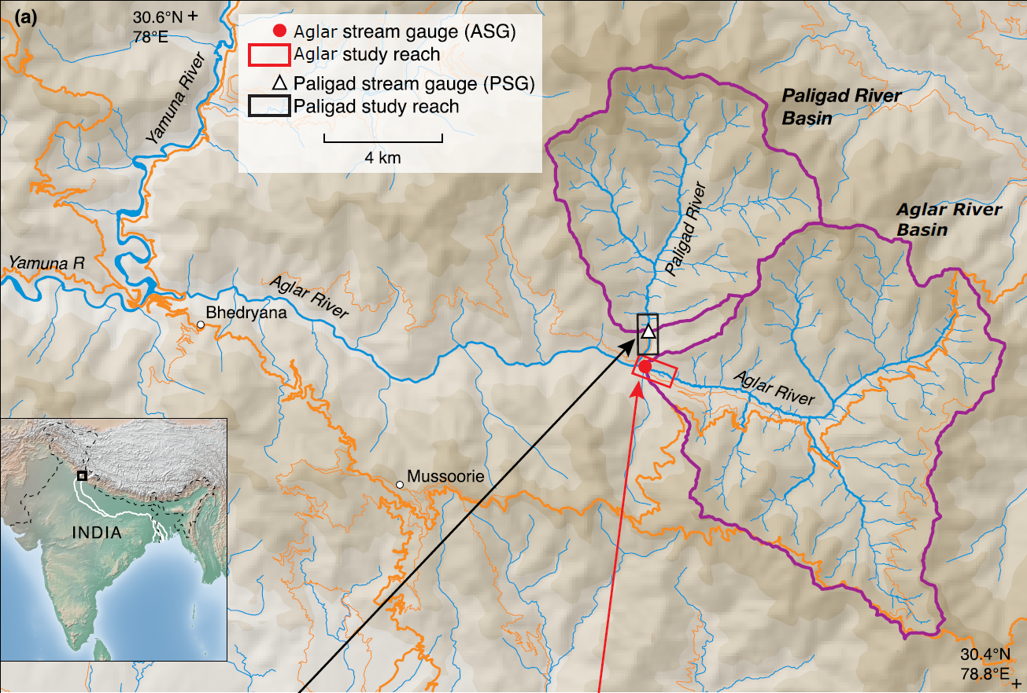
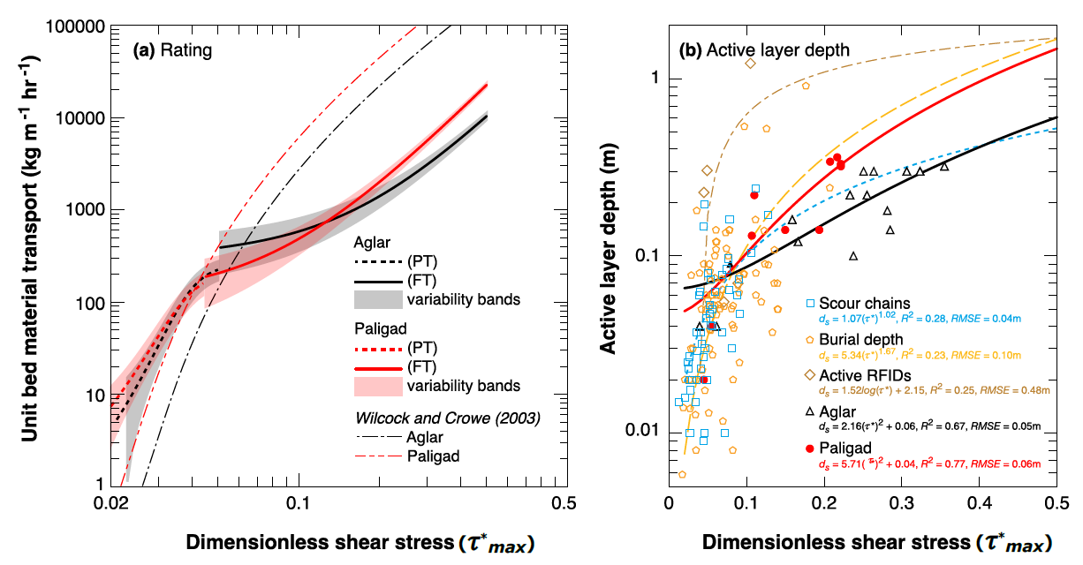
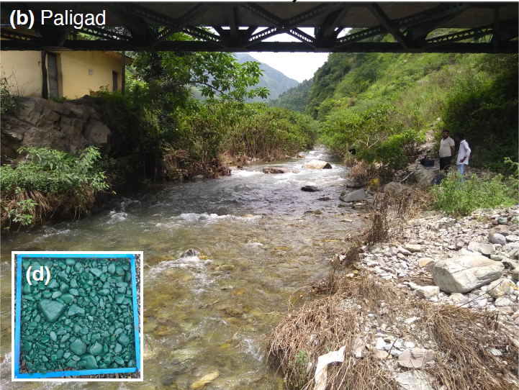
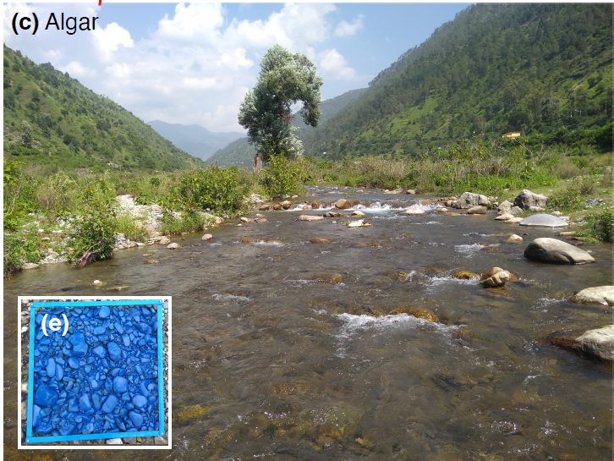
Study Area
Measurements on flood specific tracer mobility, virtual velocity, active layer depth, GSD, flow depth
Virtual velocity approach (VVA)
Break in transport curves (abrupt increase in transport rates)
Using local shear stresses, annual bed material transport → 37600 m³ (± 11500 m³), and 11000 m³ (±3600 m³) in Aglar and Paligad, respectively (~60 % during monsoon).
Using c/s averaged shear stresses, annual transport → 42300 t (±15800 t) and 12200 t (±4700 t), in Aglar and Paligad respectively, (~79 % and 68 % during monsoon respectively).

Slide 3
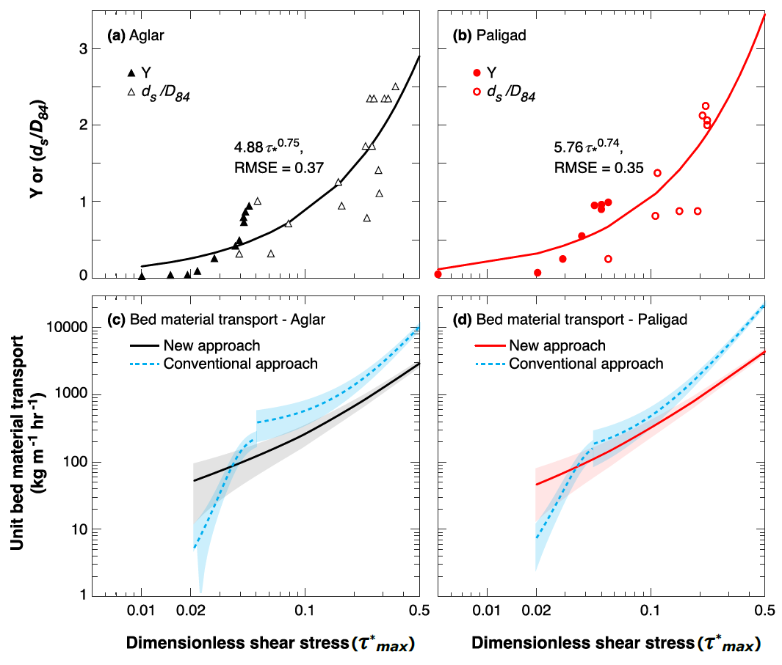
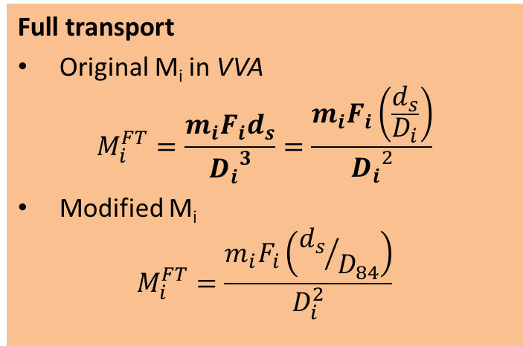
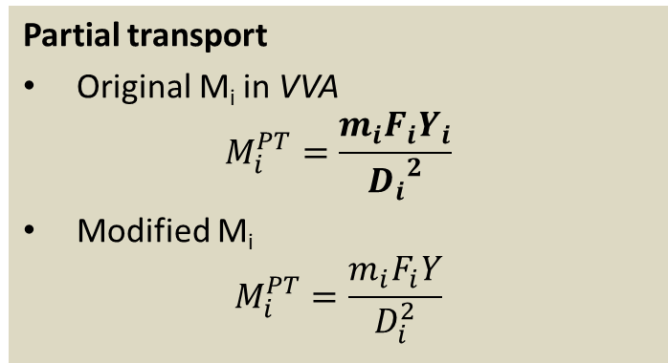
Proposal of a unified function for smoother transition from PT to FT
Partial transport
Original M_{i} in VVA
$$M_{i}^{PT}=\frac{m_{i}F_{i}Y_{i}}{{D_{i}}^{2}}$$
Modified M_{i}
$$M_{i}^{PT}=\frac{m_{i}F_{i}Y}{D_{i}^{2}}$$
Full transport
Original M_{i} in VVA
$$M_{i}^{FT}=\frac{m_{i}F_{i}d_{s}}{{D_{i}}^{3}}=\frac{m_{i}F_{i}\left(\frac{d_{s}}{D_{i}}\right)}{{D_{i}}^{2}}$$
Modified M_{i}
$$M_{i}^{FT}=\frac{m_{i}F_{i}\left({d_{s}}/{D_{84}}\right)}{D_{i}^{2}}$$
Major Conclusions:
Significant transport during long-term low magnitude non-monsoon flows (~40 %).
Using local vs c/s averaged shear stresses results in rather different transport estimates.
Proposed unified function seems to better capture the transport dynamics retaining the physics of VVA.

Slide 4
Part b – Detailed presentation

Slide 5

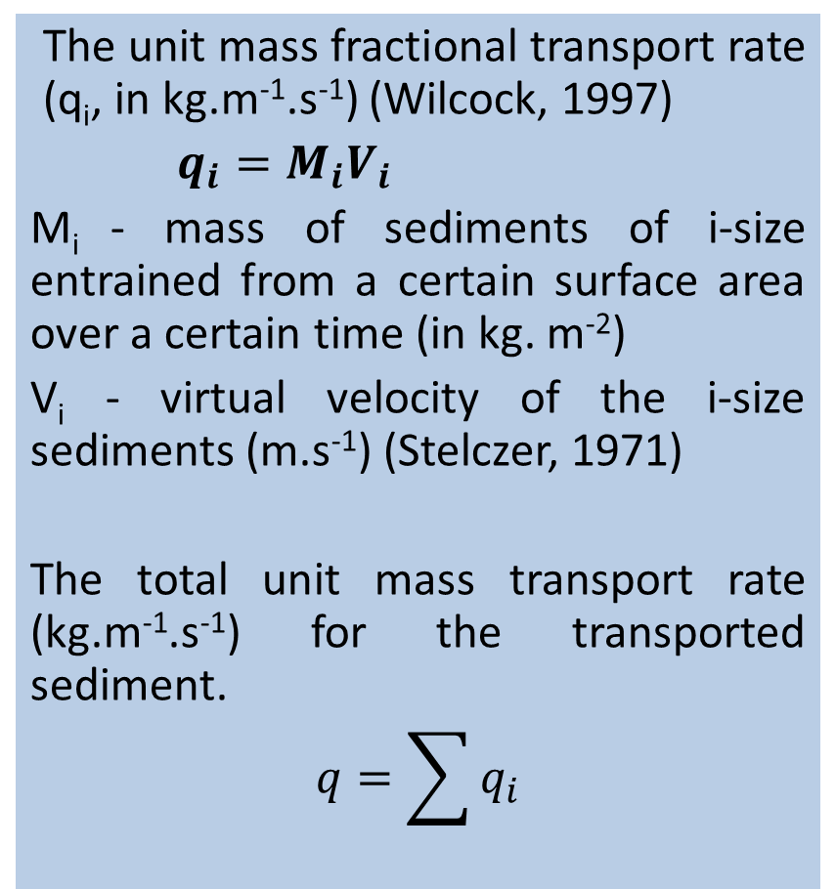
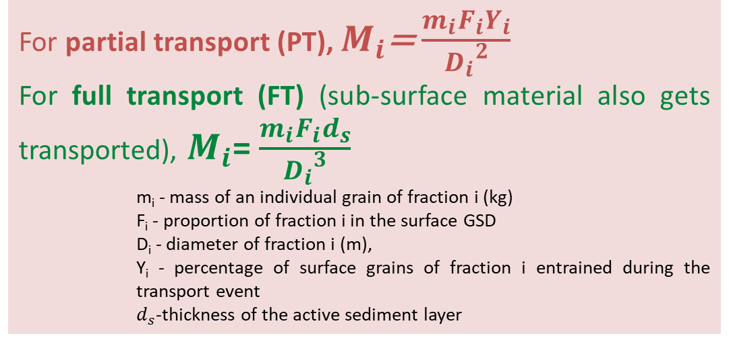
Virtual velocity approach
The unit mass fractional transport rate (q_{i}, in kg.m⁻¹.s⁻¹) (Wilcock, 1997)
$q_{i}=M_{i}V_{i}$
M_{i} - mass of sediments of i-size entrained from a certain surface area over a certain time (in kg. m⁻²)
V_{i} - virtual velocity of the i-size sediments (m.s⁻¹) (Stelczer, 1971)
The total unit mass transport rate (kg.m⁻¹.s⁻¹) for the transported sediment.
$$q=\sum{q_{i}}$$
For partial transport (PT), $M_{i}$= $\frac{m_{i}F_{i}Y_{i}}{{D_{i}}^{2}}$
For full transport (FT) (sub-surface material also gets transported), $M_{i}$= $\frac{m_{i}F_{i}d_{s}}{{D_{i}}^{3}}$
    m_{i} - mass of an individual grain of fraction i (kg)
    F_{i} - proportion of fraction i in the surface GSD
    D_{i} - diameter of fraction i (m),
    Y_{i} - percentage of surface grains of fraction i entrained during the transport event
    $d_{s}$-thickness of the active sediment layer
Virtual velocity (V_{i})= $\frac{Distance travelled by ith grain}{Duration of competent flow}$
Duration of competent flow – duration for which Shield’s stress exceeds the mobility thresholds

Slide 6
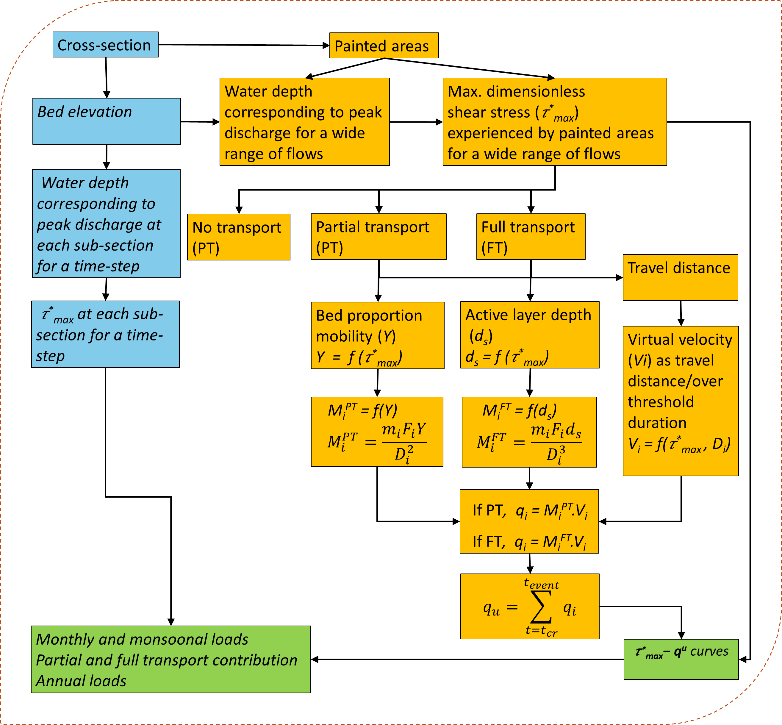
Workflow of calculations

Slide 7
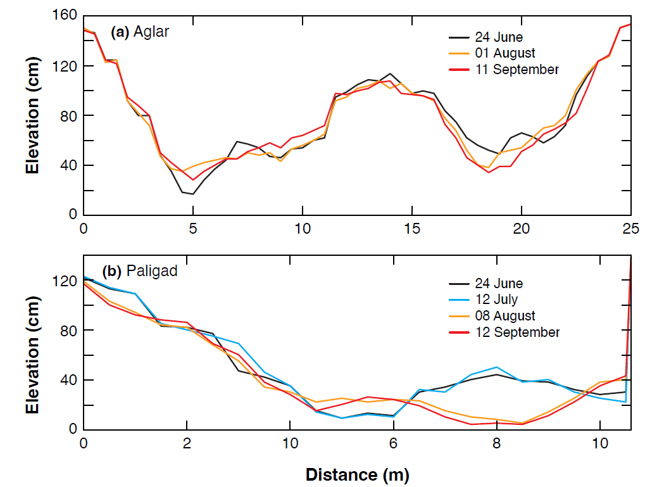
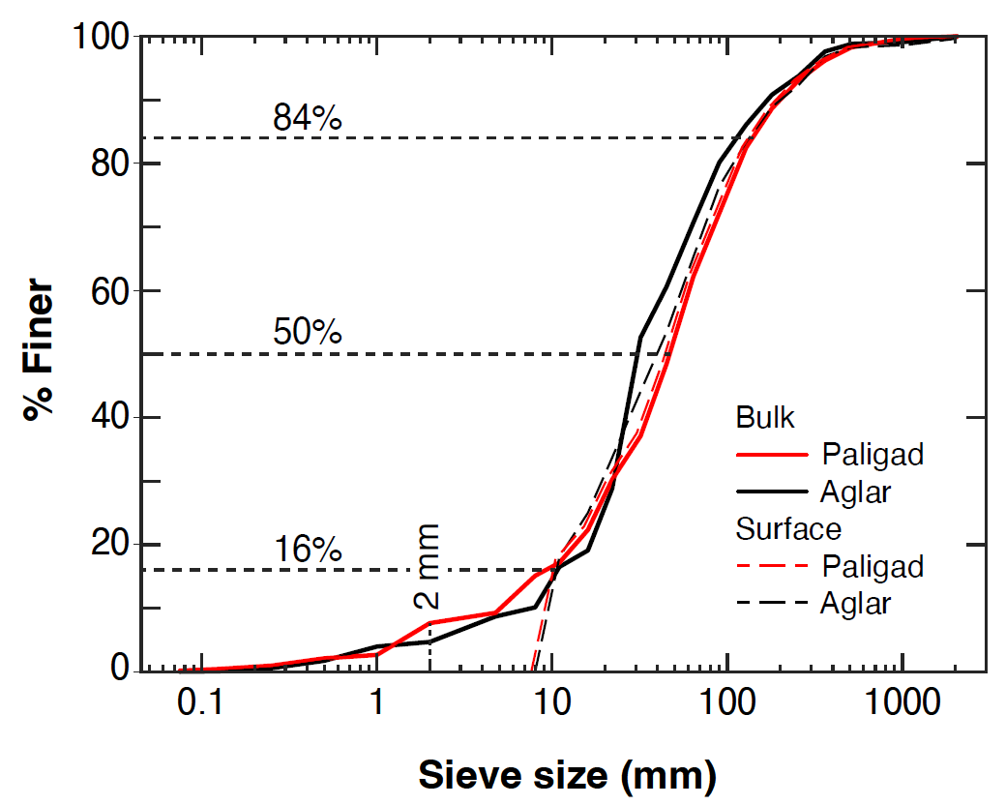
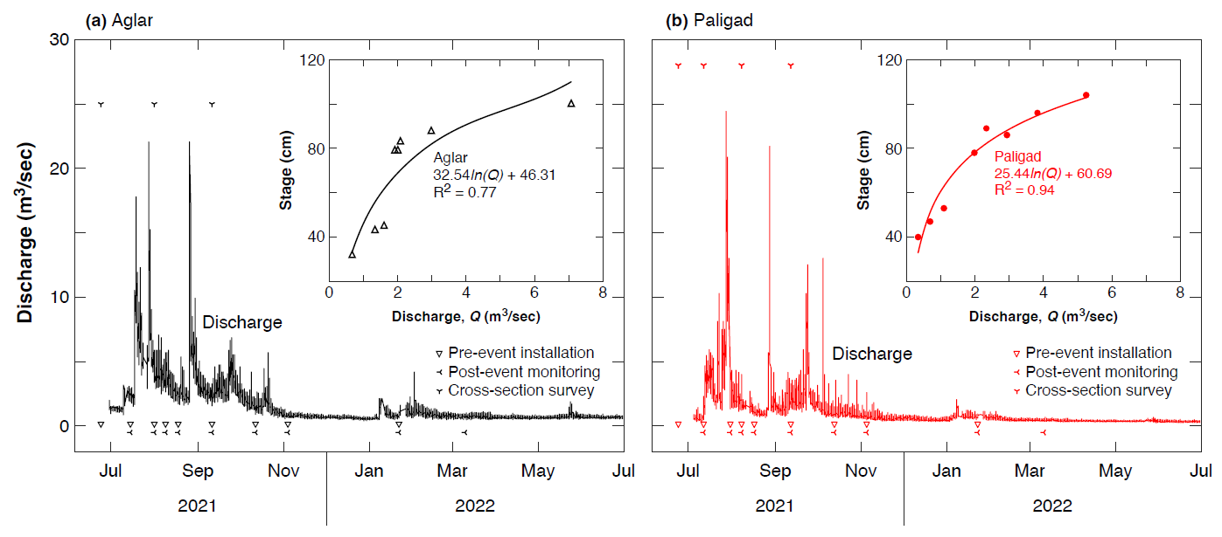
Field observations

Slide 8
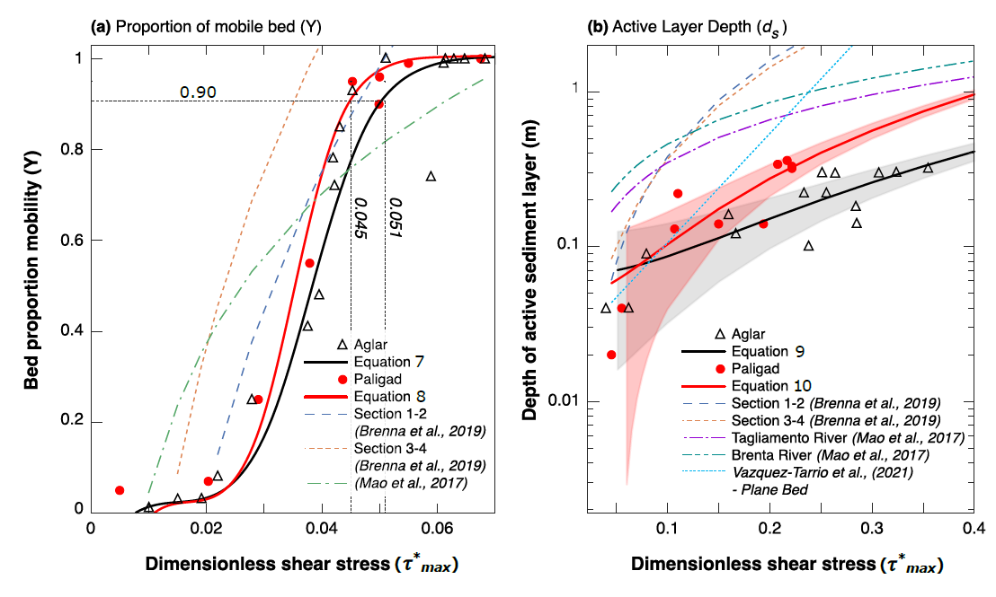
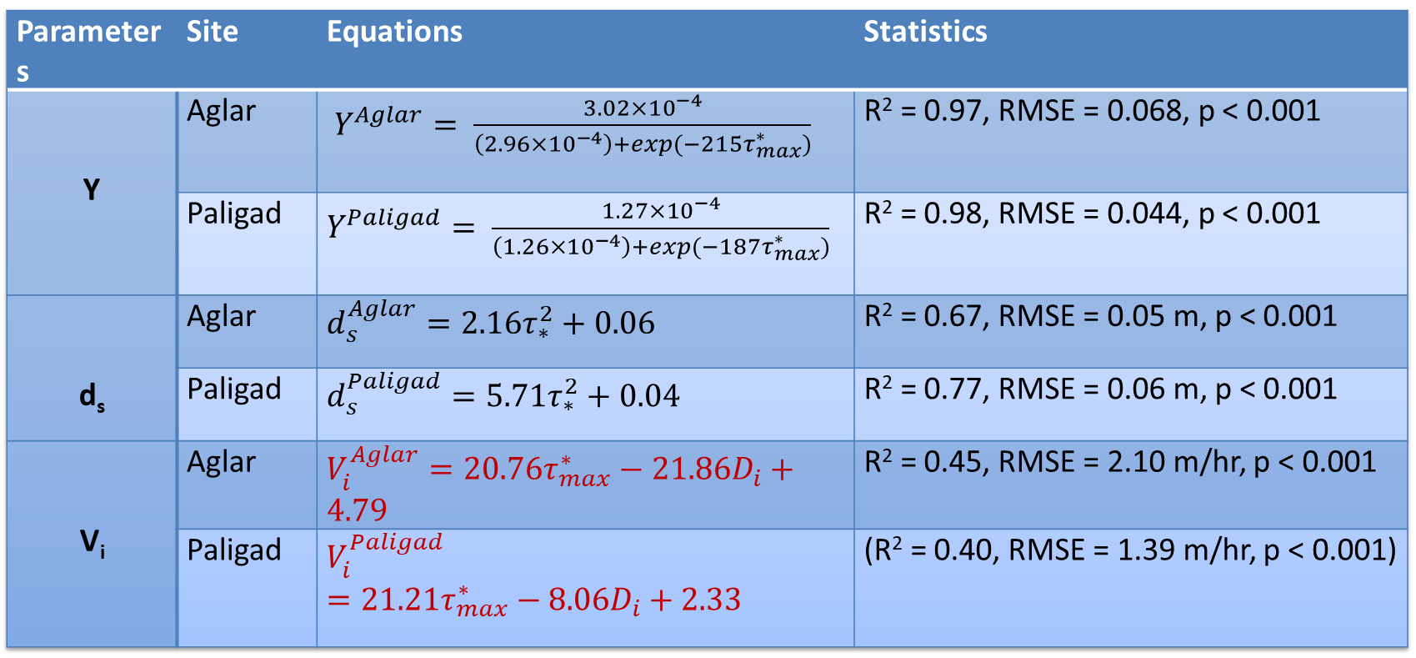
Bed proportion mobility, active layer, and virtual velocity
Parameters | Site | Equations | Statistics
Y | Aglar | $Y^{Aglar}= \frac{3.02×{10}^{−4}}{\left(2.96×{10}^{−4}\right)+exp⁡(−215τ_{max}^{∗})}$ | R² = 0.97, RMSE = 0.068, p < 0.001
 | Paligad | $Y^{Paligad}= \frac{1.27×{10}^{−4}}{\left(1.26×{10}^{−4}\right)+exp⁡(−187τ_{max}^{∗})}$ | R² = 0.98, RMSE = 0.044, p < 0.001
d_{s} | Aglar | $$d_{s}^{Aglar}=2.16τ_{∗}^{2}+0.06$$ | R² = 0.67, RMSE = 0.05 m, p < 0.001
 | Paligad | $$d_{s}^{Paligad}=5.71τ_{∗}^{2}+0.04$$ | R² = 0.77, RMSE = 0.06 m, p < 0.001
V_{i} | Aglar | $V_{i}^{Aglar}=20.76τ_{max}^{∗}−21.86D_{i}+4.79$ | R² = 0.45, RMSE = 2.10 m/hr, p < 0.001
 | Paligad | $$V_{i}^{Paligad}=21.21τ_{max}^{∗}−8.06D_{i}+2.33$$ | (R² = 0.40, RMSE = 1.39 m/hr, p < 0.001)
Overall, 1346 and 966 tracers were recovered in Aglar and Paligad, respectively

Slide 9
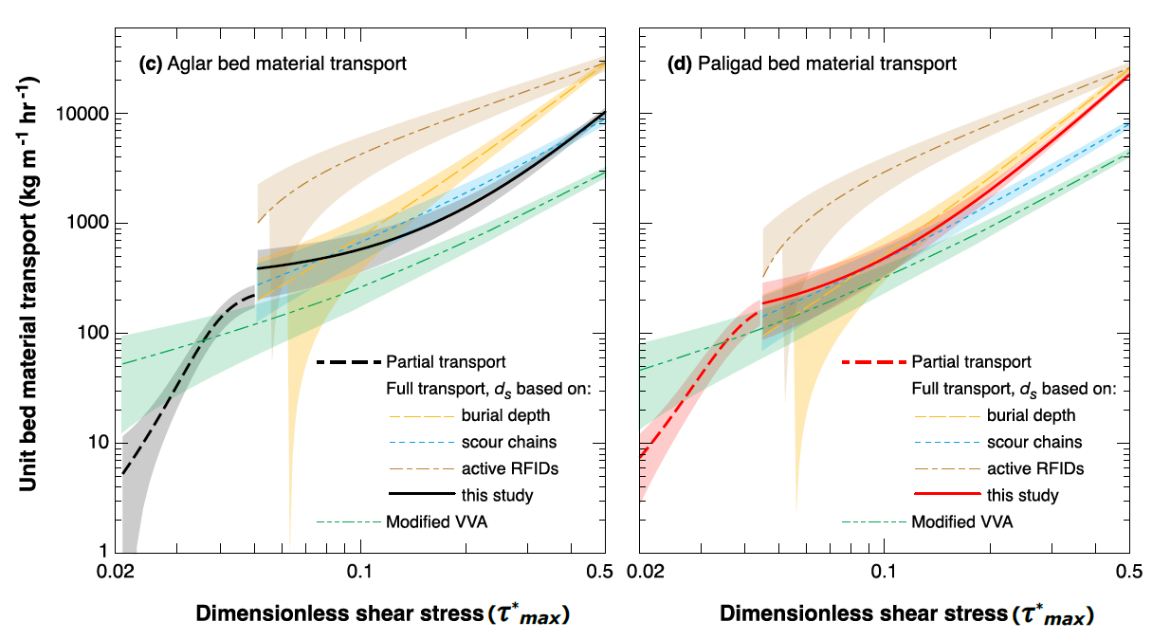
Transport curves and active sediment layer

Slide 10
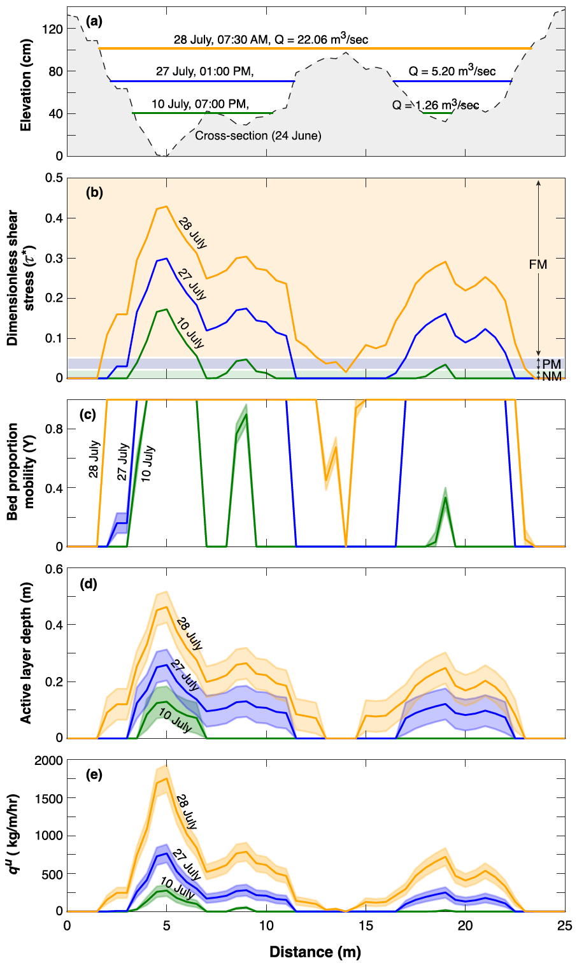
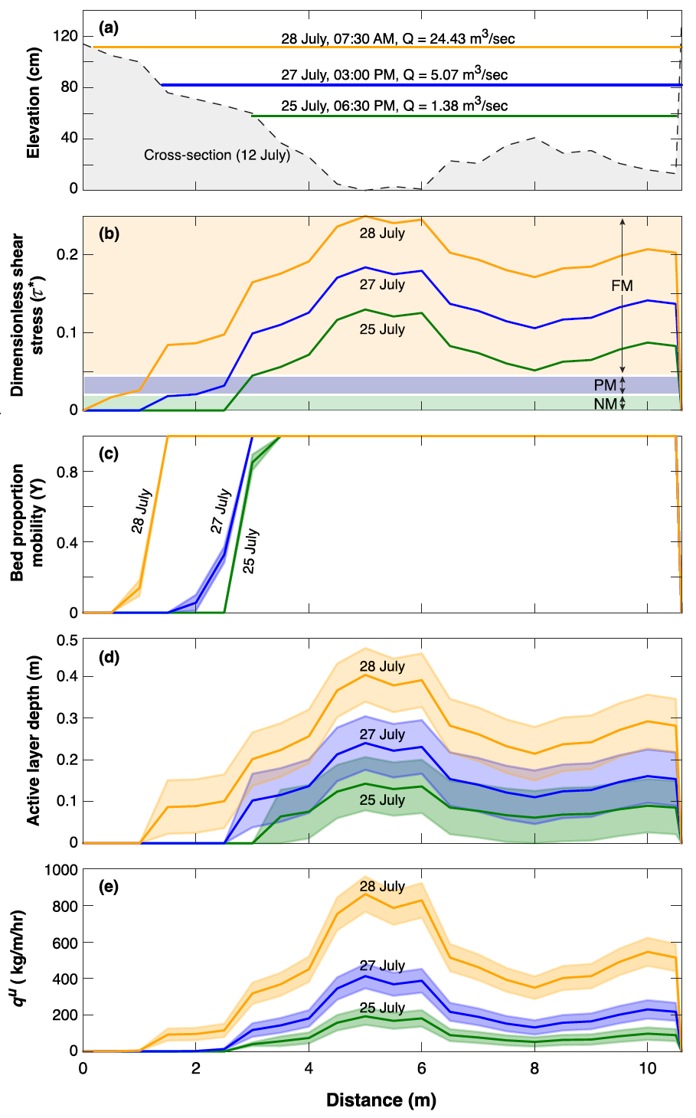
Intra cross-sectional variability of bed material transport and key input parameters

Slide 11
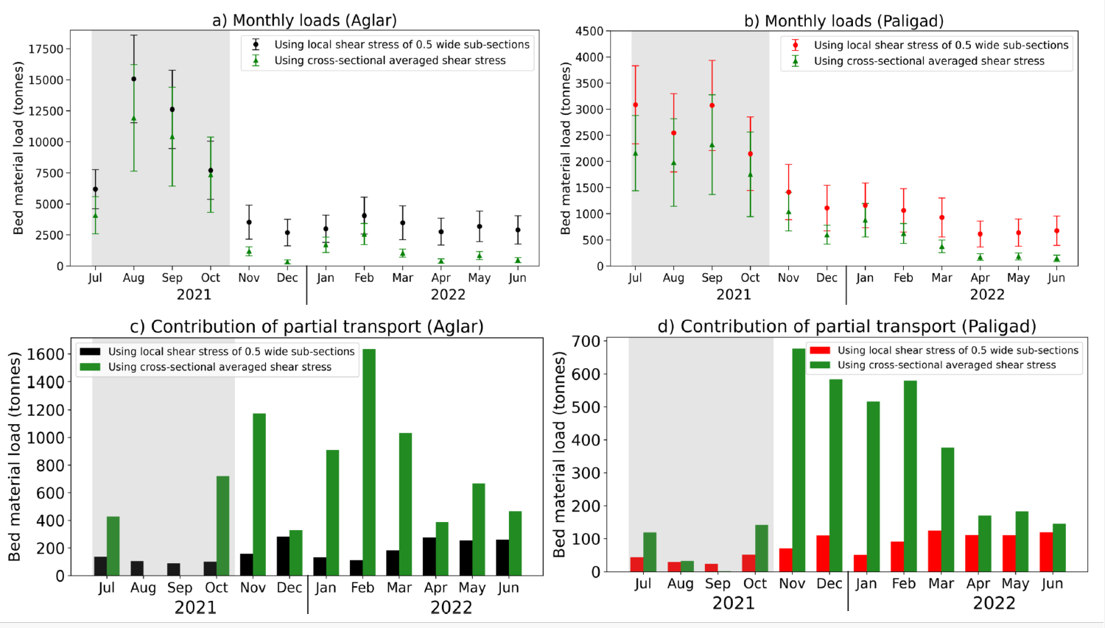
Bed material loads

Slide 12
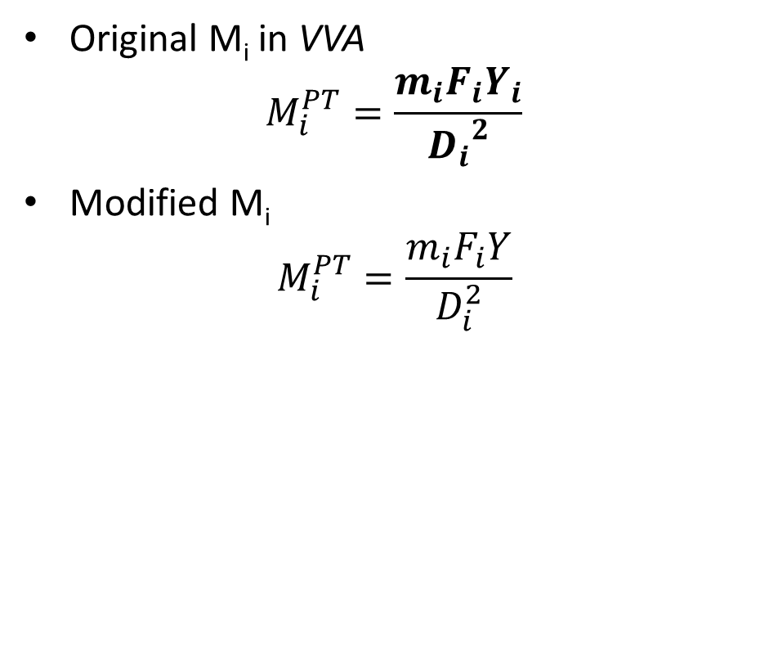

Unified function for smoother transition from PT to FT
Partial transport
Full transport
Original M_{i} in VVA
$$M_{i}^{PT}=\frac{m_{i}F_{i}Y_{i}}{{D_{i}}^{2}}$$
Modified M_{i}
$$M_{i}^{PT}=\frac{m_{i}F_{i}Y}{D_{i}^{2}}$$
Original M_{i} in VVA
$$M_{i}^{FT}=\frac{m_{i}F_{i}d_{s}}{{D_{i}}^{3}}=\frac{m_{i}F_{i}\left(\frac{d_{s}}{D_{i}}\right)}{{D_{i}}^{2}}$$
Modified M_{i}
$$M_{i}^{FT}=\frac{m_{i}F_{i}\left({d_{s}}/{D_{84}}\right)}{D_{i}^{2}}$$

Slide 13
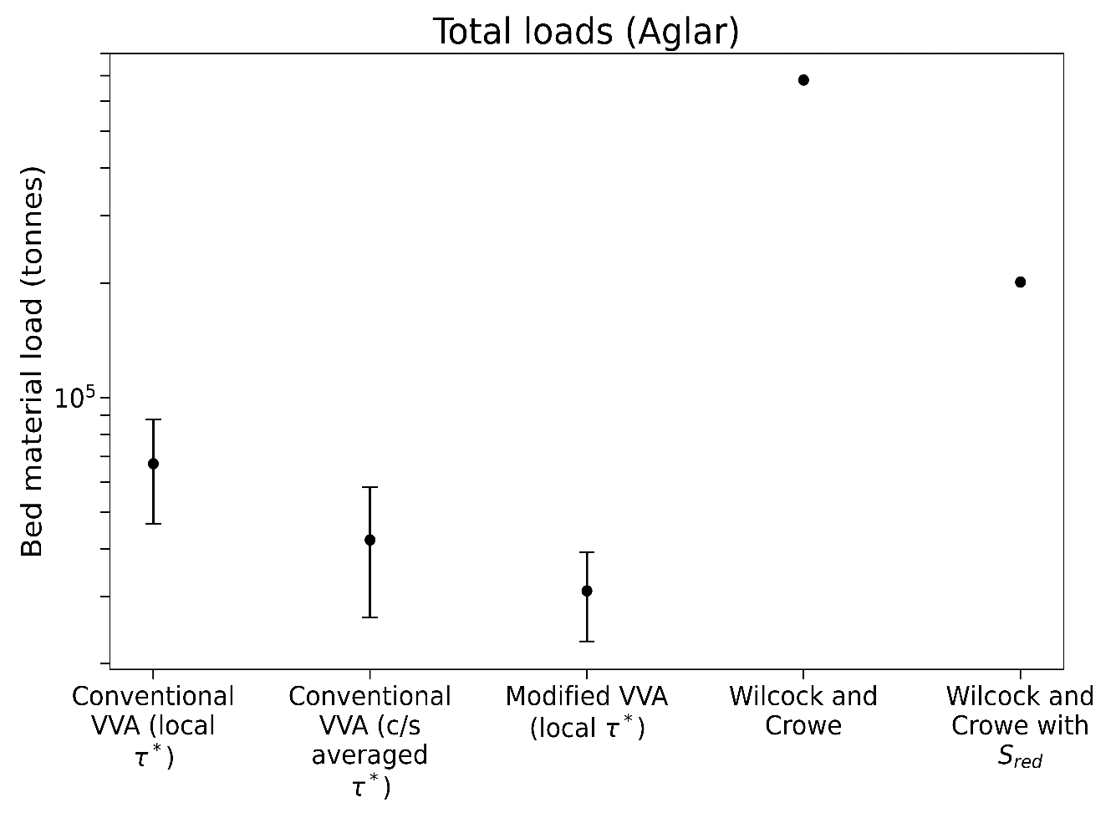
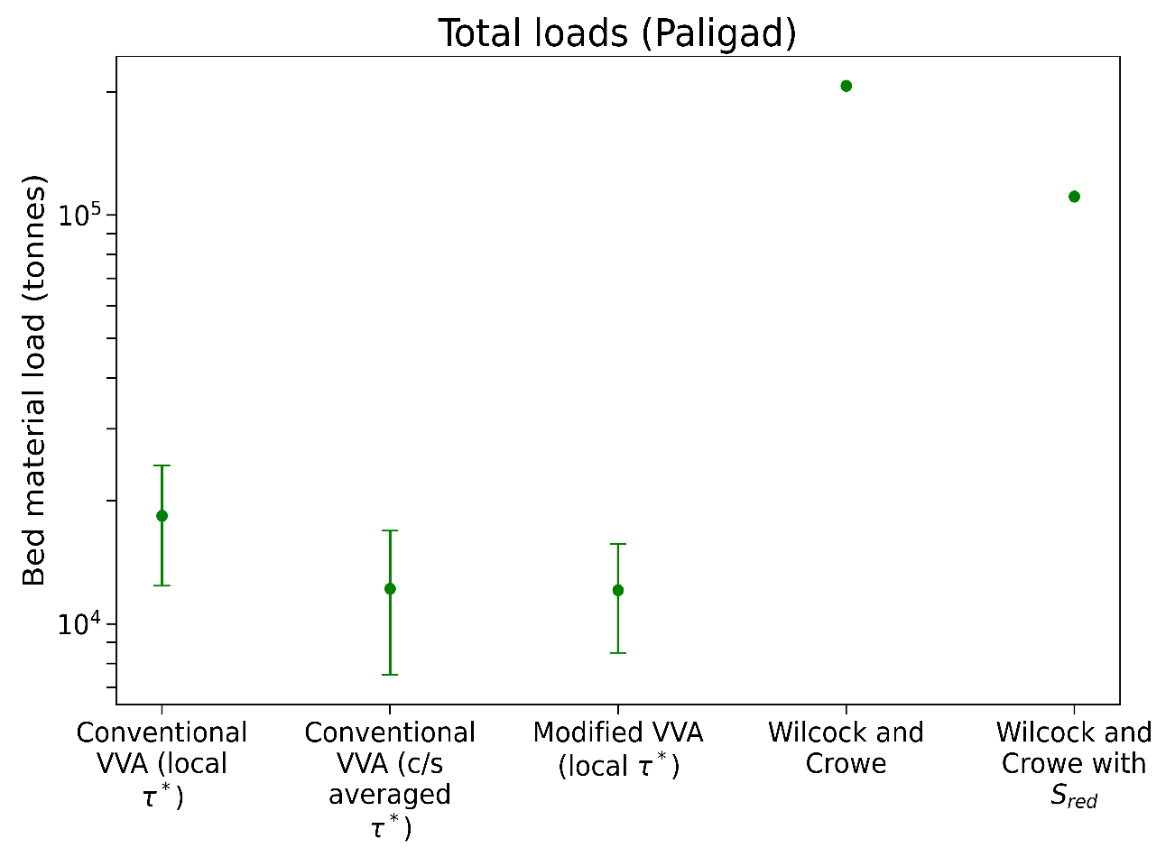

How modified flow resistance equations improves bed material transport estimated using conventional equations?
Increased flow resistance
  Either use increased mobility thresholds (evolves with space and time- difficult to measure)
  Use reduced/effective shear stress
  Slope decomposition approach
  $$S_{red}=S{\left(\sqrt{\frac{f_{0}}{f_{tot}}}\right)}^{e}$$
  Reduced/effective shear stress
  $$τ^{′}=ρgyS_{red}$$
Total loads – July 2021 – June 2022

Slide 14
Major findings
    High energetic floods → Huge mobilization of coarse sediments during the monsoon → still significant transport during long-term low-magnitude (non-monsoon) flows
    Long-term low-magnitude flows (non-monsoonal contribution) (~ 40 % using local shear stress, ~ 20 using cross-sectional average shear stress)
    The overall annual contribution of PT (~ 5 % local shear stress, ~ 20% using cross-sectional average shear stress)
    The different formulations of active layer results in different transport estimates (differing nearly one order of magnitude) → need more research on the characterization of the active layer
    Bed elevation was assumed constant throughout the event → need of technology for continuous spatiotemporal monitoring of bed elevation changes and active layer depth
Yadav, A., Sen, S., Mao, L., & Hassan, A. M. (2023). Estimation of bed material transport in gravel-bed streams using the virtual velocity approach: Insights from the North-western Himalayas, India. Earth Surface Processes and Landforms (under review)

Slide 15
Scope for future research
Need for better characterization of flow resistance and its incorporation in bedload equations/models
Technological advancements for continuous spatiotemporal measurements on bed elevation and active layer depth
Impacts of flood sequencing on tracer dispersion
Exploring the explicit effects of flow regulation and sediment mining on observed flow, sediment and morphological regime

Slide 16
References
Recking, A., Liébault, F., Peteuil, C., Jolimet, T., 2012. Testing bedload transport equations with consideration of time scales. Earth Surf. Process. Landforms 37, 774–789.
Recking, A., 2012a. Influence of sediment supply on mountain streams bedload transport. Geomorphology 175, 139–150.
Yager, E.M., Turowski, J.M., Rickenmann, D., McArdell, B.W., 2012. Sediment supply, grain protrusion, and bedload transport in mountain streams. Geophys. Res. Lett. 39.
Wilcox, A.C., Wohl, E.E., 2006. Flow resistance dynamics in step‐pool stream channels: 1. Large woody debris and controls on total resistance. Water Resour. Res. 42.
Mao, L., Toro, M., Carrillo, R., Brardinoni, F., Fraccarollo, L., 2020. Controls over particle motion and resting times of coarse bed load transport in a glacier‐fed mountain stream. J. Geophys. Res. Earth Surf. 125, e2019JF005253.
Recking, A., Frey, P., Paquier, A., Belleudy, P., Champagne, J.Y., 2008. Feedback between bed load transport and flow resistance in gravel and cobble bed rivers. Water Resour. Res. https://doi.org/10.1029/2007WR006219
Bonilla-Porras, J.A., Armanini, A., Crosato, A., 2021. Extended Einstein’s parameters to include vegetation in existing bedload predictors. Adv. Water Resour. 103928.
Kothyari, U.C., Hashimoto, H., Hayashi, K., 2009. Effect of tall vegetation on sediment transport by channel flows. J. Hydraul. Res. 47, 700–710.
Wilcock, P.R., 1992. Flow competence: A criticism of a classic concept. Earth Surf. Process. Landforms 17, 289–298.
Ancey, C., Pascal, I., 2020. Estimating mean bedload transport rates and their uncertainty. J. Geophys. Res. Earth Surf. 125, e2020JF005534.
Campbell, F.B., Bauder, H.A., 1940. A rating‐curve method for determining silt‐discharge of streams. Eos, Trans. Am. Geophys. Union 21, 603–607.
Jain, M.K., Kothyari, U.C., 2000. Estimation of soil erosion and sediment yield using GIS. Hydrol. Sci. J. 45, 771–786.
Pandey, A., Himanshu, S.K., Mishra, S.K., Singh, V.P., 2016. Physically based soil erosion and sediment yield models revisited. Catena 147, 595–620.
Turowski, J.M., Rickenmann, D., Dadson, S.J., 2010. The partitioning of the total sediment load of a river into suspended load and bedload: a review of empirical data. Sedimentology 57, 1126–1146.

Slide 17






Thanks

